Slide 1
Models + algorithms

Slide 2
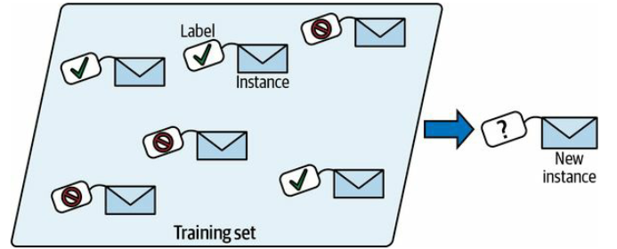
Supervised learning
In supervised learning, the training set you feed to the algorithm includes the desired solutions, called labels

Slide 3
classification
spam filter

Slide 4
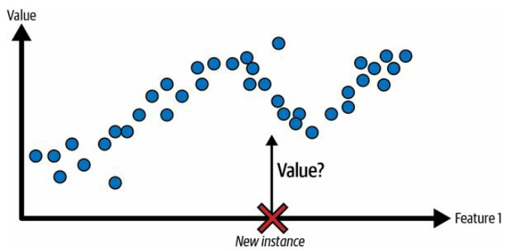
regression
price of a car, given a set of features (mileage, age, brand, etc.)

Slide 5
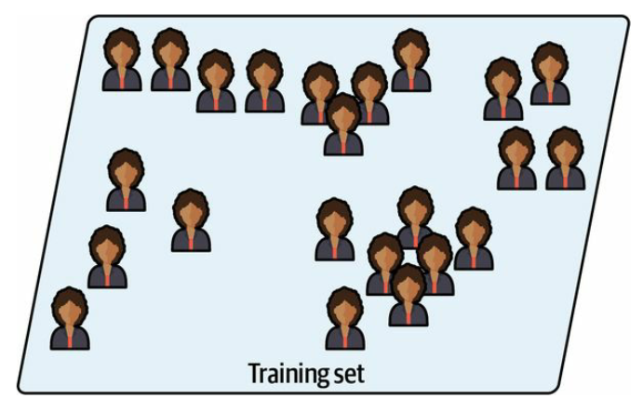
Unsupervised learning
the training data is unlabeled

Slide 6
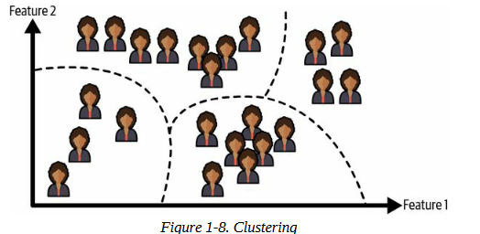

Slide 7
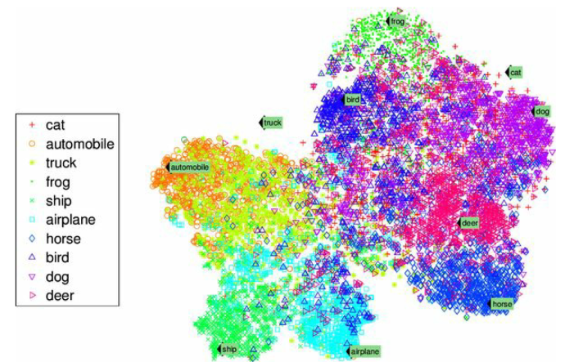
dimensionality reduction
Example of a t-SNE visualization highlighting semantic clusters⁠

Slide 8
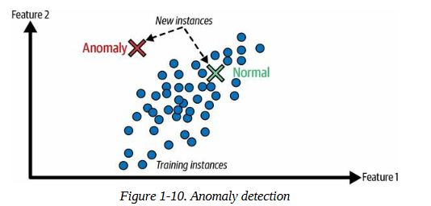
anomaly detection
detecting unusual credit card transactions to prevent fraud, catching manufacturing defects, or automatically removing outliers from a dataset before feeding it to another learning algorithm
Anomaly detection

Slide 9
association rule learning
dig into large amounts of data and discover interesting relations between attributes
suppose you own a supermarket. Running an association rule on your sales logs may reveal that people who purchase barbecue sauce and potato chips also tend to buy steak

Slide 10
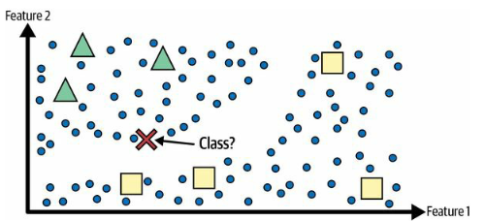
Semi-supervised learning
Since labeling data is usually time-consuming and costly, you will often have plenty of unlabeled instances, and few labeled instances
Semi-supervised learning with two classes (triangles and squares): the unlabeled examples (circles) help classify a new instance (the cross) into the triangle class rather than the square class, even though it is closer to the labeled squares

Slide 11
Some photo-hosting services, such as Google Photos, are good examples of this. Once you upload all your family photos to the service, it automatically recognizes that the same person A shows up in photos 1, 5, and 11, while another person B shows up in photos 2, 5, and 7. This is the unsupervised part of the algorithm (clustering). Now all the system needs is for you to tell it who these people are. Just add one label per person⁠ and it is able to name everyone in every photo, which is useful for searching photos

Slide 12
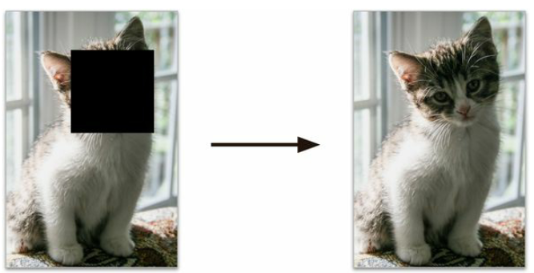
Self-supervised learning
generating a fully labeled dataset from a fully unlabeled one
to repair damaged images or to erase unwanted objects from pictures
input (left) and target (right)

Slide 13
در بسیاری از اوقات مکانیزم خودیادگیری را به کار می بریم تا عکس های فراوانی را تعمیر کند؛ اما چنانچه مدل کارش را خوب انجام دهد می توان از آن برای کلاس بندی استفاده کرد.
چون برای تعمیر از عکس سگ برای گربه نباید استفاده کند، بنابراین در مورد نوع کلاسها اطلاعاتی بدست آورده است.

Slide 14
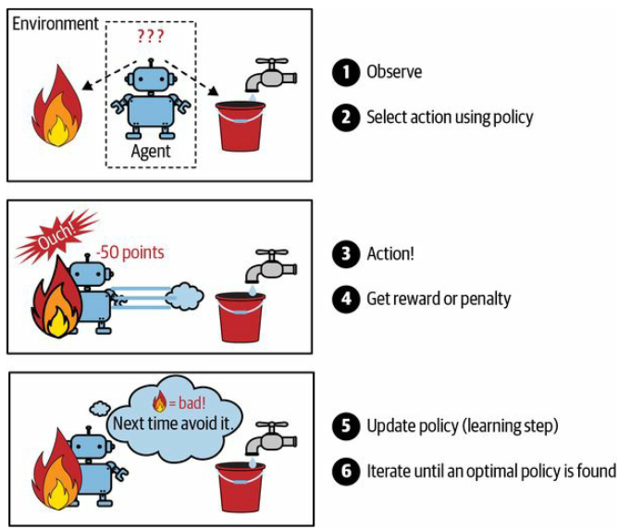
Reinforcement learning
DeepMind’s AlphaGo program

Slide 15
AlphaGo was just applying the policy it had learned. As you will see in the next section, this is called offline learning

Slide 16
Batch Versus Online Learning
In batch learning, the system is incapable of learning incrementally: it must be trained using all the available data. This will generally take a lot of time and computing resources, so it is typically done offline.

Slide 17
model rot or data drift
a model’s performance tends to decay slowly over time, simply because the world continues to evolve while the model remains unchanged

Slide 18
Even a model trained to classify pictures of cats and dogs may need to be retrained regularly, not because cats and dogs will mutate overnight, but because cameras keep changing, along with image formats, sharpness, brightness, and size ratios. Moreover, people may love different breeds next year, or they may decide to dress their pets with tiny hats—who knows?

Slide 19
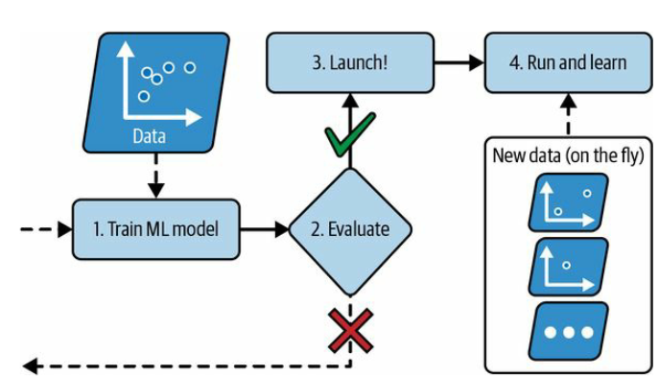
Online learning
train the system incrementally by feeding it data instances sequentially, either individually or in small groups called minibatches
In online learning, a model is trained and launched into production, and then it keeps learning as new data comes in

Slide 20
Online learning is useful for systems that need to adapt to change extremely rapidly (e.g., to detect new patterns in the stock market)
It is also a good option if you have limited computing resources; for example, if the model is trained on a mobile device.

Slide 21
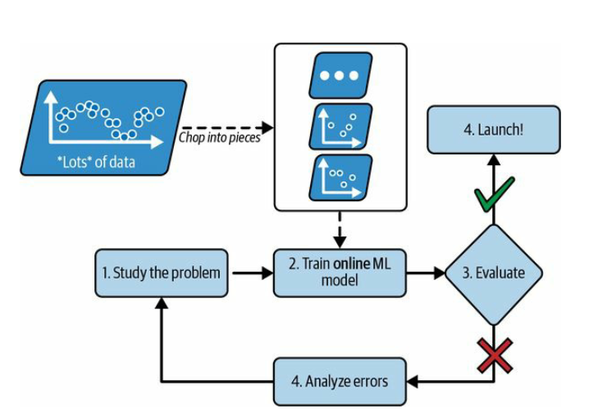
online learning algorithms can be used to train models on huge datasets that cannot fit in one machine’s main memory (this is called out-of-core learning)
Using online learning to handle huge datasets

