Slide 1
Introduction to Artificial Neural Networks with Keras

Slide 2
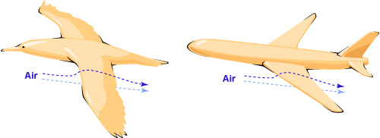
پرنده به هواپیما
الهام از طبیعت

Slide 3
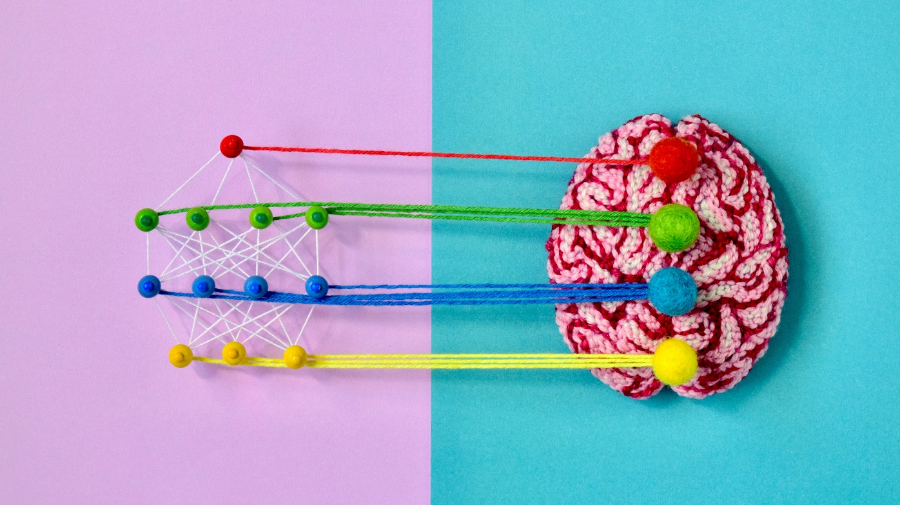
پرنده به هواپیما
الهام از طبیعت

Slide 4
classifying billions of images (e.g., Google Images)
powering speech recognition services (e.g., Apple’s Siri)
beat the world champion at the game of Go (DeepMind’s AlphaGo)
ChatGPT

Slide 5
in 1943 McCulloch and Pitts “A Logical Calculus of Ideas Immanent in Nervous Activity”, presented a simplified computational model

Slide 6
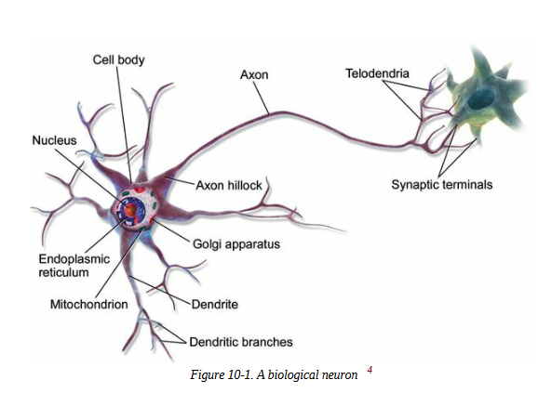

Slide 7
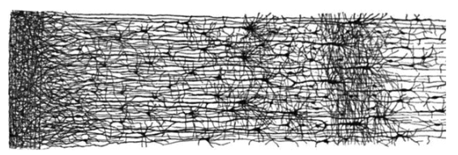
The architecture of biological neural networks (BNNs)⁠ is the subject of active research, but some parts of the brain have been mapped. These efforts show that neurons are often organized in consecutive layers, especially in the cerebral cortex (the outer layer of the brain)

Slide 8
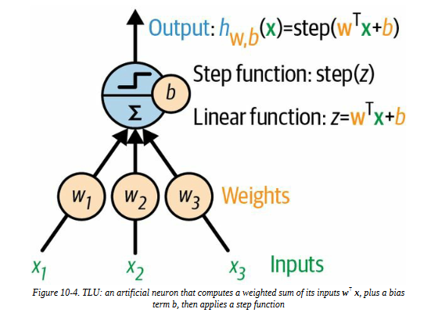
The Perceptron
threshold logic unit (TLU)
linear threshold unit (LTU)

Slide 9
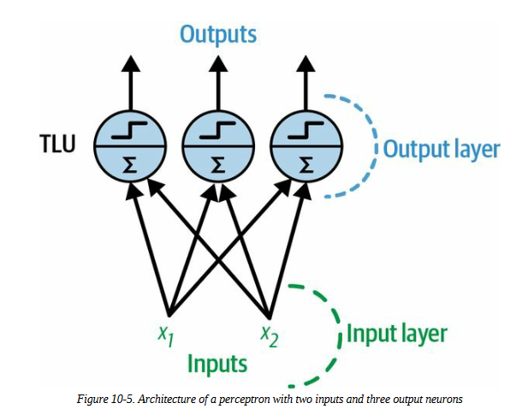

Slide 10
how is a perceptron trained?
The perceptron training algorithm proposed by Rosenblatt was largely inspired by Hebb’s rule. In his 1949 book The Organization of Behavior (Wiley), Donald Hebb suggested that when a biological neuron triggers another neuron often, the connection between these two neurons grows stronger.

Slide 11
A single-layer perceptron can only learn linearly separable patterns, whereas a straight line or hyperplane can separate the data points.

Slide 12
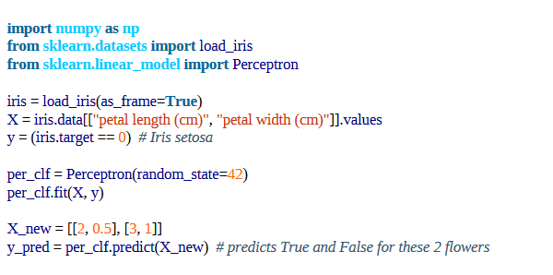

Slide 13
Siegrid Löwel later summarized Hebb’s idea in the catchy phrase
“Cells that fire together, wire together”

Slide 14
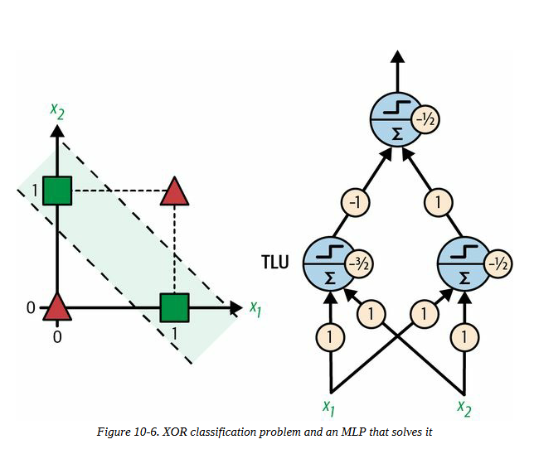

Slide 15
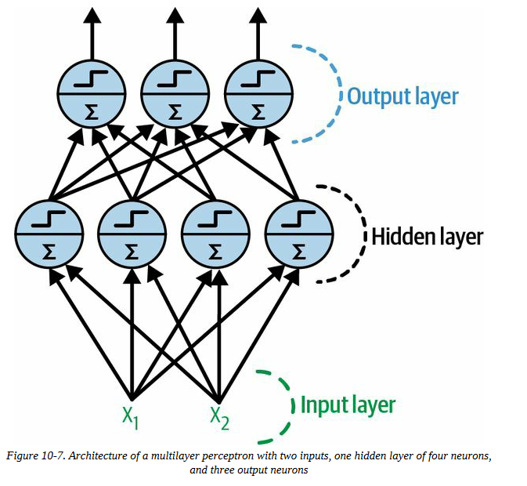
The Multilayer Perceptron and Backpropagation
upper layers
lower layers

Slide 16
When an ANN contains a deep stack of hidden layers,⁠ it is called a deep neural network (DNN)

Slide 17
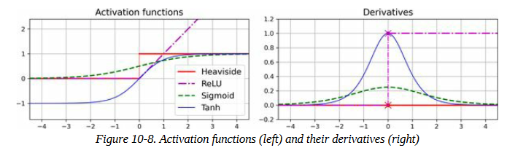
Activation functions

Slide 18
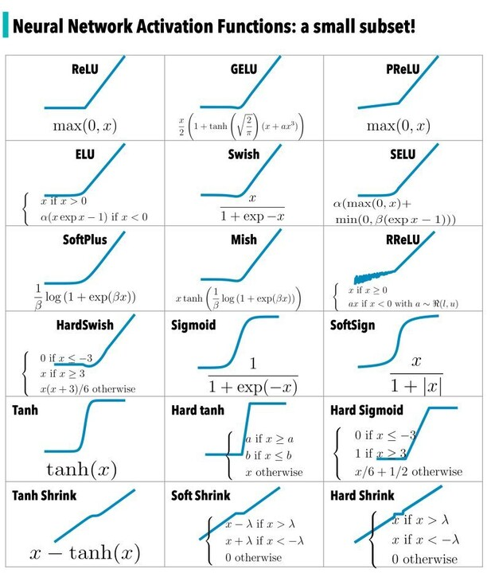

Slide 19
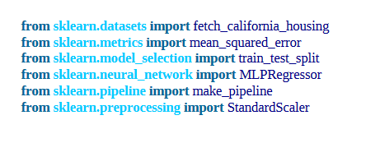
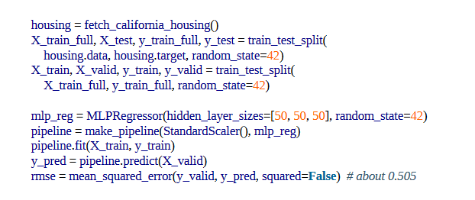
Regression MLPs

Slide 20
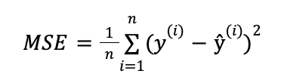

Mean Squared Error (MSE)

Slide 21
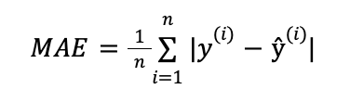

Mean Absolute Error (MAE)

Slide 22
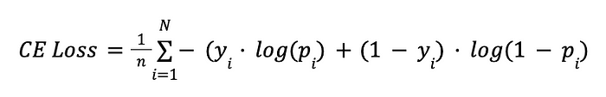
Binary Cross-Entropy/Log Loss

Slide 23
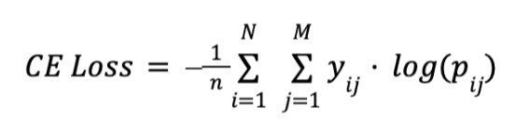
Categorical Cross-Entropy Loss

Slide 24


Slide 25
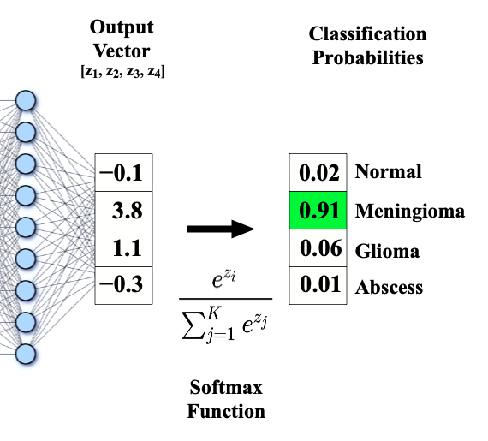
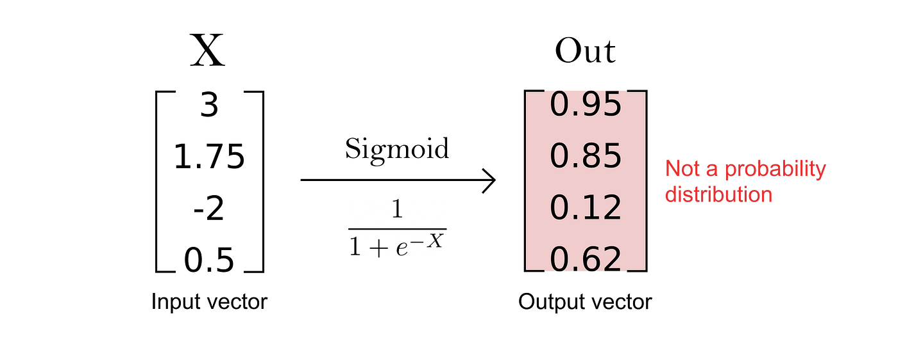

Slide 26
Binary Classification
پیش بینی دو کلاس
تابع فعال سازی: sigmoid مقدار احتمال بین 0-1
تابع هزینه: Binary Crossentropy مقدار اختلاف میان دو توزیع احتمال را اندازه می گیرد.
نوع برچسب: 0 یا 1

Slide 27
Multi-Class Classification
پیش بینی بیش از دو کلاس
تابع فعال سازی: softmax مقدار تابع توزیع احتمال بین 0-1
تابع هزینه: sparse Categorcial Crossentropy مقدار اختلاف میان دو توزیع احتمال را اندازه می گیرد.
نوع برچسب: مقادیر صحیح 0، 1، 2، ...

Slide 28
اشتباه نشود!
Binary | Multi-class
Binary Crossentropy (0, 1) | sparse Categorical Crossentropy (0, 1, 2, 3 ..)
sigmoid | softmax
spam - email | pant, T-shirt, etc.
Categorical Crossentropy → one-hot encoding

Slide 29
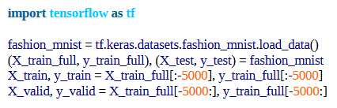
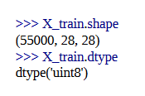

Implementing MLPs with Keras

Slide 30


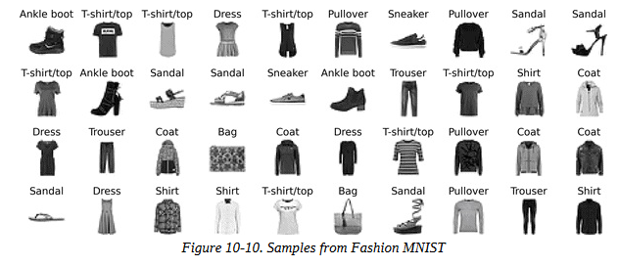

Slide 31
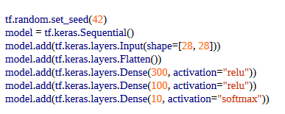
Creating the model using the sequential API
set TensorFlow’s random seed to make the results reproducible
simplest kind of Keras model for neural network
convert each input image into a 1D array

Slide 32
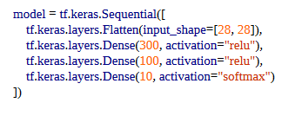
another way (passing list of layers)

Slide 33
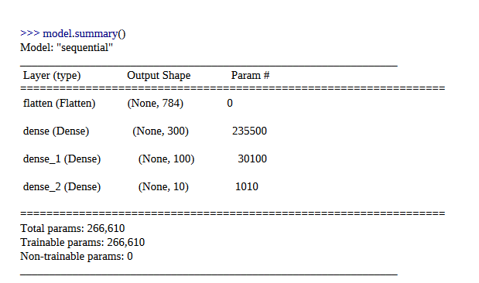
784 × 300 connection weights, plus 300 bias terms

Slide 34
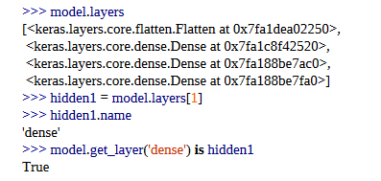

Slide 35
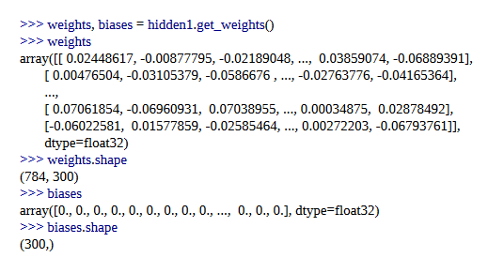

Slide 36

Compiling the model

Slide 37

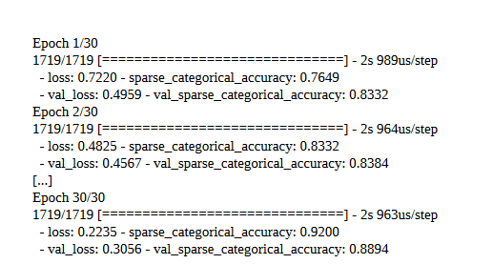
Training
default to just 1
optional

Slide 38

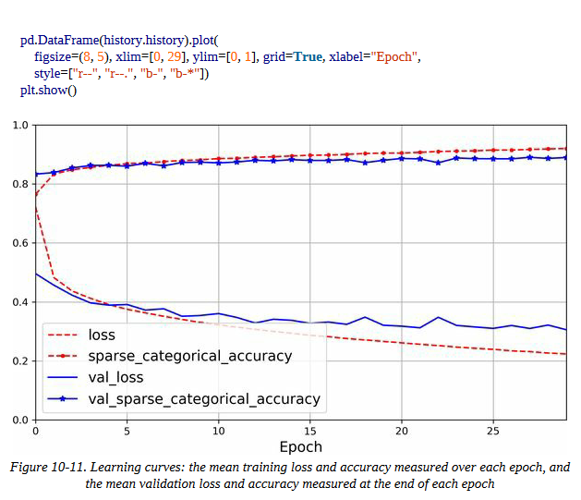

Slide 39
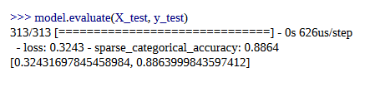
Evaluate

Slide 40
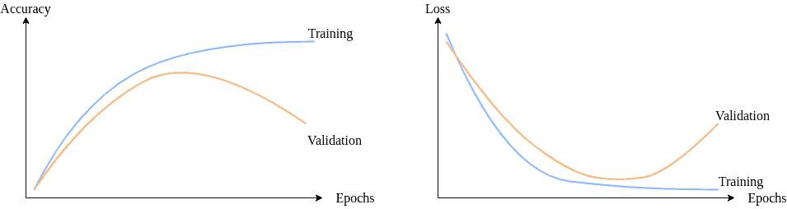
epochs

Slide 41
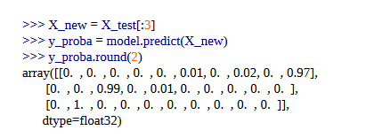
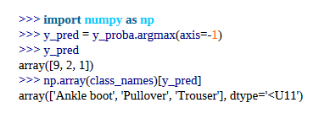
Using the model to make predictions

Slide 42

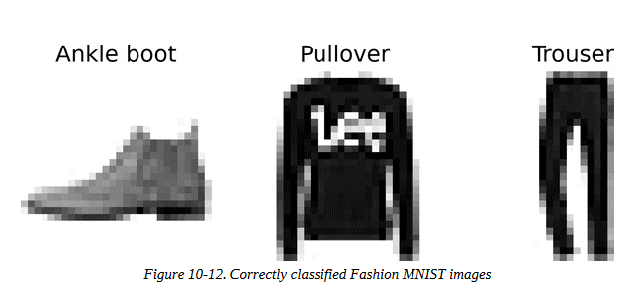

Slide 43
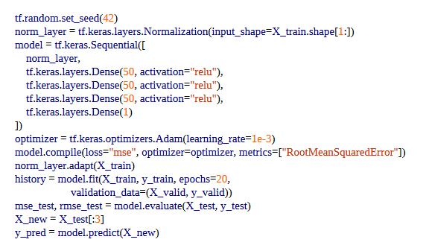
Building a Regression MLP Using the Sequential API

