Slide 1
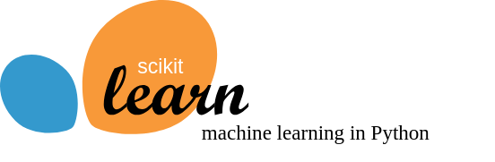

Slide 2

Which iris is that?
Setosa
Versicolor
Virginica

Slide 3
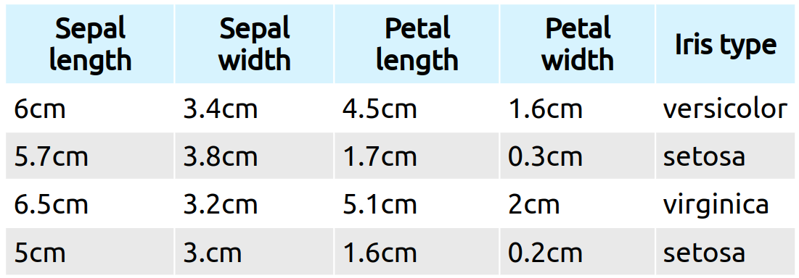

Slide 4
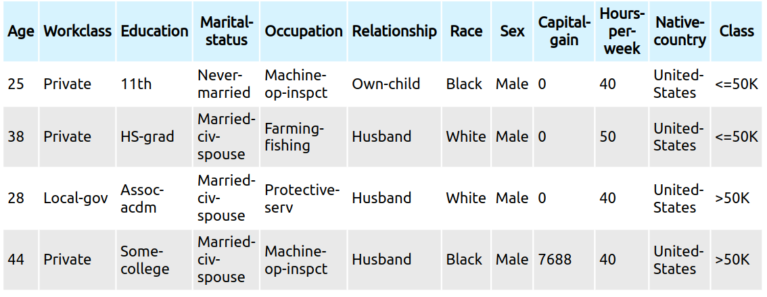
Is this person rich?
US Census data:

Slide 5
Engineering rules: data versus experts
Expert knowledge: setosa irises have small petals

Slide 6
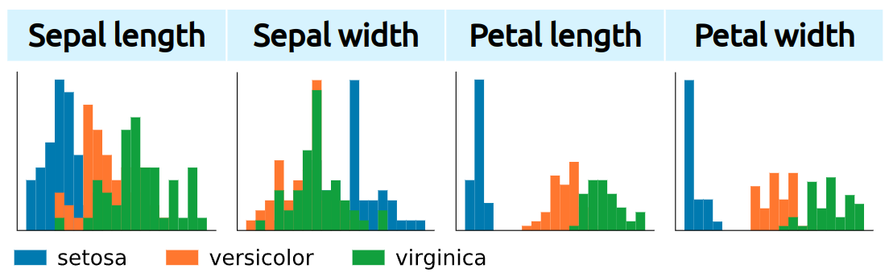
Engineering rules: data versus experts
Expert knowledge: setosa irises have small petals
This rule can be inferred from the data

Slide 7
Predictive analysis
Beyond classic statistical tools

Slide 8
Generalizing
Concluding on new instances

Slide 9
Many sources of variability:
Concluding on new instances
Many sources of variability:
age
workclass
education
marital-status
occupation
relationship
race
sex
capital-gain
hours-per-week
native-country
+ Noise: unexplainable variance

Slide 10
Memorizing
store all known individuals (the census)
given a new individual, predict the income of its closest match in our database

Slide 11
Trying out this strategy on individuals picked from the data we have (the census) what error rate do we expect?

Slide 12
Trying out this strategy on individuals picked from the data we have (the census) what error rate do we expect?
0 errors

Slide 13
Trying out this strategy on individuals picked from the data we have (the census) what error rate do we expect?
0 errors
Yet, we will make errors on new data

Slide 14
Generalizing ≠ Memorizing
"test" data ≠ "train" data
Data on which the predictive model is applied
Data used to learn
the predictive model
Different sampling of noise
Unobserved combination of features

Slide 15
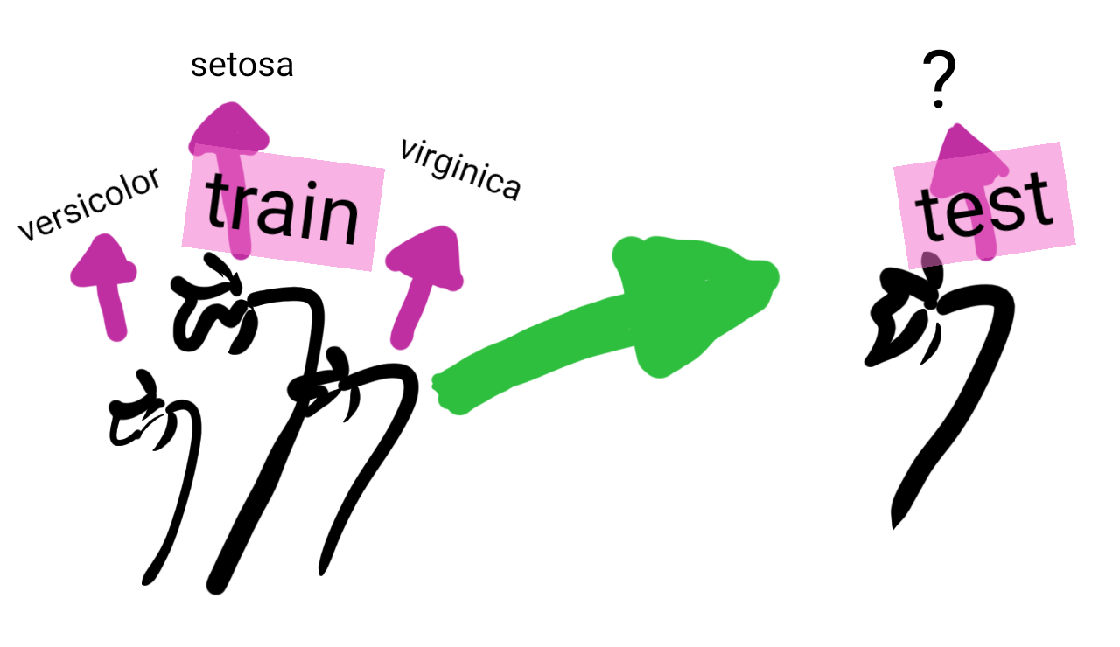
The machine-learning workflow

Slide 16
Some vocabulary

Slide 17
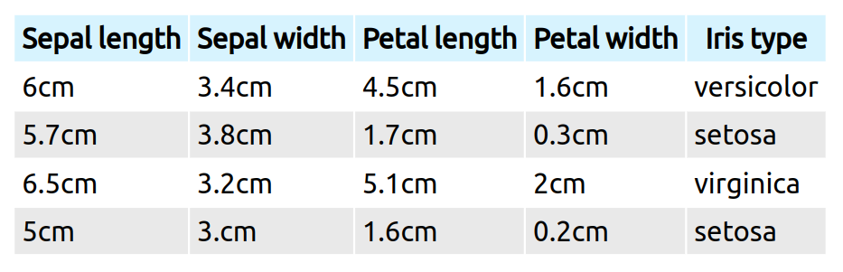
The data matrix
We deal with a table of data (figuratively, an Excel sheet):
Rows are different observations, or samples
Columns are different descriptors, or features

Slide 18
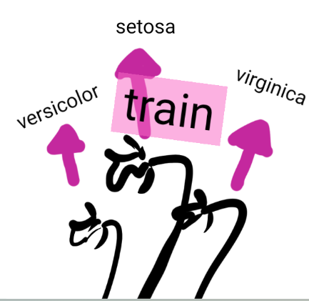
Supervised machine learning
A data matrix X with n observations
A target y: a property of each observation
The goal is to predict y

Slide 19

Unsupervised machine learning
A data matrix X with n observations
The goal is to extract from X a structure that generalizes.
Very wide variety of different problems.

Slide 20
Regression and classification
Supervised learning: predicting a target y
Classification: y is discrete (qualitative), made of different classes
eg types of irises: Setosa, Versicolor, Virginica
Regression: y is continuous (quantitative), a numerical quantity
eg wage prediction

Slide 21
Take home messages
Machine learning is about extracting from data rules that generalizes to new observations
We work with:
a data matrix X n_samples * n_features
a target y of length n_samples, made of numbers for regression and of discrete classes for classification

