Slide 1


Slide 2
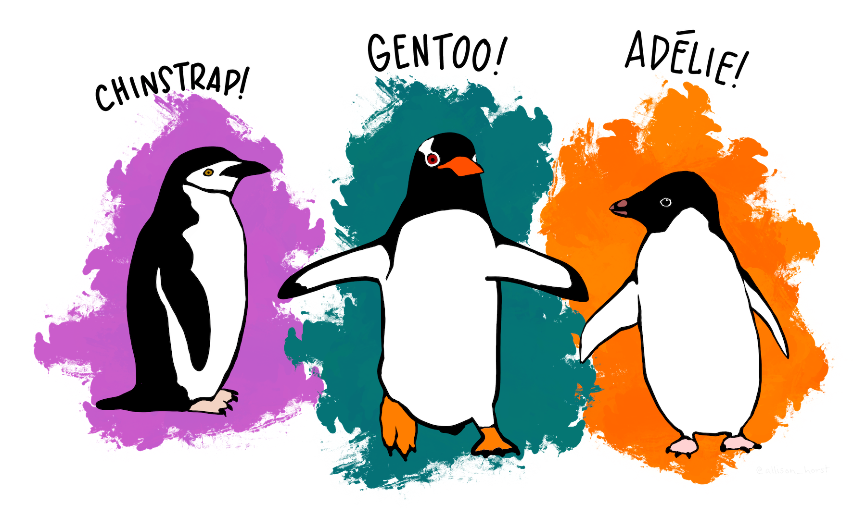

Slide 3
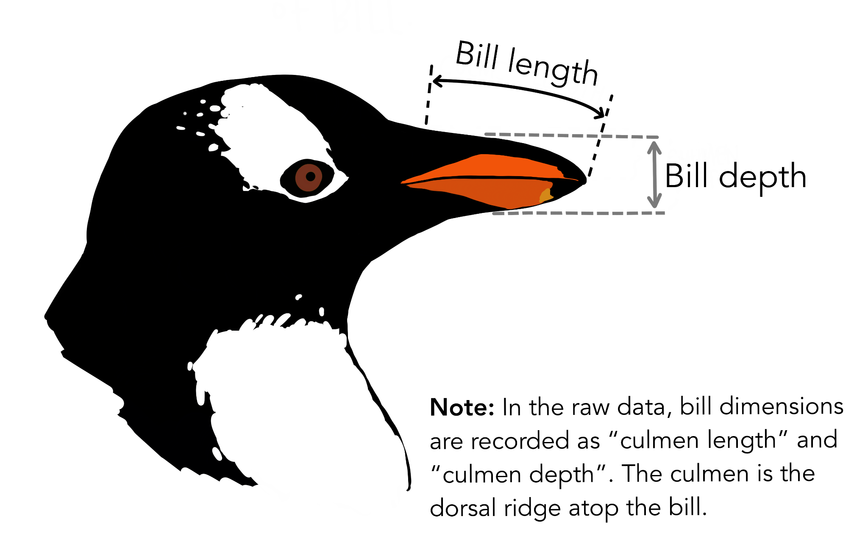

Slide 4
Linear Models
For classification and regression.
Simple models, easy to understand and fast to train.

Slide 5
Outline
What is a linear model?
For regression: linear regression
For classification: logistic regression
Non linearly separable data

Slide 6
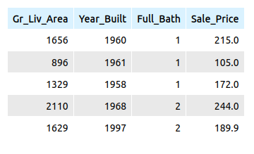
An example: estimating housing prices

Slide 7
An example: estimating housing prices
Linear approximation of Sale_Price:
Sale_Price = 0.1 * Gr_Liv_Area
+ 1.1 * Year_Built
- 8.9 * Full_Bath
- 2200.0

Slide 8
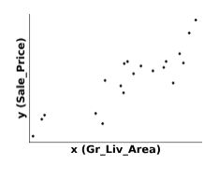
Linear regression
Linear approximation of Sale_Price:
Sale_Price = 0.1 * Gr_Liv_Area
- 2200.0

Slide 9
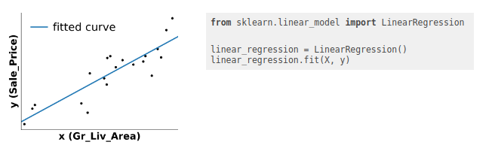
Linear regression
Fit a prediction line as close as possible to all training points.

Slide 10
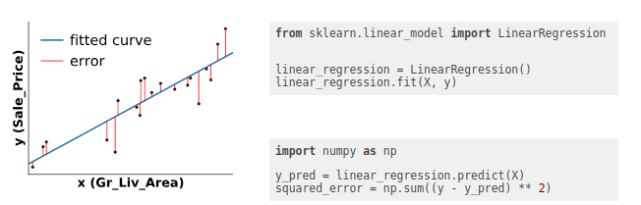
Linear regression
minimize the distance between the prediction and the data points

Slide 11
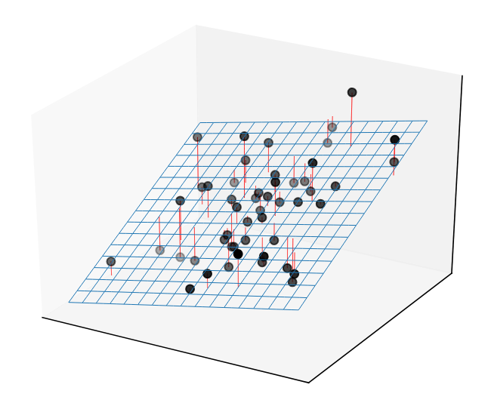
Linear regression with several variables
The mental picture needs to be extended to several dimensions.
For instance, in 2D:
Sale_Price = 0.1 * Gr_Liv_Area
+ 1.1 * Year_Built
- 2209.0

Slide 12
Linear models for classification

Slide 13
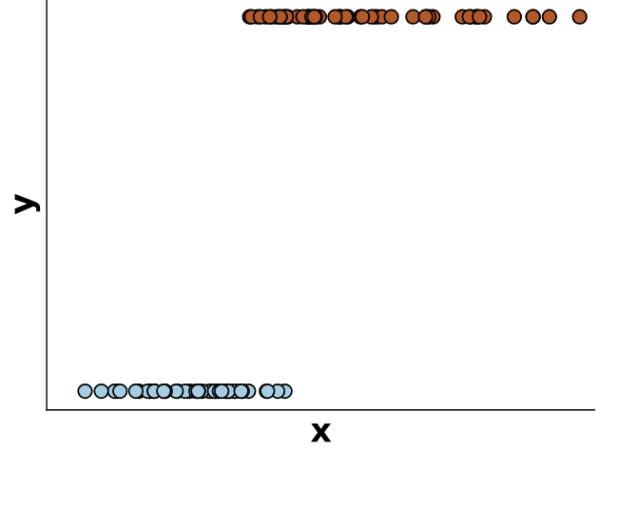

For classification, we use a logistic regression model: y is either 0 (blue) or 1 (red)

Slide 14
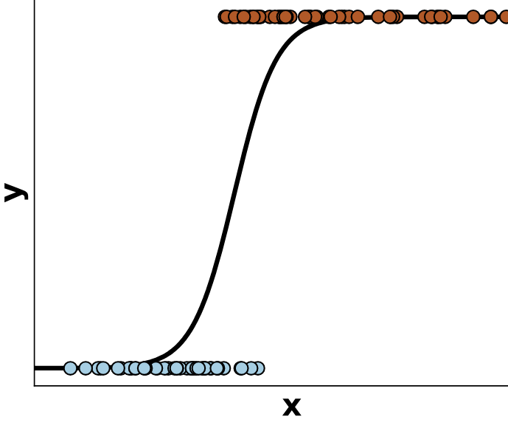

The output of the model is interpreted as the probability of y being 1 (red) for a given x.

Slide 15
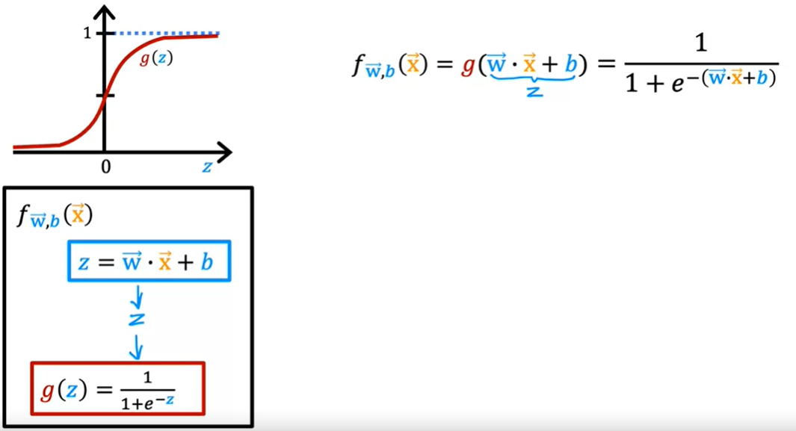

Slide 16

logit
z is the logit.
β0​ is the intercept (bias term)
β1​,β2​,…,βn​ are the coefficients (or weights)
x1​,x2​,…,xn​ are the input features.
With the weights we would know the feature importance

Slide 17
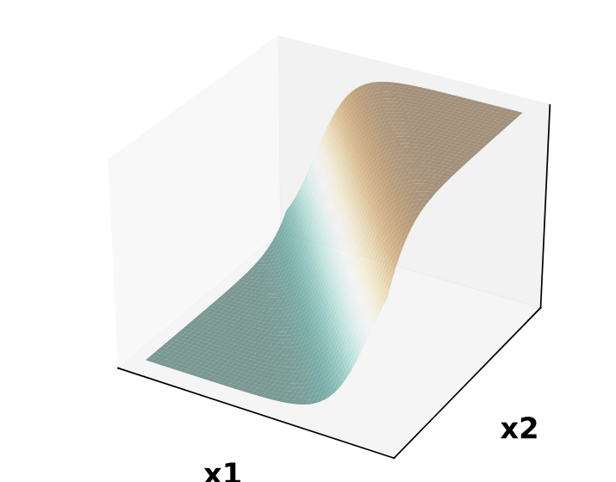
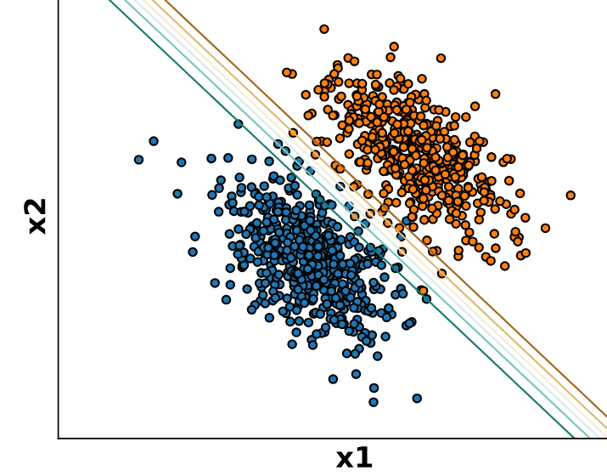
Logistic regression in 2 dimensions
X is 2-dimensional, y is represented by the color

Slide 18
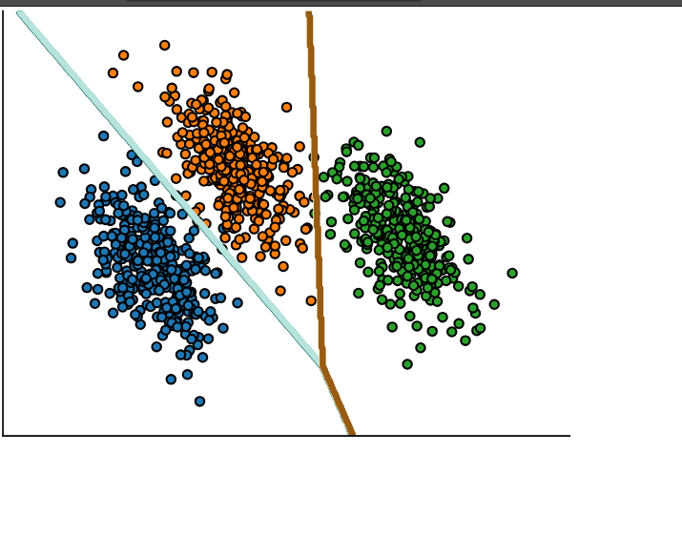
Logistic regression & multiclass classification
y in {0, 1, 2}
y in {blue, orange, green}
For a given input x:
predict one probability per class
probabilities sum to 1

Slide 19
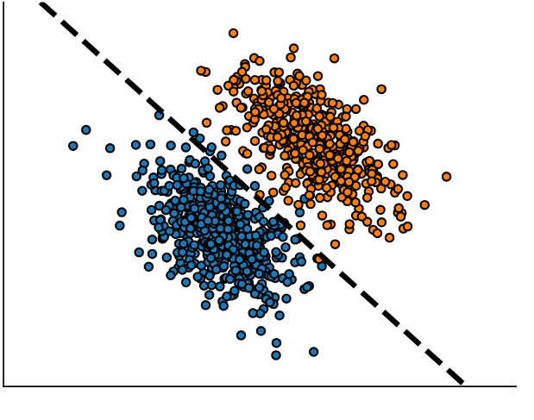
Linear models are not suited to all data
Almost linearly separable

Slide 20
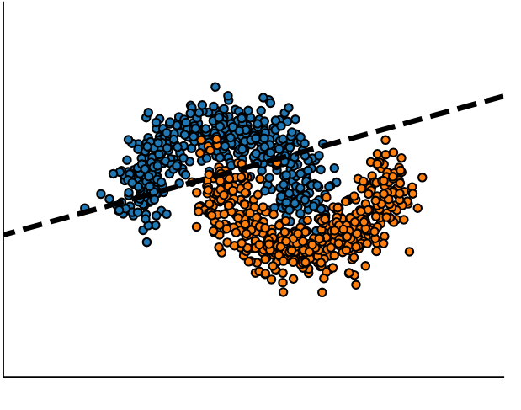
Linear models are not suited to all data
Almost linearly separable
Not linearly separable → Underfitting

Slide 21
Take home messages on linear models
Simple and fast baselines for:
regression: linear regression
classification: logistic regression
Can underfit when: n_features << n_samples → engineering new features can help!
Hard to beat when n_features is large

Slide 22
checkout:
linear_regression_without_sklearn.ipynb

Slide 23
Exercise:
Linear_models_ex_01.ipynb
linear_models_sol_01.ipynb

Slide 24
How to find the best parameters?
We created Two metrics:
Mean squared error (MSE)
Mean absolute error (MAE)

Slide 25
The parameter finding have a closed-form solution, you need to solve an equation. (implemented in sklearn)
This avoids the need for brute-force search

Slide 26
checkout
linear_regression_in_sklearn.ipynb

Slide 27
Binary classification

Slide 28
Go back to the penguin dataset
Goal: predict the penguin species
simplify our classification problem by selecting only 2 of the penguin species (Binary classification)

Slide 29
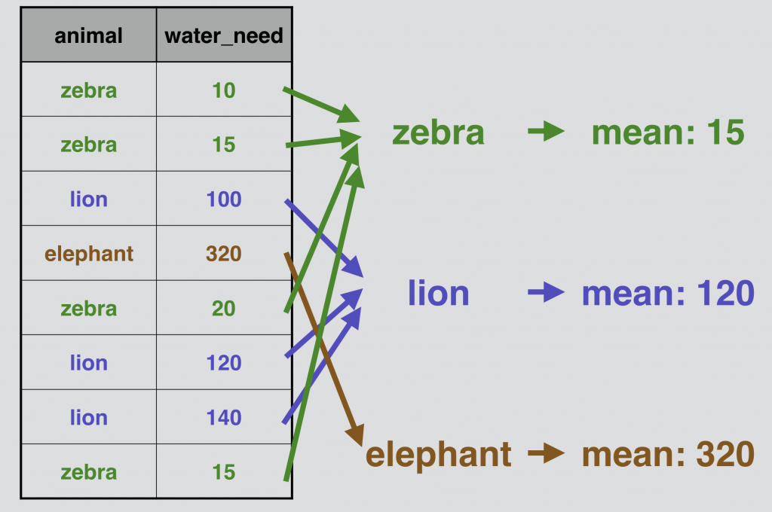
Pandas groupby
data.groupby("animal")[“water_need”].plot.hist(alpha=0.5, legend=True)
data.groupby("animal")[“water_need”].mean()

Slide 30
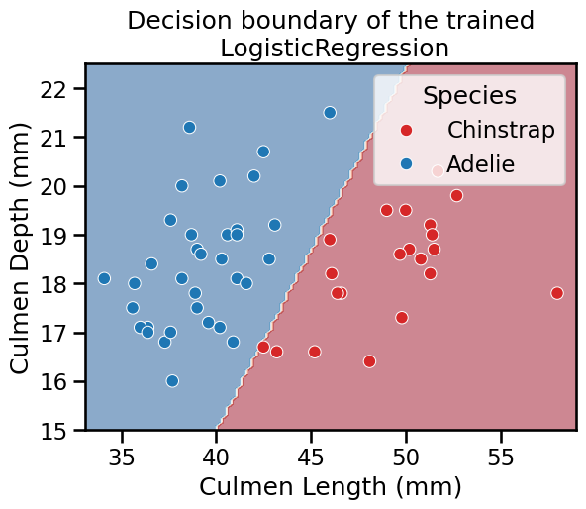
decision function boundary

Slide 31
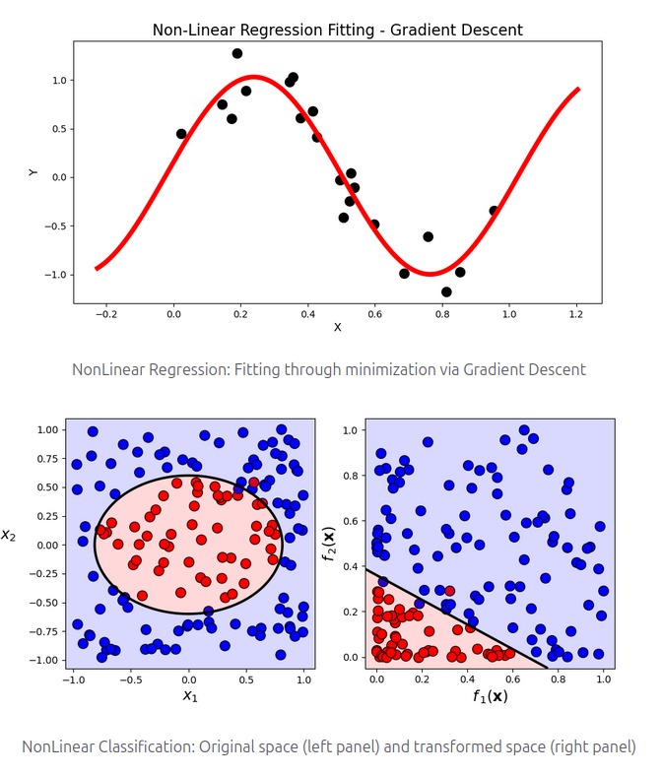
Non-linear feature engineering for Logistic Regression

Slide 32
checkout
linear_models_feature_engineering_classification.ipynb
KBinsDiscretizer: binning transformation of the features
SplineTransformer: smooth version of the binning transformation

Slide 33
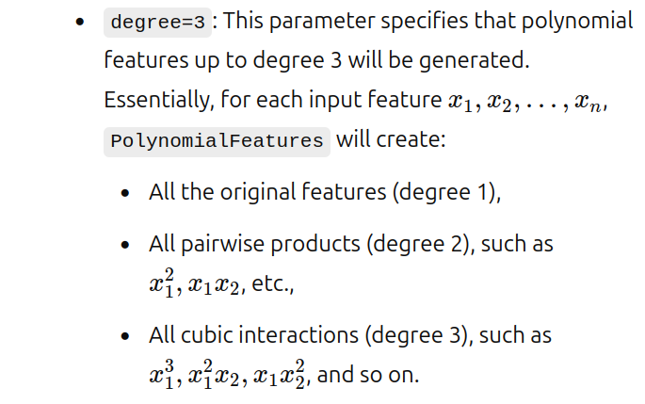
PolynomialFeatures(degree=3, include_bias=False)

Slide 34
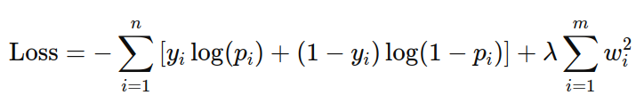
log-loss function
discourages large coefficients
C = 1/ λ

