Slide 1
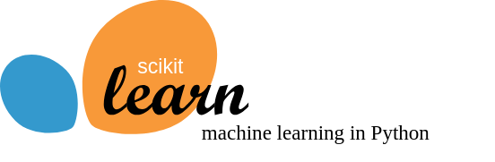

Slide 2
Overfitting and underfitting
Understand when and why a model does or does not generalize well on unseen data.

Slide 3
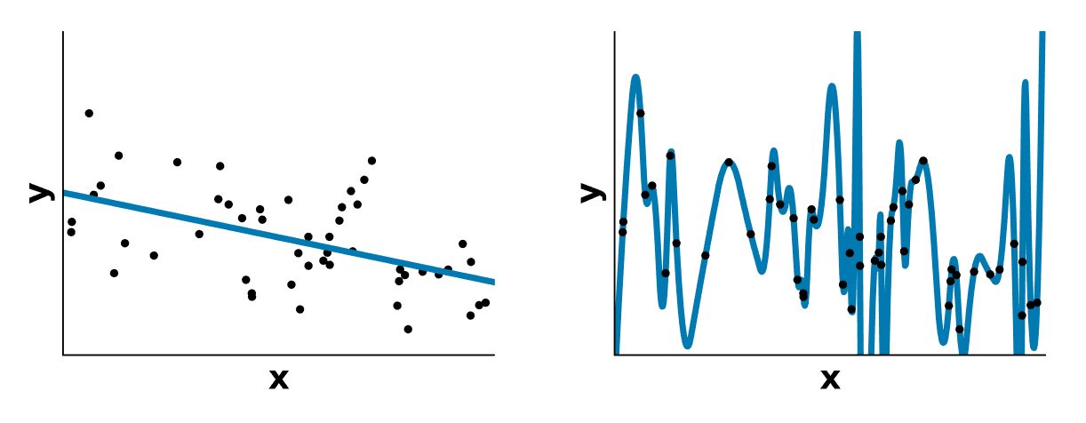
Which data fit do you prefer?

Slide 4
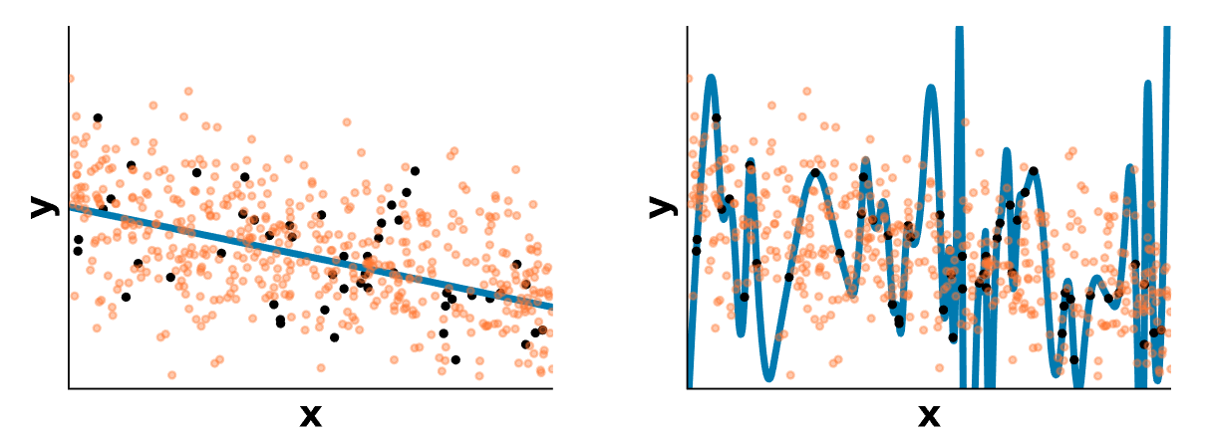
Which data fit do you prefer?
On new data

Slide 5
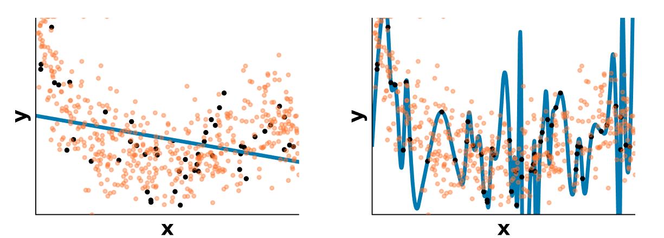
A harder example

Slide 6
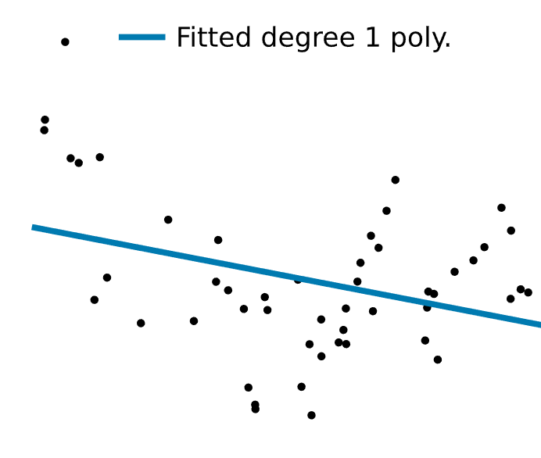

Slide 7
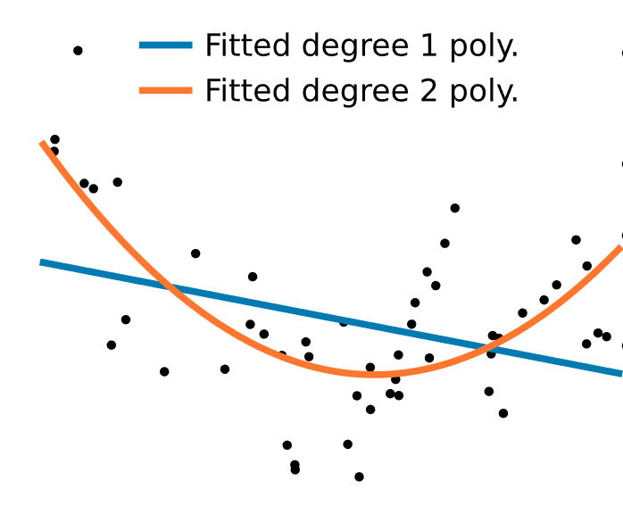

Slide 8
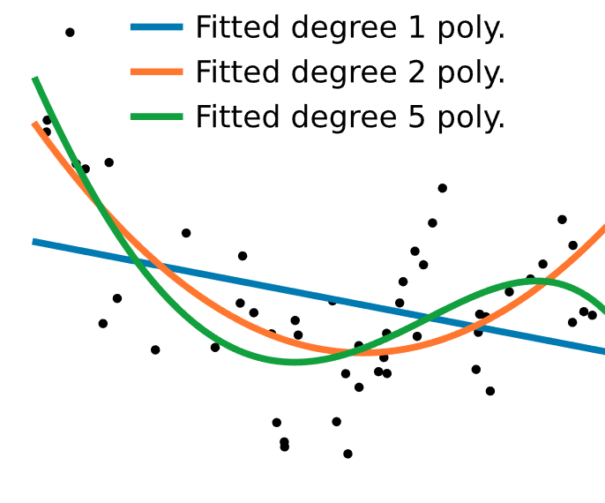

Slide 9
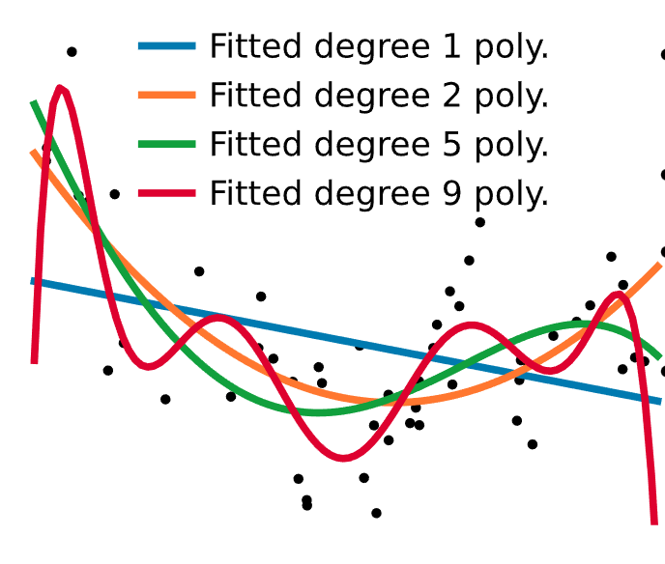

Slide 10
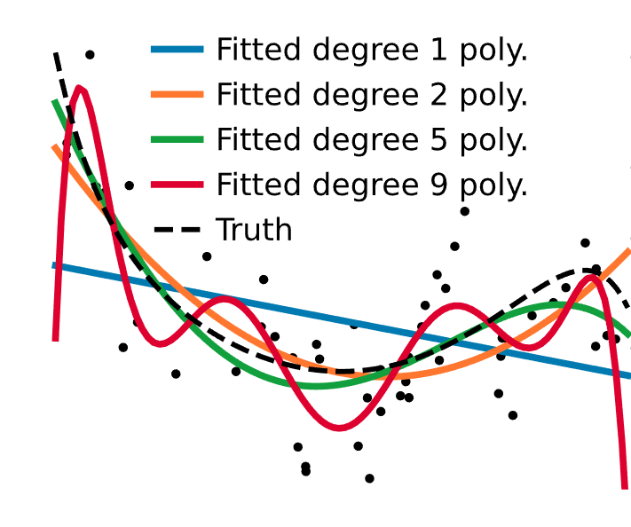

Slide 11
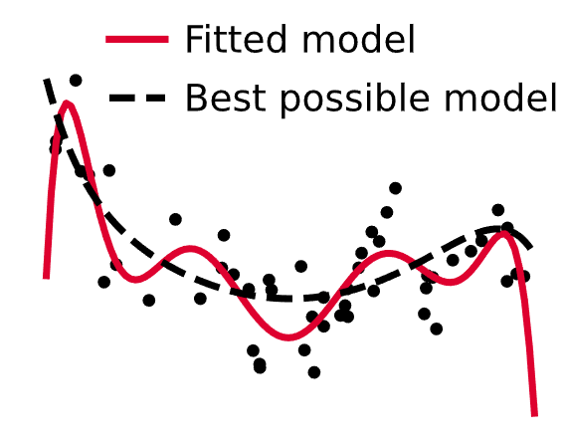
Not enough data Too much noise

Slide 12
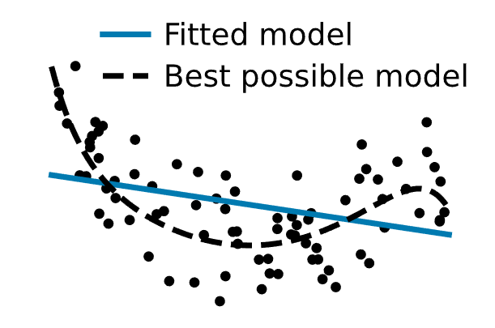
Plenty of data Low noise

Slide 13
Take home messages
Models too complex for the data overfit:
they explain too well the data that they have seen
they do not generalize
Models too simple for the data underfit:
they capture no noise
they are limited by their expressivity
How to find the right trade-off?

Slide 14
Comparing train and test errors
Varying complexity: validation curves
Varying the sample size: learning curves
Goal: understand the overfitting / underfitting trade-off

Slide 15
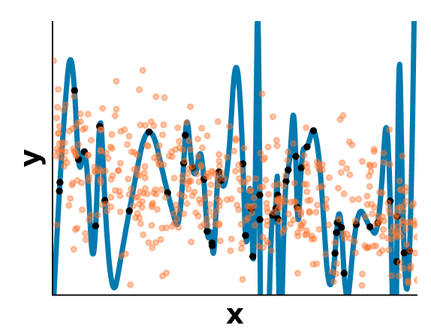
Train vs test error
Measure:
errors on test data (generalization)
errors on the train data

Slide 16
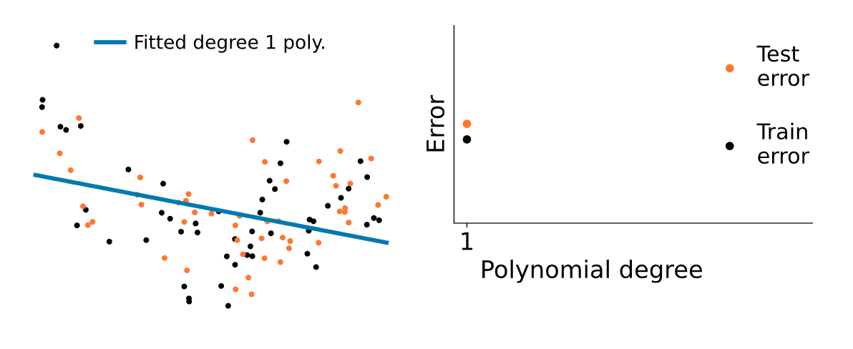

Slide 17
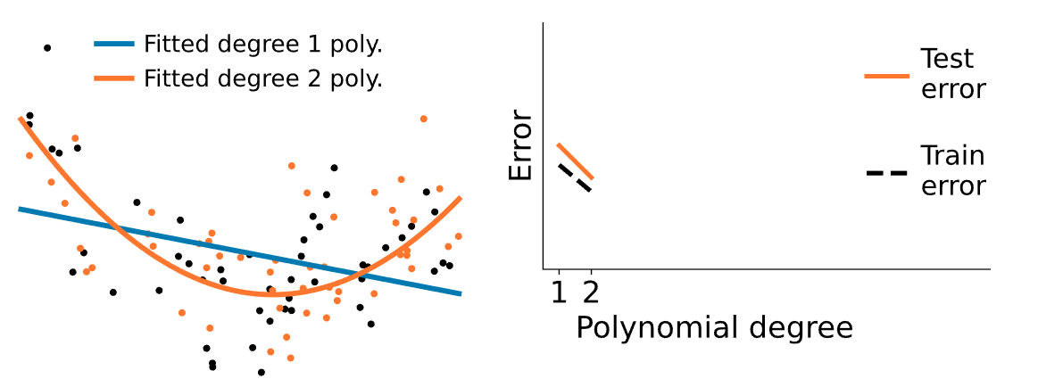

Slide 18
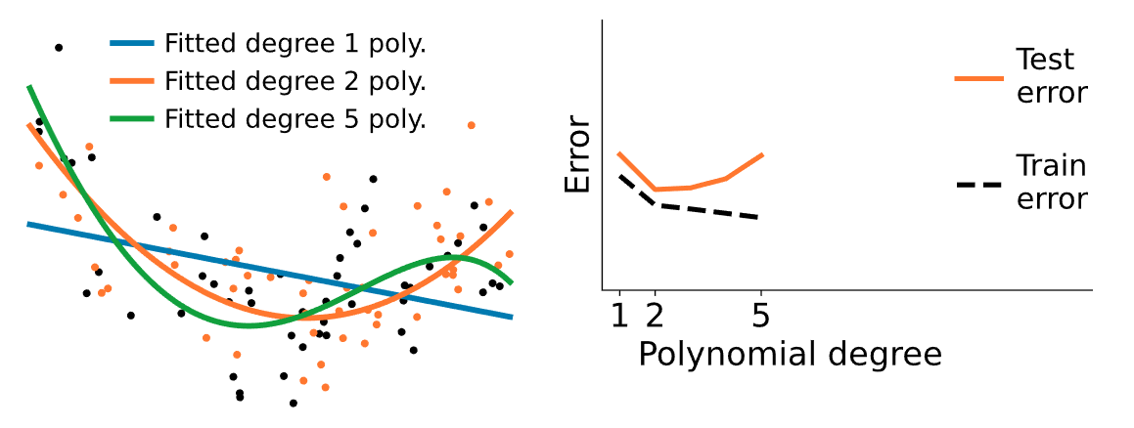

Slide 19
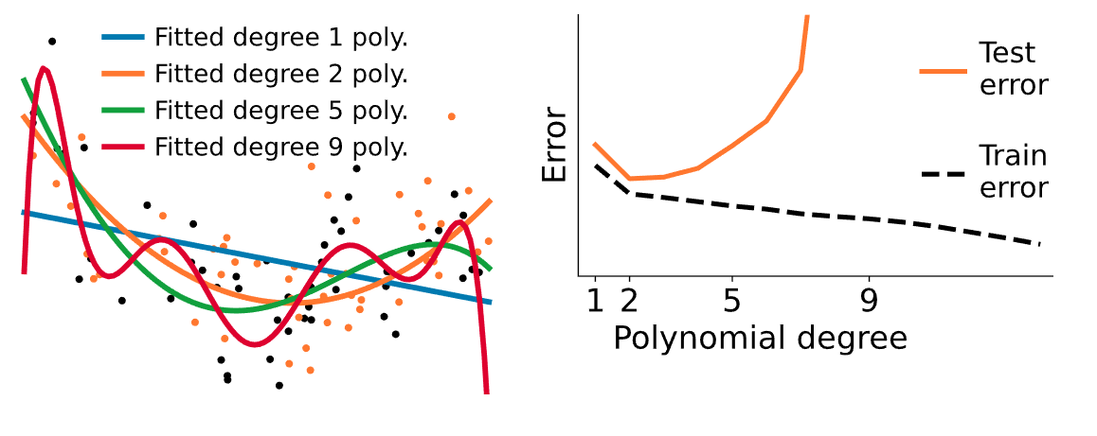

Slide 20
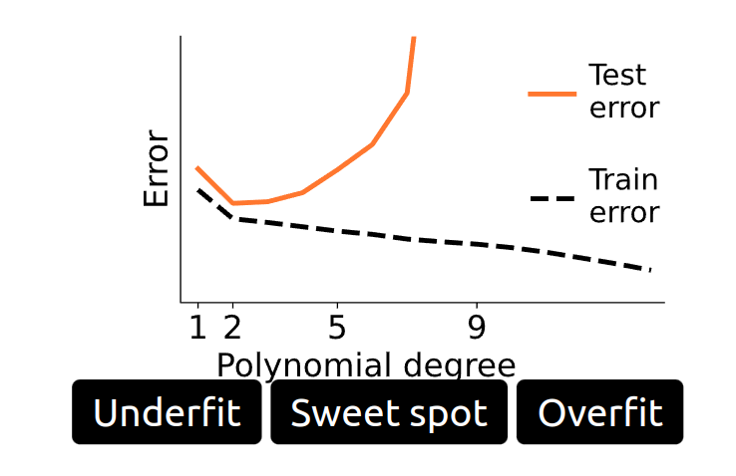
Train vs test error: increasing complexity

Slide 21
Varying sample size
Learning curves

Slide 22
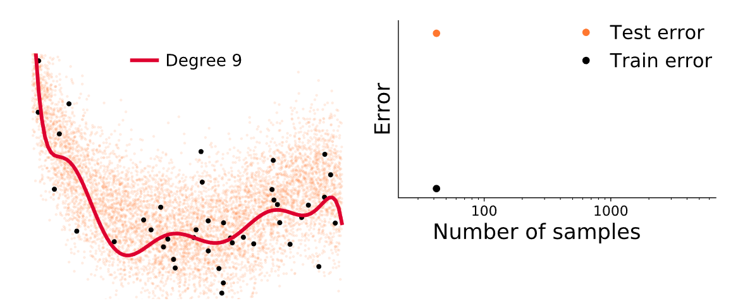
Overfit

Slide 23
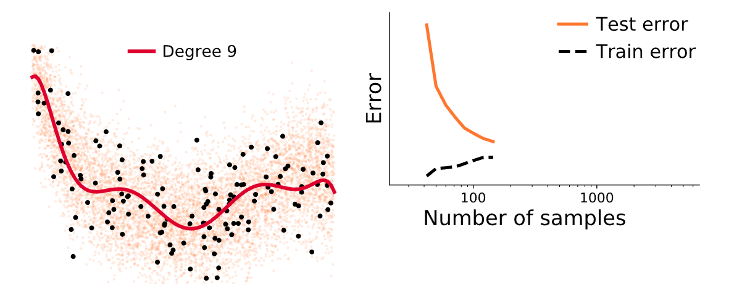

Slide 24
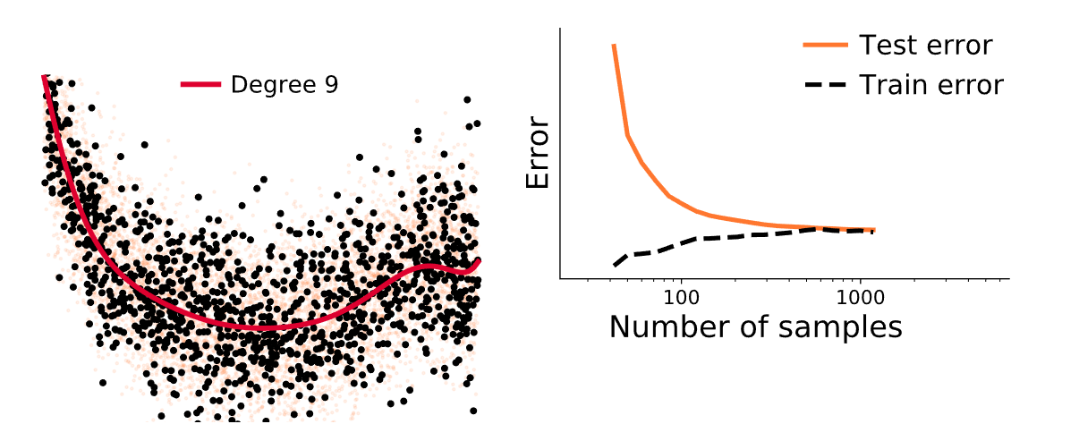
Sweet spot?

Slide 25
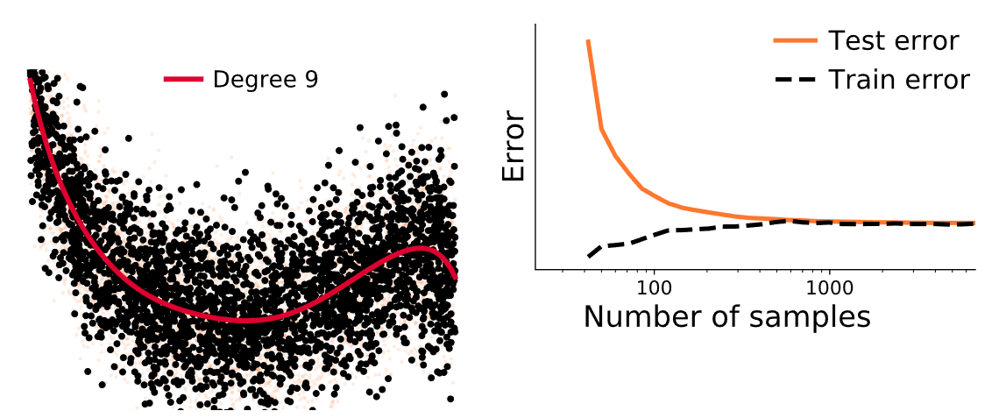
Diminishing returns

Slide 26
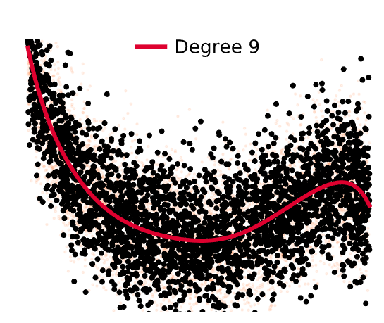
The error of the best model trained on unlimited data.
Here, the data-generating process is a degree-9 polynomial
We cannot do better
Predictions limited by noise

Slide 27
Model families
So far: polynomials for both
Some family names: linear models, decision trees, random forests, kernel machines, multi-layer perceptrons

Slide 28
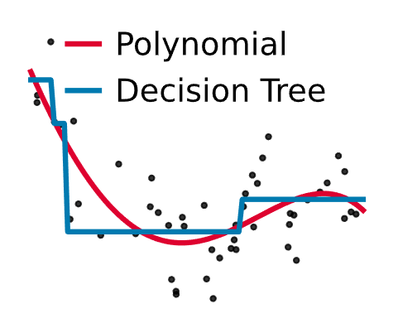
Different model families

Slide 29
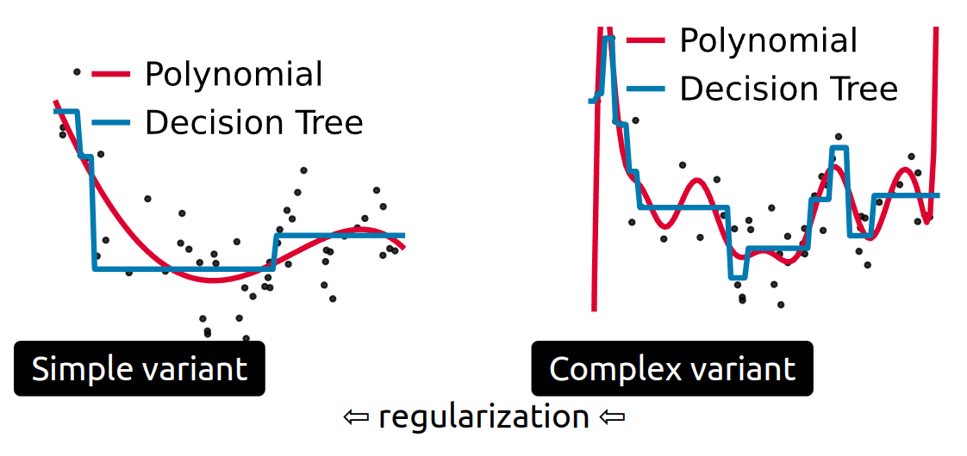

Slide 30
Different model families = different complexity & inductive bias

Slide 31
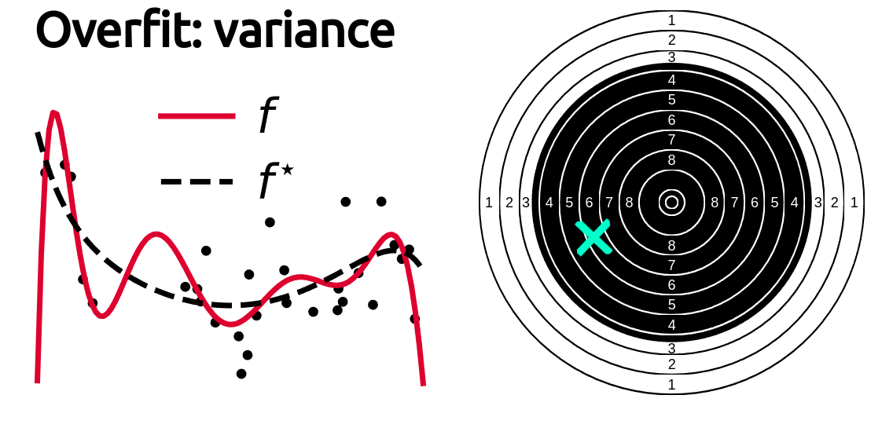

Slide 32
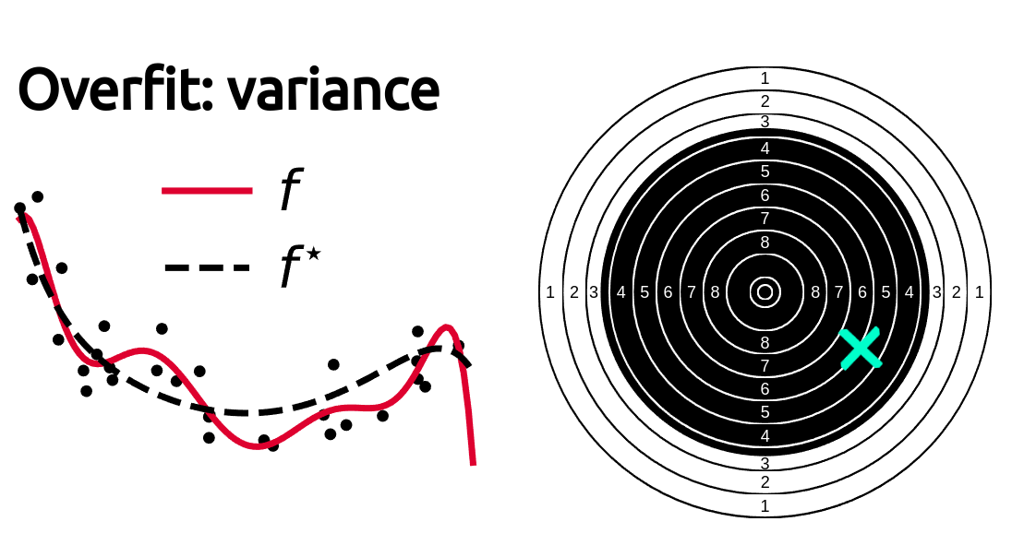

Slide 33
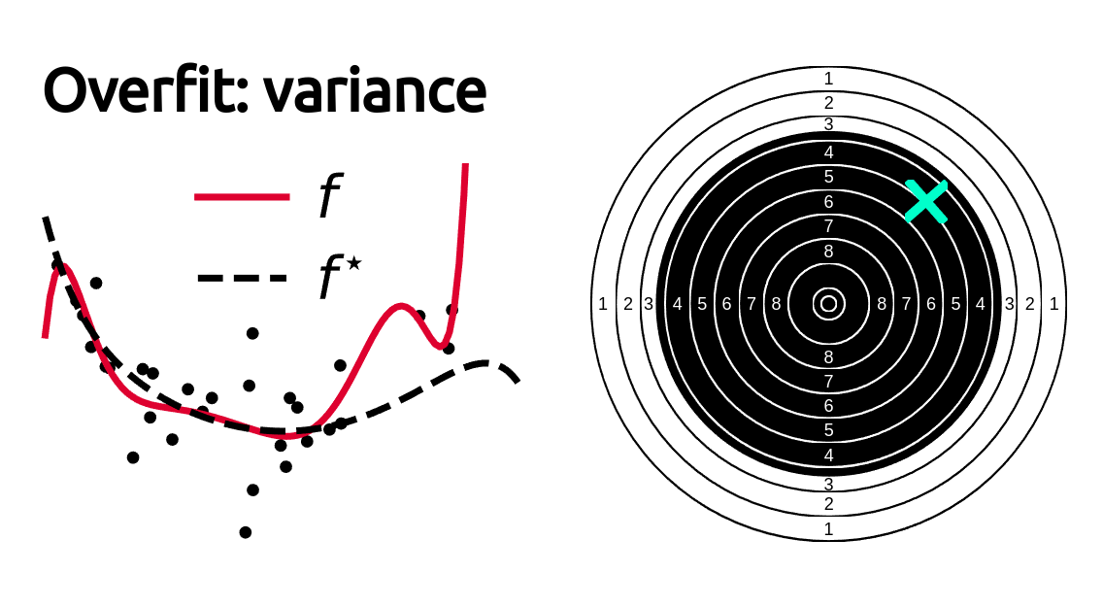

Slide 34
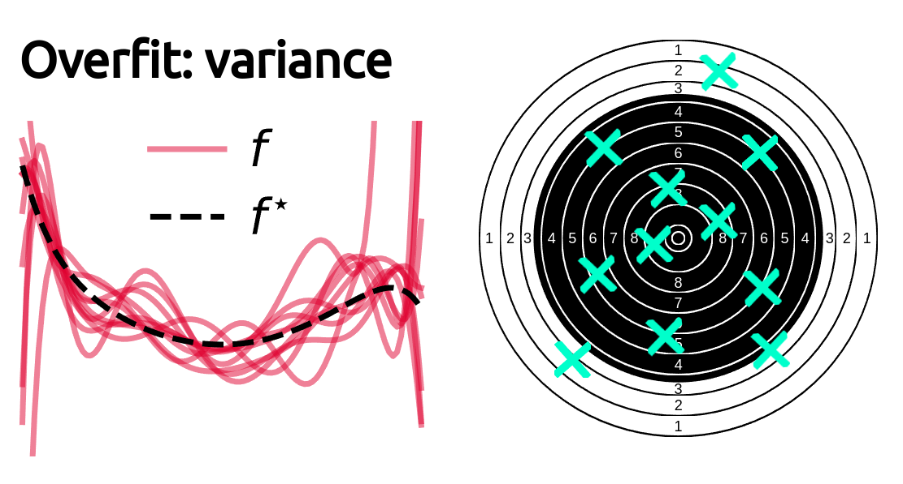

Slide 35
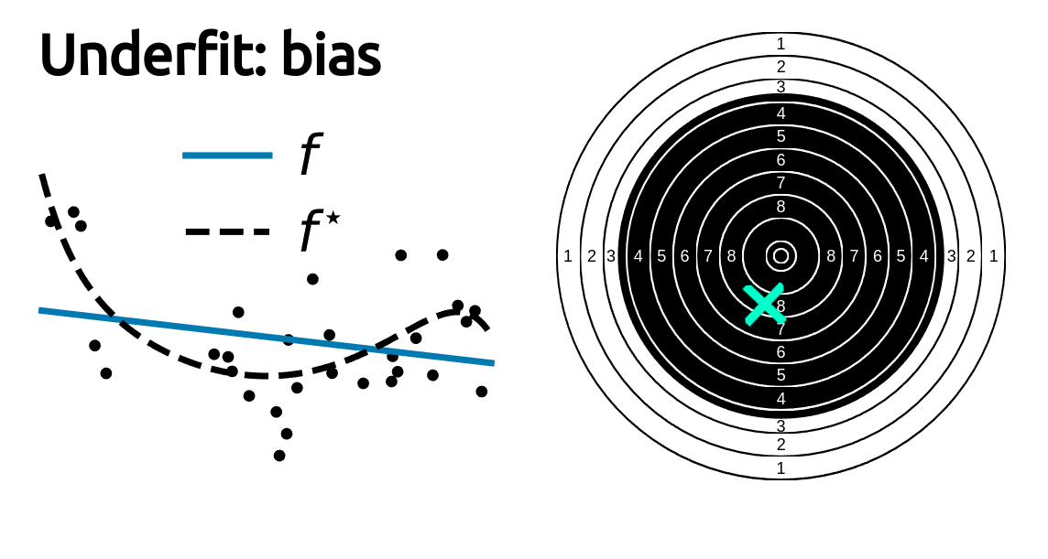

Slide 36
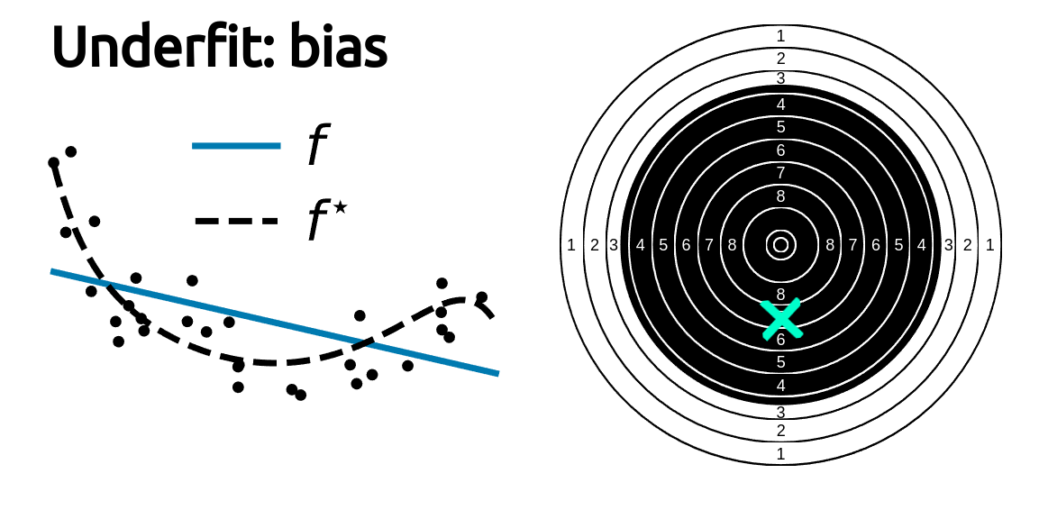

Slide 37
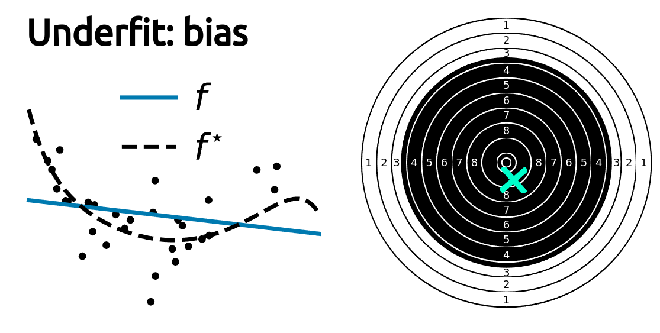

Slide 38
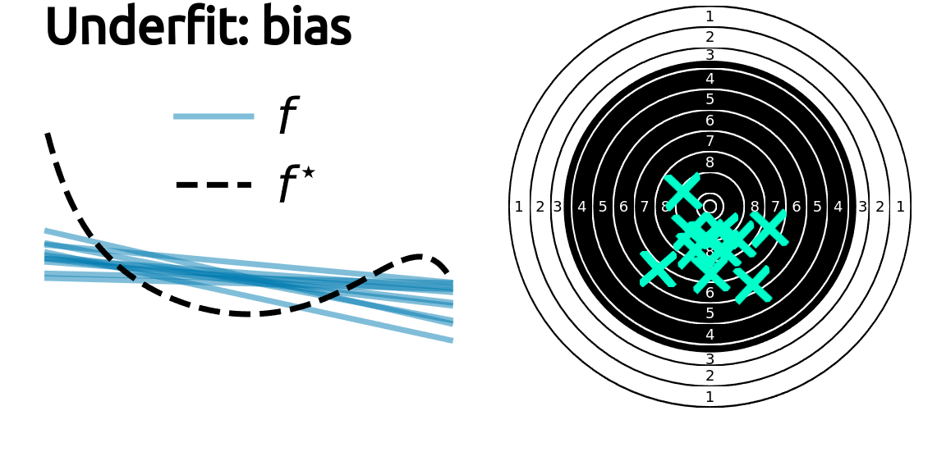

Slide 39
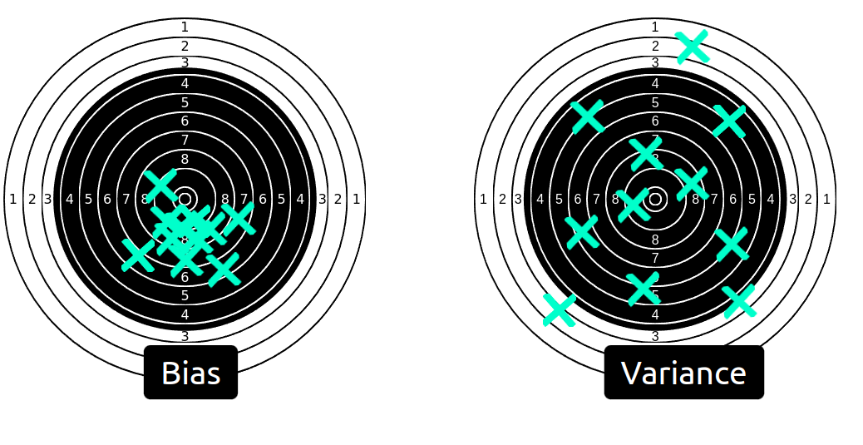
Underfit versus overfit

Slide 40
Take home messages
High bias == underfitting
High variance == overfitting

