Slide 1
Sklearn
Decision Trees

Slide 2
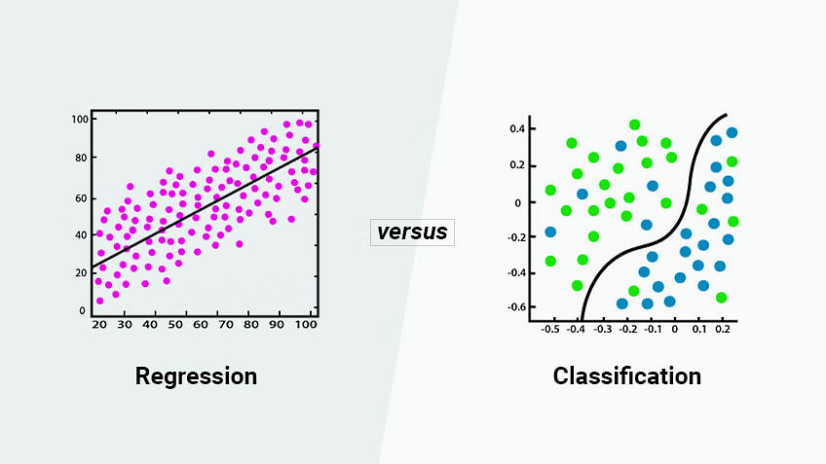
regression and classification

Slide 3
What is a decision tree?

Slide 4
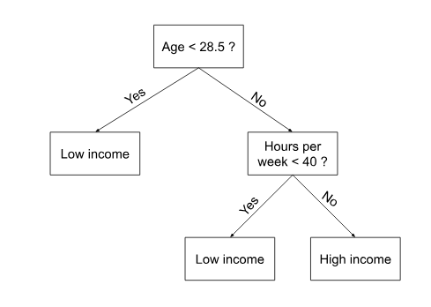

Slide 5
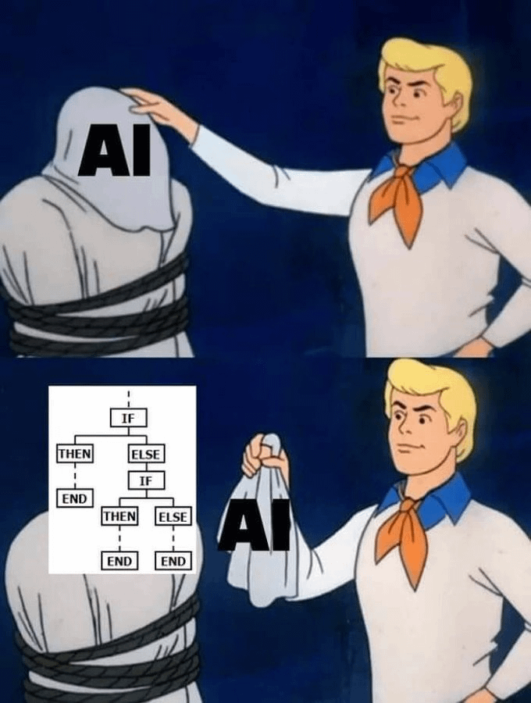

Slide 6
Growing a classification tree

Slide 7
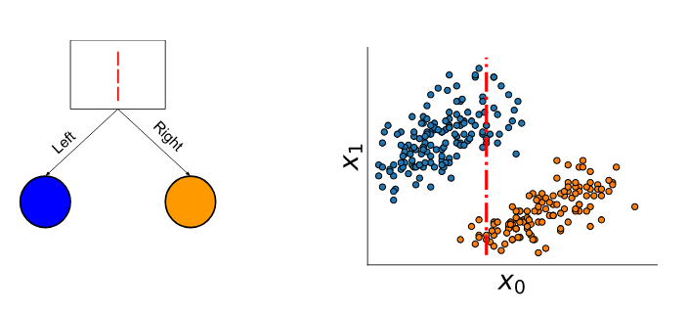
Classification with a decision tree

Slide 8
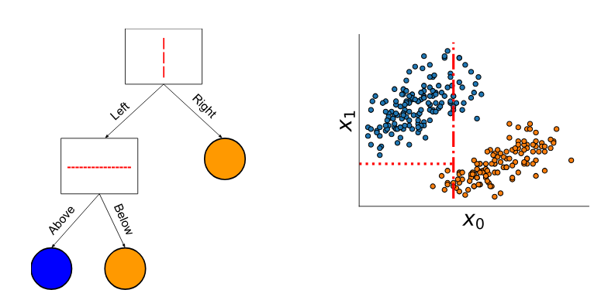

Slide 9
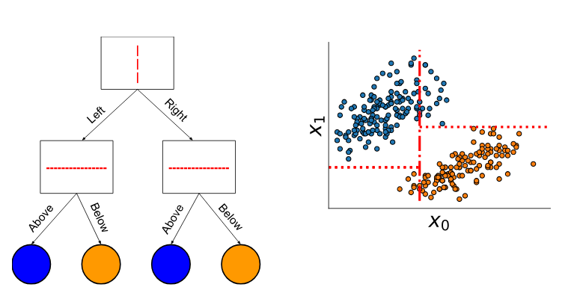

Slide 10
Growing a regression tree

Slide 11
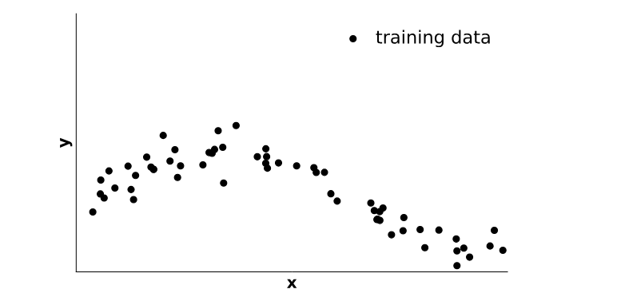
Regression with a decision tree

Slide 12
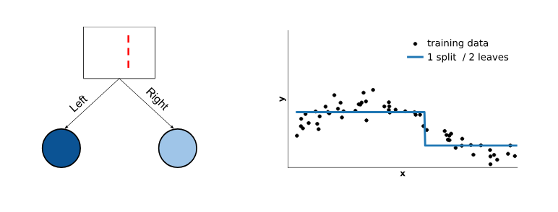

Slide 13
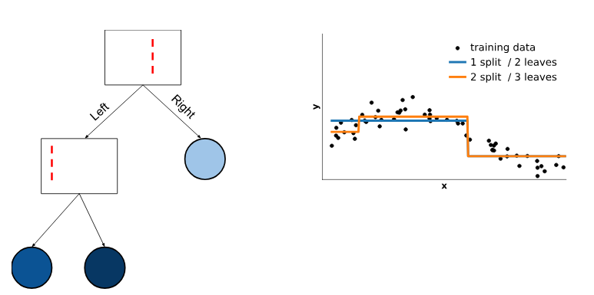

Slide 14
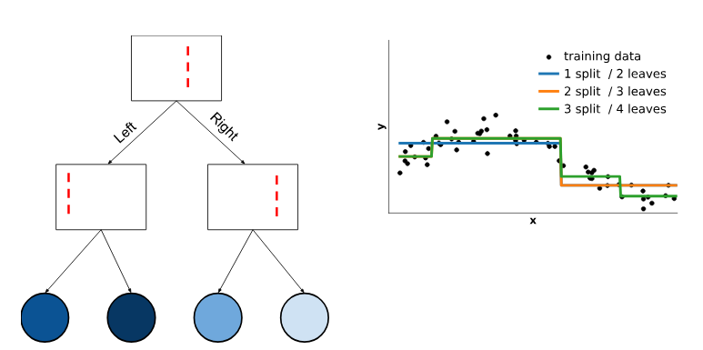

Slide 15
Tree depth and overfitting
How the maximum depth impacts generalization?

Slide 16
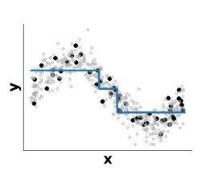
Tree: underfit / overfit tradeoff

Slide 17
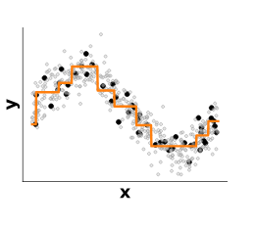
Tree: underfit / overfit tradeoff

Slide 18
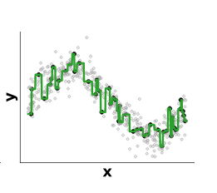
Tree: underfit / overfit tradeoff
Underfitting
Best trade-off
Overfitting
max_depth or max_leaf_nodes too small
max_depth or max_leaf_nodes too large

Slide 19
Sequence of simple decision rules: one feature and one threshold at a time
No scaling required for numerical features
max_depth controls the trade-off between underfitting and overfitting
Mostly useful as a building block for ensemble models
Random Forests
Gradient Boosting Decision Trees

Slide 20
Quiz
for which kind of supervised learning tasks decision trees can be applied to:
a) classification tasks
b) regression tasks
c) clustering tasks

Slide 21
checkout
decision_trees/trees_classification.ipynb
decision_trees/trees_ex_01.ipynb
decision_trees/trees_regression.ipynb

Slide 22
Checkout, extrapolation
exercise,
trees_ex_02.ipynb

Slide 23
Importance of decision tree hyperparameters on generalization

Slide 24
Importance of decision tree hyperparameters on generalization

Slide 25
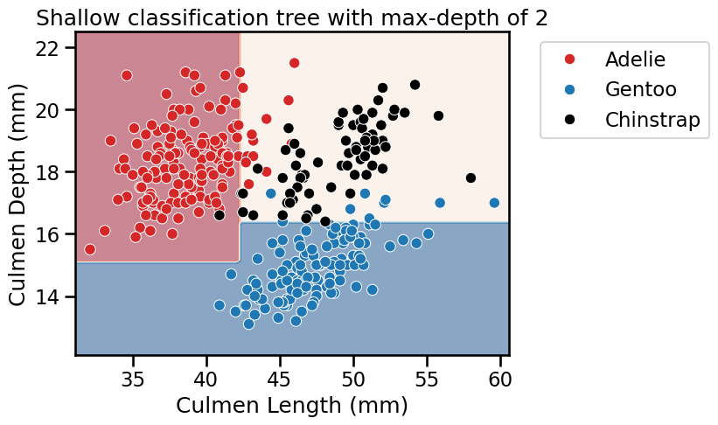
Effect of max-depth: shallow

Slide 26
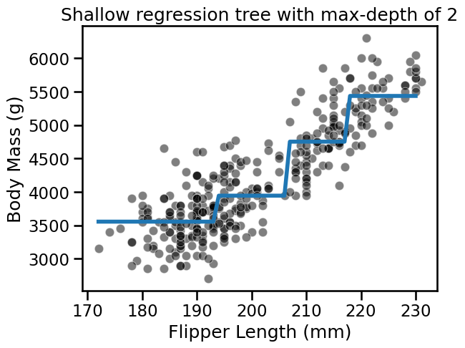
Effect of max-depth: shallow (regression)

Slide 27
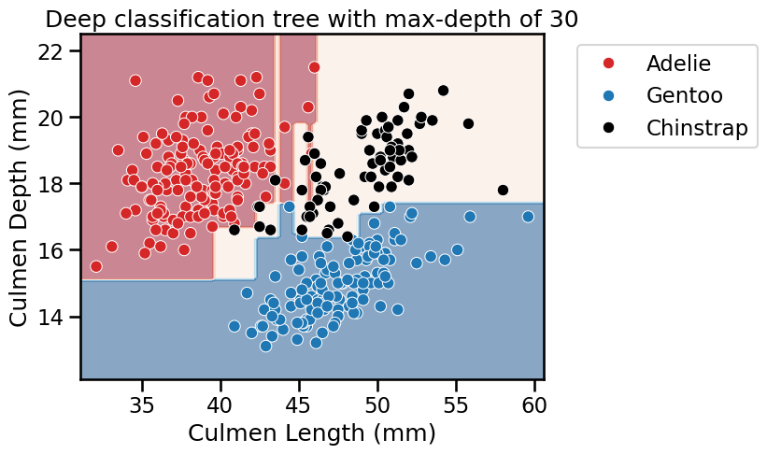
Effect of max-depth: overfit? noisy,

Slide 28
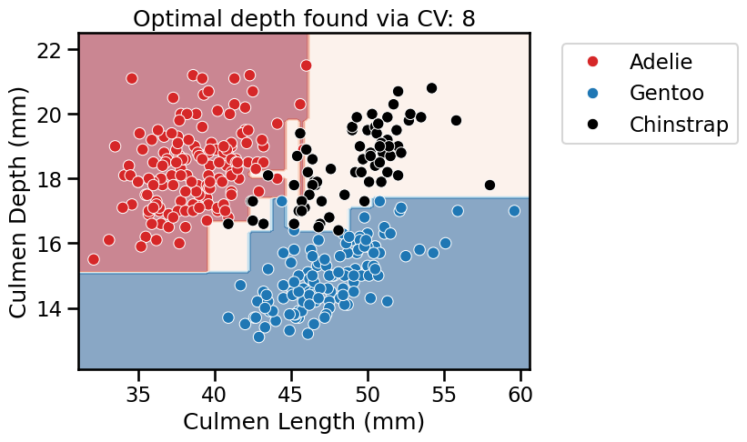
Effect of max-depth: By using CV on max_depth

Slide 29
Should the tree be always symmetric?

Slide 30
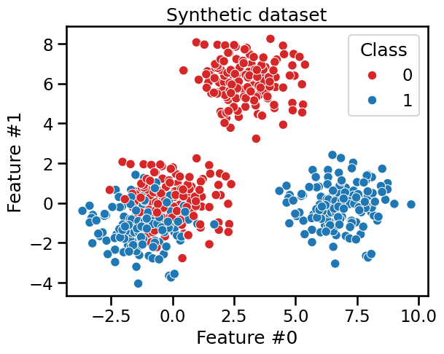

Slide 31
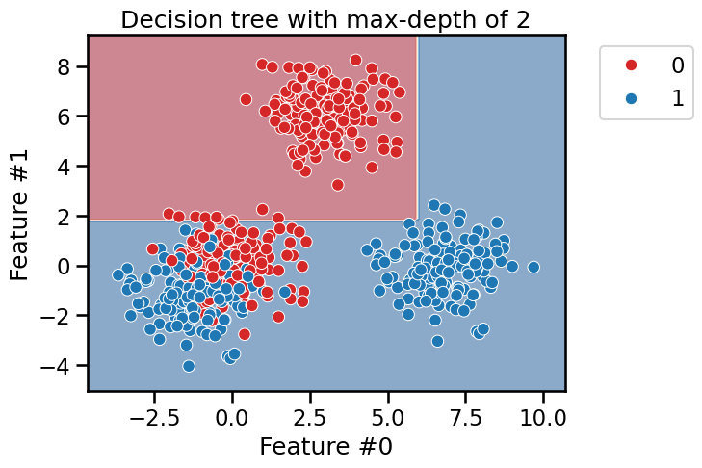

Slide 32
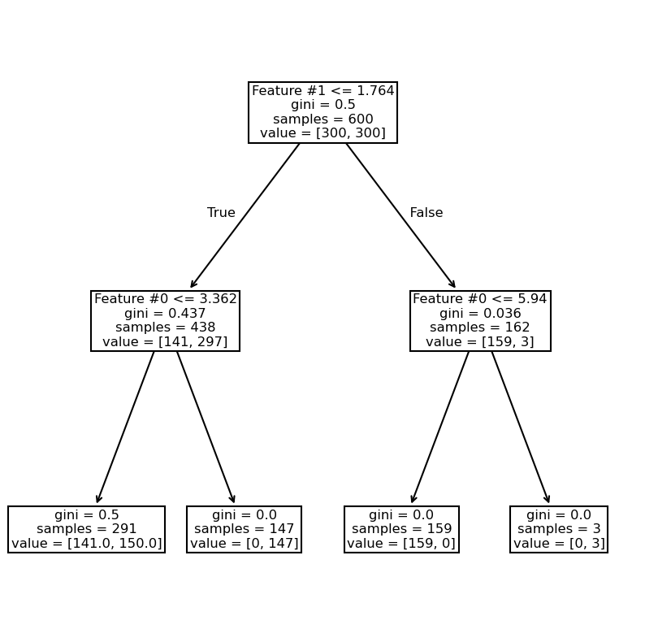

Slide 33
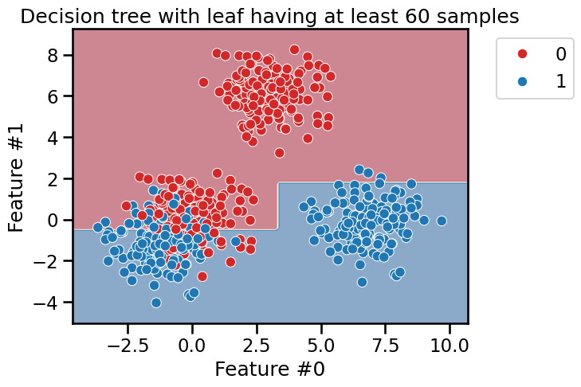

Slide 34
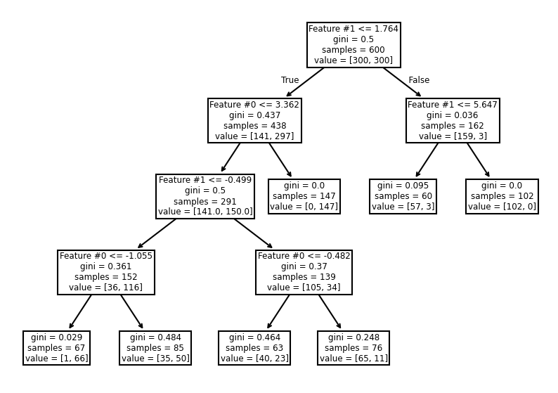

Slide 35
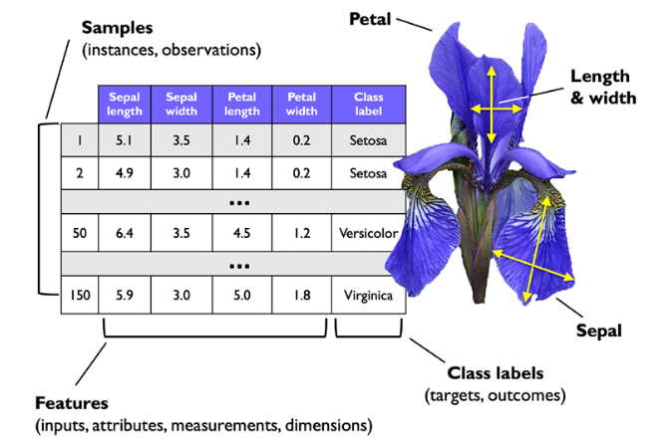

Slide 36

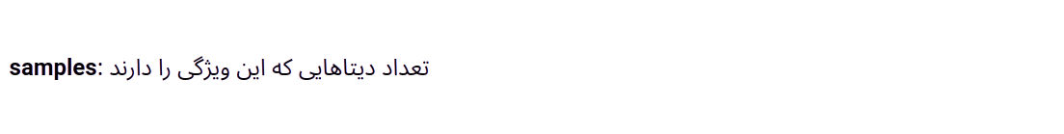
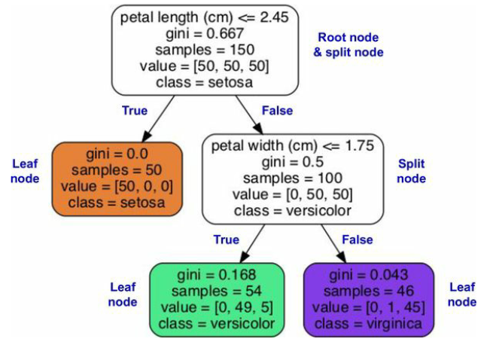

Slide 37
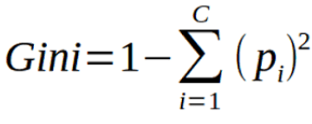
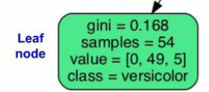
Gini Impurity

