Slide 1
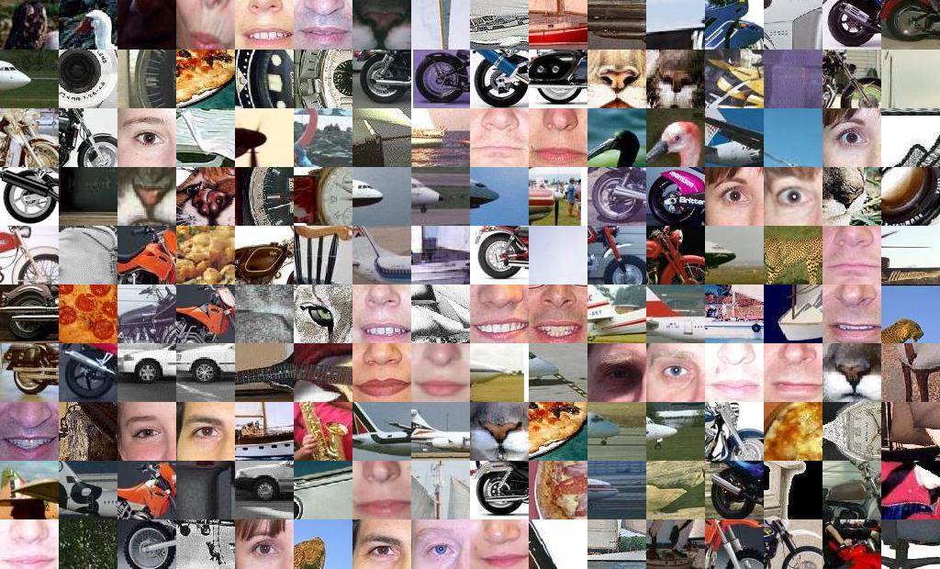
Feature detectors and descriptors
Slides are adopted from : 16-385 Computer Vision Spring 2020, Lecture 6

Slide 2
Why do we need feature descriptors?

Slide 3
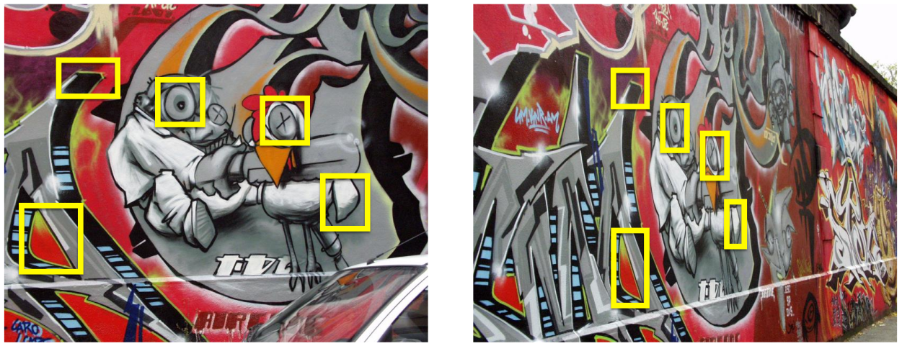
If we know where the good features are,
how do we match them?

Slide 4
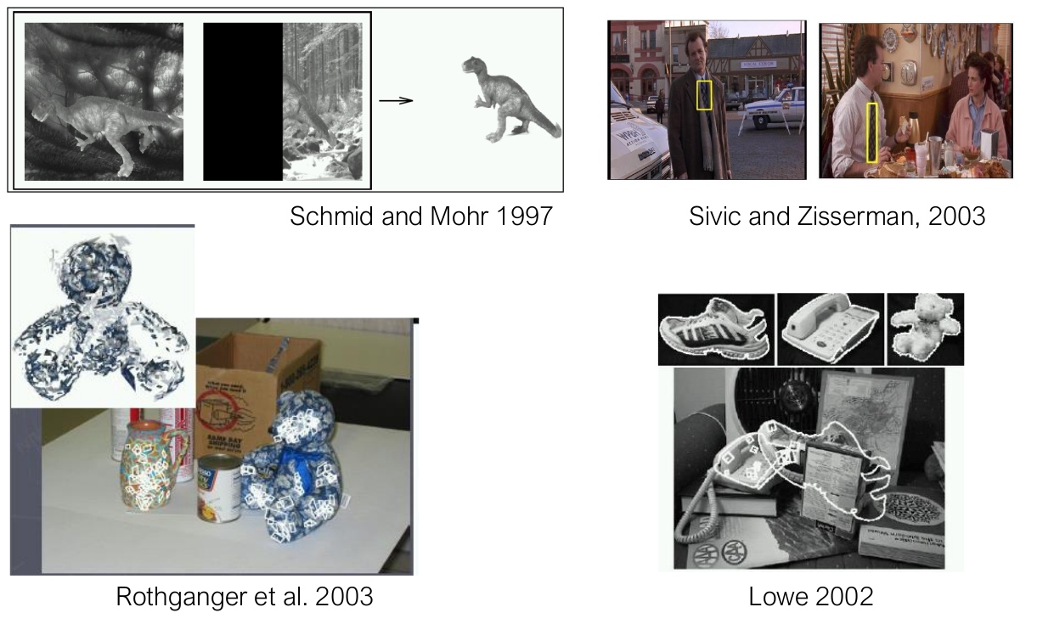
Object instance recognition

Slide 5
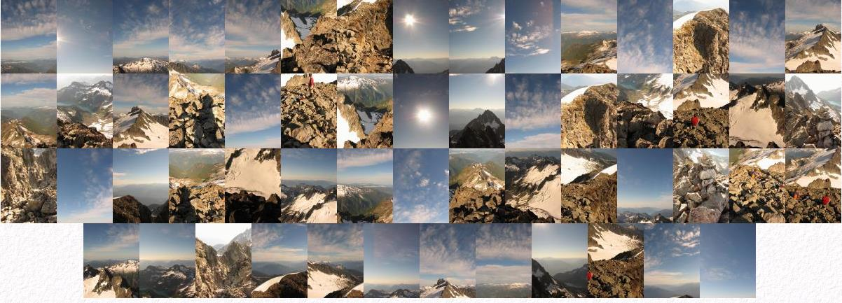
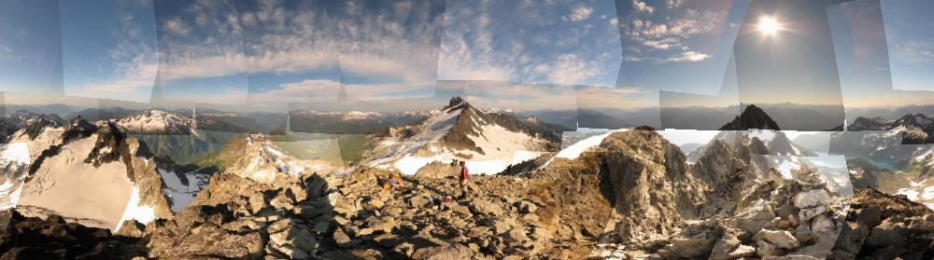
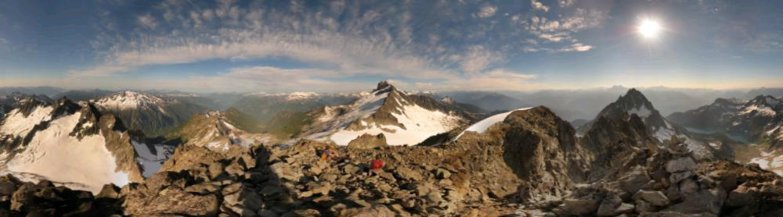
Image mosaicing

Slide 6
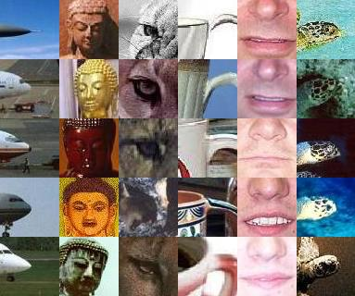
How do we describe an image patch?
Patches with similar content should have similar descriptors

Slide 7
Designing feature descriptors

Slide 8
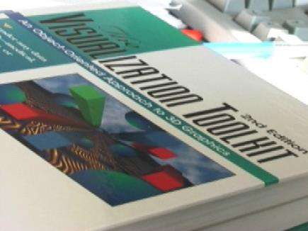
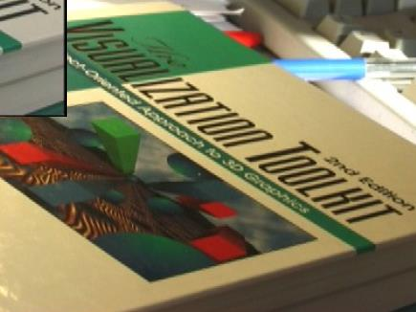
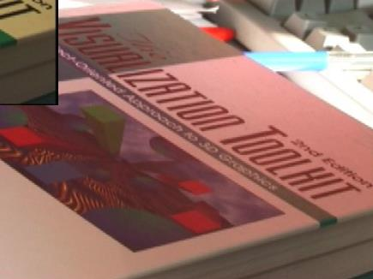
Photometric transformations

Slide 9
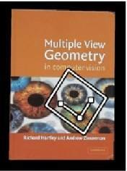
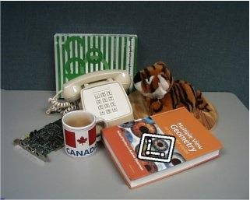
Geometric transformations
objects will appear at different scales, translation and rotation

Slide 10
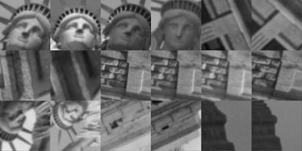
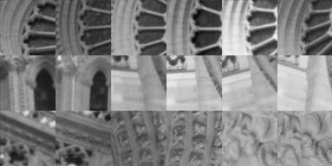
What is the best descriptor for an image feature?

Slide 11
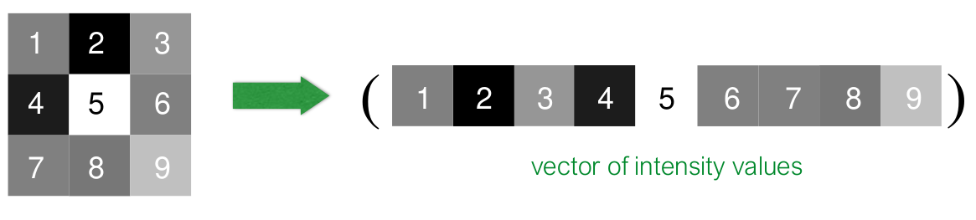
Image patch
Just use the pixel values of the patch
Perfectly fine if geometry and appearance is unchanged
(a.k.a. template matching)

Slide 12
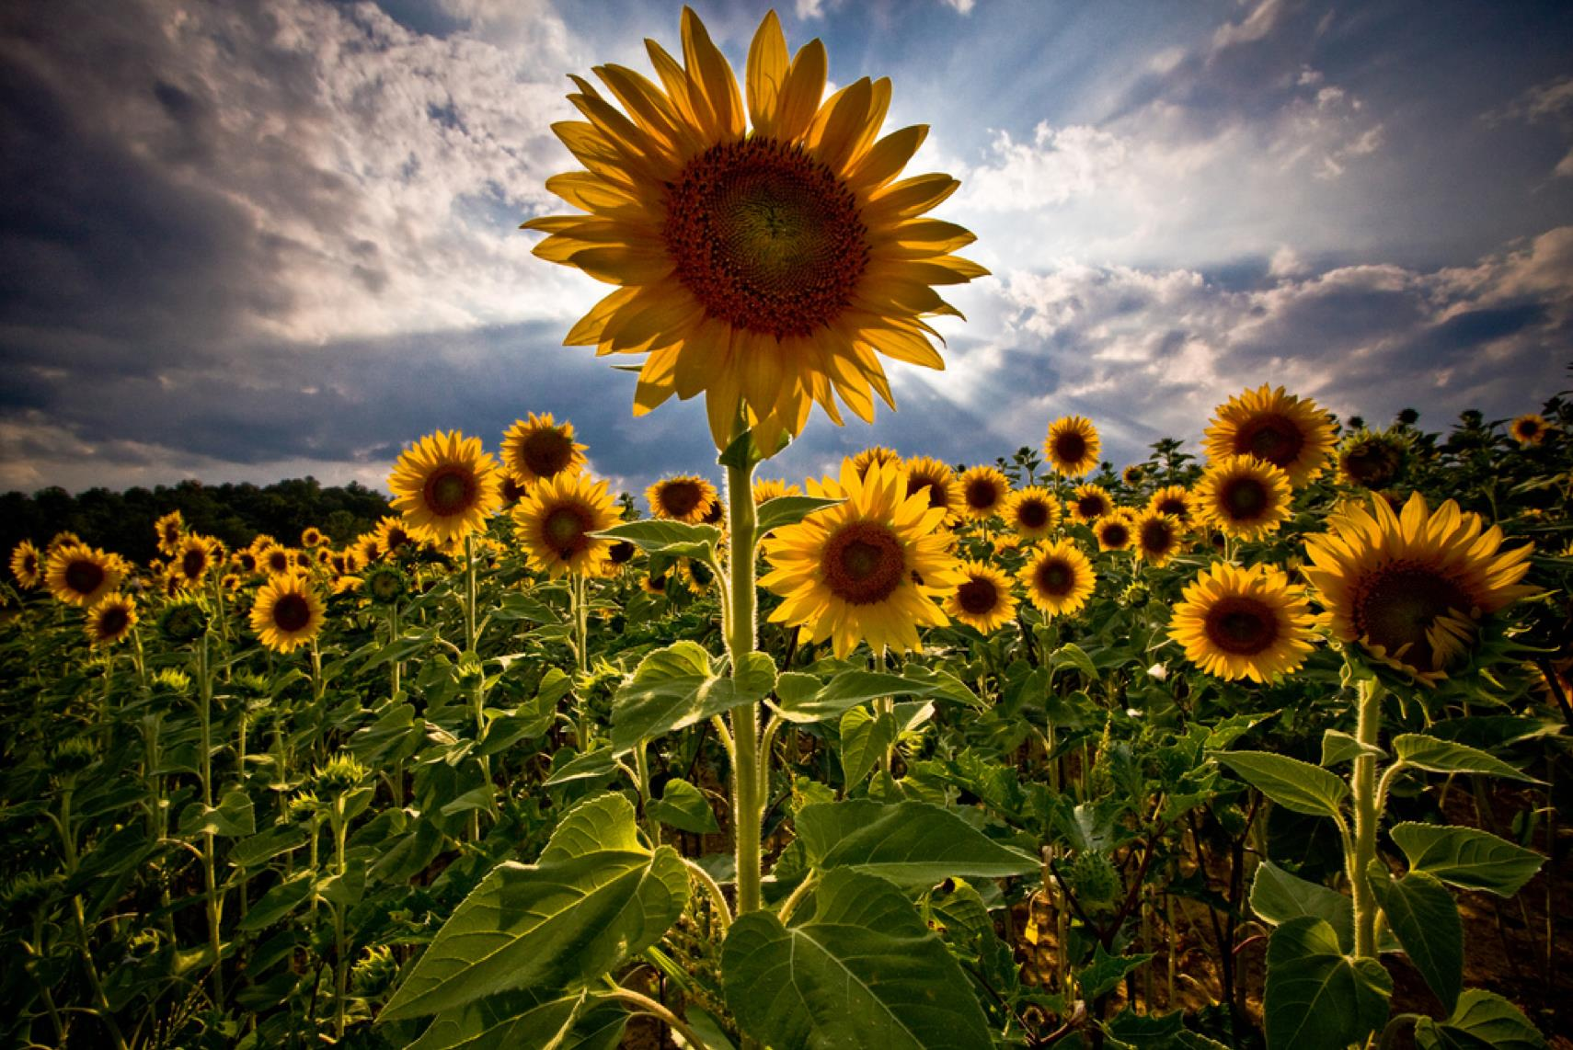
Tiny Images

Slide 13
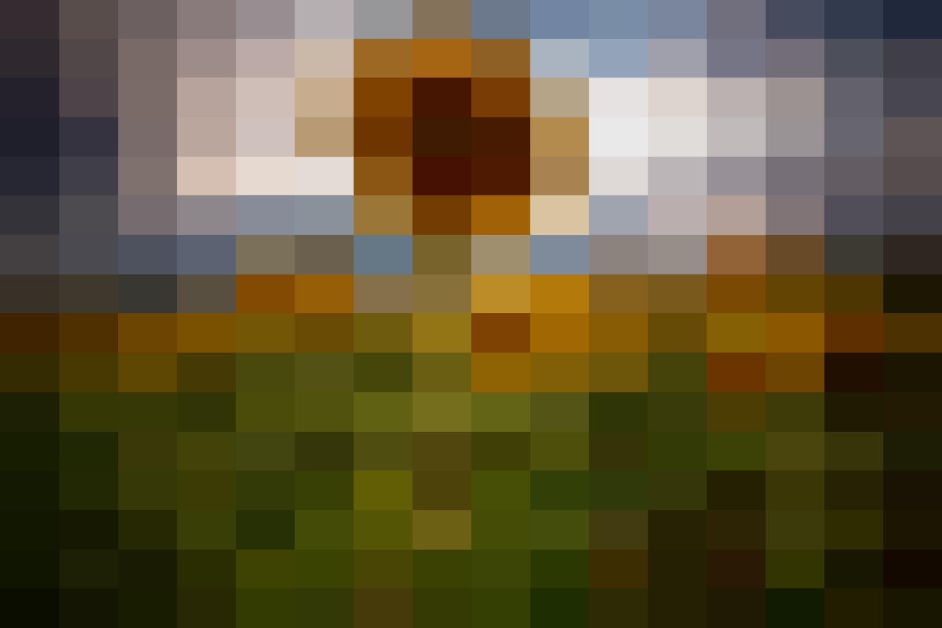
Just down-sample it!
Simple, fast, robust to small affine transforms.

Slide 14
Image patch
Just use the pixel values of the patch
Perfectly fine if geometry and appearance is unchanged
(a.k.a. template matching)
What are the problems?

Slide 15
Image patch
Just use the pixel values of the patch
Perfectly fine if geometry and appearance is unchanged
(a.k.a. template matching)
What are the problems?
How can you be less sensitive to absolute intensity values?

Slide 16
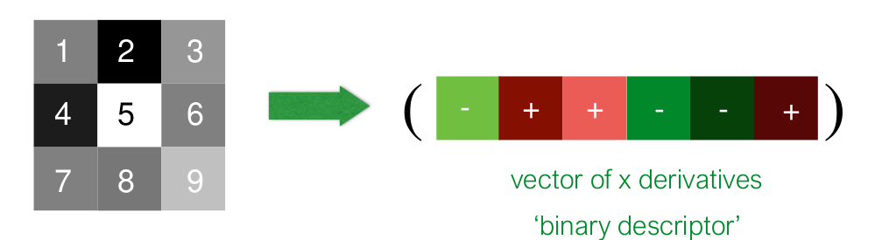
Image gradients
Use pixel differences
Feature is invariant to absolute intensity values
What are the problems?

Slide 17
Image gradients
Use pixel differences
Feature is invariant to absolute intensity values
What are the problems?
How can you be less sensitive to deformations?

Slide 18
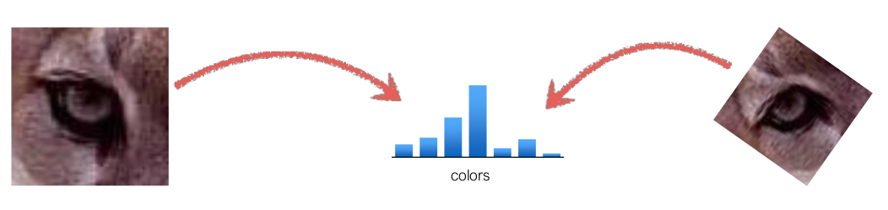
Color histogram
Count the colors in the image using a histogram
Invariant to changes in scale and rotation
What are the problems?

Slide 19
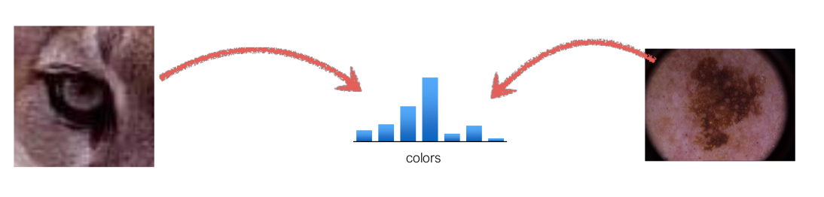
Color histogram
Count the colors in the image using a histogram
Invariant to changes in scale and rotation
What are the problems?

Slide 20
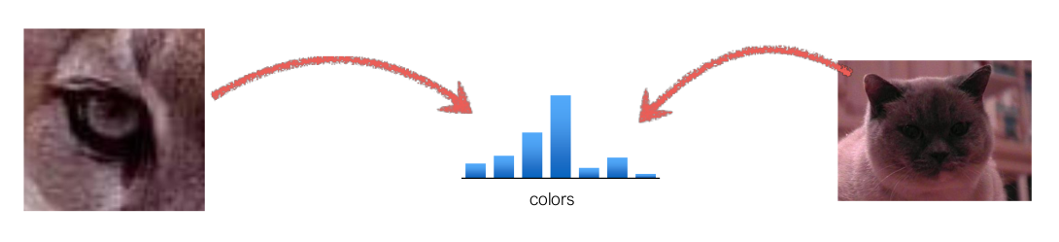
Color histogram
Count the colors in the image using a histogram
Invariant to changes in scale and rotation
What are the problems?
How can you be more sensitive to spatial layout?

Slide 21
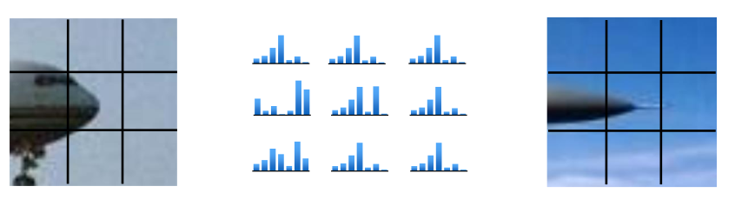
Spatial histograms
Compute histograms over spatial ‘cells’
Retains rough spatial layout
Some invariance to deformations
What are the problems?

Slide 22
Spatial histograms
Compute histograms over spatial ‘cells’
Retains rough spatial layout
Some invariance to deformations
What are the problems?
How can you be completely invariant to rotation?

Slide 23
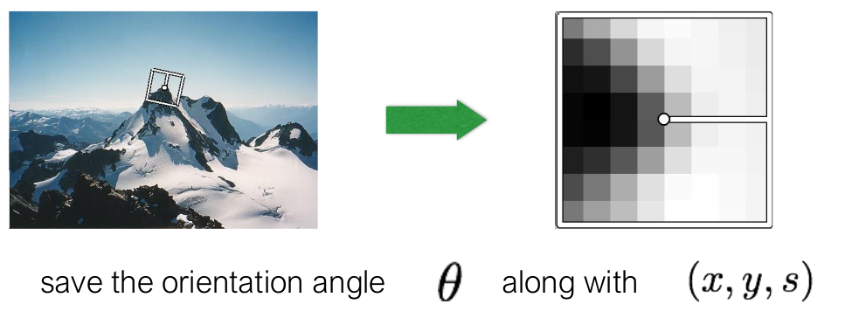
Orientation normalization
Use the dominant image gradient direction to normalize the orientation of the patch
s: represents the spatial extent or size of the patch around the keypoint. It determines how large a region of the image is used for feature analysis.
What are the problems?

Slide 24
MOPS descriptor

Slide 25
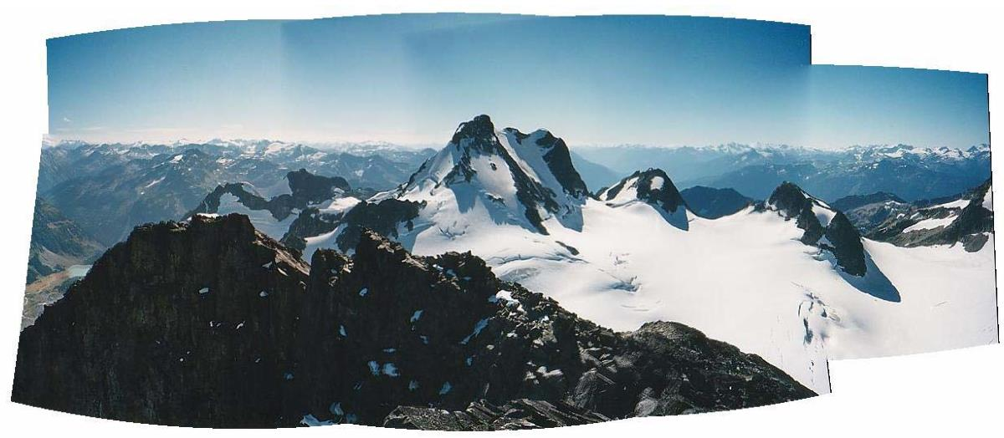
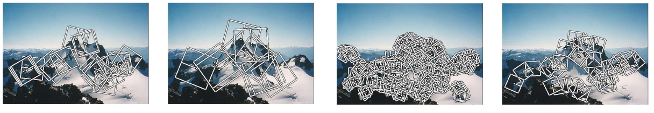
Multi-Scale Oriented Patches (MOPS)
Multi-Image Matching using Multi-Scale Oriented Patches. M. Brown, R. Szeliski and S. Winder. International Conference on Computer Vision and Pattern Recognition (CVPR2005). pages 510-517

Slide 26
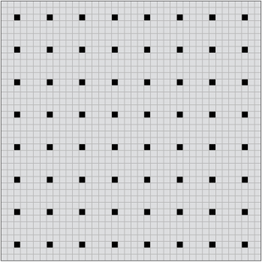

Multi-Scale Oriented Patches (MOPS)
Multi-Image Matching using Multi-Scale Oriented Patches. M. Brown, R. Szeliski and S. Winder. International Conference on Computer Vision and Pattern Recognition (CVPR 2005). pages 510-517
Given a feature
Get 40 x 40 image patch, subsample every 5th pixel
(what’s the purpose of this step?)
Subtract the mean, divide by standard deviation
(what’s the purpose of this step?)
Haar Wavelet Transform
(what’s the purpose of this step?)

Slide 27
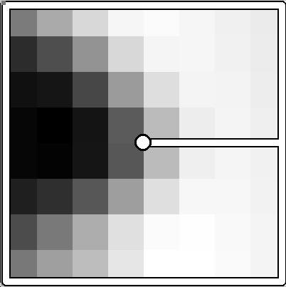
Multi-Scale Oriented Patches (MOPS)
Multi-Image Matching using Multi-Scale Oriented Patches. M. Brown, R. Szeliski and S. Winder. International Conference on Computer Vision and Pattern Recognition (CVPR 2005). pages 510-517
Given a feature
Get 40 x 40 image patch, subsample every 5th pixel
(low frequency filtering, absorbs localization errors)
Subtract the mean, divide by standard deviation
(what’s the purpose of this step?)
Haar Wavelet Transform
(what’s the purpose of this step?)

Slide 28

Multi-Scale Oriented Patches (MOPS)
Multi-Image Matching using Multi-Scale Oriented Patches. M. Brown, R. Szeliski and S. Winder. International Conference on Computer Vision and Pattern Recognition (CVPR 2005). pages 510-517
Given a feature
Get 40 x 40 image patch, subsample every 5th pixel
(low frequency filtering, absorbs localization errors)
Subtract the mean, divide by standard deviation
(removes bias and gain)
Haar Wavelet Transform
(what’s the purpose of this step?)

Slide 29
Multi-Scale Oriented Patches (MOPS)
Multi-Image Matching using Multi-Scale Oriented Patches. M. Brown, R. Szeliski and S. Winder. International Conference on Computer Vision and Pattern Recognition (CVPR 2005). pages 510-517
Given a feature
Get 40 x 40 image patch, subsample every 5th pixel
(low frequency filtering, absorbs localization errors)
Subtract the mean, divide by standard deviation
(removes bias and gain)
Haar Wavelet Transform
(low frequency projection)

Slide 30
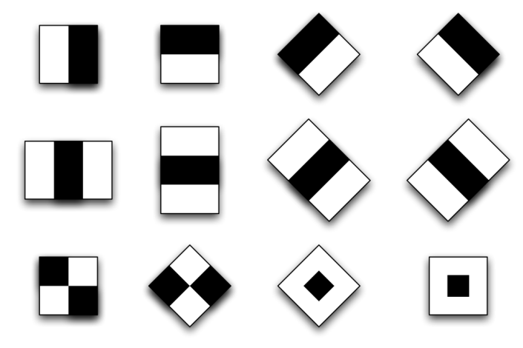
Haar Wavelets
(actually, Haar-like features)
Use responses of a bank of filters as a descriptor
We will see later in class how to compute Haar wavelet
responses efficiently (in constant time) with integral images

Slide 31
GIST descriptor

Slide 32
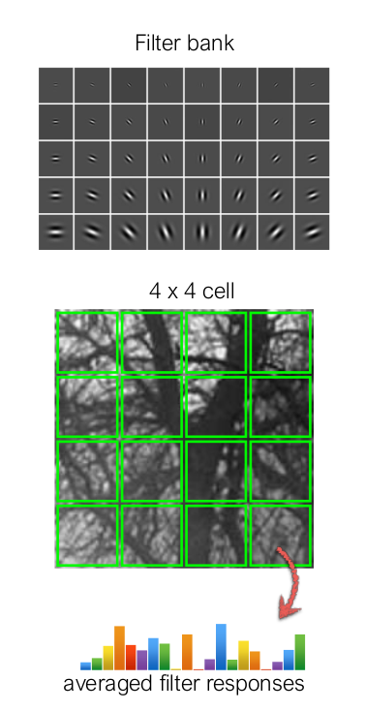
GIST
1. Compute filter responses (filter bank of Gabor filters)
2. Divide image patch into 4 x 4 cells
3. Compute filter response averages for each cell
4. Size of descriptor is 4 x 4 x N, where N is the size of the filter bank

Slide 33
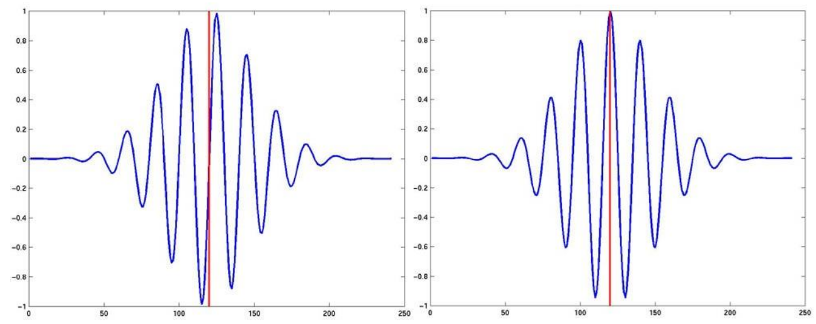
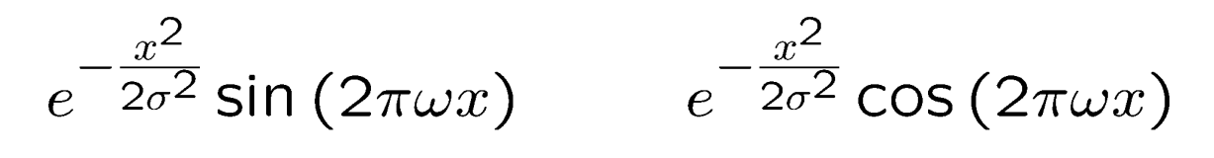
Gabor Filters
(1D examples)

Slide 34
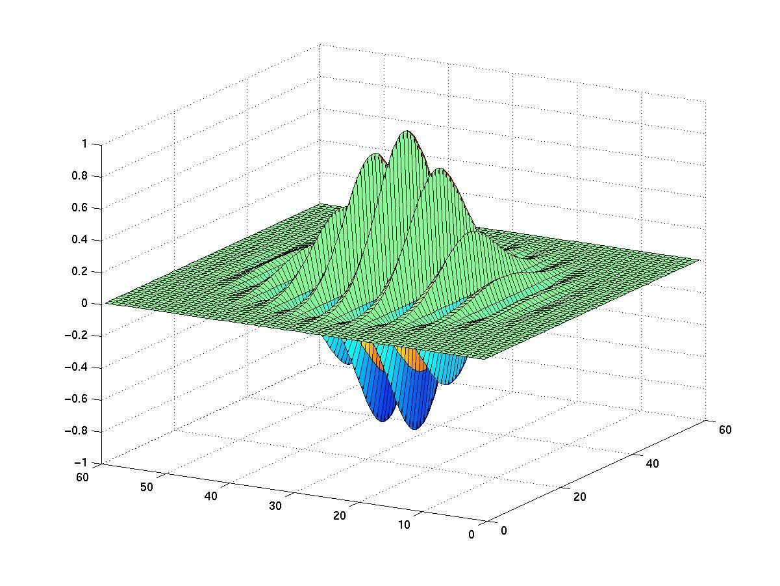
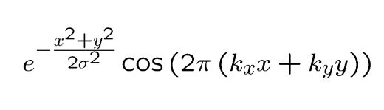
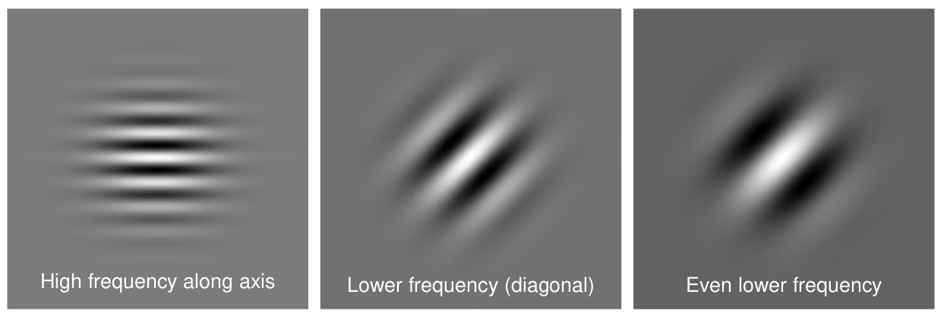
2D Gabor Filters

Slide 35
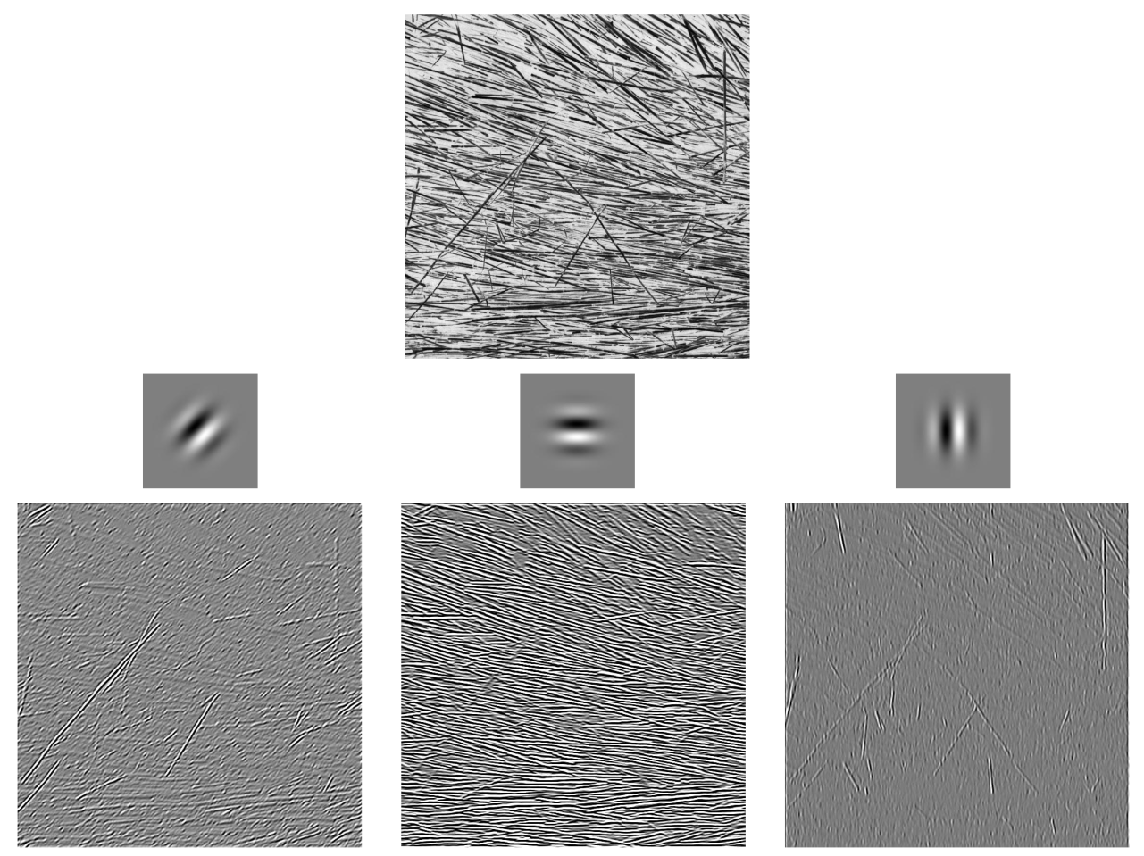

Slide 36
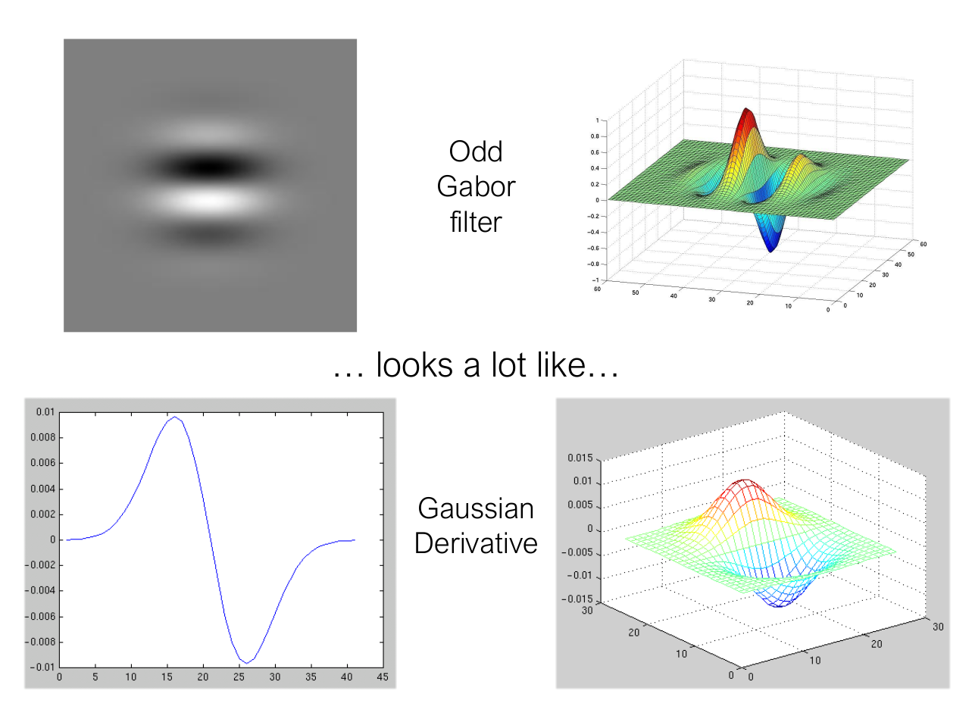

Slide 37
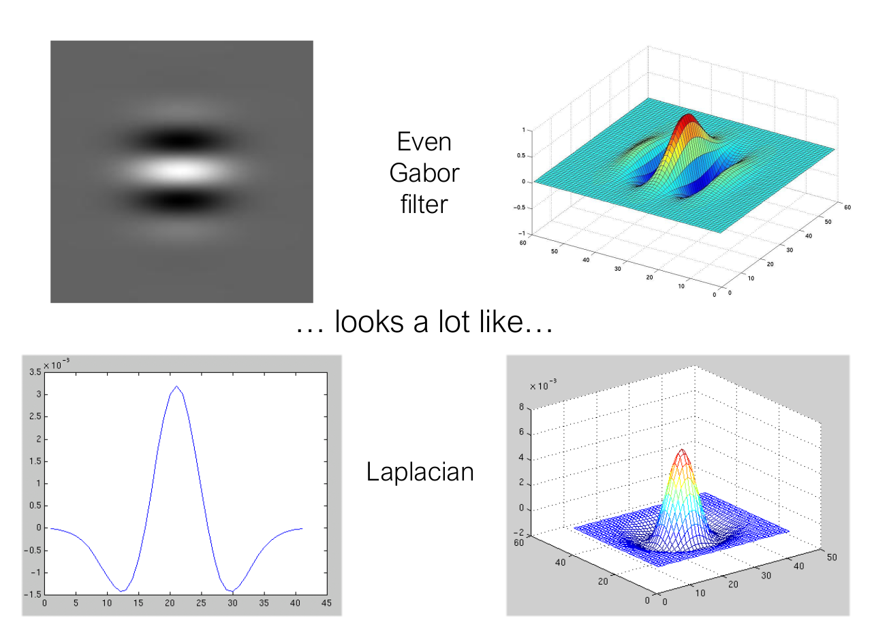

Slide 38
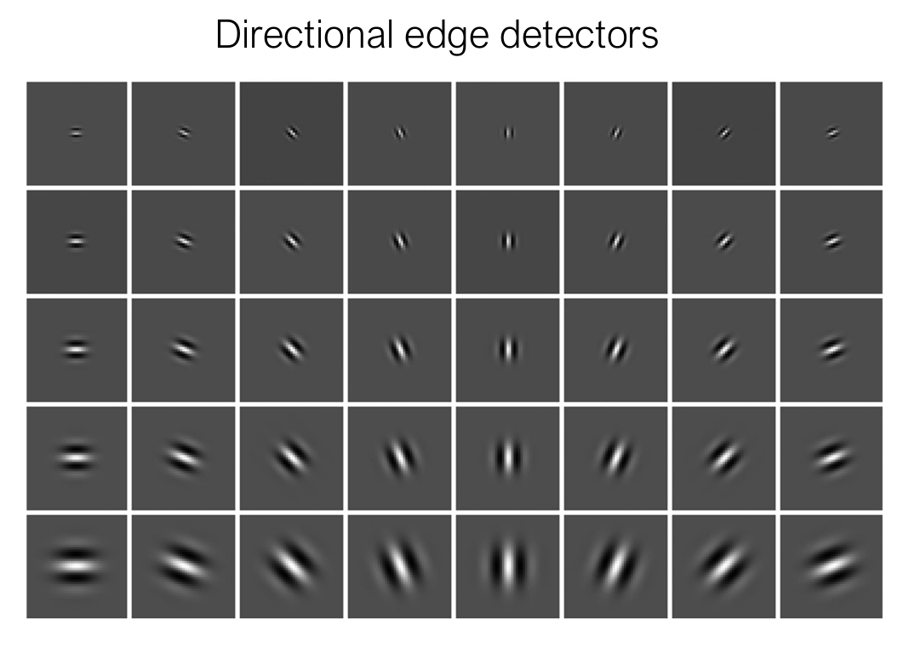

Slide 39
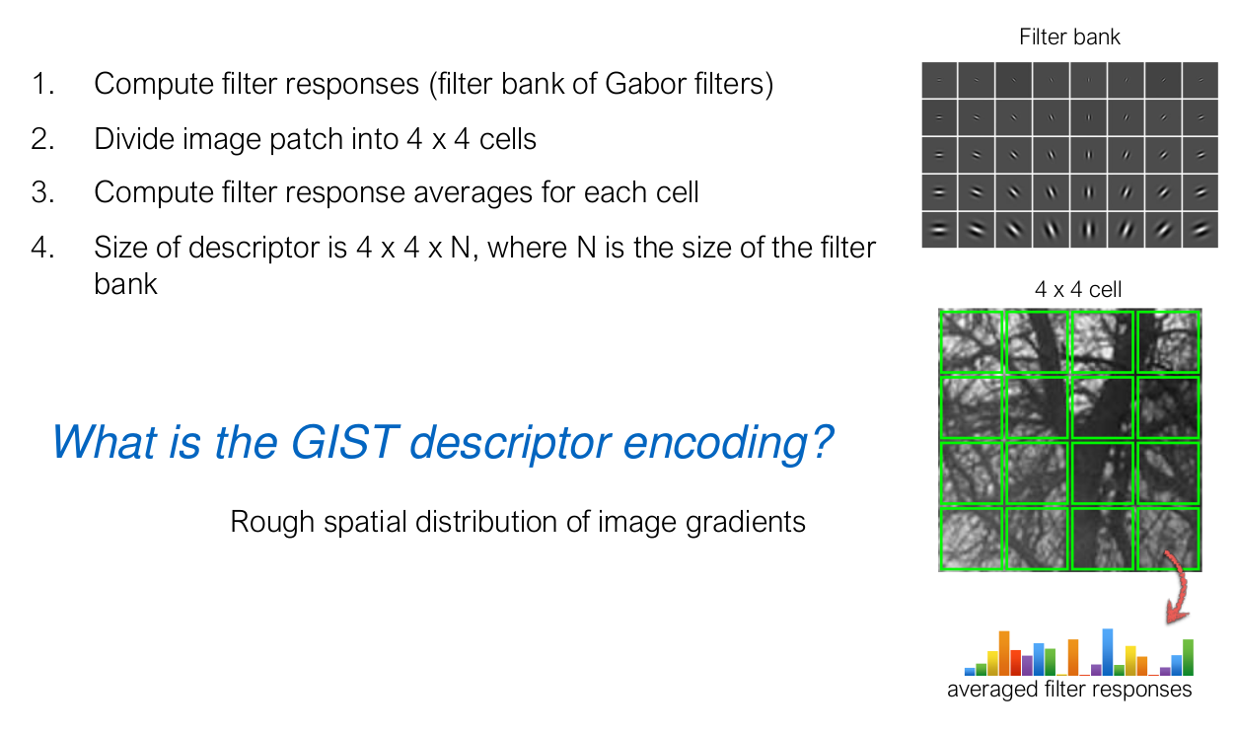
GIST

Slide 40
HOG descriptor

Slide 41
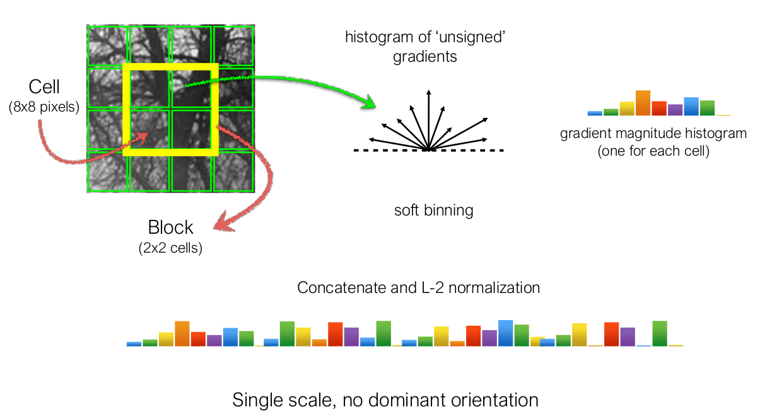
HOG
Dalal, Triggs. Histograms of Oriented Gradients for Human Detection. CVPR, 2005

Slide 42
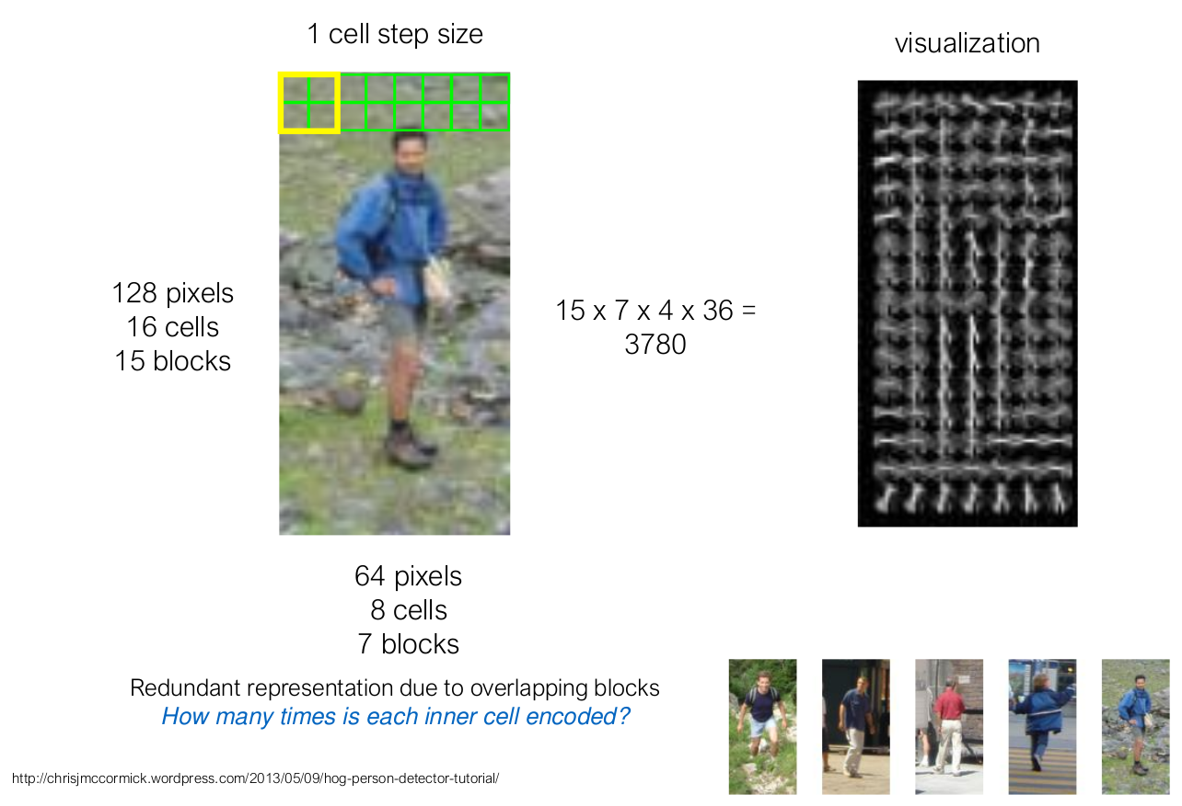
Pedestrian detection

