Slide 1
Corner Detection
16-385 Computer Vision (Kris Kitani)
Carnegie Mellon University

Slide 2
Why detect corners?
Image alignment (homography, fundamental matrix)
3D reconstruction
Motion tracking
Object recognition
Indexing and database retrieval
Robot navigation

Slide 3
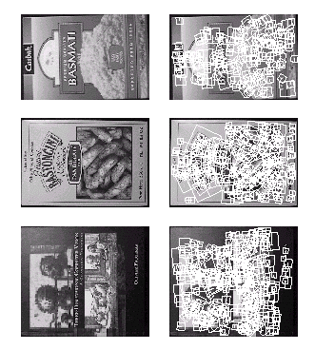
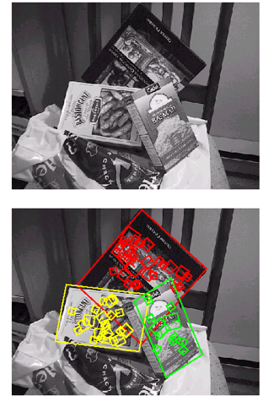

Slide 4
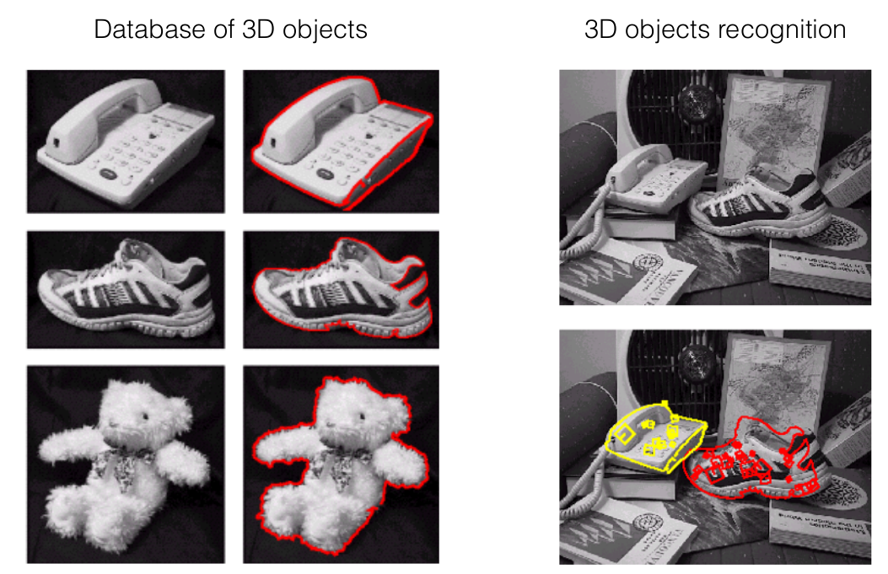
3D object recognition

Slide 5
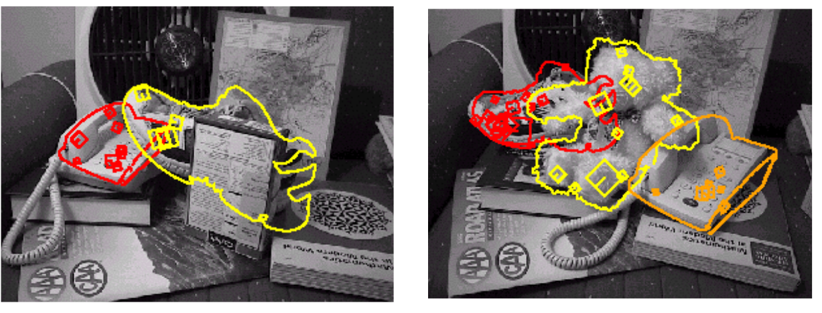
Recognition under occlusion

Slide 6
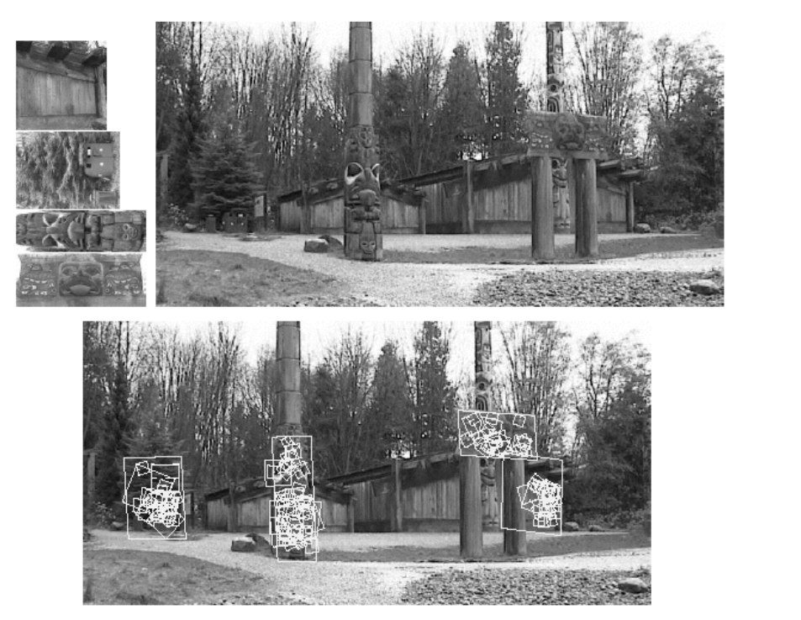
Location Recognition

Slide 7
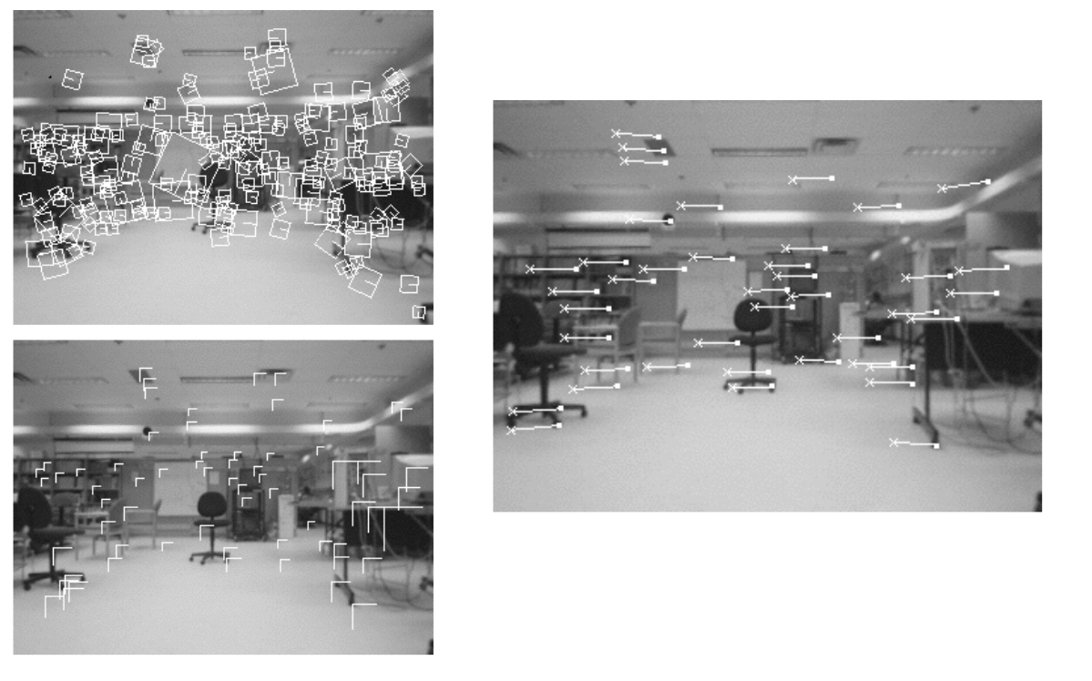
Robot Localization

Slide 8
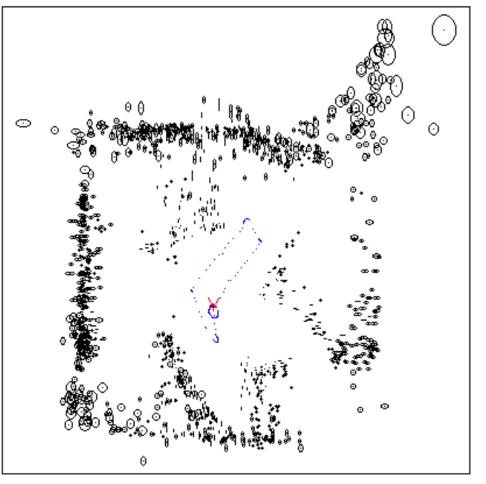
Map built over time

Slide 9
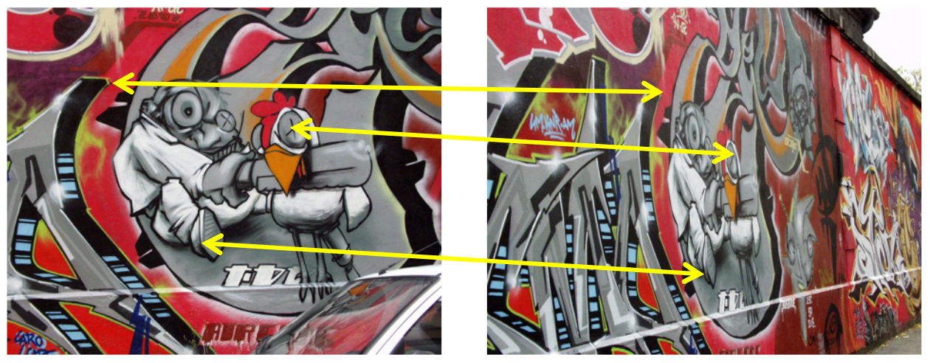
Example: Image Matching
How would you find corresponding points?

Slide 10
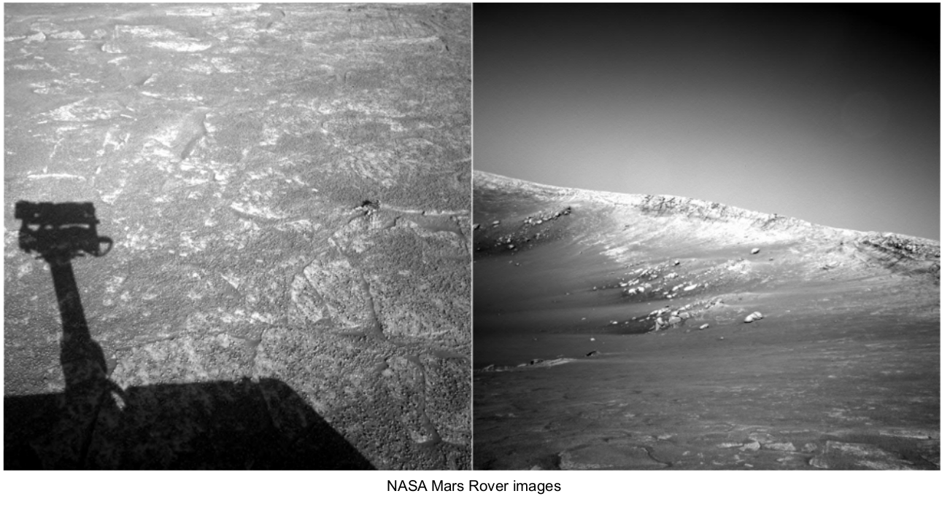
Where are the corresponding points?

Slide 11
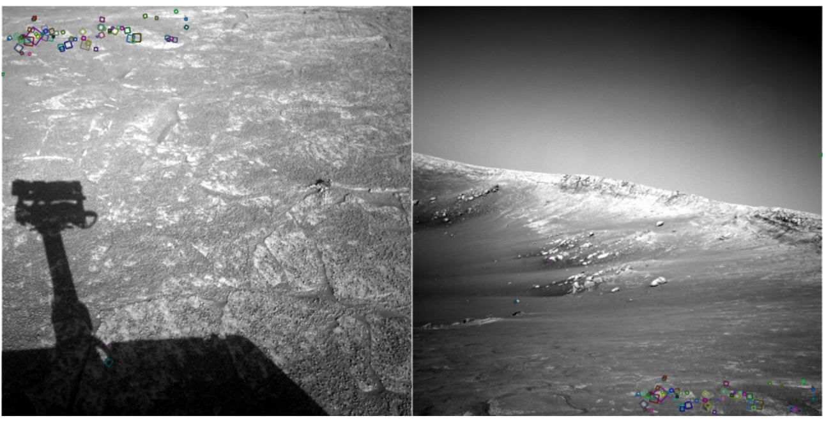
What type of features were you trying to match?
Explain to me your thought process.

Slide 12
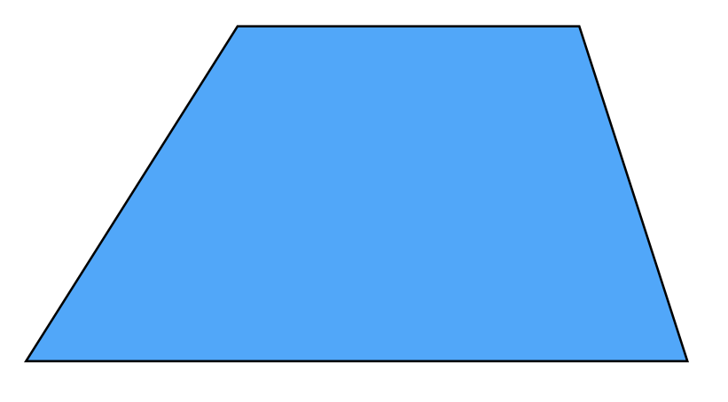
Pick a point in the image.
Find it again in the next image.
What type of feature would you select?

Slide 13
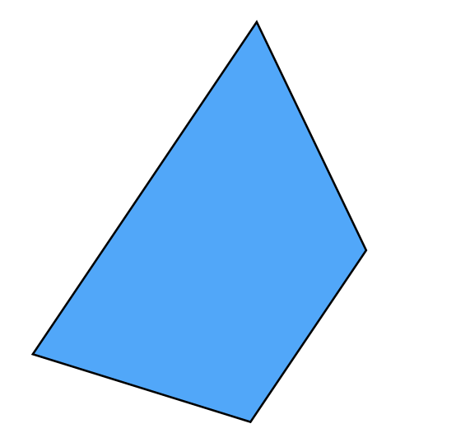
Pick a point in the image.
Find it again in the next image.
What type of feature would you select?

Slide 14
Pick a point in the image.
Find it again in the next image.
What type of feature would you select?
A corner!

Slide 15
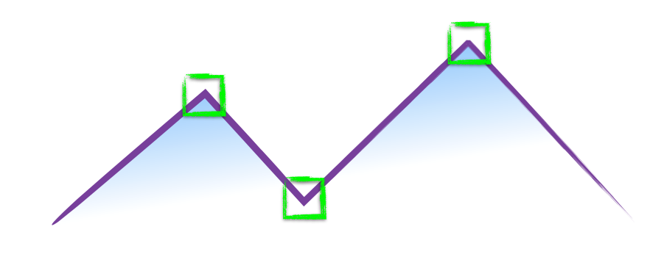
How do you find a corner?

Slide 16
How do you find a corner?
[Moravec 1980]
Easily recognized by looking through a small window
Shifting the window should give large change in intensity

Slide 17
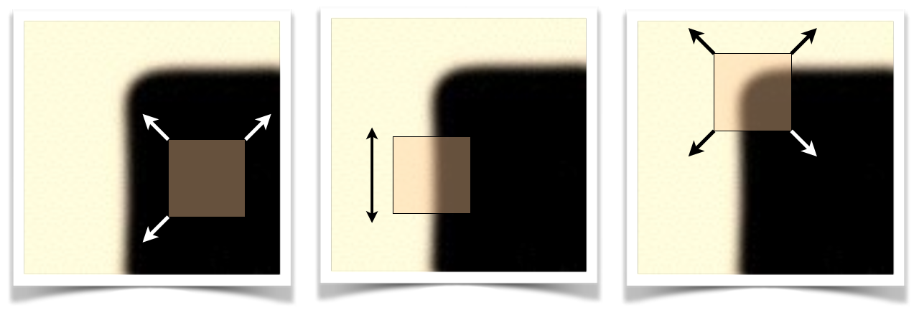
“flat” region:
no change in all
directions
“edge”:
no change along the edge
direction
“corner”:
significant change in all
directions
[Moravec 1980]

