Slide 1
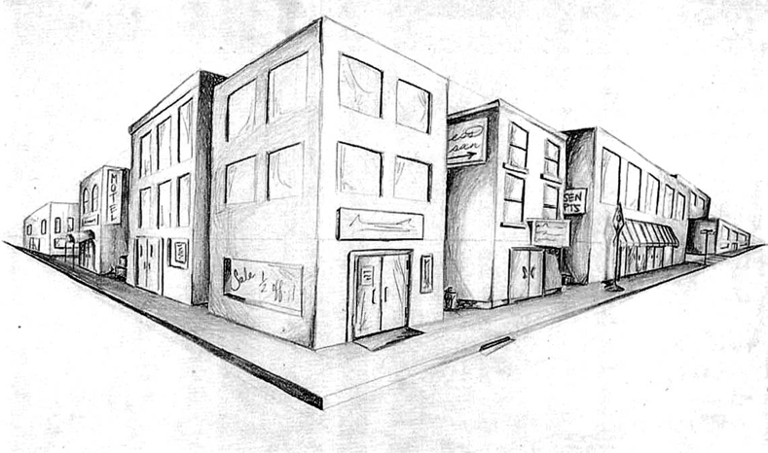
Harris Corners

Slide 2
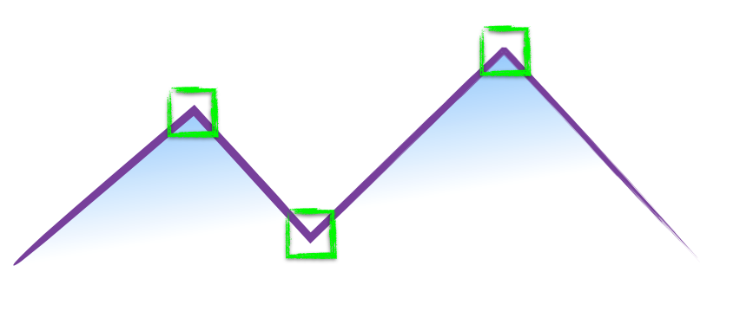
How do you find a corner?
[Moravec 1980]
Easily recognized by looking through a small window
Shifting the window should give large change in intensity

Slide 3
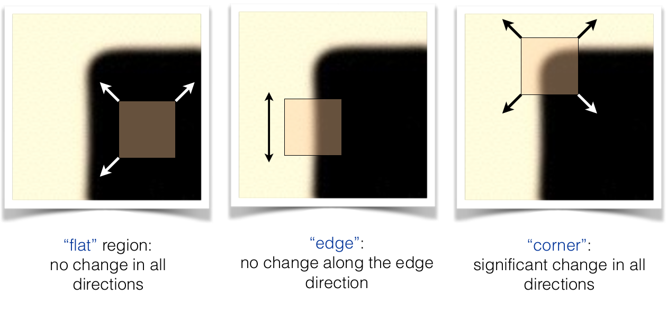
[Moravec 1980]

Slide 4
Design a program to detect corners
(hint: use image gradients)

Slide 5
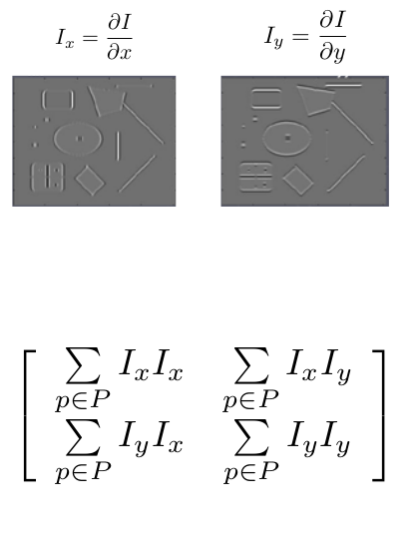
Finding corners
(a.k.a. PCA)
1.Compute image gradients over small region
2.Subtract mean from each image gradient
3.Compute the covariance matrix
4.Compute eigenvectors and Eigenvalues
5.Use threshold on eigenvalues to detect corners

Slide 6
1. Compute image gradients over a small region
(not just a single pixel)

Slide 7
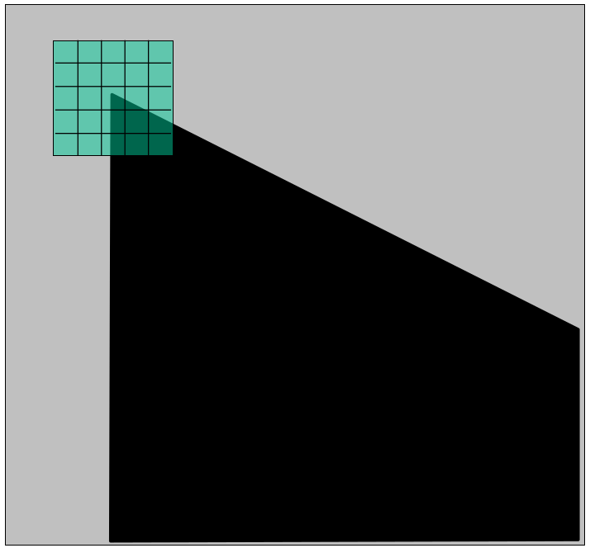
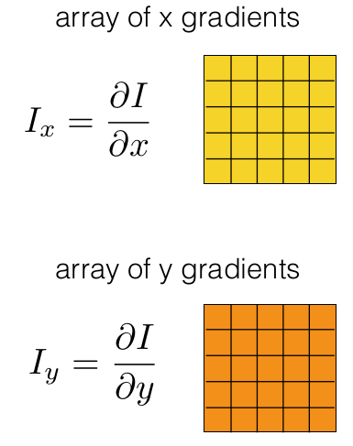
1. Compute image gradients over a small region
(not just a single pixel)

Slide 8
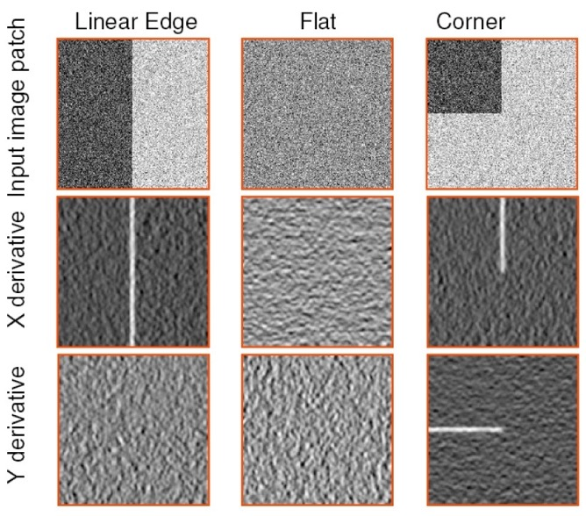
visualization of gradients

Slide 9
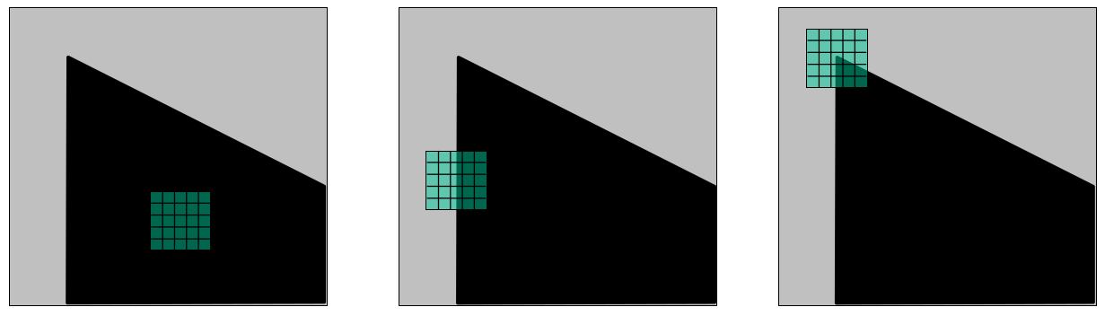
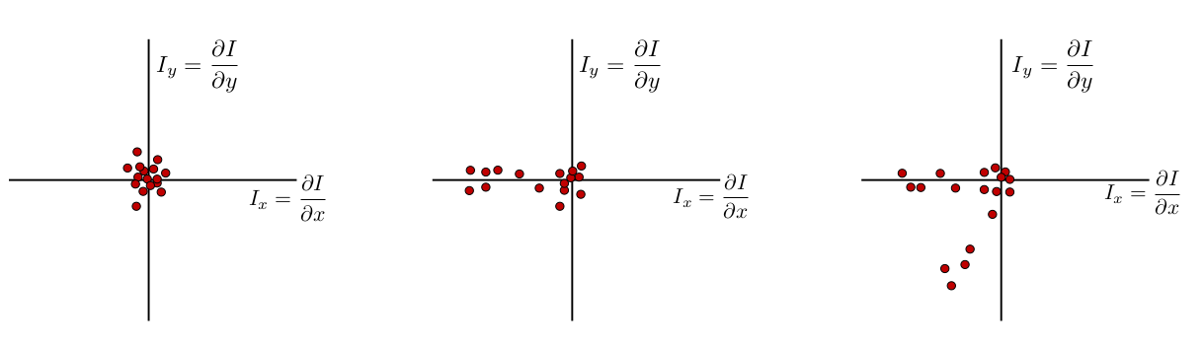
What does the distribution tell you about the region?

Slide 10
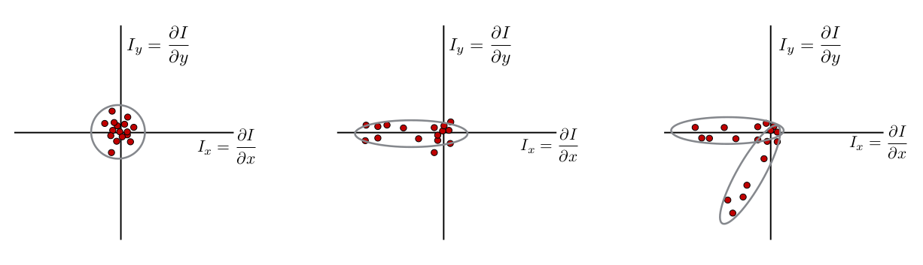
distribution reveals edge orientation and magnitude

Slide 11
How do you quantify orientation and magnitude?

Slide 12
2. Subtract the mean from each image gradient

Slide 13
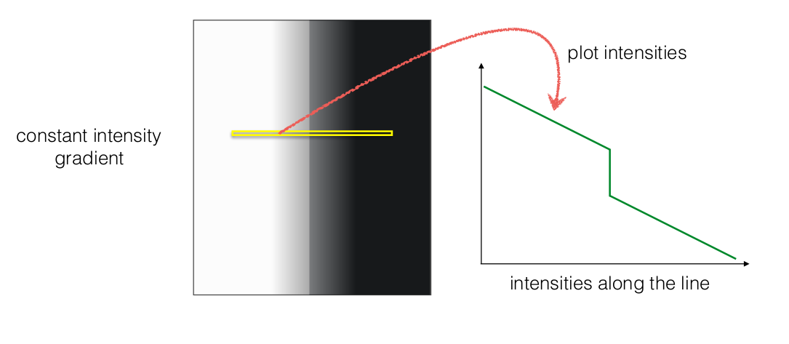
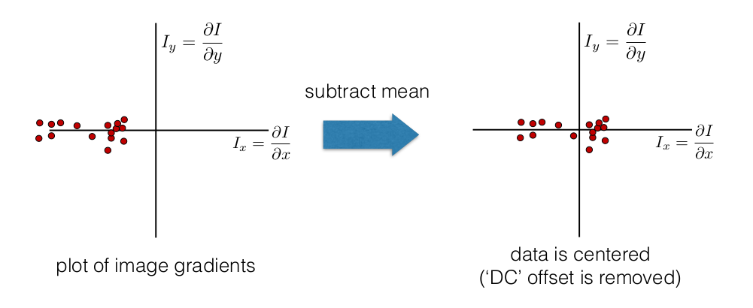
2. Subtract the mean from each image gradient

Slide 14
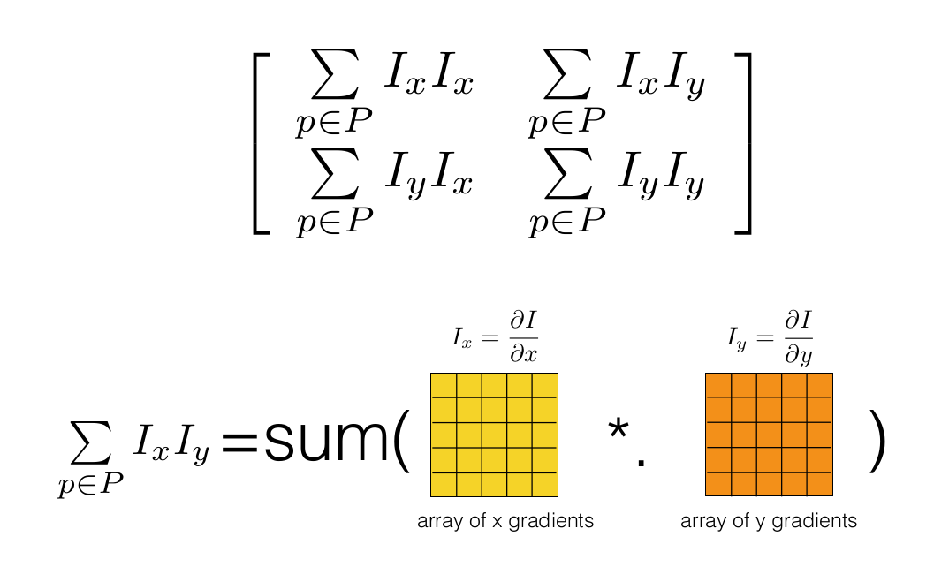
3. Compute the covariance matrix

Slide 15
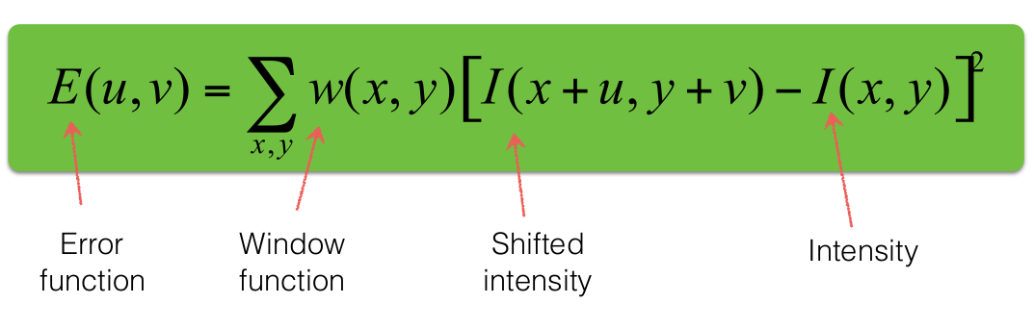
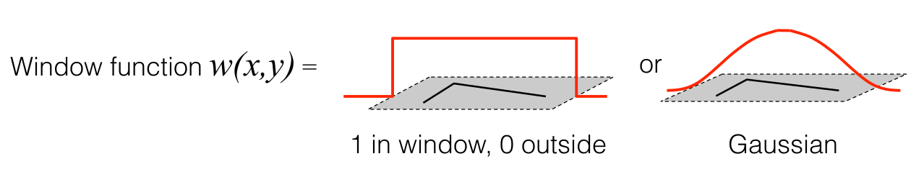
Change of intensity for the shift [u,v]:
Error function

Slide 16
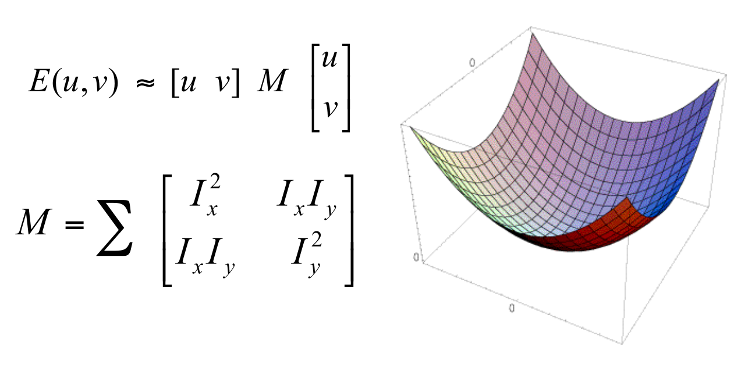

Slide 17
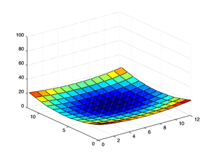
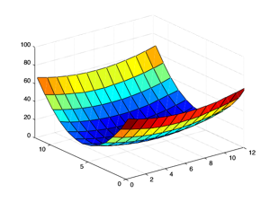
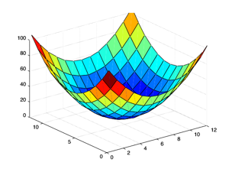
Which error surface indicates a good image feature?
What kind of image patch do these surfaces represent?

Slide 18
edge
‘line’
flat
corner
‘dot’

Slide 19
4. Compute eigenvalues and eigenvectors
eig(M)

Slide 20
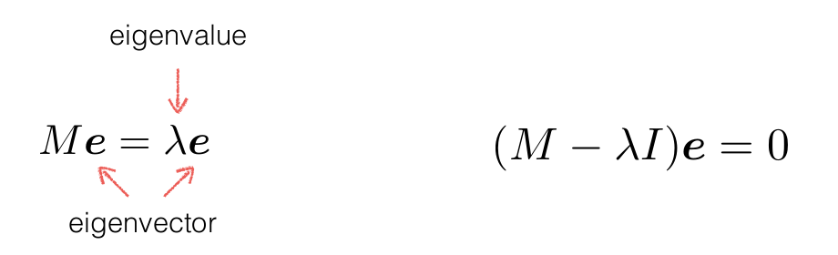
4. Compute eigenvalues and eigenvectors

Slide 21

4. Compute eigenvalues and eigenvectors

Slide 22
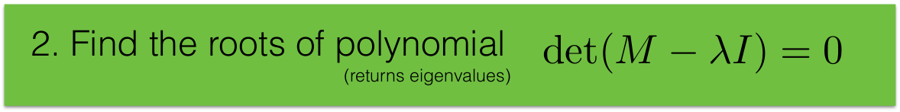
4. Compute eigenvalues and eigenvectors

Slide 23
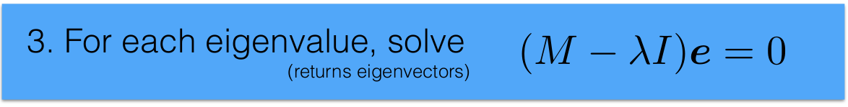
4. Compute eigenvalues and eigenvectors

Slide 24
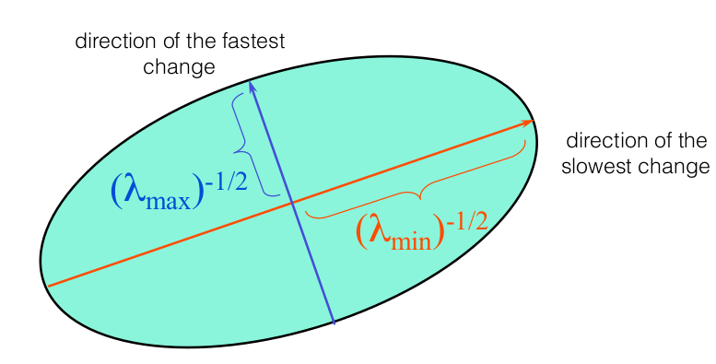
Visualization as an ellipse

Slide 25
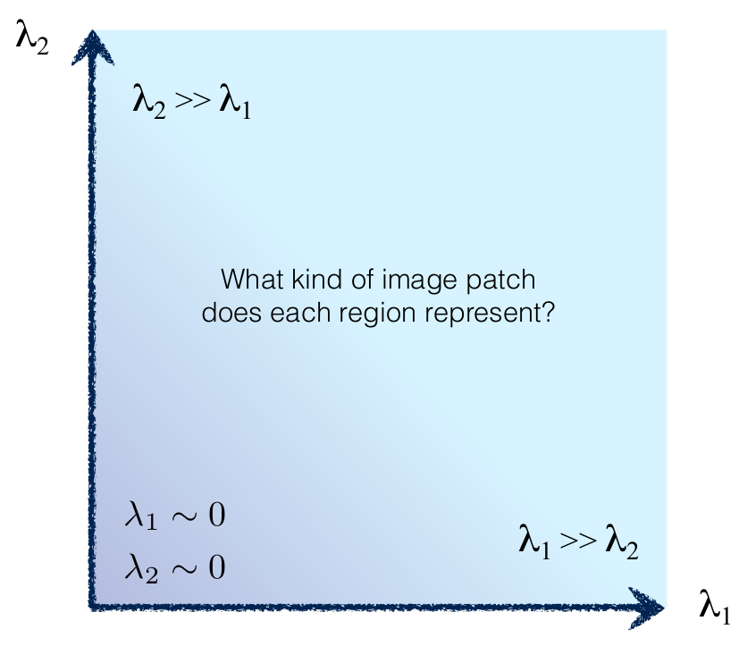
interpreting eigenvalues

Slide 26
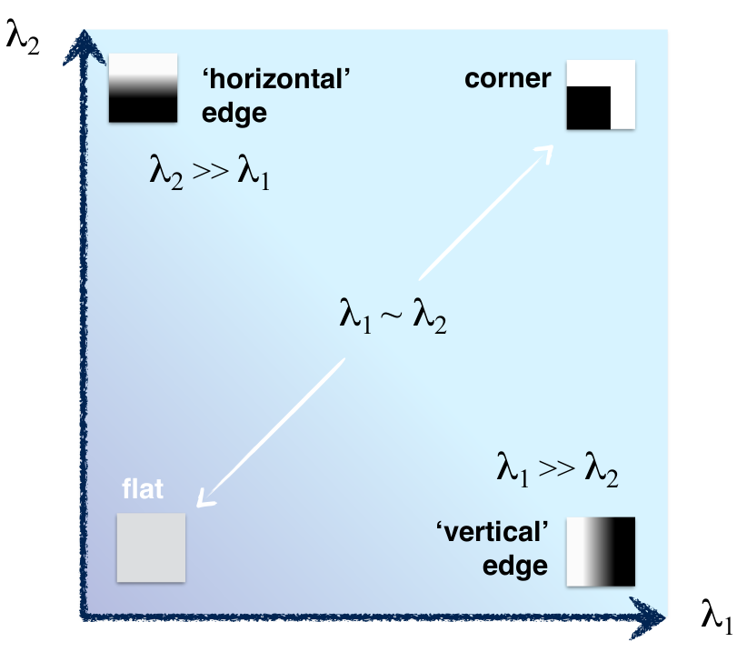
interpreting eigenvalues

Slide 27
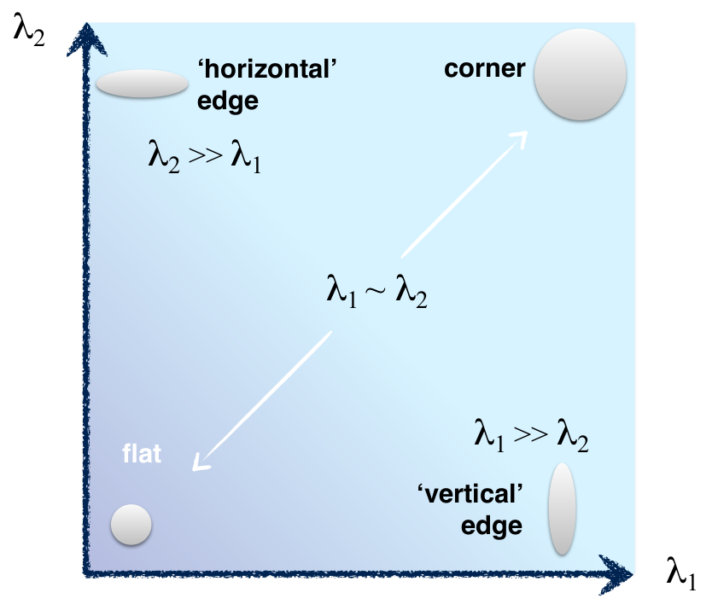
interpreting eigenvalues

Slide 28
5. Use threshold on eigenvalues to detect corners

Slide 29
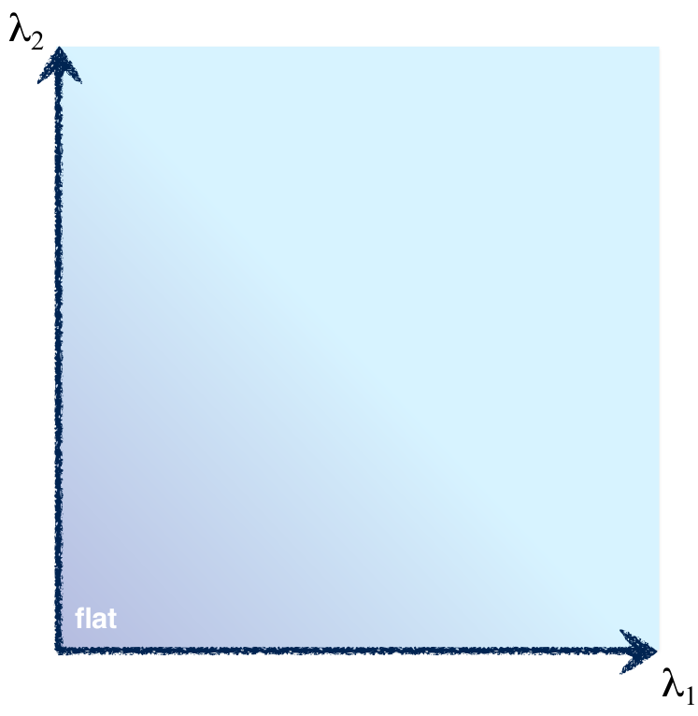
5. Use threshold on eigenvalues to detect corners
Think of a function to
score ‘cornerness’

Slide 30
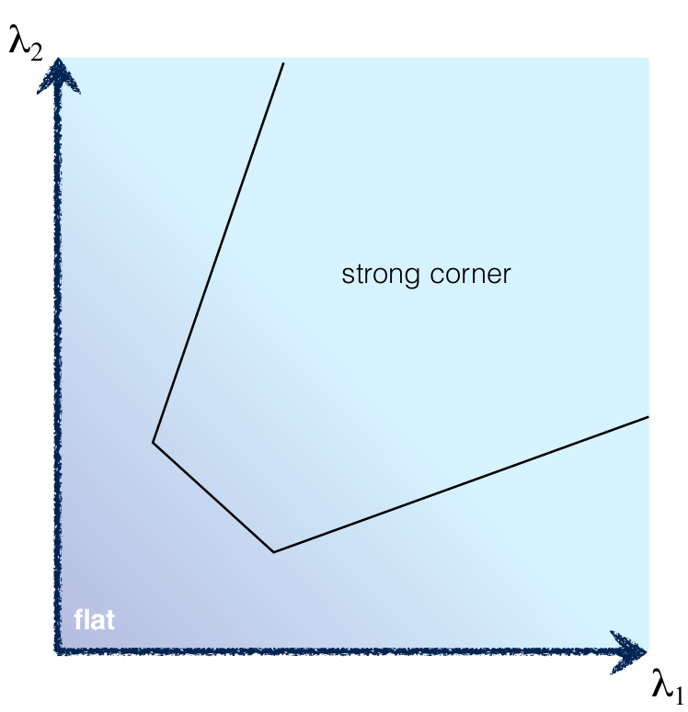
5. Use threshold on eigenvalues to detect corners
Think of a function to
score ‘cornerness’

Slide 31

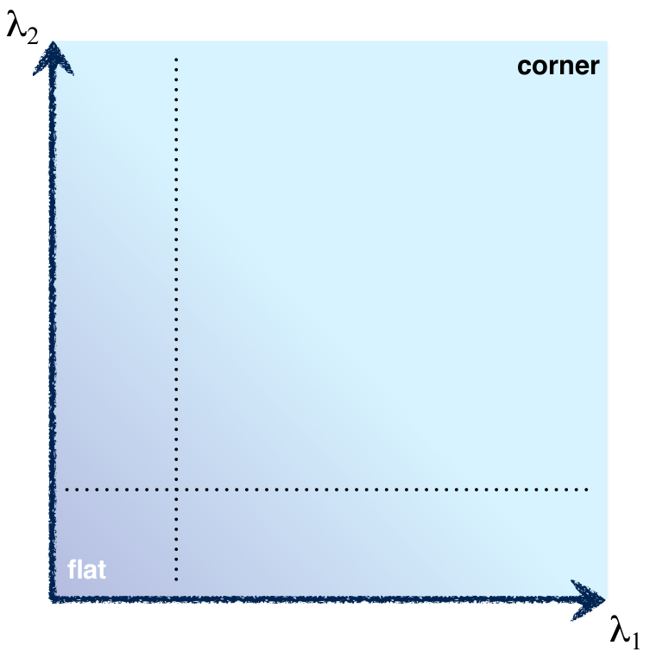
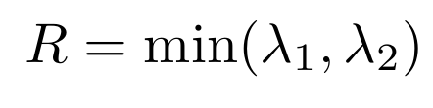
5. Use threshold on eigenvalues to detect corners
Use the smallest eigenvalue
as the response function

Slide 32
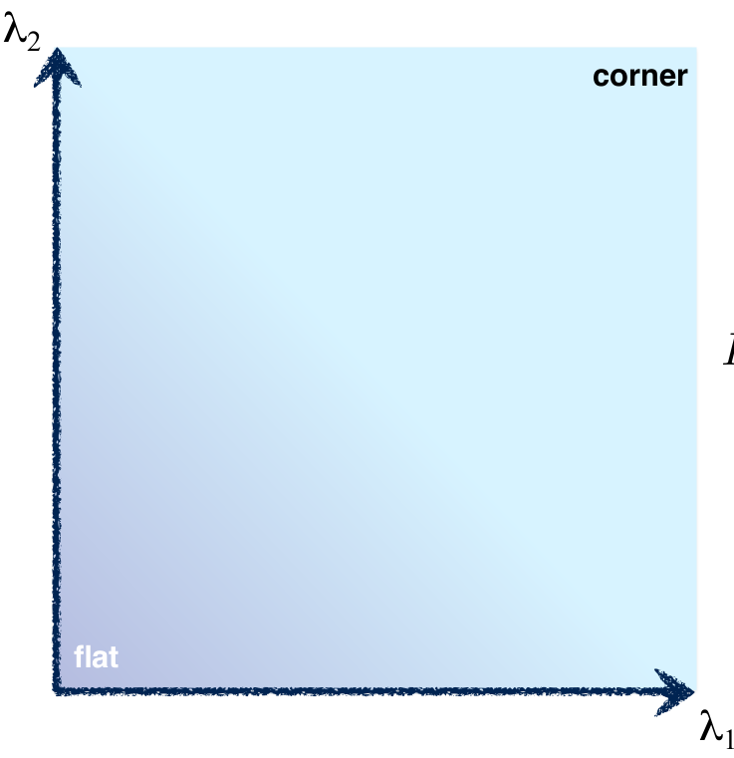
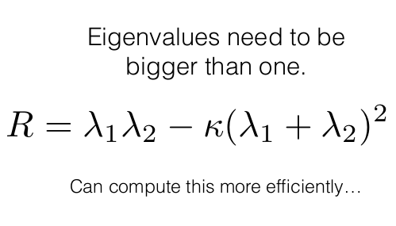
5. Use threshold on eigenvalues to detect corners

Slide 33
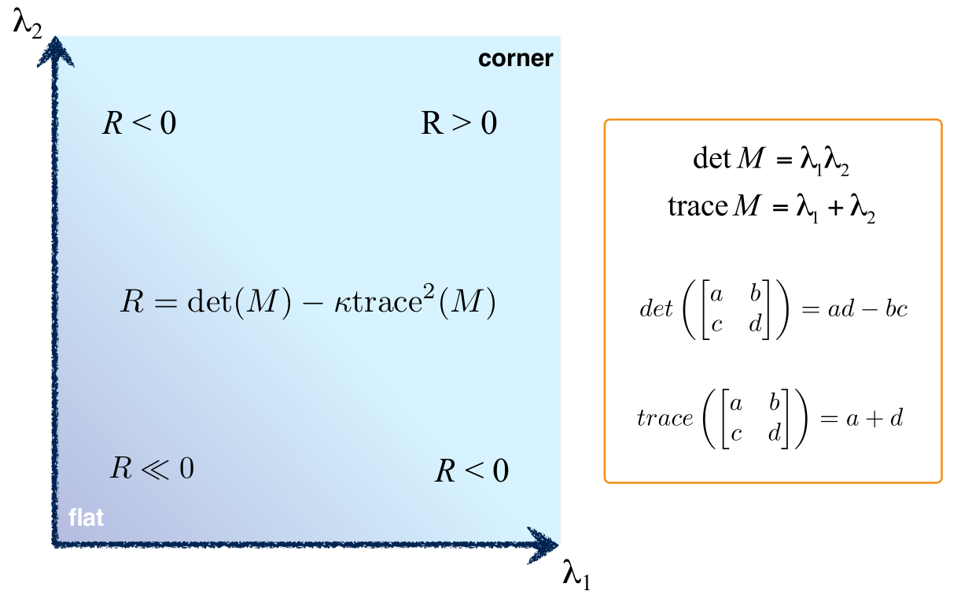

Slide 34
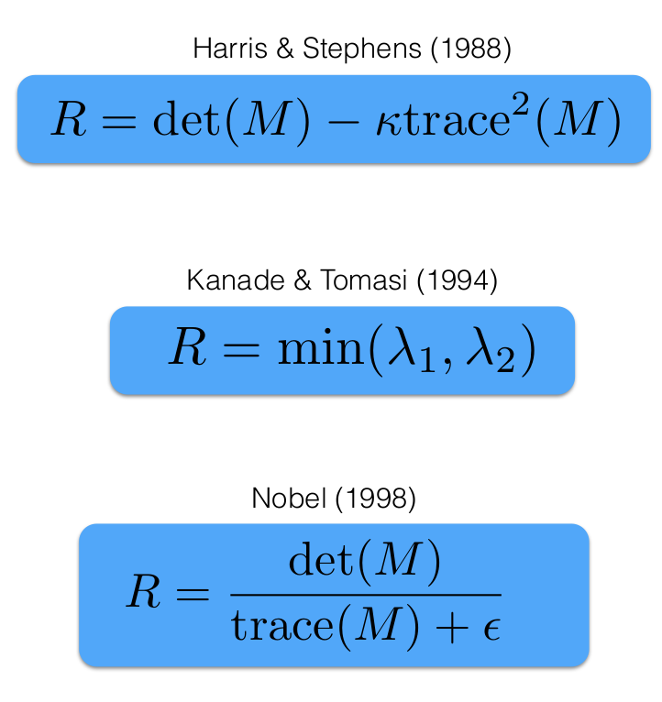

Slide 35
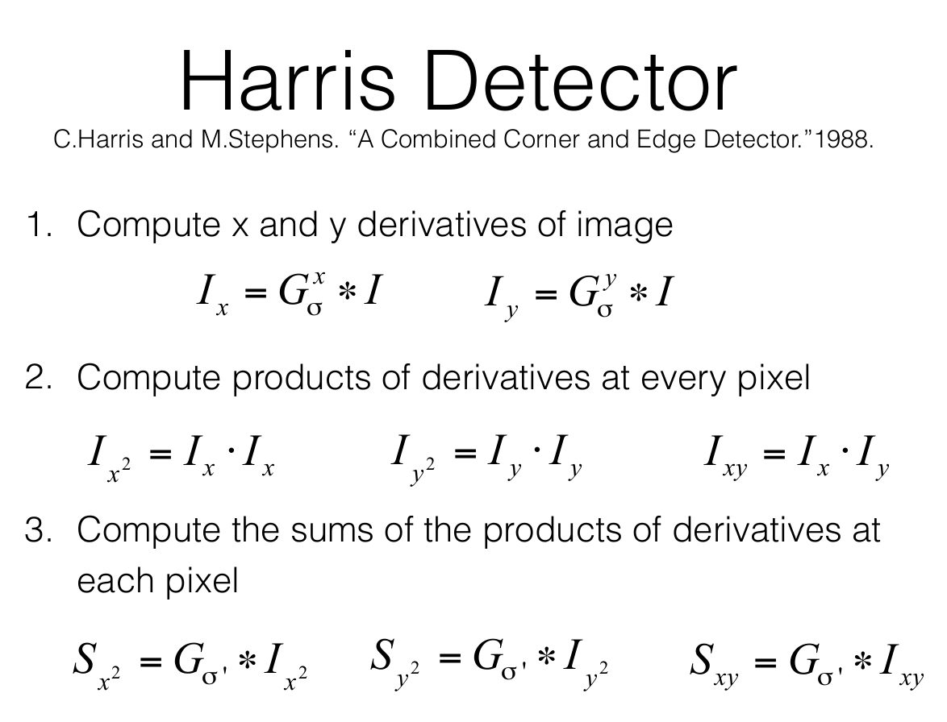

Slide 36
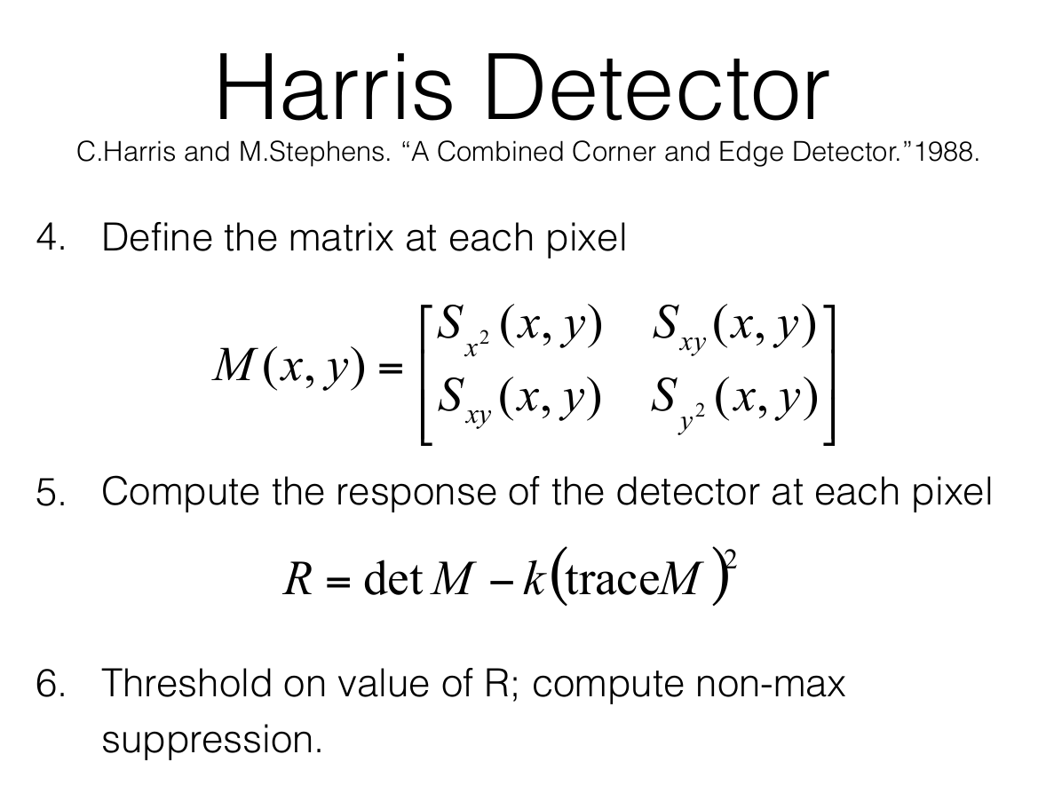

Slide 37
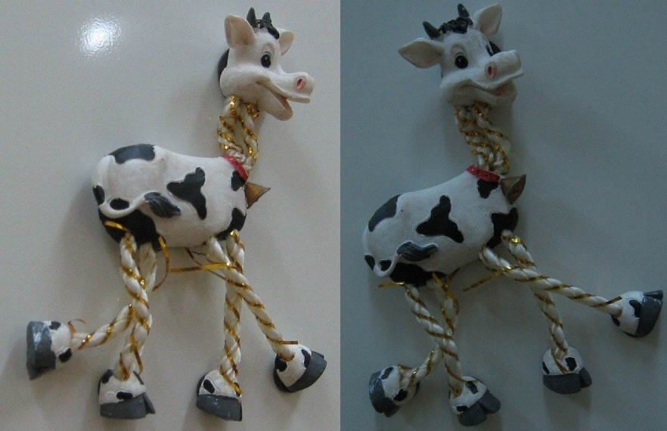

Slide 38
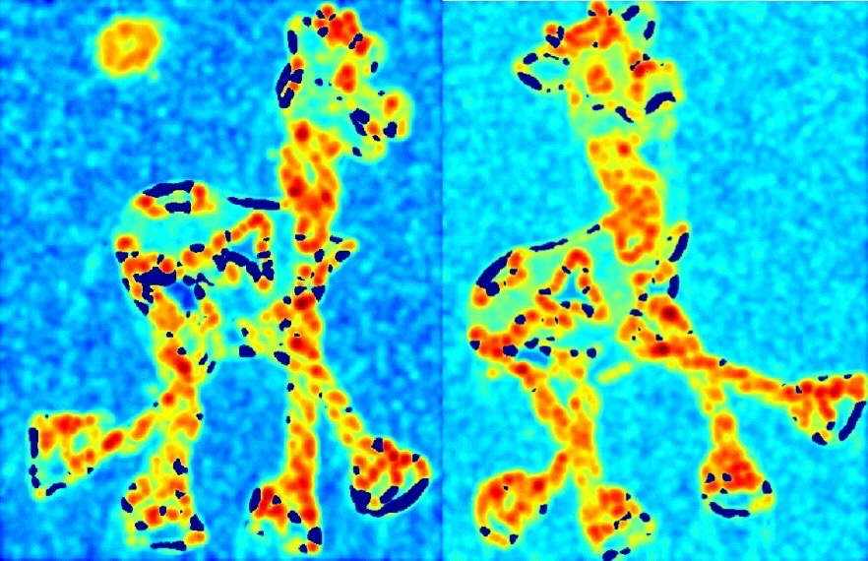

Slide 40
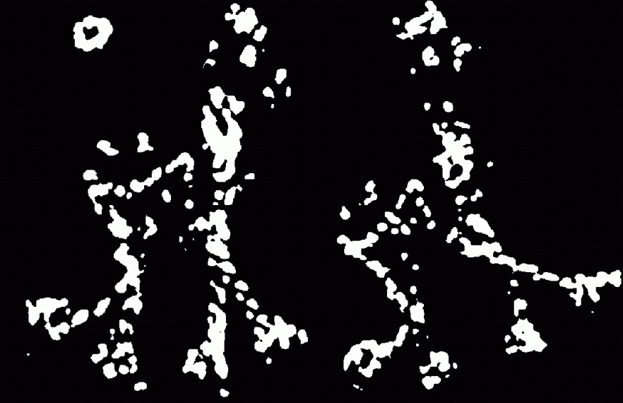
Thresholded corner response

Slide 41
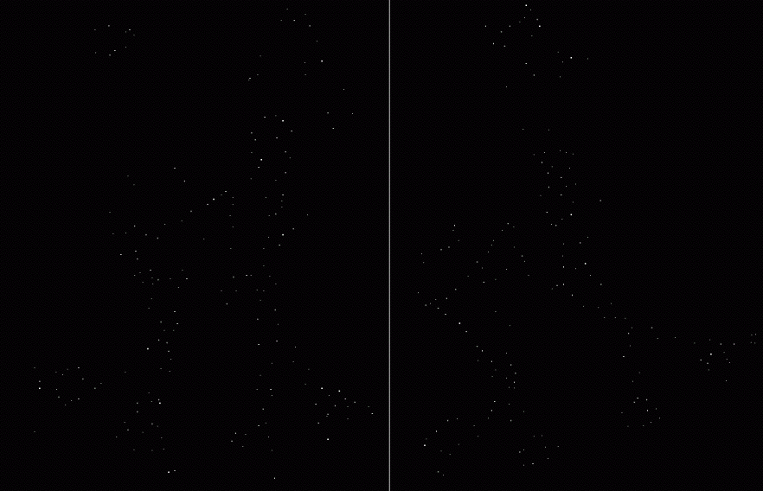
Non-maximal suppression

Slide 42


Slide 43
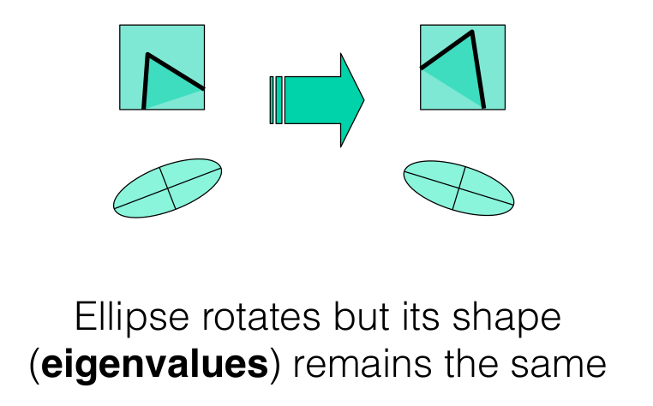
Harris corner response is rotation invariant
Corner response R is invariant to image rotation

Slide 44
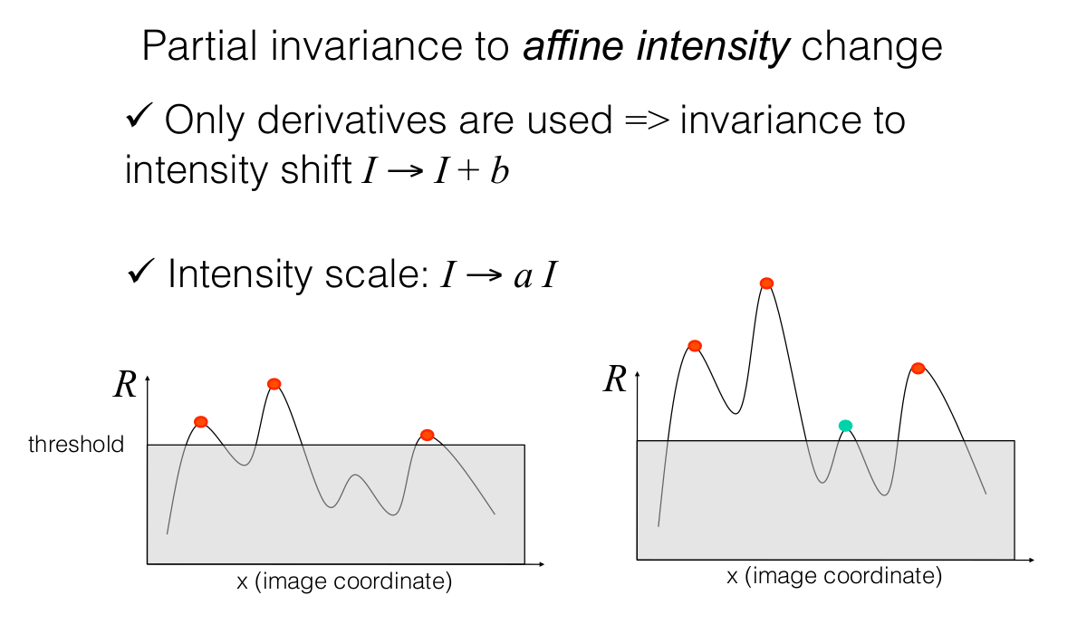
intensity changes

