Slide 1
Computer Vision
We are not worms!
Seeing: Earthworms have no eyes, but they do have light receptors and can tell when they are in the dark, or in the light.

Slide 2
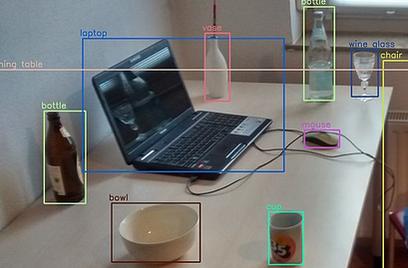
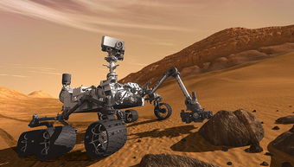
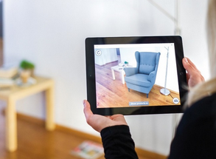
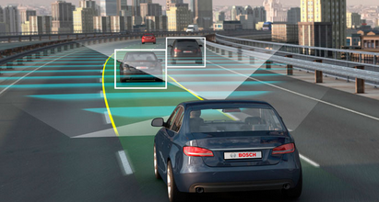
Ref: Cornell Tech Instructor: Noah Snavely

Slide 3
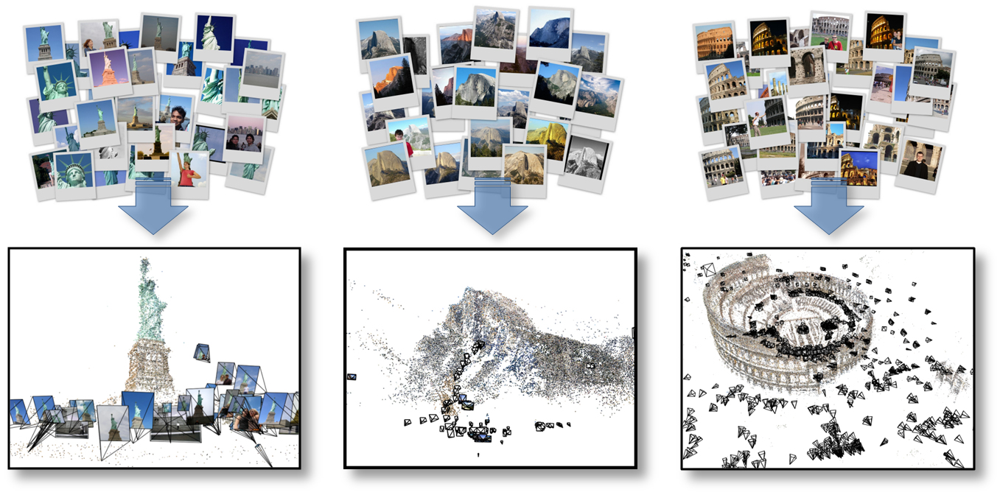


Automatic 3D reconstruction from Internet photo collections

Slide 4
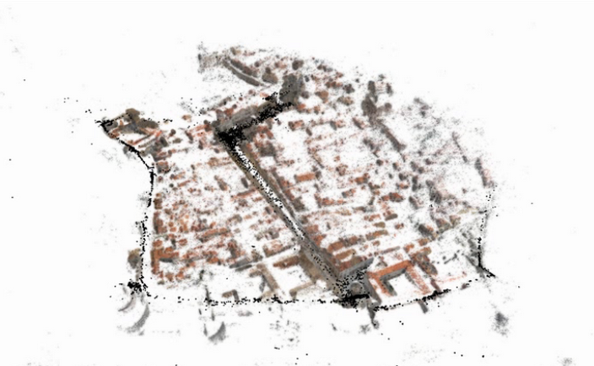
City-scale 3D reconstruction
Reconstruction of Dubrovnik, Croatia, from ~40,000 images

Slide 5
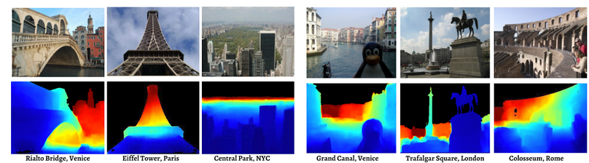
Depth from a single image

Slide 6
The goal of computer vision

Slide 7
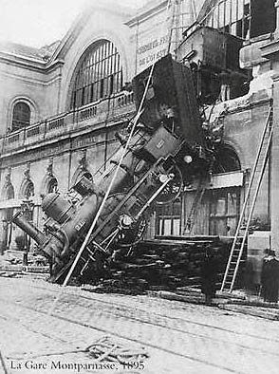
Every image tells a story
Goal of computer vision: perceive the “story” behind the picture
Compute properties of the world
3D shape
Names of people or objects
What happened?

Slide 8
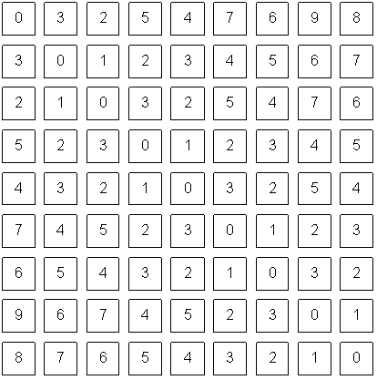

Slide 9
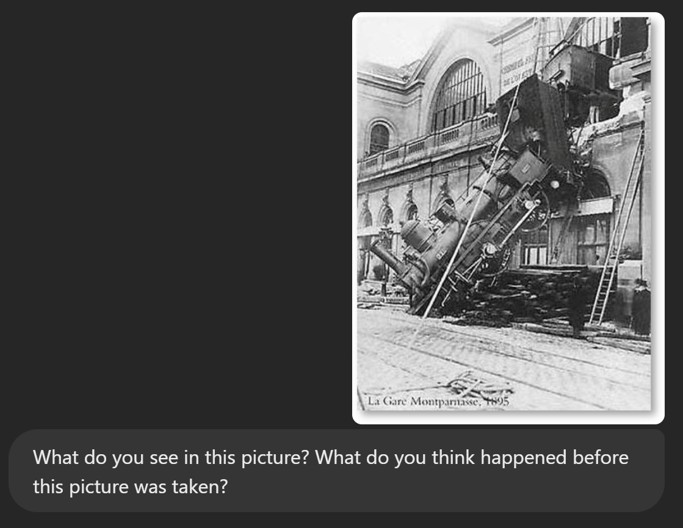
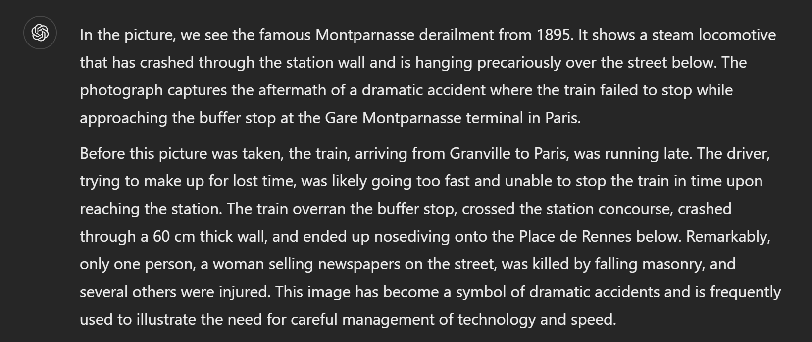
Yes and no
humans are better at “hard” things, are more robust, and make inferences quickly and cheaply
But huge progress
Accelerating in the last 10 years due to deep learning, large
vision-language models What is considered “hard” keeps changing

Slide 10
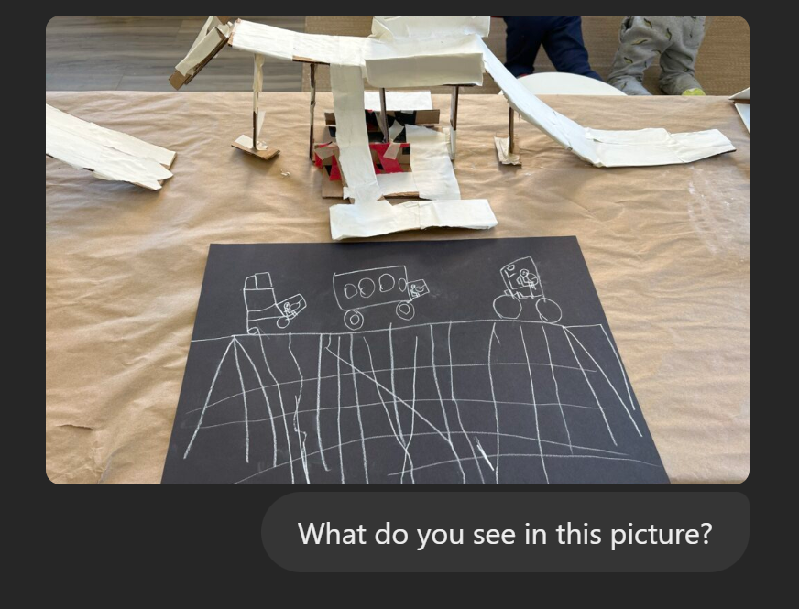


Slide 11
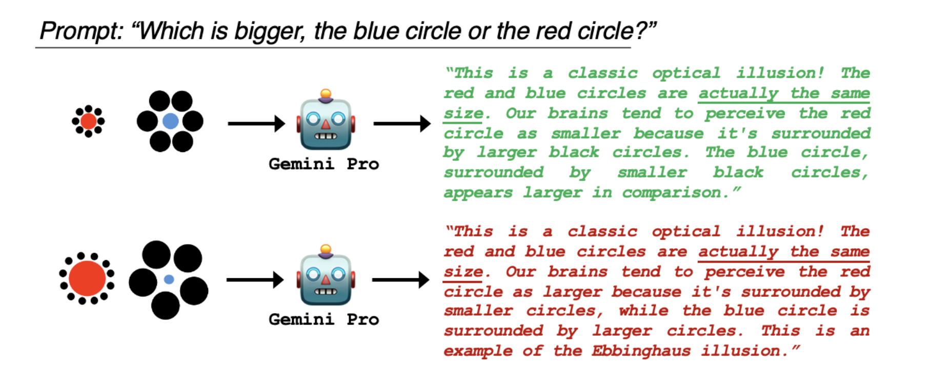
Current models still make very silly mistakes

Slide 12
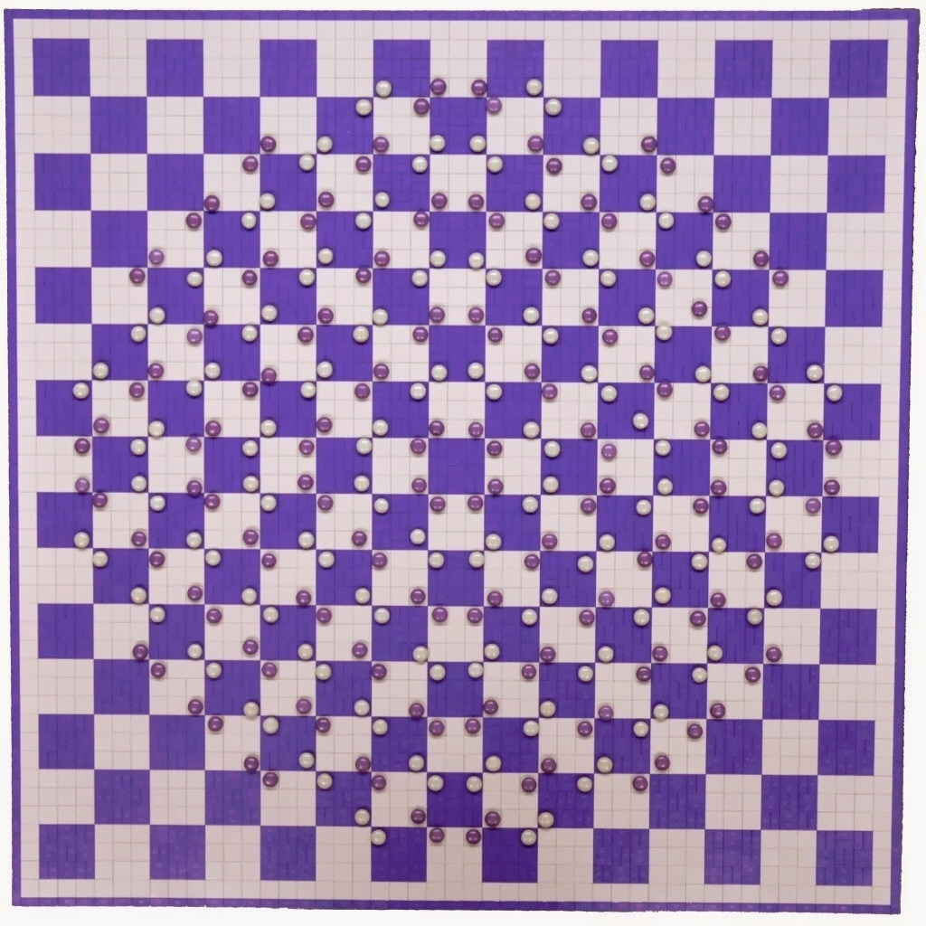
Human perception has its shortcomings
https://twitter.com/pickover/status/1460275132958662657/

Slide 13


But humans can tell a lot about a scene from a little information…
Source: “80 million tiny images” by Torralba, et al.

Slide 14
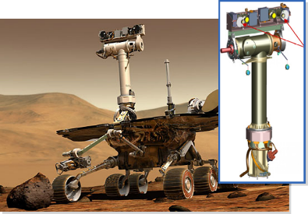
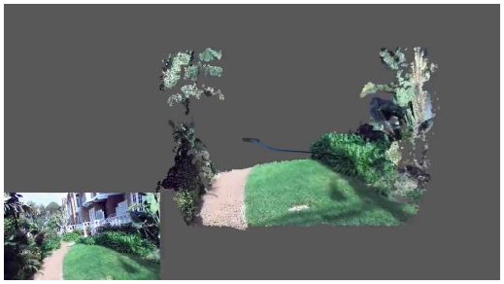
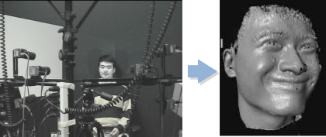
The goal of computer vision
Compute the 3D shape of the world

Slide 15
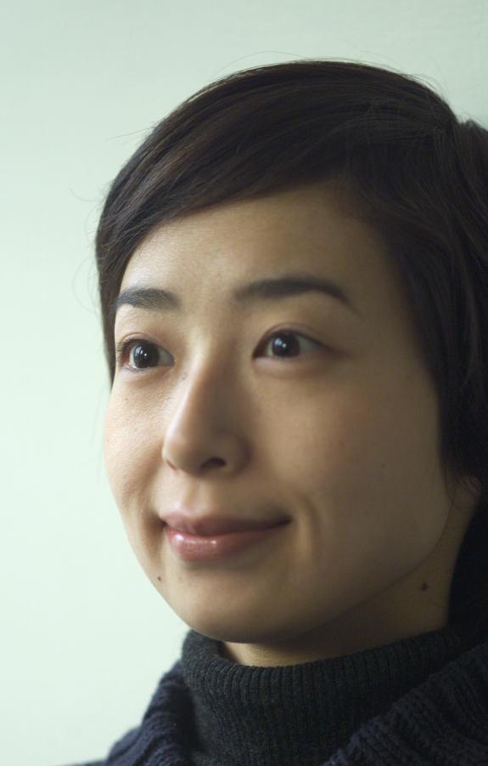
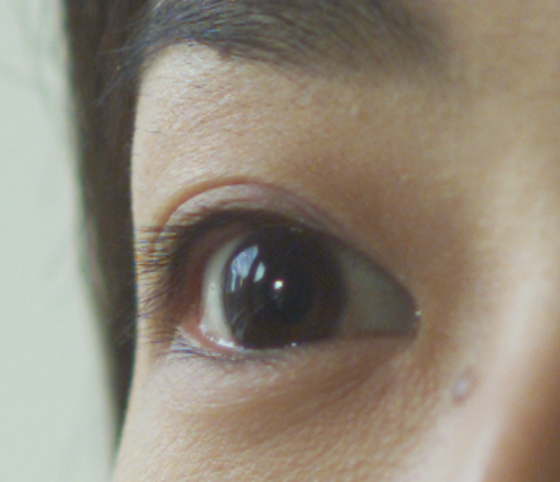
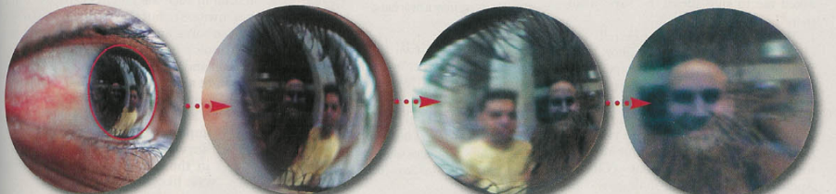
The goal of computer vision
Forensics
Source: Nayar and Nishino, “Eyes for Relighting”

Slide 16

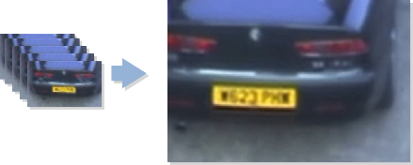
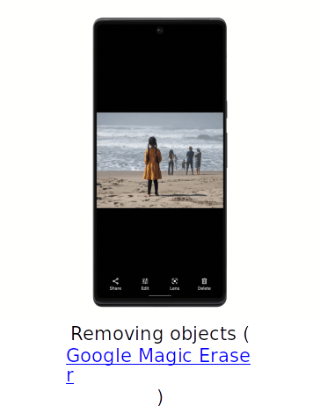
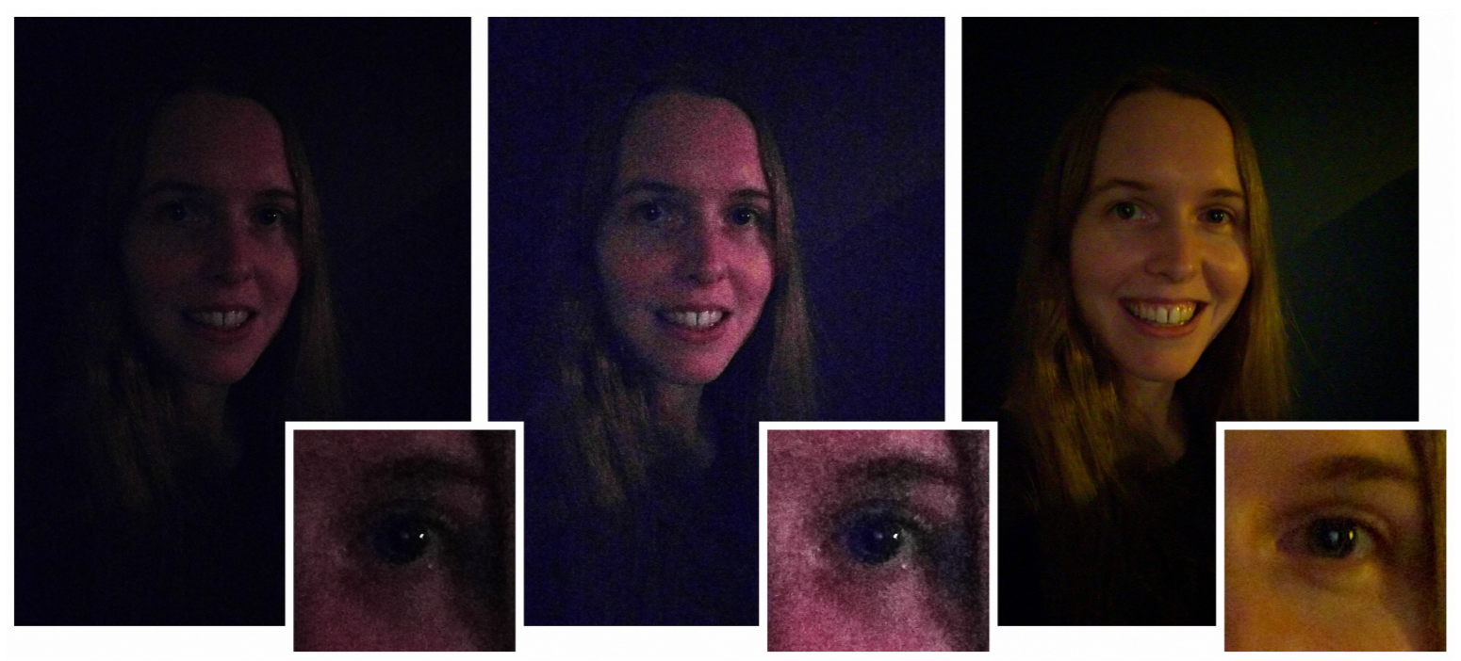
The goal of computer vision
Improve photos (“Computational Photography”)
Depth of field on cell phone camera (source: Google Research Blog)
Super-resolution (source: 2d3)
Low-light photography
(credit: Hasinoff et al., SIGGRAPH ASIA 2016)

Slide 17
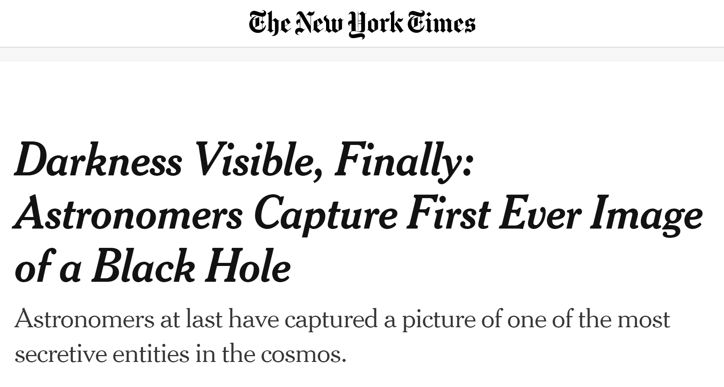


Slide 18

Why study computer vision?
Billions of images/videos captured per day

Slide 19
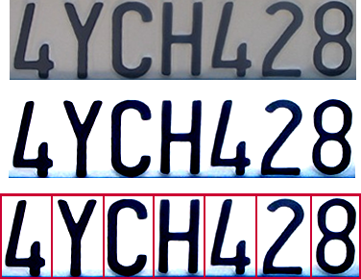
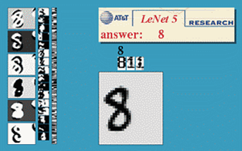
Optical character recognition (OCR)
License plate readers
http://en.wikipedia.org/wiki/Automatic_number_plate_recognition
Digit recognition, AT&T labs (1990’s)

Slide 20
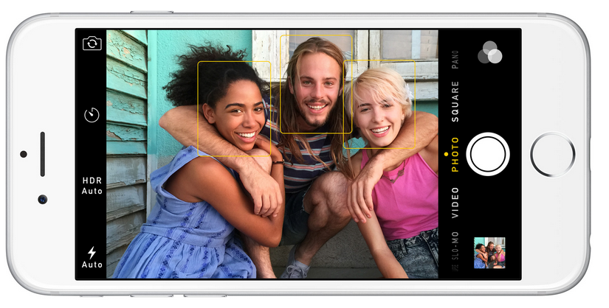
Nearly all cameras detect faces in real time
(Why?)

Slide 21
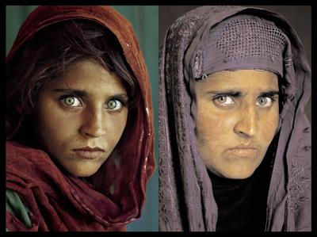
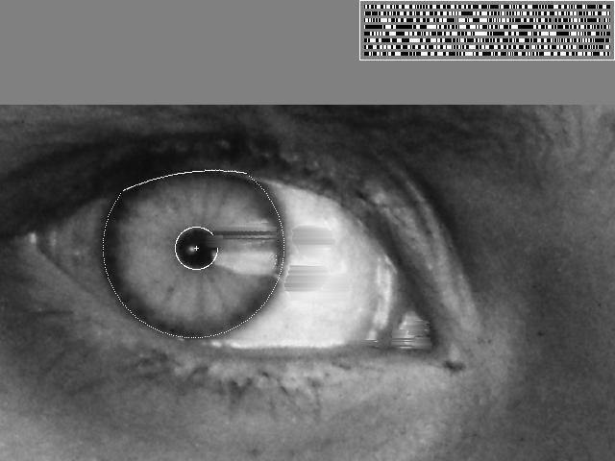
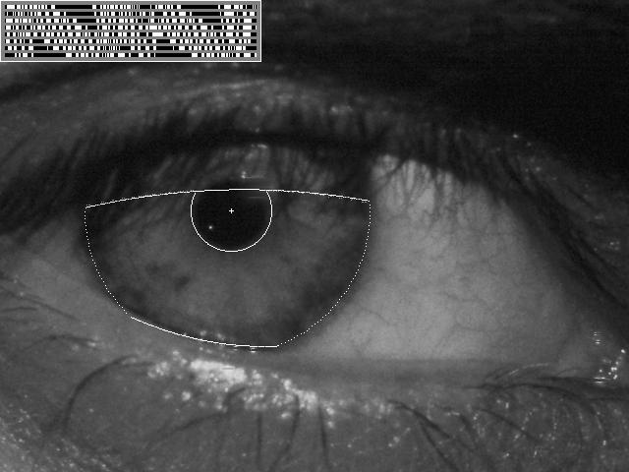
Vision-based biometrics
“How the Afghan Girl was Identified by Her Iris Patterns” Read the story
The remarkable story of Sharbat Gula,

Slide 22
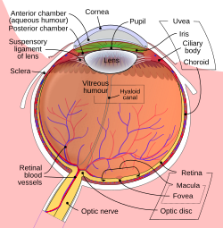
IrisCodes: These are binary codes that represent the unique patterns in a person's iris
Localization: Identifying the iris boundaries in an eye image
Normalization: Converting the circular iris into a rectangular form
Feature Extraction: Creating a binary code that represents the iris pattern
Matching: Comparing IrisCodes using Hamming Distance (a measure of dissimilarity)

Slide 23

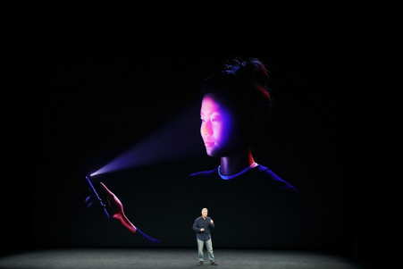
Face unlock on Apple iPhone X
See also http://www.sensiblevision.com/
Fingerprint scanners on many new smartphones and other devices

Slide 24
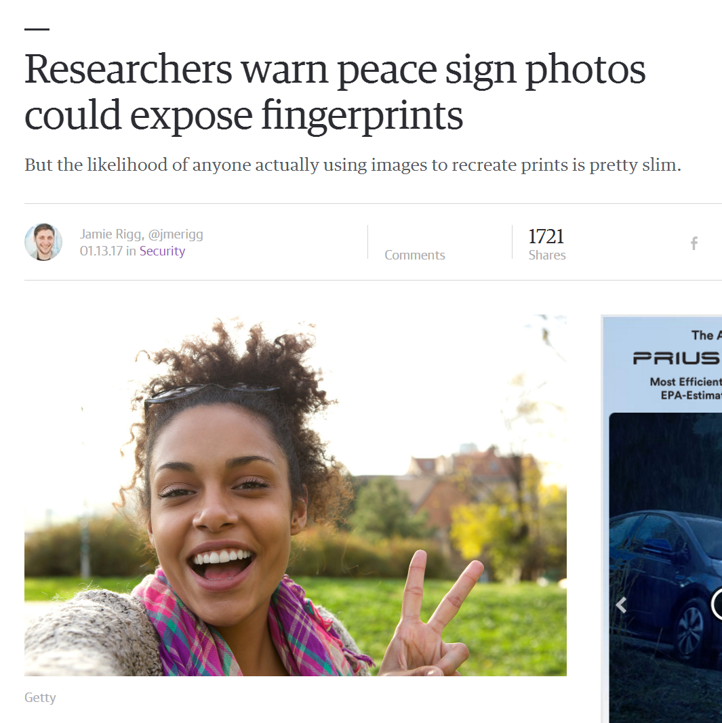

Slide 25

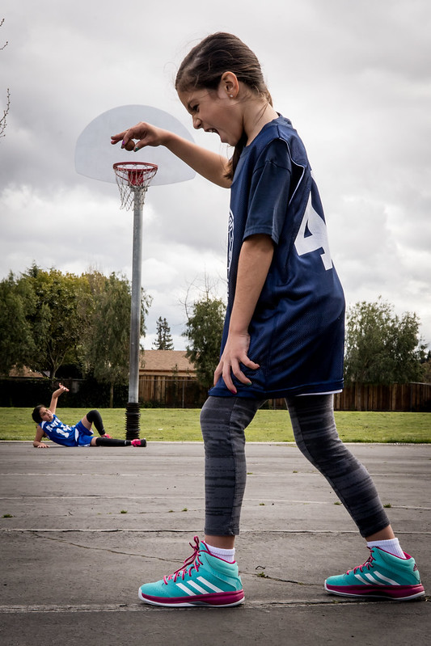


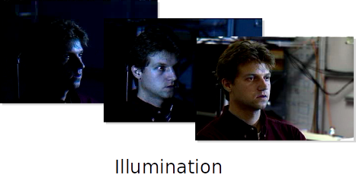
Why is computer vision difficult?
Viewpoint variation
Scale

Slide 26
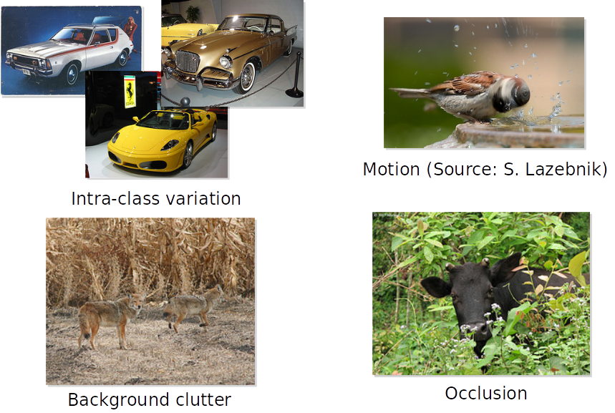
Why is computer vision difficult?

