Slide 1
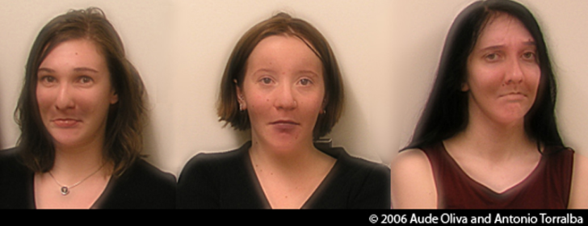
Lecture 1: Images and image filtering

Slide 2

Hybrid Images, Oliva et al., http://olivalab.mit.edu/hybridimage.htm

Slide 3
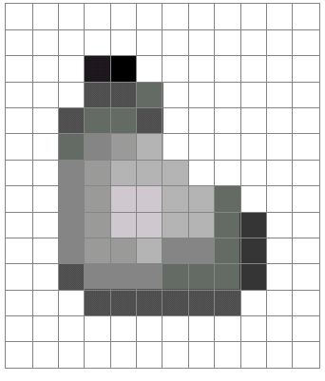
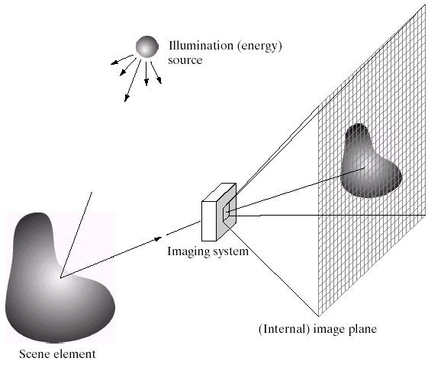

What is an image?
We’ll focus on these in this class
Source: A. Efros

Slide 4

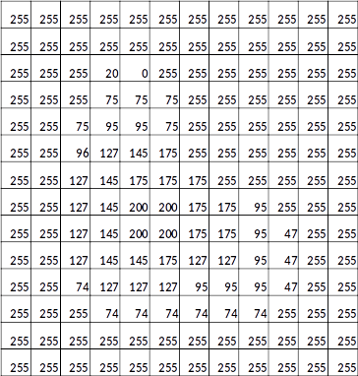
What is an image?
A grid (matrix) of intensity values
=
(common to use one byte per value: 0 = black, 255 = white)

Slide 5
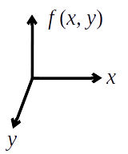
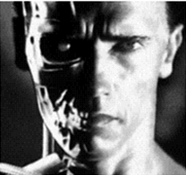
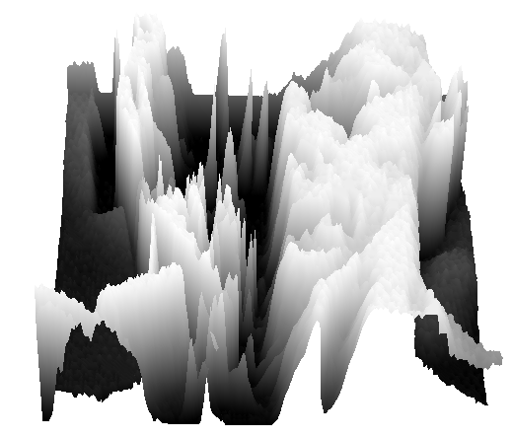
What is an image?
A digital image is a discrete (sampled, quantized) version of this function
A digital image is a discrete (sampled, quantized) version of this function

Slide 6
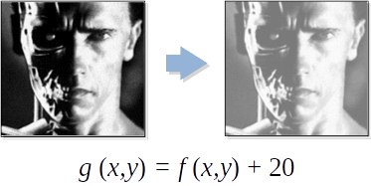
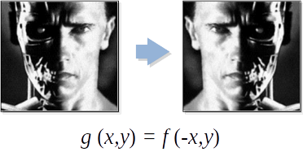
Image transformations
As with any function, we can apply operators to an image
Today we’ll talk about a special kind of operator, convolution (linear filtering)

Slide 7
Filters
Filtering
Form a new image whose pixel values are a combination of the original pixel values
Why?
To get useful information from images
E.g., extract edges or contours (to understand shape)
To enhance the image
E.g., to remove noise
E.g., to sharpen and “enhance image” a la CSI
A key operator in Convolutional Neural Networks

Slide 8
Canonical Image Processing problems
Image Restoration
denoising
deblurring
Image Compression
JPEG, HEIF, MPEG, …
Locating Structural Features
corners
edges

Slide 9
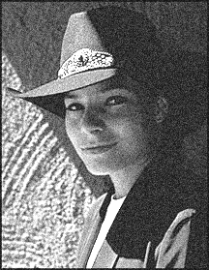
Question: Noise reduction
Given a camera and a still scene, how can you reduce noise?
Take lots of images and average them!
What’s the next best thing?

Slide 10
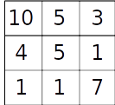
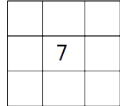

Image filtering
Modify the pixels in an image based on some function of a local neighborhood of each pixel
Some function
Source: L. Zhang

Slide 11
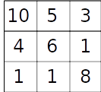
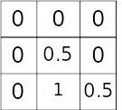
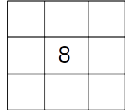
Linear filtering
One simple version of filtering: linear filtering (cross-correlation, convolution)
Local image data
kernel
Modified image data

Slide 12
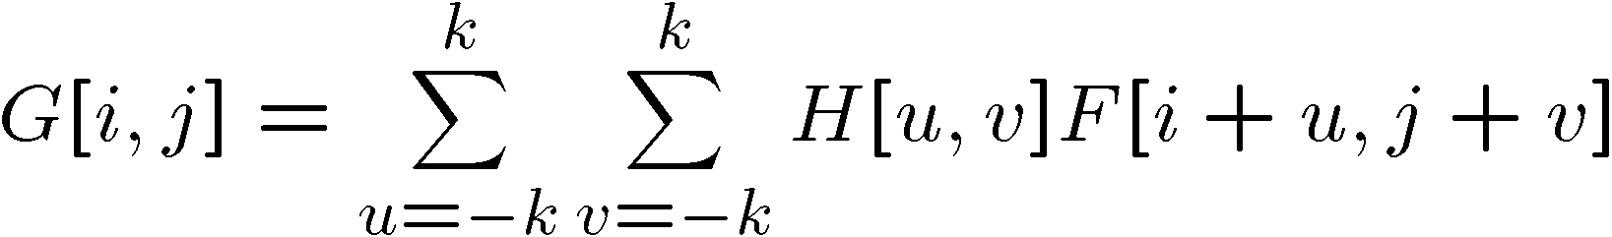

Cross-correlation
Let F be the image, H be the kernel (of size 2k+1 x 2k+1), and G be the output image
Can think of as a “dot product” between local neighborhood and kernel for each pixel

Slide 13
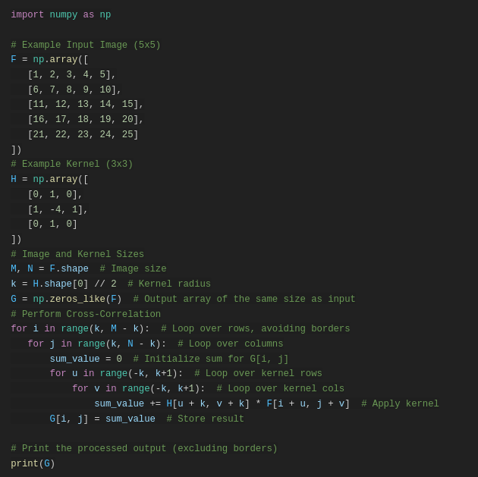
H_flipped = np.flipud(np.fliplr(H)) # Flip both vertically and horizontally

Slide 14
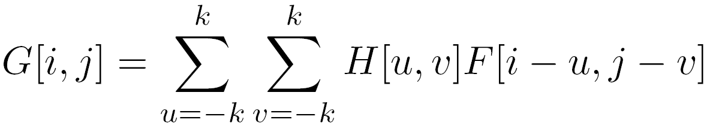

Convolution
Same as cross-correlation, except that the kernel is “flipped” (horizontally and vertically)
This is called a convolution operation:
Convolution is commutative and associative

Slide 15
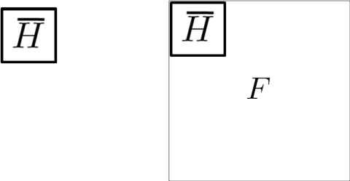

Slide 16
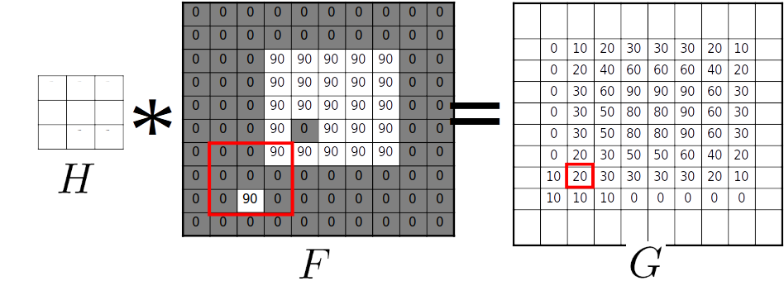
Mean filtering

Slide 17
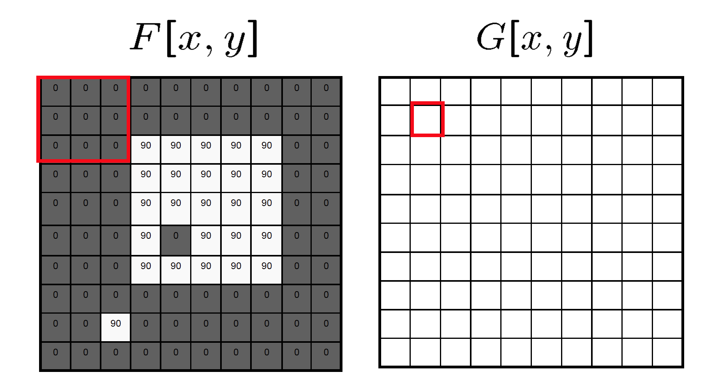

Slide 18
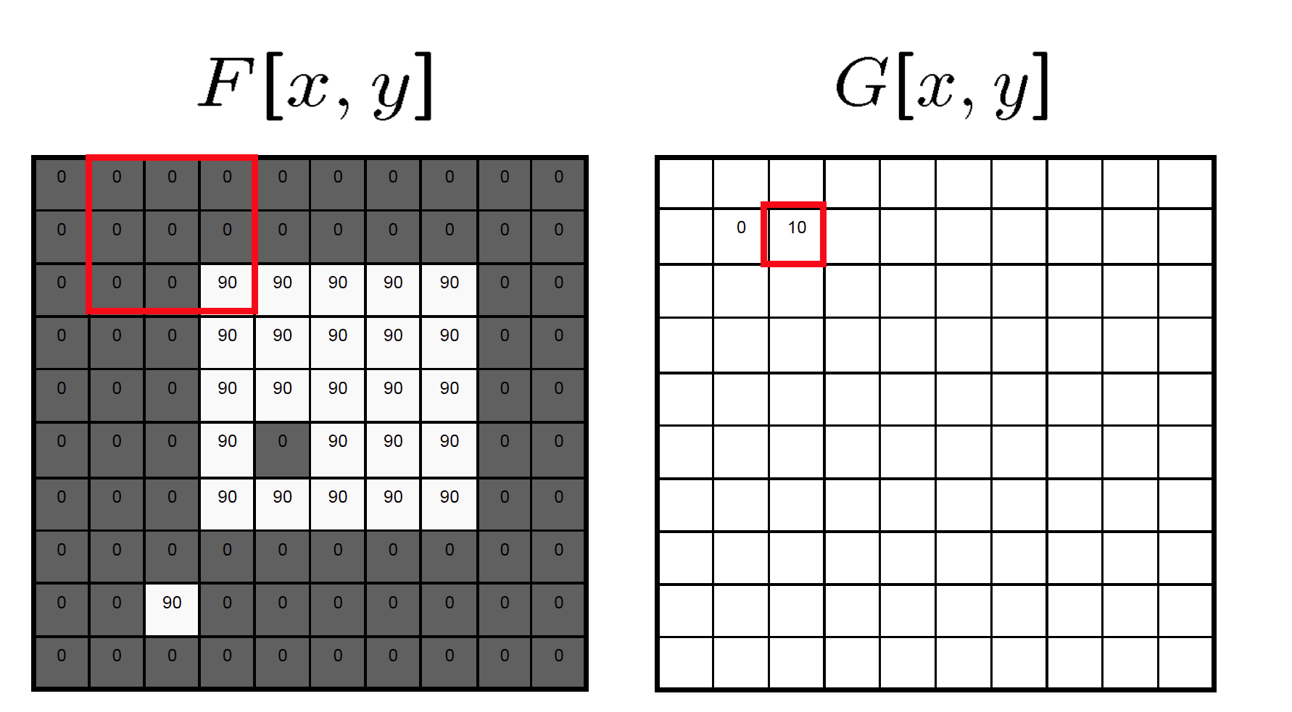

Slide 19
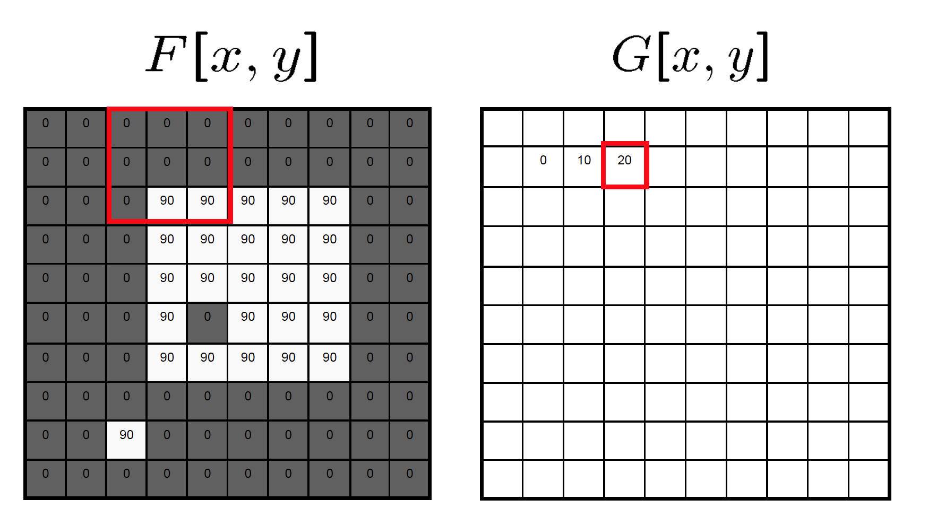

Slide 20
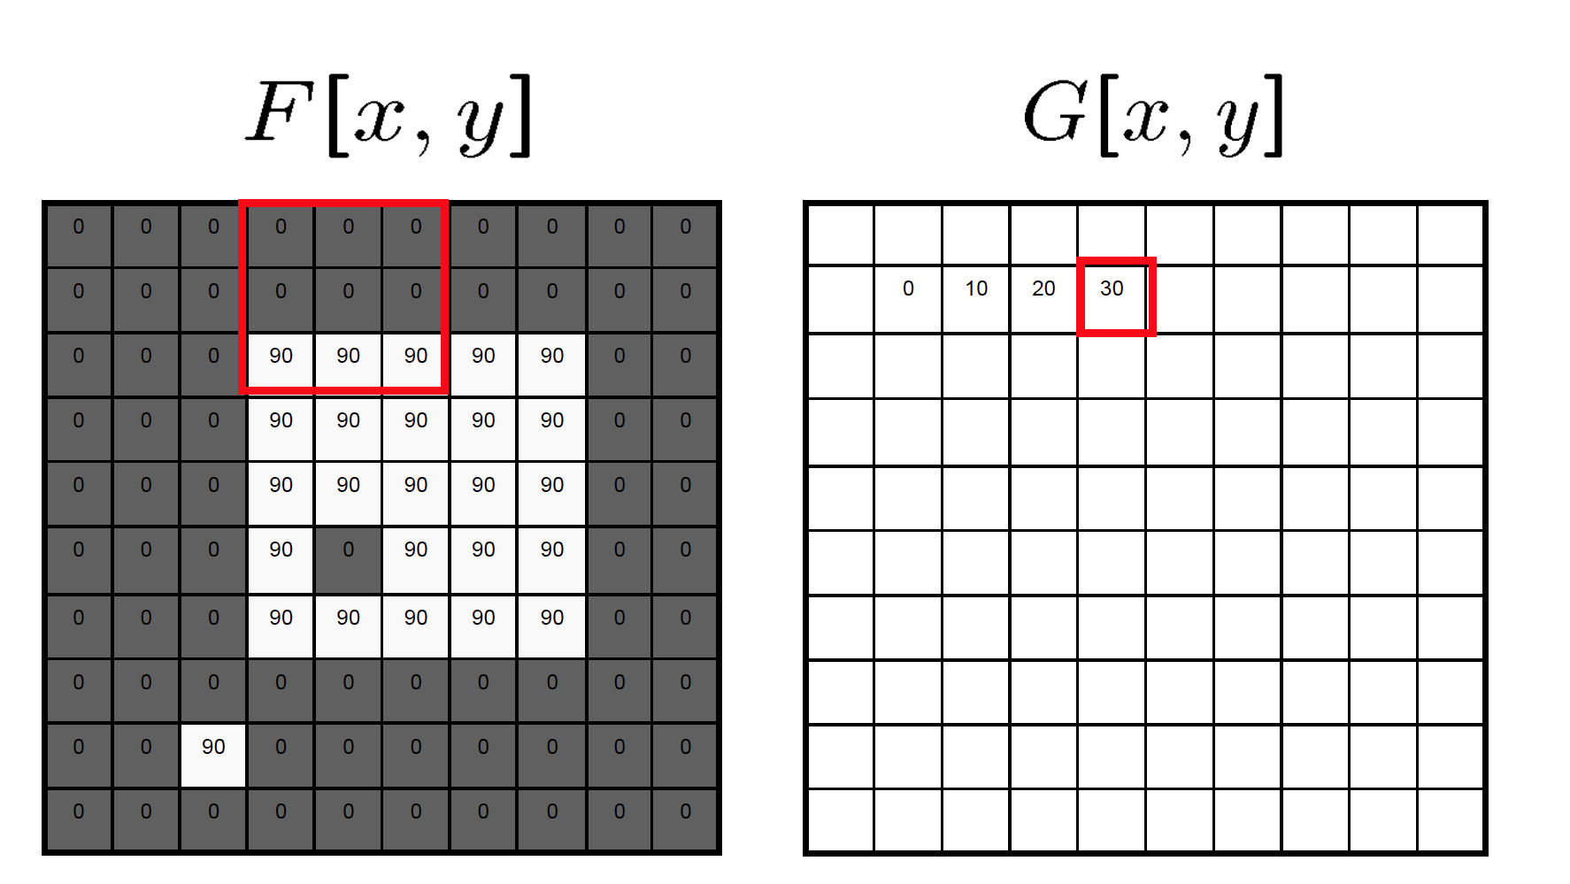

Slide 21
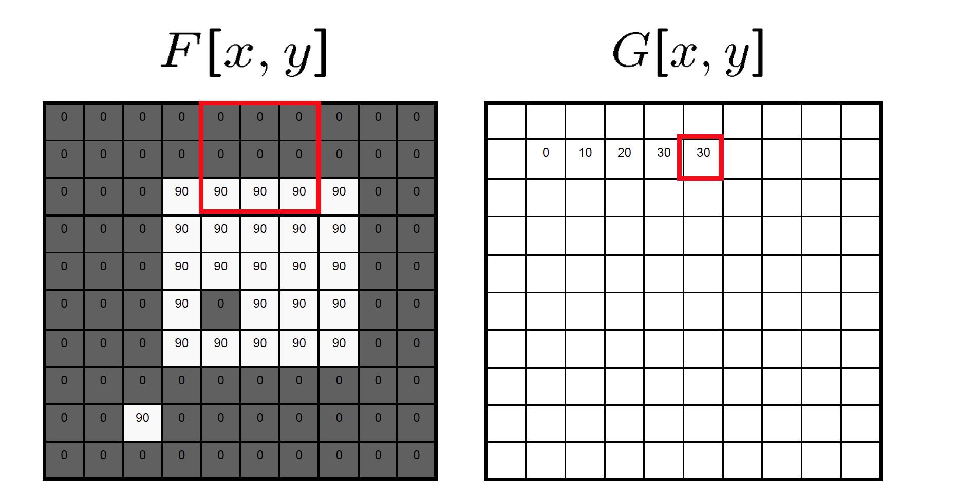

Slide 22
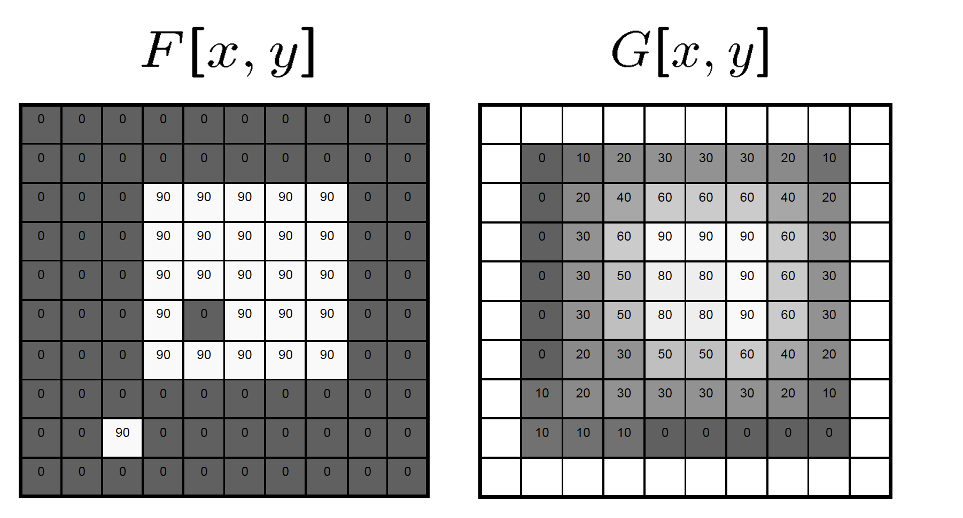

Slide 23
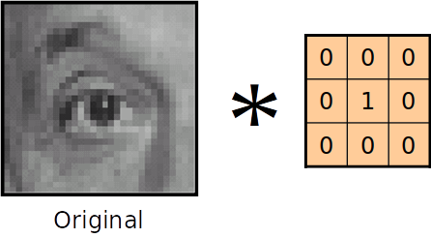
Linear filters: examples

Slide 24
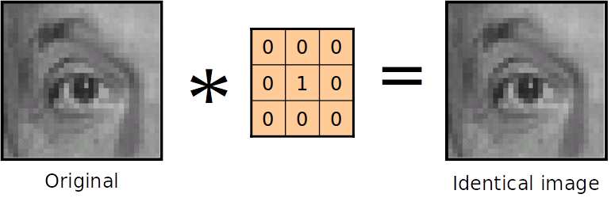

Slide 25
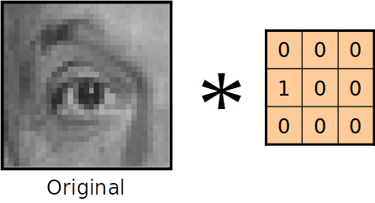

Slide 26
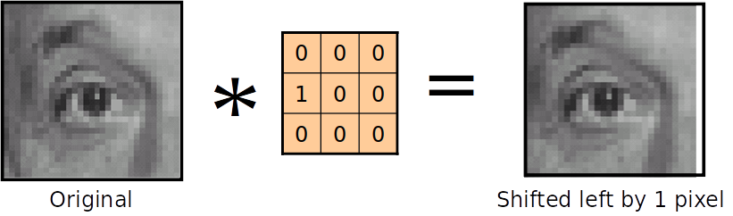
each pixel in the output is replaced by the value of the pixel to its left.

Slide 27
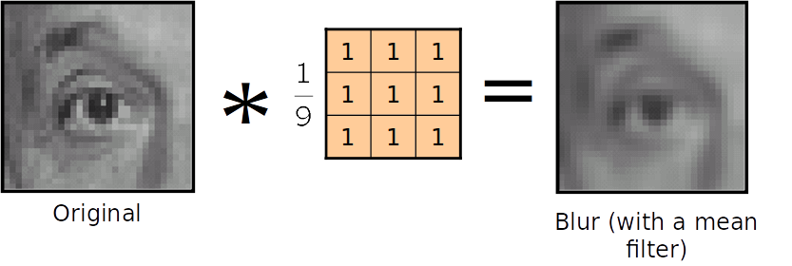

Slide 28
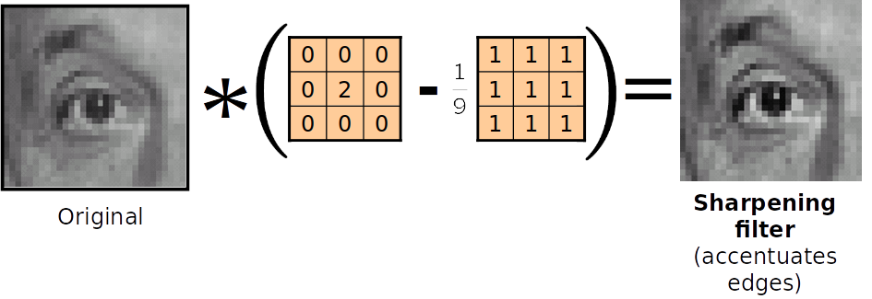

Slide 29
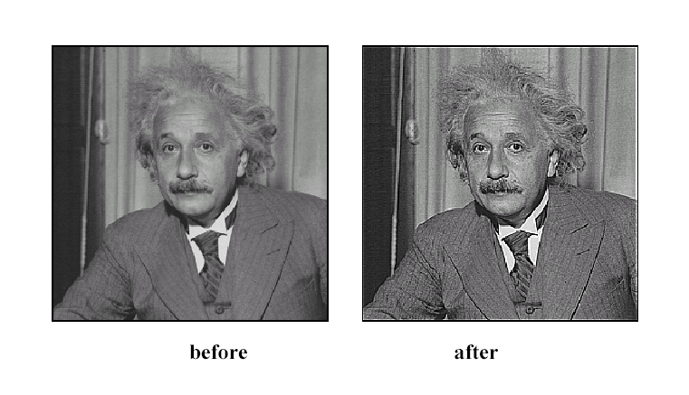
Sharpening

Slide 30
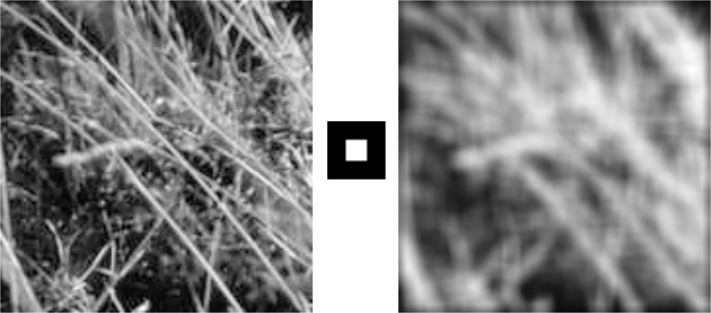
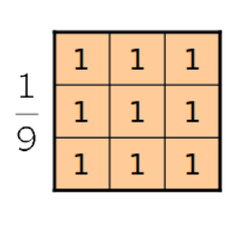
Smoothing with box filter revisited
box blur (also known as a box linear filter)

Slide 31
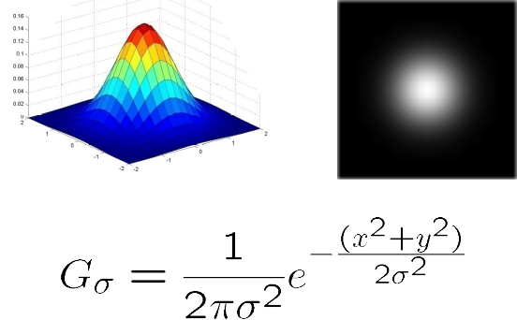
Gaussian kernel

Slide 32
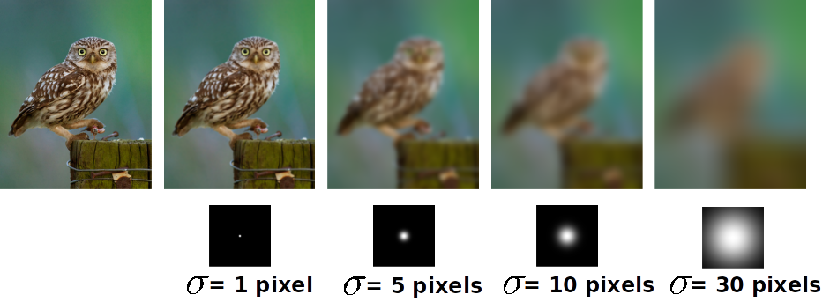
Gaussian filters

Slide 33
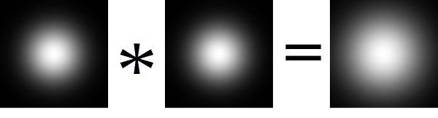
Gaussian filter
Removes “high-frequency” components from the image (low-pass filter)
Convolution with self is another Gaussian

Slide 34
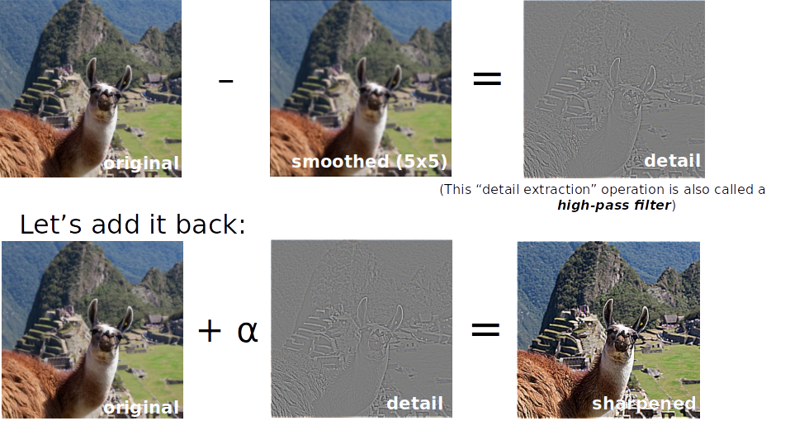
Sharpening revisited
What does blurring take away?
Photo credit: https://www.flickr.com/photos/geezaweezer/16089096376/

Slide 35
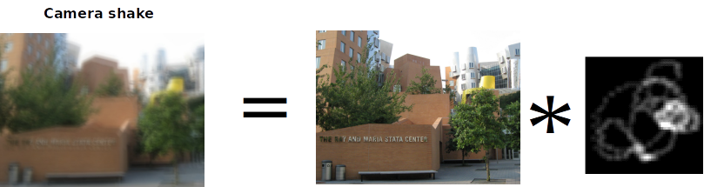
“Optical” convolution
Source: Fergus, et al. “Removing Camera Shake from a Single Photograph”, SIGGRAPH 2006

Slide 36
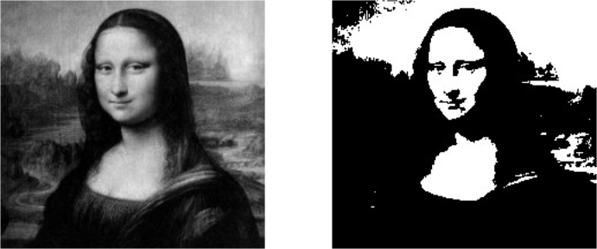

Filters: Thresholding

Slide 37
backup

Slide 38
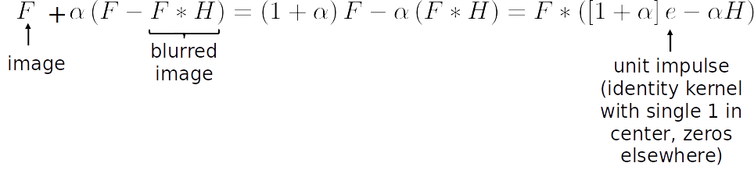
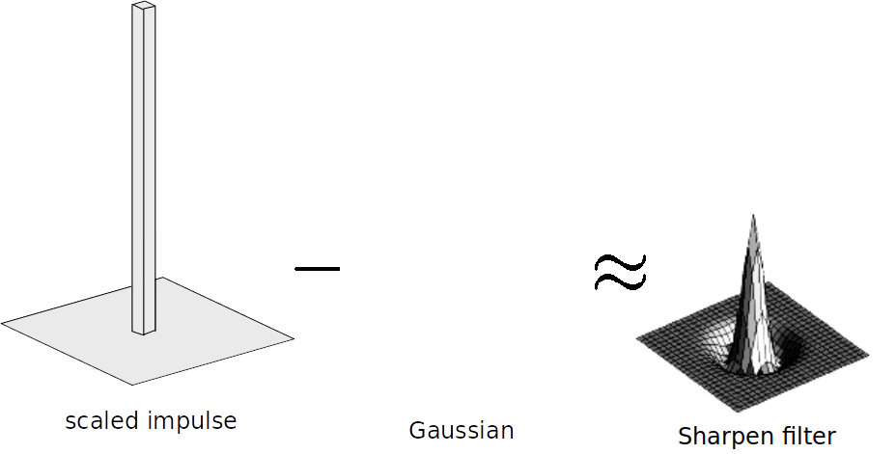
Sharpen filter

