Slide 1
Lecture 2: Edge detection

Slide 2
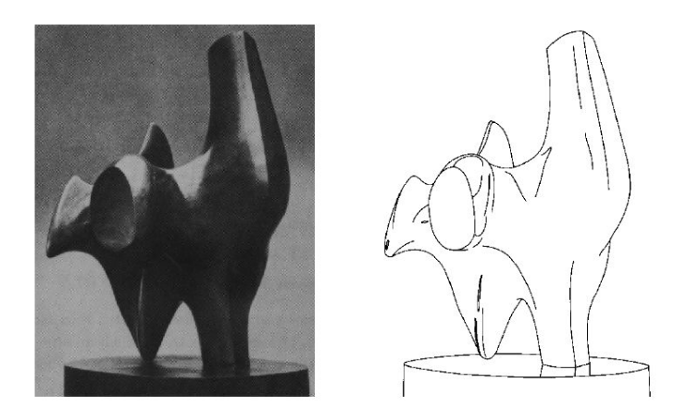
Edge detection
• Convert a 2D image into a set of curves

Slide 3
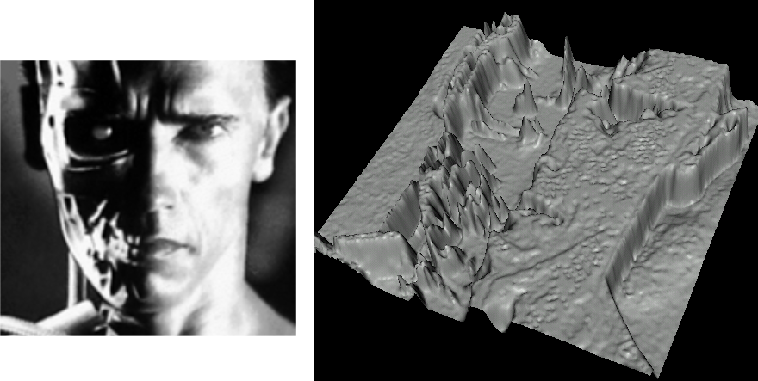
Images as functions…
Edges look like steep cliffs

Slide 4
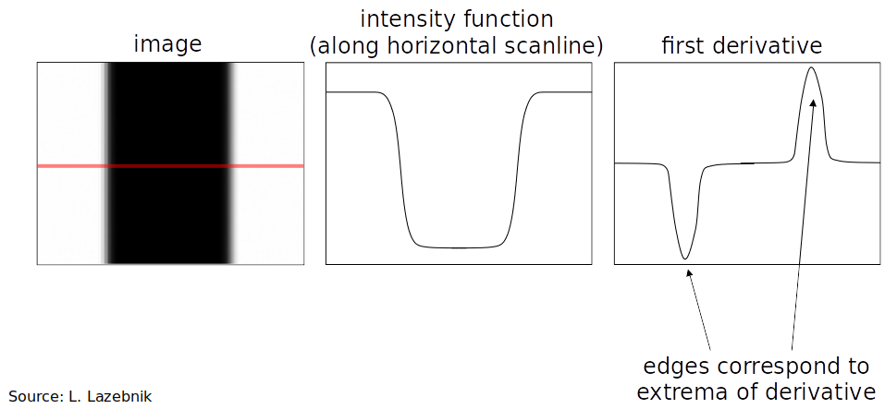
Characterizing edges
An edge is a place of rapid change in the image intensity function

Slide 5
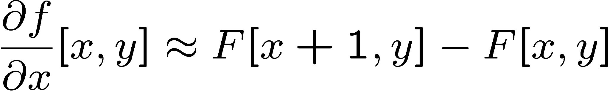
Image derivatives
How can we differentiate a digital image F[x,y]?
Option 1: reconstruct a continuous image, f, then compute the derivative
Option 2: take discrete derivative (finite difference)
How would you implement this as a linear filter?

Slide 6
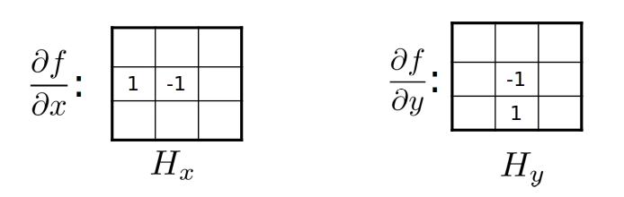

Slide 7
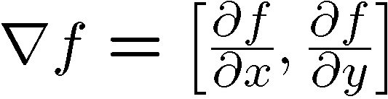
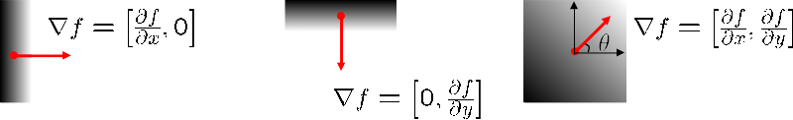
Image gradient
The gradient of an image:
The gradient points in the direction of most rapid increase in intensity

Slide 8
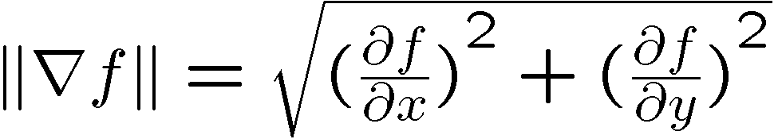
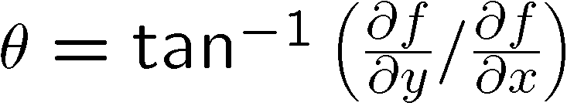
The edge strength is given by the gradient magnitude:
The gradient direction is given by:

Slide 9
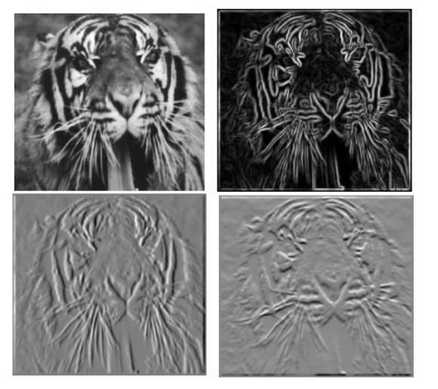
Image gradient

Slide 10
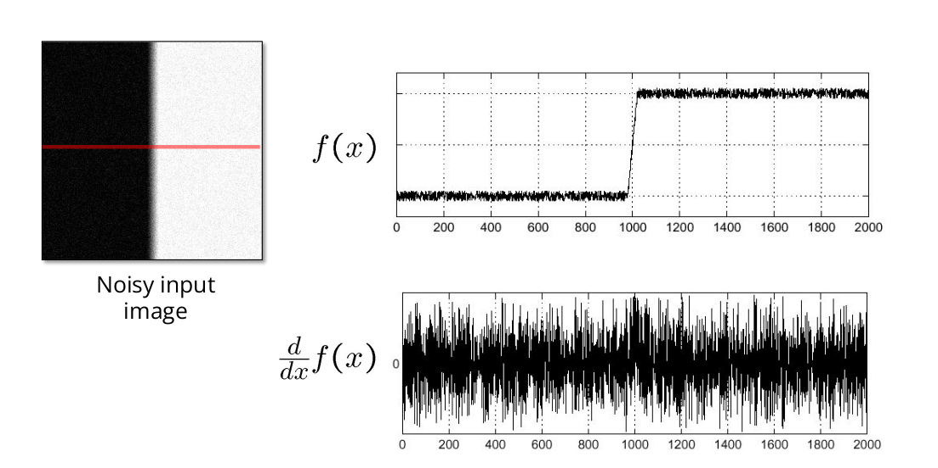
Effects of noise

Slide 11
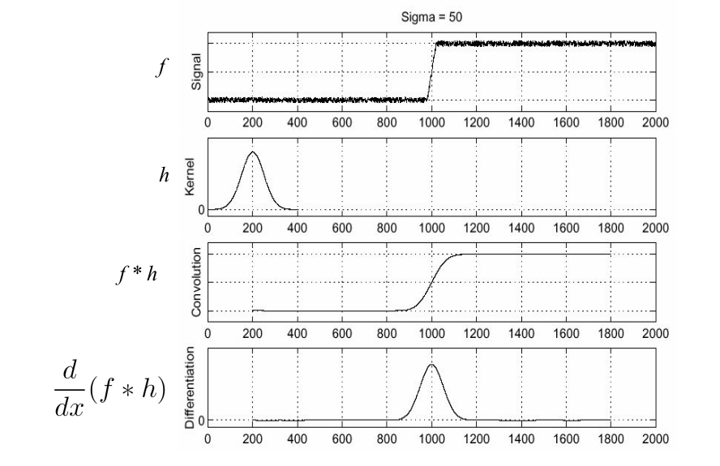
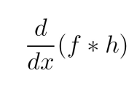
Solution: smooth ﬁrst
To ﬁnd edges, look for peaks in

Slide 12
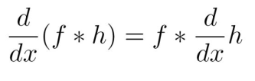
Associative property of convolution
Diﬀerentiation is convolution, and convolution is associative:
• This saves us one operation: f

Slide 13
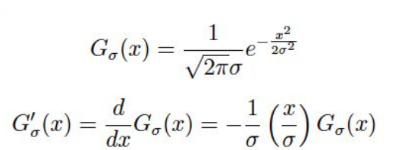
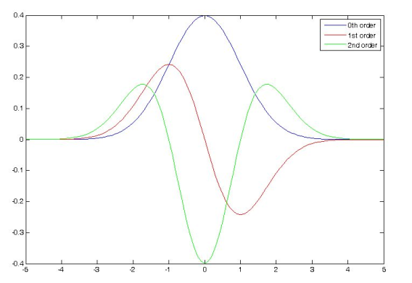
The 1D Gaussian and its derivatives

Slide 14
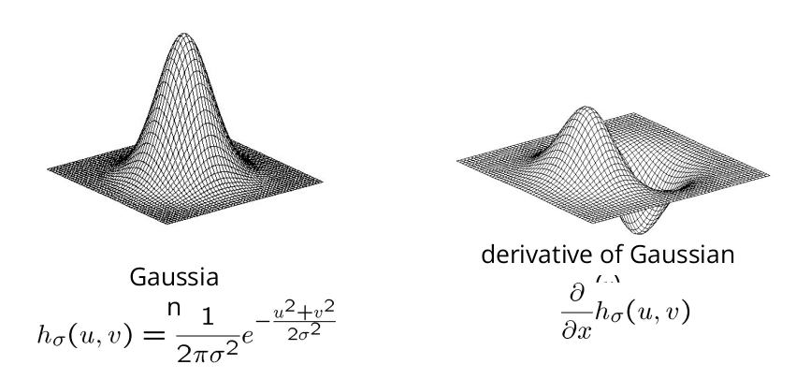
2D edge detection ﬁlters

Slide 15
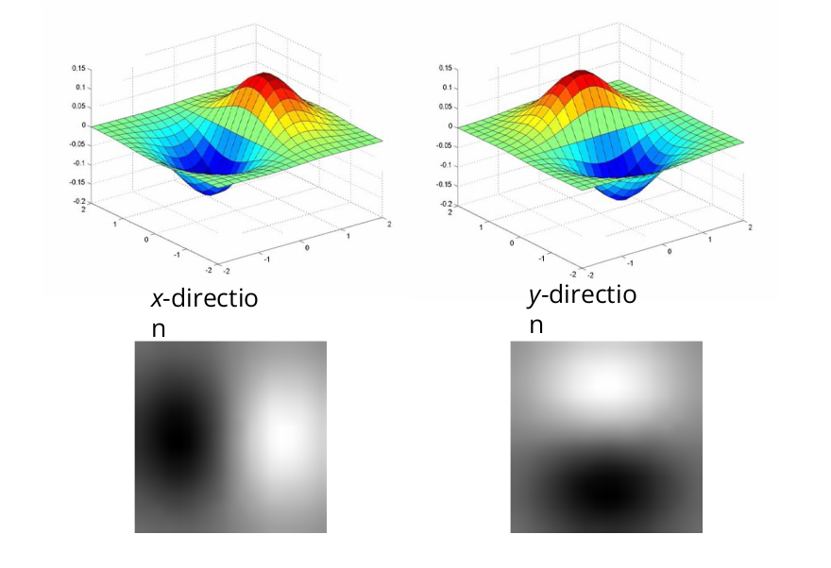

Slide 16
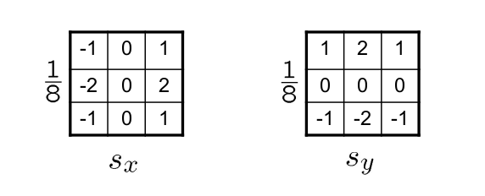
The Sobel operator
• Common approximation of derivative of Gaussian
• The standard deﬁnition of the Sobel operator omits the 1/8 term
– doesn’t make a diﬀerence for edge detection
– the 1/8 term is needed to get the right gradient magnitude

Slide 17
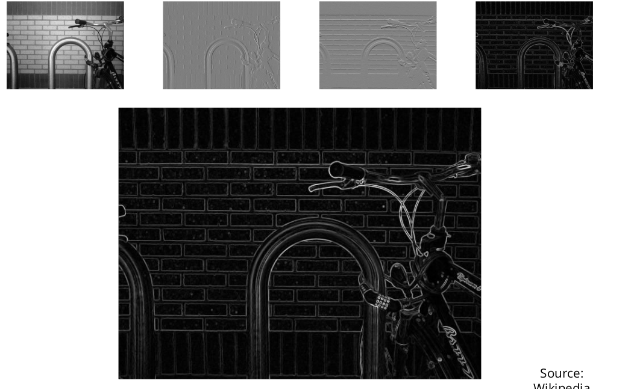
Sobel operator: example

Slide 18
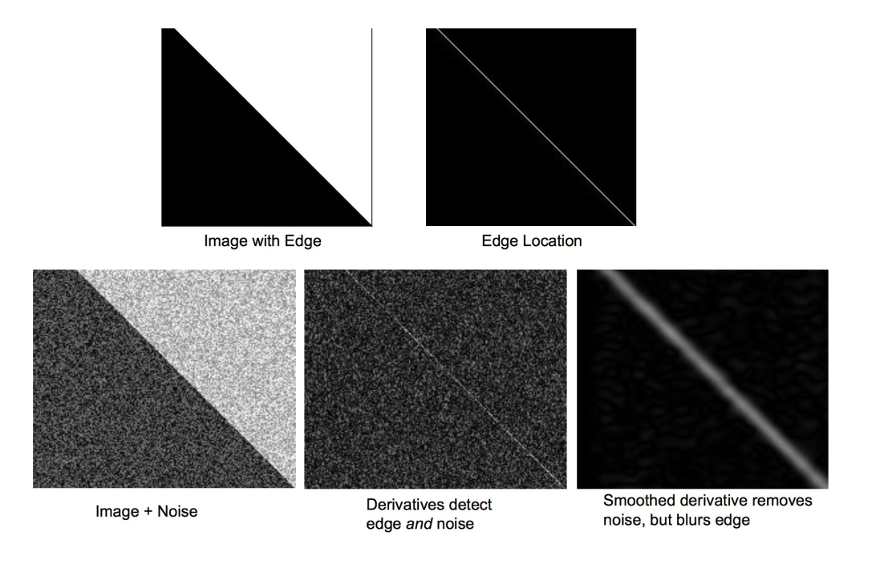

Slide 19
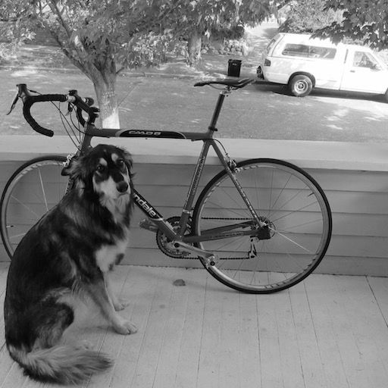
Example
Demo: http://bigwww.epﬂ.ch/demo/ip/demos/edgeDetector/

Slide 20
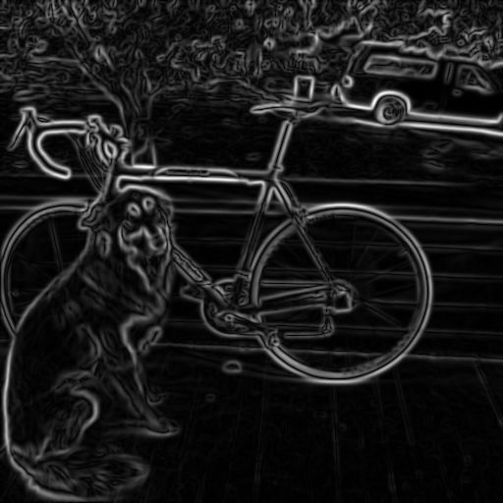
Finding edges
smoothed gradient magnitude

Slide 21
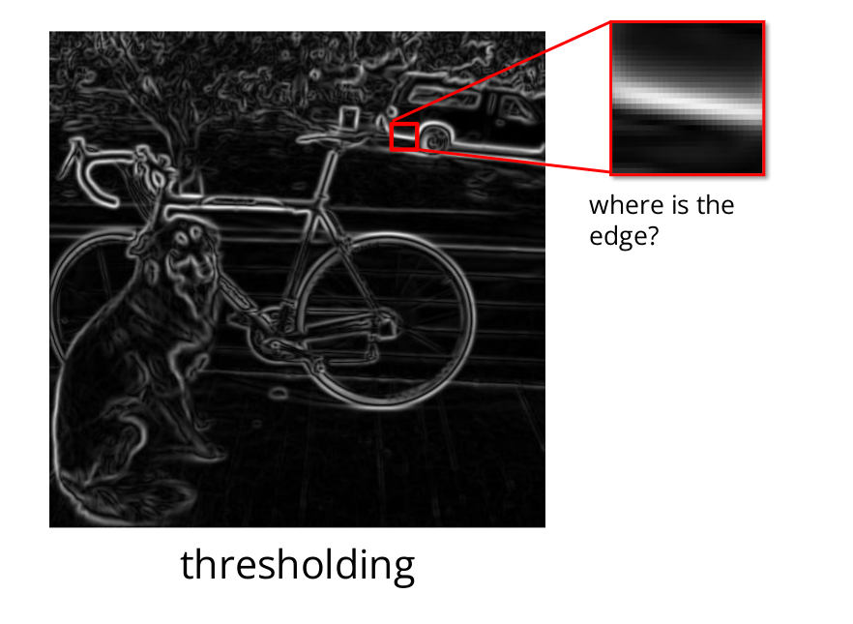

Slide 22
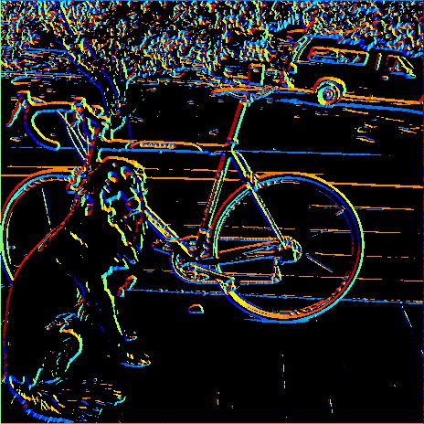
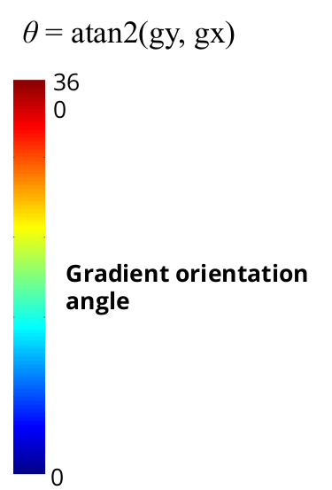
Get Orientation at Each Pixel
• Get orientation (below, threshold at minimum gradient magnitude)

Slide 23
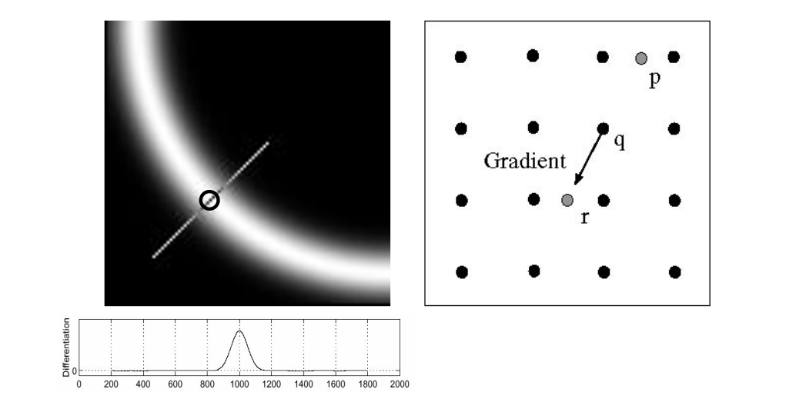
Non-maximum suppression
• Check if pixel is local maximum along gradient direction
– requires interpolating pixels p and r

Slide 24
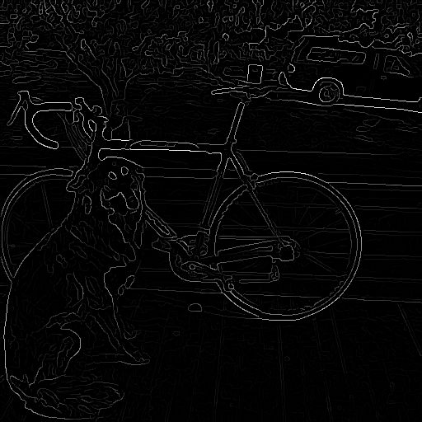
Before Non-max Suppression
After Non-max Suppression

Slide 25
Thresholding edges
Still some noise
• Only want strong edges
• 2 thresholds, 3 cases
• R > T: strong edge
• R < T but R > t: weak edge
• R < t: no edge
• Why two thresholds?

Slide 26
Canny edge detector
• Our ﬁrst computer vision pipeline!
• Still a widely used edge detector in computer vision
J. Canny, A Computational Approach To Edge Detection, IEEE Trans. Pattern Analysis and Machine Intelligence, 8:679-714, 1986

Slide 27
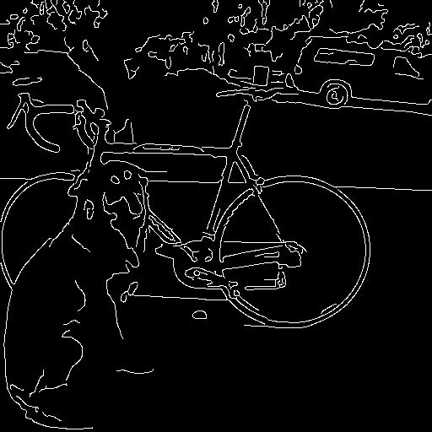
Connecting edges
Strong edges are edges!
Weak edges are edges if they connect to strong
• Look in some neighborhood
(usually 8 closest)

Slide 28
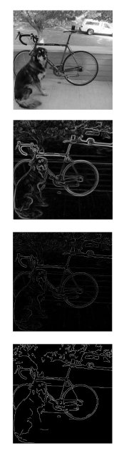
Canny edge detector
1. Filter image with derivative of Gaussian
2. Find magnitude and orientation of Gradient
3. Non-maximum suppression
4. Linking and thresholding (hysteresis):
– Deﬁne two thresholds: low and high
– Use the high threshold to start edge curves and the low threshold to continue them
Source: D. Lowe, L. Fei-Fei, J.

Slide 29
Edge Tracking by Hysteresis (Double Thresholding)
Why: After non-maximum suppression, we have some pixels that are strong edges, some that are weak edges, and some that are not edges at all. The weak edges may or may not be part of the real edge. To decide which weak edges should be kept, hysteresis is used.
How: This is done by applying two thresholds, a low threshold and a high threshold:
Strong edges: Pixels with gradient magnitudes greater than the high threshold are considered strong edges and are retained.
Weak edges: Pixels with gradient magnitudes between the low and high thresholds are considered weak edges. These are retained only if they are connected to strong edges.
Non-edges: Pixels with gradient magnitudes below the low threshold are discarded.

Slide 30
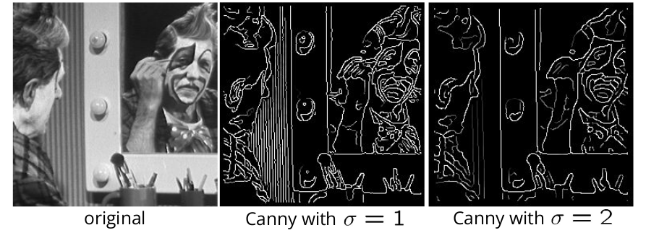
Canny edge detector
The choice of sigma depends on desired behavior
– large sigma detects “large-scale” edges
– small sigma detects ﬁne edges

