Slide 1
Local features & Harris corner detection

Slide 2
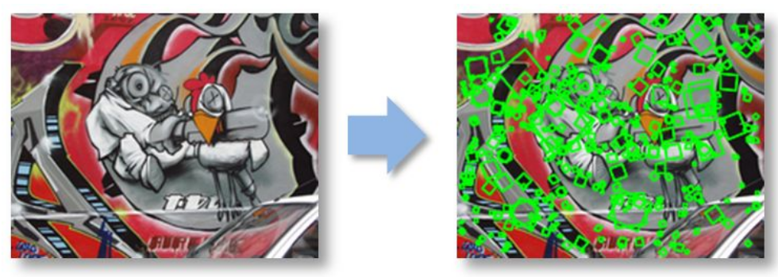

Slide 3
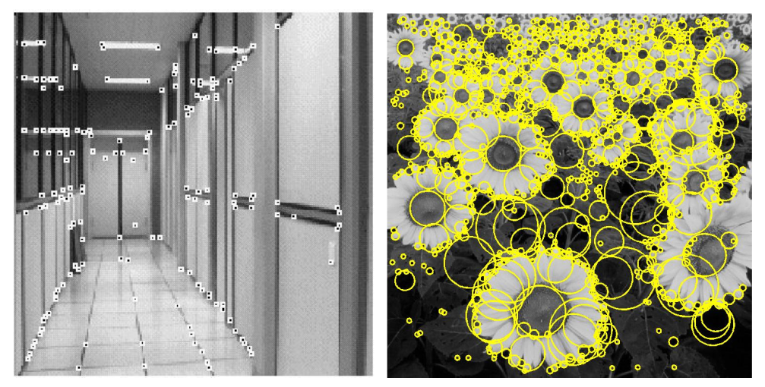
Feature extraction—Corners and blobs

Slide 4
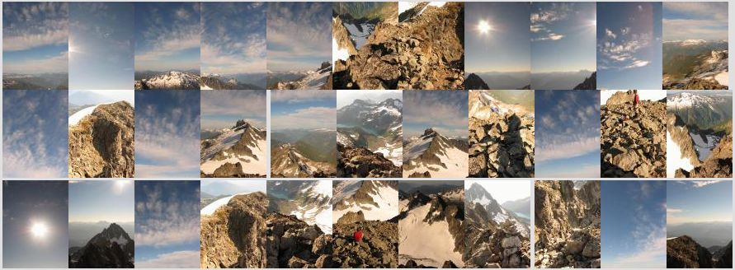
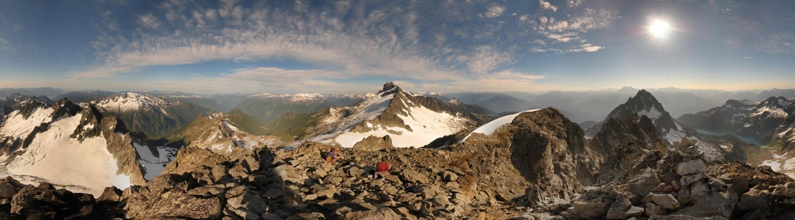
Motivation: Automatic panoramas

Slide 5
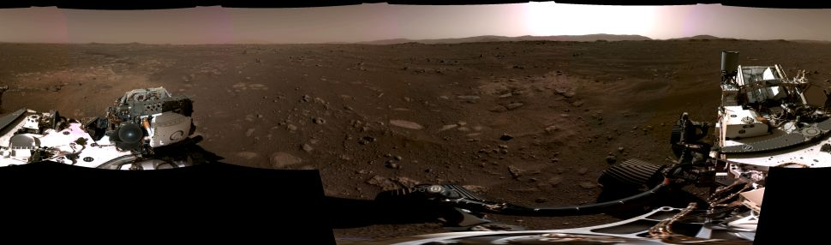
Panorama stitching
Panorama captured by Perseverence Rover, Feb. 20, 2021
https://www.space.com/nasa-perseverance-rover-ﬁrst-panorama-mars

Slide 6
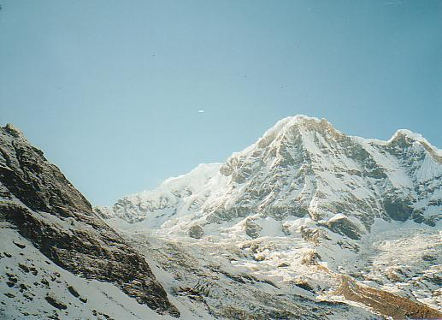
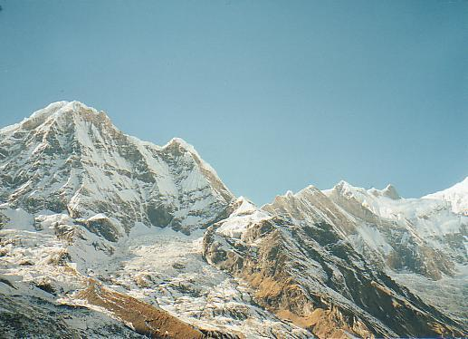
Why extract features?
• Motivation: panorama stitching
– We have two images – how do we combine them?

Slide 7
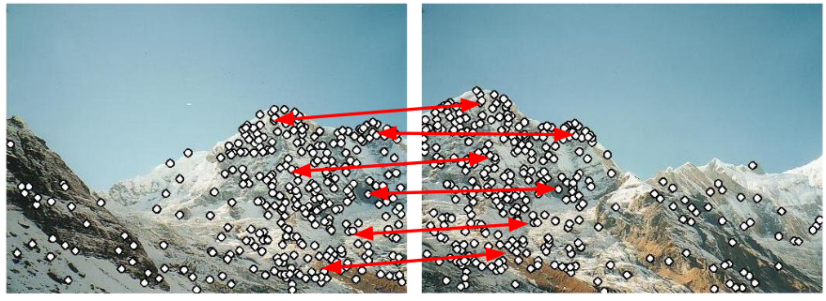
Why extract features?
• Motivation: panorama stitching
– We have two images – how do we combine them?
Step 1: extract features
Step 2: match features

Slide 8
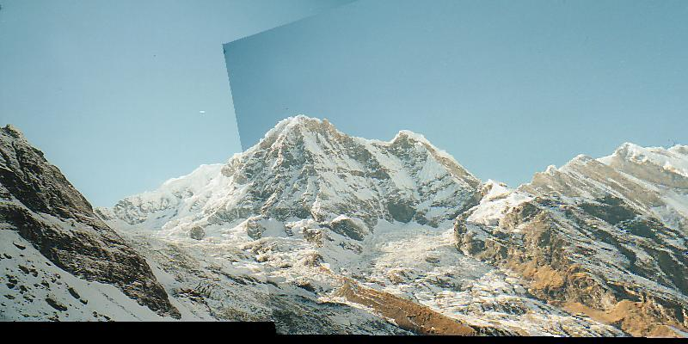
Step 1: extract features
Step 2: match features
Step 3: align features

Slide 9
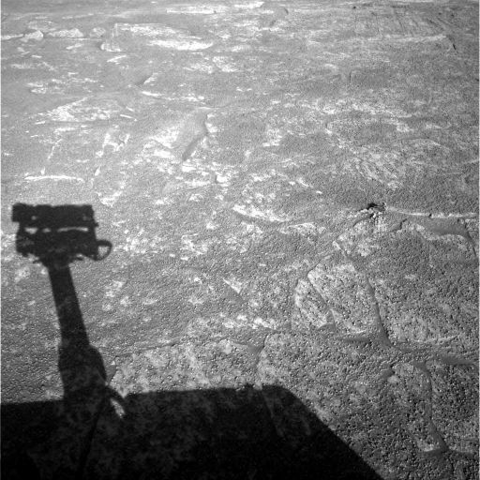
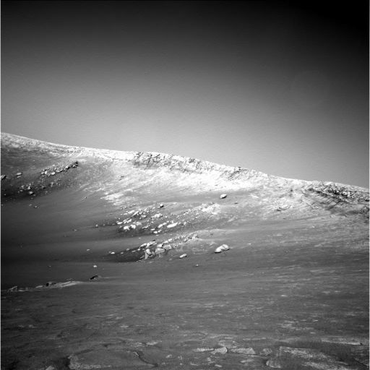
Do these images overlap?

Slide 10
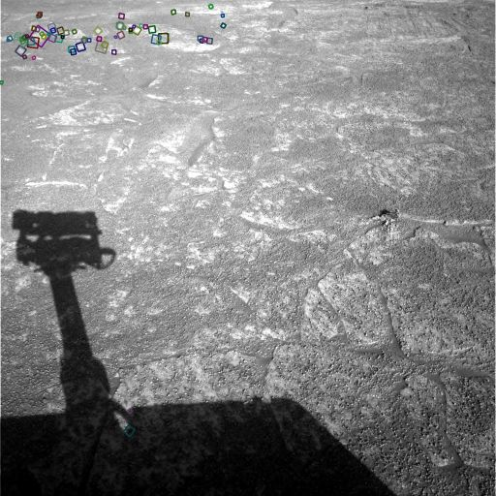
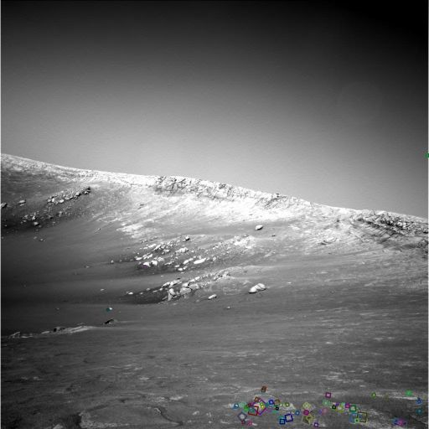
Answer below (look for tiny colored squares…)
NASA Mars Rover images with SIFT feature matches

Slide 11
ORB
Keypoints are detected using FAST. These keypoints are typically corners in the image. (points with brightness differences)
Orientation is calculated for each keypoint
BRIEF is used to create a binary descriptor for each keypoint, which describes the local region around the keypoint.
The descriptor is made rotation-invariant by adjusting for the keypoints orientation (it does calculate the gradient around it and then use the dominant gradient)

Slide 12
Do the code
algorithms/SLAM/main.py

Slide 13
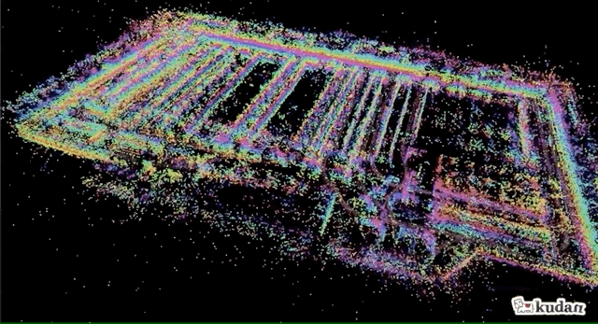
Simultaneous Localization and Mapping (SLAM)

Slide 14
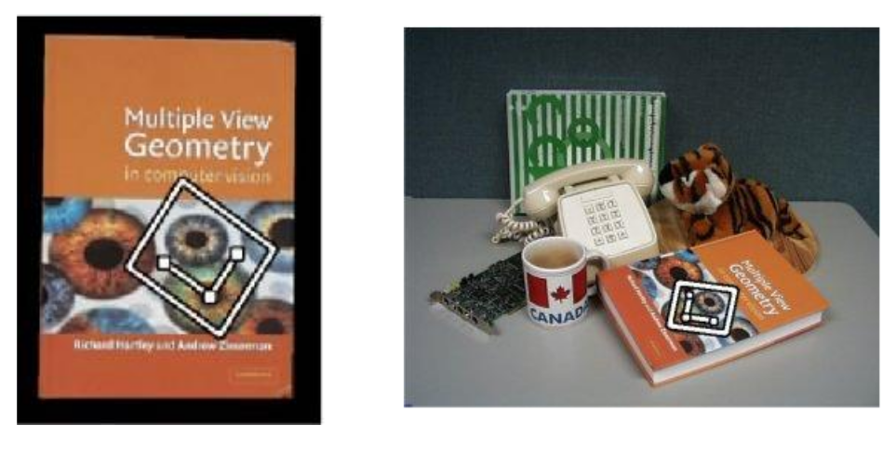
Feature matching for object search

Slide 15
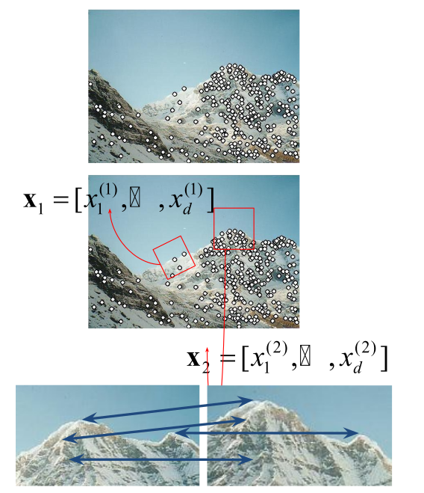
Local features: main components
1) Detection: Identify the interest points
2) Description: Extract vector feature descriptor surrounding each interest point
3) Matching: Determine correspondence between descriptors in two views

Slide 16
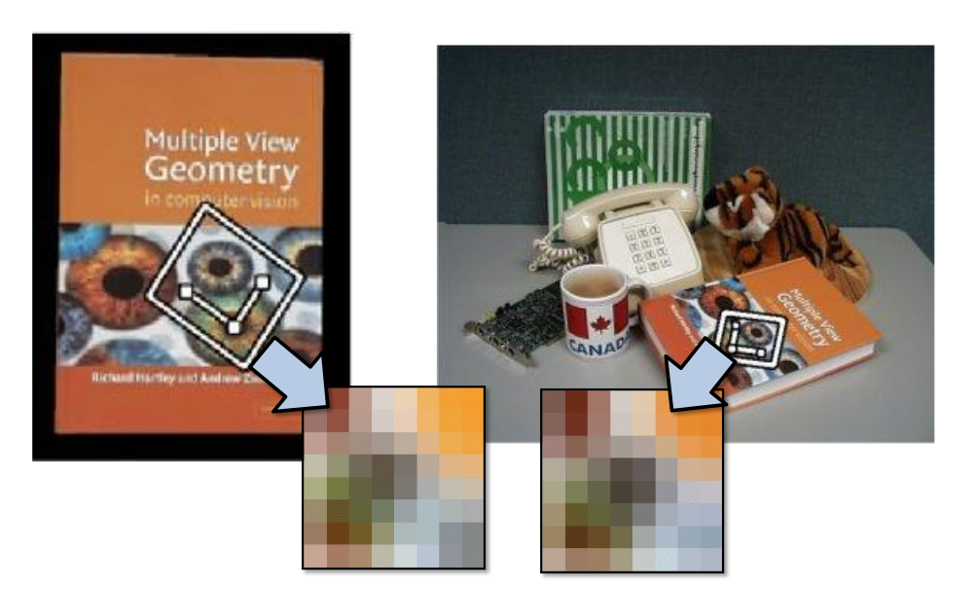

Slide 17
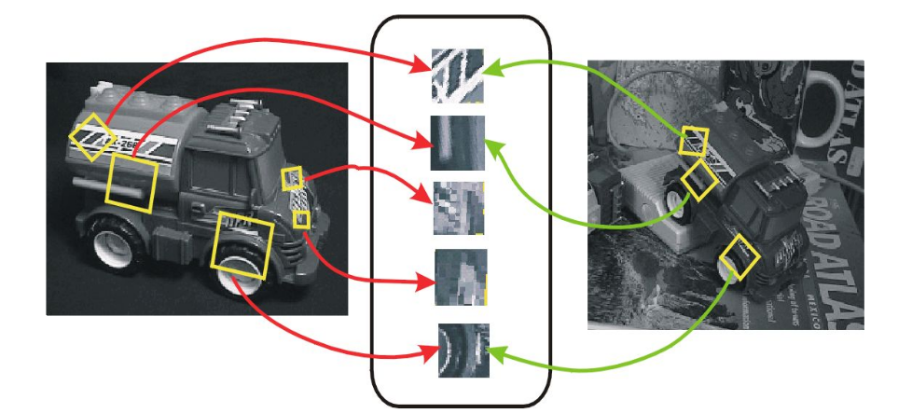
Invariant local features
Find features that are invariant to transformations
– geometric invariance: translation, rotation, scale
– photometric invariance: brightness, exposure, …

Slide 18
backup

Slide 19
Visual Slam
https://www.kudan.io/blog/visual-slam-the-basics/

Slide 20

SLAM process

