Slide 1
Pytest

Slide 2
To catch bugs early

Slide 3
To improve the quality of your code

Slide 4
To increase confidence in your code

Slide 5
To reduce the cost of maintenance

Slide 6
To improve communication

Slide 7
Unit tests: Unit tests can be used to test individual units of code, such as functions and classes. This can help you to catch bugs early and to ensure that your code is working as expected.
Integration tests: Integration tests can be used to test how different units of code work together. This can help you to catch bugs that may not be caught by unit tests.
End-to-end tests: End-to-end tests can be used to test your entire application from start to finish. This can help you to ensure that your application works as expected in a real-world environment.

Slide 8
What is Pytest?

Slide 9
Why use Pytest?

Slide 10
Why use Pytest?

Slide 11
Pytest features

Slide 12
Fixtures: Fixtures can be used to set up and tear down test environments, and to provide data to test cases. This can help to make your tests more reusable and maintainable.
Parameterization: Parameterization allows you to run a single test with different sets of data. This can help to reduce code duplication and improve test coverage.
Markers: Markers allow you to categorize your tests and to control how they are run. For example, you can use markers to skip tests on certain platforms or to run tests in a specific order.
Reporting: Pytest provides a number of reporting options, including HTML, JUnit XML, and JSON. This can help you to identify and fix problems in your code.

Slide 13
Why use Pytest?

Slide 14
Pytest installation and configuration

Slide 15
pip install pytest

Slide 16
techniques and functions for handling assertions and error checking

Slide 17
assert Statement:

Slide 18
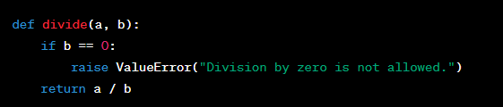
Raise Exceptions Manually:

Slide 19
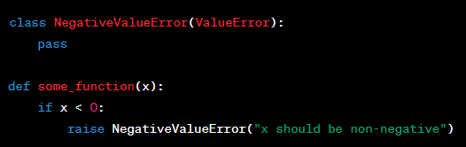
Custom Exception Classes:

Slide 20
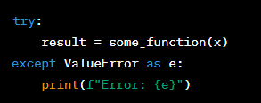
Try and Except Blocks:

Slide 21
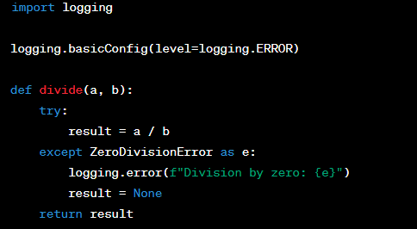
Logging

Slide 22
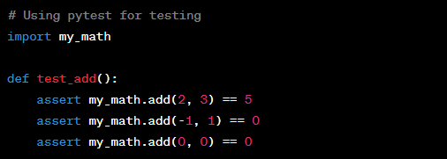
Unit Testing Frameworks (using pytest)

Slide 23
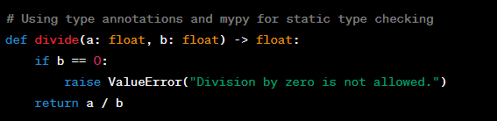
Type Checking (using mypy)

Slide 24
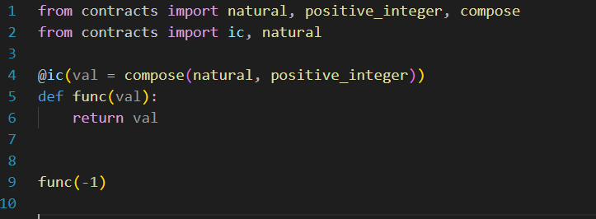

Contract-Based Programming (using PyContracts)

Slide 25
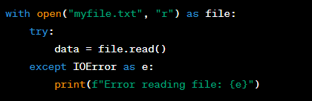
Error Handling with Context Managers

Slide 26

Validation Functions

Slide 27
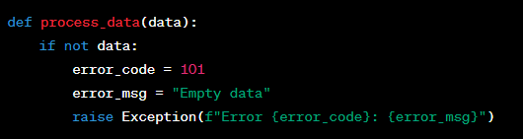
Error Codes and Messages

Slide 28
Error Reporting Services
Usage depends on the specific service (e.g., Sentry, Rollbar) and requires API configuration.

Slide 29
Contract Testing
Usage depends on the specific contract testing library (e.g., Pact).

Slide 30
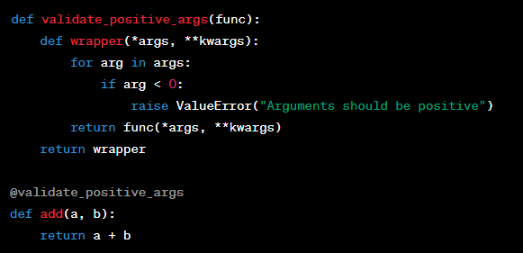
Decorator-Based Validation

Slide 31
Static Analysis Tools
Use tools like pylint and flake8 to analyze and enforce code quality and style. Configuration and usage vary based on the tool.

Slide 32

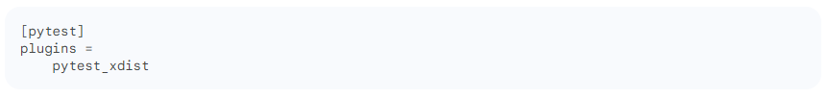
pytest.ini

Slide 33
Pytest Fixtures

Slide 34
What are fixtures?

Slide 35
Scopes of fixtures

Slide 36
Fixtures for data setup and teardown

Slide 37
Fixtures for parameterization

Slide 38
Fixtures for mocker

Slide 39
Pytest Test Cases

Slide 40
Writing test cases

Slide 41
Organizing test cases

Slide 42
Parameterizing test cases

Slide 43
Skipping and failing test cases

Slide 44
Pytest Test Reports

Slide 45
Generating test reports

Slide 46
Understanding test reports

Slide 47
Using test reports to improve your code

Slide 48
Advanced Pytest Topics

Slide 49
Using Pytest with plugins

Slide 50
Integrating Pytest with CI/CD

Slide 51
Pytest best practices

Slide 52
Conclusion
Summary of key concepts
Resources for learning more about Pytest

