Slide 1

Flask
Microframework

Slide 2
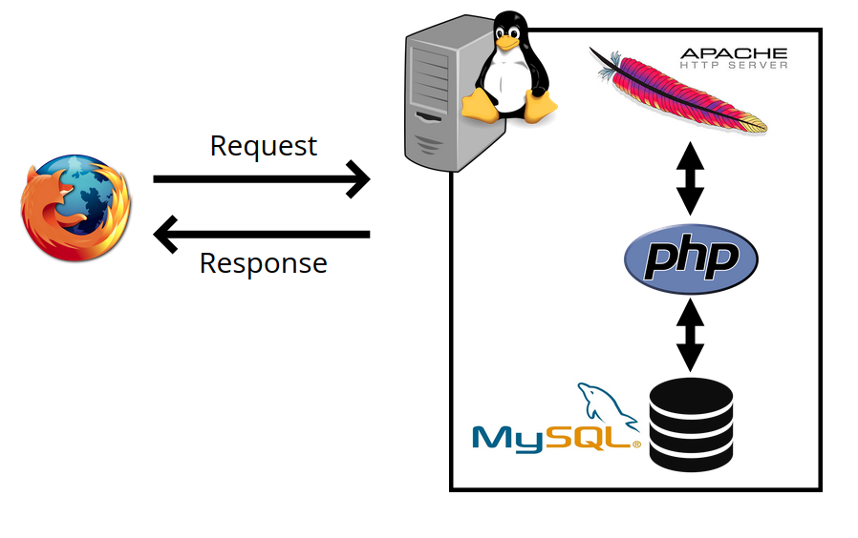
LAMP architecture
Linux, Apache, MySQL, PHP

Slide 3
LAMP architecture
Linux
Apache (web server software for handling incoming HTTP)
MySQL Relational database management system (RDBMS)
PHP (or Perl/Python)

Slide 4
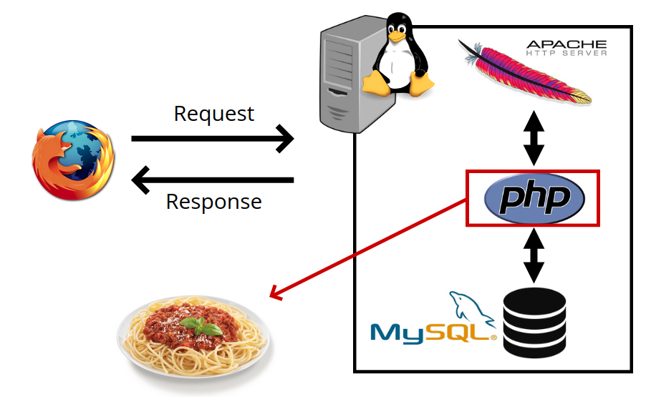
LAMP architecture
Linux, Apache, MySQL, PHP

Slide 5
همواره کارهای تکراری انجام می‌دهیم
CRUD (Create, Read, Update, Delete)
Read and parse GET and POST parameters
Handle users (register, login, password...)
Write HTML pages with a lot in common
Development principle: DRY (Don't Repeat Yourself)
Code organization: Model - View - Controller

Slide 6
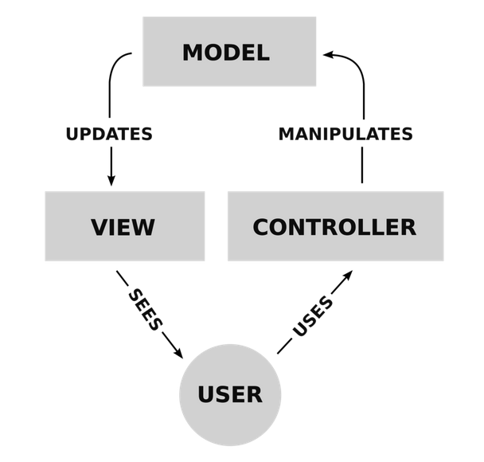
Model - View - Controller

Slide 7
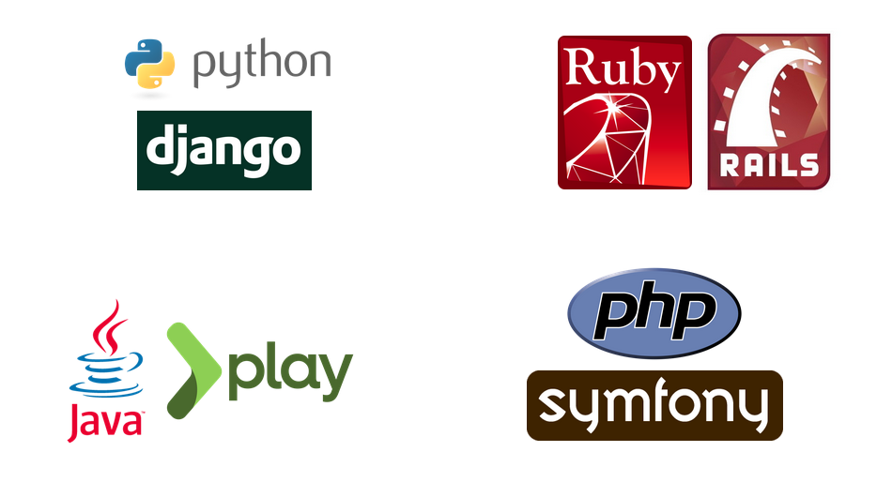
Frameworks

Slide 8
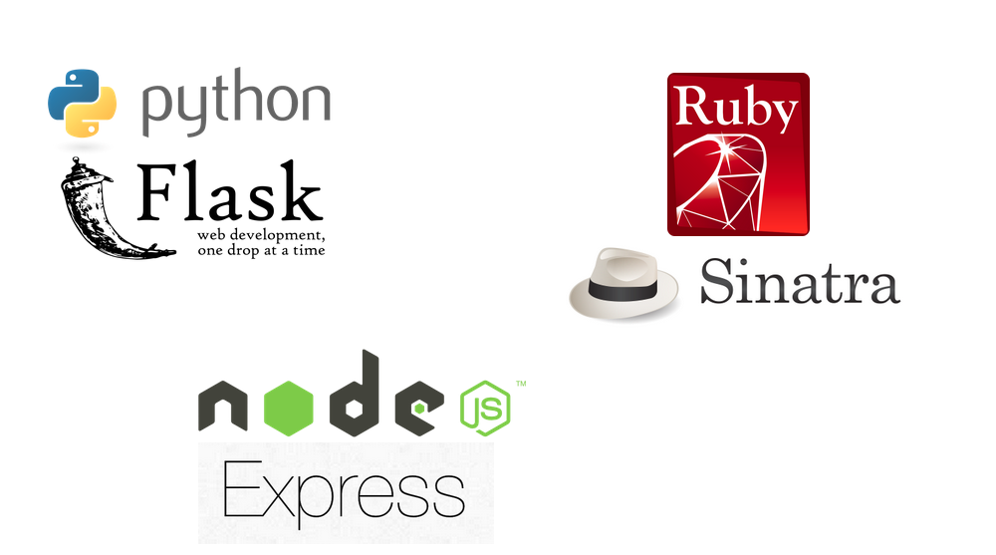
Microframeworks

Slide 9

What is Flask?
Flask is based on the Werkzeug WSGI toolkit and Jinja2 template engine.
WSGI
Web Server Gateway Interface (WSGI)
Jinja2
Jinja2 is a popular templating engine for Python.

Slide 10
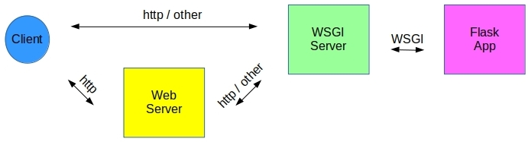
ارتباط میان وب سرور و اپلیکیشن توسط WSGI Serverانجام می‌شود
فقط یک مترجم است؟
خیر! هدفش توزیع ریکوست به صورت threading بر روی نمونه‌هایی از اپلیکیشن فلسک می‌باشد.

Slide 11
pip install Flask

Slide 12
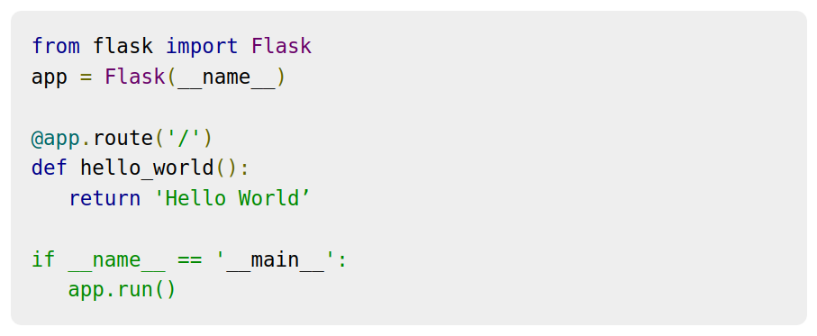
Hello World

Slide 13
Hello World
Flask constructor

Slide 14
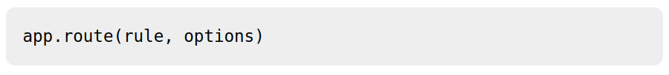
The rule parameter represents URL binding with the function.
The options is a list of parameters to be forwarded to the underlying Rule object.

Slide 15
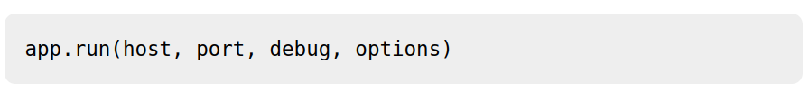

Slide 16
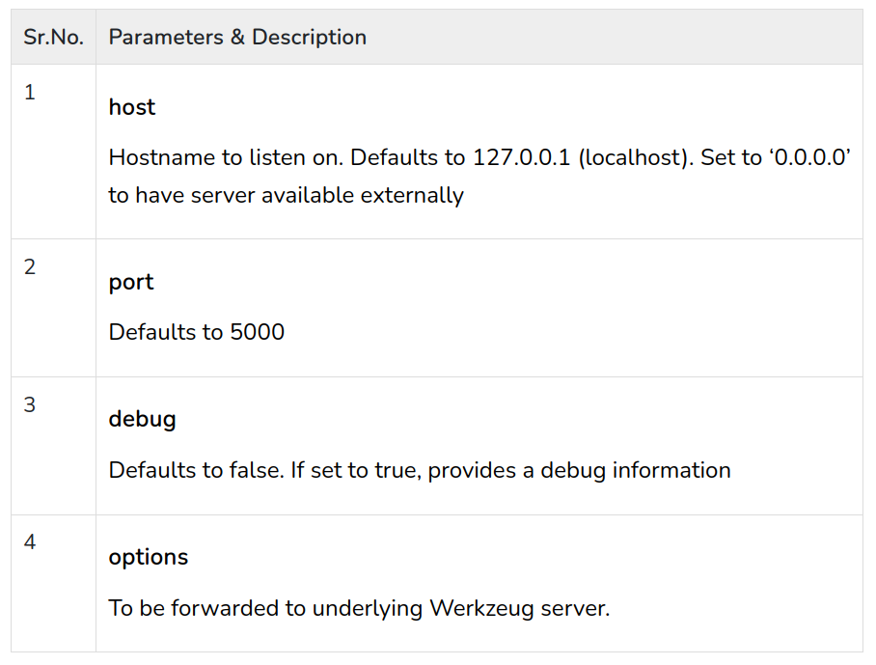

Slide 17
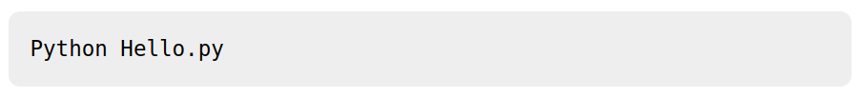
اجرای اپلیکیشن

Slide 18
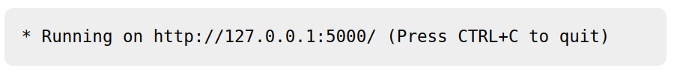

Slide 19
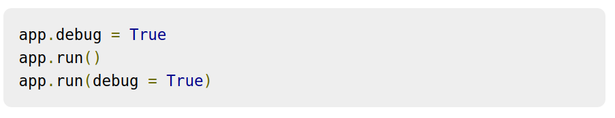

Slide 20
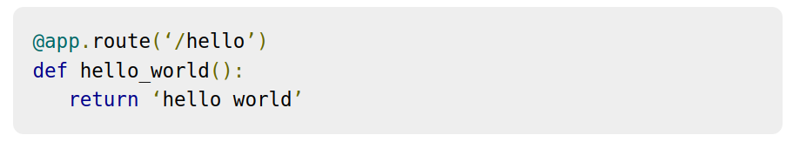
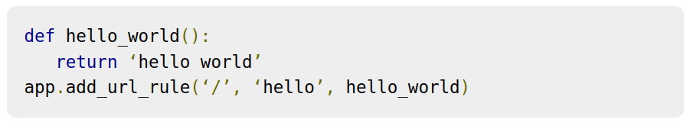
Flask – Routing

Slide 21
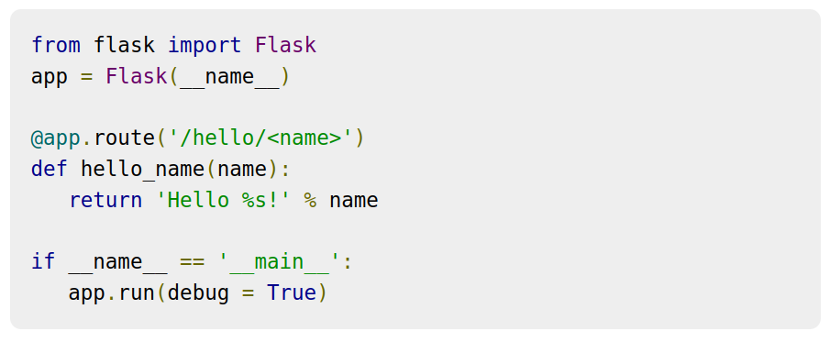
Variable Rules

Slide 22
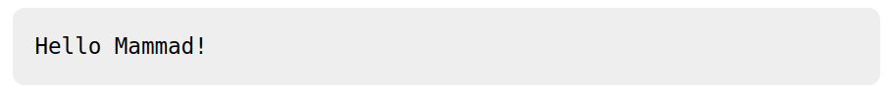

Slide 23
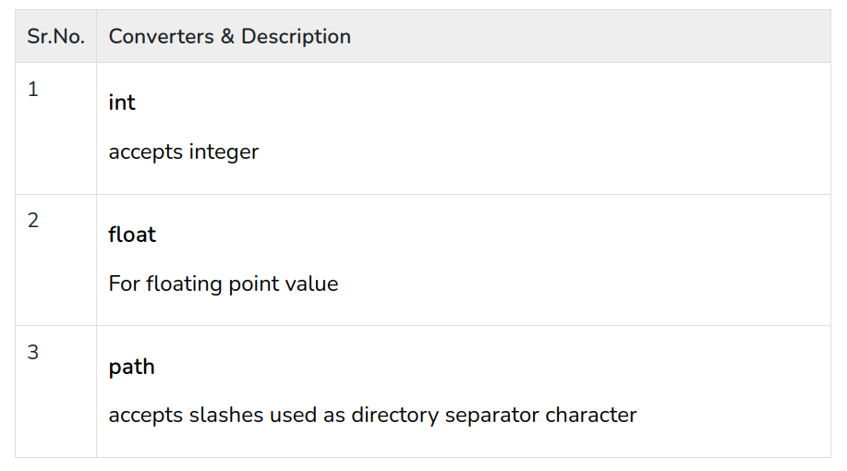

Slide 24
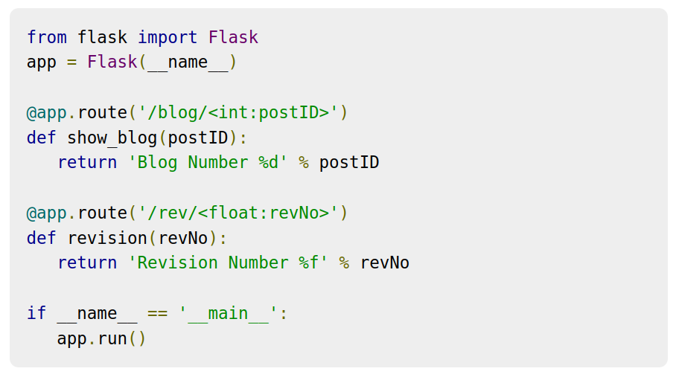

Slide 25
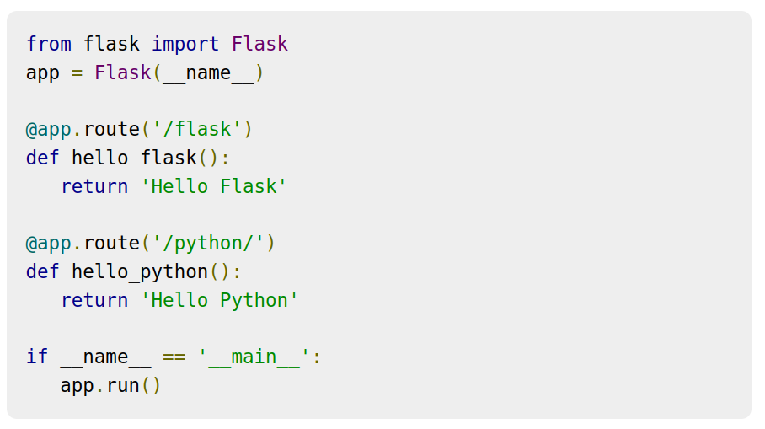
/flask/ URL results in 404 Not Found
canonical URL.
/python or /python/ returns the same output

Slide 26
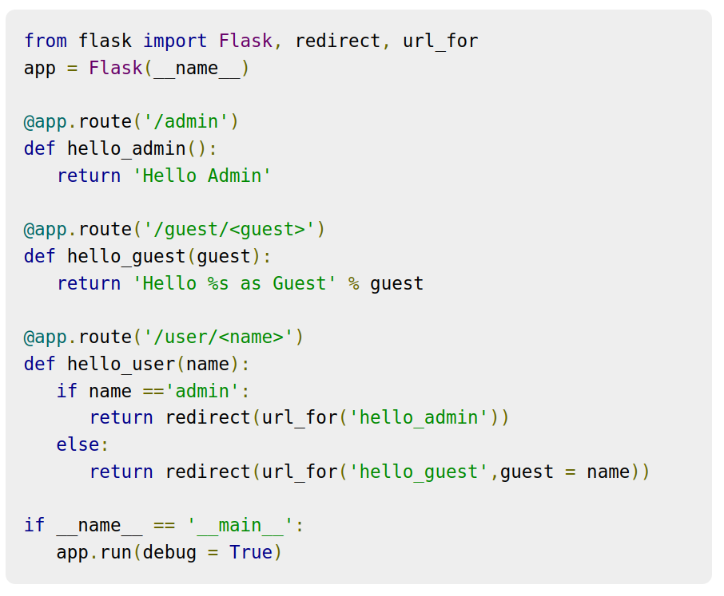
Flask – URL Building

Slide 27

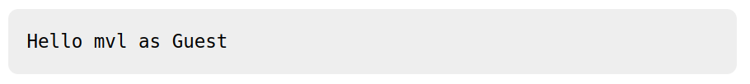
http://localhost:5000/user/admin
http://localhost:5000/user/mvl

Slide 28
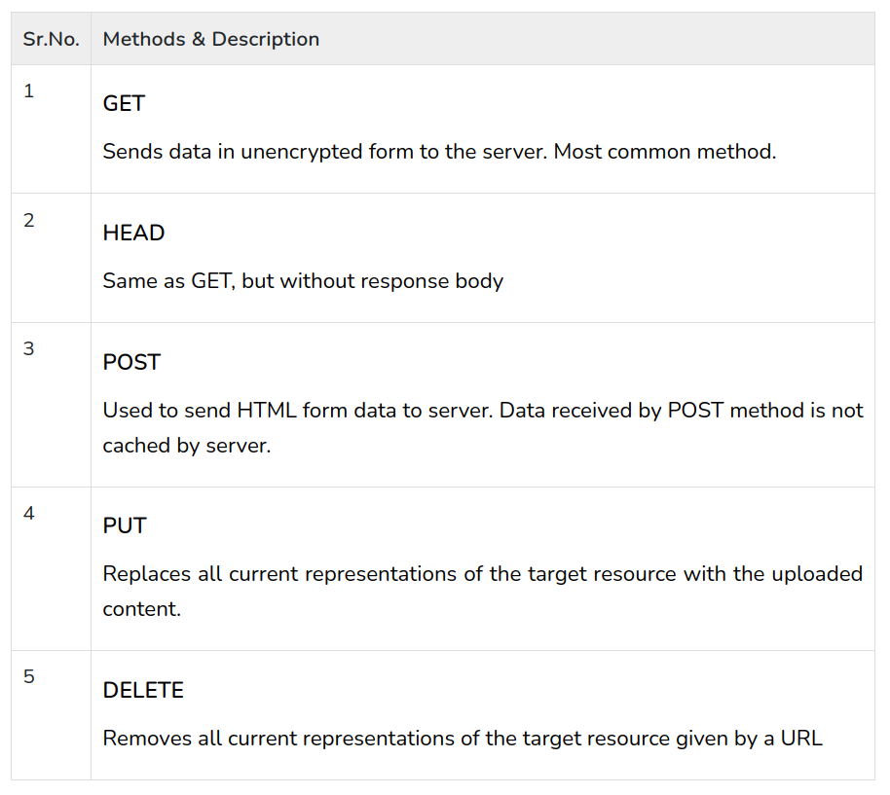
HTTP methods

Slide 29
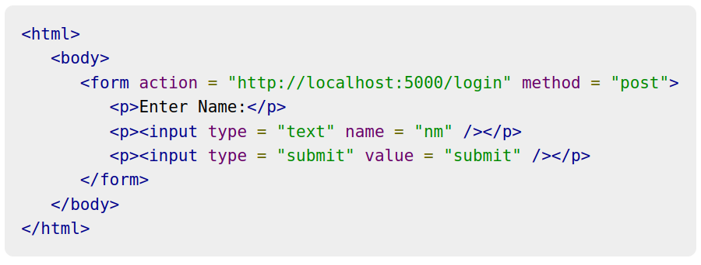
login.html

Slide 30
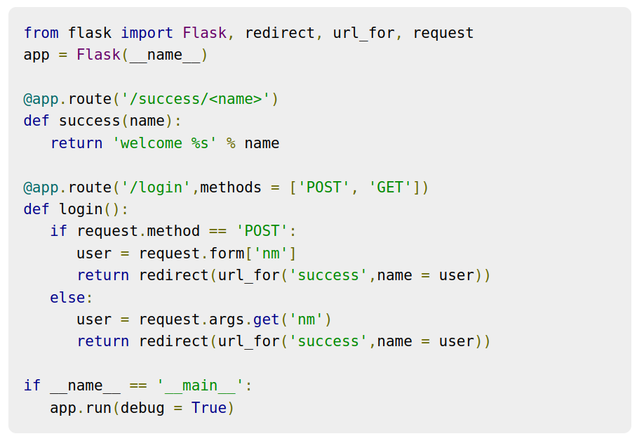

Slide 31
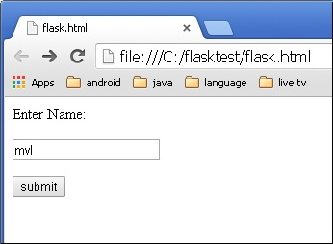

Slide 32


Slide 33
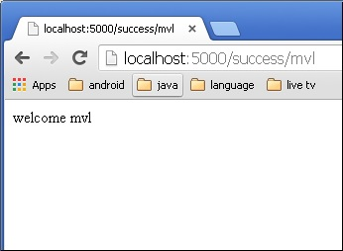

Slide 34
Change to GET in the login.html
Args is a dictionary object

Slide 35
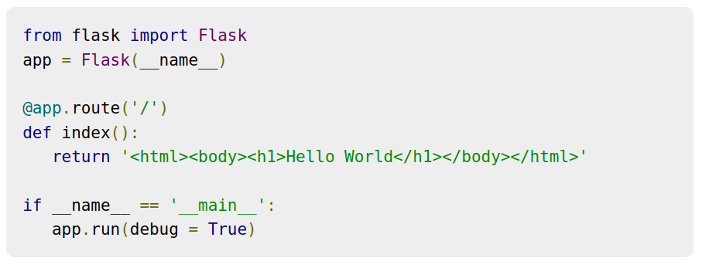
Templates

Slide 36
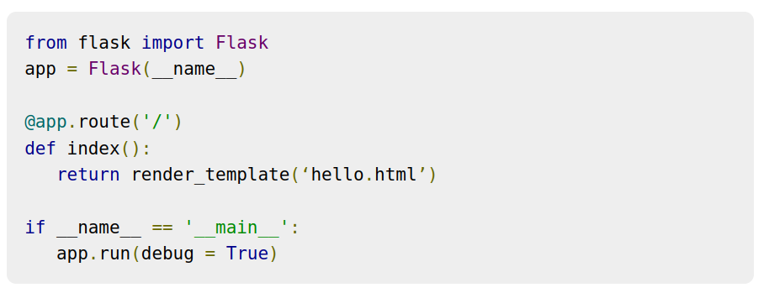

Slide 37
Flask will try to find the HTML file in the templates folder, in the same folder in which this script is present.
Application folder
Hello.py
templates
hello.html

Slide 38
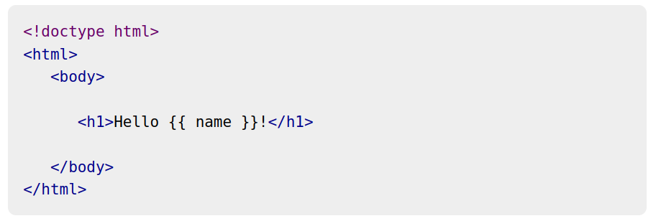
Flask uses jinja2 template engine.

Slide 39
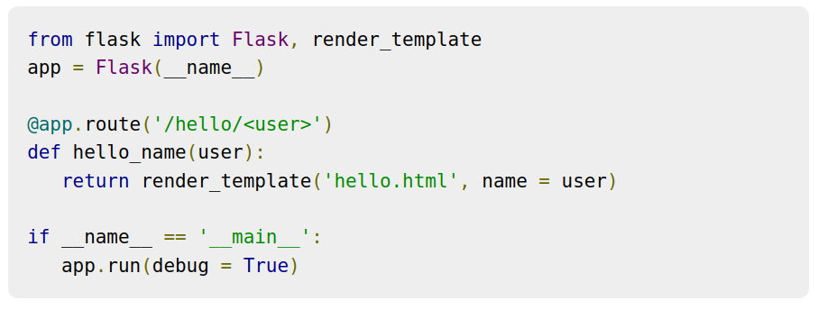
Run it with the template

Slide 40
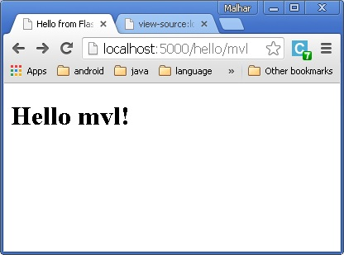
renders

Slide 41
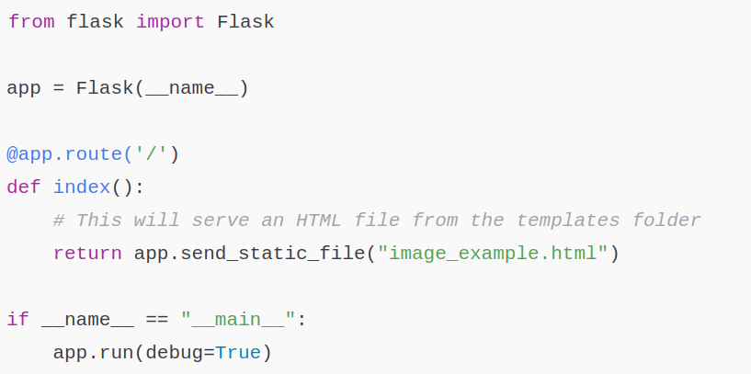
Load and image

Slide 42
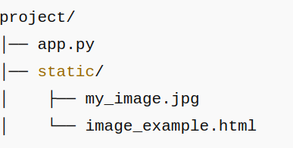
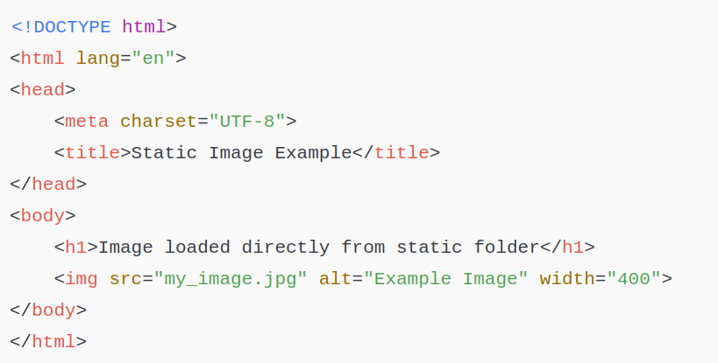
HTML file (place inside static/image_example.html):

Slide 43
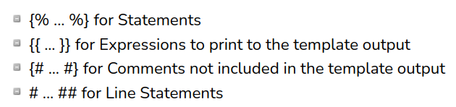
jinja2

Slide 44
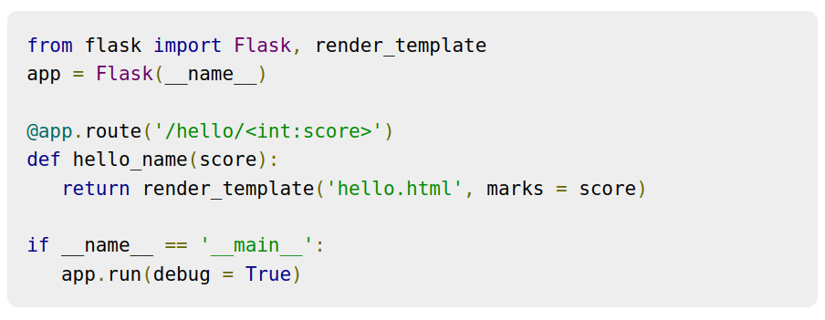

Slide 45
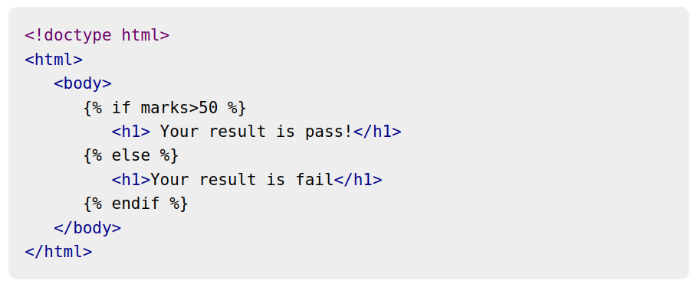

Slide 46
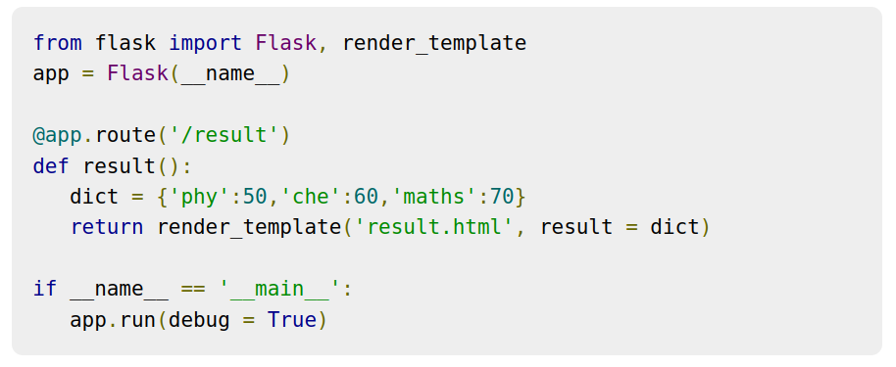

Slide 47
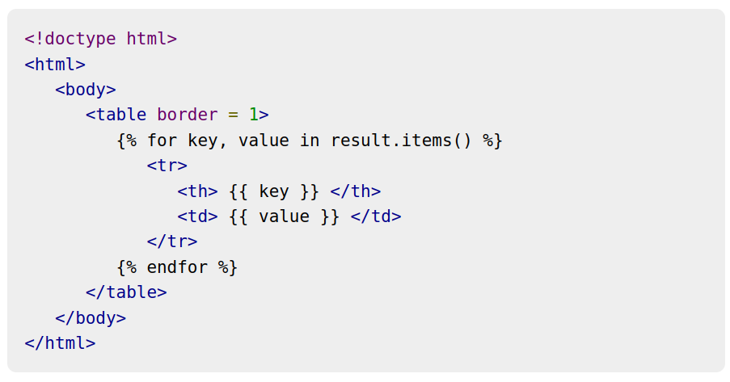

Slide 48
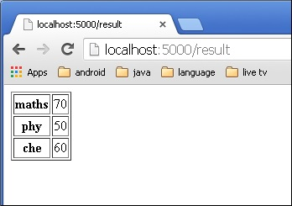

Slide 49
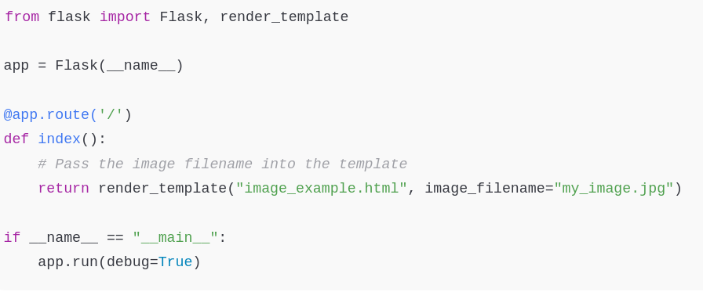
With jinja2

Slide 50
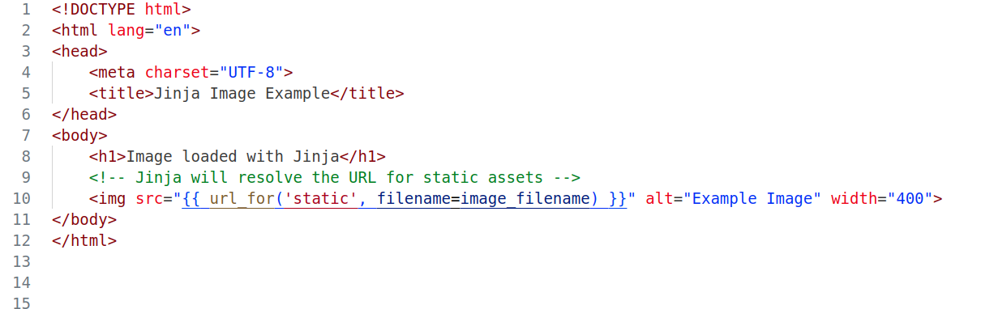
Jinja html static file

Slide 51
Flask – Static Files
CSS or Javascript files
/static
A special endpoint ‘static’ is used to generate URL for static files.

Slide 52
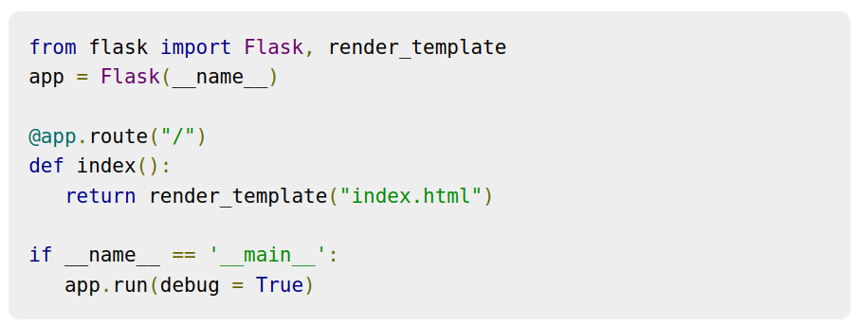
javascript function defined in hello.js

Slide 53
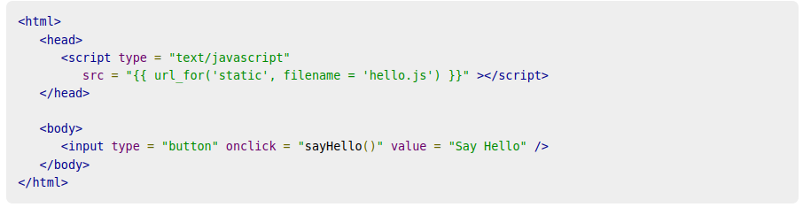
index.html

Slide 54
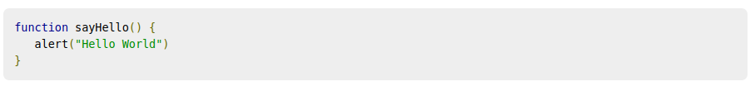
hello.js

Slide 55
Flask – Request Object
When a user interacts with a web page, for example by filling out a form and submitting it, the data from that interaction is sent to the server. In Flask, this data is made available as a global request object.
Form − It is a dictionary object containing key and value pairs of form parameters and their values.
args − parsed contents of query string which is part of URL after question mark (?).
Cookies − dictionary object holding Cookie names and values.
files − data pertaining to uploaded file.
method − current request method.

Slide 56
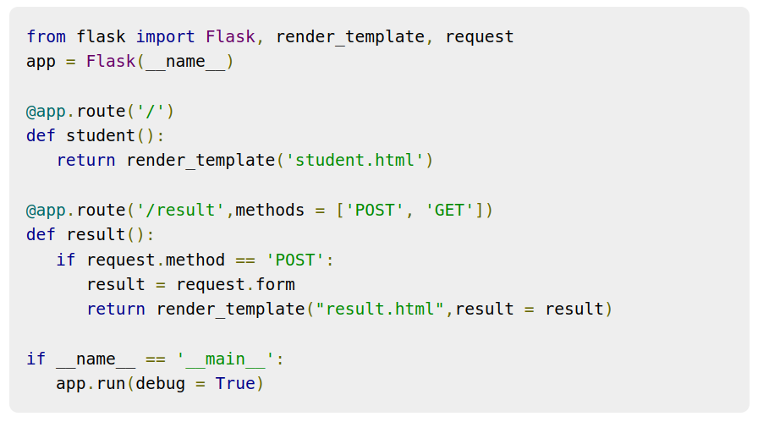
Flask – Sending Form Data to Template

Slide 57
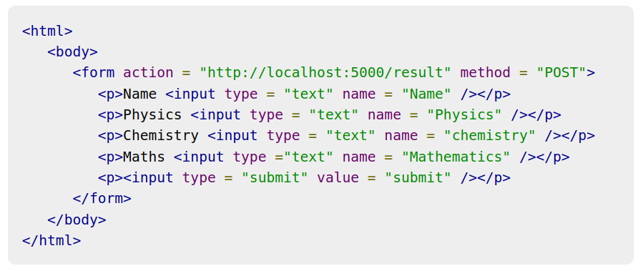
student.html.

Slide 58
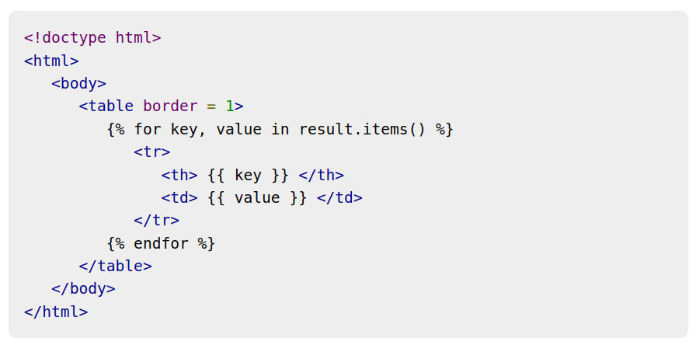

Slide 59
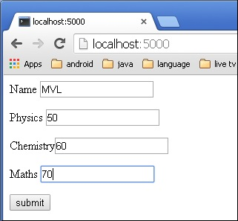

Slide 60

result.html

Slide 61
Flask – Cookies
A cookie is stored on a client’s computer in the form of a text file. Its purpose is to remember and track data pertaining to a client’s usage for better visitor experience and site statistics.
Request object contains:
a cookie’s attribute (It is a dictionary object of all the cookie variables and their corresponding values, a client has transmitted)
cookie also stores its expiry time, path and domain name of the site.

Slide 62
In Flask, cookies are set on response object
make_response()
to get response object from return value of a view function
use the set_cookie() function of response object to store a cookie

Slide 63


Slide 64
Sessions
stored on client
each client is assigned a Session ID
The Session data is stored on top of cookies and the server signs them cryptographically.
For this encryption, a Flask application needs a defined SECRET_KEY

Slide 65



Slide 66

Session example

Slide 67

Flask – Redirect & Errors

Slide 68


Slide 69


Slide 70


