Slide 1
SQLITE

Slide 2
What is SQLite

Slide 3
What is SQLite
provides a relational database management system

Slide 4
features
self-contained
serverless
zero-configuration
transactional.

Slide 5
features
self-contained
serverless
zero-configuration
transactional.

Slide 6
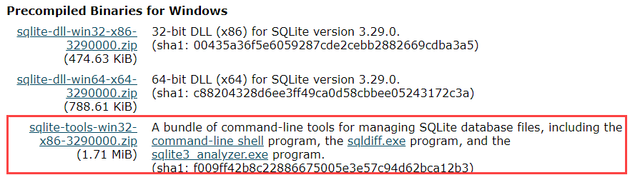

Slide 7

Create Folder:

Slide 8

Extract the zip file:

Slide 9

Execute:

Slide 10
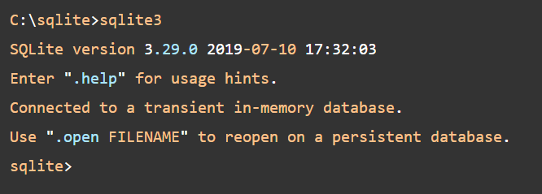
Execute:

Slide 11
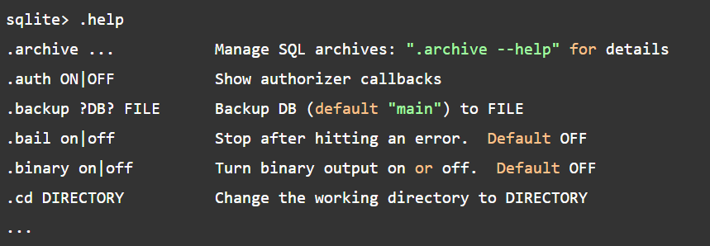
help:

Slide 12
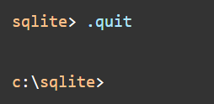
quit:

Slide 13
Install SQLite GUI tool
shell is good but..

Slide 14
SQLiteStudio
download from:
download page
put it into:
C:\sqlite\gui\

Slide 15
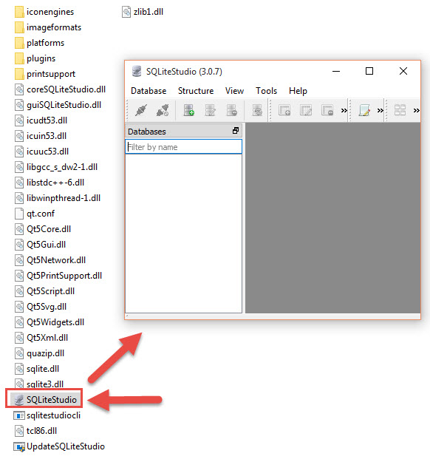
SQLiteStudio

Slide 16
Other SQLite GUI tools
DBeaver
DB Browser for SQLite

Slide 17
Other SQLite GUI tools
DBeaver
DB Browser for SQLite

