Slide 1


Slide 2
Plain Text vs. SQLite
Data organization
Querying
Scalability
Data integrity
Security

Slide 3
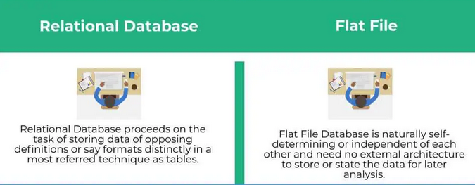
Plain Text vs. SQLite

Slide 4

Plain Text vs. SQLite

Slide 5
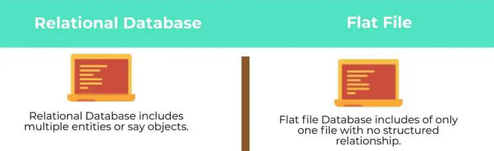
Plain Text vs. SQLite

Slide 6
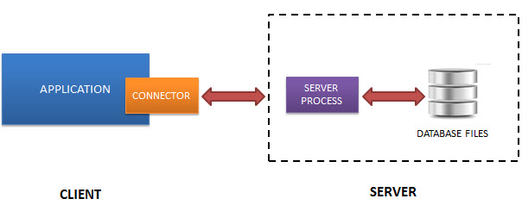
MySQL

Slide 7

MySQL

Slide 8
import sqlite3

Slide 9
conn = sqlite3.connect(database)

Slide 10
c = conn.cursor()

Slide 11
c.execute(sql_statement)

Slide 12
sql_statement

Slide 13
conn.commit()

Slide 14
c.fetchall()

Slide 15
c.fetchone()

Slide 16
c.fetchone()
vs.
c.fetchall()
import sqlite3
# Connect to the database
conn = sqlite3.connect('example.db')
# Create a cursor object
cursor = conn.cursor()
# Execute a SELECT statement
cursor.execute('SELECT * FROM mytable')
# Fetch all the rows and print them
rows = cursor.fetchall()
for row in rows:
print(row)
# Close the cursor and the connection
cursor.close()
conn.close()
import sqlite3
# Connect to the database
conn = sqlite3.connect('example.db')
# Create a cursor object
cursor = conn.cursor()
# Execute a SELECT statement
cursor.execute('SELECT * FROM mytable')
# Fetch the first row and print it
row = cursor.fetchone()
print(row)
# Fetch the second row and print it
row = cursor.fetchone()
print(row)
# Close the cursor and the connection
cursor.close()
conn.close()

Slide 17
conn.close()

Slide 18
# Create a new database:
import sqlite3
conn = sqlite3.connect('example.db')

Slide 19
# Create a new database:
import sqlite3
conn = sqlite3.connect('example.db')
c = conn.cursor()
c.execute('''CREATE TABLE stocks
(date text, trans text, symbol text, qty real, price real)''')

Slide 20
# Insert data into a table:
import sqlite3
conn = sqlite3.connect('example.db')
c = conn.cursor()
c.execute("INSERT INTO stocks VALUES ('2006-01-05','BUY','RHAT',100,35.14)")

Slide 21
# Select data from a table:
import sqlite3
conn = sqlite3.connect('example.db')
c = conn.cursor()
c.execute("SELECT * FROM stocks")
rows = c.fetchall()
for row in rows:
print(row)

Slide 22
# Update data in a table:
import sqlite3
conn = sqlite3.connect('example.db')
c = conn.cursor()
c.execute("UPDATE stocks SET price = 20.0 WHERE symbol = 'RHAT'")

Slide 23
# Delete data from a table:
import sqlite3
conn = sqlite3.connect('example.db')
c = conn.cursor()
c.execute("DELETE FROM stocks WHERE symbol = 'RHAT'")

Slide 24
# Create an index on a table:
import sqlite3
conn = sqlite3.connect('example.db')
c = conn.cursor()
c.execute("CREATE INDEX idx_symbol ON stocks (symbol)")

Slide 25
# Join two tables:
import sqlite3
conn = sqlite3.connect('example.db')
c = conn.cursor()
c.execute('''SELECT *
FROM stocks
INNER JOIN purchases
ON stocks.symbol = purchases.symbol''')
rows = c.fetchall()
for row in rows:
print(row)

Slide 26
# Create a trigger:
import sqlite3
conn = sqlite3.connect('example.db')
c = conn.cursor()
c.execute('''CREATE TRIGGER update_purchase_history
AFTER INSERT ON purchases
BEGIN
UPDATE stocks
SET qty = qty + NEW.qty
WHERE stocks.symbol = NEW.symbol;
END''')

Slide 27
# Create a trigger:
import sqlite3
# Connect to the database
conn = sqlite3.connect('example.db')
# Create a table
conn.execute('''CREATE TABLE products
(id INTEGER PRIMARY KEY,
name TEXT NOT NULL,
price REAL NOT NULL,
stock INTEGER NOT NULL)''')
conn.execute('''CREATE TABLE orders
(id INTEGER PRIMARY KEY,
product_id INTEGER NOT NULL,
quantity INTEGER NOT NULL)''')
# Create a trigger that updates the stock level of a product after an order is placed
conn.execute('''CREATE TRIGGER update_stock
AFTER INSERT ON orders
FOR EACH ROW
BEGIN
UPDATE products SET stock = stock - NEW.quantity WHERE id = NEW.product_id;
END''')
# Insert some data into the tables
conn.execute("INSERT INTO products (name, price, stock) VALUES (?, ?, ?)", ("Shoes", 50.0, 10))
conn.execute("INSERT INTO orders (product_id, quantity) VALUES (?, ?)", (1, 2))
# Commit the changes
conn.commit()
# Print the updated stock level
result = conn.execute("SELECT stock FROM products WHERE id = 1")
print(result.fetchone()[0]) # Output: 8

Slide 28
# Create a user-defined function:
import sqlite3
import math
conn = sqlite3.connect('example.db')
c = conn.cursor()
def my_sqrt(x):
return math.sqrt(x)
conn.create_function('sqrt', 1, my_sqrt)
c.execute("SELECT sqrt(4)")
print(c.fetchone())

Slide 29
# Use the in-memory database:
import sqlite3
conn = sqlite3.connect(':memory:')

Slide 30
# Import data from a CSV file:
import sqlite3
import csv
conn = sqlite3.connect('example.db')
c = conn.cursor()
with open('data.csv') as f:
reader = csv.reader(f)
for row in reader:
c.execute("INSERT INTO stocks VALUES (?, ?, ?, ?, ?)", row)

Slide 31
# Export data to a CSV file:
import sqlite3
import csv
conn = sqlite3.connect('example.db')
c = conn.cursor()
c.execute("SELECT * FROM stocks")
rows = c.fetchall()
with open('data.csv', 'w') as f:
writer = csv.writer(f)
writer

Slide 32
# Primary key
import sqlite3
# Connect to the database
conn = sqlite3.connect('example.db')
# Create a table
conn.execute('''CREATE TABLE users
(id INTEGER PRIMARY KEY,
name TEXT,
email TEXT)''')
# Insert data into the table
conn.execute("INSERT INTO users (name, email) VALUES ('John Doe', 'johndoe@gmail.com')")
conn.execute("INSERT INTO users (name, email) VALUES ('Jane Smith', 'janesmith@gmail.com')")
# Commit the changes and close the connection
conn.commit()
conn.close()

Slide 33
# types of data in sqlite
NULL: The NULL data type represents a missing or undefined value. Columns defined as NULL can contain no data or a value of NULL.
INTEGER: (positive, negative, or zero - 1, 2, 3, 4, 6, or 8-byte
REAL: floating-point numbers with decimal places.
TEXT: store character strings of any length, including letters, numbers, and symbols. Text values are enclosed in single quotes when used in SQL statements.
BLOB: The BLOB (Binary Large Object) data type is used to store binary data such as images, audio, or video. BLOB values are represented as hexadecimal strings when used in SQL statements.

Slide 34
# NULL
# Create a table with a column that allows NULL values
conn.execute('''CREATE TABLE users
(id INTEGER PRIMARY KEY,
first_name TEXT,
last_name TEXT,
middle_name TEXT)''')
# Insert a row with a NULL value for the middle_name column
conn.execute("INSERT INTO users (first_name, last_name, middle_name) VALUES ('John', 'Doe', NULL)")

Slide 35
# INTEGER
# Create a table with an INTEGER column
conn.execute('''CREATE TABLE students
(id INTEGER PRIMARY KEY,
first_name TEXT,
last_name TEXT,
age INTEGER)''')
# Insert a row with an INTEGER value for the age column
conn.execute("INSERT INTO students (first_name, last_name, age) VALUES ('Jane', 'Smith', 21)")

Slide 36
# REAL
# Create a table with a REAL column
conn.execute('''CREATE TABLE products
(id INTEGER PRIMARY KEY,
name TEXT,
price REAL)''')
# Insert a row with a REAL value for the price column
conn.execute("INSERT INTO products (name, price) VALUES ('Widget', 3.99)")

Slide 37
# Text
# Create a table with a TEXT column
conn.execute('''CREATE TABLE books
(id INTEGER PRIMARY KEY,
title TEXT,
author TEXT,
description TEXT)''')
# Insert a row with a TEXT value for the description column
conn.execute("INSERT INTO books (title, author, description) VALUES ('To Kill a Mockingbird', 'Harper Lee', 'A classic novel about racial injustice')")

Slide 38
# BLOB
# Create a table with a BLOB column
conn.execute('''CREATE TABLE images
(id INTEGER PRIMARY KEY,
name TEXT,
data BLOB)''')
# Insert a row with a BLOB value for the data column
with open('image.jpg', 'rb') as f:
image_data = f.read()
conn.execute("INSERT INTO images (name, data) VALUES (?, ?)", ('Image1', image_data))

Slide 39
# SQL Main Commands
SELECT: used to retrieve data from one or more tables
INSERT: used to add new rows to a table
UPDATE: used to modify existing rows in a table
DELETE: used to remove rows from a table
CREATE: used to create a new table, view, or index
DROP: used to delete a table, view, or index
ALTER: used to modify the structure of a table or view
WHERE: used to specify conditions that must be met for a row to be selected
ORDER BY: used to sort the results of a query
GROUP BY: used to group the results of a query based on a specified column or columns
JOIN: used to combine data from two or more tables based on a common column or columns
LIMIT: used to limit the number of rows returned by a query
DISTINCT: used to retrieve only unique values from a column.

Slide 40
# SQL Main Commands
import sqlite3
# Connect to a SQLite database
conn = sqlite3.connect('example.db')
# Create a table
conn.execute('''CREATE TABLE employees
(id INT PRIMARY KEY NOT NULL,
name TEXT NOT NULL,
age INT NOT NULL);''')
# Insert some data into the table
conn.execute("INSERT INTO employees (id, name, age) VALUES (1, 'John Doe', 30)")
conn.execute("INSERT INTO employees (id, name, age) VALUES (2, 'Jane Smith', 25)")
# Create a view
conn.execute("CREATE VIEW employee_names AS SELECT name FROM employees")
# Create an index
conn.execute("CREATE INDEX age_index ON employees(age)")
# Query the table
cursor = conn.execute("SELECT * FROM employees")
for row in cursor:
print(row)
# Query the view
cursor = conn.execute("SELECT * FROM employee_names")
for row in cursor:
print(row)
# Close the database connection
conn.close()

Slide 41
# SQL Main Commands
import sqlite3
# Connect to a SQLite database
conn = sqlite3.connect('example.db')
# Create a table
conn.execute('''CREATE TABLE IF NOT EXISTS users
(id INTEGER PRIMARY KEY,
name TEXT NOT NULL,
email TEXT NOT NULL UNIQUE)''') # Insert a row into the table
conn.execute("INSERT INTO users (name, email) VALUES (?, ?)", ('Alice', 'alice@example.com'))
# Update a row in the table
conn.execute("UPDATE users SET email = ? WHERE name = ?", ('alice@example.org', 'Alice'))
# Delete a row from the table
conn.execute("DELETE FROM users WHERE name = ?", ('Alice',))
# Select data from the table
cursor = conn.execute("SELECT * FROM users")
for row in cursor:
print(row) # Close the connection
conn.close()

Slide 42
# CREATE
import sqlite3
# Connect to a SQLite database
conn = sqlite3.connect('example.db')
# Create a table
conn.execute('''CREATE TABLE IF NOT EXISTS products
(id INTEGER PRIMARY KEY,
name TEXT NOT NULL,
price REAL NOT NULL)''')
# Close the connection
conn.close()

Slide 43
# DROP
import sqlite3
# Connect to a SQLite database
conn = sqlite3.connect('example.db')
# Drop a table
conn.execute("DROP TABLE IF EXISTS products")
# Close the connection
conn.close()

Slide 44
# ALTER
import sqlite3
# Connect to a SQLite database
conn = sqlite3.connect('example.db')
# Add a new column to a table
conn.execute("ALTER TABLE products ADD COLUMN description TEXT")
# Close the connection
conn.close()

Slide 45
# WHERE
This example selects all rows from the "products" table where the "price" column is greater than 10.0.
import sqlite3
# Connect to a SQLite database
conn = sqlite3.connect('example.db')
# Select rows that meet a condition
cursor = conn.execute("SELECT * FROM products WHERE price > 10.0")
for row in cursor:
print(row)
# Close the connection
conn.close()

Slide 46
# ORDER BY
This example selects all rows from the "products" table and orders them by the "name" column.
import sqlite3
# Connect to a SQLite database
conn = sqlite3.connect('example.db')
# Select rows and order them by a column
cursor = conn.execute("SELECT * FROM products ORDER BY name")
for row in cursor:
print(row)
# Close the connection
conn.close()

Slide 47
# GROUP BY
This example selects all rows from the "products" table, groups them by the "name" column, and returns the count of each group.
import sqlite3
# Connect to a SQLite database
conn = sqlite3.connect('example.db')
# Group rows by a column and return the count of each group
cursor = conn.execute("SELECT name, COUNT(*) FROM products GROUP BY name")
for row in cursor:
print(row)
# Close the connection
conn.close()

Slide 48
# JOIN
This example creates a second table called "orders" with three columns: "id", "product_id", and quantity
import sqlite3
# Connect to a SQLite database
conn = sqlite3.connect('example.db')
# Create a second table
conn.execute('''CREATE TABLE IF NOT EXISTS orders
(id INTEGER PRIMARY KEY,
product_id INTEGER NOT NULL,
quantity INTEGER NOT NULL)''') # Insert data into the tables
conn.execute("INSERT INTO products (name, price) VALUES (?, ?)", ('Apple', 1.0))
product_id = conn.execute("SELECT id FROM products WHERE name = 'Apple'").fetchone()[0]
conn.execute("INSERT INTO orders (product_id, quantity) VALUES (?, ?)", (product_id, 5))
# Select data from two tables using a JOIN
cursor = conn.execute("SELECT products.name, orders.quantity FROM products JOIN orders ON products.id = orders.product_id")
for row in cursor:
print(row)
# Close the connection
conn.close()

Slide 49

# INNER JOIN: This type of JOIN returns only the rows that have matching values in both tables. In other words, it returns the intersection of the two tables. The syntax for INNER JOIN is as follows:

Slide 50
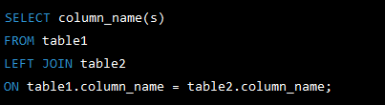
LEFT JOIN: This type of JOIN returns all the rows from the left table (the first table specified in the JOIN clause) and the matching rows from the right table. If no matching rows are in the right table, it returns NULL values for the corresponding columns. The syntax for LEFT JOIN is as follows:

Slide 51
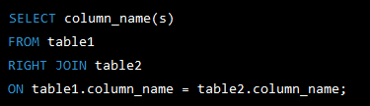
RIGHT JOIN: This type of JOIN is similar to LEFT JOIN but returns all the rows from the right table and the matching rows from the left table. If no matching rows are in the left table, it returns NULL values for the corresponding columns. The syntax for RIGHT JOIN is as follows:

Slide 52
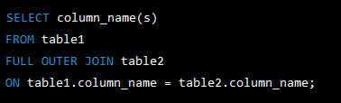
FULL OUTER JOIN: This type of JOIN returns all the rows from both tables, with NULL values for any columns that do not have matching values in the other table. The syntax for FULL OUTER JOIN is as follows:

