Slide 1
matplotlib

Slide 2
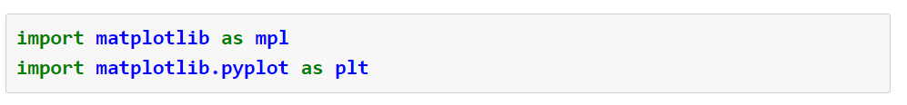

Slide 4


Slide 5
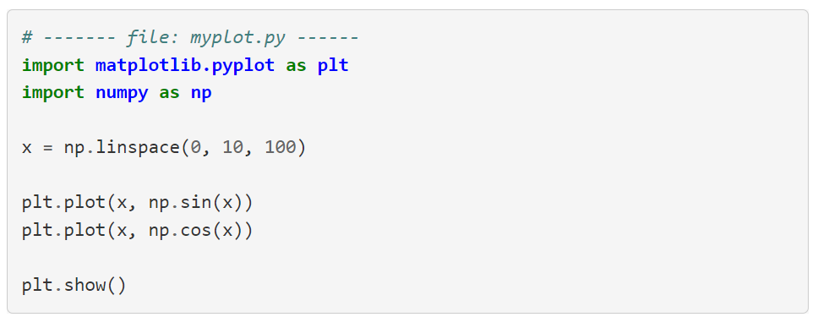

Slide 7
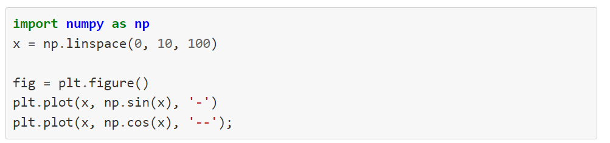
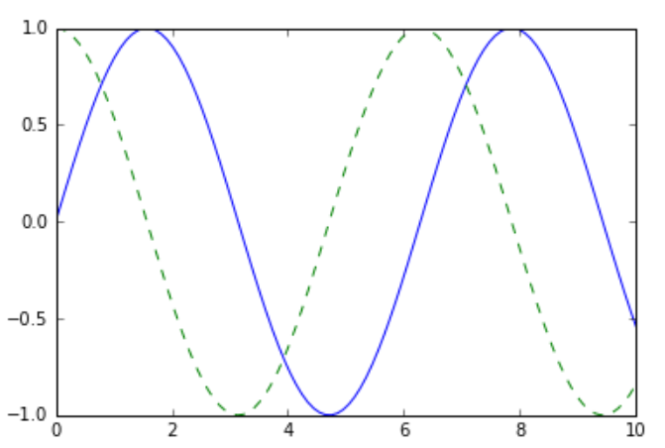

Slide 9
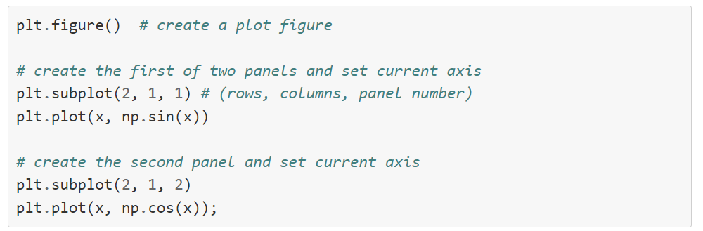
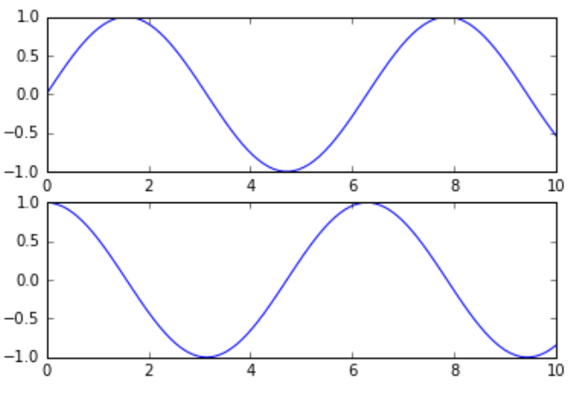

Slide 10
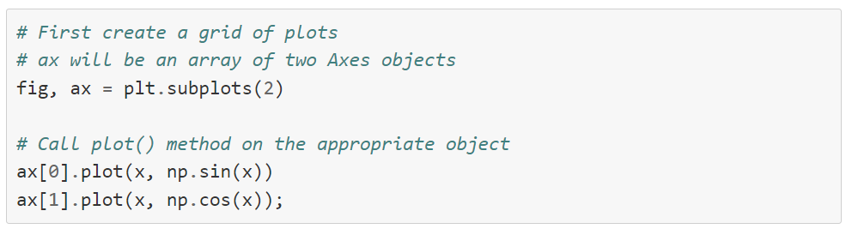
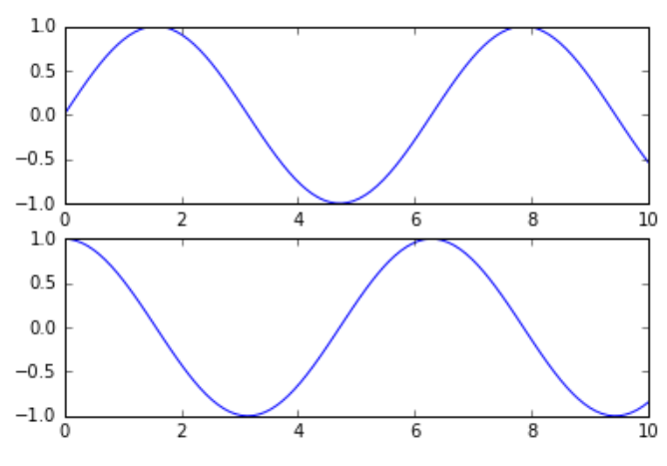

Slide 11
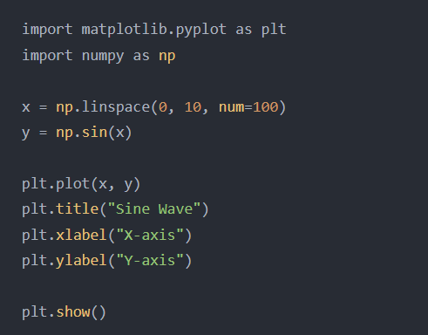

Slide 12
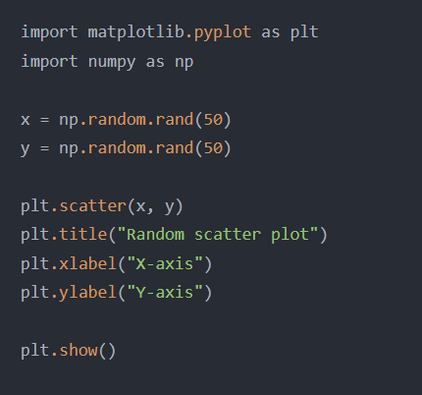

Slide 13
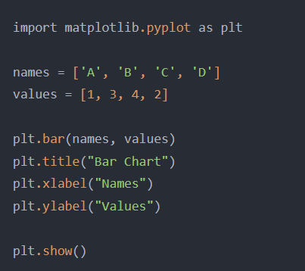

Slide 14
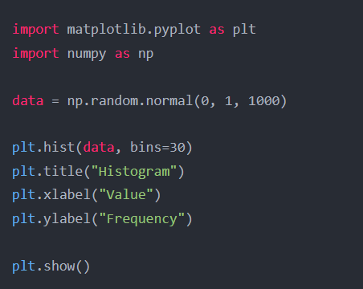

Slide 15
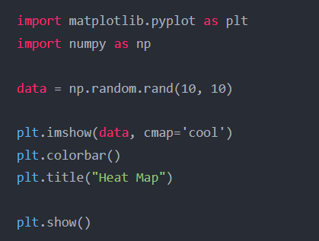

Slide 16
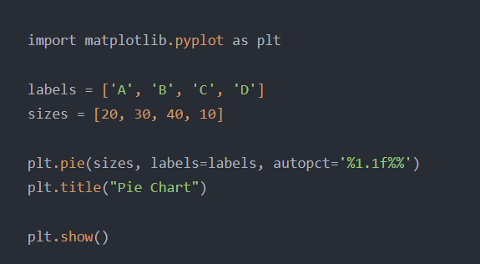

Slide 17
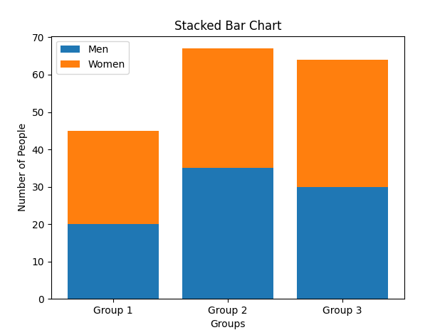
import matplotlib.pyplot as plt
labels = ['Group 1', 'Group 2', 'Group 3']
men = [20, 35, 30]
women = [25, 32, 34]
plt.bar(labels, men, label='Men')
plt.bar(labels, women, bottom=men, label='Women')
plt.title("Stacked Bar Chart")
plt.xlabel("Groups")
plt.ylabel("Number of People")
plt.legend()
plt.show()

Slide 18
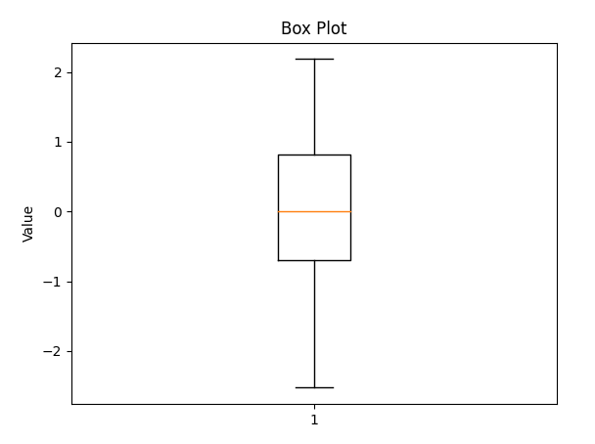
import matplotlib.pyplot as plt
import numpy as np
data = np.random.normal(0, 1, 100)
plt.boxplot(data)
plt.title("Box Plot")
plt.ylabel("Value")
plt.show()

Slide 19
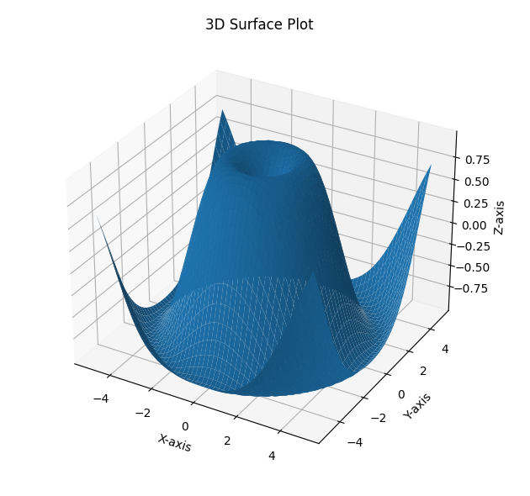
import matplotlib.pyplot as plt
import numpy as np
from mpl_toolkits.mplot3d import Axes3D
x = np.linspace(-5, 5, num=50)
y = np.linspace(-5, 5, num=50)
X, Y = np.meshgrid(x, y)
Z = np.sin(np.sqrt(X**2 + Y**2))
fig = plt.figure()
ax = fig.add_subplot(111, projection='3d')
ax.plot_surface(X, Y, Z)
ax.set_xlabel('X-axis')
ax.set_ylabel('Y-axis')
ax.set_zlabel('Z-axis')
ax.set_title('3D Surface Plot')
plt.show()

