Slide 1
numpy

Slide 2
pip install numpy

Slide 3
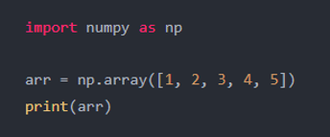
Creating an array

Slide 4
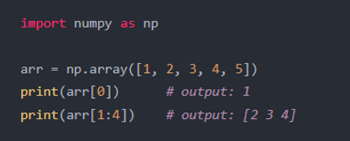
Indexing and slicing an array

Slide 5
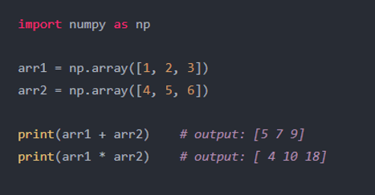
Arithmetic operations on arrays

Slide 6
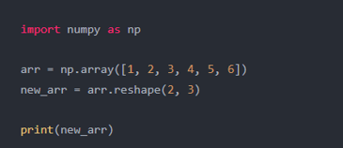
Reshaping an array

Slide 7
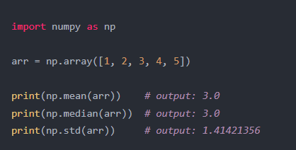
Statistical functions

Slide 8
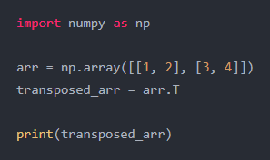
Transposing an array

Slide 9
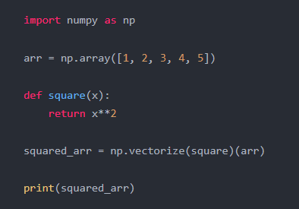
Transposing an array

Slide 10
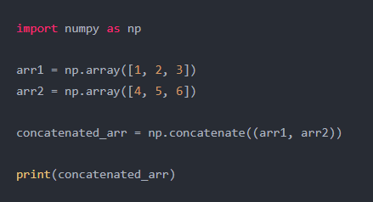
Transposing an array

Slide 11
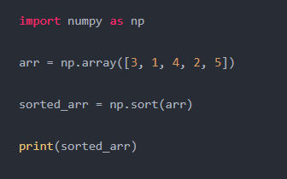
Sorting an array

Slide 12
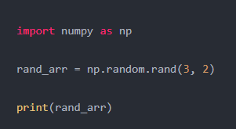
Creating a random array

Slide 13
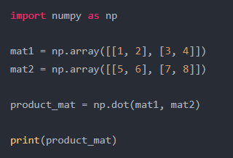
Matrix multiplication

Slide 14
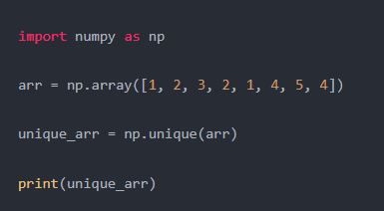
Finding unique elements in an array

Slide 15
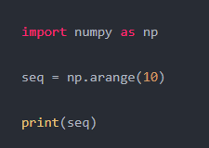
Generating a sequence of numbers

Slide 16
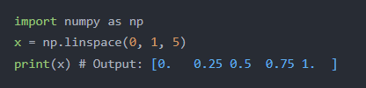
Creating an array with 5 equally spaced values between 0 and 1

