Slide 1
1. Object Oriented Programming
General introduction in object-oriented Programming and the way it is used in Python
https://python-course.eu/oop/

Slide 2
OOP
پارادایم برنامه‌نویسی بر پایه object که در آن اشیا داده+کد دارند.

Slide 3
داده: attributes
تابع: methods

Slide 4
The first programming language to use objects was Simula 67. As the name implies, Simula 67 was introduced in the year 1967. A major breakthrough for object-oriented programming came with the programming language Smalltalk in the 1970s.

Slide 5
اصول اساسی شی گرایی
Encapsulation
Data Abstraction
Polymorphism
Inheritance

Slide 6
Everything is a class in Python
در پایتون هر چیزی یک کلاس است!

Slide 7
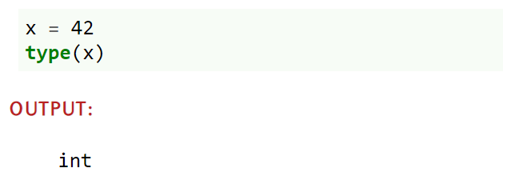

Slide 8
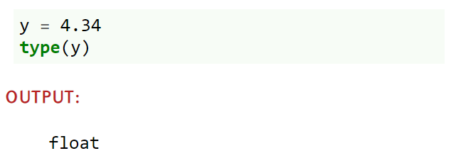

Slide 9
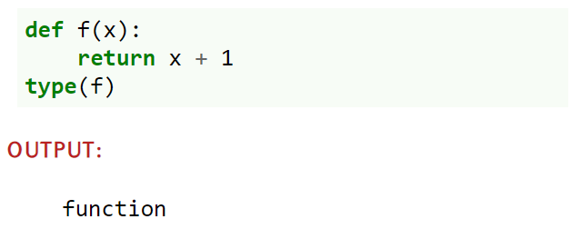

Slide 10
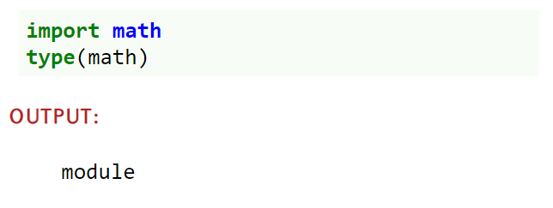

Slide 11
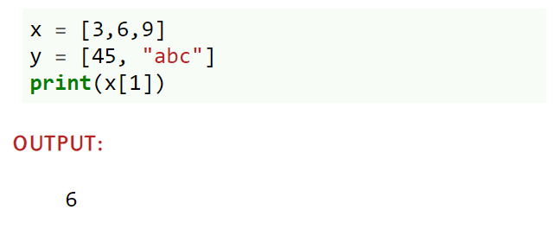

Slide 12
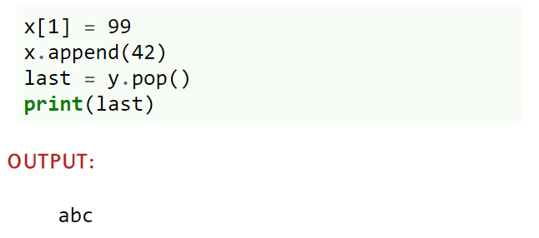

Slide 13
methods
pop and append

Slide 14
A Minimal Class in Python
یک کلاس مینیمال در پایتون

Slide 15
class Robot:
pass

Slide 16
superclasses
base classes
parent classes
class Robot( ):
pass

Slide 17
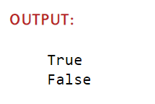
class Robot:
pass
if __name__ == "__main__":
x = Robot()
y = Robot()
y2 = y
print(y == y2)
print(y == x)

Slide 18
if __name__ == "__main__":

Slide 19
در اسلاید قبل دو نمونه متفاوت ایجاد نمودیم
instance

Slide 20
properties and attributes
در پایتون دو چیز متفاوت هستند
property <-- متدی که مانند attr اجرا می‌شود

Slide 21
attributesایجاد
به صورت پویا

Slide 22

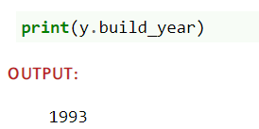
class Robot:
pass
x = Robot()
y = Robot()
x.name = "Marvin"
x.build_year = "1979"
y.name = "Caliban"
y.build_year = "1993"
print(x.name)

Slide 23
__dict__
نمونه‌ها دیکشنری دارند که attributeها را در خود ذخیره می‌کنند

Slide 24
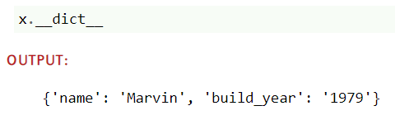
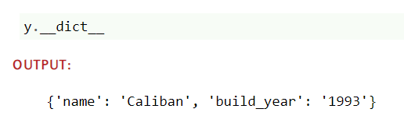

Slide 25
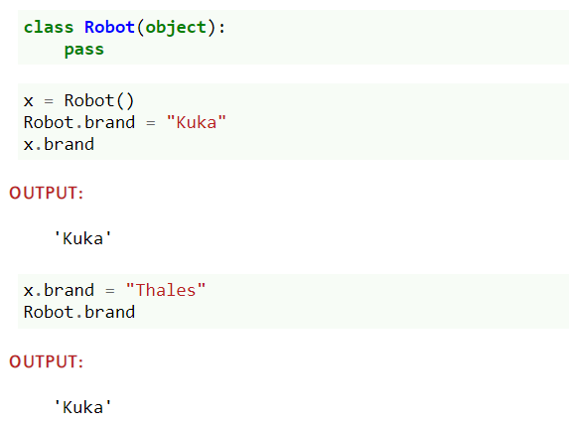
کلاسAttributes

Slide 26
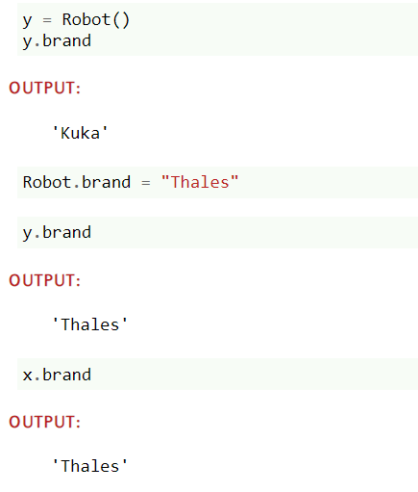
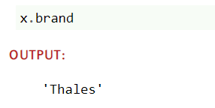

Slide 27
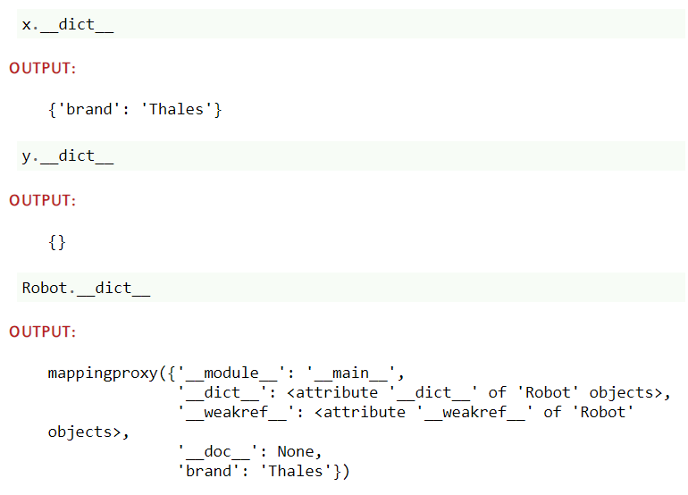

Slide 28
وقتی y.brand را درخواست می‌کنیم، پایتون دیکشنریy.__dict__ و سپس Robot.__dict__ را بررسی می‌کند.

Slide 29
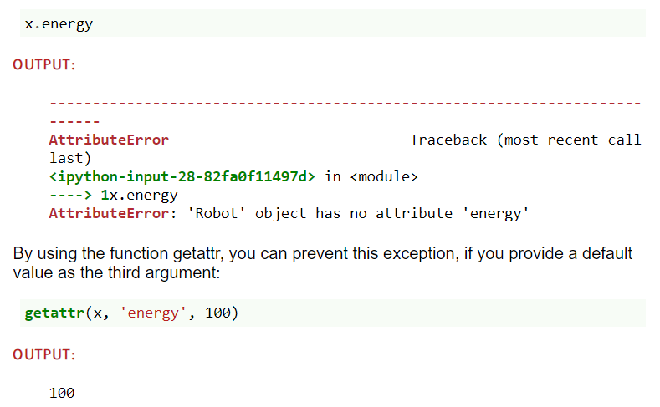
getattr

Slide 30
متصل کردن attribute به اشیا کار معمولی می‌باشد که برای تابع نیز می‌توان انجام داد

Slide 31
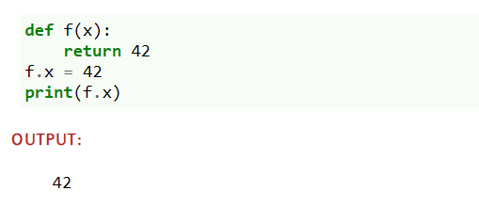

Slide 32
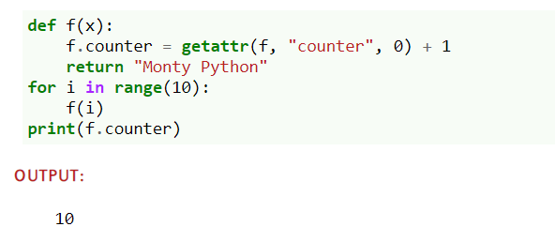

Slide 33
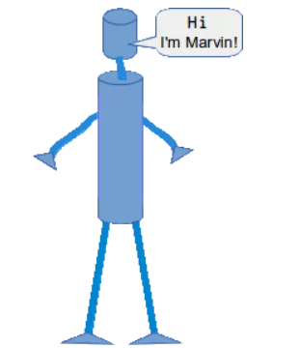
Methods

Slide 34
Methods in Python are essentially functions
Guido's saying "first-class everything".

Slide 35
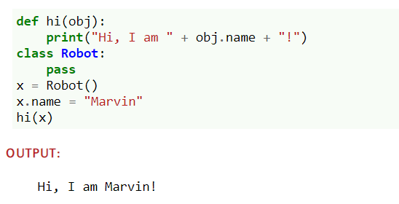

Slide 36
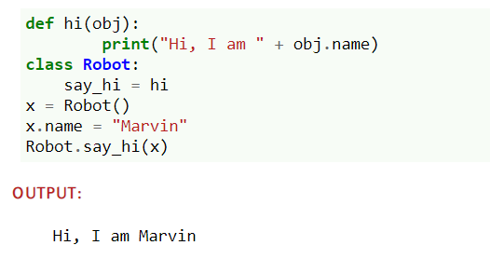

Slide 37
"say_hi" is called a method.
x.say_hi()

Slide 38
می‌توان اینگونه متد تعریف کرد، ولی:
درون خود کلاس تعریف کنید
یک متد فقط یک تابع درون کلاس است
اولین پارامتر آن برای ارجاع به نمونه خواهد بود
این پارامتر معمولا self است
self به شی Robot اشاره می‌کند

Slide 39
بنابراین:
متد یک تابع درون کلاس است
اولین پارامتر آن مقدار نمونه خواهد بود

Slide 40
self
می‌توان هر نامی گذاشت، ولی قرار داد است که self باشد

Slide 41
__init__ متد
اولین متدی که بعد از ایجاد کلاس فراخوانی می‌شود
immediately and automatically

Slide 42
__init__ متد
نام این متد fix است و نمی‌توان تغییر داد
یکی از magic متدهاست
می‌توان در هر جایی از کلاس تعریف شود ولی عموما در ابتدا تعریف می‌شود

Slide 43
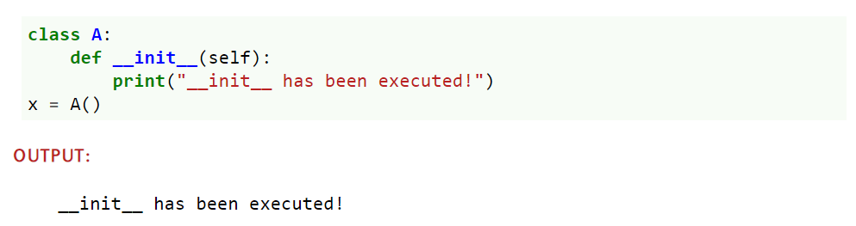

Slide 44
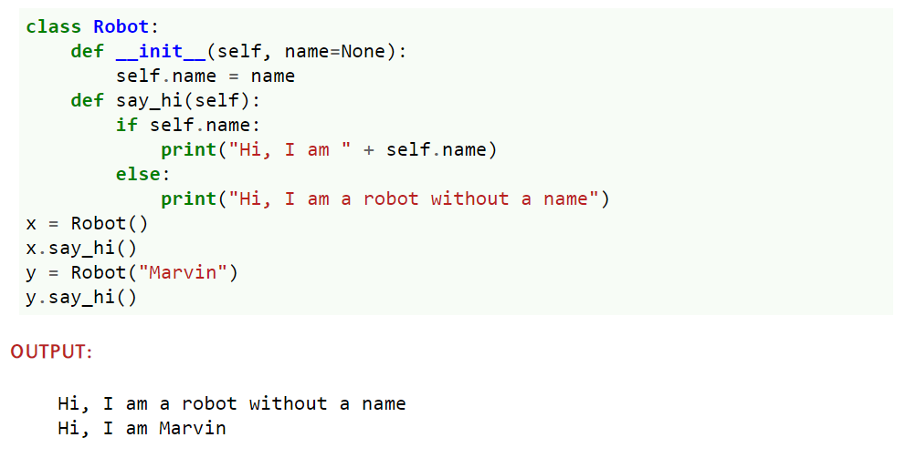

Slide 45
Data Abstraction, Data Encapsulation, and Information Hiding

Slide 46
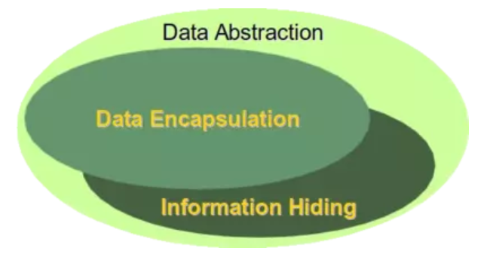
Definitions of Terms

Slide 47
Encapsulation is seen as the bundling of data with the methods that operate on that data.

Slide 48
Information hiding on the other hand is the principle that some internal information or data is "hidden", so that it can't be accidentally changed

Slide 49
Data encapsulation via methods doesn't necessarily mean that the data is hidden. You might be capable of accessing and seeing the data anyway, but using the methods is recommended.

Slide 50
data abstraction is present, if both data hiding and data encapsulation is used. In other words, data abstraction is the broader term:
Data Abstraction = Data Encapsulation + Data Hiding

Slide 51
Encapsulation
setter
getter

Slide 52
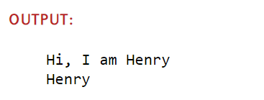
class Robot:
def __init__(self, name=None):
self.name = name
def say_hi(self):
if self.name:
print("Hi, I am " + self.name)
else:
print("Hi, I am a robot without a name")
def set_name(self, name):
self.name = name
def get_name(self):
return self.name
x = Robot()
x.set_name("Henry")
x.say_hi()
y = Robot()
y.set_name(x.get_name())
print(y.get_name())

Slide 53
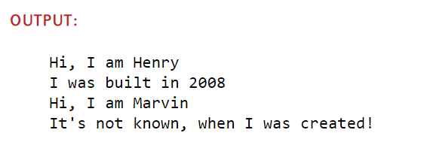
class Robot:
def __init__(self, name=None, build_year=None):
self.name = name
self.build_year = build_year
def say_hi(self):
if self.name:
print("Hi, I am " + self.name)
else:
print("Hi, I am a robot without a name")
if self.build_year:
print("I was built in " + str(self.build_year))
else:
print("It's not known, when I was created!")
def set_name(self, name):
self.name = name
def get_name(self):
return self.name
def set_build_year(self, by):
self.build_year = by
def get_build_year(self):
return self.build_year
x = Robot("Henry", 2008)
y = Robot()
y.set_name("Marvin")
x.say_hi()
y.say_hi()

Slide 54
Problem
Zen of Python says:
"There should be one-- and preferably only one --obvious way to do it."
Why we have two?

Slide 55
Our Robot class provides us with two ways to access or to change the "name" or the "build_year" attribute.

Slide 56
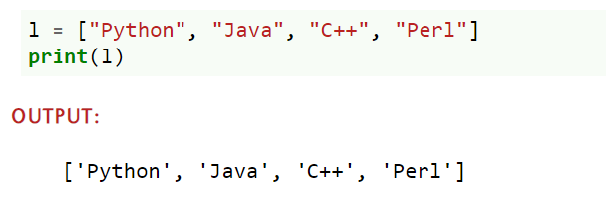
__str__ & __repr__

Slide 57
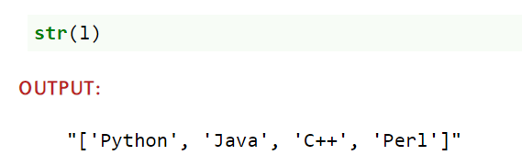

Slide 58
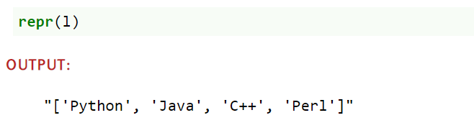

Slide 59
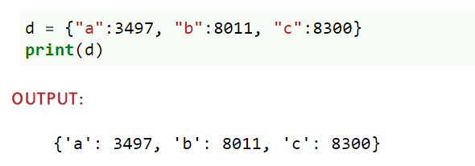

Slide 60
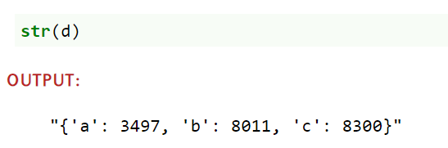

Slide 61
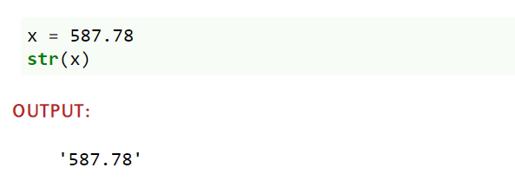

Slide 62
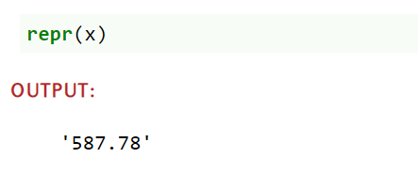

Slide 63
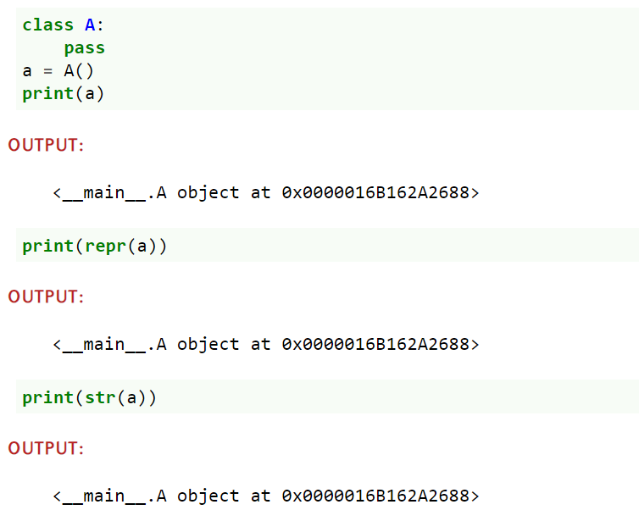

Slide 64
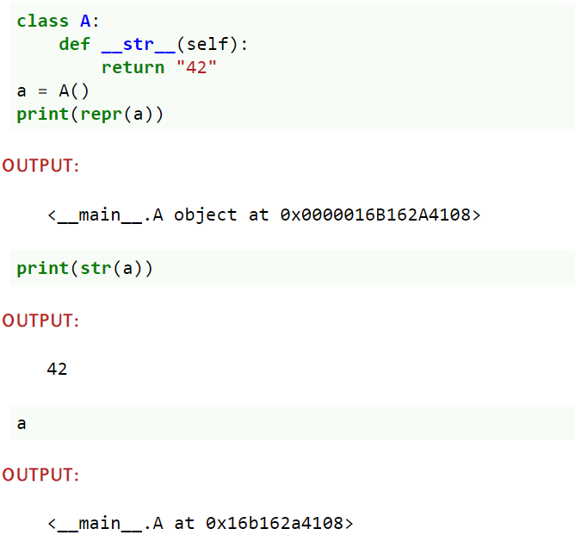

Slide 65
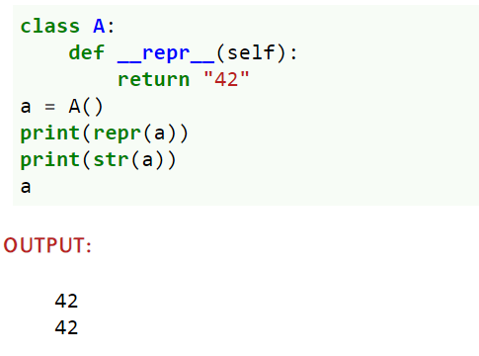

Slide 66
__str__
برای نمایش به کاربر
__repr__
برای استفاده در داخل برنامه

Slide 67
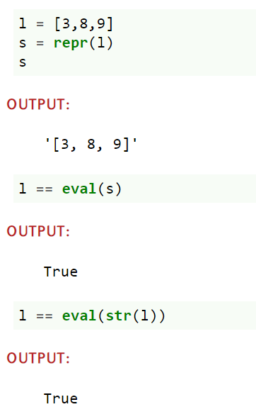

Slide 68
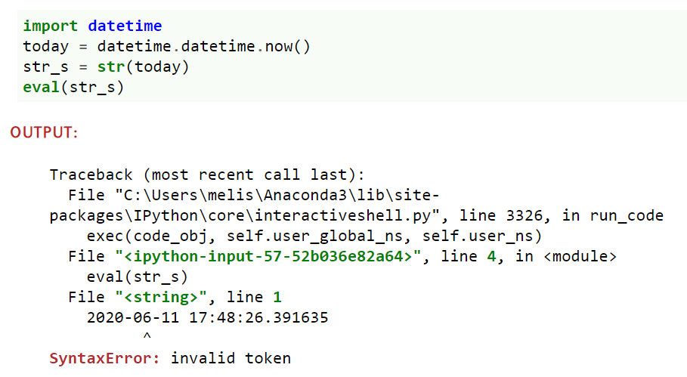
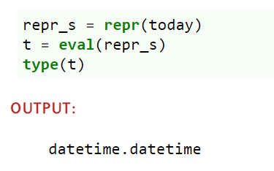
eval را می‌توان فقط بر روی استرینگ حاصل از انجام داد

Slide 69
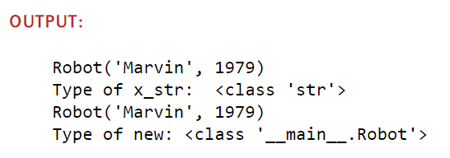
class Robot:
def __init__(self, name, build_year):
self.name = name
self.build_year = build_year
def __repr__(self):
return "Robot('" + self.name + "', " + str(self.build_year) + ")"
if __name__ == "__main__":
x = Robot("Marvin", 1979)
x_str = str(x)
print(x_str)
print("Type of x_str: ", type(x_str))
new = eval(x_str)
print(new)
print("Type of new:", type(new))

Slide 70
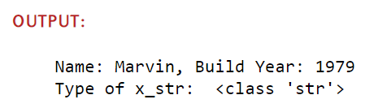
class Robot:
def __init__(self, name, build_year):
self.name = name
self.build_year = build_year
def __repr__(self):
return "Robot('" + self.name + "', " + str(self.build_year) + ")"
def __str__(self):
return "Name: " + self.name + ", Build Year: " + str(self.build_year)
if __name__ == "__main__":
x = Robot("Marvin", 1979)
x_str = str(x)
print(x_str)
print("Type of x_str: ", type(x_str))
new = eval(x_str)
print(new)
print("Type of new:", type(new))

Slide 71
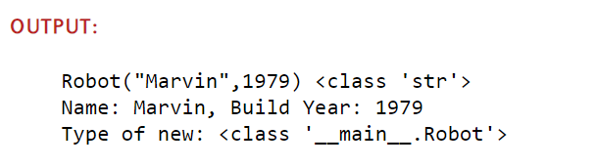
class Robot:
def __init__(self, name, build_year):
self.name = name
self.build_year = build_year
def __repr__(self):
return "Robot(\"" + self.name + "\"," + str(self.build_year) + ")"
def __str__(self):
return "Name: " + self.name + ", Build Year: " + str(self.build_year)
if __name__ == "__main__":
x = Robot("Marvin", 1979)
x_repr = repr(x)
print(x_repr, type(x_repr))
new = eval(x_repr)
print(new)
print("Type of new:", type(new))

Slide 72

Public, - Protected-, and Private Attributes

Slide 73
چگونه باید از داده‌های درون objectها محافظت کنیم؟

Slide 74
Private attributes should only be used by the owner, i.e. inside of the class definition itself.
Protected (restricted) Attributes may be used, but at your own risk. Essentially, they should only be used under certain conditions.
Public Attributes can and should be freely used

Slide 75
مقادیری که تا کنون گفتیم public بود

Slide 76
First, we can prefix an attribute name with a leading underscore "_". This marks the attribute as protected. It tells users of the class not to use this attribute unless, they write a subclass. We will learn about inheritance and subclassing in the next chapter of our tutorial.

Slide 77
Second, we can prefix an attribute name with two leading underscores "__". The attribute is now inaccessible and invisible from outside. It's neither possible to read nor write to those attributes except inside the class definition itself*.

Slide 78
Naming | Type | Meaning
name | Public | These attributes can be freely used inside or outside a class definition.
_name | Protected | Protected attributes should not be used outside the class definition, unless inside a subclass definition.
__name | Private | This kind of attribute is inaccessible and invisible. It's neither possible to read nor write to those attributes, except inside the class definition itself.

Slide 79
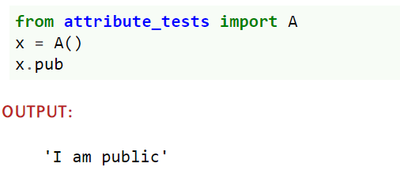
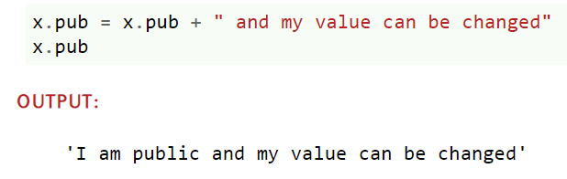
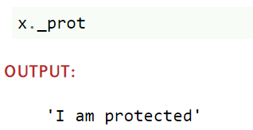
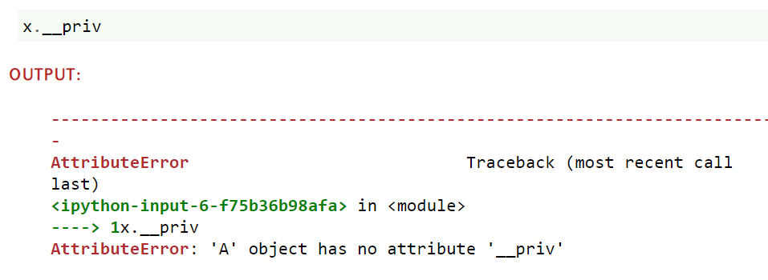
class A():
def __init__(self):
self.__priv = "I am private"
self._prot = "I am protected"
self.pub = "I am public"

Slide 80
AttributeError
A lie!

Slide 81
Data Encapsulation means, that we should only be able to access private attributes via getters and setters.

Slide 82
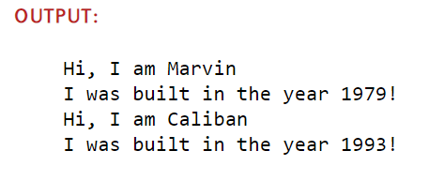
class Robot:
def __init__(self, name=None, build_year=2000):
self.__name = name
self.__build_year = build_year
def say_hi(self):
if self.__name:
print("Hi, I am " + self.__name)
else:
print("Hi, I am a robot without a name")
def set_name(self, name):
self.__name = name
def get_name(self):
return self.__name
def set_build_year(self, by):
self.__build_year = by
def get_build_year(self):
return self.__build_year
def __repr__(self):
return "Robot('" + self.__name + "', " + str(self.__build_year) + ")"
def __str__(self):
return "Name: " + self.__name + ", Build Year: " + str(self.__build_year)
if __name__ == "__main__":
x = Robot("Marvin", 1979)
y = Robot("Caliban", 1943)
for rob in [x, y]:
rob.say_hi()
if rob.get_name() == "Caliban":
rob.set_build_year(1993)
print("I was built in the year " + str(rob.get_build_year()) + "!")

Slide 83
Every private attribute of our class has a getter and a setter
class A():
def __init__(self, x, y):
self.__x = x
self.__y = y
def GetX(self):
return self.__x
def GetY(self):
return self.__y
def SetX(self, x):
self.__x = x
def SetY(self, y):
self.__y = y

Slide 84
این روش خوبی نیست!
class A():
def __init__(self, x, y):
self.__x = x
self.__y = y
def GetX(self):
return self.__x
def GetY(self):
return self.__y
def SetX(self, x):
self.__x = x
def SetY(self, y):
self.__y = y
هر ویژگی خصوصی نیازمند دسترسی از خارج ندارد.
با این روش کد غیرپایتونی ایجاد خواهیم کرد

Slide 85
Destructor
__del__

Slide 86
این متد موقعی که نمونه در شرف نابودی است فراخوانی می‌شود
__del__

Slide 87
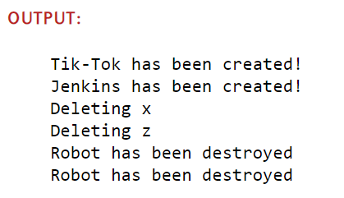
class Robot():
def __init__(self, name):
print(name + " has been created!")
def __del__(self):
print ("Robot has been destroyed")
if __name__ == "__main__":
x = Robot("Tik-Tok")
y = Robot("Jenkins")
z = x
print("Deleting x")
del x
print("Deleting z")
del z
del y

Slide 88
مداخله در destructor ممکن است خطازا باشد

Slide 89
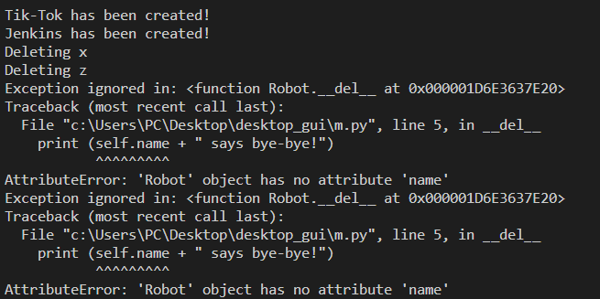
class Robot():
def __init__(self, name):
print(name + " has been created!")
def __del__(self):
print (self.name + " says bye-bye!")
if __name__ == "__main__":
x = Robot("Tik-Tok")
y = Robot("Jenkins")
z = x
print("Deleting x")
del x
print("Deleting z")
del z
del y

Slide 90
2. Class vs. Instance Attributes
Object-oriented programming in Python: instance attributes vs. class attributes and their proper usage.

Slide 91
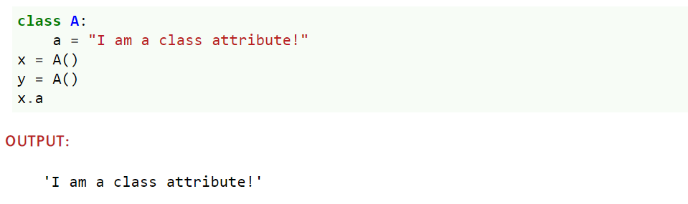

Slide 92
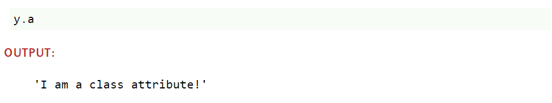

Slide 93


Slide 94


Slide 95


Slide 96


Slide 97


Slide 98


Slide 99
ویژگی‌های کلاس و نمونه‌ها در دو دیکشنری متفاوت ذخیره می‌شوند
__dict__

Slide 100



Slide 101


Slide 102


Slide 103
Example with Class Attributes

Slide 104
Isaac Asimov devised and introduced the so-called "Three Laws of Robotics" in 1942

Slide 105
class Robot:
Three_Laws = (
"""A robot may not injure a human being or, through inaction, allow a human being to come to harm.""",
"""A robot must obey the orders given to it by human beings, except where such orders would conflict with the First Law.,""",
"""A robot must protect its own existence as long as such protection does not conflict with the First or Second Law."""
)
def __init__(self, name, build_year):
self.name = name
self.build_year = build_year
# other methods as usual

Slide 106

from robot_asimov import Robot
for number, text in enumerate(Robot.Three_Laws):
print(str(number+1) + ":\n" + text)

Slide 107

class C:
counter = 0
def __init__(self):
type(self).counter += 1
def __del__(self):
type(self).counter -= 1
if __name__ == "__main__":
x = C()
print("Number of instances: : " + str(C.counter))
y = C()
print("Number of instances: : " + str(C.counter))
del x
print("Number of instances: : " + str(C.counter))
del y
print("Number of instances: : " + str(C.counter))

Slide 108
Static Methods

Slide 109
می‌توان برای دسترسی به ویژگی‌های خصوصی از متد نمونه بهره برد

Slide 110

class Robot:
__counter = 0
def __init__(self):
type(self).__counter += 1
def RobotInstances(self):
return Robot.__counter
if __name__ == "__main__":
x = Robot()
print(x.RobotInstances())
y = Robot()
print(x.RobotInstances())

Slide 111
اما این همیشه خوب نیست!

Slide 112


تعداد ربات‌ها ارتباطی به هر یک از نمونه‌ها ندارد و نمی‌توانیم تعداد ربات را پیش از ایجاد نمونه بپرسیم.
پرسش از کلاس:

Slide 113
راه حل؟
حذف self

Slide 114
3. Properties vs. Getters and Setters
Object oriented programming in Python: instance attributes vs. class attributesand their proper usage.
https://python-course.eu/oop/

Slide 115
4. Implementing a Custom Property Class
Python Class implementing a custom property class.
https://python-course.eu/oop/

Slide 116
5. Introduction to Descriptors
Introduction to descriptors. Defining descriptors, summarizing the protocol, and showing how descriptors are called.
https://python-course.eu/oop/

Slide 117
6. Inheritance
Tutorial on Python: Inheritance
https://python-course.eu/oop/

Slide 118
7. Multiple Inheritance
Object-Oriented Programming in Python: Covering Multiple inheritance, the diamond problem, MRO and polymorphism in Python''
https://python-course.eu/oop/

Slide 119
8. Multiple Inheritance: Example
Extensive example of multiple inheritance in Python
https://python-course.eu/oop/

Slide 120
9. Magic Methods
Python Tutorial: Magic methods and operator overloading with examples. __call__ method to turn class instances into callables
https://python-course.eu/oop/

Slide 121
10. Callable Instances of Classes
Python Tutorial: Callables in Python and class instances which can be used like functions. Introduction in the __call__ method
https://python-course.eu/oop/

Slide 122
11. Inheritance Example
Object Oriented Programming: Example of Inheritance in Python.
https://python-course.eu/oop/

Slide 123
12. Slots: Avoiding Dynamically Created Attributes
Slots in Python: A way to prevent the dynamical creation of attributes and to save memory space in certain cases
https://python-course.eu/oop/

Slide 124
13. Polynomial Class
Python Class implementing polynomial functions.
https://python-course.eu/oop/

Slide 125
14. Dynamically Creating Classes with type
Relationship between classes and type for advanced programmers: deeper insight into what happens when we define a class or create an instance of a class.
https://python-course.eu/oop/

Slide 126
15. Road to Metaclasses
Incentive and motivation for learning and using metaclasses. Example classes,which could be designed by using metaclasses
https://python-course.eu/oop/

Slide 127
16. Metaclasses
Tutorial on Metaclasses, theory, usage and example classes using metaclasses
https://python-course.eu/oop/

Slide 128
17. Count Function calls with the help of a Metaclass
Use Cases for Metaclasses: Counting Function Calls
https://python-course.eu/oop/

Slide 129
18. The 'ABC' of Abstract Base Classes
Abstract Classes in Python using the abc module

