Slide 1


Slide 2


Slide 3


Slide 4


Slide 5


Slide 6
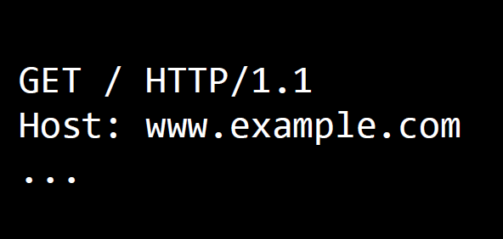

Slide 7
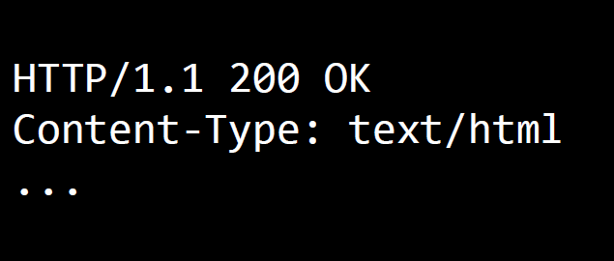

Slide 8
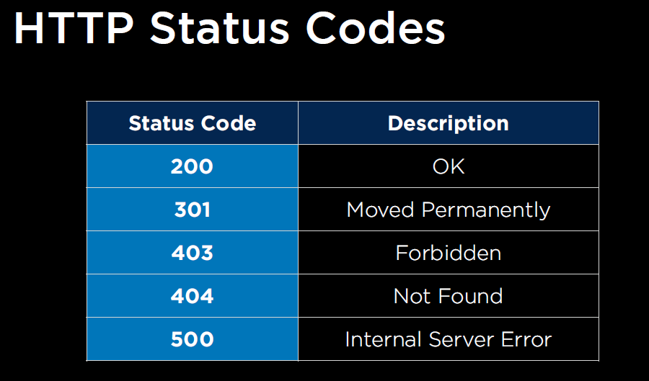

Slide 9


Slide 10
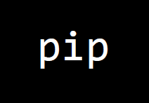

Slide 11
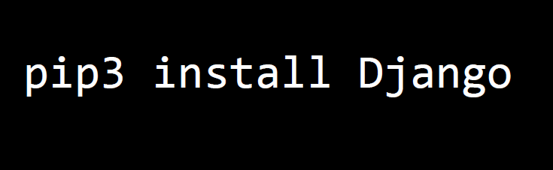

Slide 13
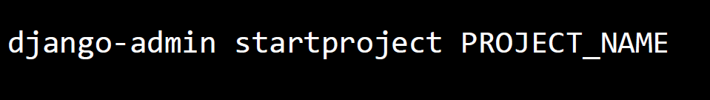

Slide 14
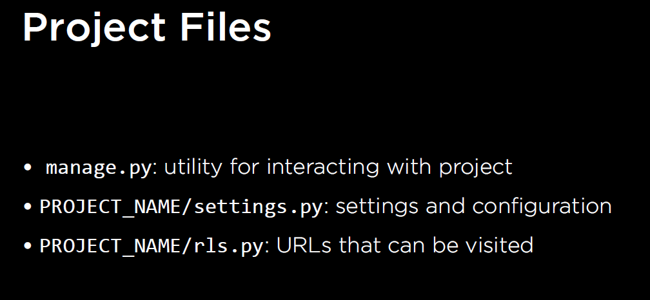

Slide 15


Slide 16
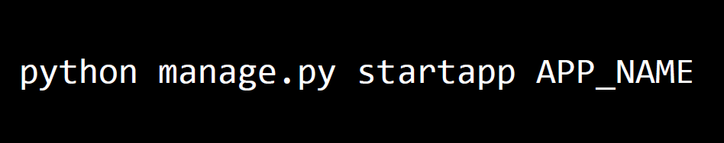

Slide 17


Slide 18


Slide 19
django-admin startproject PROJECT_NAME

Slide 20
cd PROJECT_NAME

Slide 21
manage.py

Slide 22
settings.py

Slide 23
urls.py

