Slide 1
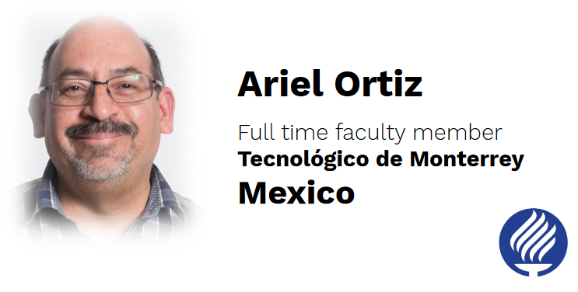
Design Patterns
Design Patterns in Python for the Untrained Eye

Slide 2
What is a Pattern?
Pattern capture experiences in software development that has been proven to work again and again, and thus provide a solution to specific problems. They are not invented, they are discovered.

Slide 3
categories by Abstraction
Idioms
Architectural patterns
Design Patterns

Slide 4
Idioms

Slide 5
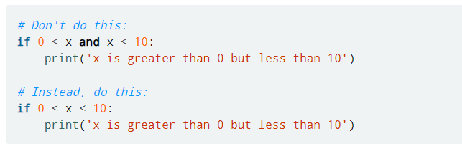
Chained comparison operators:

Slide 6
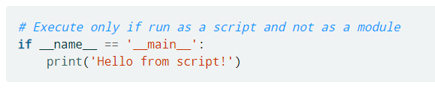
Top-level script environment:

Slide 7
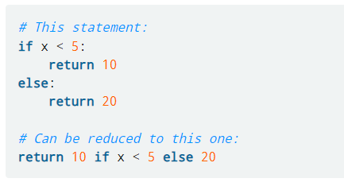
Conditional expressions:

Slide 8
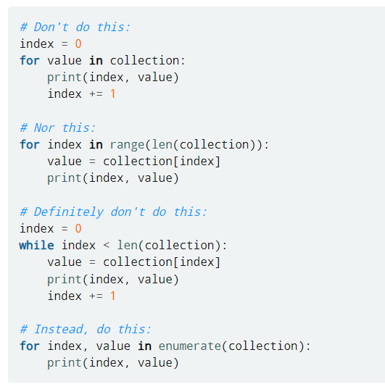
Indexing during iteration:

