Slide 1
QTdesigner

Slide 2
نسخه‌ی کوچک
https://build-system.fman.io/qt-designer-download

Slide 3
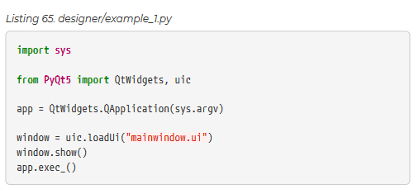
Loading your .ui file in Python

Slide 4
Loading your .ui file in Python

Slide 5
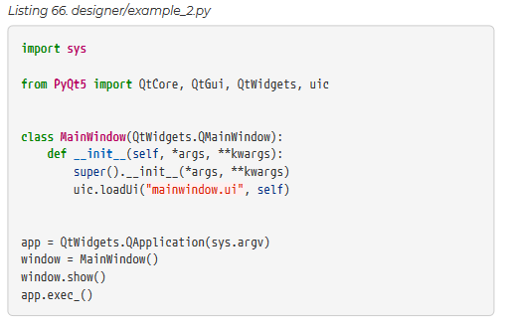
Loading your .ui file in Python

Slide 6

Converting your .ui file to Python

Slide 7

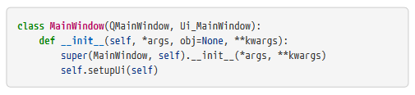
Building your application

Slide 8
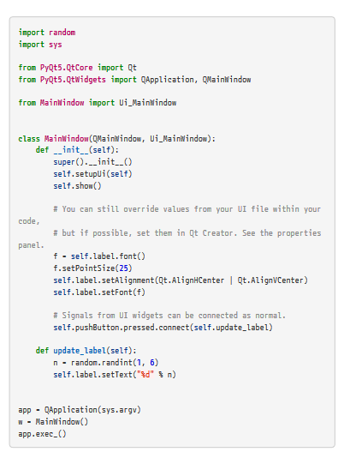
Adding application logic

Slide 9
Adding application logic

