Slide 1
PyQT6

Slide 2
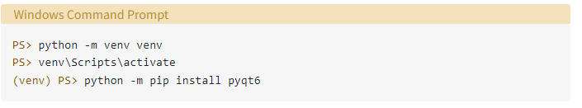

Slide 3


Slide 4
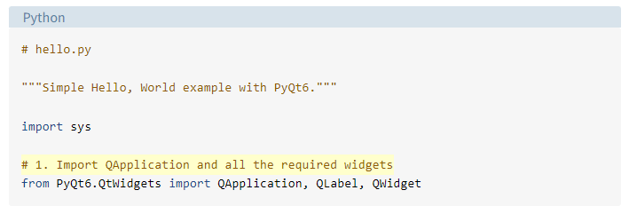

Slide 5


Slide 6
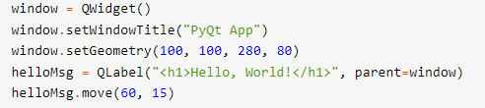

Slide 7
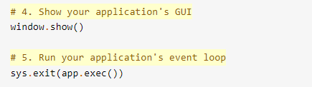

Slide 9
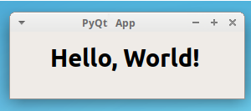

Slide 10
Code Styles
camel case
PEP 8
…practicality beats purity.

Slide 11
Basics of PyQt

Slide 12
Widgets
Layout managers
Dialogs
Main windows
Applications
Event loops
Signals and slots

Slide 13
Widgets

Slide 14
Buttons
Labels
Line edits
Combo boxes
Radio buttons

Slide 15

Buttons
Labels
Line edits
Combo boxes
Radio buttons

Slide 16

Buttons
Labels
Line edits
Combo boxes
Radio buttons

Slide 17
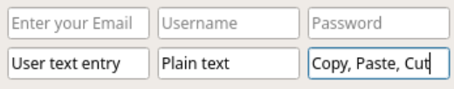
Buttons
Labels
Line edits
Combo boxes
Radio buttons

Slide 18
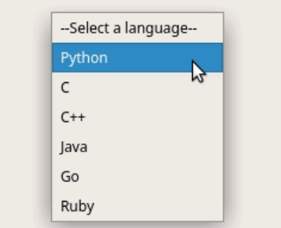
Buttons
Labels
Line edits
Combo boxes
Radio buttons

Slide 19
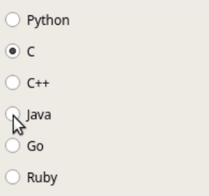
Buttons
Labels
Line edits
Combo boxes
Radio buttons

Slide 20
Layout Managers
Hello

Slide 21
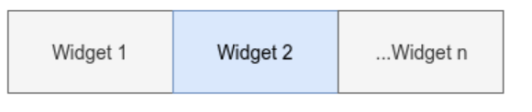
QHBoxLayout

Slide 22
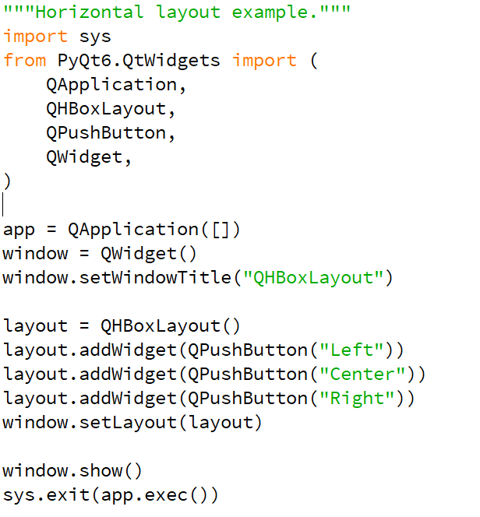

QHBoxLayout

Slide 23
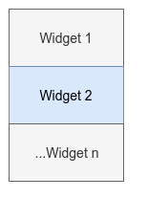
QVBoxLayout

Slide 24
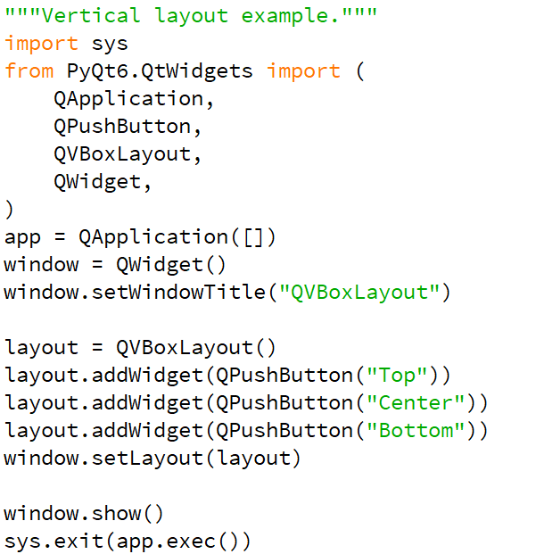
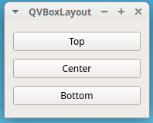
QVBoxLayout

Slide 25
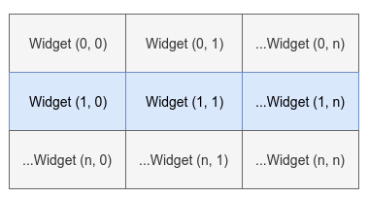
QGridLayout

Slide 26
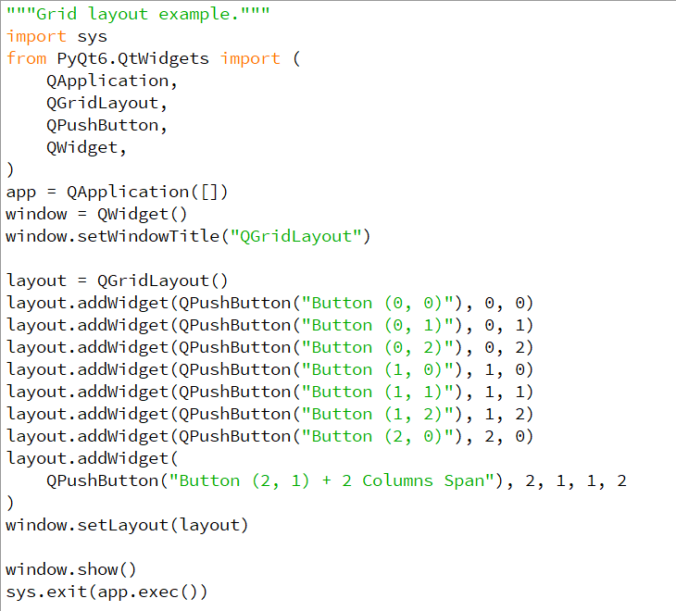
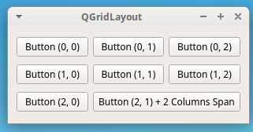
QGridLayout

Slide 27
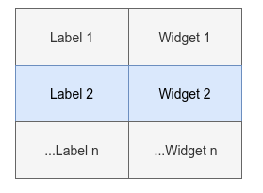
QFormLayout

Slide 28
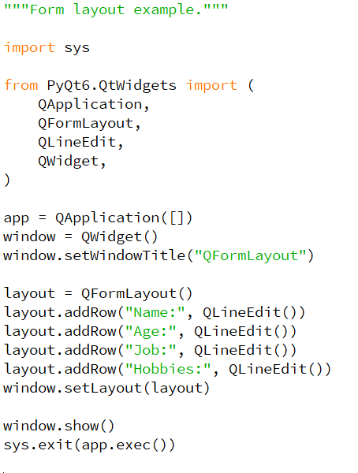
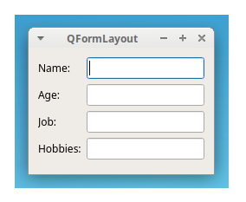
QFormLayout

Slide 29
Signals and Slots
signal
f

Slide 30
Signals and Slots
widget.signal.connect(slot_function)

Slide 31
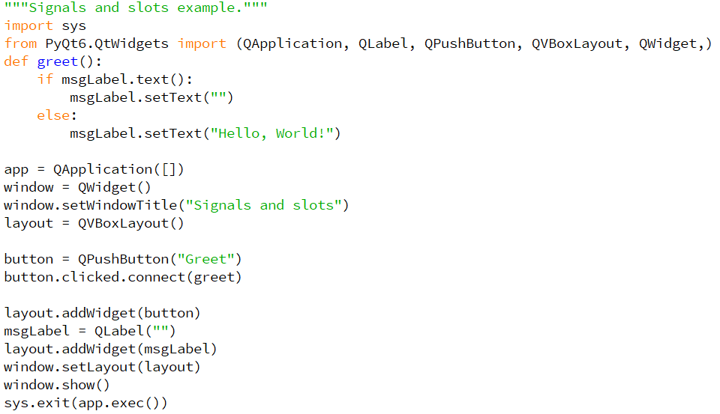
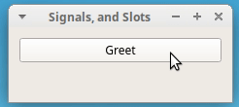
Signals and Slots

