Slide 1
Bytecode
Tomas Bures
bures@d3s.mff.cuni.cz

Slide 2
Bytecode
Machine code of a JVM
stack-based
with constructs for manipulation with classes/instances
The Java™ Virtual Machine Specification
http://docs.oracle.com/javase/specs/jvms/se7/html/index.html
Instructions Overview
http://en.wikipedia.org/wiki/Java_bytecode_instruction_listings

Slide 3
Example – Basics
void spin() {
int i;
for (i = 0; i < 100; i++) {
; // Loop body is empty
}
}
Method void spin()
0 iconst_0 // Push int constant 0
1 istore_1 // Store into local variable 1 (i=0)
2 goto 8 // First time don't increment
5 iinc 1 1 // Increment local variable i by 1
8 iload_1 // Push local variable 1 (i)
9 bipush 100 // Push int constant 100
11 if_icmplt 5 // Compare and loop if (i < 100)
14 return // Return void when done

Slide 4
Instruction set – Load and Store
Load a local variable onto the operand stack
iload, iload_<n>, lload, lload_<n>, fload, fload_<n>, dload, dload_<n>, aload, aload_<n>
Store a value from the operand stack into a local variable
istore, istore_<n>, lstore, lstore_<n>, fstore, fstore_<n>, dstore, dstore_<n>, astore, astore_<n>
Load a constant onto the operand stack
bipush, sipush, ldc, ldc_w, ldc2_w, aconst_null, iconst_m1, iconst_<i>, lconst_<l>, fconst_<f>, dconst_<d>
Gain access to more local variables using a wider index, or to a larger immediate operand
wide

Slide 5
Example – Constants
void useManyNumeric() {
int i = 100;
int j = 1000000;
long l1 = 1;
long l2 = 0xffffffff;
double d = 2.2;
...do some calculations...
}
Method void useManyNumeric()
0 bipush 100 // Push a small int with bipush
2 istore_1
3 ldc #1 // Push int constant 1000000
5 istore_2
6 lconst_1 // A tiny long value uses short, fast lconst_1
7 lstore_3
8 ldc2_w #6 // Push long 0xffffffff (that is, an int -1)
11 lstore 5
13 ldc2_w #8 // Push double constant 2.200000
16 dstore 7
...do those calculations...

Slide 6
Instruction set – Arithmetics
Add
iadd, ladd, fadd, dadd
Subtract
isub, lsub, fsub, dsub
Multiply
imul, lmul, fmul, dmul
Divide
idiv, ldiv, fdiv, ddiv
Remainder
irem, lrem, frem, drem
Negate
ineg, lneg, fneg, dneg
Shift
ishl, ishr, iushr, lshl, lshr, lushr
Bitwise OR
ior, lor
Bitwise AND
iand, land
Bitwise exclusive OR
ixor, lxor
Local variable increment
iinc
Comparison
dcmpg, dcmpl, fcmpg, fcmpl, lcmp

Slide 7
Example – Arithmetics
int align2grain(int i, int grain) {
return ((i + grain-1) & ~(grain-1));
}
Method int align2grain(int,int)
0 iload_1
1 iload_2
2 iadd
3 iconst_1
4 isub
5 iload_2
6 iconst_1
7 isub
8 iconst_m1
9 ixor
10 iand
11 ireturn

Slide 8
Instruction set – Execution control
Conditional branch
ifeq, iflt, ifle, ifne, ifgt, ifge, ifnull, ifnonnull, if_icmpeq, if_icmpne, if_icmplt, if_icmpgt, if_icmple, if_icmpge, if_acmpeq, if_acmpne
Compound conditional branch
tableswitch, lookupswitch
Unconditional branch
goto, goto_w, jsr, jsr_w, ret

Slide 9
Example – Switch
int chooseNear(int i) {
switch (i) {
case 0: return 0;
case 1: return 1;
case 2: return 2;
default: return -1;
}
}
Method int chooseNear(int)
0 iload_1
1 tableswitch 0 to 2:
0: 28
1: 30
2: 32
default:34
28 iconst_0
29 return
...
34 iconst_m1
35 ireturn

Slide 10
Example – Switch
int chooseFar(int i) {
switch (i) {
case -100: return -1;
case 0: return 0;
case 100: return 1;
default: return -1;
}
}
Method int chooseFar(int)
0 iload_1
1 lookupswitch 3:
-100: 36
0: 38
100: 40
default:42
36 iconst_m1
37 ireturn
...
42 iconst_m1
43 ireturn

Slide 11
Example – Comparison
int lessThan100(double d) {
if (d < 100.0) {
return 1;
} else {
return -1;
}
}
Method int lessThan100(double)
0 dload_1
1 ldc2_w #4 // Push double constant 100.0
4 dcmpg // Push 1 if d is NaN or d \> 100.0;
// push 0 if d == 100.0
5 ifge 10 // Branch on 0 or 1
8 iconst_1
9 ireturn
10 iconst_m1
11 ireturn

Slide 12
Instruction set – Type conversions
Widening numeric conversions
i2l, i2f, i2d, l2f, l2d, f2d
Narrowing numeric conversions
i2b, i2c, i2s, l2i, f2i, f2l, d2i, d2l, d2f

Slide 13
Example – Type conversion
void sspin() {
short i;
for (i = 0; i < 100; i++) {
; // Loop body is empty
}
}
Method void sspin()
0 iconst_0
1 istore_1
2 goto 10
5 iload_1 // The short is treated as though an int
6 iconst_1
7 iadd
8 i2s // Truncate int to short
9 istore_1
10 iload_1
11 bipush 100
13 if_icmplt 5
16 return

Slide 14
Instruction set – Calling a method
invokevirtual
invokes an instance method of an object, dispatching on the (virtual) type of the object. This is the normal method dispatch in the Java programming language.
invokeinterface
invokes a method that is implemented by an interface, searching the methods implemented by the particular runtime object to find the appropriate method.
invokespecial
invokes an instance method requiring special handling, whether an instance initialization method, a private method, or a superclass method.
invokestatic
invokes a class (static) method in a named class.
invokedynamic
invokes a method obtained by calling a bootstrap method

Slide 15
Example – Calling a virtual method
int add12and13() {
return addTwo(12, 13);
}
Method int add12and13()
0 aload_0 // Push local variable 0 (this)
1 bipush 12 // Push int constant 12
3 bipush 13 // Push int constant 13
5 invokevirtual #4 // Method Example.addtwo(II)I
8 ireturn // Return int on top of operand stack; it is
// the int result of addTwo()

Slide 16
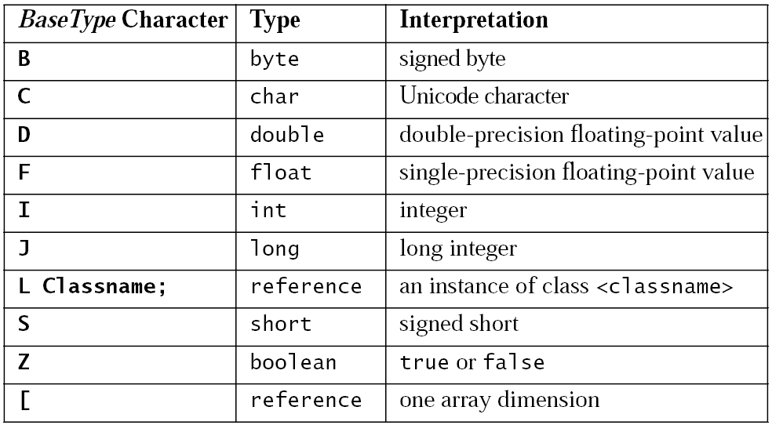
Type specification
Examples:
double d[][][] [[[D
Object mymethod(int i, double d, Thread t) (IDLjava/lang/Thread;)Ljava/lang/Object;

Slide 17
Example – Calling a static method
int add12and13() {
return addTwoStatic(12, 13);
}
Method int add12and13()
0 bipush 12
2 bipush 13
4 invokestatic #3 // Method Example.addTwoStatic(II)I
7 ireturn

Slide 18
Example – Calling a special method
class Near {
int it;
public int getItNear() {
return getIt();
}
private int getIt() {
return it;
}
}
Method int getItNear()
0 aload_0
1 invokespecial #5
// Method Near.getIt()I
4 ireturn
class Far extends Near {
int getItFar() {
return super.getItNear();
}
}
Method int getItFar()
0 aload_0
1 invokespecial #4
// Method
// Near.getItNear()I
4 ireturn

Slide 19
Invokedynamic
static void test() throws Throwable {
// THE FOLLOWING LINE IS PSEUDOCODE FOR A JVM INSTRUCTION
InvokeDynamic[#bootstrapDynamic].baz("baz arg", 2, 3.14);
}
private static void printArgs(Object... args) {
System.out.println(java.util.Arrays.deepToString(args));
}
private static CallSite bootstrapDynamic(MethodHandles.Lookup caller,
String name, MethodType type) {
MethodHandles.Lookup lookup = MethodHandles.lookup();
Class thisClass = lookup.lookupClass(); // (who am I?)
MethodHandle printArgs = lookup.findStatic(thisClass,
"printArgs", MethodType.methodType(void.class, Object[].class));
// ignore caller and name, but match the type:
return new ConstantCallSite(printArgs.asType(type));
}

Slide 20
Instruction set – Instance manipulation
Create a new class instance
new
Access fields of classes (static fields, known as class variables) and fields of class instances (non-static fields, known as instance variables)
getfield, putfield, getstatic, putstatic
Check properties of class instances or arrays
instanceof, checkcast

Slide 21
Example – Instance creation
Object create() {
return new Object();
}
Method java.lang.Object create()
0 new #1 // Class java.lang.Object
3 dup
4 invokespecial #4 // Method java.lang.Object.<init>()V
7 areturn

Slide 22
Example – Attribute access
void setIt(int value) {
i = value;
}
int getIt() {
return i;
}
Method void setIt(int)
0 aload_0
1 iload_1
2 putfield #4 // Field Example.i I
5 return
Method int getIt()
0 aload_0
1 getfield #4 // Field Example.i I
4 ireturn

Slide 23
Instruction set – Array manipulation
Create a new array
newarray, anewarray, multianewarray
Load an array component onto the operand stack
baload, caload, saload, iaload, laload, faload, daload, aaload
Store a value from the operand stack as an array component
bastore, castore, sastore, iastore, lastore, fastore, dastore, aastore
Get the length of array
arraylength

Slide 24
Example – Array (primitive type)
void createBuffer() {
int buffer[]; int bufsz = 100;
int value = 12; buffer = new int[bufsz];
buffer[10] = value; value = buffer[11];
}
Method void createBuffer()
0 bipush 100 // Push int constant 100 (bufsz)
2 istore_2 // Store bufsz in local variable 2
3 bipush 12 // Push int constant 12 (value)
5 istore_3 // Store value in local variable 3
6 iload_2 // Push bufsz...
7 newarray int // ...and create new array of int of that length
9 astore_1 // Store new array in buffer
10 aload_1 // Push buffer
11 bipush 10 // Push int constant 10
13 iload_3 // Push value
14 iastore // Store value at buffer[10]
15 aload_1 // Push buffer
16 bipush 11 // Push int constant 11
18 iaload // Push value at buffer[11]...
19 istore_3 // ...and store it in value
20 return

Slide 25
Example – Array (reference)
void createThreadArray() {
Thread threads[];
int count = 10;
threads = new Thread[count];
threads[0] = new Thread();
}
Method void createThreadArray()
0 bipush 10 // Push int constant 10
2 istore_2 // Initialize count to that
3 iload_2 // Push count, used by anewarray
4 anewarray class #1 // Create new array of class Thread
7 astore_1 // Store new array in threads
8 aload_1 // Push value of threads
9 iconst_0 // Push int constant 0
10 new #1 // Create instance of class Thread
13 dup // Make duplicate reference...
14 invokespecial #5 // ...to pass to instance initialization
// method Method java.lang.Thread.<init>()V
17 aastore // Store new Thread in array at 0
18 return

Slide 26
Example – Array (multidimensional)
int[][][] create3DArray() {
int grid[][][];
grid = new int[10][5][];
return grid;
}
Method int create3DArray()[][][]
0 bipush 10 // Push int 10 (dimension one)
2 iconst_5 // Push int 5 (dimension two)
3 multianewarray #1 dim #2 // Class [[[I, a three
// dimensional int array; only
// create first two dimensions
7 astore_1 // Store new array...
8 aload_1 // ...then prepare to return it
9 areturn

Slide 27
Instruction set – Stack manipulation
pop, pop2, dup, dup2, dup_x1, dup2_x1, dup_x2, dup2_x2, swap

Slide 28
Example – Array (multidimensional)
public long nextIndex() {
return index++;
}
private long index = 0;
Method long nextIndex()
0 aload_0 // Push this
1 dup // Make a copy of it
2 getfield #4 // One of the copies of this is consumed
// pushing long field index,
// above the original this
5 dup2_x1 // The long on top of the operand stack is
// inserted into the operand stack below the
// original this
6 lconst_1 // Push long constant 1
7 ladd // The index value is incremented...
8 putfield #4 // ...and the result stored back in the field
11 lreturn // The original value of index is left on top
// of the operand stack, ready to be returned

Slide 29
Instruction set – Monitors
monitorenter
monitorexit

Slide 30
Example – Exceptions (throw)
void cantBeZero(int i) throws TestExc {
if (i == 0) {
throw new TestExc();
}
}
Method void cantBeZero(int)
0 iload_1 // Push argument 1 (i)
1 ifne 12 // If i==0, allocate instance and throw
4 new #1 // Create instance of TestExc
7 dup // One reference goes to the constructor
8 invokespecial #7 // Method TestExc.<init>()V
11 athrow // Second reference is thrown
12 return // Never get here if we threw TestExc

Slide 31
Example – Exceptions (catch)
void catchOne() {
try {
tryItOut();
} catch (TestExc e) {
handleExc(e);
}
}
Method void catchOne()
0 aload_0 // Beginning of try block
1 invokevirtual #6 // Method Example.tryItOut()V
4 return // End of try block; normal return
5 astore_1 // Store thrown value in local variable 1
6 aload_0 // Push this
7 aload_1 // Push thrown value
8 invokevirtual #5 // Invoke handler method:
// Example.handleExc(LTestExc;)V
11 return // Return after handling TestExc
Exception table:
From To Target Type
0 4 5 Class TestExc

Slide 32
Example – Exceptions (nested)
void nestedCatch() {
try {
try {
tryItOut();
} catch (TestExc1 e) {
handleExc1(e);
}
} catch (TestExc2 e) {
handleExc2(e);
}
}
Method void nestedCatch()
.....
.....
Exception table:
From To Target Type
0 4 5 Class TestExc1
0 11 12 Class TestExc2

Slide 33
Instruction set – Exceptions
Throwing an exception
athrow
Try-catch declaration
Via special exception table associated with a method
Finally
Implemented by the compiler

Slide 34
Example – Monitors
void onlyMe(Foo f) {
synchronized(f) {
doSomething();
}
}
Method void onlyMe(Foo)
0 aload_1 // Push f
1 astore_2 // Store it in local variable 2
2 aload_2 // Push local variable 2 (f)
3 monitorenter // Enter the monitor associated with f
4 aload_0 // Holding the monitor, pass this and...
5 invokevirtual #5 // ...call Example.doSomething()V
8 aload_2 // Push local variable 2 (f)
9 monitorexit // Exit the monitor associated with f
10 return // Return normally
11 aload_2 // In case of any throw, end up here
12 monitorexit // Be sure to exit monitor...
13 athrow // ...then rethrow the value to the invoker
Exception table:
From To Target Type
4 8 11 any

Slide 35
Statically-typed Class-based languages (Scala)
Tomas Bures
bures@d3s.mff.cuni.cz

Slide 36
Scala
Statically-typed language
Compiles to bytecode
Modern concepts
Example: E01

Slide 37
Semicolon inference
A line ending is treated as a semicolon unless one of the following conditions is true:
The line in question ends in a word that would not be legal as the end of a statement, such as a period or an infix operator.
The next line begins with a word that cannot start a statement.
The line ends while inside parentheses (...) or brackets [...], because these cannot contain multiple statements anyway.

Slide 38
Static vs. dynamic typing
Target function is determined
at compile time – static typing
at runtime – dynamic typing
Example: E02
Decompiled – DynamicTypingMain

Slide 39
Classes vs. objects
Scala does not have static method
Instead it features a singleton object
Defines a class and a singleton instance
Example: E03
Decompiled – AppLogger, Logger

Slide 40
Type inference
Types can be omitted – they are inferred automatically
At compile time
Example: E04

Slide 41
Type Hierarchy
Everything is an object
primitive data types behind the scene (boxing/unboxing)
Compiler optimizes the use of primitive types
a primitive type is used if possible
Null and Nothing types

Slide 42
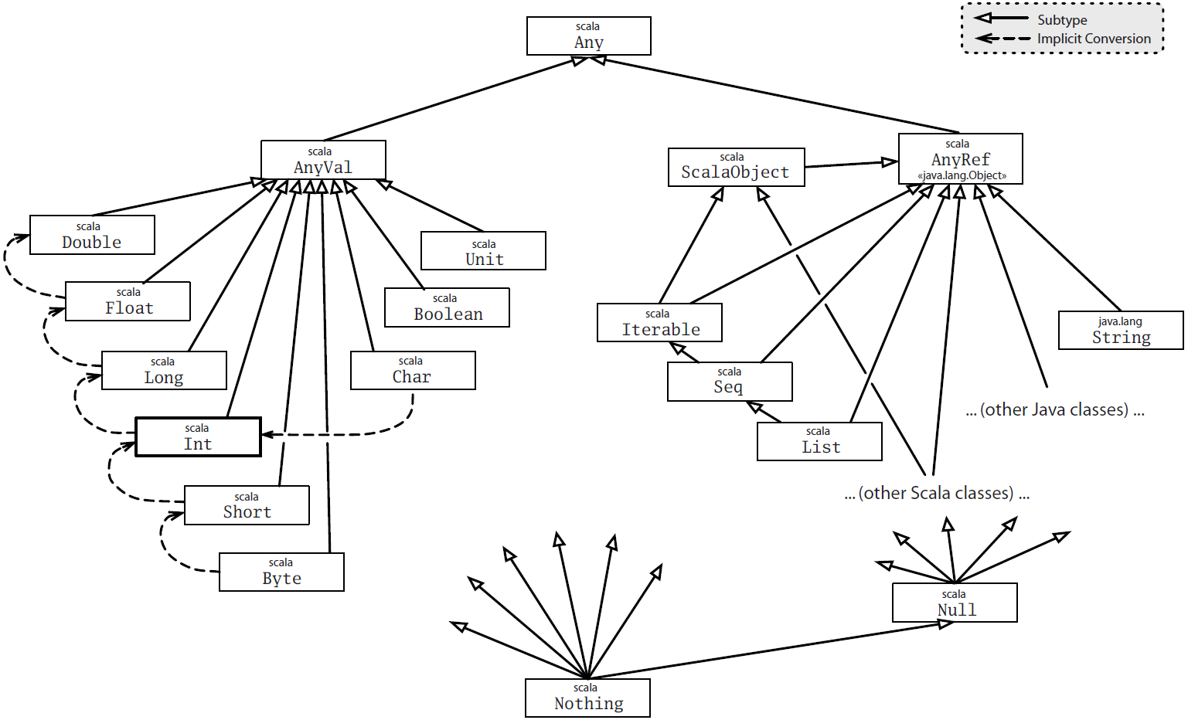
Type Hierarchy

Slide 43
Null and Nothing types
null is singleton instance of Null
can be assigned to any AnyRef
Nothing is a subtype of everything
Can be assigned to anything, but does not have any instance
def doesNotReturn(): Nothing = {
throw new Exception
}

Slide 44
Companion object
A class and object may have the same name
Must be defined in the same source
Then the class and object may access each others private fields
Example: E05

Slide 45
Constructors
One primary constructor
class parameters
can invoke superclass constructor
Auxiliary constructors
must invoke the primary constructor (as the first one)
must not invoke superclass constructor

Slide 46
Operators
Scala allows almost arbitrary method names (including operators)
A method may be called without a dot
Prefix operators have special names
Example: E06

Slide 47
Flexibility in Identifiers and Operators
Alphanumeric identifier
starts with letter or underscore
Operator identifier
an operator character belongs to the Unicode set of mathematical symbols(Sm) or other symbols(So), or to the 7-bit ASCII characters that are not letters, digits
any sequence of them
Mixed identifier
e.g. unary_- to denote a prefix operator
Literal identifier
with backticks (e.g. `class`) to avoid clashes with reserved words, etc.

Slide 48
Implicit conversions
Scala allows specifying functions that are applied automatically to make the code correct
conversion to the type of the argument or to the type of the receiver
must be in current scope or source or target type scope
scalac -Xprint:typer mocha.scala
program after implicits added and fully-qualified types substituted
Example: E07

Slide 49
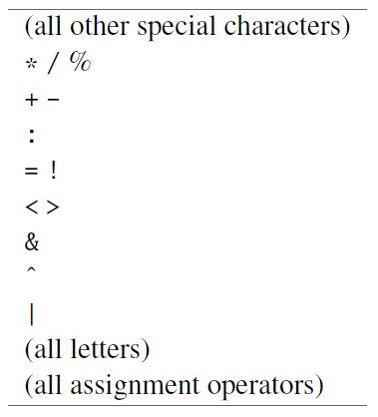
Operator precedences
Operator precedence determined by the first character
Only if the operator ends with “=“, the last character is used

Slide 50
Traits
Scala does not have interfaces
It has something stronger – mixins (called traits)
A trait is like an interface, but allows for defining methods and variables
Example: E08

Slide 51
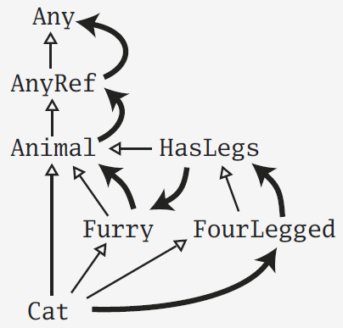
Linearization
As opposed to multiple inheritance, traits do not suffer from the diamond problem
This is because the semantics of super is determined only when the final type is defined
Example: E09

Slide 52
Scala – Java interoperability
trait T
interface T – method declarations
class T$class – method implementations
class C extends T
instance methods of C
delegate methods to methods of T$class
object C
static methods in C
delegate to methods of C$.MODULE
class C$
instance methods of C
static field C$.MODULE of type C (the singleton instance)
Example: E10

Slide 53
Type parameterization
Each class and method may be parameterized by a type
Lower and upper bounds
Example: E11

Slide 54
Instance private data
The mutable state in a class typically prevents the covariance/contravariance
Why?
Example (covariance): E12
Example (contravariance): E13

Slide 55
Abstract types
What about if we want methods in a subclass to specialize method parameters?
Example: E14

Slide 56
Structural subtyping
It is possible to specify only properties of a type
Example: E15

Slide 57
First-class functions
Functions are first-class citizens
May be passed as parameters
Anonymous functions, …
Anonymous functions are instances of classes
Function1, Function2, …
Example: E16

Slide 58
Tail recursion
The compiler can do simple tail recursion
If the return value of a function is a recursive call to the function itself
Example: E17

Slide 59
For-comprehension
Generalized for-loops
generators, definitions, filters
Translated to operations over collections
map, flatMap, withFilter, foreach
Example: E18

Slide 60
New control structures
Currying – function that returns function
By-name parameters
omitting empty parameter list in an anonymous function
Example: E19

Slide 61
Behavior Driven Development
Unit test as a specification
Human readable style
Still executable
Example: E20

Slide 62
Case-classes, pattern matching
Scala allows for simple pattern matching (similar to Prolog terms)
Case-classes
factory method (no new necessary)
all parameters are vals
Example: E21

Slide 63
Case sequences & Partial functions
Functions may be defined as case sequences
It’s like a function with more entry points
Since the case sequence does not have to cover all cases, it yields a partial function
Partial function may be queried if a given value is in its domain
or it throws a runtime exception if called with an unsupported input argument
Example: E22 + H2

Slide 64
Delayed init
If a class extends the DelayedInit trait
the compiler turns the class initializer to a function
and calls delayedInit function on the class instance giving it the initializer function
Example: E23

Slide 65
XML
Scala has native support for parsing XML
XML can be included where expression is expected
It gets transformed to a runtime structure
Example: E24

Slide 66
Lift
Web-framework written in Scala
Utilizes advanced Scala concepts
DSL, functions, XML

Slide 67
Extractors + regular expressions

Slide 68
default parameter values
d(i) … apply
d(i) = 3 … update
tuples
any method can be an operator

Slide 69
Functional data structures
lists
mutable/immutable
how inside?

Slide 70
Implicit parameters

