Slide 1
MLlib Method Summary and Implementation Details
Big Data Systems
School of Data Science
University of Virginia
Last updated: September 24, 2025

Slide 2
MLlib DataFrames API
The interface makes it relatively easy to experiment across models
The common activities include:
- fit() to train a model
- transform() to make predictions
- evaluate() to assess predictive performance

Slide 3
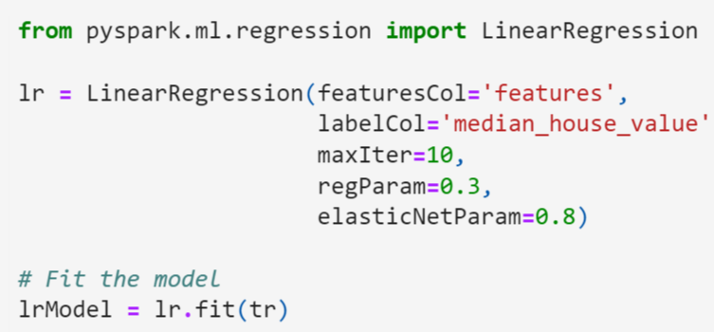
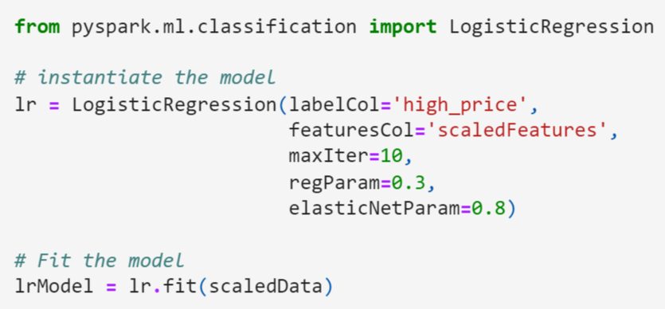
MLlib DataFrames API, contd.
Methods are analogous for different tasks e.g., regression, classification
Will call different library, different functions but ideas are the same
Regression
Classification

Slide 4
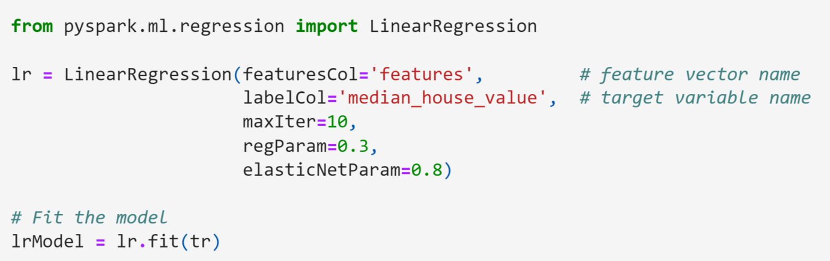
Train a Model
Import the model from the ml library
Instantiate the model by passing:
- name of features column
- name of label column
- hyperparameters

Slide 5
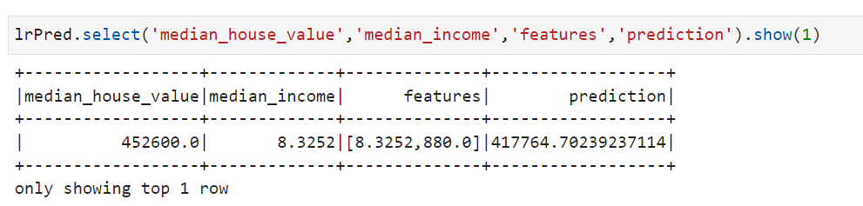
Make Predictions
Predict with the transform() method
Inspect a record with some columns

Slide 6
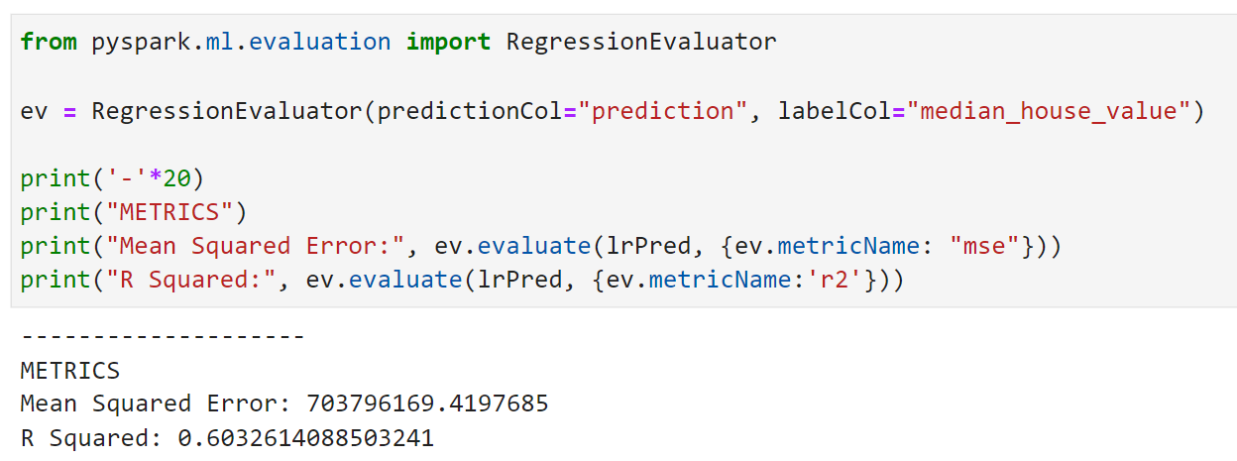
Assess Predictive Performance
Import an evaluator and call evaluate() method
Pass name of prediction column, label column
Inspect a record with some columns

Slide 7
Spark MLlib Implementation Details
Source: https://stanford.edu/~rezab/slides/strata2015.pdf

Slide 8
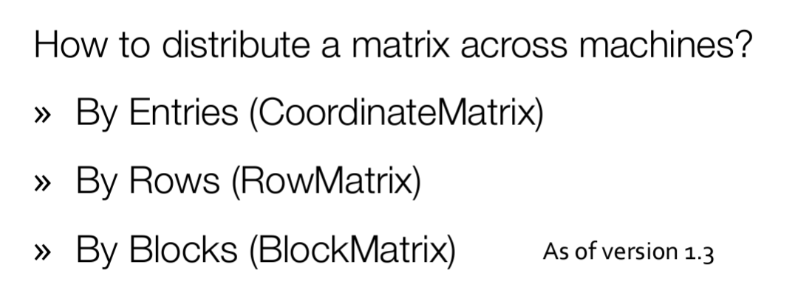
Matrix Operations are Foundational

Slide 9
Mllib Data Handling
> Data stored in distributed collections partitioned across nodes in cluster
> Model training algorithms implemented to aggregate statistics from partitions
and efficiently compute parameters

Slide 10
Mllib Data Handling
> Data stored in distributed collections partitioned across nodes in cluster
> Model training algorithms implemented to aggregate statistics from partitions
and efficiently compute parameters
Examples:
> Linear models: use distributed gradient descent
- Each worker computes partial gradients on its partition
- Partial gradients are aggregated
> Tree-based models: feature statistics (e.g., node impurity) computed
in distributed manner

Slide 11
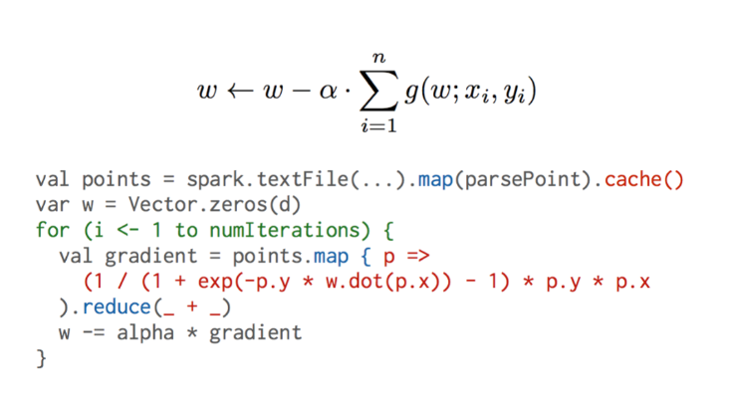
Logistic Regression
Each iteration calls training data, so cache it for speedup
Aggregate partial gradients across partitions

