Slide 1
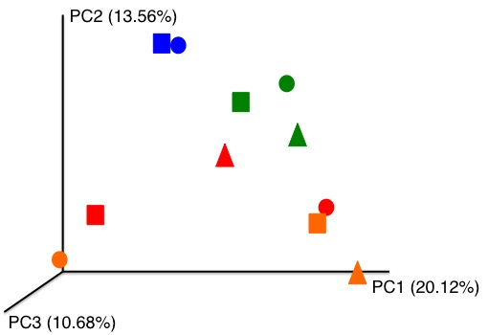
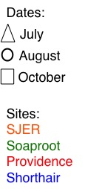
Dust Bacterial (16S) Communities Differed Between Sites
Legend
Principal Coordinates Analysis; Unweighted UniFrac

Slide 2
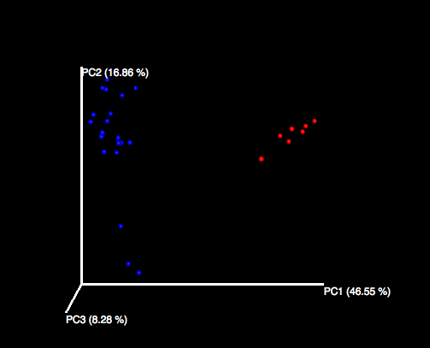
Dust and Soil Bacterial (16S) Communities Differed Across Sites
Soil
Dust

Slide 3
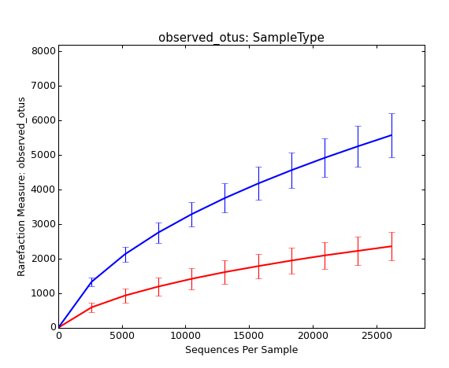
Dust bacterial (16S) communities were less “species” rich than corresponding soil communities
Soil
Dust

