Slide 1
CSCI 565 Programming Languages Fall 2010
Logic Programming
(Sebesta)
_{Instructor : Prof. Rajeev Raje}

Slide 2
Brief History of Logic (http://blue.utb/edu/tang/cosc4350/ch7.ppt#257,2)
1st age of logic (500 BC to 19th Century): Symbolic Logic
Developed by Aristotle (384-322 BC)
Used by “Sophist” (A Greek Philosopher who speculated on a wide range of subjects back in 500 BC)
2nd age of logic (mid to late 19th Century): Algebraic Logic
Developed by George Boole in 1847
Attempted to formulate logic in terms of mathematics, rules of inferences were modeled after various laws for manipulating algebraic expressions.

Slide 3
History of Logic
3rd age of logic (late 19th to mid 20th Century): Mathematical Logic
Frege proposed logic to be used as a language for mathematics in 1879
Get rid of nasty paradoxes constructed because of flawed reasoning
Strengthen the rigor of mathematical proofs
4th age of logic (Mid 20th to present): Logic for Computer Science
Logic Circuits
Logic Programming
Formal Verification for Program Correctness

Slide 4
Logic Programming
Express programs in forms of symbolic logic and use a logical inference process to produce results.
Declarative – ‘what’ – unlike imperative (‘how’) specifications of the desired results are stated rather than the detailed procedures for producing them.
Predicate Calculus
Brief investigation of the basis of logic programming …. (Remember – Axiomatic and Denotational Semantics (‘A language of propositions’))
A ‘proposition’ is a logical statement, which MAY or MAY NOT be true …..Depends upon the environment.
Made up of the objects and their relations to each other .
e.g., CS56500 is a simple class.

Slide 5
Logic Programming
Symbolic logic can be used for three basic needs of formal logic –
to express propositions, to express relationships between propositions and to describe how new propositions can be inferred from other prepositions, which are assumed to be true.
(Remember the axiomatic semantics theory?)
A great deal of similarity exists between mathematics and formal logic. The fundamental axioms of numbers and set theory are the initial set of propositions, which are assumed to be true.
Theorems are the additional propositions that can be inferred from the initial set.
Logic programming uses a particular form of symbolic logic called first-order predicate calculus.

Slide 6
Propositions
Objects in logic programming propositions are represented by simple terms, which are either constants or variables.
A constant is a symbol that represents an object. A variable is a symbol that represents different objects at different times.
Atomic proposition consists of single compound terms.
A compound term is one element of a mathematical relation, written in a form that has the appearance of mathematical function notation. A compound term consists of two parts – a functor and an ordered list of parameters.

Slide 7
Eg. Student (john) ← Compound Term
Functor Parameter
1-tuple, i.e., contains one parameter
(This means john is a 1-tuple in a relation named student)
likes(steve, apples) ⇒ 2-tuple
(Means (steve, apples) is a 2-tuple in a relationship named likes)
student(tom)
(The relation student has two distinct elements, {john} and {tom})
student, john, likes, steve, apples, tom are all constants.
THESE PROPOSITIONS HAVE NO INTRINSIC SEMANTICS – THEY MEAN WHATEVER WE WANT THEM TO MEAN!
Propositions can be stated in two modes – one in which propositions are defined to be true, and one in which the truth of the propositions is to be determined; i.e., propositions can be stated as facts or queries.

Slide 8
Compound Propositions – two or more atomic propositions connected by logical connectors or operators.
Logical Connectors
Negation ¬ ¬a not a
Conjunction ∩ a ∩ b a and b
Disjunction U a U b a or b
Equivalence Ξ a Ξ b a is equivalent to b
Implication ⇒ a ⇒ b a implies b
⇐ a ⇐ b b implies a

Slide 9
Precedence
¬
U ∩ Ξ
⇒ ⇐
E.g., (compound preposition) a ∩ ¬ b ⇒ c
is equivalent to ( a ∩ (¬ b)) ⇒ c
Variables can appear in propositions but only when introduced by special symbols called quantifiers. Predicate calculus has two quantifiers –
Universal ∀x.P For all x, P is true
Existential ∃x.P There exists a value of x such that P is true.

Slide 10
E.g.,
∀X.(child(X) ⇒ human(X))
For all X, if X is a child, then X is a human.
∀X.(gpa40(X)) ⇒ good_student(X))
For all X, if X has a GPA of 4.0 then X is a good student.
∃X.(mother(mary,X) ∩ male (X))
There exists a value of X such that mary is a mother X and X is a male, i.e.; mary has a son.

Slide 11
Clausal Form
One standard form of propositions (standardizations is necessary to avoid redundancy)
All propositions can be restricted to clausal form
In which A’s and B’s are terms.
(If all A’s are true, then at least one B is true)
Primary characteristics of clausal form
Existential quantifiers are not required.
Universal quantifiers are implicit in the use of variables in atomic propositions.
Only U and ∩ required – only as shown above.
B₁ ∪ B₂ ∪ ……. ∪ B_{n} ⇐ A₁ ∩ A_{2 …..} ∩ A_{m}

Slide 12
All predicate calculus propositions can be algorithmically converted to clausal form (proved by Nilsson – 71 – algorithm to achieve this conversion).
If tom is a father of john and jane is the mother of john and bob is the grandmother of john then either bob is a father of tom or bob is a father of jane.
B₁ ∪ B₂ ∪ ……. ∪ B_{n} ⇐ A₁ ∩ A_{2 …..} ∩ A_{n}
E.g., father (bob, tom) ∪ father(bob, jane) ⇐ father (tom, john) ∩
mother (jane, john) ∩
grandfather (bob, john)
Consequents
Antecedents

Slide 13
Predicate Calculus and Theorem Proving
Predicate calculus provides a method of expressing collections of propositions. One use of collections of propositions is to determine whether any interesting or useful facts can be inferred from them – analogous to mathematics – discover new theorems from known axioms and theorems.
Resolution (Alan Robinson – 1965 – Syracuse University)
Resolution is an inference rule that allows inferred propositions to be computed from given propositions thus providing a method with potential application to automatic theorem proving.

Slide 14
Resolution was devised to be applied to propositions in clausal form.
The process of inferring this proposition from the original two propositions is resolution.
older(joanne, jake) ⇐ mother(joanne, jake)
wiser(joanne, jake) ⇐ older(joanne, jake)
By resolution,
wiser(joanne, jake) ⇐ mother(joanne, jake)
Suppose P₁ ⇐ P₂ ( P₂ implies P₁ )
Q₁ ⇐ Q₂ ( Q₂ implies Q₁ )
Furthermore Suppose that P₁ is identical to Q₂ , so that we can rename P₁ & Q₂ with T, then
T ⇐ P₂ ( P₂ implies T )
Q₁ ⇐ T (T implies Q₁ )
Therefore P₂ implies Q₁
Q₁ ⇐ P₂

Slide 15
Process of Resolution
(Mechanics of Resolution Construction)
The terms of the left sides of the two propositions are ANDed together to make the left side of the new proposition.
Repeat 1 for the right sides to get the right side of the new proposition.
Terms which appear on both sides of the new proposition are removed from both sides.

Slide 16
An Example of Resolution
goodStudent(john) ⇐ student(john) ∩ gpa(john, 4)
chancellorList(john) ⇐ goodStudent(john) ∩ csmajor(john)
And left side –
goodStudent(john) ∩ chancellorList(john)
2) And right side –
student(john) ∩ gpa(john,4) ∩ goodStudent(john) ∩ csmajor(john)
3) Remove Common Terms from both sides –
chancellorList(john) ⇐ student(john) ∩ gpa(john,4) ∩ csmajor(john)

Slide 17
Resolution (cntd.)
goodStudent(john) ⇐ student(john) ∩ gpa35(john)
csmajor(john) ⇐ goodStudent(john) ∩ csci71credits(john)
And left side –
goodStudent(john) ∩ csmajor(john)
2) And right side –
student(john) ∩ gpa35(john) ∩ goodStudent(john) ∩ csci71credits(john)
3) Remove Common Terms from both sides –
csmajor(john) ⇐ student(john) ∩ gpa35(john) ∩ csci71credits(john)

Slide 18
Resolution (cntd.)
Resolution is more complex than such simple examples.
Presence of variables in propositions requires resolution to find values for those variables that allow the matching process to succeed.
The process of determining useful values for variables is called unification. The temporary assigning of values to variables to allow unification is called instantiation.

Slide 19
It is common for the resolution process to instantiate a variable with a values, fail to complete the required matching, and then be required to backtrack and instantiate the variable with a different value.
Resolution can detect any inconsistency in a given set of propositions.
Theorem proving is the basis of logic programming.
Query (Goal)
A list of facts + Relationships (Rules) Yes/No or Variable values
Horn Clauses (A. Horn 1951)
Special kind of propositions – Most, but not all propositions can be stated as Horn clauses.
Two forms
Headless: Empty left side, used to state fact. E.g., student(john), gpa (john, 4).
Headed: Non-empty left-side, used for rules (relations). E.g., likes (bob, mary) <- likes(bob, redhead) AND readhead (mary).

Slide 20
Prolog
Developed by Alan Colmerauer and Phillippe Roussel at the U of Aix – Marseille and Robert Kowalski at the U of Edinburgh.
Prolog received a lot of attention when the Japanese govt. launched the ‘Fifth Generation Computing Systems’ project and selected Prolog as the basis for this effort – Intention was to develop intelligent machines.
Prolog’s syntax is a modified version of the predicate calculus.

Slide 21
Basic Elements of Prolog
A Prolog program consists of a collections of sentences.
A Prolog term is a constant, a variable or a structure. A constant is either an atom or an integer.
An atom is either a string of letters, digits and underscores that begins with a lowercase letter or a string of any printable ASCII characters delimited by apostrophes.
A variable is any string of letters, digits and underscores that begin with an uppercase letter.

Slide 22
Variables are NOT BOUND to types by declarations. The binding of a value and thus type to a variable is called instantiation. Instantiation occurs only in the resolution process.
A variable that has not been assigned a value is called uninstantiated. Instantiations last only as long as it takes to satisfy one complete goal, which involves the proof or disproof of one proposition.
Structures represent atomic propositions (of predicate calculus) in Prolog. Their general form is
functor(parameter list)
Functor: atom(used to identify the structure).
Parameter list: any list of atoms, variables or other structures.
Structures are used to specify facts in Prolog.

Slide 23
Fact Statements
Two basic forms
Headless Horn clauses
Headed Horn clauses
Headless Horn Clause – simplest form is a single structure – interpreted as an unconditional assertion, or a fact – Logically facts are propositions that are assumed to be TRUE.
e.g., student(john).
mother(mary, john).
male(jake).
father(john, jake).
Every Prolog statement is terminated by a period.

Slide 24
Rule Statements
Headed Horn clauses (called Rules)
antecedent
Consequent
Antecedent can be either a single term or a conjunction.
Consequent is a single term.
Conjunction contains multiple terms which are separated by logical AND
e.g., female(jane), child(jane).
General form of the Prolog headed Horn clause is
consequence_1:- antecedent_expression.
“consequence_1 can be concluded if the antecedent expression is true or can be made to be true by some instantiation of its variables”.
e.g., ancestor(mary, shelley) :- mother(mary, shelley).

Slide 25
Variables in Rule Statements
Prolog statements can use variables to generalize their meanings. Variables in the clausal form provide a “kind-of” implied universal quantifier.
e.g., parent(X, Y) :- mother(X, Y).
parent(X, Y) :- father(X, Y).
grandparent(X, Y) :- parent(X, Z), parent(Z, Y).
sibling(X, Y) :- mother(M, X), mother(M, Y), father(F, X), father(F, Y).
If there are instantiations of X and Y such that mother(X, Y) is TRUE, then for those same instantiations of X and Y, parent(X, Y) is also true.

Slide 26
Goal Statements
Facts and Rules are the basis for theorem-proving model of Prolog.
The theorem is in the form of a proposition that we want the system to prove or disprove. These propositions in Prolog are called goals or queries.
Syntactic form of goals is same as the headless Horn clauses.
e.g., student(john).
To this query, the system will respond back by saying either Yes or No.

Slide 27
Variables are also allowed in queries. With variables present, the system not only asserts the validity of the goal but also identifies the instantiations of the variables that make the goal true.
e.g., student(john).
gpa(john, 4).
a query could be – student(X). X = john.
gpa(john, Y). Y = 4.
The system will attempt through unification, to find an instantiations of X(Y) so that the goal(s) become(s) true.

Slide 28
Inferencing Process of Prolog
Queries are called as goals. When the goal is a compound proposition, each structure is called a subgoal.
To prove that a goal is true, the inferencing process must find a chain of inference rules and/or facts in the database that connect the goal to one or more facts in the database.
E.g., If Q is the goal then either Q must be found as a fact in the database or the inferencing process must find a sequence of propositions P₁, P₂, …., P_{n} such that
P₁ :- P₂,
P₂ :- P₃,
…,
P_{n} :- Q
and P₁ is a fact.

Slide 29
As the process of proving a subgoal is done through proposition-matching process, it is also called as matching. Sometimes, proving a subgoal is called satisfying that subgoal.
e.g., student(john).
query – student(john).
This is the simplest kind of a goal – search the facts and match the pattern – if there is a match then goal is proved! (Trivial proof).
e.g., student(john).
in_program(X) :- student(X).
goal: in_ program(X).
To prove this goal, Prolog will have to instantiate X such that student(X) will be true (X=john).

Slide 30
Goal
Forward chaining: start with facts and rules and attempt to find a sequence of matches that lead to the goal (bottom-up resolution).
Backward chaining : begin with the goal and attempt to find a sequence of matching propositions that lead to some set of original facts in the database (top-down resolution).
Backward chaining works well when there is a reasonably small set of candidate answers.
Forward chaining is better when the number of possibly correct answers is large – in this situation, backward chaining would require a very large number of matches to get an answer.
Prolog uses backward chaining – designers believed backward chaining was suitable for a larger class of problems than forward chaining.
e.g., father(bob).
man(X) :- father(X).
man(bob). ← goal

Slide 31
Forward Chaining
Take father(bob) and match it with father(X) => X = bob (instantiation).
From the rule (second statement) – it will prove man(bob) – which is the query.
Backward Chaining
Match the goal to the left side of the rule – instantiate X = bob, prove father(bob).
Match father(bob) to the first fact and hence, prove the goal.

Slide 32
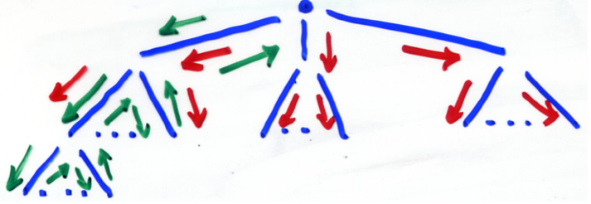
When the goal has more than one structure -> whether the solution search is done depth-first or breadth-first?
A breadth-first search works on all subgoals of a given goal in parallel – parallel search (large amount of memory)
A depth-first search finds a complete sequence of propositions – a proof – for the first subgoal before working on others.
Prolog uses depth-first approach – can be done with fewer computer resources.

Slide 33
_{Backtracking}
When a goal with multiple subgoals is being processed and the system fails to show the truth of one of the subgoals, the system abandons the subgoal it could not prove. Instead, the system reconsiders the previous subgoal, if there is one, and attempts to find an alternative solution to it.
This backing up in the goal to the reconsideration of a previously proven subgoal is called backtracking.

Slide 34
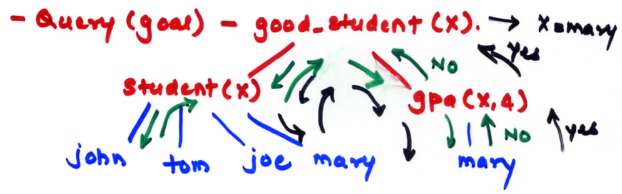
Backtracking can require a great deal of time and space because it may have to find all possible proofs to every subgoal.
e.g., student(john).
student(tom).
student(joe).
student(mary).
gpa(mary, 4).
good_student(X) :- student(X), gpa(X, 4).

Slide 35
Simple Arithmetic
Prolog supports integer variables and integer arithmetic.
e.g., A is B/17 + C.
(If B and C are instantiated and A is not then this will evaluate B/17 + C and instantiate A with that value)
All variables in the expression must be instantiated, but the left-side variables cannot already be instantiated.
(If either B or C was not instantiated or A was instantiated – clause is not satisfied and no instantiation of A will take place. )

Slide 36
Semantics of an “is” proposition is considerably different from that of an assignment statement in an imperative language!
e.g., sum is sum + number
This is useless and illegal – as sum is not instantiated, the right side is undefined and thus the clause fails.
If sum is instantiated, the clause fails because the left side cannot have a current instantiation when “is” is evaluated!
Sum will never be instantiated to the new value! – use another variable to store sum + number.
e.g., speed(ford, 100).
speed(chevy, 105).
speed(dodge, 95).
speed(volvo, 80).
time(ford, 20).
time(chevy, 21).
time(dodge, 24).
time(volvo, 24).
distance(X, Y) :- speed(X, SPEED), time(X, TIME), Y is SPEED*TIME.
goal – distance(chevy, DIS).
DIS = 2205

Slide 37
Tracing Model
Help to understand the operational details of Prolog system – while producing results.
In our Prolog – use “trace”.
Tracing model describes Prolog execution in terms of four events –
Call: which occurs at the beginning of an attempt to satisfy a goal.
Exit: which occurs when a goal is satisfied.
Redo: which occurs when backtrack causes an attempt to resatisfy a goal.
Fail: which occurs when a goal fails.
.
Trace Examples
Call
Fail
Exit
Redo

Slide 38
A Simple Prolog Program
“Anyone born in America is an American citizen. A child of an American citizen is an american citizen. Peter is Jack’s father and was born in Canada. Mary is Jack’s mother and was born in America”.
father(peter, jack).
mother(mary, jack).
born(peter, canada).
born(mary, canada)
citizen(X) :- born(X, america); father(Y, X), born(Y, america); mother(Z, X), born(Z, america).
; indicate ‘OR’.
, indicates ‘AND’.
? – father(peter, jack).
Yes
? – mother(mary, jack).
Yes
? – citizen(peter).
No
? – citizen(X).
X = mary.
X = jack (No)

Slide 39
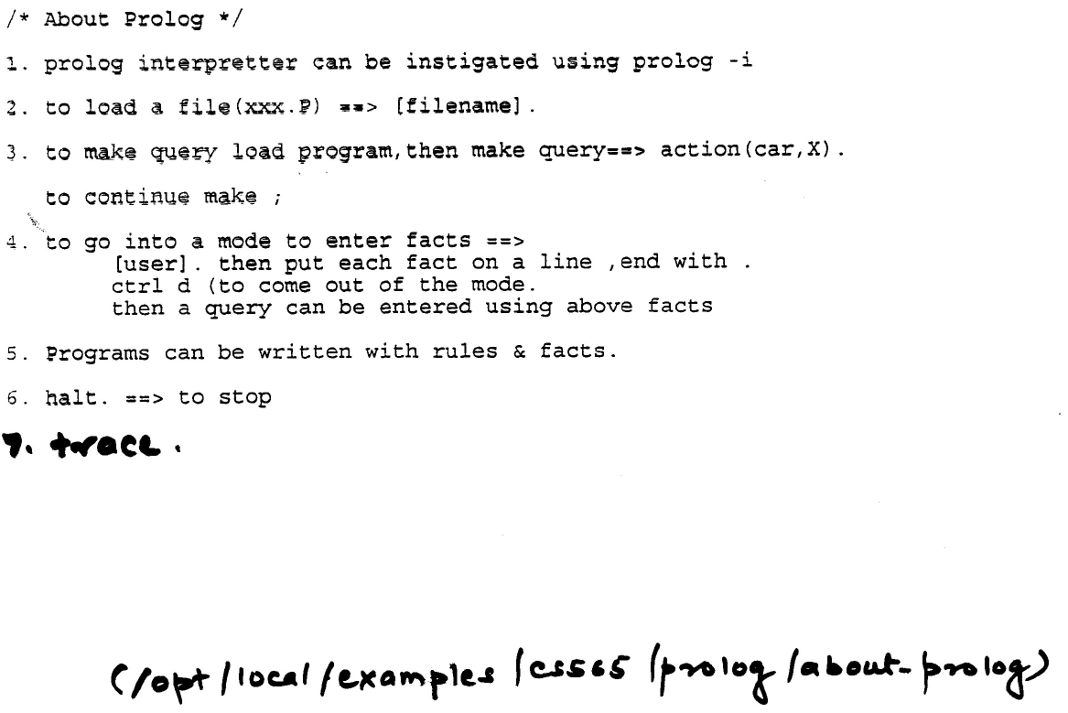
7. trace
/opt/local/examples/rajeev/56500/prolog/about-prolog

Slide 40
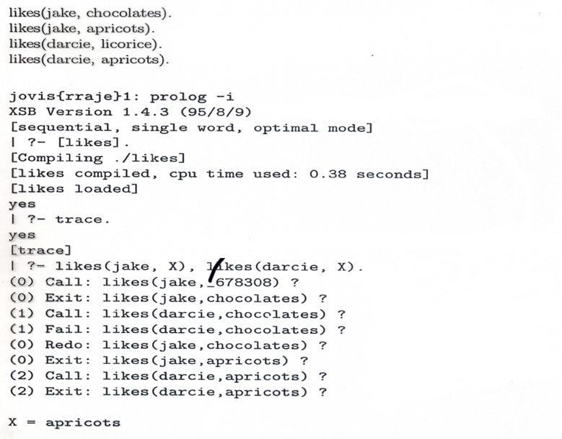
pegasus.cs.iupui.edu{rraje}67: prolog -i
[xsb_configuration loaded]
[sysinitrc loaded]
XSB Version 3.0.1 (Sagres) of August 7, 2006
[i686-pc-linux-gnu; mode: optimal; engine: slg-wam; gc: indirection; scheduling: local]
| ?-
End XSB (cputime 0.01 secs, elapsetime 3.79 secs)
_ → Indicated temporary variable
Call
Fail
likes(jake,X)
Exit
Redo
Call
Fail
likes(darcie,X)
Exit
Redo

Slide 41
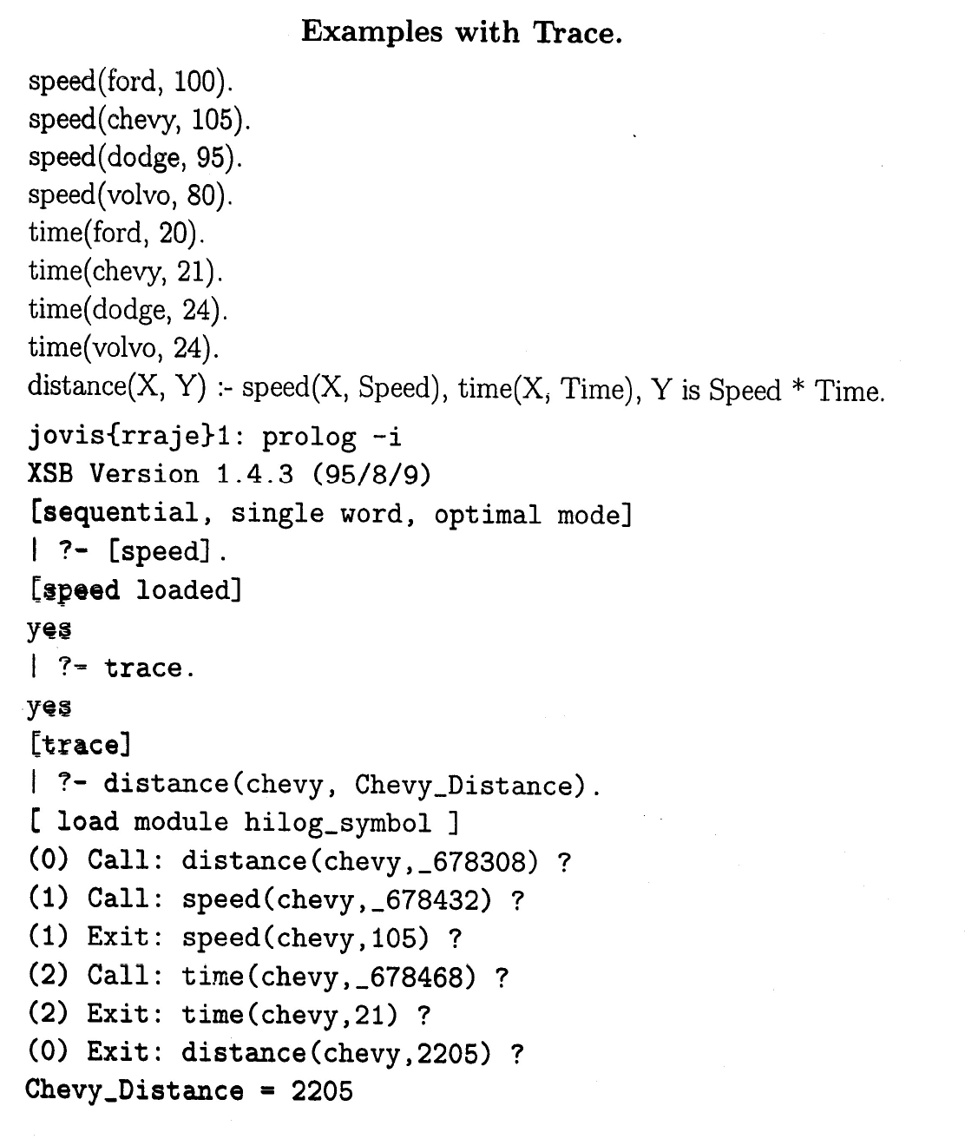

Slide 42
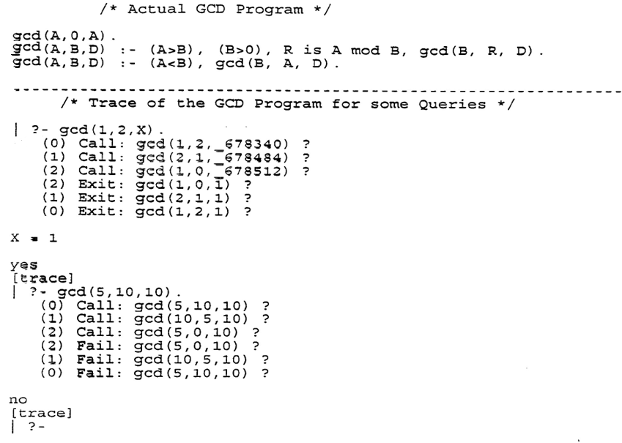

Slide 43
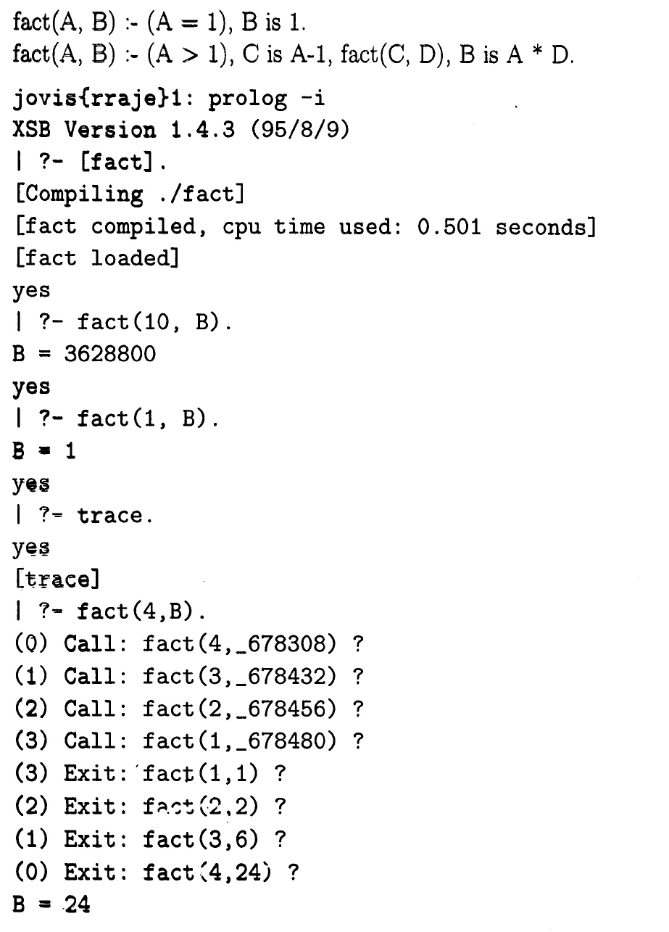

Slide 44
Lists in Prolog
Simplest way of writing a list is to enumerate its elements.
e.g., [a, b, c].
Empty list is written as [].
The initial sequence of elements and a trailing list can be specified by using |.
e.g., [a, b, c | []]
[a, b | [c]]
[a | [b, c]]
All these statements express [a, b, c].

Slide 45
Lists in Prolog (cntd.)
A special case of the notation using | is a list with head H and tail T, written as [H|T]. The head is the first element of the list, and the tail is the list consisting of the remaining elements.
Unification can be used to extract the components of a list, so explicit operators for extracting the head and the tail are not needed.
e.g. ? – [H|T] = [a, b, c].
H= a, T = [b, c]
? – [a|T] = [H, b, c].
H= a, T = [b, c]

Slide 46
Lists
Another basic structure in Prolog.
Similar to the list structure of Lisp.
A list is a sequence of any number of elements, where the elements can be atoms, atomic propositions, or any other terms including other lists.
e.g., [apple, grape, orange, mango]
[] denotes an empty list.
[X|Y] denotes a list with head X and tail Y.
| - used to create a list or dismantle a list.
[john, jake, mary |[ ] ]
[john, jake | [mary] ]
[john | [jake, mary] ]
All are equivalent.

Slide 47
APPEND
.
append( [], List, List).
append( [Head|List_1], List_2, [Head|List_3] ) :-
append( List_1, List_2, List_3 ).
append( [], List, List). – When an empty list is appended to any other list, the result is the other list.
E.g., ( [], [ john, jake, mary] ) → [ john, jake, mary]
(This is the termination condition for the recursion)
append( [Head|List_1], List_2, [Head|List_3] ) :-
append( List_1, List_2, List_3 ).
Appending [Head | List_1] to another list, List_2 results in a new list, whose first element is Head and the tail is List_3 such that List_3 is a result of appending List_1 and List_2.
E.g., Append( [ john | [jake, mary] ],[tom, peter])
Head List_1 List_2
[ john | [jake, mary, tom, peter] ]
Head List_3

Slide 48
THE TERMINATING PROPOSITION IS PLACED BEFORE THE RECURSION PROPOSITION – PROLOG WILL MATCH THE TWO PROPOSITIONS IN ORDER, STARTING WITH THE FIRST (because of the depth-first order).
Membership of an Element
member(Element, [Element| _] ).
member (Element, [ _|List] ) :- member( Element, List ).
The underscore (_) indicates an anonymous variable → we do not care what instantiation it might get from unification.
For element to be a member of a list, it either may be the head of the list
Or
It may be present in the tail of the list
Your assignment
Given a list, reverse the list.
Delete(List1, List2, List3) -> List3 should be such that it is created after deleting List2 from List1.
Prefix([ ], [ ]) -> [ [ ] [ ] ]
- Suffix([ ] , [ ]) -> [ [ ] [ ] ]

Slide 49
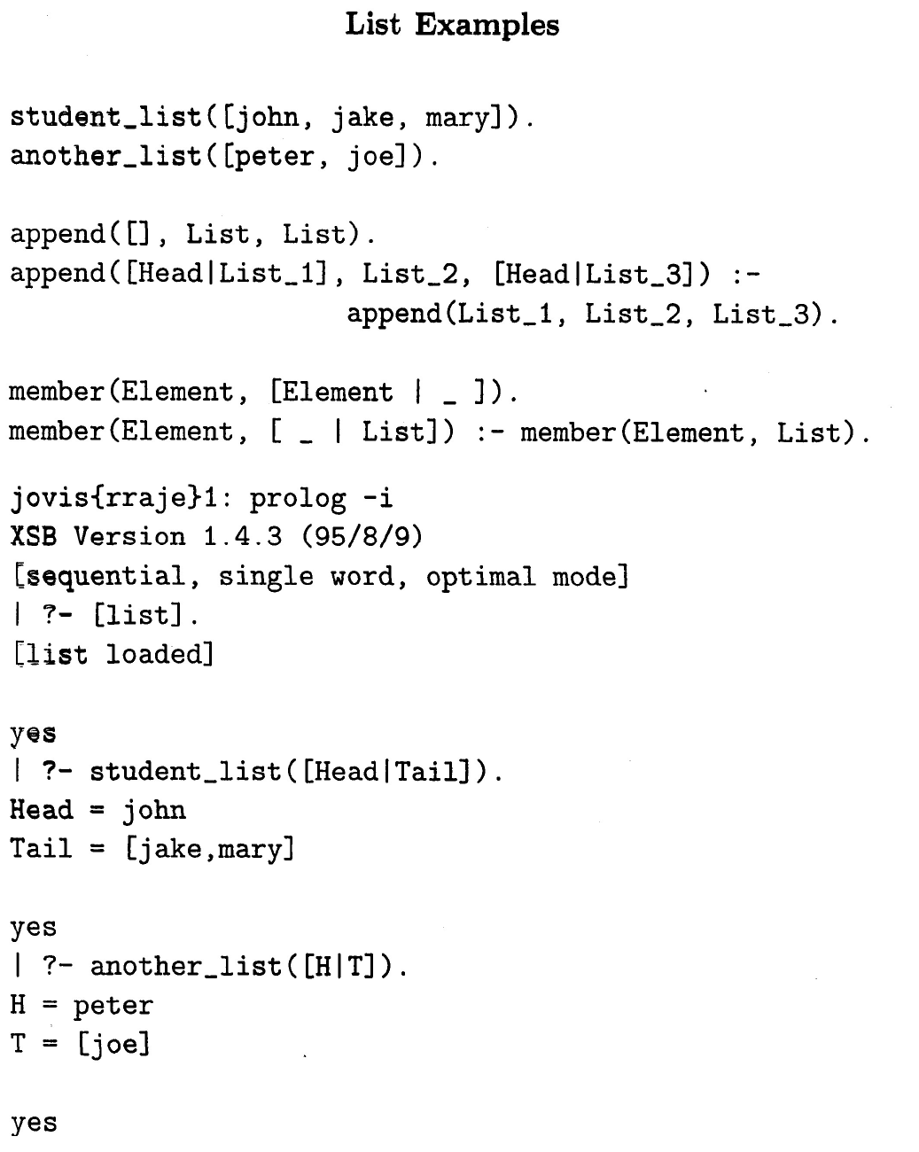

Slide 50
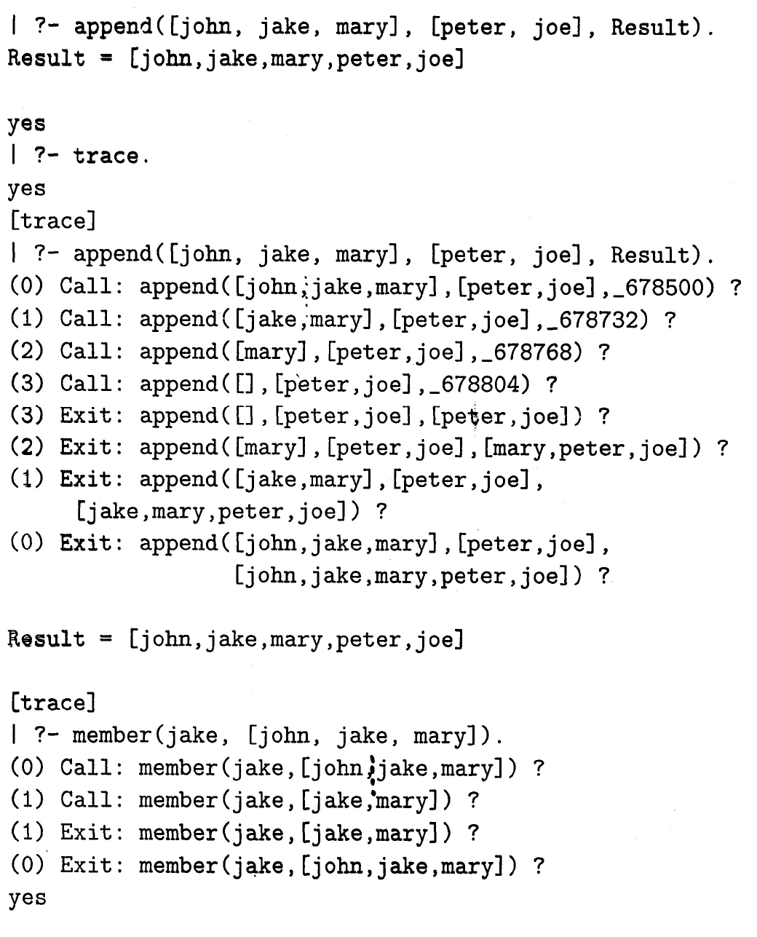

Slide 51
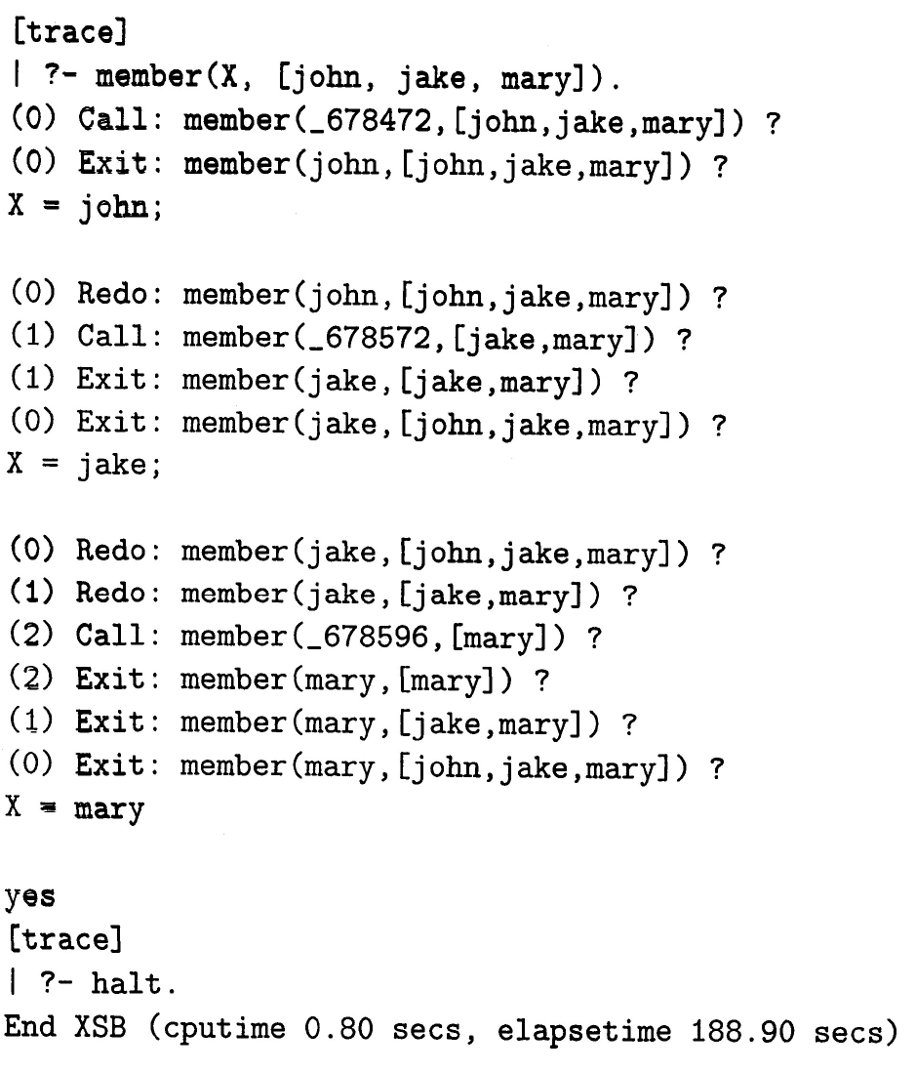

Slide 52
Deficiencies of Prolog – Resolution Order Control
Prolog, for the reasons of efficiency, allows the user to control the ordering of pattern matching during resolution – Matching always starts from the beginning of the database and at the left end of a goal => user can profoundly affect the efficiency by ordering the database statements to optimize a particular application.
Apart from the slowness, the order could even result in infinite loops and/or program failures.
e.g., f(X, Y) :- f(Z, Y), g(X, Z).
This would result in an unending recursion.
ancestor(X, X).
ancestor(X, Y) :- ancestor(Z, Y), parent(X, Z).
This will result in an infinite loop.

Slide 53
CUT Operator
In addition to allowing the user to control the database and subgoal ordering, Prolog allows some explicit control of backtracking. This is done by the CUT(!) operator.
e.g., a, b, !, c, d (If this is the goal)
If a and b succeed but c fails the WHOLE GOAL FAILS! – i.e., if it was known that failure of c will make resatisfying of a or b useless.
a(1) :- b.
a(2) :- c.
b :- c.
b :- d.
d.
e.
Query – a(x)
b
e
Yes
X = 2
c
Back-track
d
Yes
X = 1

Slide 54
CUT Operator
Change the rule b :- c. rule to b :- !, c.
a(1) :- b.
a(2) :- c.
b :- !, c.
b :- d.
d.
e.
Query – a(x)
b
e
Yes
X = 2
cut
!, c
Back-track
d

Slide 55
Negation Problem
parent(bill, jake).
parent(bill, shelley).
sibling(X, Y) :- parent(M, X), parent(M, Y).
? – sibling(X, Y).
X = jake
Y = jake
Need to satisfy, X is a sibling of Y only if they have same parents and X and NOT Y.
sibling(X, Y) :- parent(m ,X), parent(M, Y), not(X=Y).
NOT Operator
NOT is implemented by using CUT(!) and FAIL.
not(X) :- X, !, fail.
not(_).
if X is true, first proposition will fail => not(X) will be false(fail).
if X is false (X fails) => second proposition will succeed => not(X) will succeed.

Slide 56
NOT
Prolog’s NOT operator is not equivalent to a logical NOT operator, in which NOT means that its operand is provably true.
not(not(some_goal)) will be equivalent to some_goal if Prolog’s NOT operator was a true logical NOT.
member(Element, [Element|_]) :- !.
member(Element, [_|List) :- member(Element, List).
member( X, [mary, fred, bob]). → X = mary
not( not (member( X, [mary, fred, bob]) ) )
1) Inner goal would succeed => X = mary
2) Prolog will then attempt to satisfy
not (member( X, [mary, fred, bob]) )
→ would fail because member succeeded.
→ X will be uninitialized.
3) Prolog will then try to prove the not outer goal.
→ would succeed.
→ print X.
→ But X is uninitiated.

Slide 57
NOT
Prolog’s NOT is not equivalent to the logical NOT and can be misleading!
Reason
Horn Clause
A :- B₁ ∩ B_{2 …..} ∩ B_{n}
for A to be true, ALL B’s must be true.
Regardless of the truth or falseness of any or all B’s, it cannot be concluded that A is false – From positive logic, one can only conclude positive logic => the use of Horn clause prevents any negative conclusions.
Intrinsic Limitations
“what and not “how”
e.g. sorted([]).
sorted([X]).
sorted([X, Y|list]) :- X<=Y, sorted([Y|list).
The above sort process has NO idea how to sort, other than simply enumerate all permutations of the given list until it happens to create the one that has the list in sorted order => A VERY SLOW PROCESS!

Slide 58
Closed World Assumption
Prolog considers – the only truths are those that can be proved using its database.
Prolog has no knowledge of the world other than its database.
Any query about which there is insufficient information in the database to prove absolutely is assumed to be false.
Prolog can prove that a given goal is true, but it cannot prove that a given goal is false. It simply assumes that, because it cannot prove a goal true, the goal must be false!
‘Innocent until proven guilty’.
(A trial does not have to prove innocence of a person, rather if the trial cannot prove a person guilty, he/she is considered innocent).

Slide 59
Applications
RDBMS
AI/Expert Systems
NLP

