Slide 1

INTRO TO DATA AND PROGRAMMING -DEFAULT OF CREDIT CARD
BY
MADDINENI.MANASA
DARIEN VIGILANCE

Slide 2
MOTIVATION OF THE PROJECT
The goal is to predict the probability of credit default based on credit card owner’s characteristics and payment history.
With the real probability of default as the response variable (Y), and the predictive probability of default as the independent variable (X), the simple linear regression result (Y = A + BX) shows that the forecasting model produced by artificial neural network has the highest coefficient of determination; its regression intercept (A) is close to zero, and regression coefficient (B) to one.
This project is done using linear regression model and tree model hierarchy
Y = xβ + ξ

Slide 3
The file default of credit card clients.xls contains customers default payments in Taiwan . Each row in the data represents a customer. The goal is to use these data to build a model that will classify the default payment ('Y' in the dataset).
According the UCI Machine Learning Repository website the feature in formation are the following:
" This research employed a binary variable, default payment (Yes = 1, No = 0), as the response variable. This study reviewed the literature and used the following 23 variables as explanatory variables:
X1: Amount of the given credit (NT dollar): it includes both the individual consumer credit and his/her family (supplementary) credit.
X2: Gender (1 = male; 2 = female).
X3: Education (1 = graduate school; 2 = university; 3 = high school; 4 = others).
X4: Marital status (1 = married; 2 = single; 3 = others).
X5: Age (year).
X6 - X11: History of past payment. We tracked the past monthly payment records (from April to September 2005) as follows: X6 = the repayment status in September 2005; X7 = the repayment status in August 2005; . . .;X11 = the repayment status in April 2005. The measurement scale for the repayment status is: -1 = pay duly; 1 = payment delay for one month; 2 = payment delay for two months; . . .; 8 = payment delay for eight months; 9 = payment delay for nine months and above.
X12-X17: Amount of bill statement (NT dollar). X12 = amount of bill statement in September 2005; X13 = amount of bill statement in August 2005; . . .; X17 = amount of bill statement in April 2005.
X18-X23: Amount of previous payment (NT dollar). X18 = amount paid in September 2005; X19 = amount paid in August 2005; . . .;X23 = amount paid in April 2005."

Slide 4
Question 1: Exploratory Data Analysis
Load the libraries
df = pd.DataFrame(pd.read_excel("defaultofcredcard.xls", header = 1))
With this step, we are loading and reading the data. Then, go ahead and know the information of the whole table(3000, 25), so that we could plot the relations between the important parameters such as, counting the default payment next month.
And looking for the correlation between 'PAY_AMT1', 'PAY_AMT2', 'PAY_AMT3', 'PAY_AMT4', 'PAY_AMT5', 'PAY_AMT6’.
Also, Splitting the data into training (80%) and test (20%) datasets.

Slide 5
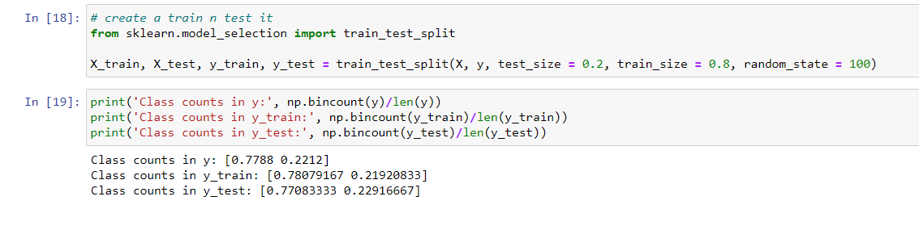

Slide 6
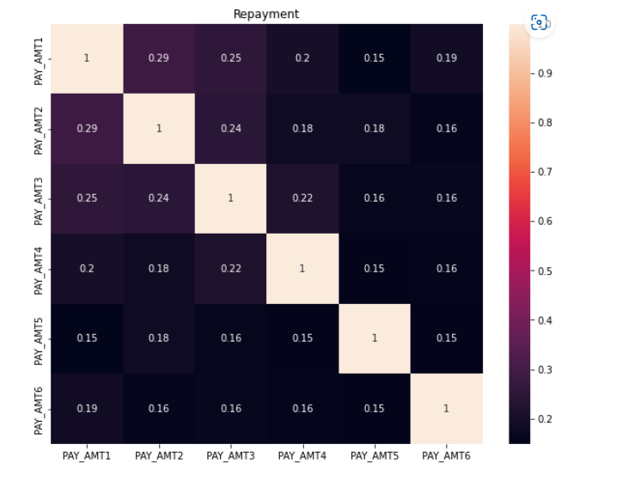
Checking for correlation using Heat map

Slide 7
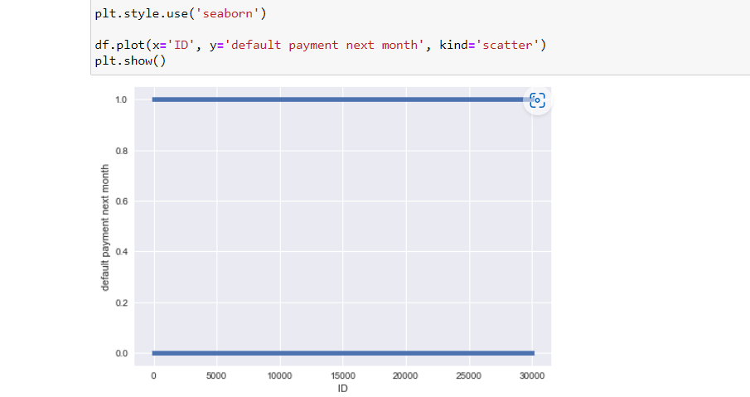

Slide 8
Question 2:
Fitting a classification tree and setting the minimum number of records in a terminal node to 40 and the maximum tree depth to 8 in order to combat overfitting.
Overfitting: Overfitting occurs when a statistical model fits exactly against its training data. When this happens, the algorithm unfortunately cannot perform accurately against unseen data, defeating its purpose.
We first use standardizing and then use linear regression to examine the relationship and determine the model coefficients. Further, use the coefficients from regression for prediction
Using DecisionTreeClassifier means it uses prelabelled data in order to train an algorithm that can be used to make a prediction. Decision trees can also be used for regression problems.

Slide 9
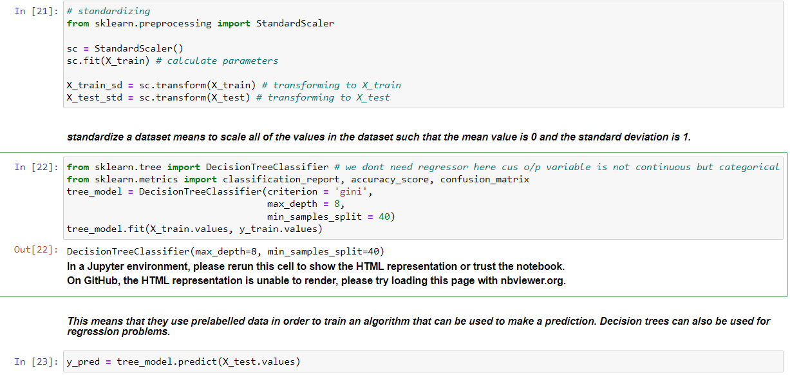
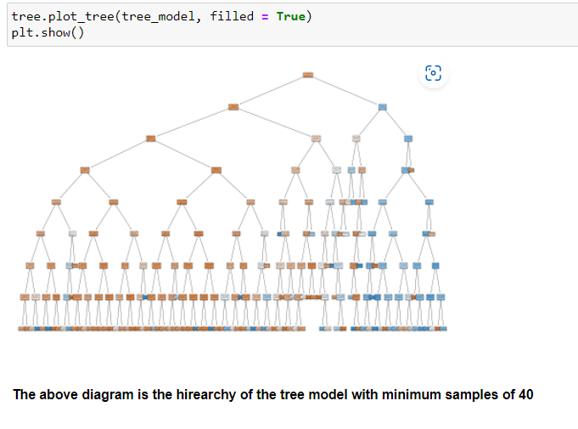

Slide 10
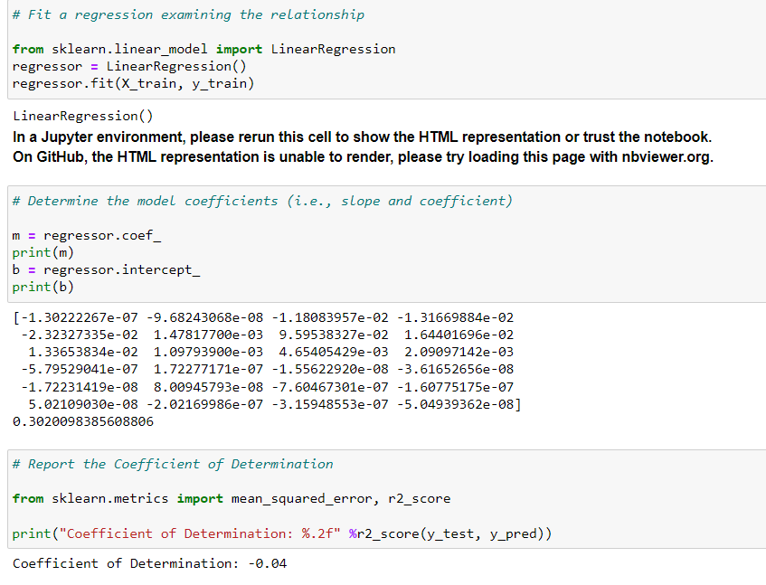

Slide 11
Question 3:
Fitting a different classification tree with a minimum of 100 data per terminal node and a maximum of 8 depths.
And the result we get with 100 nodes per terminal is different from the result we got with 40 records per terminal.
Here, we have analyzed the difference in result of 100 nodes and 40 nodes and also created the hierarchy of variables using tree plot.
And also solving the accuracy and classification report for both of them using DecisionTreeClassifier and classification_report.

Slide 12
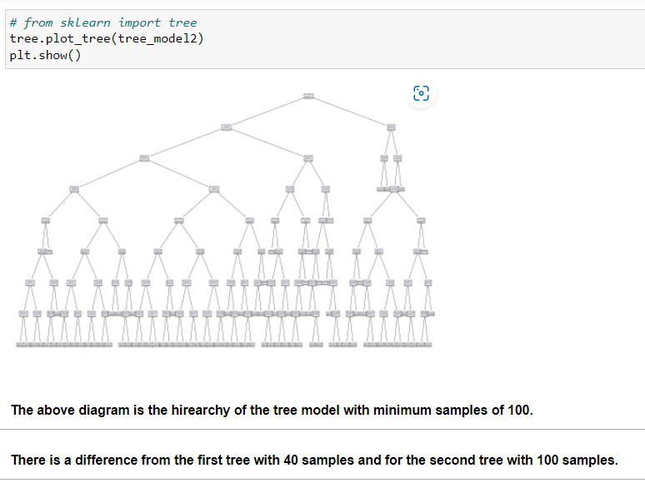
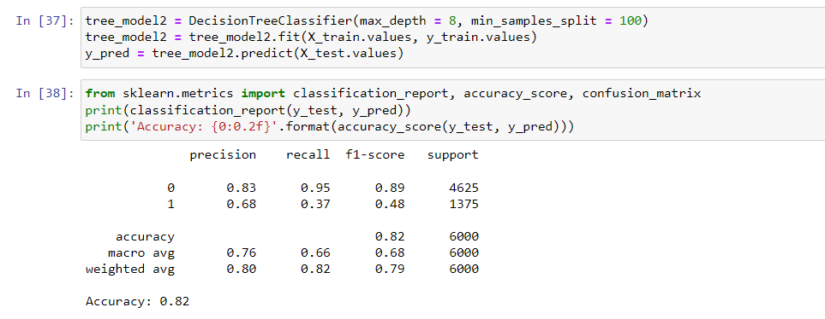

Slide 13
Question 4:
Comparing the findings from various impurity measurements (Gini, Entropy and Classification Error)
Gini Impurity Measurement: This is a measure used for generating classification trees. Information on the distribution of data per node than the classification accuracy used for reporting the tree accuracy.
Entropy and classification error: This is a term used in statistical physics as a measure of how disordered a system is.
​□
 | Measure of Orderness | Measure of Informativeness
Classification | Entropy | Information Gain
Regression | Variance | Correlation

Slide 14
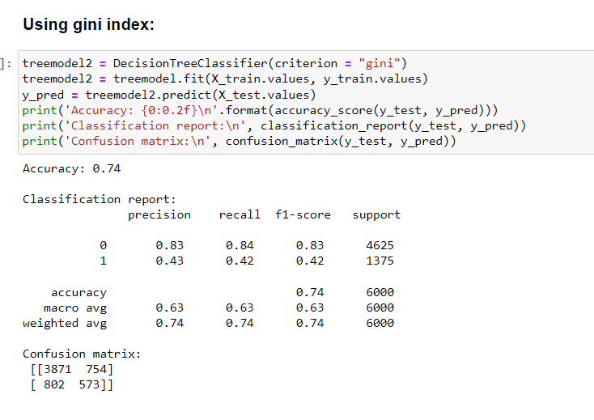
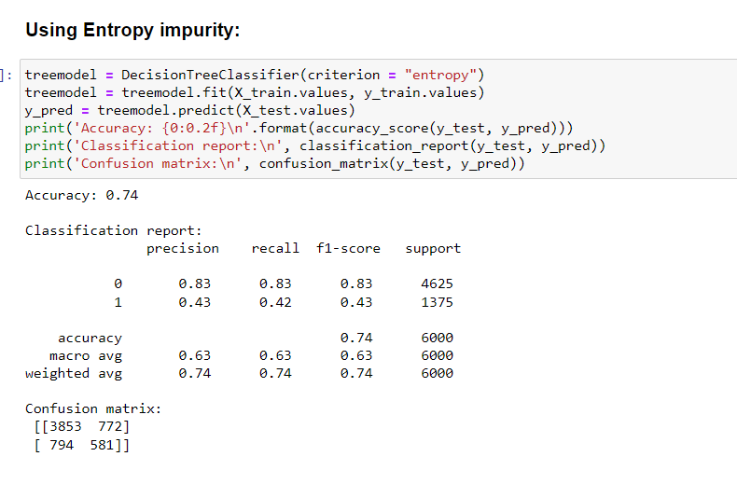
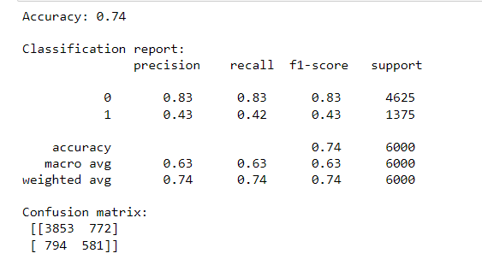

Slide 15
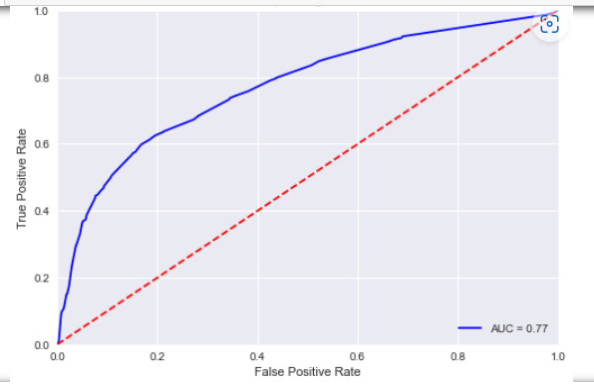
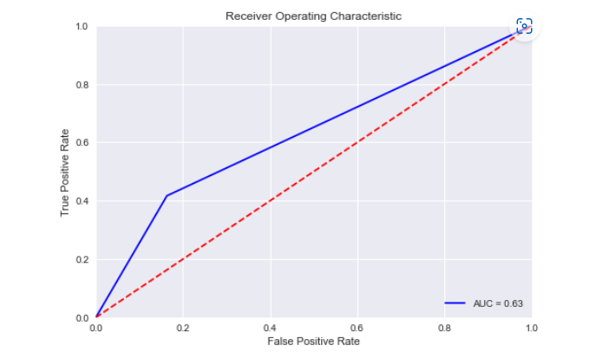
The ROC Curve for tree model of min samples = 100 n 40 respectively

Slide 16

Conclusion:
Using linear regression, tree plots and DecisionTreeClassifier, we have achieved the accuracy and classification report for two types of classification with 100 nodes per terminal and 40 nodes per terminal.
Also, classification report, accuracy and confusion matrix is achieved through gini and entropy impurity measures.
In conclusion, the highest accuracy we got was 82%.
Also successfully achieved graphs of fpr(False Positive Rate) and tpr(True Positive Rate) thresholds of the classification.

