Slide 1
Path Order: 4, 7, 2, 8, 5, 6, 3, 1
Door
Candle 4
Candle 3
DMX:25
DMX:19
Candle 2
DMX:13
6
4
8
Dimmer #1
DMX: 55
DMX: 59
Dimmer #2
7
3
Candle 5
DMX:31
TV Screen
Shamash
5
DMX: 1
2
Computer
Audio Hookup
Candle1 – Ch. 3
Candle2 – Ch. 2
Candle3 – Ch. 6
Candle4 – Ch. 8
Candle5 – Ch. 7
Candle6 – Ch. 5
Candle7 – Ch. 1
Candle8 – Ch. 4
10
1
Candle 1
DMX:7
9
11
12
Participant Entrance
Candle 6
Candle 7
Candle 8
DMX:37
DMX:43
DMX:49
Dimmer #3
DMX: 63

Slide 2
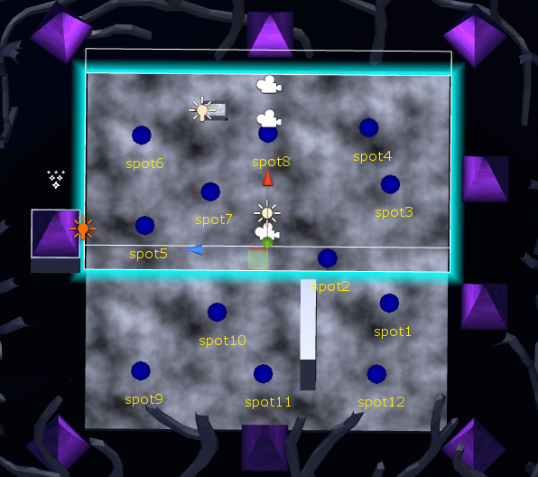

Slide 3
DMX Wiring + Setup
Door
Candle 8
Candle 7
Path Order:
Candle4
Candle2
Candle3
Candle5 -----------
Candle6
Candle8
Candle7
Candle1
DMX:49
DMX:43
Candle 6
DMX:37
Dimmer #2
DMX: 59
Candle 1
DMX:7
Computer
TV Screen
Shamash
DMX: 1
Candle 5
DMX:31
Dimmer #1
DMX: 55
Participant Entrance
Candle 2
DMX:13
Candle 3
Candle 4
DMX:19
DMX:25

