Slide 1
“Between Lands” Design
Proposed Outline of Experience

Slide 2
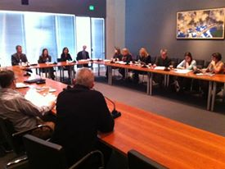
Location: Trustees Room @ MFA
Date: December 9, 2015 5pm – 10pm

Slide 3
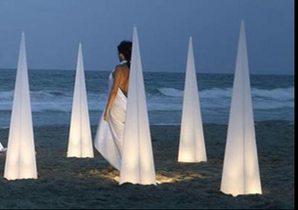
Goal: Illuminate 8 “Candle” Sculptures
Transform room from:
Dark + Mysterious
to
Vibrant + Joyous

Slide 4
Layout of Installation
Entrance
Audience
Audience
Shamash
Audience
Screen with VR Feed
Audience

Slide 5


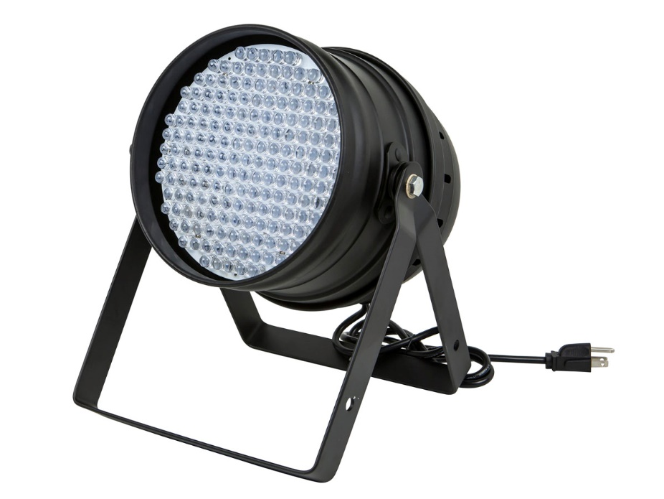
“Candles”
Sculpture
Speaker
RGB Spotlight
+
+

Slide 6
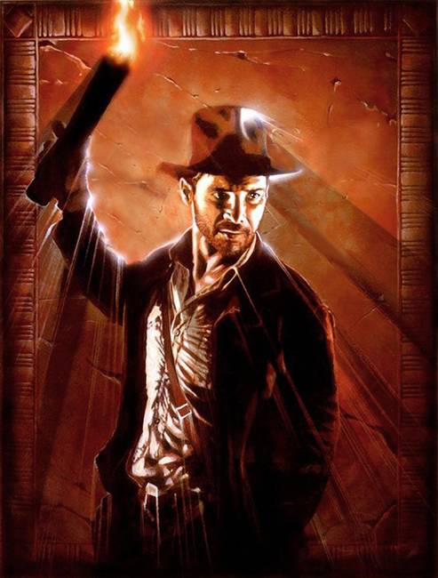
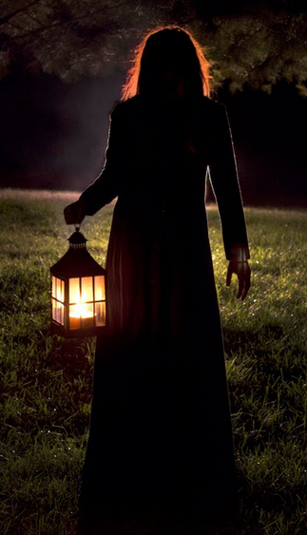

Two Participants
Lights the Candles
Leads the Way
Torch Carrier (in VR)
Lantern Carrier (not in VR)

Slide 7
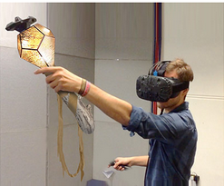
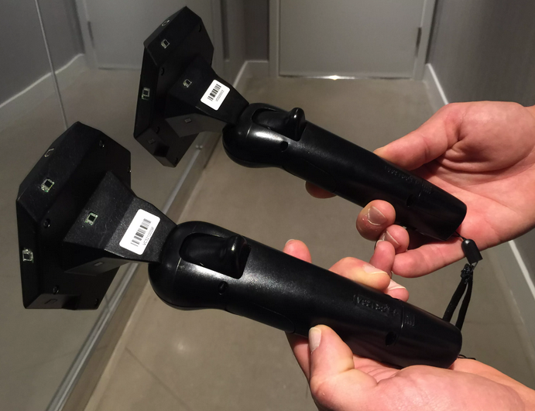
Physical + Virtual Props
Vive Controllers Provide Tracking
Torch Carrier (in VR)
Lantern Carrier (not in VR)

Slide 8



VR player starts out on the edge, with no flame. The “Shamash beacon” shining in the center. They walk down a tunnel in VR towards the light.
ROOM (top-down)
VR

Slide 9
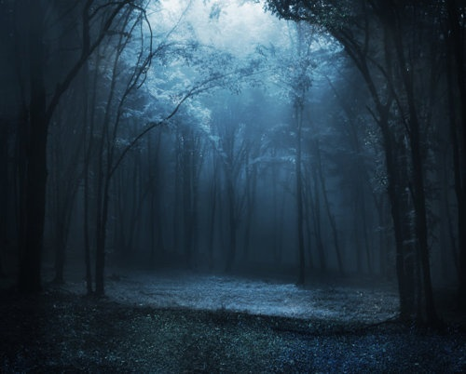
As soon as they near the Shamash, the tunnel transitions away and everything looks open and peaceful

Slide 10
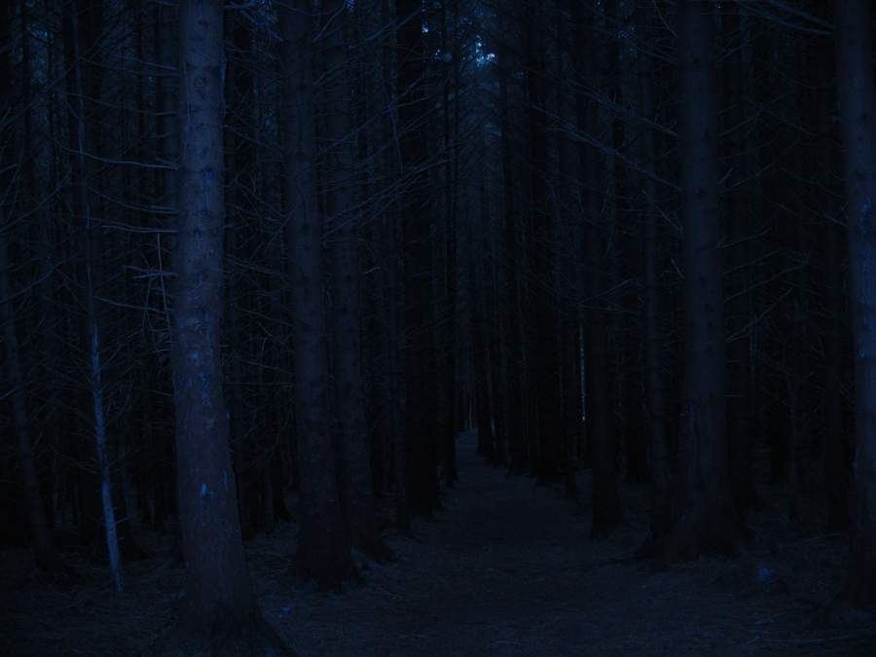
When they light the torch, a glowing path appears in the room (not visible in VR), and a windy dark forest ahead in VR.

Slide 11

It’s a little scary, but comforting to draw glowy trails in front of them by swinging the torch around as they get their bearings

Slide 12


Onward, the lantern carrier has appeared and is there to guide the way!

Slide 13
If the VR person strays too far from the path, their torch blows out. Back to the Shamash to relight!

Slide 14
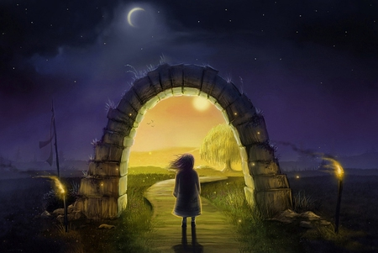
Eventually, a magic door appears in front of the torch carrier

Slide 15
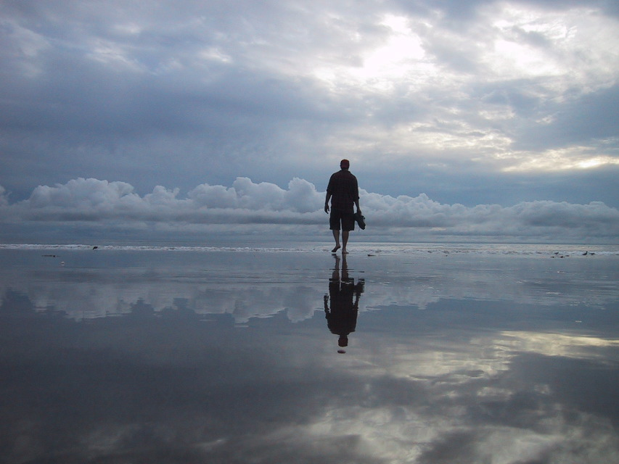
Step through the door and the torch carrier is in another land. There are many ways to go, but the lantern carrier knows the way. Onward!

Slide 16
Eventually, the two near their destination, a door appears!

Slide 17

Back in the dark forest in front of the candle. Now the torch carrier can light it!

Slide 18
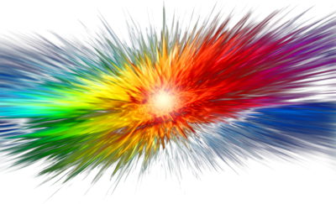

The beacon is lit! A huge burst of light comes from all the beacons. A flourish of color and a new voice begins singing, emanating from the lit beacon.

Slide 19
If time permits, they light the torch again and repeat the same process

Slide 20
If time permits, they light the torch again and repeat the same process

Slide 21
If time permits, they light the torch again and repeat the same process

Slide 22

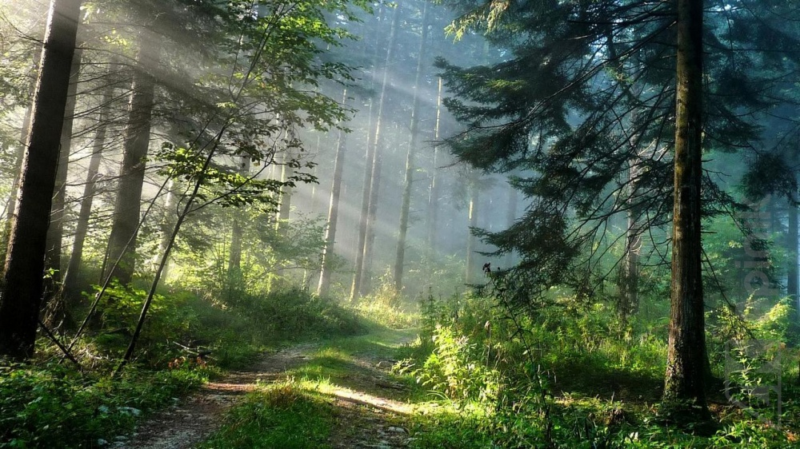
We swap in people until all the beacons are lit and 8 voices are singing. Should take about 20 minutes in total. The room has gone for dark + mysterious to vibrant + joyous

Slide 23
State Diagram
Flame Extinguished
Getting Ready
Seeking Shamash
Near Shamash
Seeking Candle
Through Entrance Portal
Through Exit Portal
Candle Lit
All Candles Lit

