Slide 1
Student-Class Management CRUD API
Documentation Overview - Manikandan M

Slide 2
Core Features
• Student & Class models with Mongoose
• Full CRUD operations (Create, Read, Update, Delete)
• Validation using Joi
• RESTful API with status codes
• MongoDB relationships
• Pagination
• Environment config
• Error handling middleware
• Modular structure
• Postman Collection

Slide 3
Getting Started
• Prerequisites:
- Node.js
- MongoDB
- Postman
• Environment (.env):
PORT=5000
MONGO_URI=mongodb://localhost:27017/student_class_api
• Start:
npm run dev

Slide 4
Project Structure
project-root/
├── models/
├── controllers/
├── routes/
├── config/
├── middleware/
├── app.js
├── server.js
├── .env
└── postman_collection.json

Slide 5
Database Models
Student Model:
• name (String)
• email (String, unique)
• age (Number)
• classId (ObjectId)
Class Model:
• name (String)
• standard (String/Int)
• students (Array of ObjectId)

Slide 6
API Endpoints - Classes
GET /api/classes
GET /api/classes/:id
POST /api/classes
PUT /api/classes/:id
DELETE /api/classes/:id

Slide 7
API Endpoints - Students
GET /api/students
GET /api/students/:id
POST /api/students
PUT /api/students/:id
DELETE /api/students/:id

Slide 8
Error Handling
• Centralized middleware
• Joi for validation
• JSON error format:
{
"success": false,
"message": "Validation failed",
"errors": [{ "field": "email", "message": "Email must be valid" }]
}

Slide 9
Postman Collection
• File: Student-Class-CRUD-API.postman_collection.json
• Steps:
1. Open Postman
2. Click Import
3. Upload the JSON file
Tip: Create a class before adding students (use classId)

Slide 10
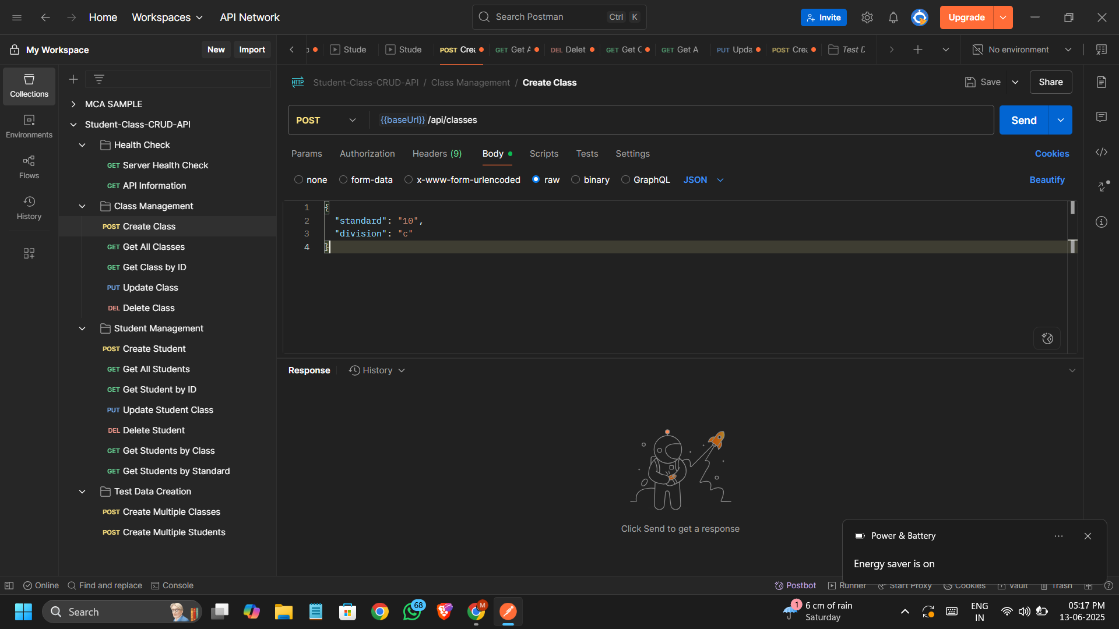
Postman Overview

Slide 11
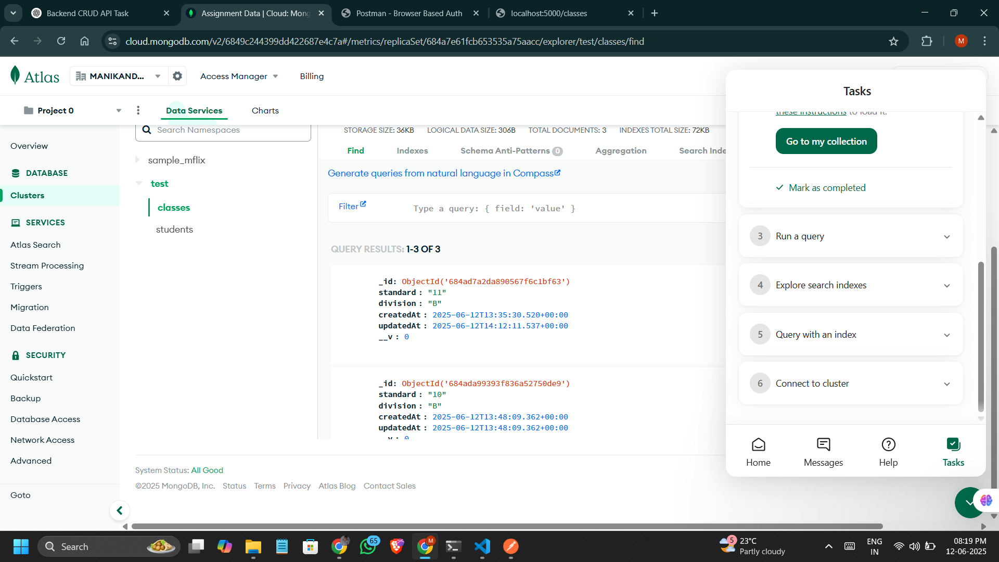
Class detail

Slide 12
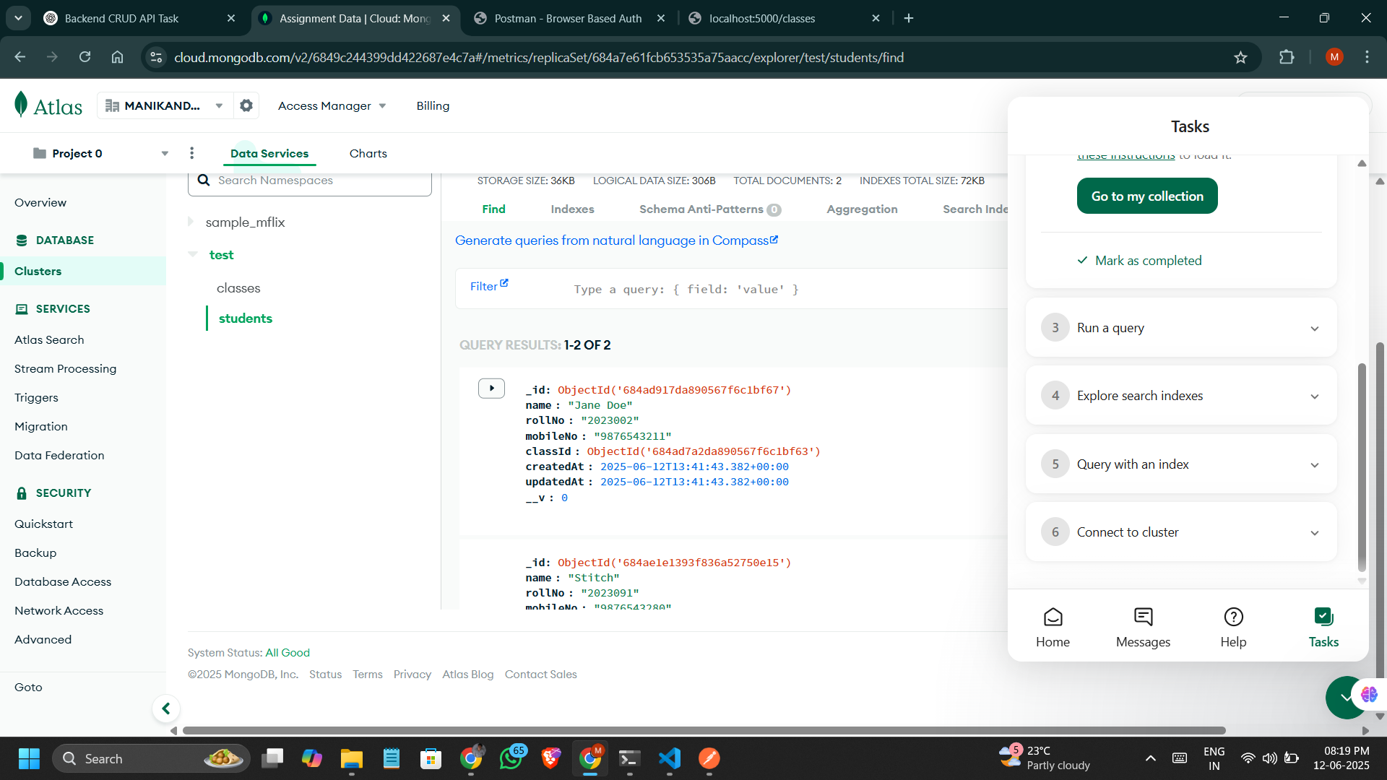
Students Details

Slide 13
Author
Created by Manikandan M
Thank You

