Slide 1
Parallel BFS for Mapping out Trajectories of Charged Defects in 4H-SiC
Rodrick Kuate Defo and Richard Wang
Harvard University

Slide 2
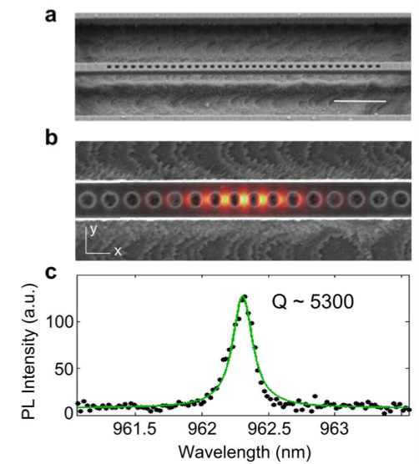
Motivation
Usefulness of defect
Nitrogen vacancy centers in diamond have potential as a system for implementing memory storage for a quantum computer.
We look at defects with similar properties in related materials such as SiC.
Process
Create defects in SiC with ion beams and heal damage by annealing.
Annealing causes movement and loss of defects. The goal is to find out the probability that the defects end up in a certain position after a certain number of time steps.
D. O. Bracher et al. arXiv:1609.03918 (2016)

Slide 3
Challenges
1D – Random Walk
Random Walk in 4H-SiC
2D – Random Walk
Observation
Defect transitions to different positions in the crystal can be mapped to a 12-ary tree
Depending on the number of layers of the tree, we would have a correspondingly large space to explore

Slide 4
Solution
Consider a sequential traversal of the tree with BFS in the semiring model
This is easily parallelizable using OpenMP pragmas (and with a little more work we can construct fast MPI-OpenMP hybrids)

Slide 5
Results

Slide 6
Thank you!

