Slide 1
BDD In Javascript
Using Jasmine
A Javascript BDD Framework

Slide 2
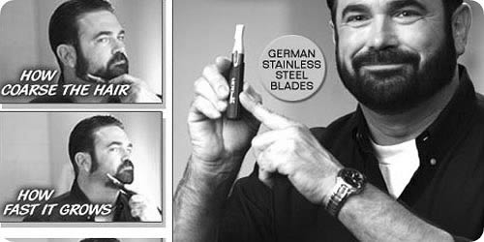
What is BDD
No, its not German engineered stainless steel blades, but it is statements that describe interactions between components in your software

Slide 3

An Example
To Ze Code

Slide 4

Could This example have been written faster and better using BDD

Slide 5

BDD to the rescue

Slide 6
Jasmine Building Blocks
matchers
spies
describe
it
before / after
spec.html

Slide 7

An Example using BDD
To Ze Code

Slide 8
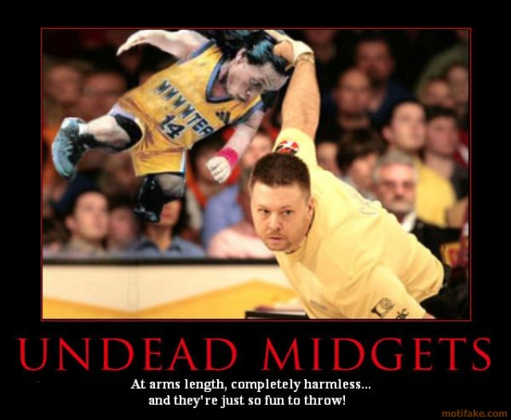
Exercise

Slide 9


Lets Go Bowling
Rules:
1. Highest score is 300
2. Total of 10 frames
3. Two Bowling attempts in each frame
4. A Spare is scored by adding 10 to the number of pins knocked down in the first bowl in the next frame
5. A Strke is scored by adding 10 to the total number of pins knocked down in the next frame

