Slide 1

Floods & Death Toll
Academic Thesis
MSc in Management - Business Analytics Supervisor: Professor Valérie Chavez-Demoulin Expert: Professor Eric Jondeau
Manunpat Sirijaturaporn
Notes:
Good morning,
Before we start, I would like to say thank you to both of you as well as Professor Linda. Your expertise and kind support have been essential to this work. This work wouldn't have been completed without your contributions.
Disasters are knocking louder on our doors than ever before. In just the first half of this year, Europe faced floods and wildfires in many regions. Meanwhile, North America was hit by several tornadoes and thunderstorms. In Asia, many regions were hit by floods and heatwaves. The economic loss is already higher than the average losses of the past decade.
And I can't help but recall, just a decade ago, my hometown, Thailand was hit by one of the worst floods where the total area under the water was equal to the entire size of Switzerland.
I mean our world is changing. This is why I am interested in this topic.
Drawing inspiration from Climate-Related Disasters and the Death Toll paper, this thesis explores how carbon emissions and GDP per capita are associated with flood events.
Through robust methods like Extreme Value Theory and trusted sources like EM-DAT and IPCC databases, we shed light on these complex connections.
The study reveals interesting findings: flood patterns and severity are influenced by carbon dioxide emissions and economic status.
Projections open up valuable avenues for risk reduction strategies and research in vulnerable regions.
-----------------------------------------------------------------------------------------------------------------------------------------------------------------------------------------------------------
2 mins 30 sec

Slide 2

Table of contents
01
04
02
05
03
Understanding Floods
Results
Exploring Floods and Assumptions
Frequency, Severity, Annual Deaths, World
Data Dive
Closing Remarks
Summarizing Data, Regions, Scenarios, and Exploration
Conclusion, Limitations, and Future Study
Analytical Framework
Focused Methods
Notes:
We will go through all the topics together starting from Understanding floods to Closing Remarks
---------------------------
01 + Opening 5mins
02 5 mins
11mins
03 2 mins
04 10 mins
05 4 mins
Total 26 mins

Slide 3
01
Understanding Floods
Exploring Floods and Assumptions
Notes:
First, we'll take a closer look at floods and explore the underlying assumptions made in this paper.

Slide 4

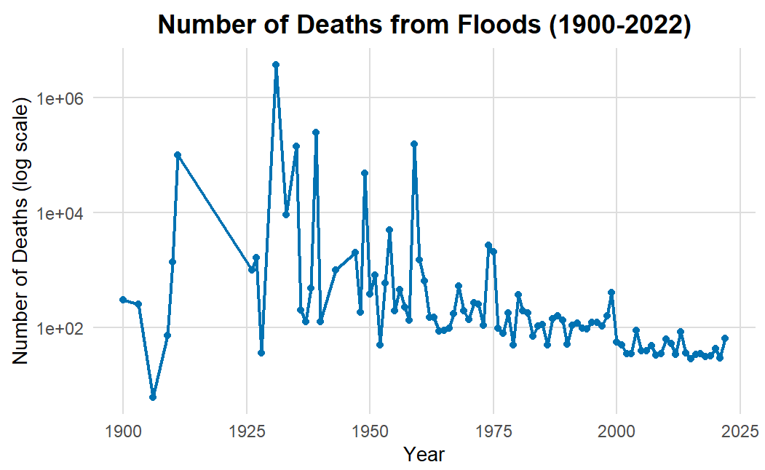
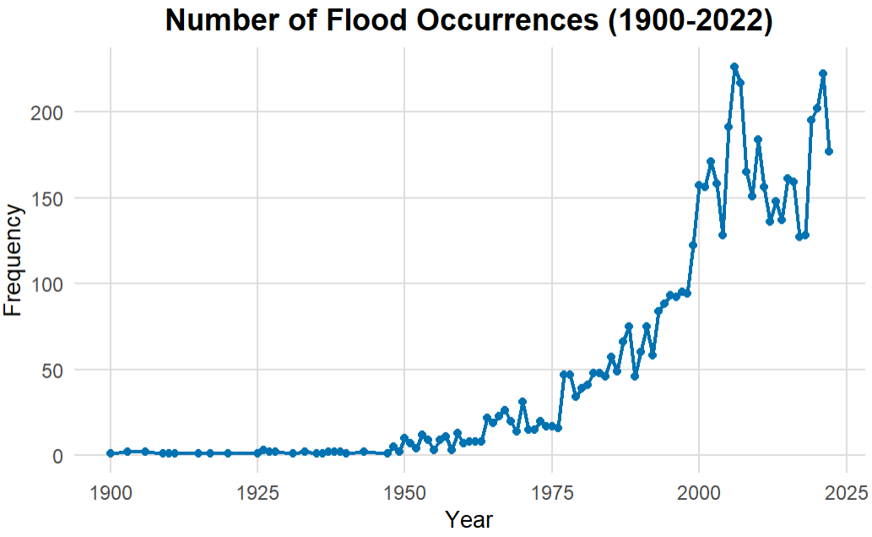
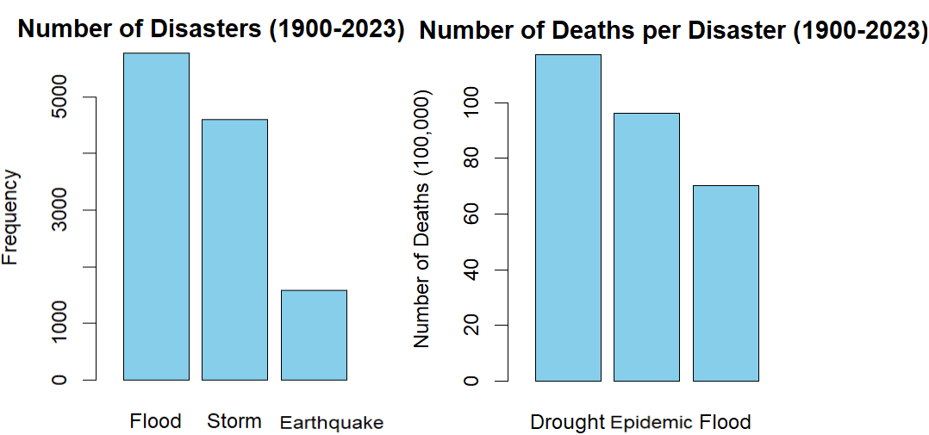
Exploring Floods
01 Understanding Floods
Floods rank the 1st in Frequency, the 3rd in Fatality among Disasters
Average Death per Flood event (1900-2022)
Notes:
Floods are the most frequent disaster and rank third in fatalities among disasters, making them a global issue.
Let’s look at the historical global flood data from 1900 to 2022. We see an upward trend, especially after the mid-20th century, with an estimated count of around 10 floods in 1950, to more than 100 floods by the year 2000.
If we look at the average deaths per flood event during the same time period, we can see a downward trend. In 1950, the average death toll fluctuated between 100 to 10,000. Then it reduced to less than 100.
From these 2 charts, we can say that both are non-stationary.
----------------------------------------------------------------
1 min

Slide 5
Assumptions
01 Understanding Floods
Assumption | Covariate | Model
Frequency: The increase in flood frequency is attributable to climate change | CO₂ emissions per capita | Poisson Distribution
Severity (Death Toll): 1. The growing population leads to a rise in the number of deaths | - | Generalized Pareto Distribution
2. As national income rises, advanced disaster risk management strategies develop, subsequently reducing the number of deaths | GDP per capita
Notes:
Moving on to the underlying assumptions.
First, flood frequency, we make an assumption that the increase in flood frequency is related to climate change.
To explore this, we consider CO2 emissions per capita, which is a key greenhouse gas driving climate change, as a factor that might influence flood frequency
and use the Poisson distribution model to predict future flood frequencies.
Second, severity or nb of deaths, we work with two assumptions which are
Nb of death increase due to the increasing population AND
An increase in national income correlates with the development of disaster risk management, which in turn, tends to mitigate the number of deaths per event.
To forecast the death per event, we employ the Generalized Pareto Distribution model.
--------------------------------------------
1 min

Slide 6
02
Data Dive
Summarizing Data, Regions, Scenarios, and Exploration
Notes:
In the second section, we'll dive into data and embark on an exploration of data analysis
--------------------
5mins

Slide 7
Summarizing Data
02 Data Dive
Source | Variable | Type
EM-DAT (Emergency Events Database) | 1. Death per flood event 2. Annual flood frequency | Historical (1960-2020)
World Bank Open Data | 1. CO₂ emissions per capita 2. GDP per capita 3. Population | Historical (1960-2020)
IPCC (Cooperation between the International Institute for Applied Systems Analysis and the Intergovernmental Panel on Climate Change) | 1. CO₂ emissions 2. GDP 3. Population | Projection (2030, 2040, 2050)
Notes:
We gather information from 3 sources:
The Emergency Events Database or EM-DAT provides “death per flood event and annual flood frequency from 1960 to 2020”
World Bank data offers insights into historical CO2 emissions per capita, GDP per capita, and population.
While the predicted CO2 emissions, GDP, and population in 2030, 2040, and 2050 are from IPCC
--------------------------------------------------------------------------------------------------------------------------------------
30 sec

Slide 8
Summarizing Regions
02 Data Dive
Europe & Central Asia
North America
Latin America & Caribbean
East Asia & Pacific
Middle East &
Africa
South Asia
Notes:
And we will analyze flood frequency and death toll in the aspect of these 6 regions

Slide 9
Summarizing Scenarios
02 Data Dive
IPCC projections present five focused Shared Socioeconomic Pathways (SSPs) scenarios, depicting
plausible future socio-economic developments
Scenario | Description
SSP1-1.9 | Sustainability: very low GHG emissions: CO2 emissions cut to net zero around 2050
SSP1-2.6 | Sustainability: low GHG emissions: CO2 emissions cut to net zero around 2075
SSP2-4.5 | Middle of the road: intermediate GHG emissions: CO2 emissions around current levels until 2050, then falling but not reaching net zero by 2100
SSP3-7.0 | Regional rivalry: high GHG emissions: CO2 emissions double by 2100
SSP5-8.5 | Fossil-fueled development: very high GHG emissions: CO2 emissions triple by 2075
Notes:
We focus on these 5 scenarios as presented in the IPCC's AR6 report due to their priorities.
The SSP1 to SSP5 is a development from the most to the least sustainability.
---------------------------------------------------------------
30 sec

Slide 10
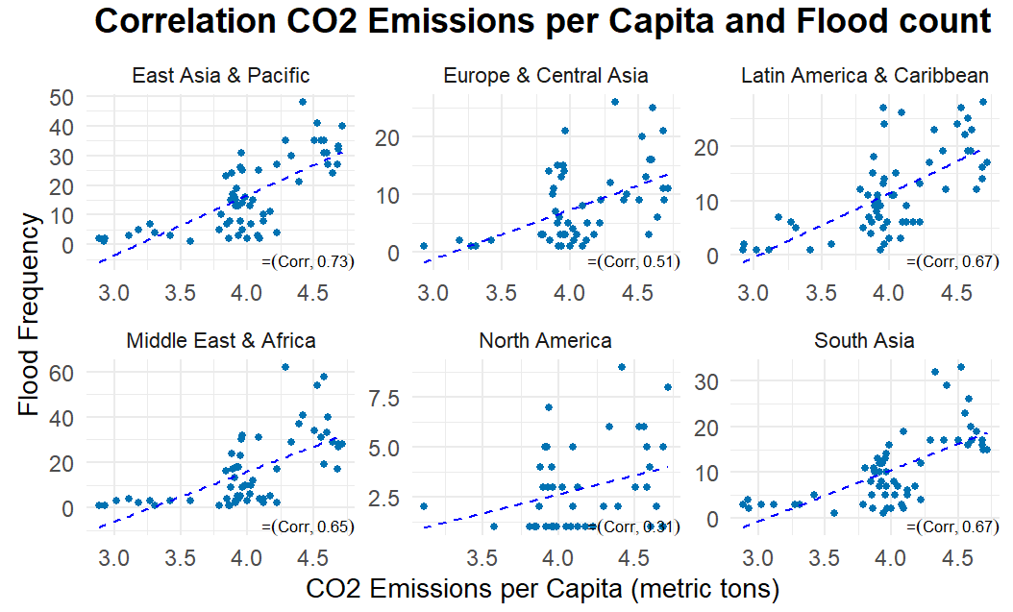
Exploratory Data Analysis - Historical data
02 Data Dive
Flood Frequency
Notes:
In the exploratory analysis, regarding the first assumption in flood frequency, we start with a correlation plot between historical CO2 emissions per capita and flood count.
All regions show a positive correlation, meaning that higher CO2 emissions are linked to increased flood frequency.
And 4 regions, mainly developing countries, display strong correlations.
----------------------------------------------
30 sec

Slide 11
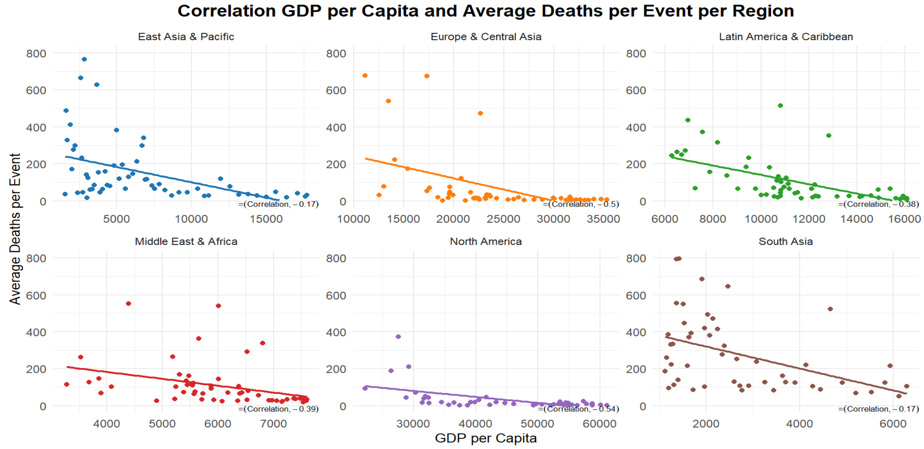
Exploratory Data Analysis - Historical data
02 Data Dive
Severity (Death Toll)
Notes:
We then analyze the correlation between historical GDP per capita and the average deaths per event per region.
The chart reveals a negative correlation between GDP per capita and average deaths per flood event for all regions.
As a country's GDP per capita increases, average deaths decrease.
This highlights economic growth's potential role// in enhancing disaster response //which aligns with our assumption.
-----------------------------------------------------
30 sec
We use rescaled death numbers, normalizing death tolls to the 2020 population for fair comparisons across years.

Slide 12
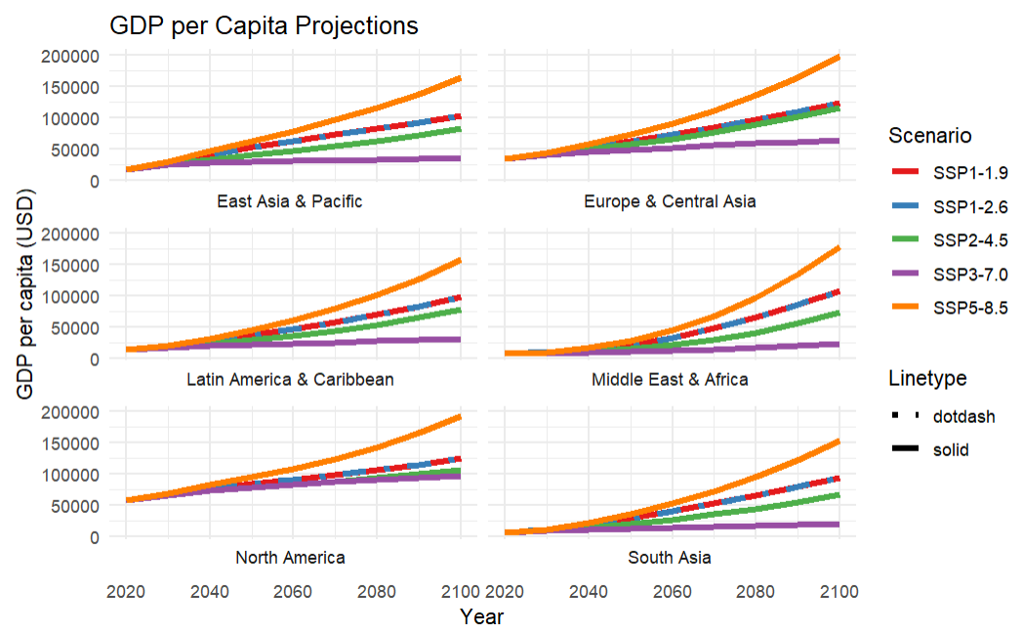
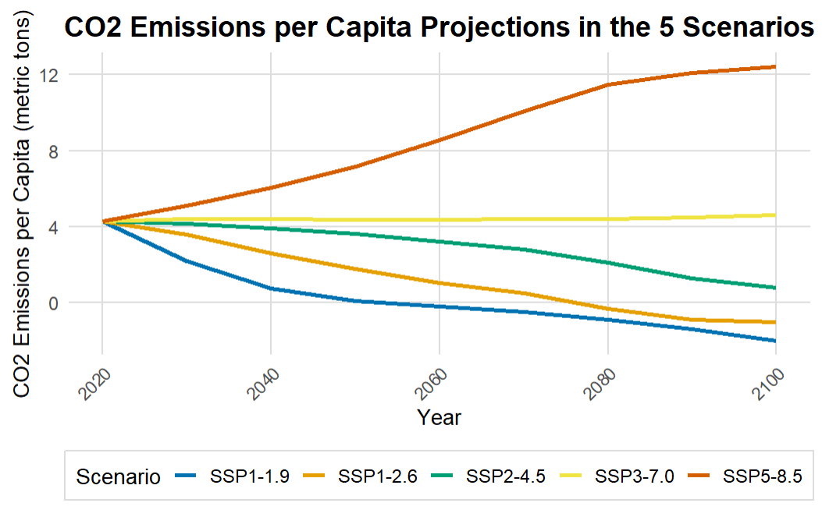
Exploratory Data Analysis - Projections
02 Data Dive
Notes:
Now, let's look at the projected data. We plot CO2 emissions per capita for five scenarios, from 2020 to 2100.
We can see: First, a decrease in SSP1 and SSP2, showing reduced CO2 emissions per capita as they shift toward sustainability. However, there are negative values after 2050 in SSP1, leading us to limit analysis to 2050.
Second, a significant increase in SSP5, indicating a three-time surge. A challenge for climate change mitigation and policy planning.
Third, SSP3 displays stable CO2 emissions per capita, representing a consistent trajectory.
----------------
Next, we analyze projected GDP per capita time series for each region.
We can see: SSP5 is the highest GDP growth across all regions. Reflects a world emphasizing economic development over environmental concerns.
SSP1: Despite CO2 reductions, the second-best GDP growth. Balances sustainability and economic growth by fostering green innovation.
Then the SSP3: the Lowest GDP growth. Reflects limited international collaboration, slowing down economic advancement and environmental progress.
-------------------------------------------------------
1 min 30 sec

Slide 13
03
Analytical Framework
Focused Methods
Notes:
In the third section, we will talk about processes and methods in use
---------------------------
2mins

Slide 14



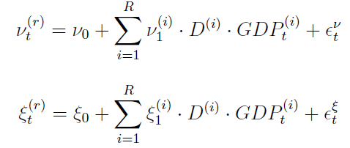


Focused Methods
03 Analytical Framework
Occurrences of rare events
Poisson Distribution
Frequency
Annual Death
Generalized Pareto Distribution
Average Death
Per event
Rescaled
Extreme Value Theory
Notes:
Referring to our assumptions, our focus is on flood frequency and death toll.
Poisson distribution is commonly used to model occurrences of rare events.
Considering our historical non-stationary flood data and its correlation with CO2 emissions per capita, we apply regression to estimate the Poisson distribution's parameter, namely lambda.
The estimated lambda represents the expected flood count per year.
We apply Extreme Value Theory to analyze death tolls per event //due to the heavy right tail in historical data. This theory is well-matched for big tail distributions.
And Generalized Pareto Distribution is a common method to analyze the tail of any distribution. So, it’s suitable for our analysis.
Similar to the frequency analysis, historical average deaths per flood event exhibit non-stationarity and correlation with GDP per capita.
In this case, we use GDP per capita as an explanatory variable to estimate parameters of G Pareto dist.
These parameters determine the expected value of GPD, representing the average death per event.
We then rescale this value by eliminating the influence of the reference year 2020.
Combining the expected values from both distributions, we can derive the annual death toll.
----------------------------------------
2 mins

Slide 15
04
Results
Frequency, Severity, Annual Deaths, World
Notes:
Move on to the results section. I’ll present in terms of regional and global perspectives by focusing on flood frequency, average deaths per flood event, and annual death toll.
-----------------------------------------------------------------
Before going through this section: Time left should be 25-11=14
Total 10 mins

Slide 16
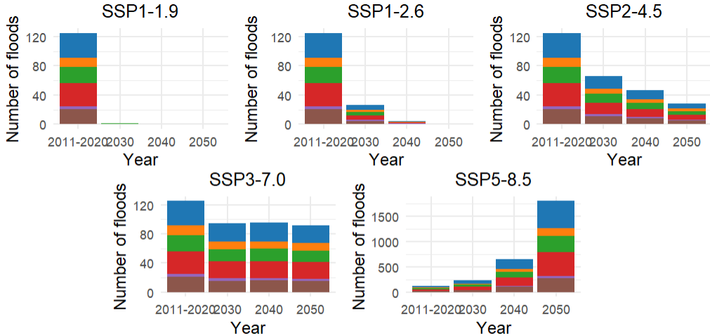
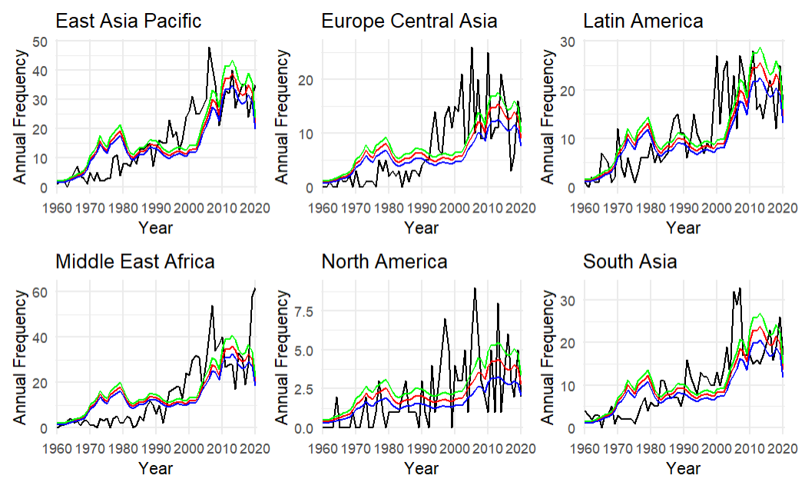
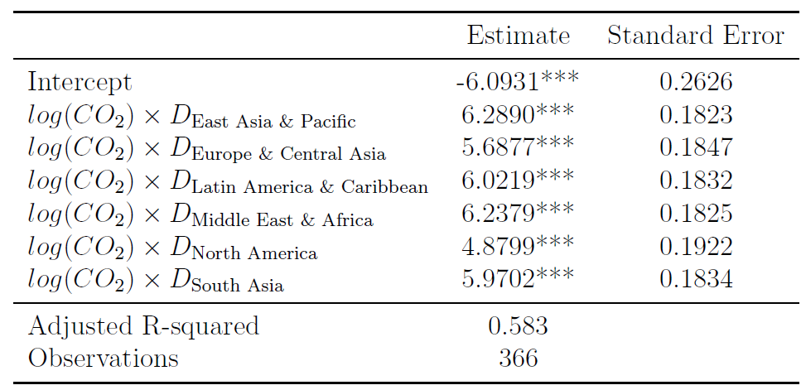

Frequency
04 Results – Regional perspective
Projections of Frequency of Flood
Projections
Estimation Results
Frequency of Flood from 1960 to 2020
Parameter estimation of the Poisson-Frequency model: *** p<0.001, ** p<0.01, *p<0.05
Notes:
First, we start with frequency in a regional perspective. We obtain estimated outcomes from historical data and the Poisson model.
The results indicate a positive and statistically significant relationship between flood frequency and world CO2 emissions per capita across all regions, at the 99.9% confidence level.
The adjusted R-squared of 58% confirms the model's ability to explain the variance.
The coefficient explains the percentage change in flood frequency associated with a 1% increase in world CO2 emissions.
For instance, a coefficient of 6.2890 for East Asia & Pacific suggests that a 1% increase in world CO2 emissions corresponds to a 6.2890% increase in flood frequency in East Asia Pacific.
-----------------------------------------
Then we plot actual flood frequency compared to the expected flood counts from the model.
The model tends to overestimate at the early stage of the time series particularly low frequency, followed by underestimations around the midpoint of the time series.
However, the model’s improved in recent years for some regions such as East Asia Pacific, Latin America, and South Asia.
It's important to note that the model’s performance is relatively weaker for the North America region, due to a limited sample size.
-----------------------------------------
We present the projected flood occurrences 5 scenarios, starting from the reference base year and extending to 2050. The reference base year is an average flood counts from 2011-2020
In SSP1 and SSP2 scenarios, we predict a decline in flood occurances across all regions.
Meanwhile, the SSP3 scenario suggests a modest decrease in flood occurrences over the years.
In contrast, SSP5 uniquely anticipates a significant increase in flood occurrences.
The results correspond to the projected CO2 emissions per capita in the EDA section.
-------------------------------------
4 mins

Slide 17
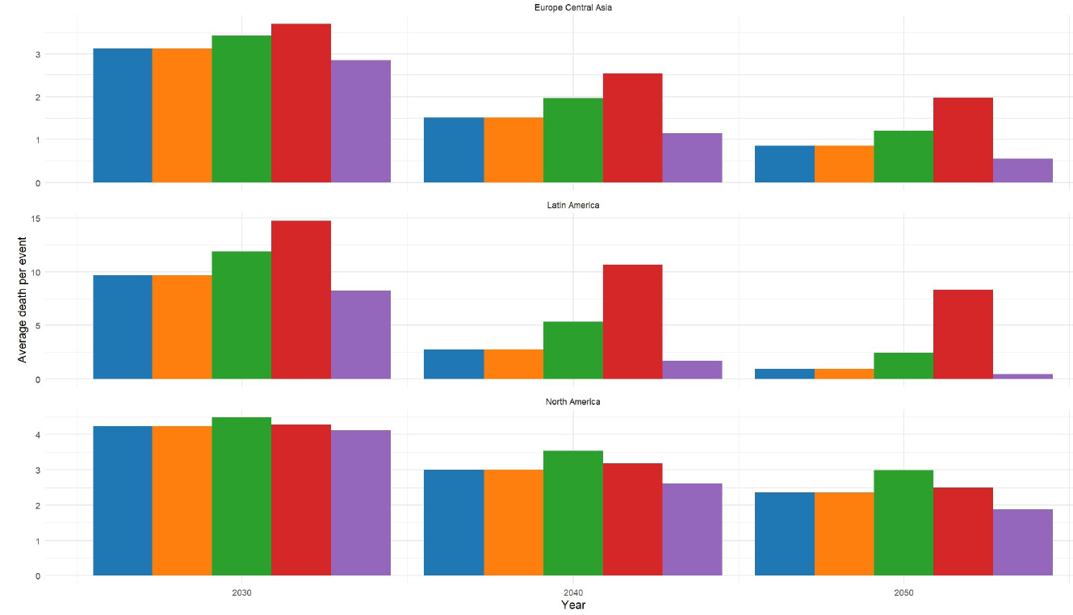
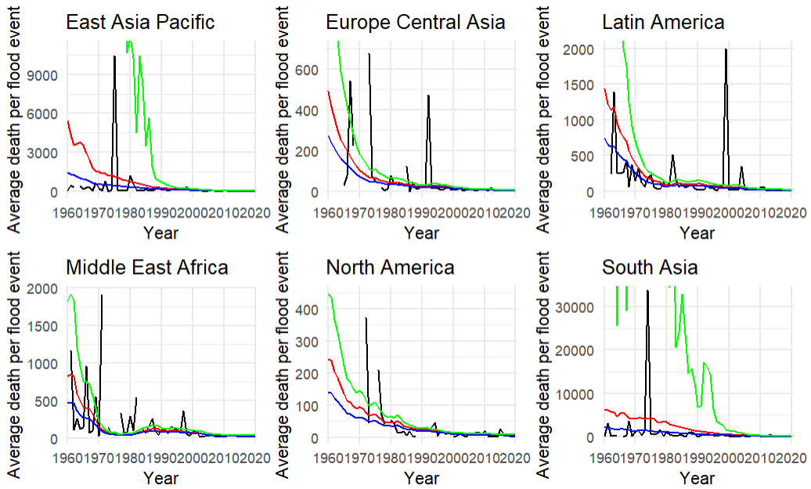
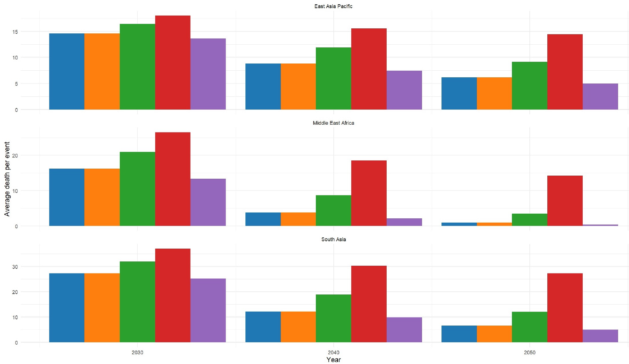
Severity – Average Death per flood event
04 Results – Regional perspective
Projections
Average Death per Flood event from 1960 to 2020
Estimation Results
Projections Average Deaths per Flood event
Notes:
Then, we move to the severity in a regional perspective.
Similar to the frequency, we plot the actual average death per flood event compared to the average death per event predicted by the model.
While estimating the tail index for East Asia & Pacific and South Asia, we encountered ξ (shape parameter) values exceeding 1, mainly in earlier time series parts.
To prevent infinite expected values of GPD, we marked these instances as n/a.
And our calculations focused on shape parameter values below 1.
--------------------------------------
We then provide the projected average death per flood event in 2030, 2040 and 2050.
The SSP5 experiences the most significant reduction, while the smallest reduction occurs in the SSP3.
These outcomes align with the GDP projections from the EDA section.
------------------------------------
2 min
It's important to mention that when ξ values near to 1 can lead to significant upper bounds, causing overestimations in average death per event figures for East Asia & Pacific, South Asia, and Latin America regions.

Slide 18
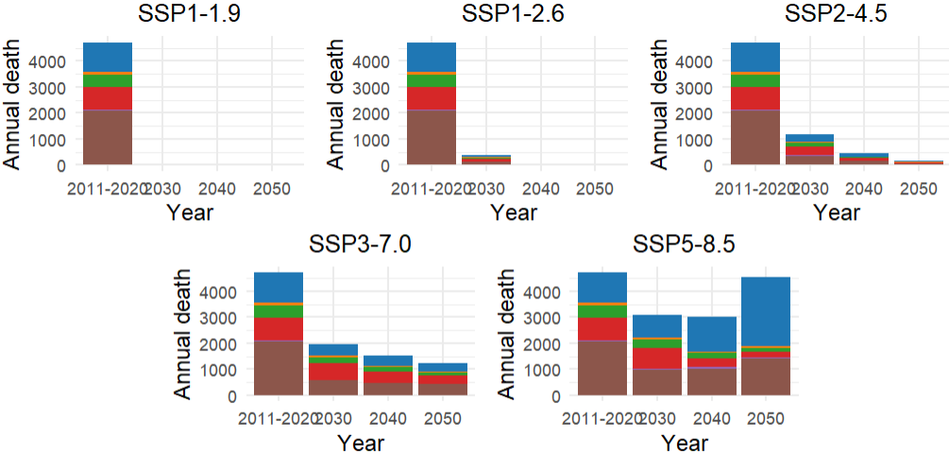
Annual Deaths
04 Results – Regional perspective
Projections
Projections Annual Death
Notes:
We present annual death projections based on the SSP scenarios, starting from the baseline period (average annual death from 2011-2020) and extending to 2050.
SSP1, SSP2, and SSP3 show varying degrees of decline in annual deaths.
However, in SSP5, deaths decrease slightly by 2040 but return to the baseline level by 2050
While GDP growth in SSP5 lowers flood severity, higher CO2 levels relate to increased flood occurrences. Thus, 2050 annual deaths are projected to align with current levels.
----------------------
1 min

Slide 19
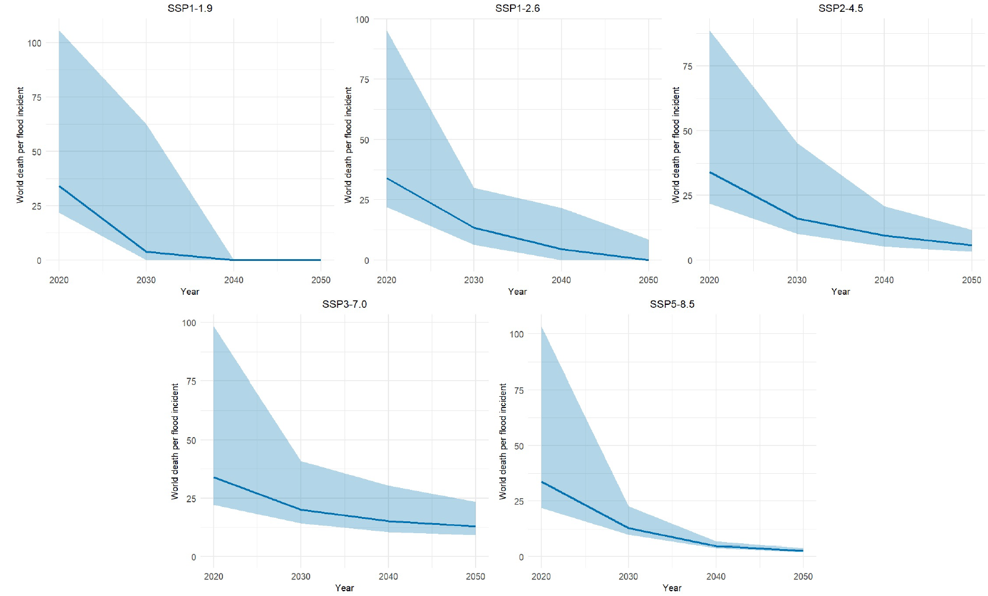
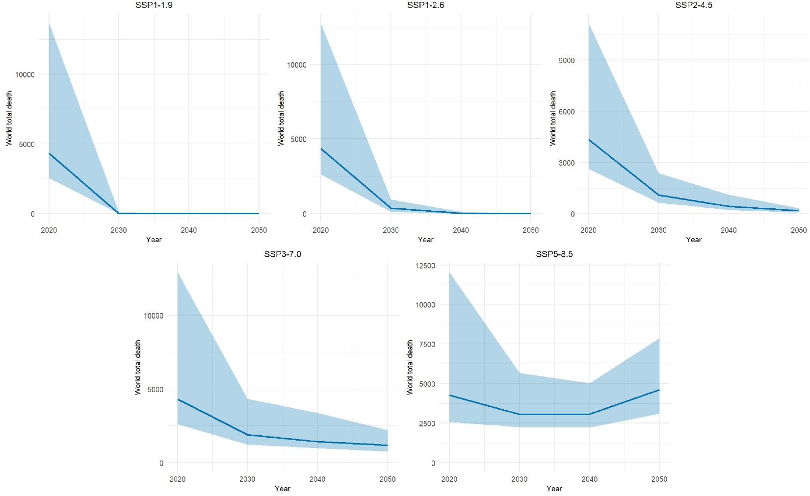
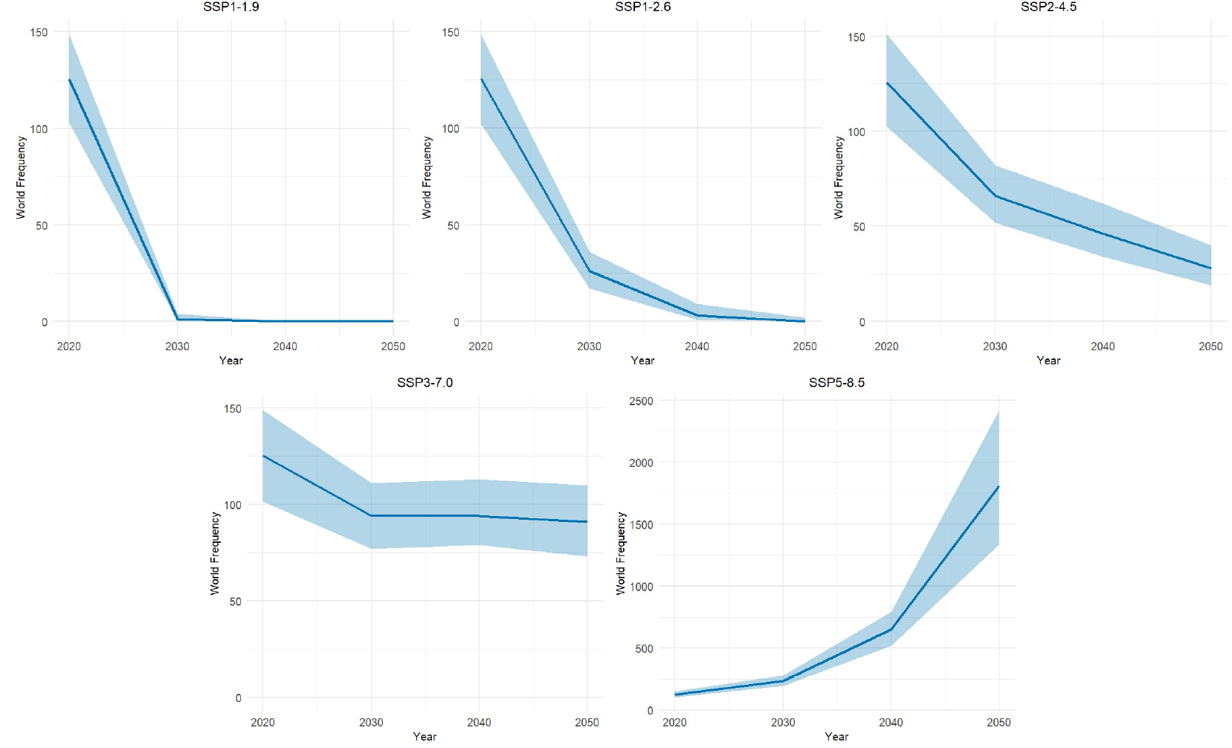
World
04 Results – Global perspective
Projections
1. Projected Global Flood Frequency with 95% Confidence Interval
2. Projected Global Death per Flood event with 95% Confidence Interval
3. Projected Total Annual Global Deaths with 95% Confidence Interval
Notes:
I visualize projected global numbers with 95% confidence interval
For the global frequency, a narrow confidence interval suggests the high confident level of this model (consistent with high R square as in the previous section)
For the global death per event, we can see a broader interval which indicates that the model precisions are lower
In general, the results on this slide are consistent with the pattern and outcome from the previous section.
---------------
3 mins

Slide 20
05
Closing Remarks
Key Findings, Limitations, and Future Study
Notes:
Now we come to the last part of this presentation. We'll cover conclusion, limitations and future study.
---------
4mins

Slide 21
Key Findings
05 Closing Remarks
Average deaths per flood event inversely relate to GDP, indicating milder floods in wealthier regions. Loss severity drops in all scenarios
Flood frequency correlates positively with CO2 emissions. Projections show declining trends except SSP5-8.5, while SSP1-1.9 sees the most reduction
Annual deaths drop across scenarios except SSP5-8.5
Globally, frequency and severity match the regional view with a narrow Confidence interval (±30%)
Notes:
The main key findings are…
Flood frequency shows a positive correlation with CO2 emissions in the Poisson model.
Projections display declining trends except for SSP5.
2. Average deaths per flood event inversely linked to GDP in the GPD model, showing less severe floods in higher GDP regions.
Loss severity decreases in all scenarios.
3. Annual deaths drop across scenarios except SSP5-8.5
4. Globally, frequency and severity match the regional view
--------------
1 min

Slide 22


Limitations and Future Study
05 Closing Remarks
1. Middle East and Africa Regional Classification | 1. Middle East and Africa Segregation
2. Limited North American Flood Data | 2. COVID-19's Impact on 2020 Data To address the problem: Sensitivity analysis If there is a problem, find a new reference point
3. Rebasement Challenges
Notes:
During the work, there are some difficulties.
We intended to divide 'Middle East and Africa' into one group 'MENA' and another group'Sub-Saharan Africa’ due to socio-economic differences.
However, IPCC projection doesn't differentiate North Africa from Sub-Saharan Africa. So, we combined them and this might caused errors in prediction.
2. Our North American data for 1960-1980 is quite limited, which might affect our model's accuracy.
3. We use 2020 as our baseline year when rebasing CO2 emissions and GDP from IPCC projections.
However, the year 2020 is quite unique due to COVID-19 lockdown which caused exceptional drops in CO2 and GDP.
By doing this, our projected CO2 and GDP may be underestimated.
Some of them could be solved in the future
In case researchers could distinguish 'Middle East and North Africa' (MENA) from 'Sub-Saharan Africa’.
It might improve forecasting accuracy.
2. To address the COVID year problem, we could perform a sensitivity analysis using nearby years (like 2019 or 2021) as a baseline. If there is a problem, we can find an average CO2 GDP from 2019, 2021 and use it as a reference point.
-------------------------------------------
2 mins 30 sec

Slide 23
Thank you very much

Slide 24
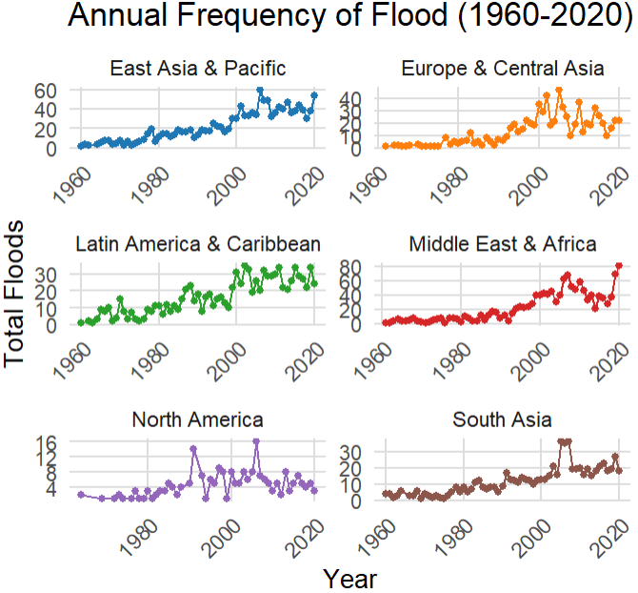
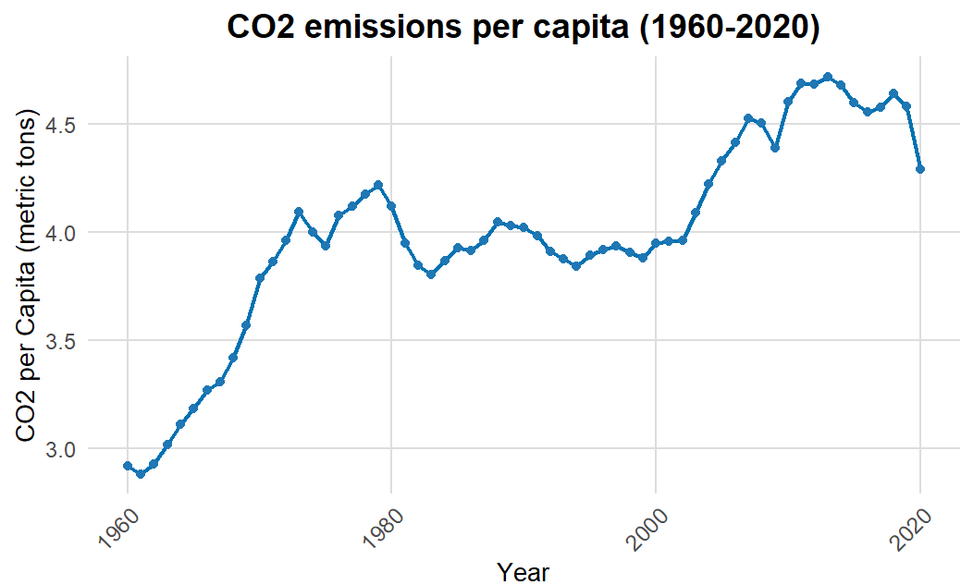
Exploratory Data Analysis - Historical data
02 Data Dive
Flood Frequency
Notes:
2 mins

Slide 25
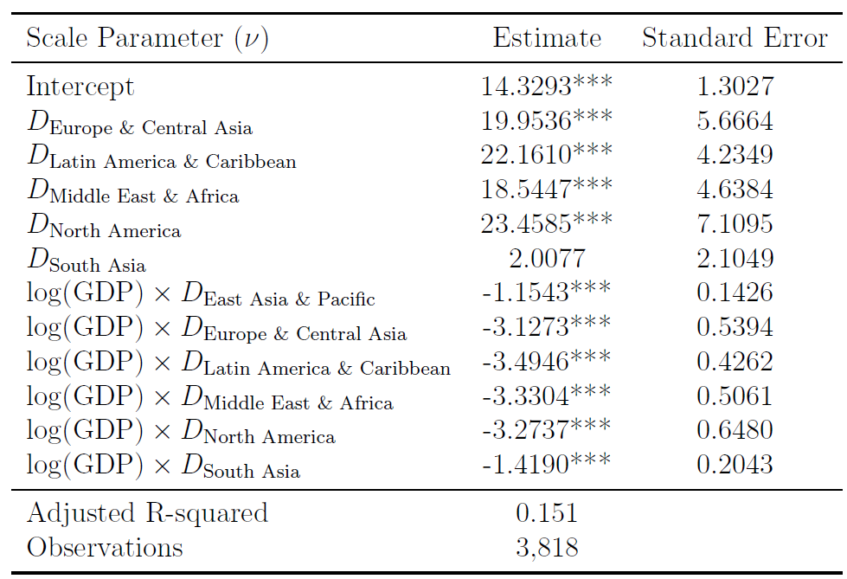
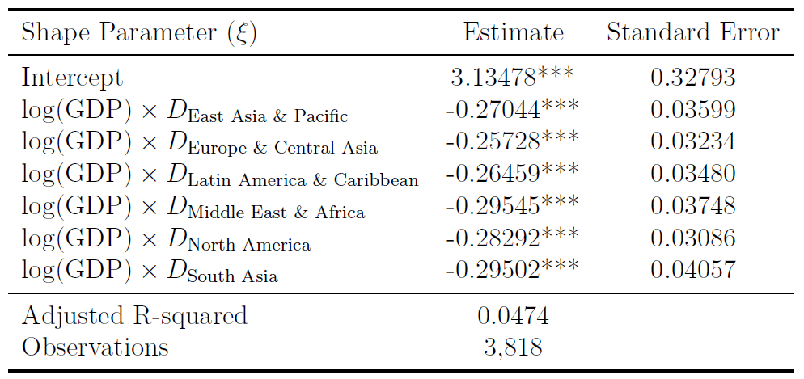
Severity – Average Death per flood event
04 Results
Estimation Results
Parameter estimation (proxy of scale and shape parameters) of the GPD-Severity model:
*** p<0.001, ** p<0.01, * p<0.05
Notes:
1 min

