Slide 1

Using Power BI to Report OS Deployment Stats
Michigan System Center User Group
11 January 2018

Slide 2





Mike Marable
Michigan Medicine (13+ years)
OS Deployment Architect
mmarable@med.umich.edu
@mike_marable
The Systems Monkey
Github.com/mmarable/MiSCUG

Slide 3
Agenda
Why would we want to do this?
Okay, so then how do we collect the data?
I have data, now what?

Slide 4
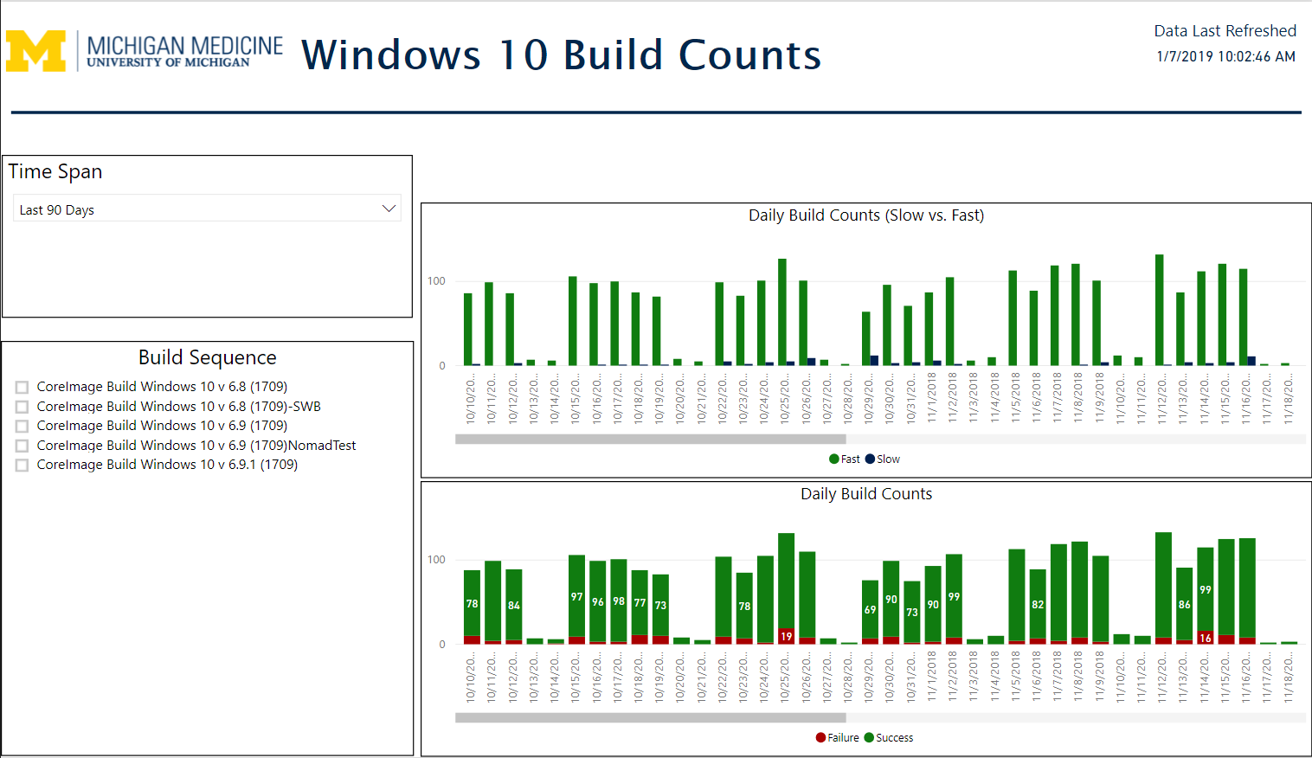
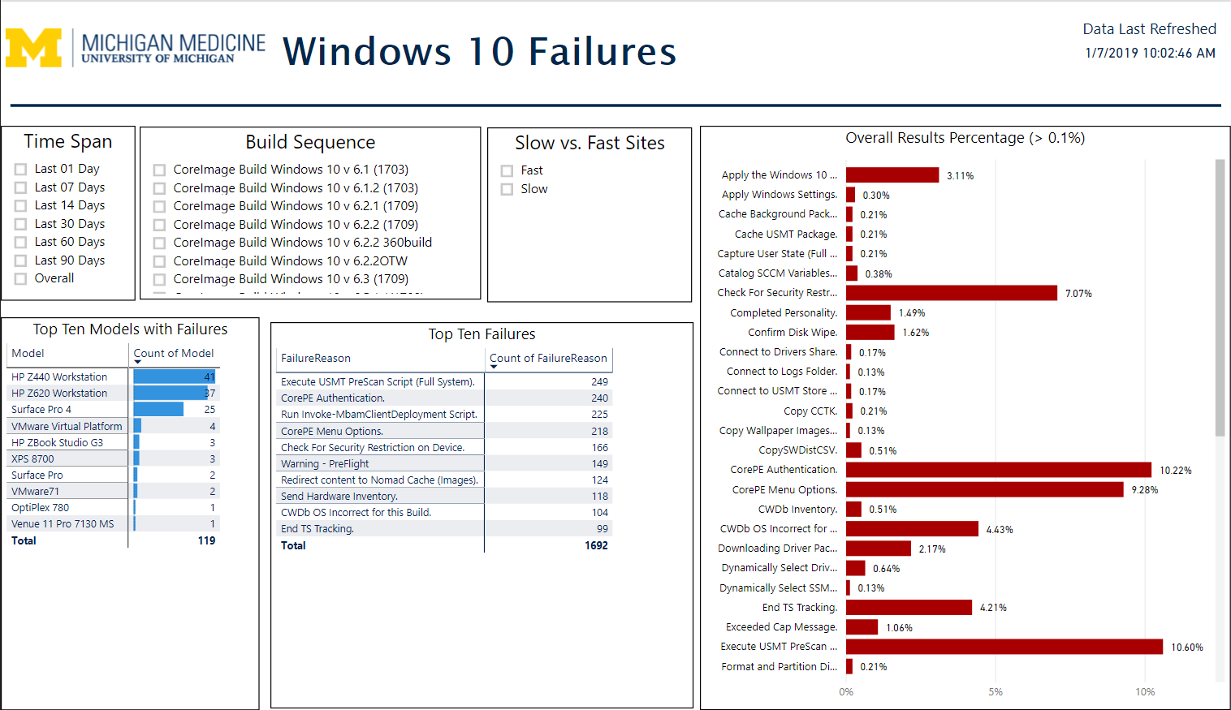
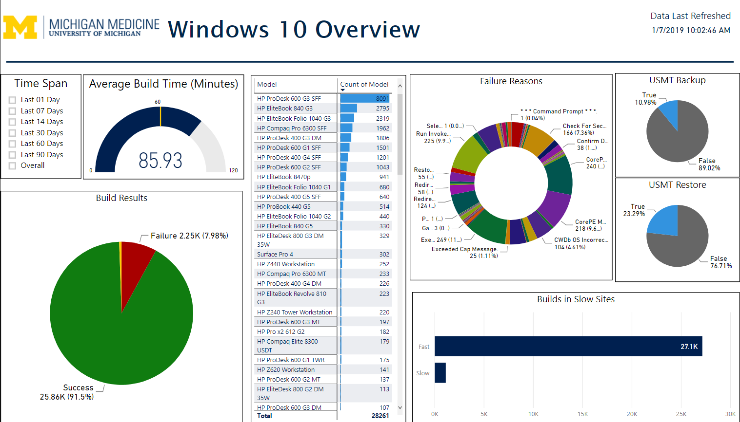
Why would we want to do this?

Slide 5
Okay, so then how do we collect the data?
What data to collect?
Where to collect it?
How to collect it?

Slide 6
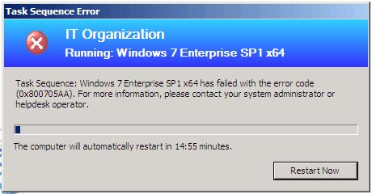
You don’t want this!

Slide 7
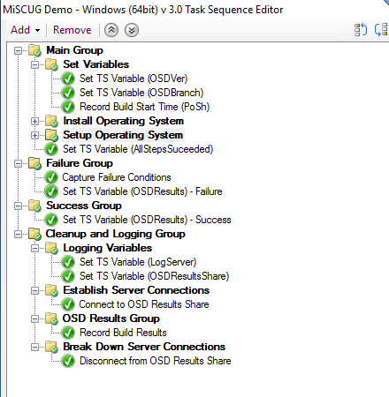
Try/Catch/Finally – Task Sequence
The “Try” Block
The “Catch” Blocks
The “Finally” Block

Slide 8

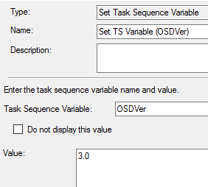
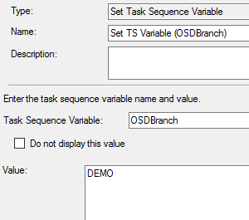
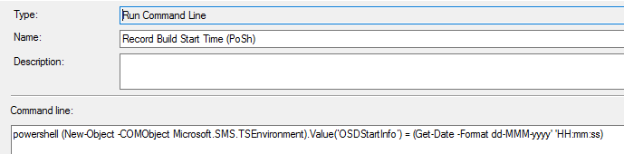
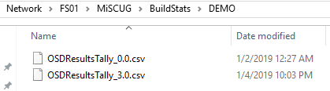
Try/Catch/Finally – Task Sequence

Slide 9

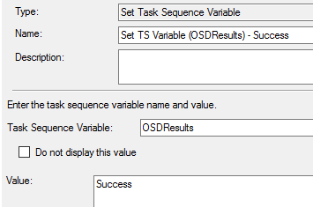
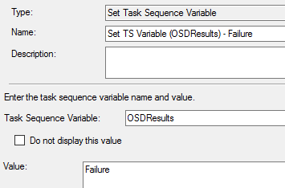
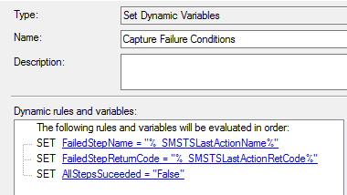
Try/Catch/Finally – Task Sequence

Slide 10
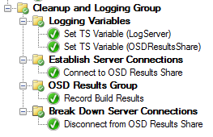
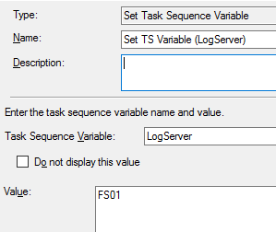
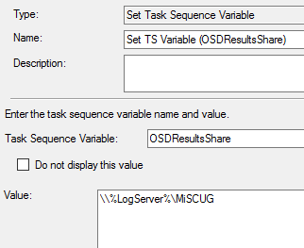
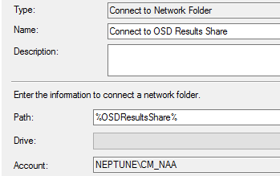
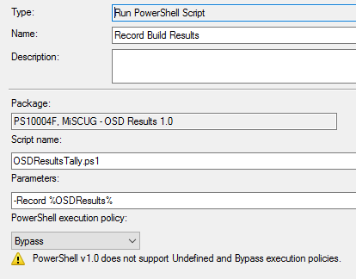
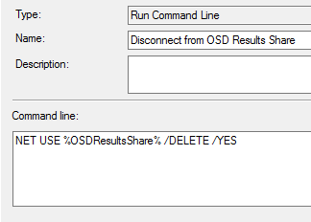
Try/Catch/Finally – Task Sequence

Slide 11
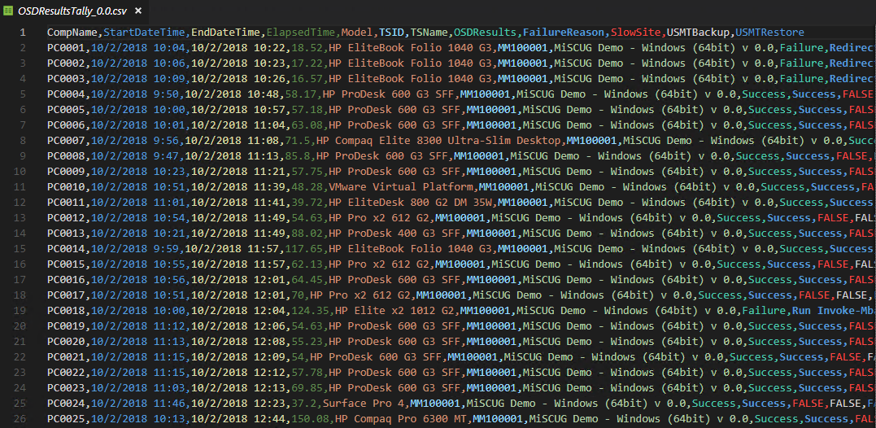
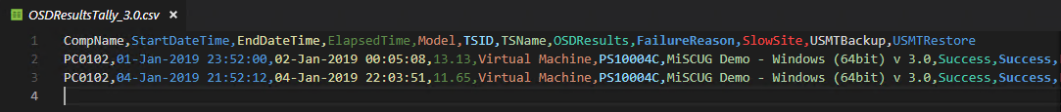
Data Files

Slide 12
Demo

Slide 13
Questions?

