Slide 1
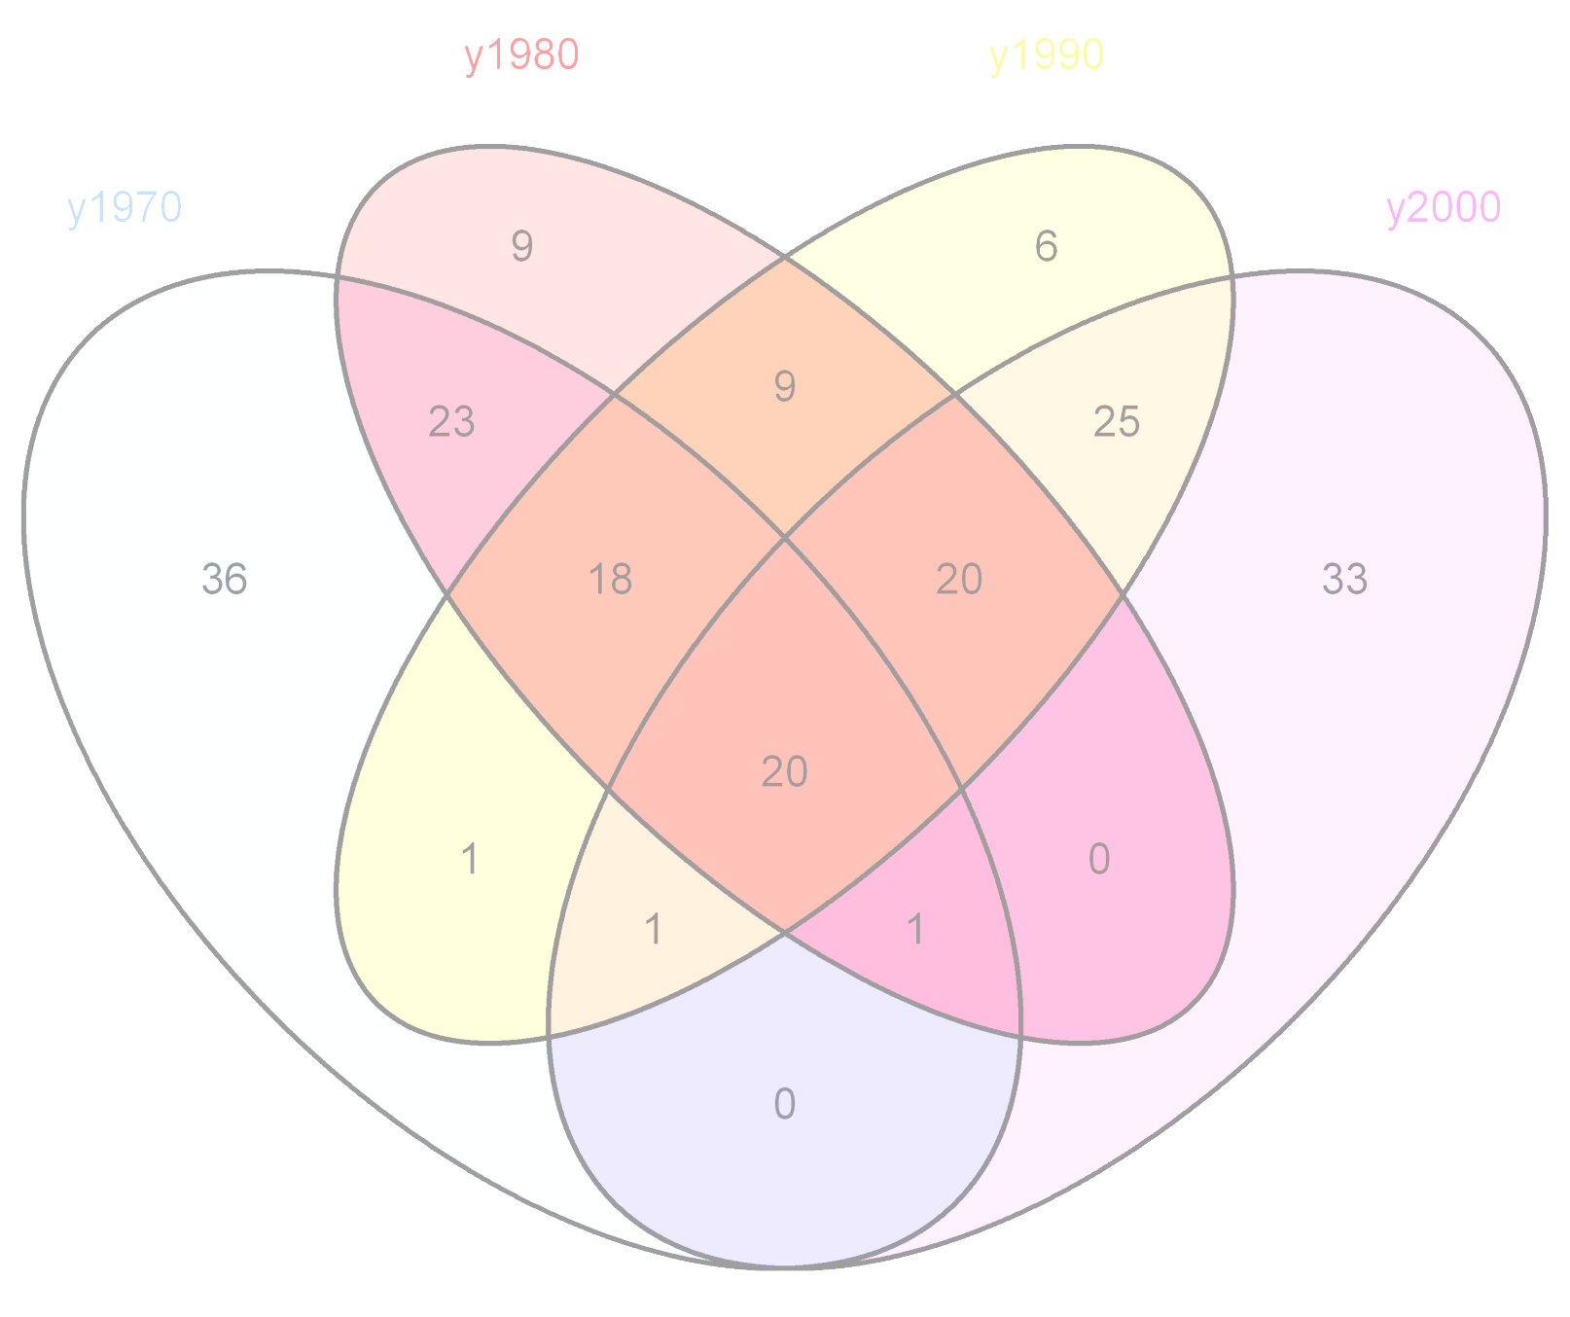
Venn and Euler Diagrams in R
Madelaine Gogol
Kansas City R Users Group
April 23rd, 2011

Slide 2
Venn Diagrams?
In Bioinformatics, we deal with lots of lists of genes or IDs
People like venn diagrams

Slide 3
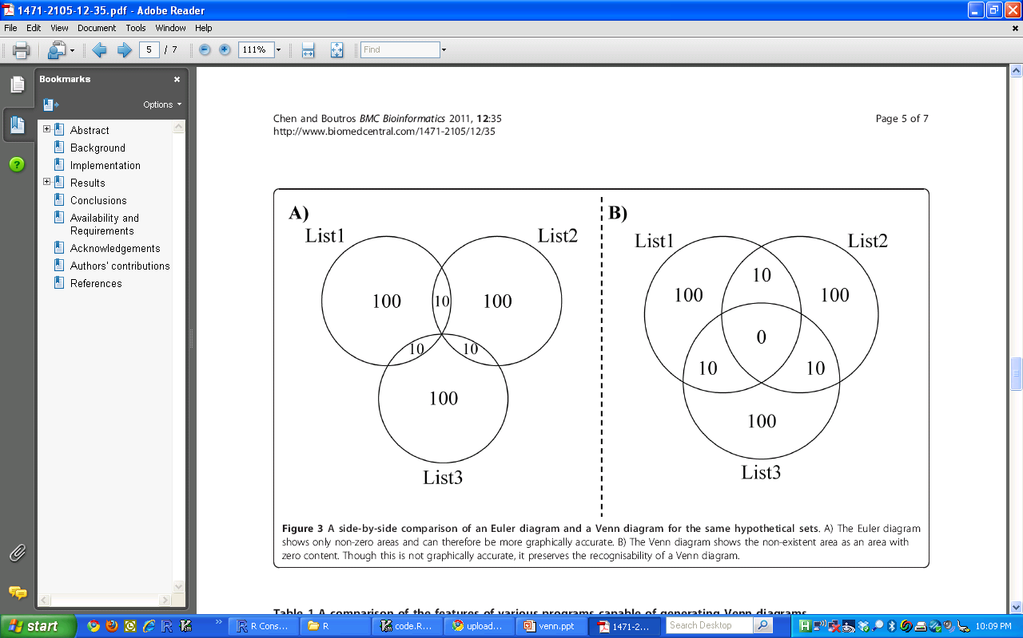
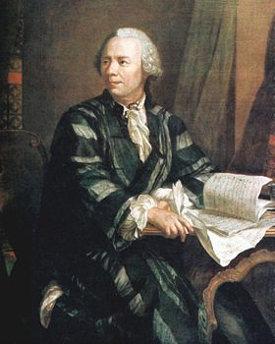
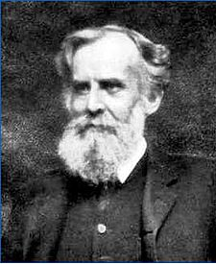
Euler vs. Venn
Venn diagrams are a more restrictive form of Euler diagrams
A Venn diagram must contain all the possible zones of overlap between its curves
in an Euler diagram some zones might be missing.

Slide 4
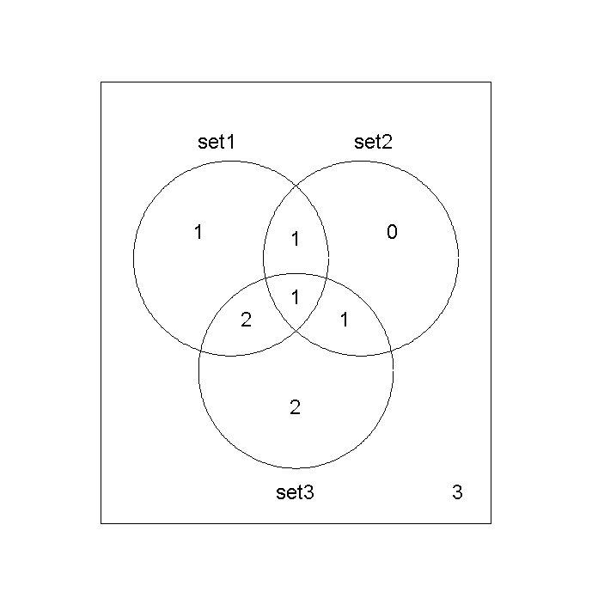

Previous R Venn Diagrams

Slide 5
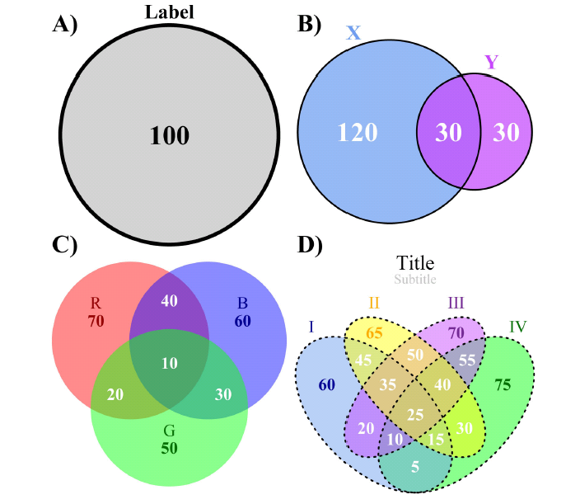
VennDiagram package

Slide 6

To safeguard privacy, we restrict our list of names to those with at least 5 occurrences. For each year of birthYYYY after 1879, we created a comma-delimited file called yobYYYY.txt. Each record in a file has the format "name,sex,number," where sex is M (male) or F (female) and "number" is the number of occurrences of the name. The files are zipped into a single file for you to download.
All names are from Social Security card applications for births that occurred in the United States after 1879.
Data qualifications
People using our data on popular names are urged to explicitly acknowledge the following qualifications.
Names are restricted to cases where the year of birth, sex, State of birth (50 States and District of Columbia) are on record, and where the given name is at least 2 characters long.
Name data are not edited. For example, the sex associated with a name may be incorrect. Entries such as "Unknown" and "Baby" are not removed from the lists.
Different spellings of similar names are not combined. For example, the names Caitlin, Caitlyn, Kaitlin, Kaitlyn, Kaitlynn, Katelyn, and Katelynn are considered separate names and each has its own rank.
When two different names are tied with the same frequency for a given year of birth, we break the tie by assigning rank in alphabetical order.
Some names are applied to both males and females (for example, Micah). Our rankings are done by sex, so that a name such as Micah will have a different rank for males as compared to females.
http://www.ssa.gov/oact/babynames/limits.html

Slide 7
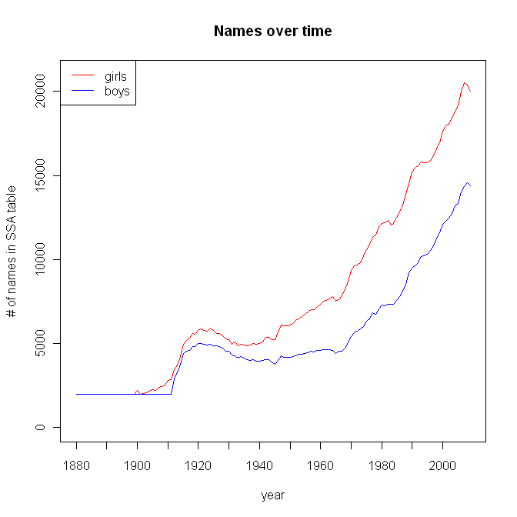

Slide 8
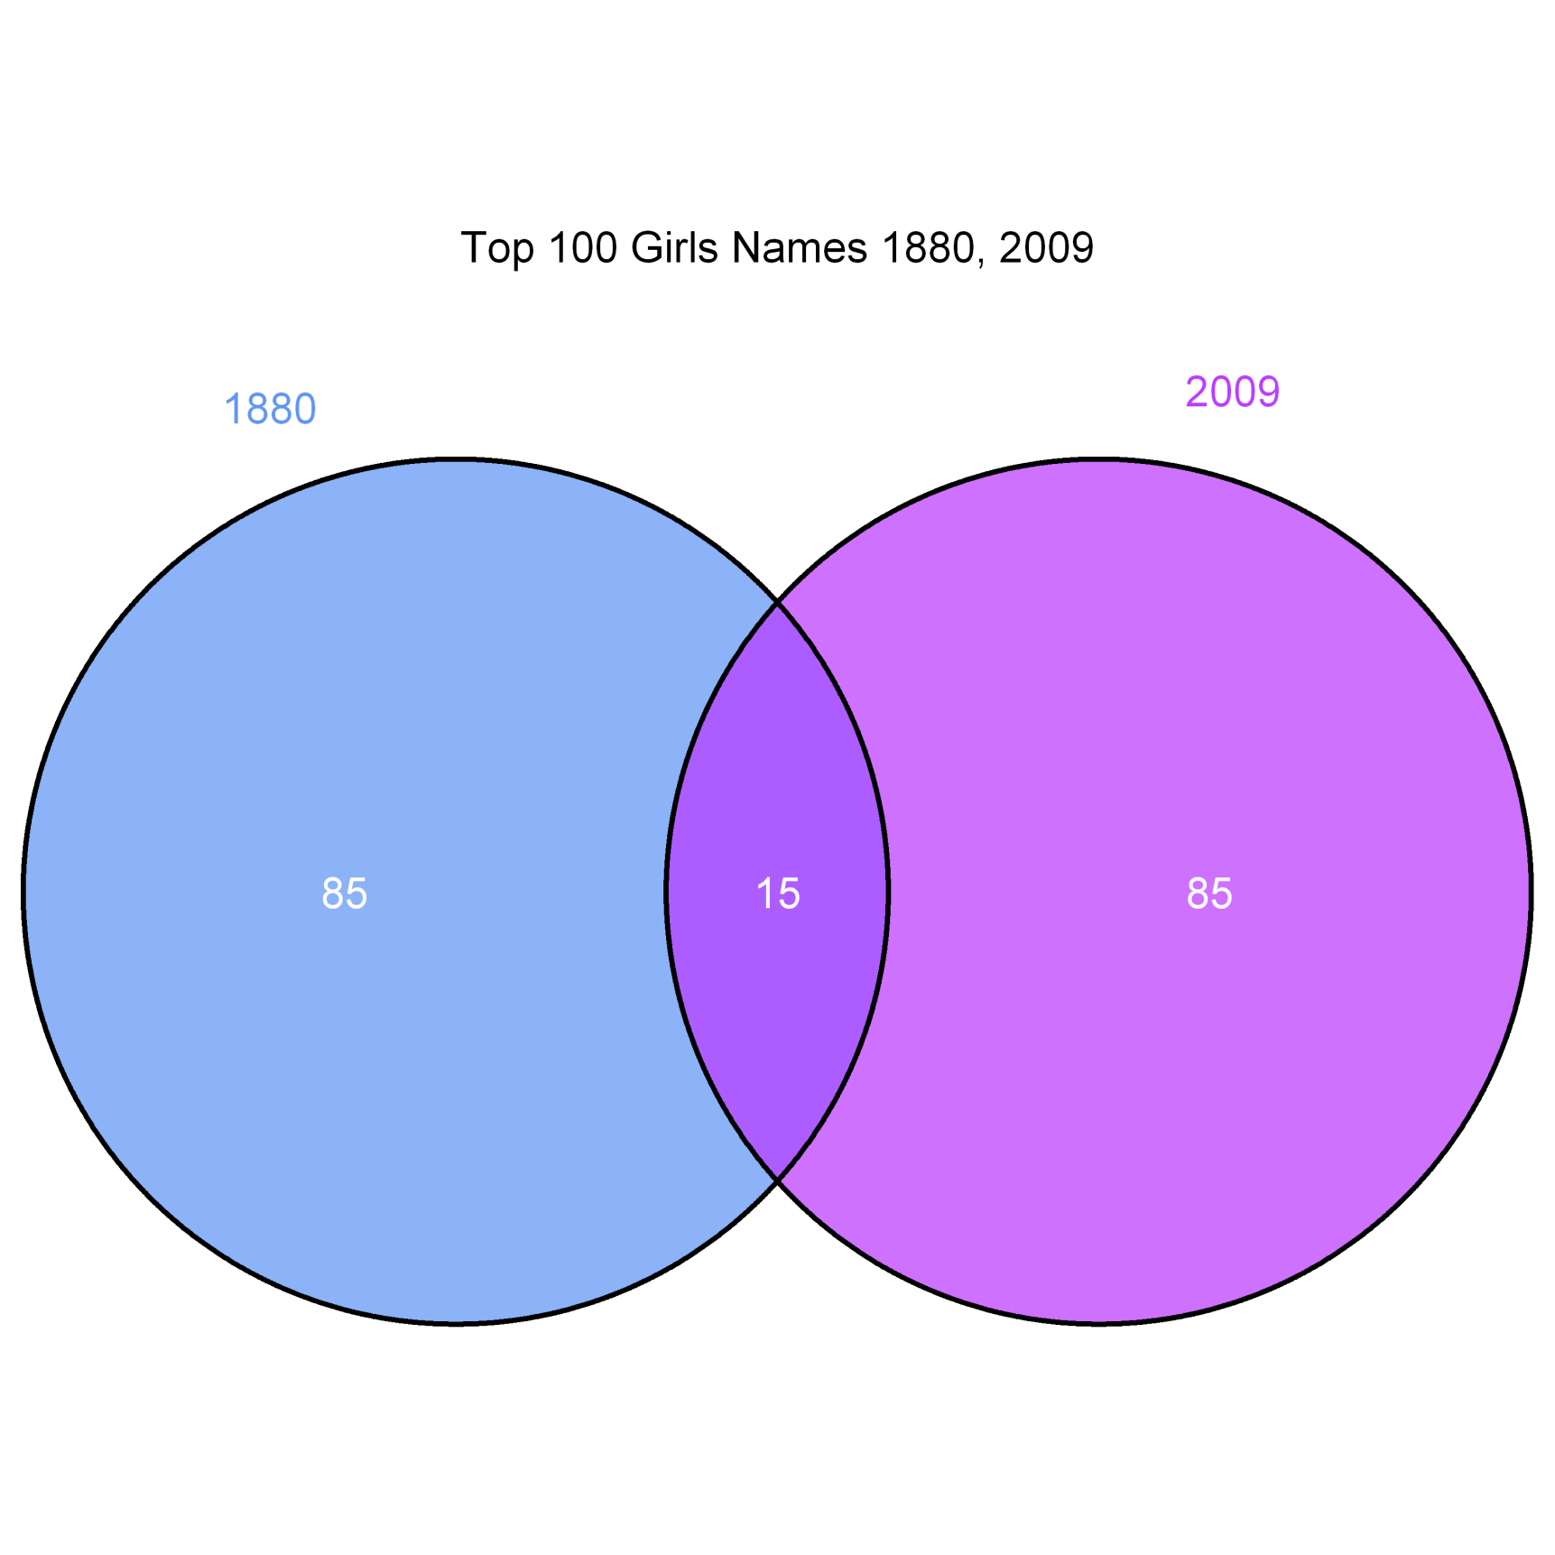
Anna
Emma
Elizabeth
Sarah
Ella
Grace
Julia
Lillian
Eva
Katherine
Caroline
Charlotte
Amelia
Hannah
Emily

Slide 9
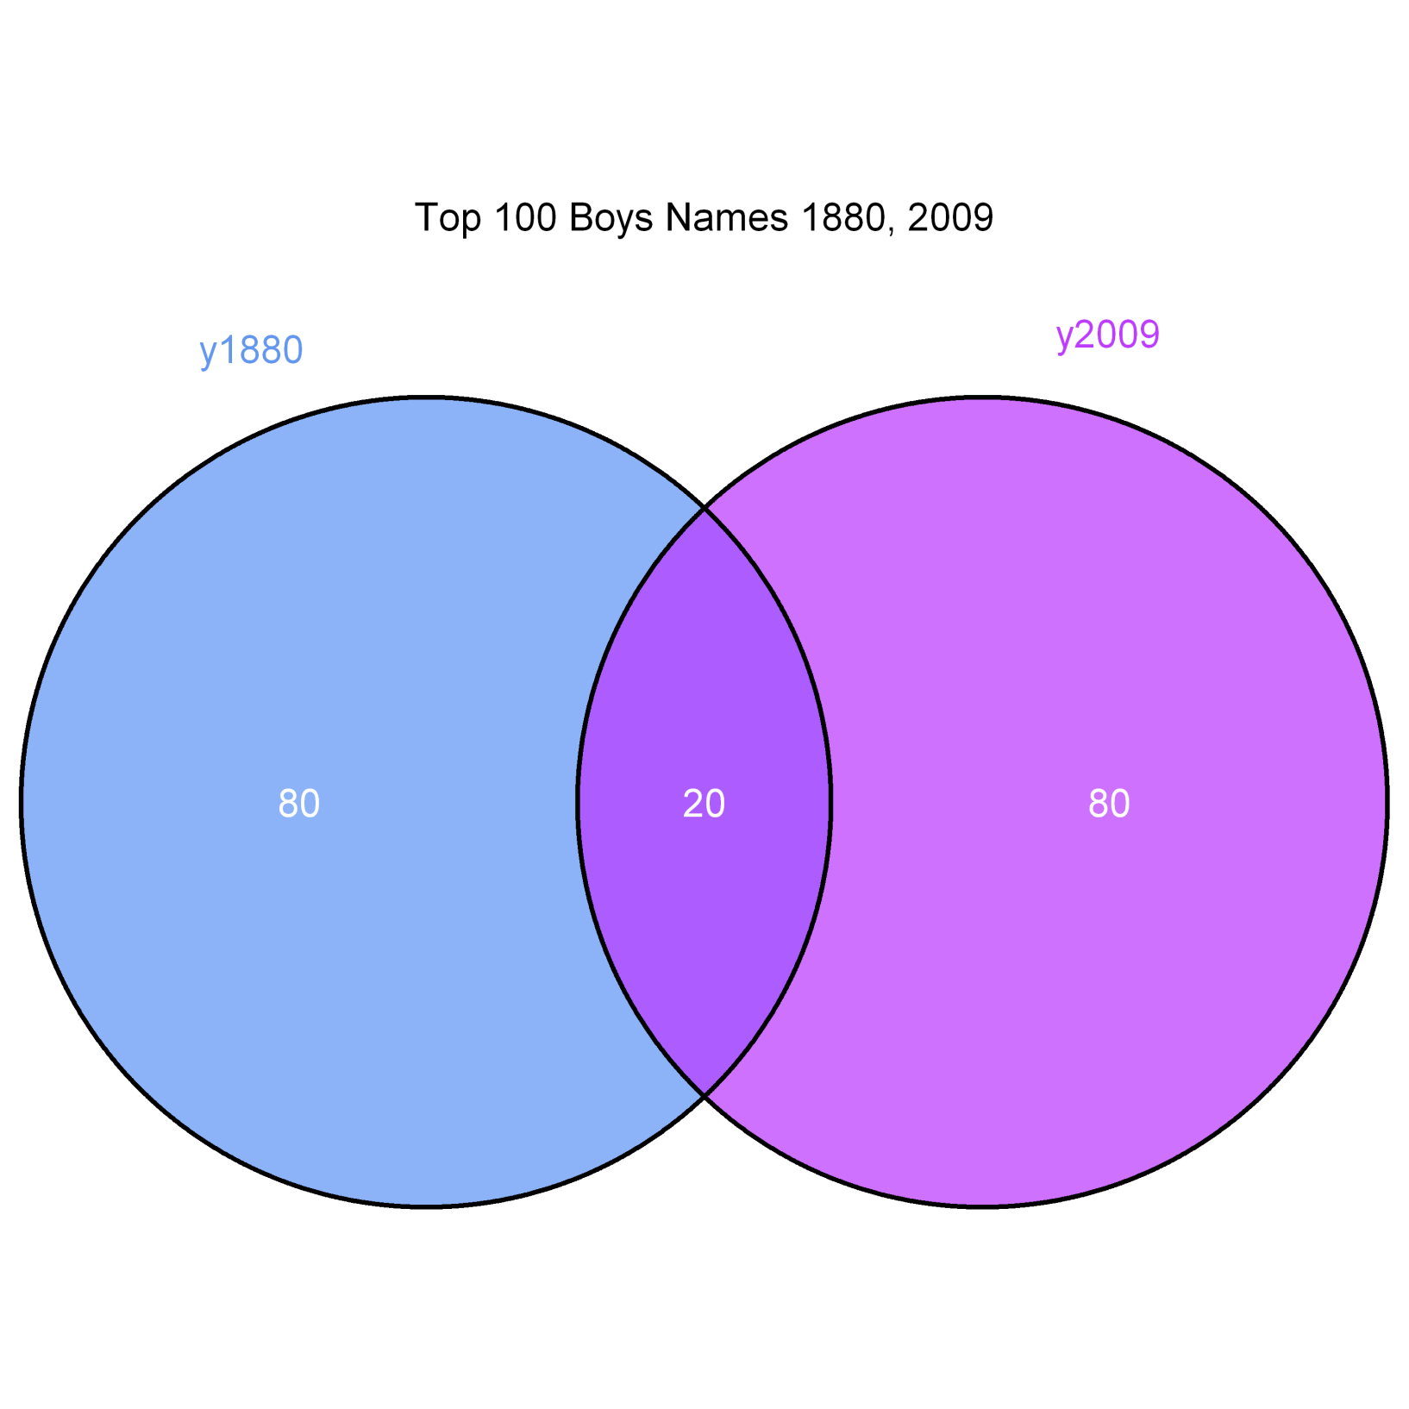
John
William
James
Charles
Joseph
Thomas
Henry
Robert
Samuel
David
Andrew
Daniel
Benjamin
Jacob
Michael
Isaac
Oliver
Alexander
Jack
Alex

Slide 10
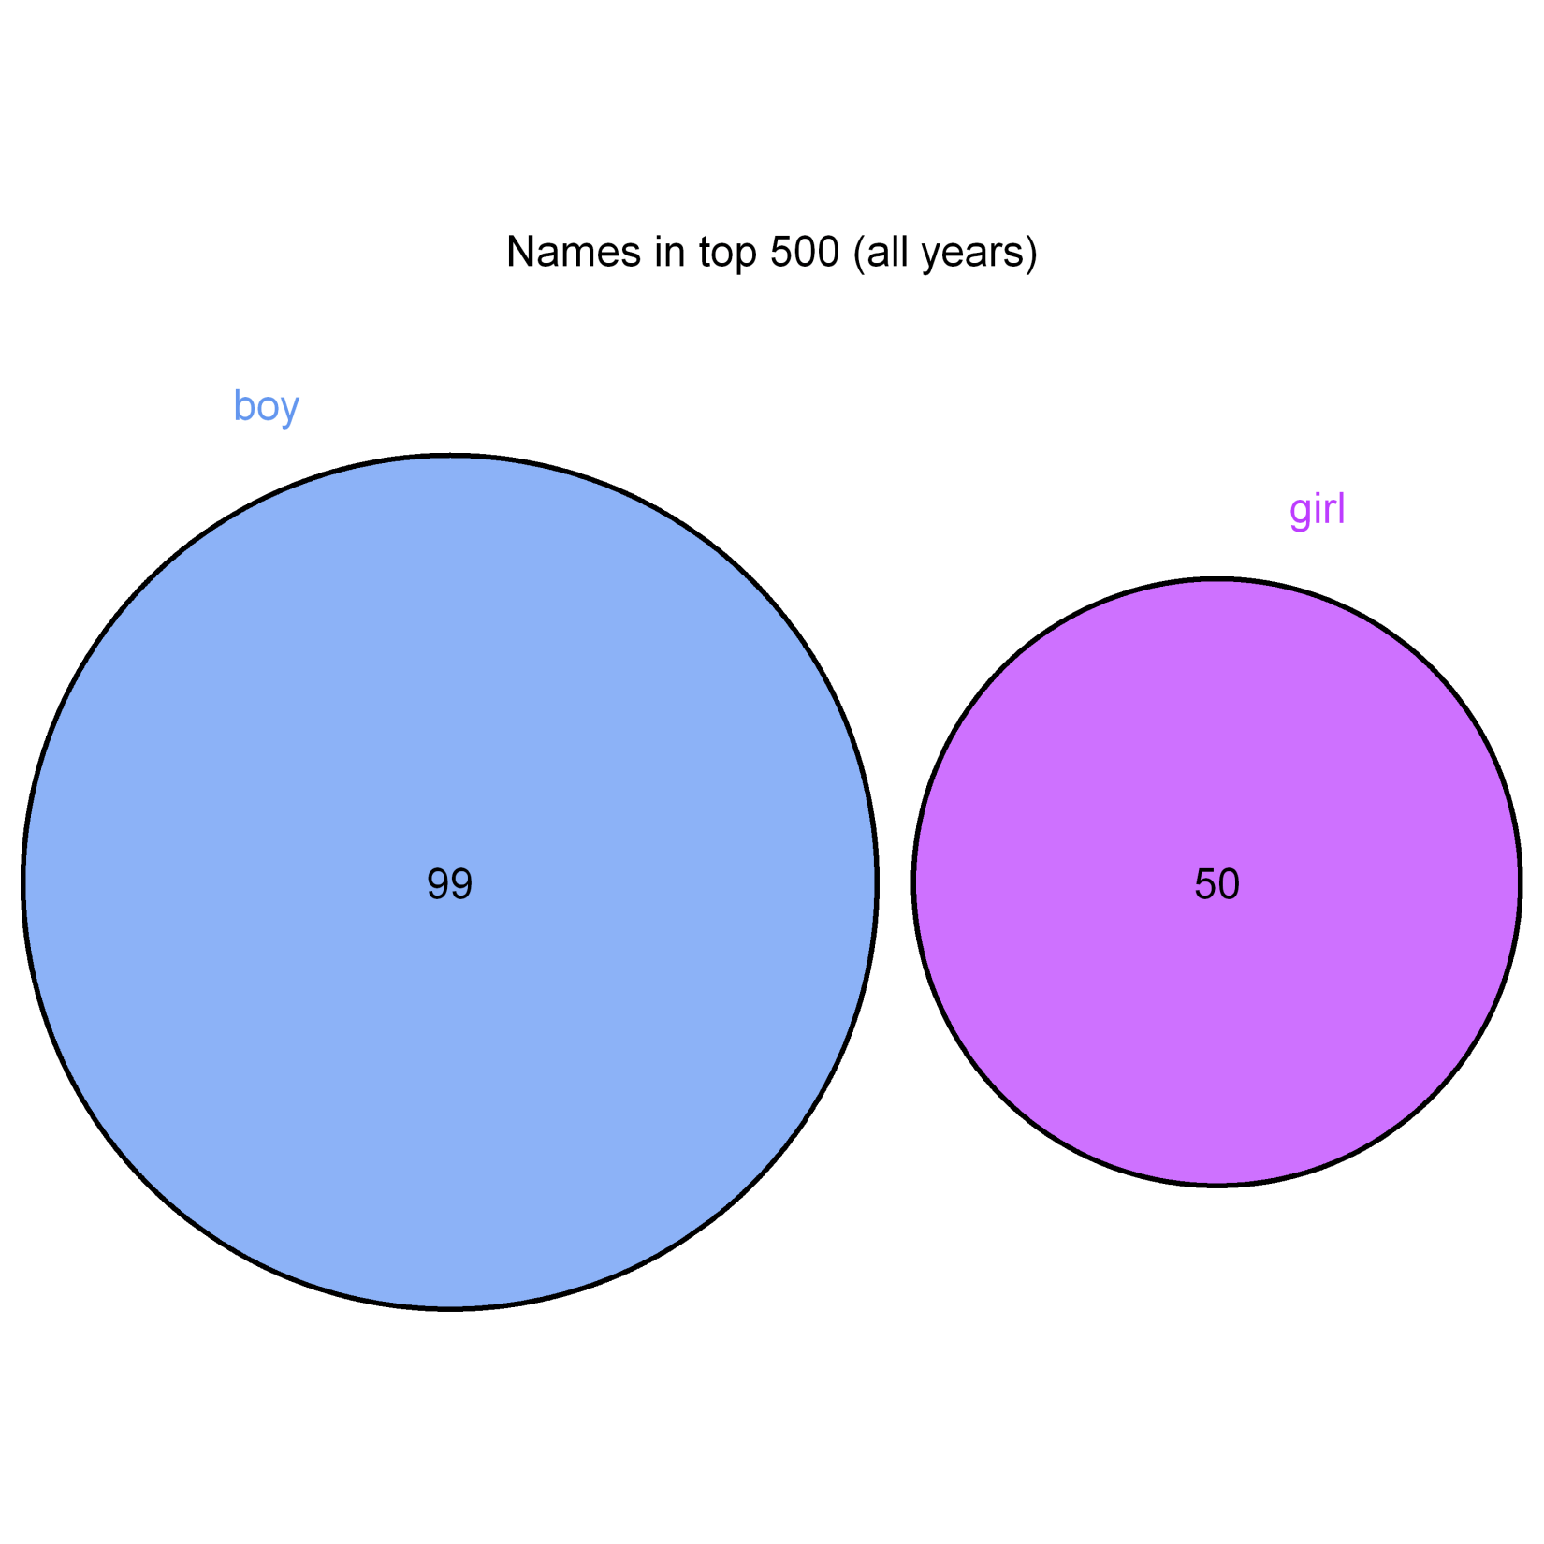

Slide 11
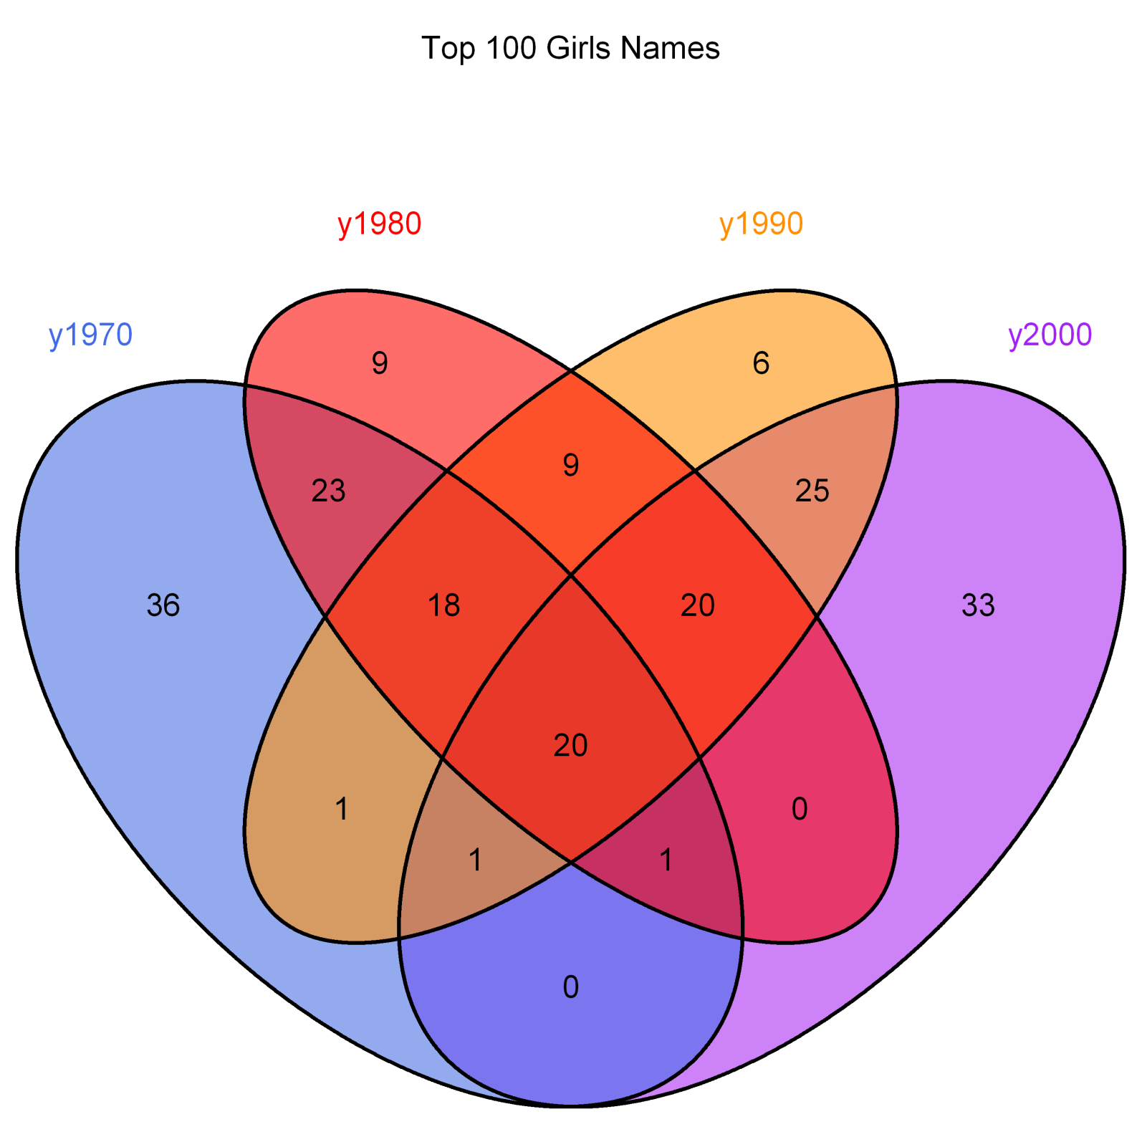

Slide 12
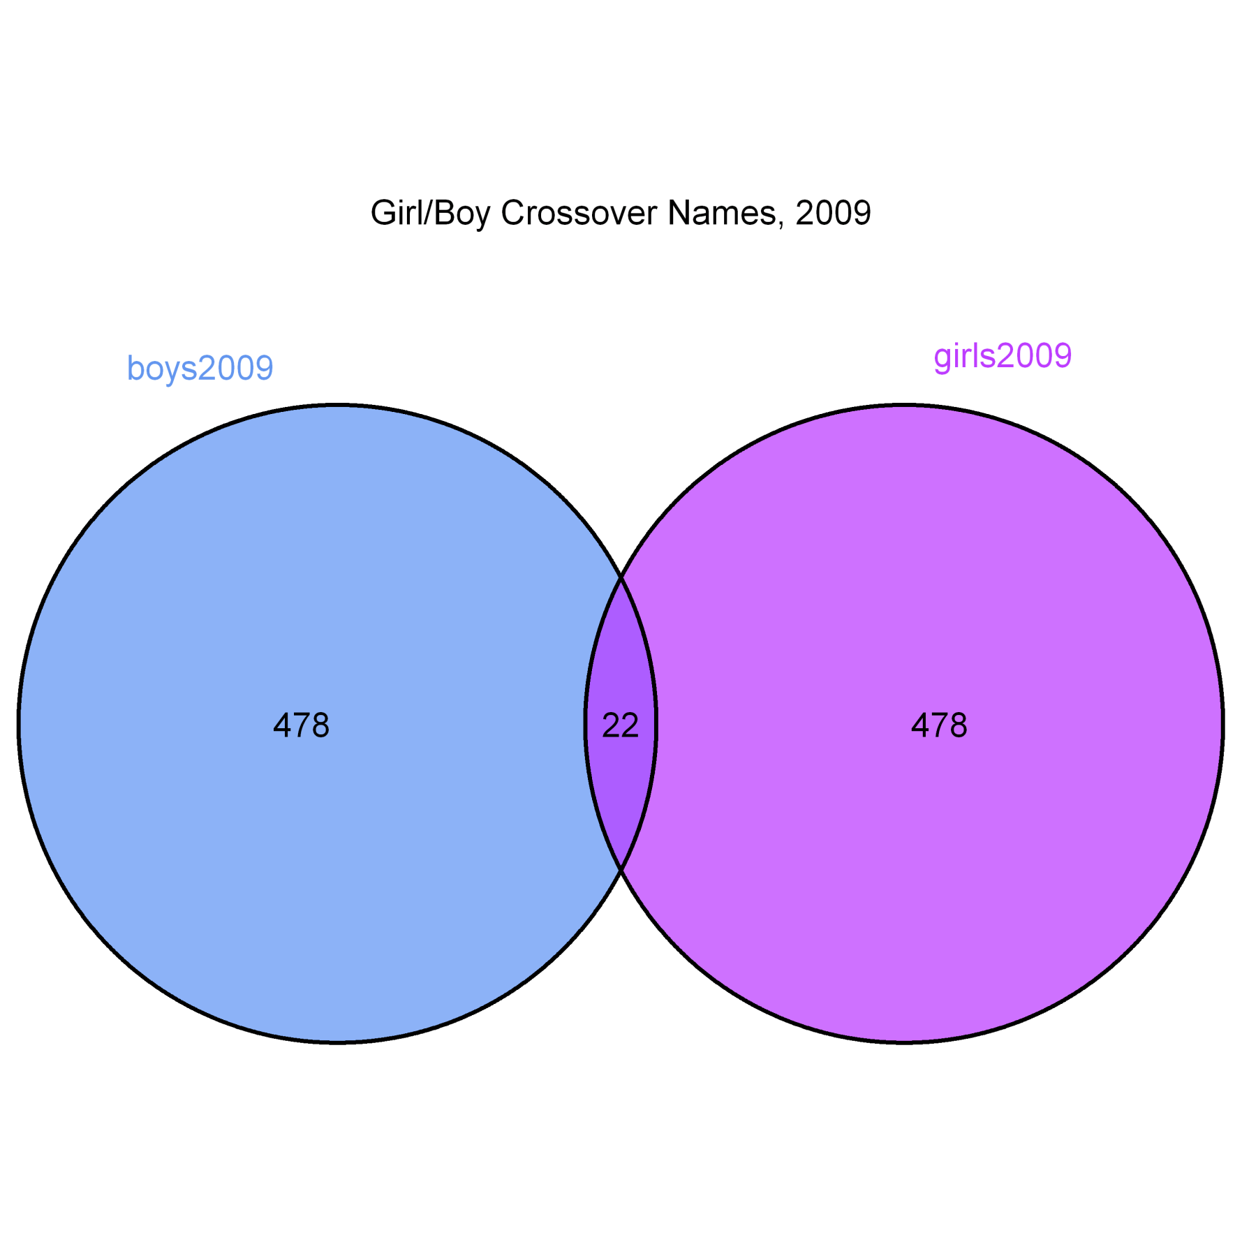
Jayden
Logan
Angel
Jordan
Cameron
Hayden
Riley
Kayden
Peyton
Alexis
Avery
Dakota
Quinn
Skyler
Taylor
Amari
Payton
Rowan
Emerson
Morgan
Reese
Skylar

Slide 13
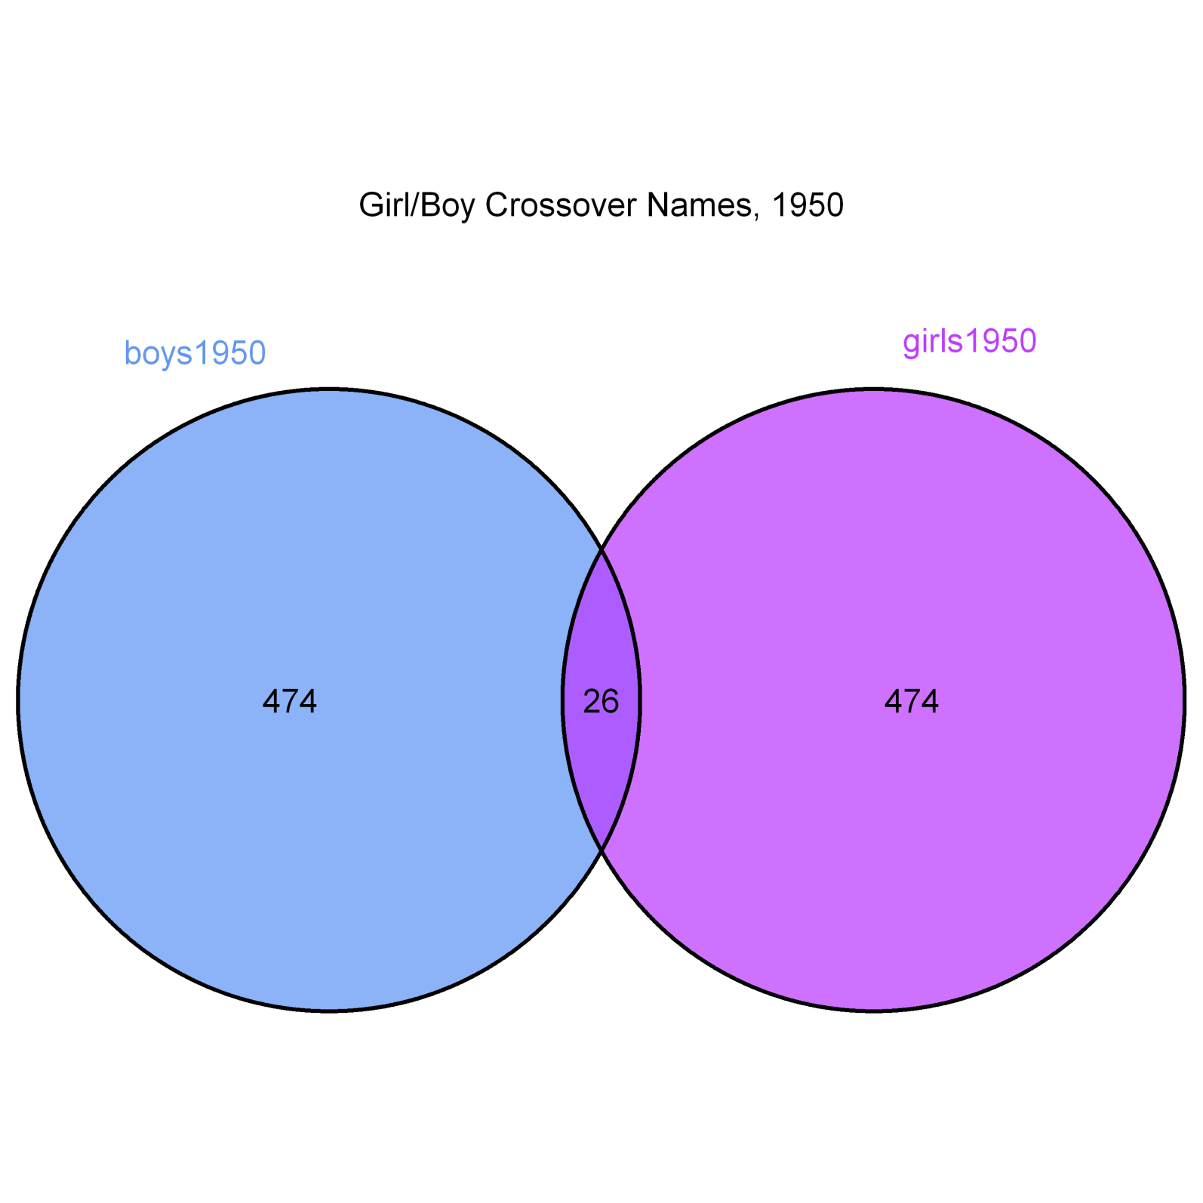

Jerry
Terry
Willie
Dale
Lee
Leslie
Jackie
Jimmie
Lynn
Johnnie
Dana
Kerry
Jessie
Marion
Kim
Robin
Frankie
Jan
Unknown
Pat
Guadalupe
Gale
Billie
Carmen
Sandy
Bobbie

Slide 14
Drawbacks to VennDiagram…
Ugly Defaults
Lots of settings

Slide 15
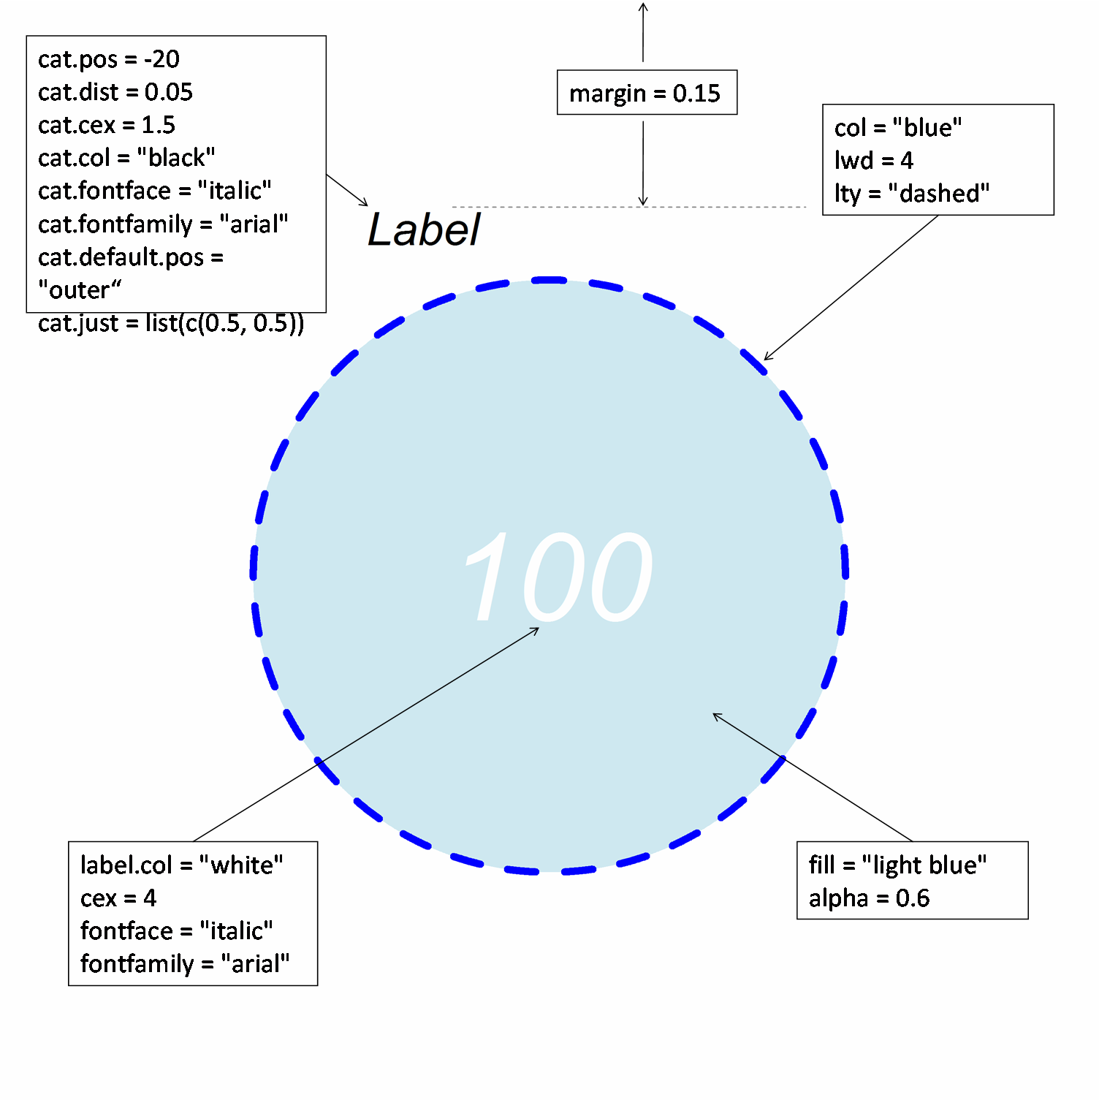

Slide 16
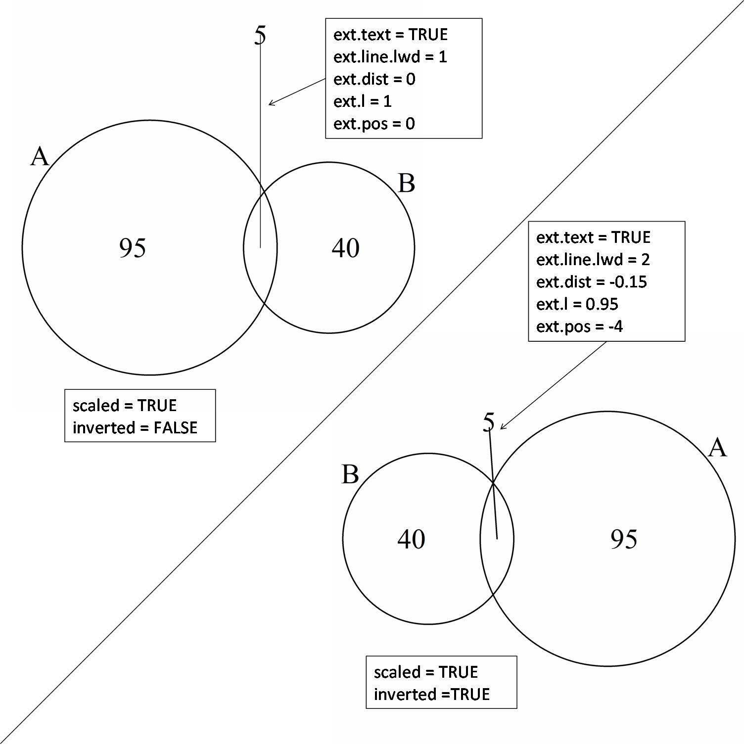

Slide 17
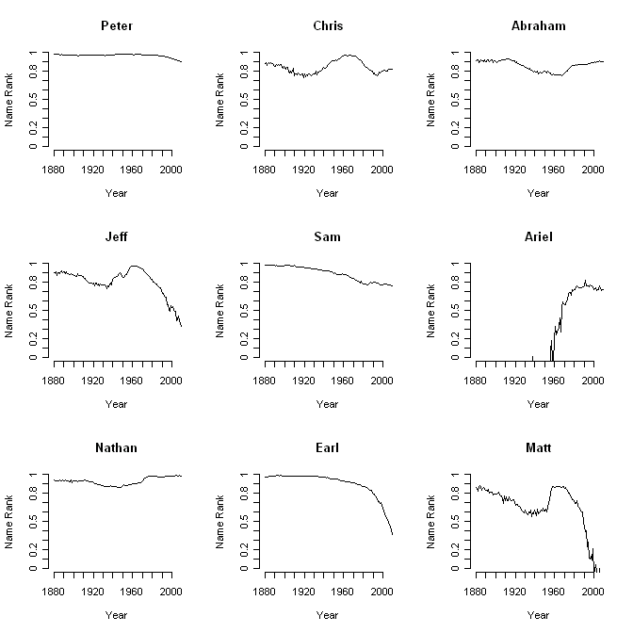

Slide 18

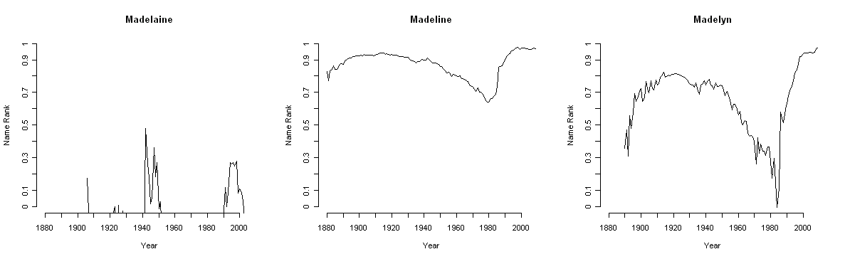

Slide 19
Summary
VennDiagram is really customizable, but will take some tweaking
Names are interesting and there are more than ever

Slide 20
> sessionInfo()
R version 2.13.0 (2011-04-13)
Platform: i386-pc-mingw32/i386 (32-bit)
locale:
[1] LC_COLLATE=English_United States.1252
[2] LC_CTYPE=English_United States.1252
[3] LC_MONETARY=English_United States.1252
[4] LC_NUMERIC=C
[5] LC_TIME=English_United States.1252
attached base packages:
[1] grid stats graphics grDevices utils datasets methods
[8] base
other attached packages:
[1] VennDiagram_1.0.1

