Slide 1
Physics 212
Lecture 4
Today's Concepts:
Conductors +
Using Gauss’ Law

Slide 2
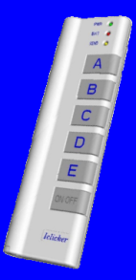

Music
Who is the Artist?
Professor Longhair
John Cleary
Allen Toussaint
David Egan
Henry Butler
Theme of week: New Orleans Jazz → Mardi Gras
Physics 212 Lecture 14

Slide 3
Your Comments
“Everything. Week 2 and I'm desperately lost...“
We'll see, won't we? Also, what do you do with overheated electrical components? Coulomb off.
“It is really hard. I want to have it all covered in lecture.”
Everything. Week 2 and I'm desperately lost...
“How is there a charge induced on the inside of a conducting shell? Is there any way to think of it intuitively instead of using Gauss's Law?”
“The checkpoint questions were extremely difficult. Many explanations will be needed.”
I find the concepts with the conductor more difficult and am not sure about some of the symbols such as Epsilon knot. DEATH TO JARGON!
“E&M is so much more confusing than mechanics.”
I still don't quite understand what the "epsilon naught" variable stands for.
Our Response
Gaussian surfaces; what they are and what you can do with them.
Most students are having difficulties with this topic: The Checkpoints show this clearly.
This whole way of thinking (Gauss’ Law) is very unfamiliar to you: calculate a field means, first, pick a surface??
The solution? DON’T PANIC… We’re confident you will master these concepts but it will take a little work.
Examples, examples, oh... and a few examples. And please of course.
I'M SO HAPPY THIS IS BACK. I HAVE A REASON TO GO TO LECTURES AGAIN!!!
E&M is so much more confusing than mechanics.
infinite sheets of charge
TODAY’S PLAN:
Do Checkpoints again! Try to understand the reasoning
Do a calculation using Gauss’ Law
“We'll see, won't we? Also, what do you do with overheated electrical components? Coulomb off.”
04

Slide 4
Conductors = charges free to move
Claim: E = 0 within any conducting material at equilibrium
Charges in conductor move to make E field zero inside. (Induced charge distribution). If E ≠ 0, then charge feels force and moves!
Claim: At equilibrium, excess charge on conductor only on surface
Why?
Apply Gauss’ Law
Take Gaussian surface to be just inside conductor surface
E = 0
E = 0 everywhere inside conductor
Gauss’ Law:
SIMULATION 2
06
Notes:
Careful here… inside means part of conductor, does NOT include cavity of a conductor!

Slide 5
Gauss’ Law + Conductors + Induced Charges
ALWAYS TRUE!
If choose a Gaussian surface that is entirely in metal, then E=0 so Q_{enclosed} must also be zero!
How Does This Work??
Charges in conductor move to surfaces to make Q_{enclosed} = 0.
We say charge is induced on the surfaces of conductors
Small aside: ε₀ is just a constant related to k
k = 1/(4πε₀ )
k = 9x10⁹ Nm²/C²
ε₀ = 8.85x10⁻¹² C²/Nm²
09

Slide 6

Charge in Cavity of Conductor
A particle with charge +Q is placed in the center of an uncharged conducting hollow sphere. How much charge will be induced on the inner and outer surfaces of the sphere?
A) inner = –Q, outer = +Q
B) inner = –Q/2 , outer = +Q/2
C) inner = 0, outer = 0
D) inner = +Q/2, outer = -Q/2
E) inner = +Q, outer = -Q
Q_{outer}
Q_{inner}
Q
Since E=0 in conductor
Gauss’ Law:
10
Notes:
Write E = 0 in conductor
Draw induced charge

Slide 7
Infinite Cylinders
A long thin wire has a uniform positive charge density of 2.5 C/m. Concentric with the wire is a long thick conducting cylinder, with inner radius 3 cm, and outer radius 5 cm. The conducting cylinder has a net linear charge density of -4 C/m.
What is the linear charge density of the induced charge on the inner surface of the conducting cylinder (λ_{i}) and on the outer surface (λ_{o})?
λ_{i}: +2.5 C/m -4 C/m -2.5 C/m -2.5 C/m 0
λ_{o}: -6.5 C/m 0 +2.5 C/m -1.5 C/m -4 C/m
λ_{ο}
λ_{ι}
A) B) C) D) E)
E = 0 in material of conducting shell
Enclosed charge = 0
λ_{i} = -2.5 C/m
λ_{i} + λ_{o} = -4 C/m
λ_{o} = -1.5 C/m
14
Notes:
Last answers allow for mistake of doing inner radius instead of outer.
Draw to explain

Slide 8
Gauss’ Law
ALWAYS TRUE!
In cases with symmetry can pull E outside and get
In General, integral to calculate flux is difficult…. and not useful!
To use Gauss’ Law to calculate E, need to choose surface carefully!
1) Want E to be constant and equal to value at location of interest
OR
2) Want E dot A = 0 so doesn’t add to integral
19

Slide 9
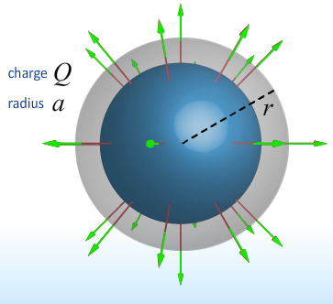
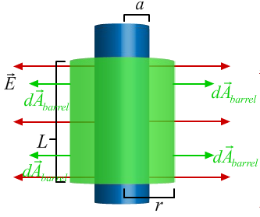
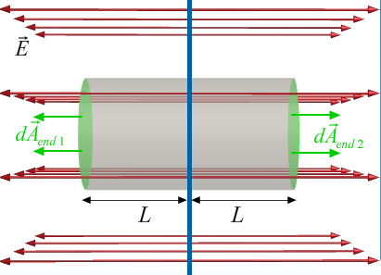
Gauss’ Law Symmetries
ALWAYS TRUE!
In cases with symmetry can pull E outside and get
Spherical
Cylindrical
Planar
21

Slide 10
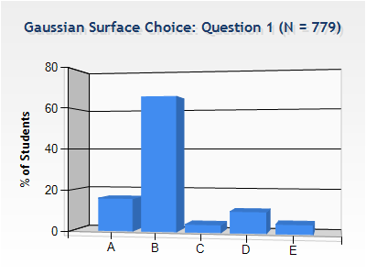
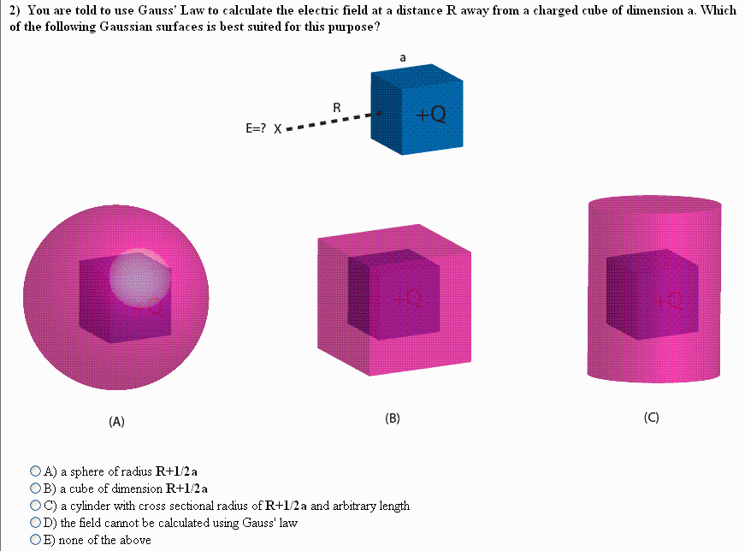
Checkpoint 1
You are told to use Gauss' Law to calculate the electric field at a distance R away from a charged cube of dimension a. Which of the following Gaussian surfaces is best suited for this purpose?
“A sphere catches all of the lines.”
“All sides of the Gaussian surface will now be perpendicular to the electric field lines.”
“The field lines are not always perpendicular to the surface and thus we cannot calculate Gauss law“
(A) (B) (C)
(D) The field cannot be calculated using Gauss’ Law
(E) None of the above
THE CUBE HAS NO GLOBAL SYMMETRY !
THE FIELD AT THE SURFACE OF THE CUBE IS NOT PERPENDICULAR OR PARALLEL TO THE SURFACE
3D POINT  SPHERICAL
2D LINE  CYLINDRICAL
1D PLANE  PLANAR
23

Slide 11
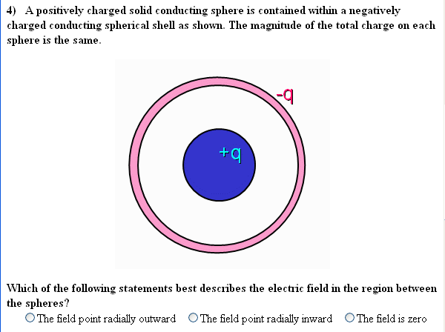
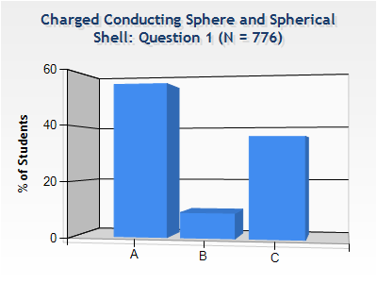
Checkpoint 3.1
A positively charged solid conducting sphere is contained within a negatively charged conducting spherical shell as shown. The magnitude of the total charge on each sphere is the same.
Which of the following statements best describes the electric field in the region between the spheres?
A. The field points radially outward B. The field points radially inward C. The field is zero
“I would expect a test charge placed in the region between the spheres to travel away from the positive inner charge and toward the outer negative charge.“
“The charge enclosed is negative. Therefore, the electric field points towards the center.”
“Electric field inside a conductor should be zero.“
Careful: what does inside mean?
This is always true for a solid conductor (within the material of the conductor)
Here we have a charge “inside”
26
Notes:
Draw gaussian surfaces and field

Slide 12
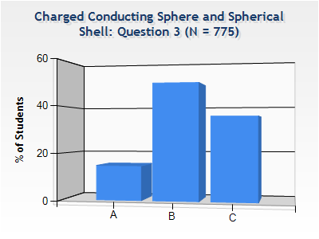
Checkpoint 3.3
A positively charged solid conducting sphere is contained within a negatively charged conducting spherical shell as shown. The magnitude of the total charge on each sphere is the same.
Which of the following statements best describes the electric field in the region outside the red sphere?
A. The field points radially outward B. The field points radially inward C. The field is zero
What is direction of field OUTSIDE the red sphere?
Imagine a Gaussian sphere larger than the red sphere:
the total charge enclosed is zero!
29

Slide 13
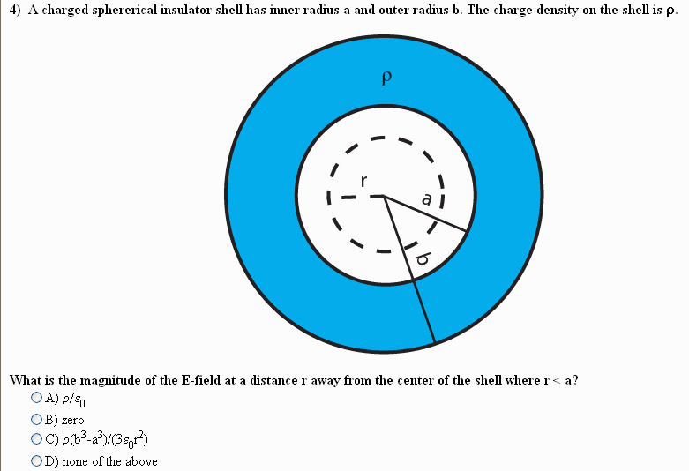
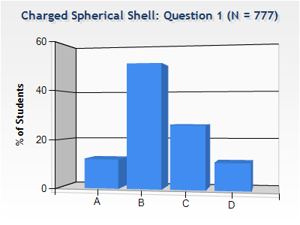
Checkpoint 2
A charged spherical insulating shell has an inner radius a and outer radius b. The charge density of the shell is ρ.
What is the magnitude of the E field at a distance r away from the center of the shell where r < a?
A. ρ/ε₀
B. zero C. ρ(b³-a³)/(3ε₀r²) D. none of the above
“The E-field isn't 0 and should not depend on b or a when r < a.”
“There is no charge inside the Gaussian surface radius r“
“The magnitude of the electric field varies with the volume of the insulator.“
31

Slide 14
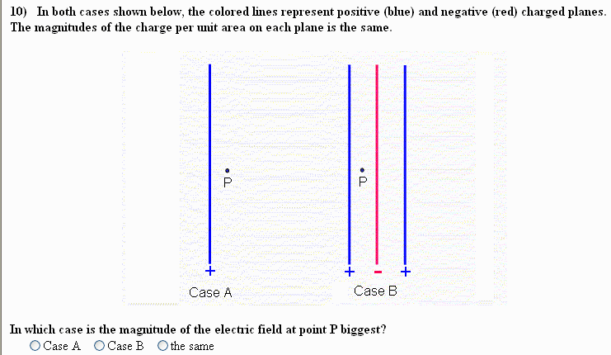
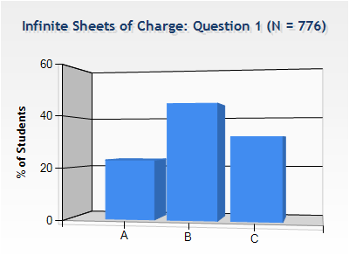
Checkpoint 4
In both cases shown below, the colored lines represent positive (blue) and negative charged planes. The magnitudes of the charge per unit area on each plane are the same.
In which case is E at point P the biggest?
A) A B) B C) the same
“In case B the positive and negative planes around P will create an electric field of 0, so the only other contribution is the positive plane on the right, which is farther away than the plane in case A.“
“Because there are multiple charges around P in case B, the field is larger there.“
“distance does not matter for charged planes. So one negative and one positive plane will cancel out in Case B.“
27

Slide 15
Superposition:
NET
+
+
-
+
Case A
Case B
34

Slide 16
Calculation
y
r₂
neutral
conductor
Point charge +3Q at center of neutral conducting shell of inner radius r₁ and outer radius r₂.
a) What is E everywhere?
+3Q
r₁
x
First question: Do we have enough symmetry to use Gauss’ Law to determine E?
Yes.. Spherical Symmetry (what does this mean???)
A
B
C
D
Magnitude of E is fcn of r
A
B
C
D
Direction of E is along
Magnitude of E is fcn of (r-r₁)
Direction of E is along
Magnitude of E is fcn of (r-r₂)
Direction of E is along
None of the above
None of the above
SPHERICAL SYMMETRY IS GENERATED BY A POINT !!
36

Slide 17
y
Calculation
r₂
neutral
conductor
Point charge +3Q at center of neutral conducting shell of inner radius r₁ and outer radius r₂.
a) What is E everywhere?
+3Q
r₁
We know:
magnitude of E is fcn of r
direction of E is along
x
We can use Gauss’ Law to determine E
Use Gaussian surface = sphere centered on origin
r < r₁
r₁ < r < r₂
r > r₂
A
B
C
A
B
C
40
Notes:
Do calculation

Slide 18
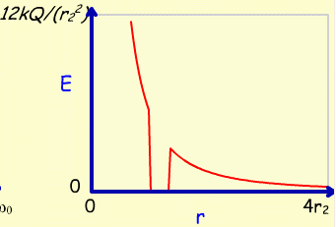
y
Calculation
r₂
neutral
conductor
Point charge +3Q at center of neutral conducting shell of inner radius r₁ and outer radius r₂.
a) What is E everywhere?
+3Q
r₁
We know:
x
r < r₁
r > r₂
r₁ < r < r₂
b) What is charge distribution at r₁?
A
B
C
Gauss’ Law:
r₂
+3Q
Similarly:
r₁
44

Slide 19
y
Calculation
-Q
Suppose give conductor a charge of -Q
What is E everywhere?
What are charge distributions at r₁ and r₂?
r₂
conductor
+3Q
r₁
+
+
+
+
x
r₂
+
+
+
+
+3Q
r₁
+
+
+2Q
+
+
-3Q
+
+
+
+
+
+
r < r₁
r > r₂
r₁ < r < r₂
A
B
C
A
B
C
46

