Slide 1
Quiz me application
Muhammed Marenah

Slide 2
Application Scenario and Problem Statement
Essential to have a platform that provides opportunities for self-testing
My goal was t create a simple project that covers a range of material I learned this semester.
In addition to create a quiz application that tests the users knowledge and provides feedback as well.

Slide 3
What Quiz me can do
User authentication via the Login class
Shows presentation of rules before beginning the quiz through the Rules class
Interactive multiple-choice quiz with a timer, managed by the Quiz class
Detailed score report and performance review in the Score class when test is completed

Slide 4
Building The System
Developed using Java and Swing for the user interface
Leveraged Object-Oriented Programming concepts to create a modular and scalable design
Used arrays and loops to manage questions, answers, and user interactions
Revised code and user experience with the help of user Feeback/ external sources e.g. Stack overflow

Slide 5
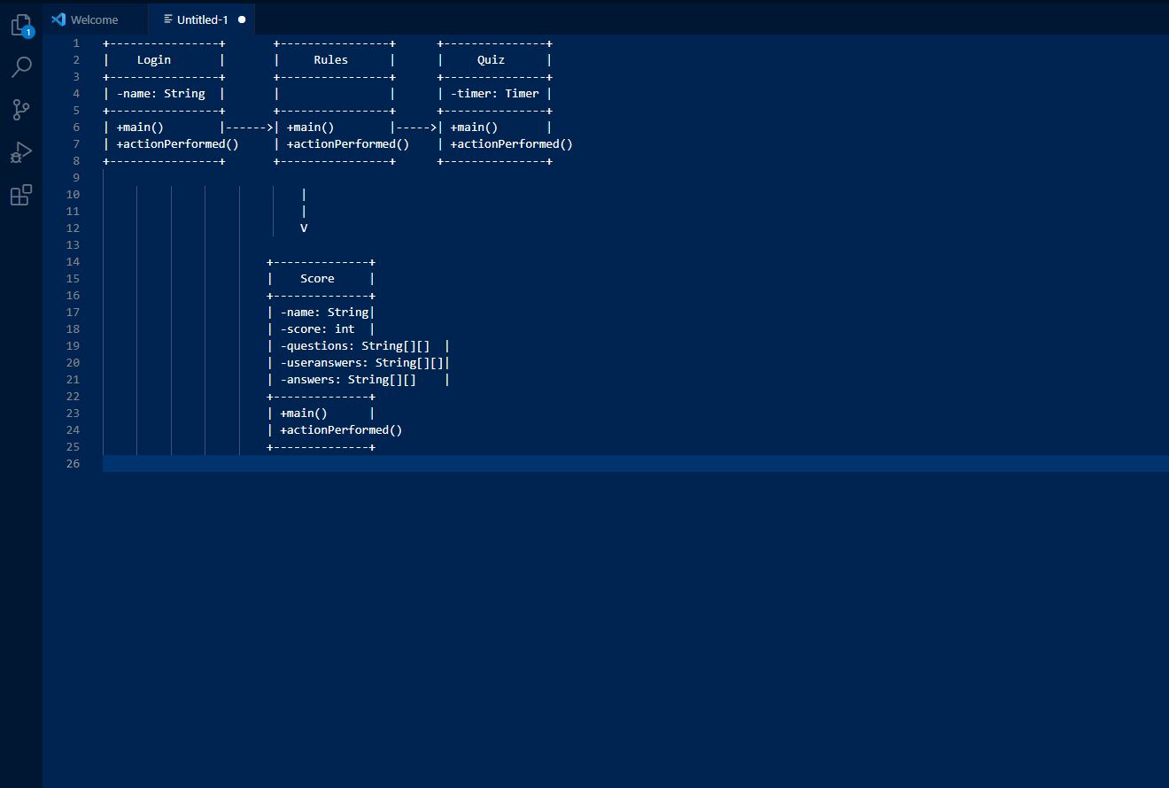
UML Class Diagram
Login class: Handles user authentication.
Rules class: Presents quiz rules and guidelines.
Quiz class: Manages quiz process, questions, user answers, and score calculation.
Score class: Displays user's performance and correct answers.
The UML Class Diagram highlights their relationship and ensures a well-structured, modular design.

Slide 6
What I Learned
I learned how to use java swings more efficiently and able to understand them more
Apply these principles in real world scenarios
Got a better understanding of OOP concepts such as inheritance, encapsulation and polymorphism.

Slide 7
Future Plans
In the future I would like to create a mobile version on an app so it can be more portable and convenient
In addition, my original idea was to create a database, but I had trouble establishing a connection, in the future I would like to learn more about databases and how to establish a connection to store data.

Slide 8
THANK YOU

