Slide 1
Quiz me application
Muhammed Marenah

Slide 2
Application Scenario and Problem Statement
I always believed the best way of studying was to perform self assessments rather than studying the notes constantly.
My goal was to create a simple project that covers a range of material I learned this semester.
In addition to create a quiz application that tests the user's knowledge and learn new things while providing feedback

Slide 3
What Quiz me can do
Contains User authentication via the Login class where the user can input their name.
Shows presentation of rules before beginning the quiz through the Rules class
Interactive multiple-choice quiz with a timer, managed by the Quiz class.
Made using a timer object in the quiz class with and if and else statements incorporates.
50-50 lifeline feature where it can eliminate two incorrect answers making it easier for the user to choose the correct answer
Detailed score report and performance review in the Score class when test is completed

Slide 4
Building The System
Developed using Java Swing library which provides tolls and components for the user interface with Netbeans as the Ide
Incorporating Java Abstract Window Toolkit classes such as color, font, dimension to manage appearance of the interface
Used arrays and loops to manage questions, answers, and user interactions in addition to inheritance to extend properties and methods.
Revised code and user experience with the help of user Feeback/ external sources e.g. Stack overflow

Slide 5
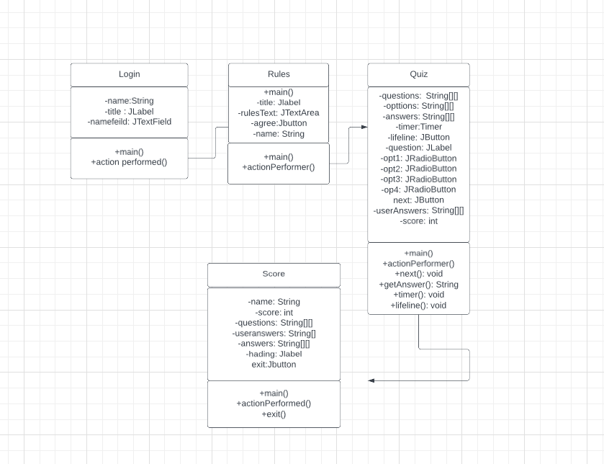
UML Class Diagram
Login class: Handles user authentication. Extends Jframe class which allows it to create the application window. Also instantiating the Rules class.
Rules class: Presents quiz rules and guidelines. Receives users name from the login class and creates an instance of the quiz class when the start button is pressed
Quiz class: Displays quiz question manages quiz process, questions, user answers, and score calculation. Also has a timer and lifeline object.
Score class: Displays user's performance and correct answers.
The UML Class Diagram highlights their relationship and ensures a well-structured, modular design.
The Login class leads to the Rules class, which then moves to the Quiz class, and finally ends at the Score class. and the classes are connected by passing data between them, such as the user's name, score, and question-related information.

Slide 6
What I Learned
I learned how to use java swing library more efficiently and able to understand them more and apply these principles in real world scenarios.
how to handle various user events, such as button clicks and text field input, to create interactive and responsive applications.
Got a better understanding of OOP concepts such as inheritance, encapsulation and link classes
Learned how to use different IDES such as NetBeans and eclipse incorporate GUIs with them
Timer implementation: Learned to includes a timer that counts down during the quiz helped which learn about Java's timer functionality and its application in real-world scenarios.

Slide 7
Future Plans
In the future I would like to create a mobile version app so it can be more portable and convenient for the user.
In addition, my original idea was to create a database, but I had trouble establishing a connection, in the future I would like to learn more about databases and how to establish a connection to store data.

Slide 8
THANK YOU

