Slide 1
Dexy Bot
ETHDenver 2025
DeFi | Base AgentKit | Onchain AI Trading & Risk Management
Team Name: VIN ROUGE

Slide 2
Introduction
Autonomous AI-driven crypto trading bot
Combines onchain & offchain risk signals
Leverages Base’s AgentKit for onchain execution
Helps traders & investors manage portfolio risk
Uses Telegram bot as friendly UI layer

Slide 3
Problem Statement
Crypto traders lack automated risk management tools
Onchain investors struggle with timely portfolio adjustments
Yield farmers & leveraged traders need adaptive risk exposure
Non-experts & HNW investors require easy risk-adjustment solutions

Slide 4
Solution: AI Agent Powered Trading Bot
AI Agent integrates onchain & offchain signals
Automates trading decisions based on risk signals
Uses Base AgentKit for seamless execution
Offers real-time portfolio rebalancing & risk adjustment

Slide 5
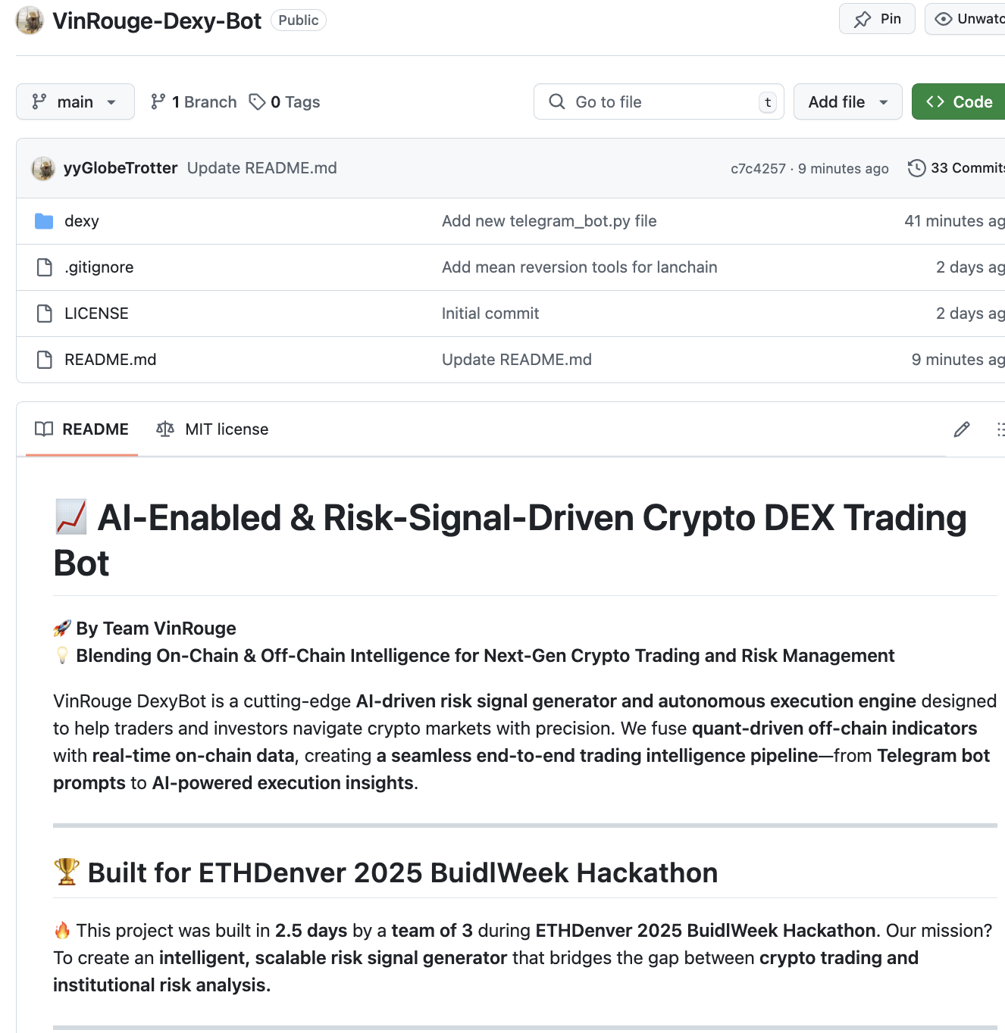
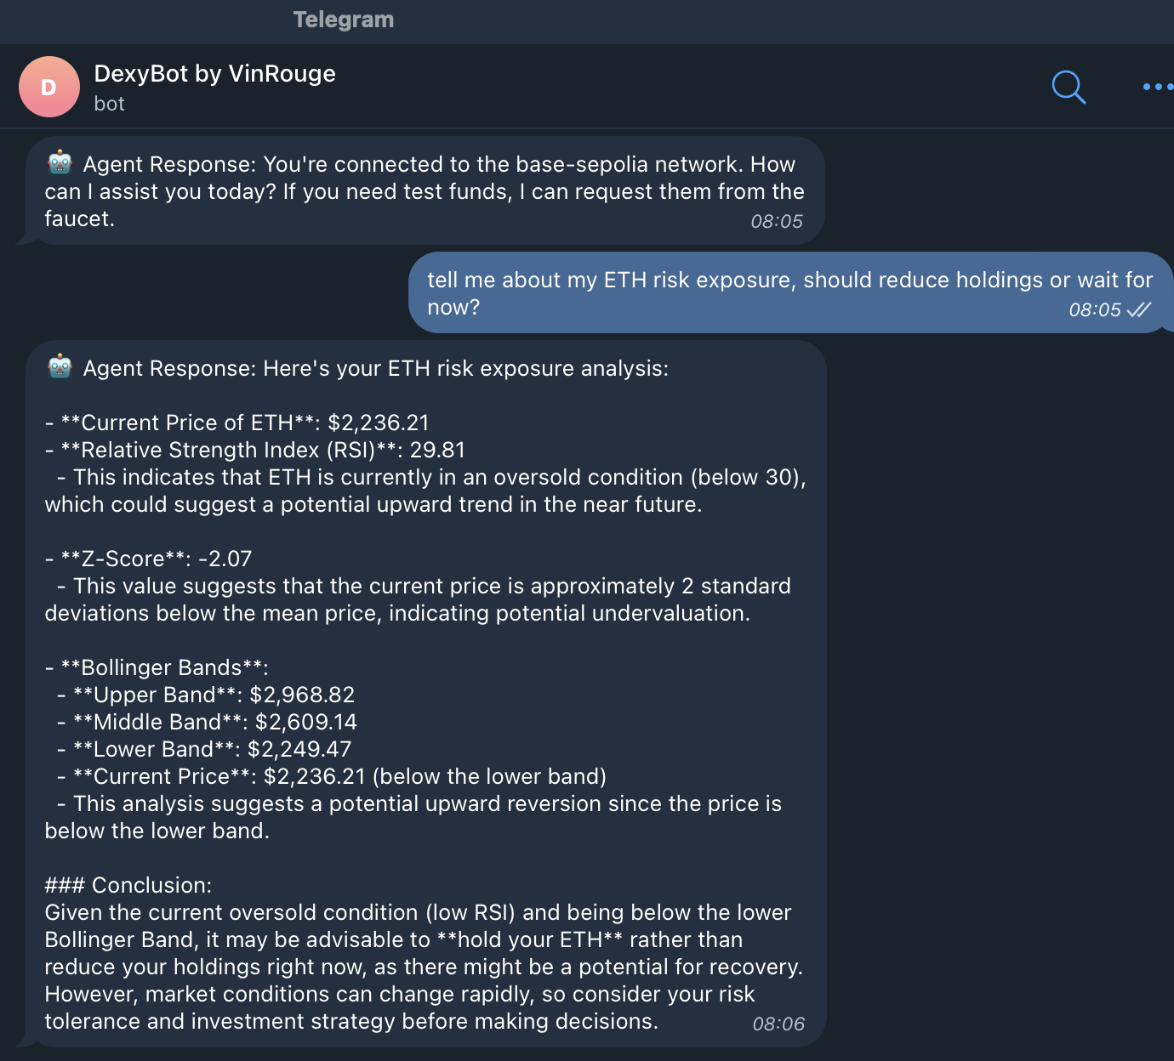
Buidler/User experience

Slide 6
How It Works
1. User requests portfolio risk analysis
2. AI agent fetches onchain & offchain trading signals
3. Generates smart recommendations (e.g., reduce exposure immediately if high risk signal received)
4. Executes trades autonomously using Base AgentKit

Slide 7
Technology Stack
AI & ML: Z-score, RSI, SMA, Bollinger Bands
Onchain Data: Whale transactions, BTC dominance
Execution: Base AgentKit (autonomous trade execution)
Smart Wallet for automated fund management
Telegram Bot: Next gen user interface
Speed Optimized for Real-time Decisions
Scalable to CEX & DEX Integrations
Secure & Resilient Infrastructure

Slide 8
Competitive Advantage
Combines both offchain & onchain signals
Uses Base’s latest AgentKit for execution
Autonomous portfolio management for different user types
Scalable, modular framework for future enhancements

Slide 9
Demo & Use Case
Watch our AI trading bot in action!
[Insert Demo Video Link]
Example: Rebalancing a high-yield farming portfolio
Example: Helping an HNW investor reduce BTC exposure

Slide 10
Future Roadmap
Expand data sources for better accuracy
Enhance execution speed for real-time trading
Integrate with both DEX & CEX platforms
Add advanced dashboards & reporting
Explore DeFi 2.0 integrations for yield optimization

Slide 11
What Prize we aim to win & Why us
✔ DeFi 2.0: Advanced risk management for traders & investors
✔ Base AgentKit Prize: Fully autonomous trading execution on Base
✔ Base Bounty: Open-source, deployed on Base, fully onchain
* Innovative AI Agent that abstracts crypto complexities
* Consumer-friendly UX & solves real-world trading pain points

Slide 12
Next Steps & Call to Action
Test our trading bot prototype
Collaborate & refine AI trading signals
Scale to more DeFi protocols
Seeking feedback & potential partnerships!
Team VinRouge on TG: @Dolce0xVita @Louis_yellow @mitch0x

