Slide 1
Illumina paired-end read sequencing simulator
Marija Maricic 3044/18
Ivana Cicvaric 3042/18

Slide 2
Agenda
Goal of our project
Illumina sequencer
Our sequencer
Bwa mem tool
Quality evaluation for bwa mem tool
Future work

Slide 3
Goal of our project
Implement sequencing simulator that creates artificial Illumina paired-end reads
Align created reads and save it in SAM file
Evaluate the quality of BWA-MEM tool

Slide 4
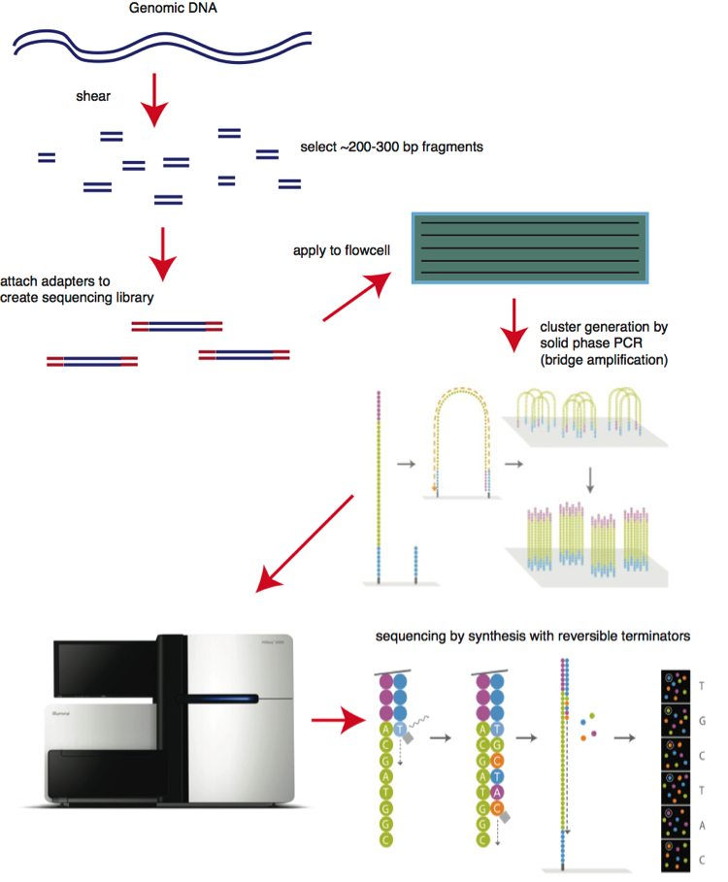
Illumina sequencer
Illumina sequencing is a technique used to determine the series of base pairs in DNA.
The way it works can be summed up to 7 steps:
Shearing (fragmentation of the genome)
Attaching adapters
PCR amplification (optional)
Attaching template to surface/flowcel
PCR/bridge amplification (cluster creation)
Adding fluorescent bases and taking a picture after each cycle
Stack up images and read the sequence

Slide 5
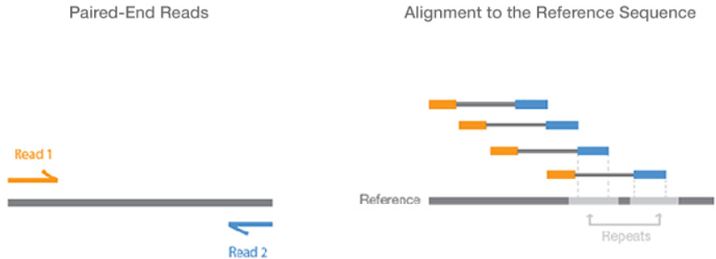
Paired-end reads
Two reads from the two ends of the same fragment
One read is “forward” while the other is “reverse” and complemented

Slide 6


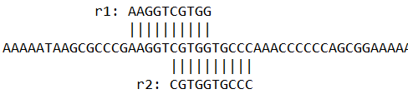

Paired-end reads
Reads are written in FASTQ
Example from our sequencer
Read1: Read2:
Alignments of the reads on reference genome:
Read2 was reverse complemented

Slide 7
Our sequencer
Sequencer parameters:
refGenomeFile - path to the FASTA file with reference genome
quality - average quality of nucleotids.
coverage - wanted coverage
readSize - size of a single read
insertSize - size of a fragment
[OPTIONAL] errorSNV(=0) - error probability for SNV.
[OPTIONAL] errorInDel(=0) - error probability for INS/DEL.

Slide 8
Our sequencer
Process steps:
[Optional] Generate mutations
Calculate number of fragments
Randomly select fragment from reference genome
Get first read and generate its quality
Get second read and generate its quality
Write reads in FASTQ file and its alignments in SAM file
Repeat steps 3. – 6. until all fragments are selected

Slide 9

Our sequencer
Example of our SAM file for the reads shown earlier
It contains
Header lines
QNAME
POS
SEQ
QUAL

Slide 10
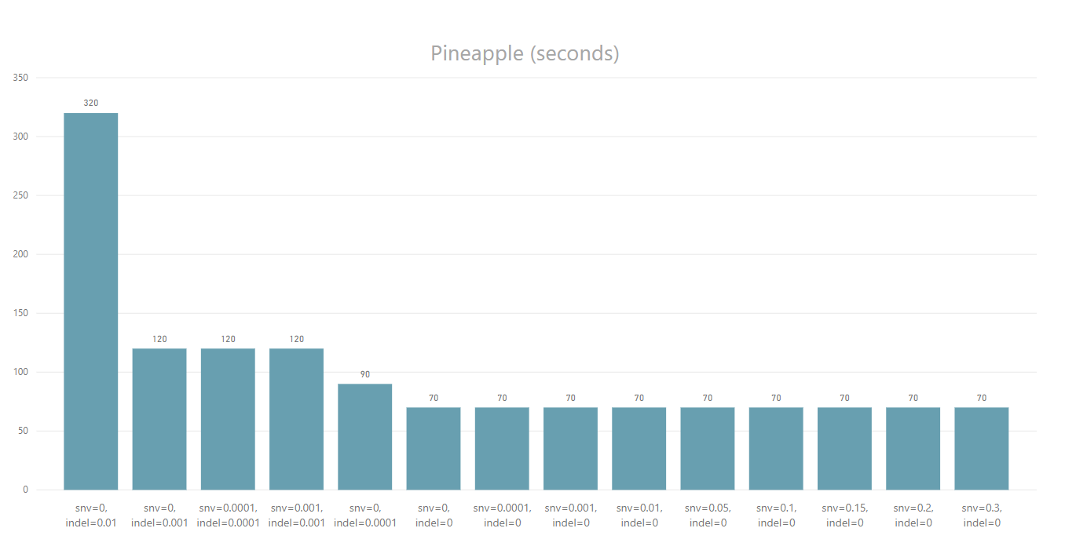
Our sequencer – execution time for pineapple chromosome
Ananas comosus chromosome 23 (~8M base pairs)

Slide 11
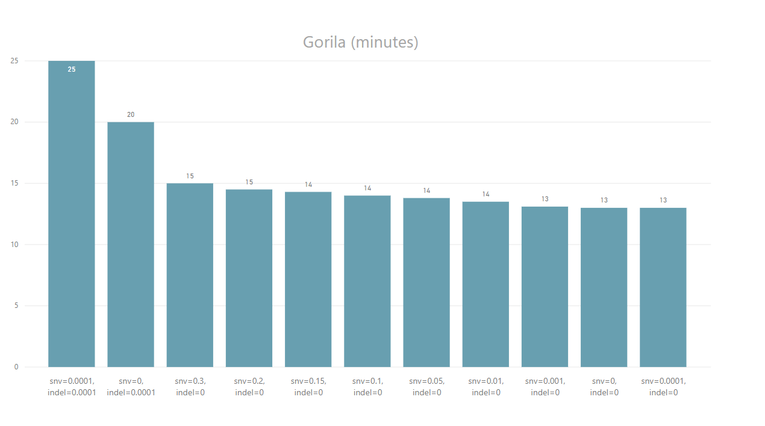
Our sequencer – execution time for gorila chromosome
Gorilla gorilla chromosome 16 (~80M base pairs)

Slide 12
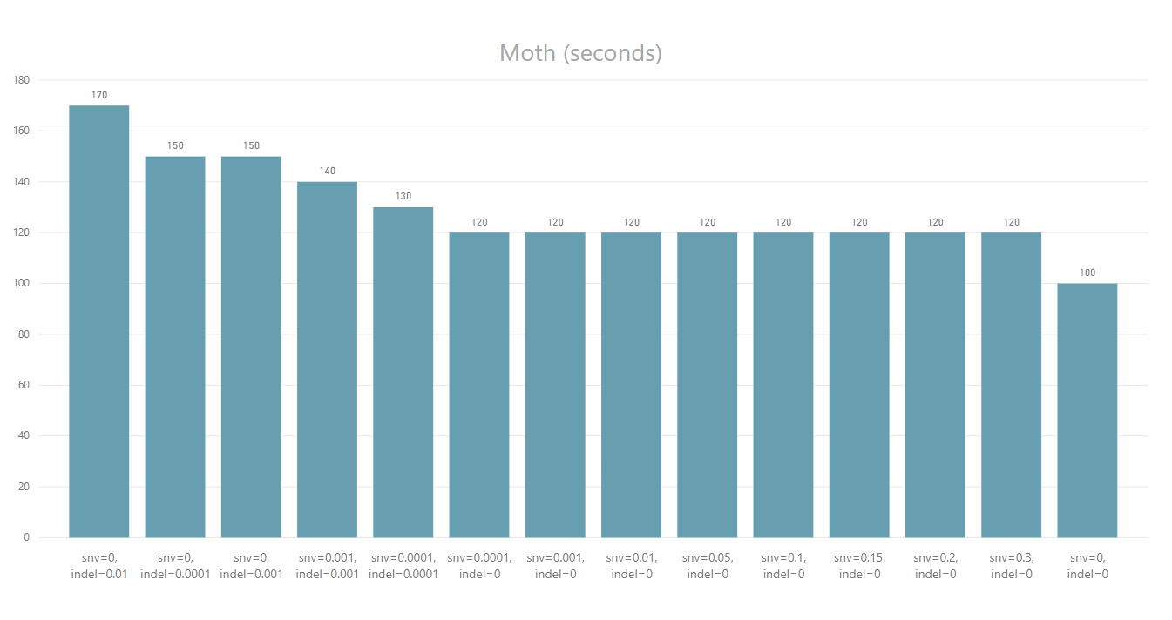
Our sequencer – execution time for moth chromosome
Spodoptera litura chromosome 12 (~10M base pairs)

Slide 13
BWA-MEM tool
BWA is a software package for mapping low-divergent sequences against a large reference genome.
BWA-MEM is one of the three algorithms it consists of. It is designed for Illumina sequence reads ranged from 70bp to 1Mbp.
BWA-MEM is generally recommended for high-quality queries as it is faster and more accurate.
In order to use the algorithm, FM-index has to be created first

Slide 14
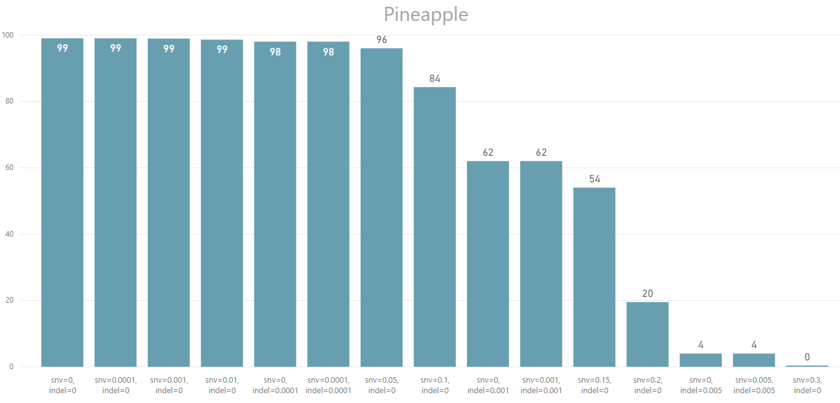
Quality evaluation for BWA-MEM tool
Ananas comosus chromosome 23

Slide 15
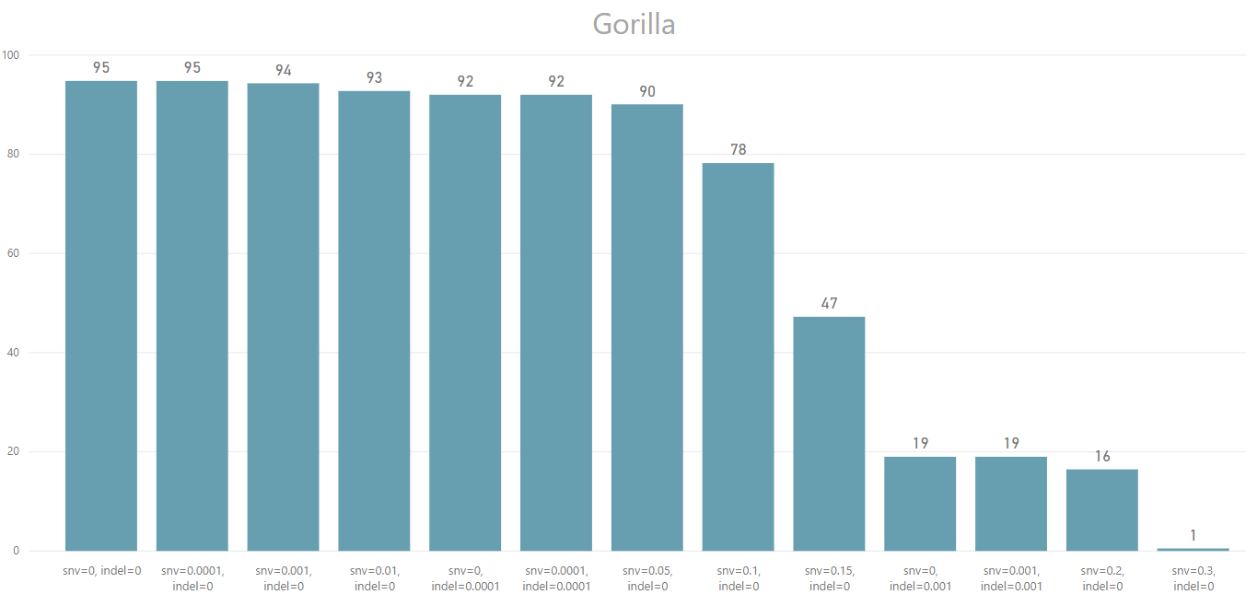
Quality evaluation for BWA-MEM tool
Gorilla gorilla chromosome 16

Slide 16
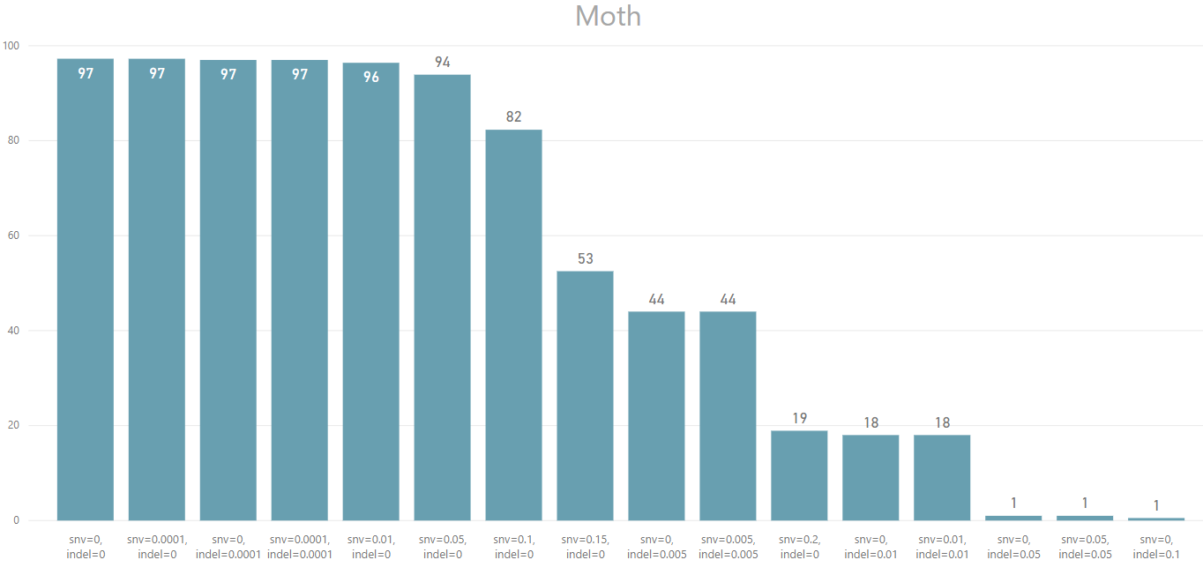
Quality evaluation for BWA-MEM tool
Spodoptera litura chromosome 12

Slide 17
Future work
Improve the time necessary for sequencing
Parallelization
Improved code
Other programming language
Modify the look of created SAM file – respect the format completely
BWA-MEM algorithm – improve aligning when INDEL mutations are present

Slide 18
Thanks for your attention!

