Slide 1
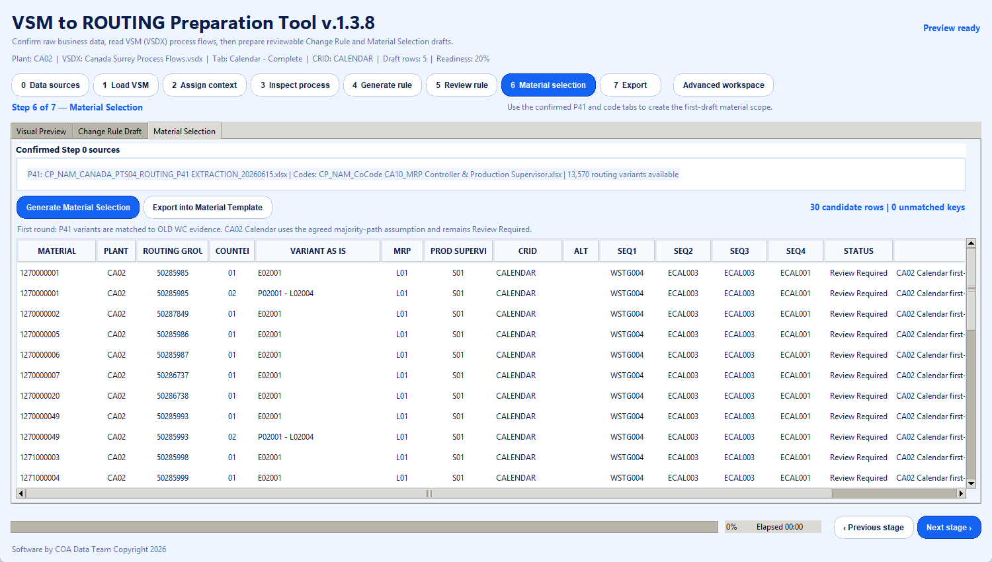
VSM TO ROUTING
Preparation Tool
v1.3.8
Simulated operating walkthrough
CA02 • Calendar department
Real source workbooks and VSM page
5 draft Change Rule rows
30 draft Material Selection candidates
Purpose
Automate the first draft; keep manufacturing executives and process owners responsible for final approval.
Software by COA Data Team Copyright 2026
Notes:
This deck documents a simulated end-to-end run of VSM to ROUTING Preparation Tool v1.3.8 using the CA02 Calendar department. The simulation uses the shared source workbooks and the Canada Surrey Process Flows VSDX. Outputs are first drafts and remain subject to process-owner review.

Slide 2
PROCESS OVERVIEW
Eight gated stages from raw data to reviewable outputs
The operator advances only after the current gate has enough evidence. Advanced controls stay available without crowding the guided path.
0
1
2
3
4
5
6
7
Data
sources
Load
VSM
Assign
context
Inspect
process
Generate
rule
Review
rule
Material
selection
Export
INPUT PREPARATION
RULE PREPARATION
OUTPUT PREPARATION
Confirm workbook sheets, load the VSM, and bind each page to Plant + CRID.
Inspect workcentres, generate draft rules, and resolve ambiguous mappings.
Generate material candidates and export templates or a complete package.
Control principle: the app proposes; the manufacturing process owner approves.
Simulated walkthrough | CA02 Calendar
2
Notes:
This is a manufacturing-style gated workflow. Stages 0 to 2 establish trusted context, stages 3 to 5 prepare and review routing changes, and stages 6 to 7 prepare material selection and exportable packages.

Slide 3
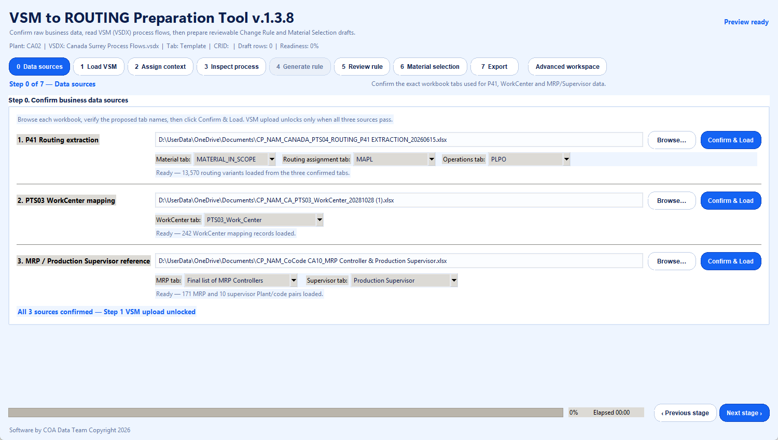
STEP 0 OF 7
Confirm the three data sources
0
Data sources
Establish one trusted source set before any VSM is loaded.
OPERATOR CONFIRMS
Workbook identity and the exact sheet selected for every required dataset.
13,570 routing variants • 242 WorkCenter mappings • 171 MRP codes • 10 supervisor Plant/code pairs
Simulated walkthrough | CA02 Calendar
3
Notes:
Selected tabs: P41 extraction — MATERIAL_IN_SCOPE, MAPL, PLPO; WorkCenter reference — PTS03_Work_Center; code reference — Final list of MRP Controllers and Production Supervisor. The user confirms each sheet before the source is accepted.

Slide 4
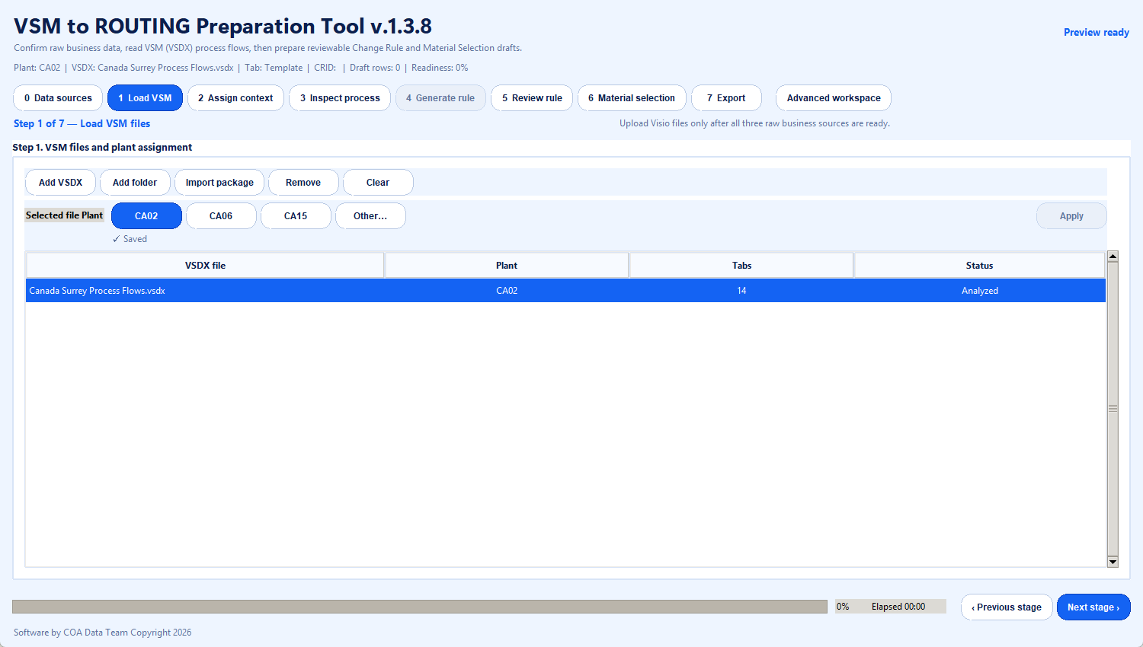
STEP 1 OF 7
Load the VSM and assign its Plant
1
Load VSM
Add the process-flow file, scan its pages, and set the Plant context.
OPERATOR CONFIRMS
The intended VSDX file and CA02 as the Plant for this simulation.
Canada Surrey Process Flows.vsdx • 14 pages detected • file status Analyzed
Simulated walkthrough | CA02 Calendar
4
Notes:
The simulation loads Canada Surrey Process Flows.vsdx and assigns Plant CA02. The file is scanned before moving to page-level context.

Slide 5
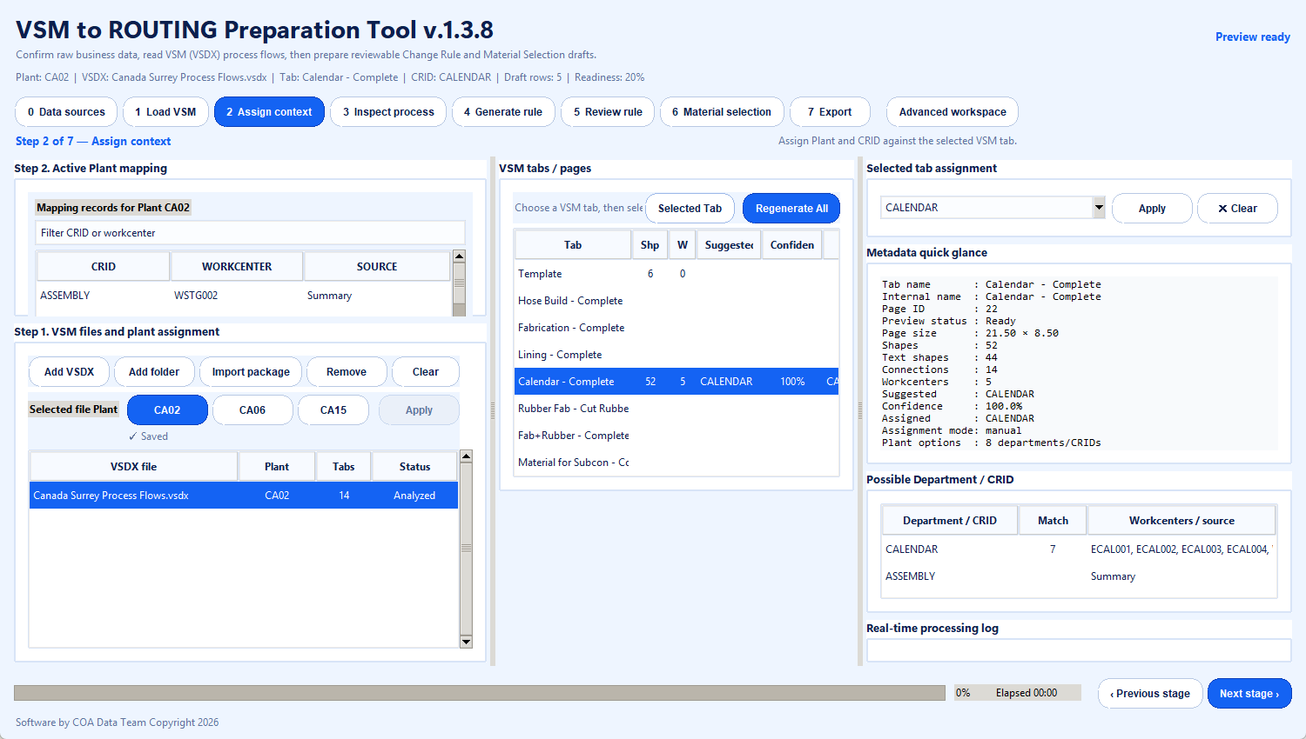
STEP 2 OF 7
Assign the Calendar page to its CRID
2
Assign context
Bind the selected VSM page to the business department used downstream.
OPERATOR CONFIRMS
Calendar - Complete is the intended page and CALENDAR is the correct CRID.
52 shapes • 44 text shapes • 14 connections • 5 workcentres • selected assignment CALENDAR
Simulated walkthrough | CA02 Calendar
5
Notes:
The CA02 Calendar page is selected from VSM tabs/pages and assigned to CRID CALENDAR. This prevents rules from being generated under the wrong department.

Slide 6
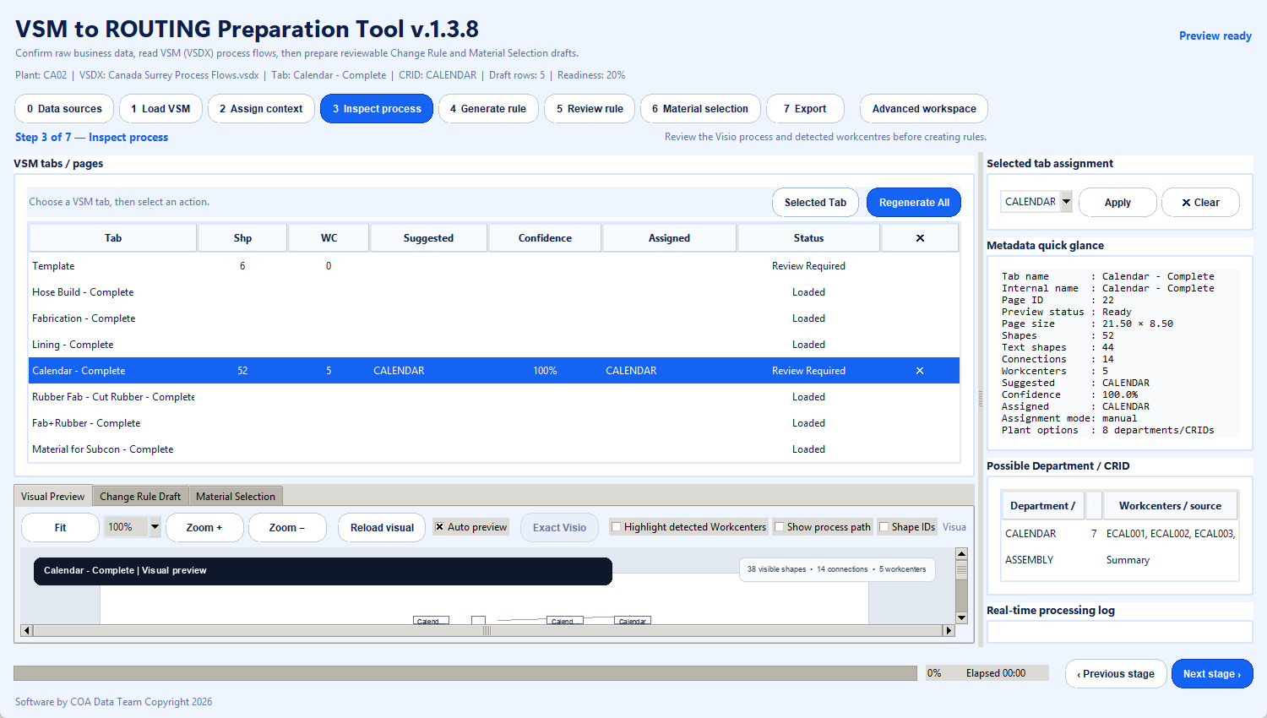
STEP 3 OF 7
Inspect the process before generating rules
3
Inspect process
Review the visual sequence and detected workcentres against the mapping context.
OPERATOR CONFIRMS
The diagram is the right process and its five workcentres are credible inputs.
Visual preview of Calendar - Complete with process text, connectors, sequence and workcentre labels
Simulated walkthrough | CA02 Calendar
6
Notes:
Inspection is a human control gate. The operator verifies that the VSM page, process flow, and detected workcentre labels represent the intended department before rule generation.

Slide 7
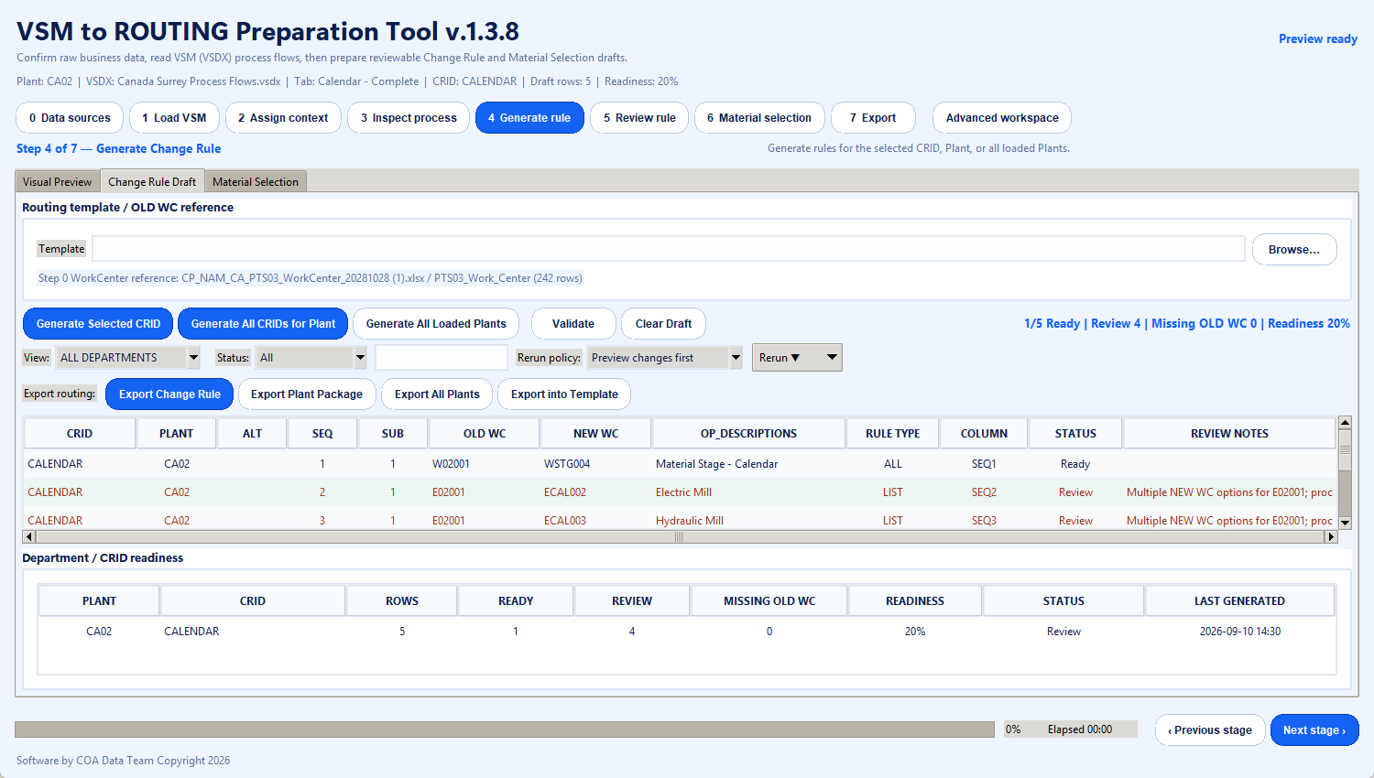
STEP 4 OF 7
Generate the draft Change Rule
4
Generate rule
Translate VSM workcentres into proposed old-to-new routing assignments.
OPERATOR CONFIRMS
Generation scope: selected CRID, every CRID for CA02, or all loaded Plants.
5 Calendar rows generated • 1 Ready • 4 Review • 0 missing OLD WC • readiness 20%
Simulated walkthrough | CA02 Calendar
7
Notes:
For CA02 Calendar the simulation generates five rows: one ALL rule and four LIST rules. Four rows remain Review Required because old workcentre E02001 has multiple possible new-workcentre assignments.

Slide 8
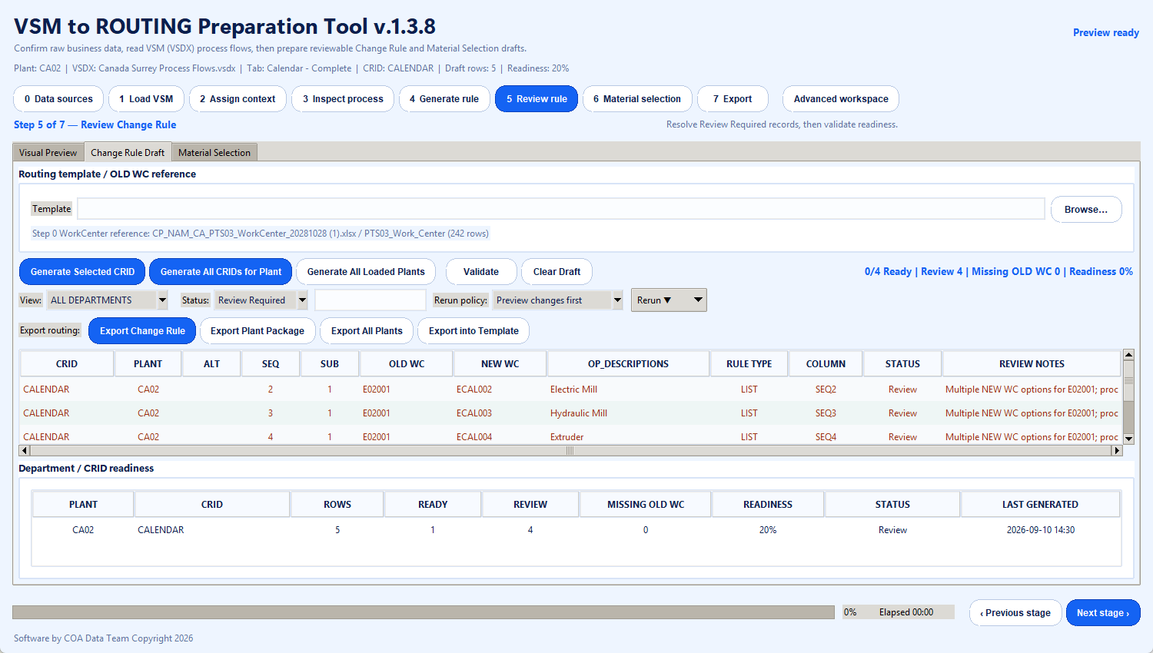
STEP 5 OF 7
Resolve review-required routing rows
5
Review rule
Focus attention on ambiguity instead of treating every generated row as final.
OPERATOR CONFIRMS
The correct new workcentre and sequence for each flagged operation.
Review Required filter isolates 4 LIST rows for process-owner confirmation
Simulated walkthrough | CA02 Calendar
8
Notes:
The review screen filters out the ready row and shows the four ambiguous LIST rules. Manufacturing executives or the process owner must validate the proposed new workcentre before the draft is approved.

Slide 9
STEP 6 OF 7
Generate Material Selection candidates
6
Material selection
Combine P41 routing variants with MRP and Production Supervisor references.
OPERATOR CONFIRMS
Plant and CRID scope, reference files, and whether Review Required candidates are acceptable.
30 candidate material rows • 0 unmatched routing references • all retained for human review
Simulated walkthrough | CA02 Calendar
9
Notes:
The simulation uses the shared P41 extraction plus MRP Controller and Production Supervisor references. It generates 30 CA02 Calendar material candidates. These are first-draft candidates, not autonomous approvals.

Slide 10
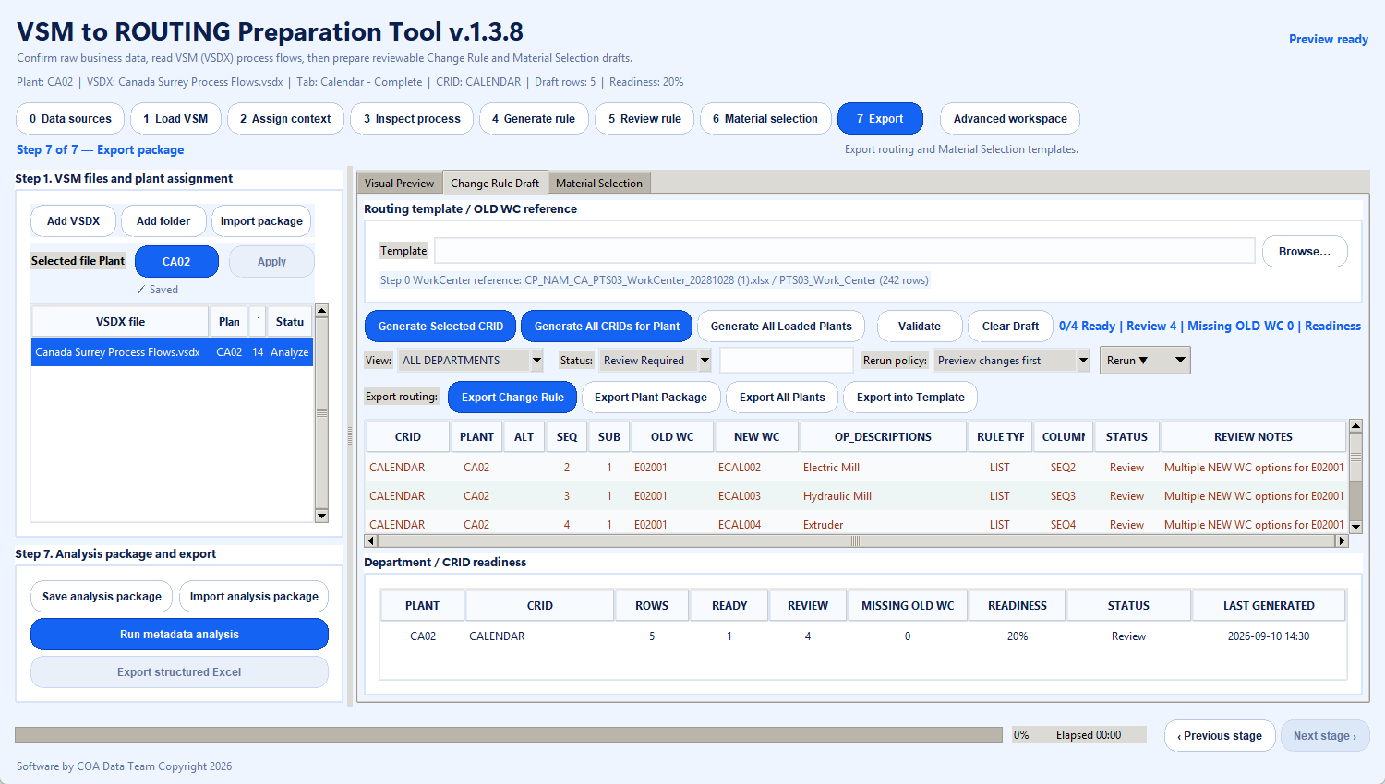
STEP 7 OF 7
Export reviewable outputs
7
Export
Package the prepared Change Rule and Material Selection data for business review.
OPERATOR CONFIRMS
Correct routing template, material template, Plant scope, and destination package.
Available outputs: Change Rule, Plant Package, All Plants, Material Selection, or combined analysis package
Simulated walkthrough | CA02 Calendar
10
Notes:
The export gate keeps output choices together. Templates remain explicit inputs, and final files should be reviewed by the process owner before downstream use.

