Slide 1

Project Manager Web-Application “vqManager” Assanov Temirlan Csse-1803

Slide 2
Table of contents
Omportance
What is it
Features
Unlimited tables
Customization
Teams
Implementation

Slide 3

Hello!
Nice to meet you
Contact us at:
https://github.com/mmario3121
temirlan.asanov.ta@gmail.com
@vqass

Slide 4

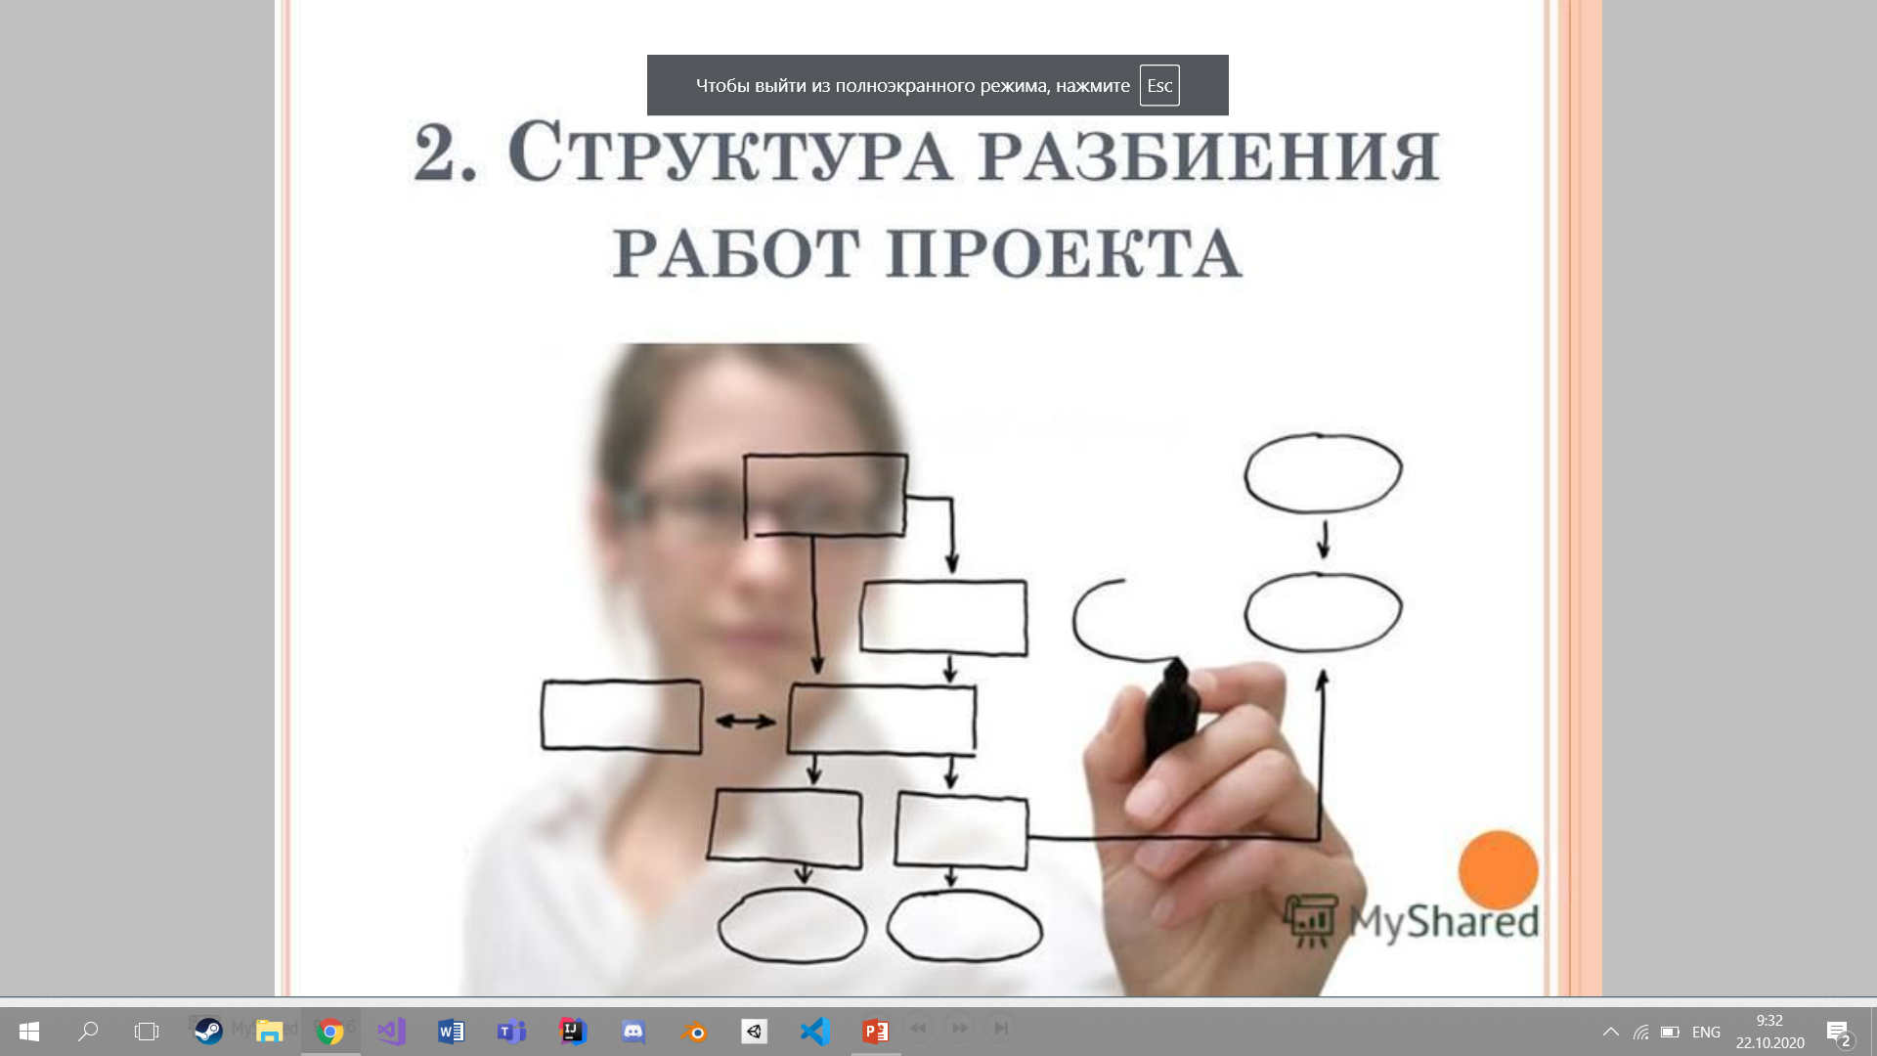
1.
Project planning

Slide 5
Importance
Millions of people start projects everyday. The most important part is almost always the planning and communication between personnel.
Our project is used for:
Planning
Keeping track on the way
Keep track of bugs
List of features that can be added on an update
Before starting
In progress
After

Slide 6
BIG COMPANIES
In the future this project might be popular, since every company uses this kind of apps. And there is no monopoly on the scene

Slide 7

Features

Slide 8
Features
Colors
Customization of tables,
Puncts,
lists
Teams
Work with colleagues with different ideas, tasks, capabilities
Logical
With the coloring, teaming
The whole process is easy and understandable
Achieve your goals
Flexibility of this project will allow users from all differnet spheres to enter.

Slide 9
Project Management
Capture your
ideas
Save time
THE
CONCEPT
Save money
Work together

Slide 10
Our process is easy
Done!
List
Idea

Slide 11
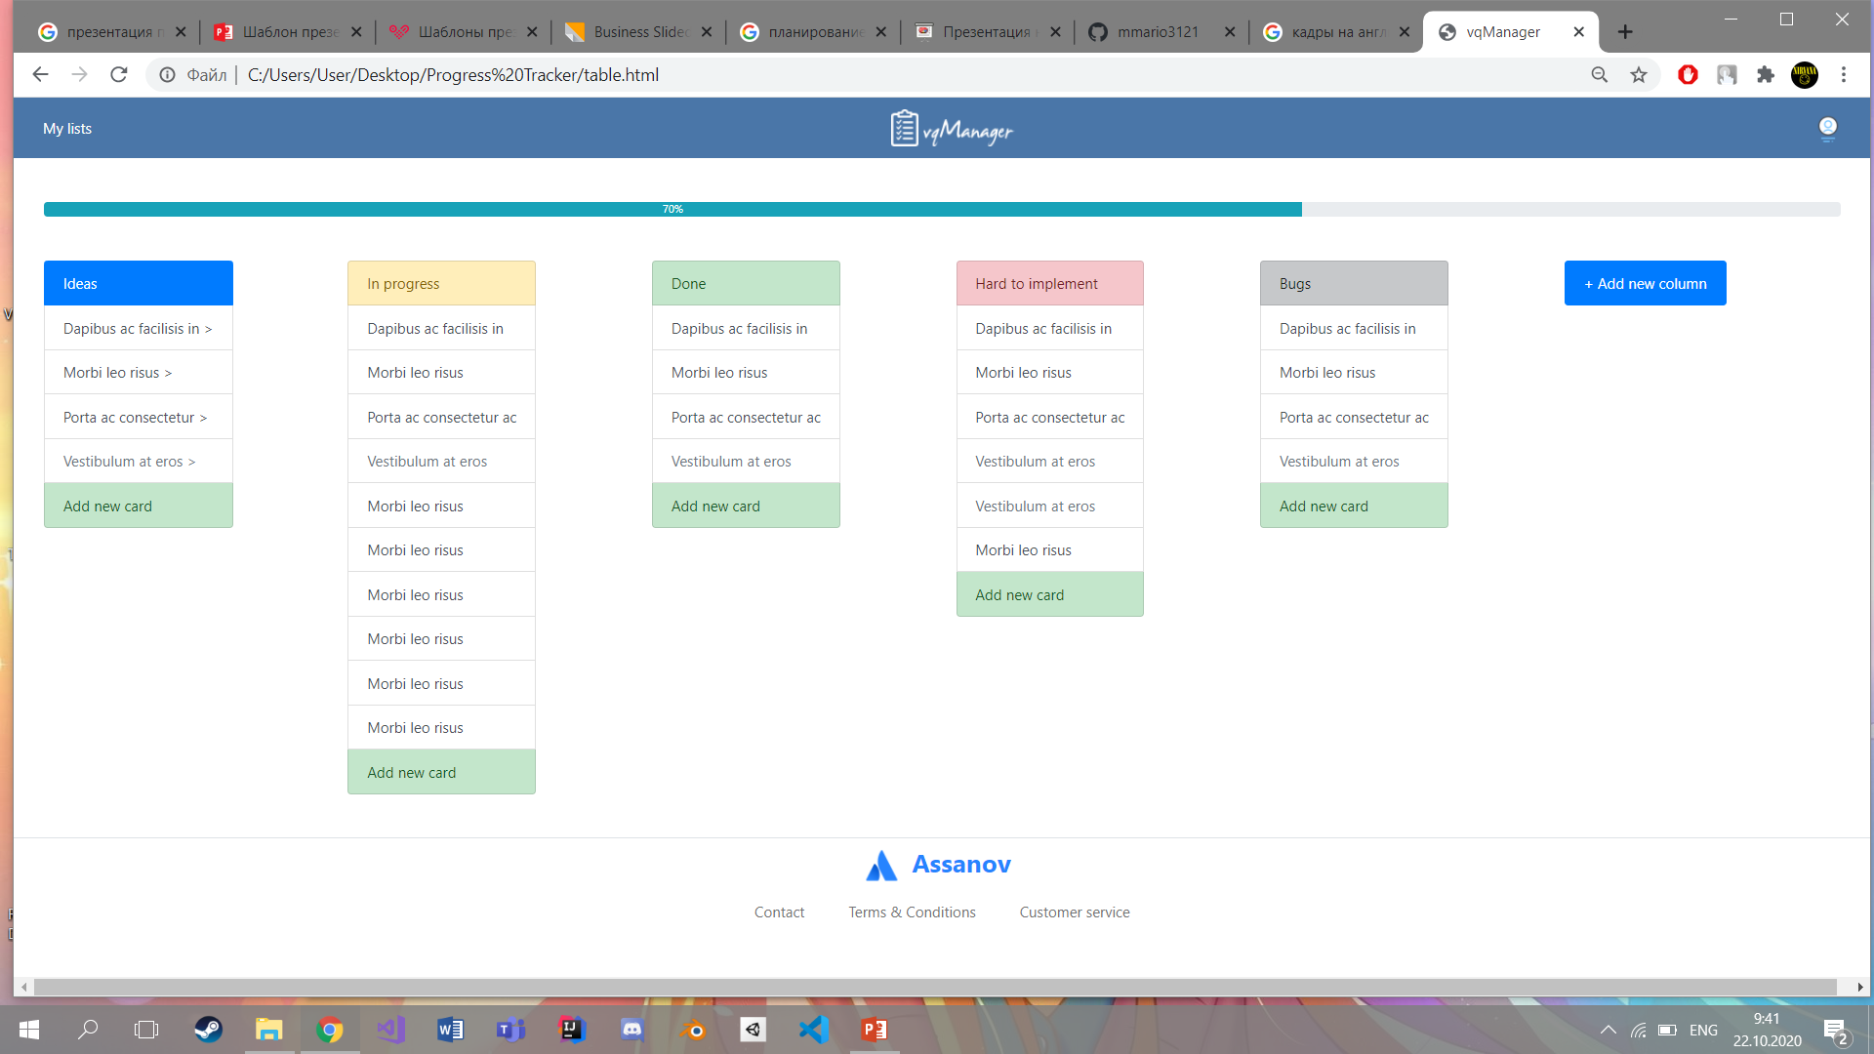
Desktop
Place your screenshot here
The design is simple and can be used on desktop

Slide 12
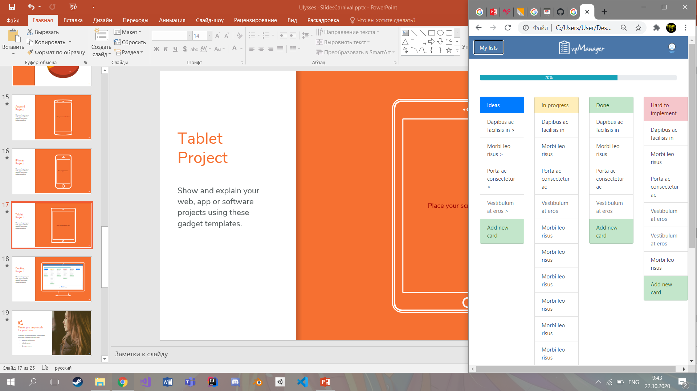
Compatibility
Place your screenshot here
Since this is a web project, it can be used in every platform.
The goal is make the app as responsive as possible

