Slide 1

Recommender Systems class Evaluation and testing

Slide 2
Evaluation measures
Regression
MSE
RMSE
MAE
MAPE (MRE)
TRE
Classification
Sensitivity/Recall/True Positive Rate
Precision
Accuracy
F1 score
Ranking
HR@n
NDCG@n
MAP@n

Slide 3
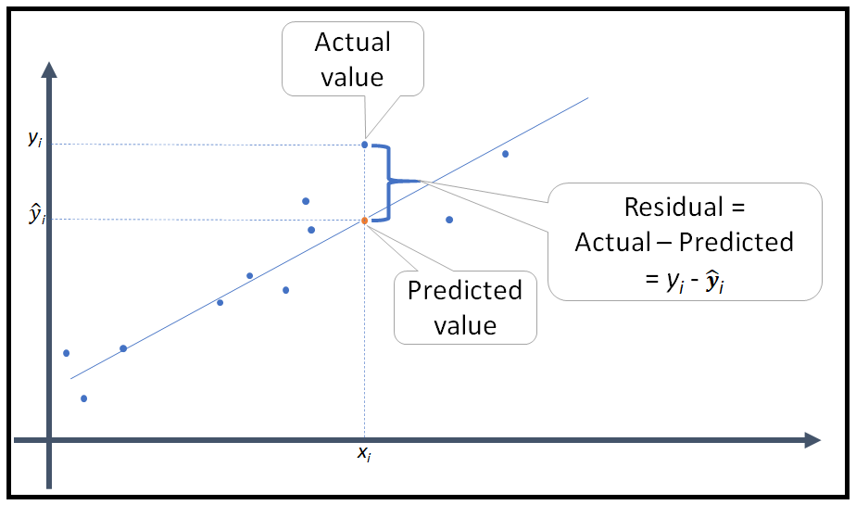
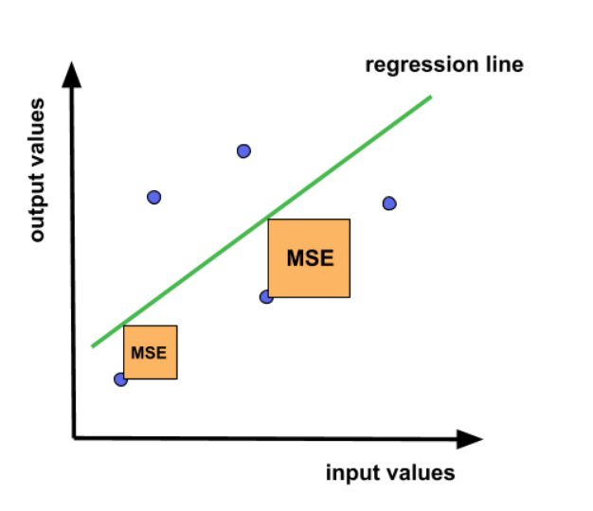

Regression evaluation measures
MAE – Mean Absolute Error
$$\frac{1}{n}\sum_{i=1}^{n}{\left|{\hat{y}}_{i}−y_{i}\right|}$$
MSE – Mean Squared Error
$$\frac{1}{n}\sum_{i=1}^{n}{{ ({\hat{y}}_{i}−y_{i})}^{2}}$$
RMSE – Root Mean Squared Error
$$\sqrt{\frac{1}{n}\sum_{i=1}^{n}{{ ({\hat{y}}_{i}−y_{i})}^{2}}}$$
MAPE (MRE) – Mean Absolute Percentage Error (Mean Relative Error)
$$\frac{1}{n}\sum_{i=1}^{n}{\frac{\left|{\hat{y}}_{i}−y_{i}\right|}{\left|y_{i}\right|}}$$
TRE – Total Relative Error
$$\frac{\sum_{i=1}^{n}{\left|{\hat{y}}_{i}−y_{i}\right|}}{\sum_{i=1}^{n}{\left|y_{i}\right|}}$$

Slide 4
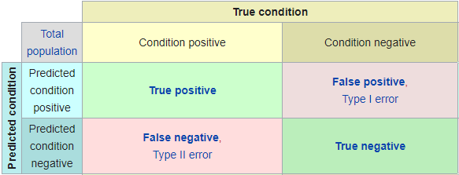
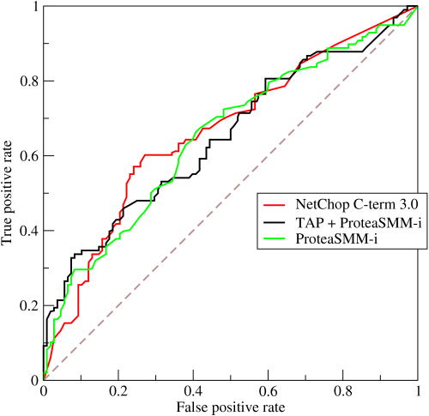

Classification evaluation measures
Sensitivity/Recall/True Positive Rate
$$\frac{TP}{TP+FN}$$
Precision
$$\frac{TP}{TP+FP}$$
Accuracy
$$\frac{TP+TN}{P+N}$$
F1 score
$$\frac{2}{\frac{1}{Sensitivity}+\frac{1}{Precision}}$$
ROC curve
Close to one – good
Close to zero – bad

Slide 5
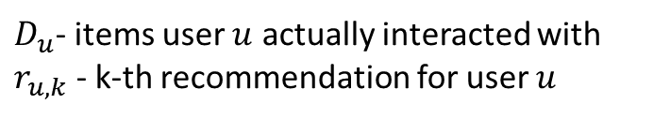
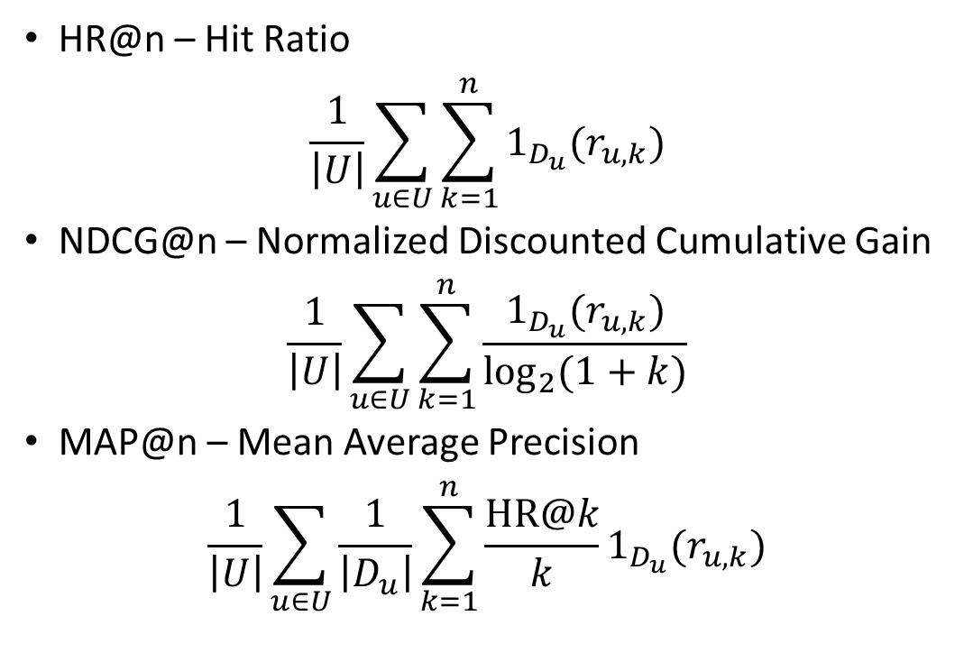
Ranking evaluation measures
Position | Movie | Score
1 | Rocky | 0.98
2 | Interstellar | 0.86
3 | Shrek | 0.83
4 | Shawshank Redemption | 0.75
5 | Lion King | 0.69
6 | Star Wars | 0.61
7 | Apocalypto | 0.55
HR@n – Hit Ratio
$$\frac{1}{\left|U\right|}\sum_{u∈U}{\sum_{k=1}^{n}{1_{D_{u}}(r_{u, k})}}$$
NDCG@n – Normalized Discounted Cumulative Gain
$$\frac{1}{\left|U\right|}\sum_{u∈U}{\sum_{k=1}^{n}{\frac{1_{D_{u}}(r_{u, k})}{\log_{2}{(1+k)}}}}$$
MAP@n – Mean Average Precision
$$\frac{1}{\left|U\right|}\sum_{u∈U}{\frac{1}{\left|D_{u}\right|}\sum_{k=1}^{n}{\frac{\text{HR}\text{@}k}{k}1_{D_{u}}(r_{u, k})}}$$
$$\text{HR}\text{@}7=1+0+1+1+0+0+1= 4$$
$$\text{NDCG}\text{@}7=\frac{1}{\log_{2}2}+\frac{0}{\log_{2}3}+\frac{1}{\log_{2}4}+\frac{1}{\log_{2}5}+\frac{0}{\log_{2}6}+\frac{0}{\log_{2}7}+\frac{1}{\log_{2}2}=2.26401$$
$D_{u}$- items user $u$ actually interacted with
$r_{u, k}$ - k-th recommendation for user $u$
$$\text{MAP}\text{@}7=\left(\frac{1}{1}∙1+\frac{1}{2}∙0+\frac{2}{3}∙1+\frac{3}{4}∙1+\frac{3}{5}∙0+\frac{3}{6}∙0+\frac{4}{7}∙1\right)/4=0.7470238095$$

Slide 6
Other evaluation measures
Coverage
The percentage of all available items in the first n recommendations for all users
Novelty
Evaluates the likelihood that the user was not aware of the recommended items
Serendipity
Should measure the surprise effect in recommendations
Diversity
The first n recommendations should be diverse enough so that if the user does not like the first item he/she might still like the other recommendations

Slide 7
Testing schemes
Online
A/B tests
Counterfactuals
Offline
Train-test split
Train-validation-test split
Cross-validation
Leave-one-out
Simulation

Slide 8
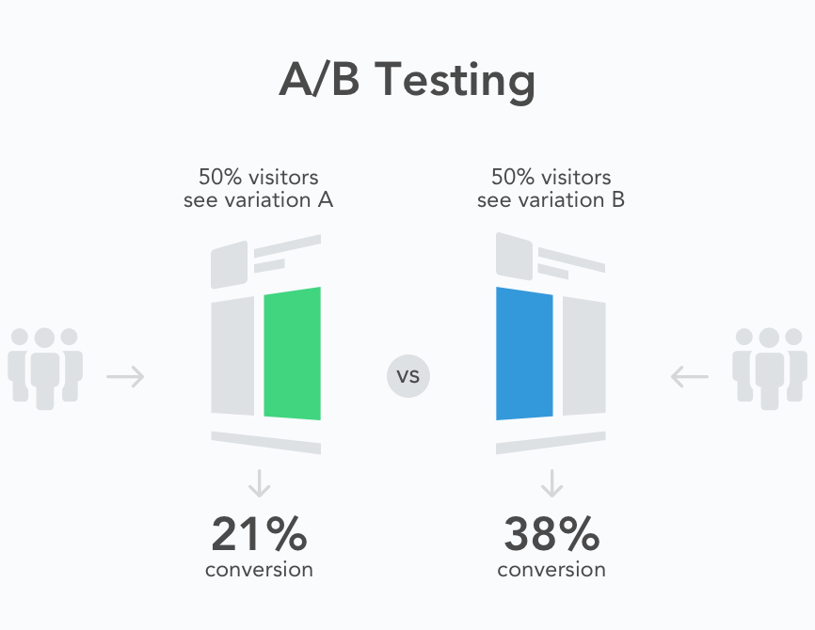
A/B tests
Assumes that a model/algorithm is already used in production
Split all cases when the algorithm is used into two groups: A and B (typically 50%-50%)
After a predefined time gather and compare results of both models/algorithms
Examples:
Two recommenders on YouTube – users are randomly split in half
Two trading algorithms – budget is split in half
Two website versions are presented to users – cookies are randomly assigned to both groups

Slide 9
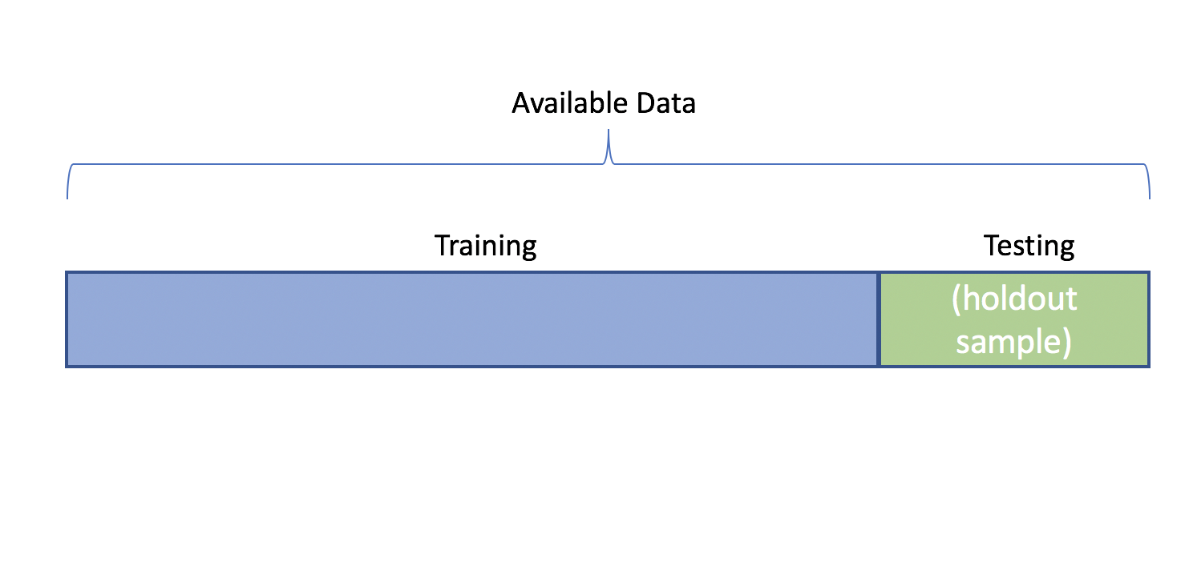
Train-test split
Divide the dataset into two parts:
training set
test set
Train the model on the training set
Evaluate the model on the test set
Good when the dataset is large and training is expensive
A single dataset split may not properly reflect model’s ability to generalize

Slide 10
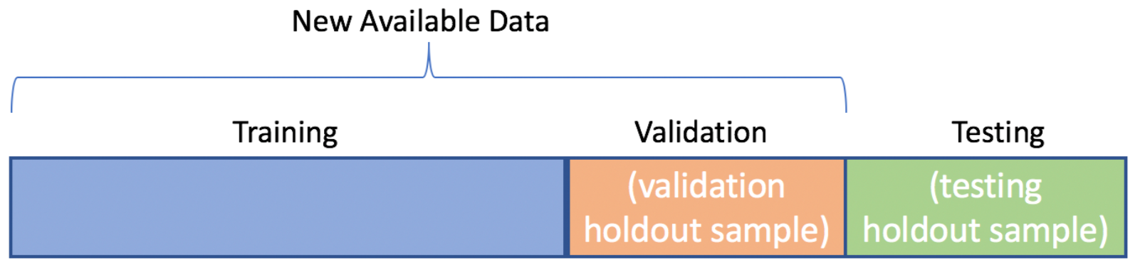
Train-validation-test split
Divide the dataset into three parts:
training set
validation set
test set
Train the model on the training set with many sets of hyperparameters
Evaluate all trained models on the validation set
Choose hyperparameters which give the best result
Evaluate the final model on the test set to check for overfitting
Good when the dataset is large and training is expensive
Allows for a proper hyperparameter tuning
A single dataset split may not properly reflect model’s ability to generalize

Slide 11
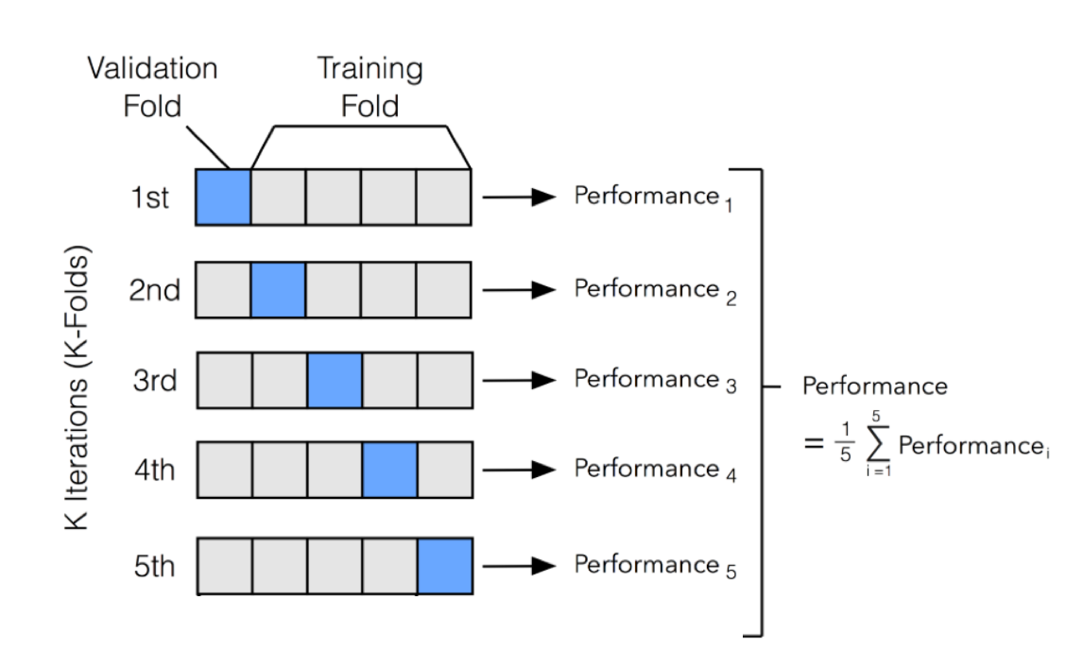

Cross-validation
Divide the dataset $D$ into K equal-sized parts
Train and evaluate the model K times in the following way:
Choose the i-th dataset part $D_{i}$
Train the model on $D\backslash D_{i}$
Evaluate the model on $D_{i}$
Gather all K results and aggregate them into a single measure (for instance by taking an average)
Allows to test the model on the entire dataset removing the risk of choosing an atypical split
When K is large and model training is expensive, this method requires a long processing time

Slide 12
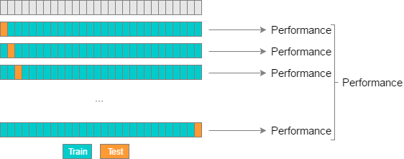

Leave-one-out
Leave-one-out is an extreme case of cross-validation where K is equal to the number of elements in the dataset
Train and evaluate the model K times in the following way:
Choose the i-th element $y_{i}∈D$
Train the model on $D\backslash \{y_{i}\}$
Evaluate the model on $y_{i}$
Gather all results and aggregate them into a single measure
Allows to test the model on the entire dataset removing the risk of choosing an atypical split
Good when the training set is small
Good when the typical proportion of the production training dataset size is large compared to the number of predictions to be made
For even moderately complex models requires a long processing time

Slide 13
Explicit feedback vs implicit feedback testing
Explicit feedback, e.g. ratings
Treat the recommender as a typical regressor and use regression measures to evaluate it
Generate prediction for every pair user-item in the test set
You can simplify the testing scheme by generating a single prediction at a time
Implicit feedback, e.g. binary indicators if there was an interaction or not
Generate a set of recommendations for each user in the test set (typically by assigning a score to every item in the set of items the user have not interacted with)
Use ranking evaluation measures to take positions into account
When serving recommend items with the highest predictions first

