Slide 1

Stock market prediction using machine learning techniques
Mateusz Marszałek
Faculty of Mechanical engineering and Robotics
Cracow, 18.12.2017

Slide 2
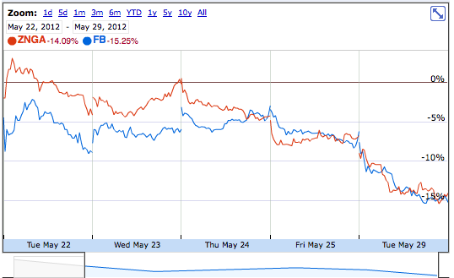
Problem definition
Notes:
The goal is to show you power of Pythons libraries (development approach) than scientific approach
Naive approach, because most methods predicts relative rather than absolute values (deviation from previous state).
https://github.com/Vaibhav/Stock-Analysis

Slide 3
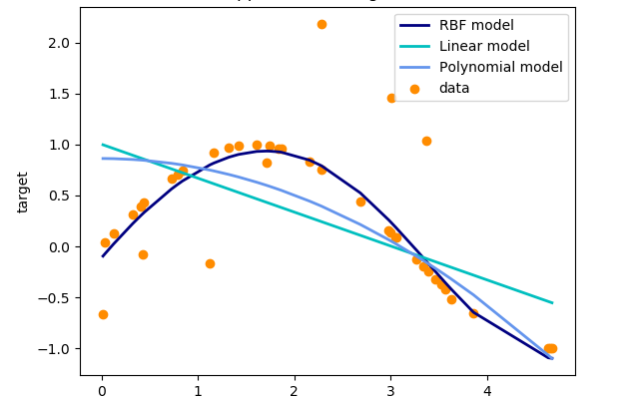
Regression
Regression is a technique that displays the relationship between variable “y” based on the values of variable “x”.
Notes:
However we need some theoretical introduction
We know as the temperature drops people put on more jackets to keep warm
As the fuel price increases more people drive less to save money.

Slide 4
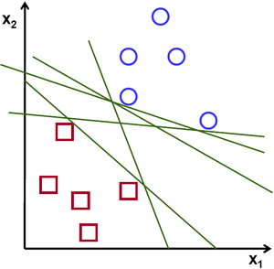
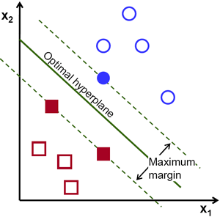
Support Vector Machines
Classical way SVM

Slide 5
Code structure
reading data and saving it into Pandas DataFrame
normalizing and dividing data into training and testing sets using NumPY
preparing SVMs, fitting data and predicting future values using scikit-learn
plotting results with Matplotlib
Notes:
Script is divided is 4 parts (whitch is pretty standard for machine learning problems (read, process data, learn & test, plot)):

Slide 6
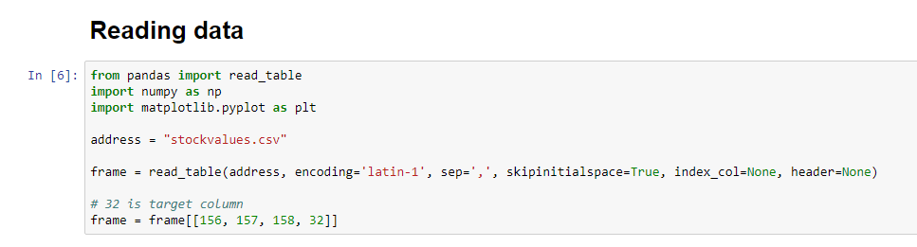
Data source

Slide 7
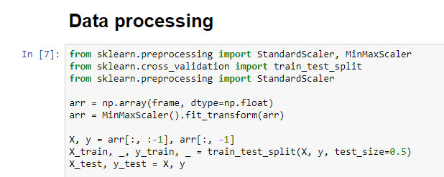
Data processing

Slide 8
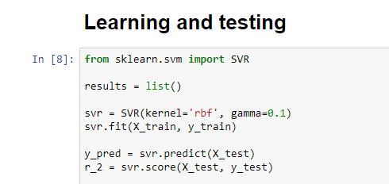
Training and testing sets

Slide 9
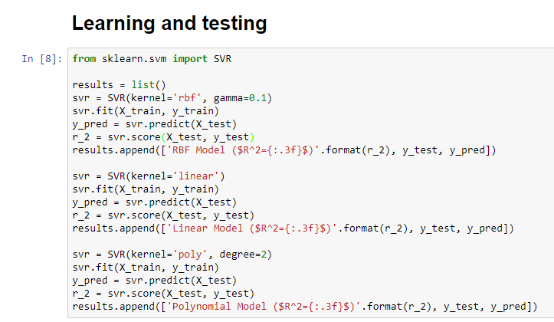
Learning and testing

Slide 10
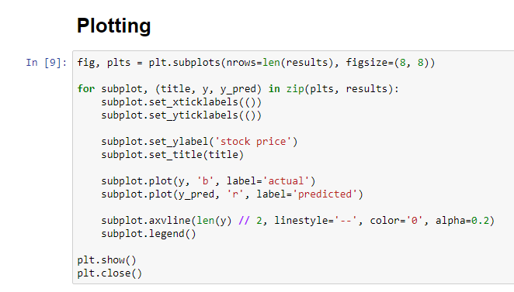
Plotting results

Slide 11
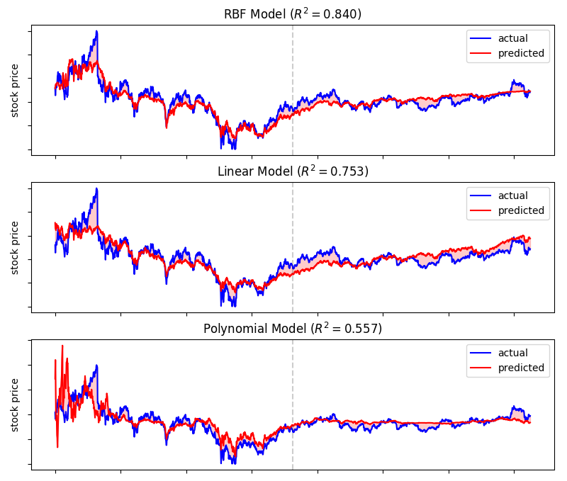
Results

Slide 12
Another possible implementations
This approach can be used in many cases, where the task is connected with prediction/forecasting:
Future signal state – failure prediction
Weather
Income or productivity - comparing customer waiting time and his satisfaction or ticket prices and attendance
All trends and relationships

Slide 13
Thank you for your attention!

