Slide 1
Understanding Anxiety Causes, symptoms, and tools for management Candice Jones, RN

Slide 2
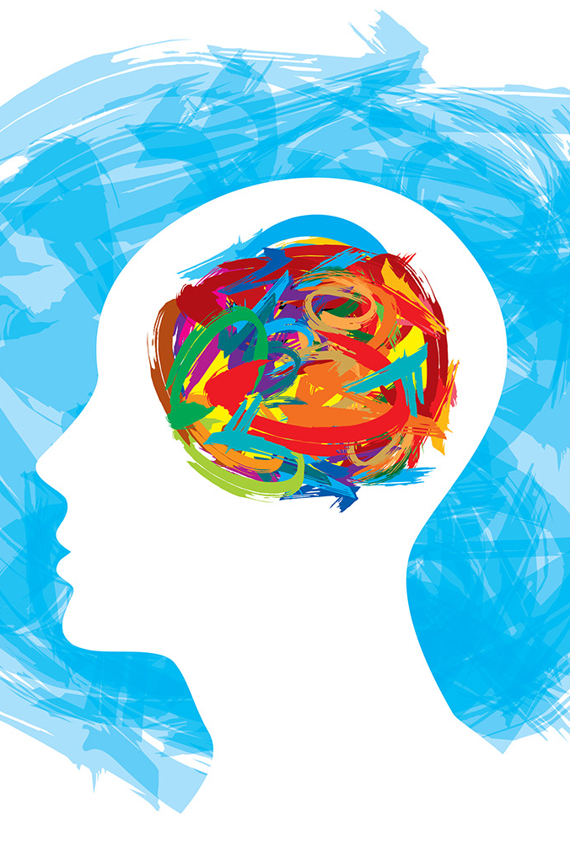
What is Anxiety?
Anxiety is a natural response to stress or danger and having occasional anxiety is a normal part of everyday life. But in some situations it can also become excessive and get worse over time, this is known as an anxiety disorder.
(National Institute of Mental Health, 2024)
This Photo by Unknown Author is licensed under CC BY-SA

Slide 3
Types of Anxiety
Generalized Anxiety Disorder (GAD)
Panic Disorder
Social Anxiety Disorder
Specific Phobias
Obsessive Compulsive Disorder (OCD)
Post-Traumatic Stress Disorder (PTSD)

Slide 4
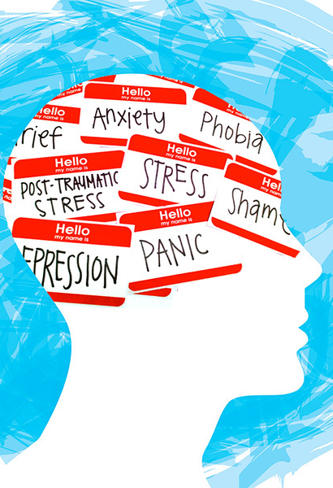
Generalized anxiety disorder (GAD)
GAD is a constant feeling of anxiety or fear that is happening often and interfering with normal daily life activities.
Symptoms include:
Restless, on edge, irritable
Fatigue
Unable to concentrate
Stomachache or other pains
Difficulty sleeping
(National Institute of Mental Health, 2024)
This Photo by Unknown Author is licensed under CC BY

Slide 5
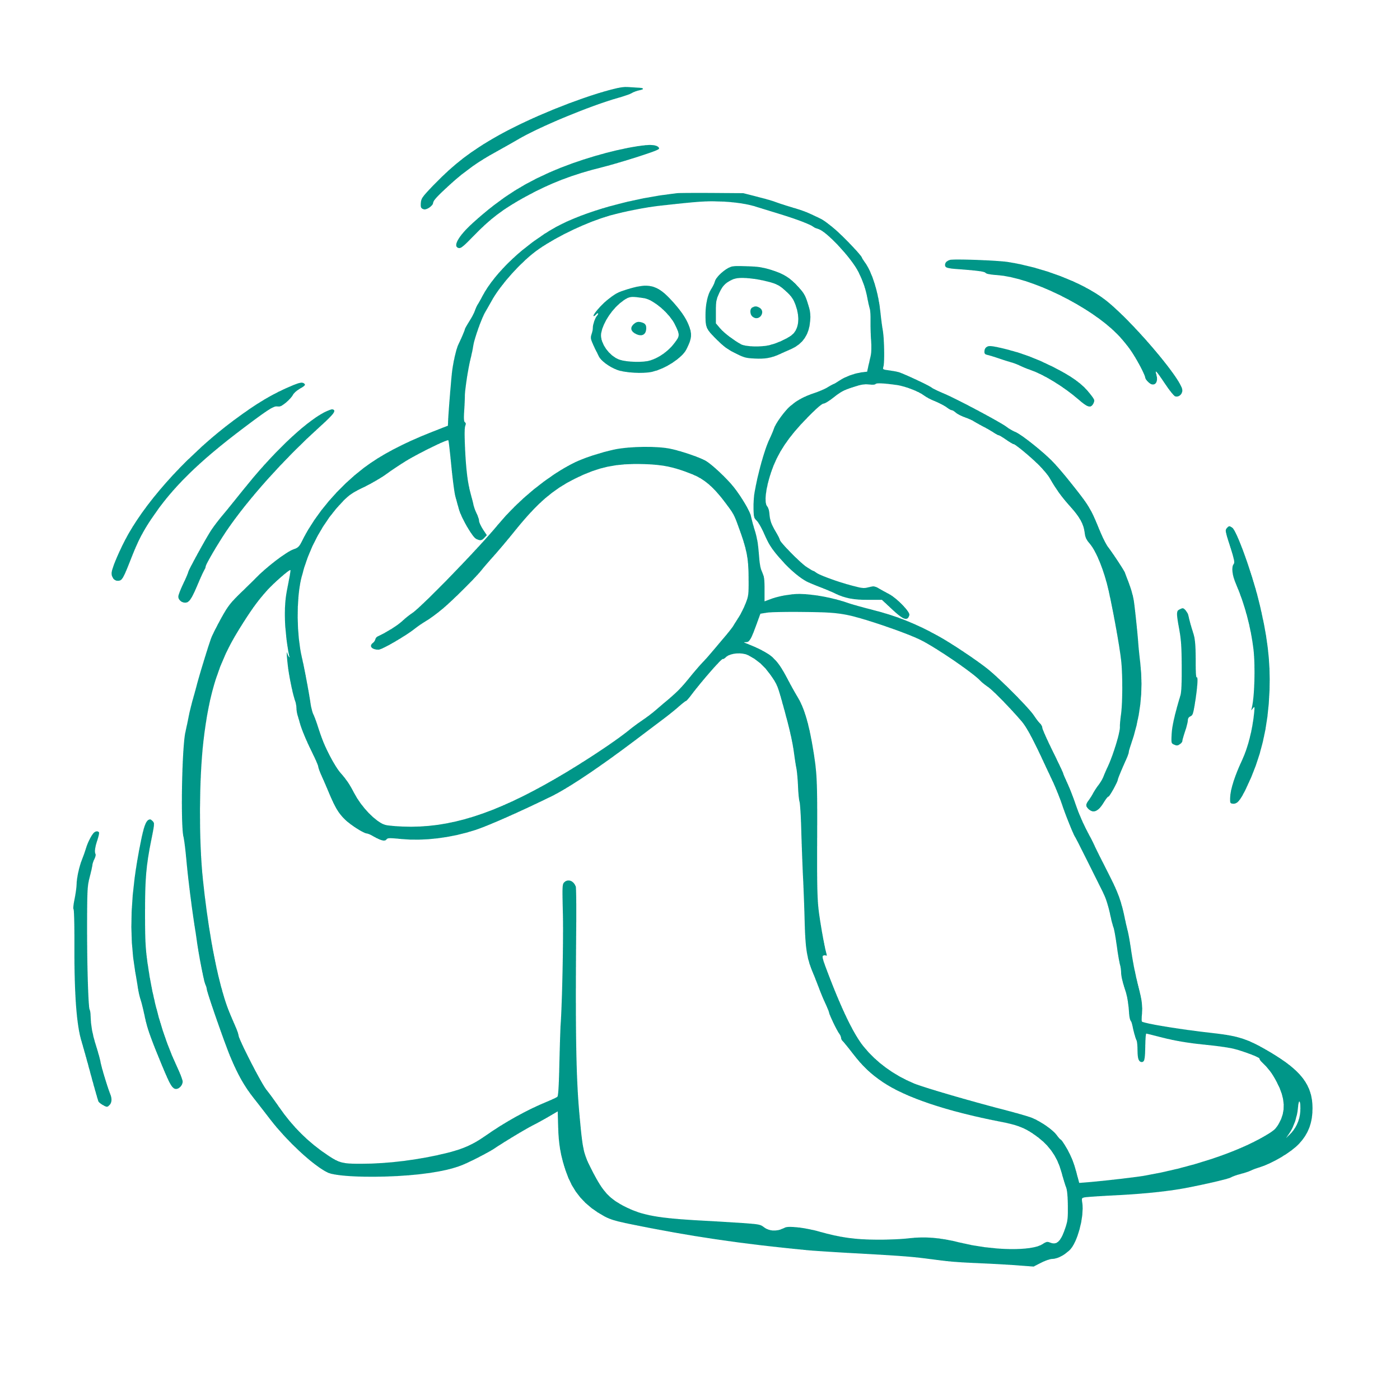
PANIC DISORDER
People with Panic Disorder have frequent panic attacks. Panic attacks are intense fear and feeling of losing control when majority of the time there is no danger or known trigger that causes it.
Symptoms include:
Heart pounding or racing
Trembling
Chest pain
Feeling of impending doom
(National Institute of Mental Health, 2024)

Slide 6
Social Anxiety Disorder
Social anxiety disorder is when there is fear of social situations. People with this often have a fear of being watched and judged by others. For some cases, people with this can even have trouble working, going to school, or doing things that are normal daily life activities such as going to the grocery store.
Symptoms include:
Heart pounding or racing
Blushing or trembling
Stomachache
Speaking in soft voice, rigid body posture
Self-consciousness
Not able to make eye contact with people they don’t know
(National Institute of Mental Health, 2024)

Slide 7
PHOBIAs
A phobia is an intense or irrational fear of an objective or situation. There are several types of phobias, some include flying, blood, needles, heights, animals (dogs, snakes, etc).

Slide 8
Obsessive Compulsive Disorder (OCD)
OCD is repetitive behaviors from obsessive thoughts. It can be unwanted thoughts or intrusive thoughts that cause anxiety. Some people try to get rid of this by doing rituals (i.e. Washing hands multiple times, clicking lights on and off several times before leaving, etc). This is an example of compulsions.
Some obsession symptoms can include:
Fear of touching objects others have thinking it is contaminated
Doubts you locked the door, turned the stove off, or maybe turned off the lights or curling iron
Highly stressed when things are not organized or put away a certain way. Not being cleaned enough or a certain way.
Thoughts of shouting obscenities.
Thoughts of driving car into crowd
Some compulsion symptoms include:
Washing (handwashing until raw)
Cleaning
Checking (checking doors, lights, stove etc- over and over)
Counting
Following a strict routing
(Mayo Clinic, 2023)

Slide 9
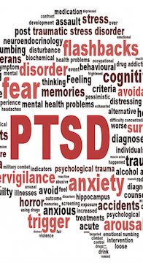
Post-Traumatic Stress Disorder (PTsd)
PTSD is a mental health disorder that happens when someone is apart of or witnesses a stressful or scary event. Symptoms can appear months to years from the event happening.
Symptoms can include:
Flashbacks
Nightmares
Uncontrolled thoughts about what happened
Severe anxiety
(Mayo Clinic, 2022)
This Photo by Unknown Author is licensed under CC BY

Slide 10

Causes of Anxiety
Biologic & Environmental Factors
Genetic predisposition, trauma, stress, childhood experiences
Some people say that shyness or being nervous in certain situations as a child is a risk factor.
Psychological Factors
Coping mechanisms, personality traits
Medical Conditions
Thyroid disorders, heart arrhythmias
Caffeine and other medications or substances
(National Institute of Mental Health, 2024)

Slide 11
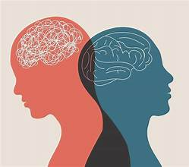
Symptoms of anxiety
Psychological:
Worrying excessively
Sweating
Trembling
Shortness of Breath
Physical:
Pounding heart
Sweating
Trembling
Shortness of Breath

Slide 12
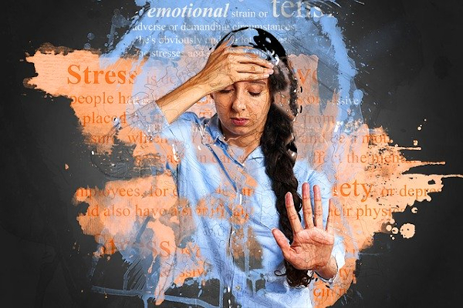
How does anxiety affect your everyday life?
Work/School
Difficulty in concentrating
Frequently absent due to symptoms
Relationships
Increased tension at times
Isolation
Feeling like your partner doesn’t understand
Physical Health
Poor sleep
Stomach Aches
Chronic Pain for some

Slide 13

DIAGNOSIS
Clinical Assessment
Meet with a mental health professional or your PCP to discuss your symptoms
They may use questionnaire tools to help evaluate
Differential Diagnosis
Your doctor may rule out other potential diagnosis to make sure there are no other conditions that may be causing your symptoms.

Slide 14
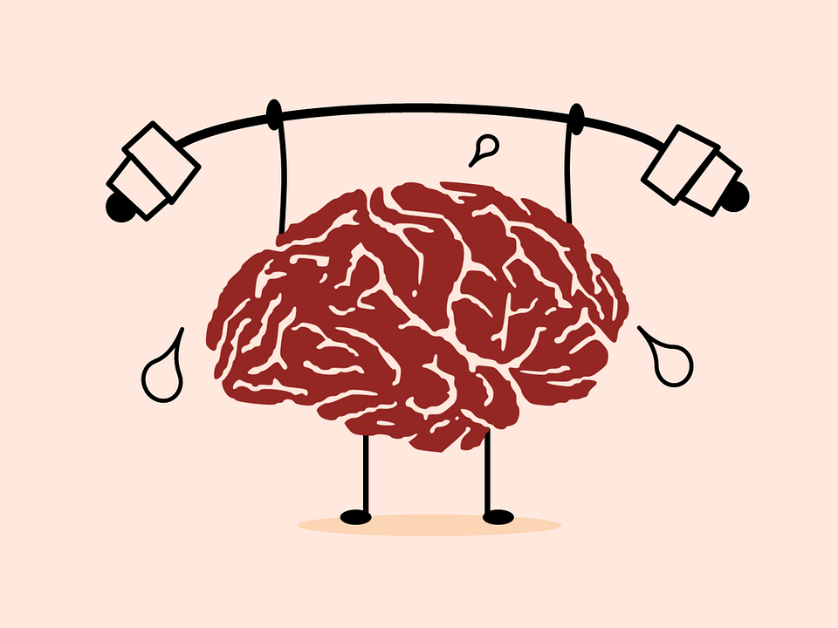
Treatment Options
Therapy
Cognitive Behavioral Therapy (CBT)- This therapy teaches people different ways of reactive, behaving, and thinking to help them feel less anxious in situations.
Exposure Therapy- This is a way of confronting fears and learning to participate in activities they have avoided. They do this therapy along with learning relaxation techniques.
(National Institute of Mental Health, 2024)
Lifestyle Changes
Healthy Diet
Eliminate or reduce caffeine
Good Sleep Habits
Support Groups
Stress Management
Regular Exercise
Mindfulness
Meditation
Grounding
Medications
Anti-Anxiety Medication
Antidepressants
Beta Blockers
Your doctor will work with you to find a medication that works best.

Slide 15

Additional TECHNIQUES FOR ANXIETY Management
Binaural Beats- use of sound waves to decrease anxiety or even improve concentration. It is also used to help with sleep (Smith, 2019)
Mindfulness/Meditation- Mindfulness is a way to train the mind to be present in the now. It can be something you stop and do in the middle of the day to center yourself. A quick 10 minutes can help you regroup. There are many benefits to mindfulness including reducing stress and anxiety, improving cognitive abilities, slowing brain aging, and more (Hoshaw, 2022)
*Videos for this can be found under the Anxiety Management Tools tab*

Slide 16

Additional TECHNIQUES FOR ANXIETY Management
Self care- Set boundaries, take breaks when needed, connect with family, friends, and church for support,
Support Groups- this is a good way to share experiences with others who also have anxiety. Look for groups that do activities that aren’t necessarily for anxiety but are known to help with it such as gardening or cooking classes.

Slide 17

When & how to seek help
*RED FLAGS TO BE AWARE OF*
Unable to control your anxiety
Not able to do normal daily activities
Consistently having panic attacks
Thoughts of self-harm or suicide
Local therapists, psychiatrists, and mental health providers located under Local Providers tab
Remember to speak also with your Primary Care Provider as they can direct you to local providers as well.

Slide 18
KEY Takeaways
Anxiety is common and it is treatable. You are not alone in this journey, there are many people that suffer alongside of you and want to be a support. And remember that anxiety doesn’t always look the same for every person.
It is important to seek professional help, especially if your anxiety is interfering with daily activities, so they can intervene and help you.

Slide 19
References
Hoshaw, C. (2022, March 29). What is mindfulness? A simple practice for greater wellbeing. Healthline. https://www.healthline.com/health/mind-body/what-is-mindfulness
Mayo Clinic. (2022). Post-traumatic stress disorder (PTSD). Mayo Foundation for Medical Education and Research. https://www.mayoclinic.org/diseases-conditions/post-traumatic-stress-disorder/symptoms-causes/syc- 20355967
Mayo Clinic. (2023, December 21). Obsessive-compulsive disorder (OCD). Mayo Clinic. https://www.mayoclinic.org/diseases-conditions/obsessive-compulsive-disorder/symptoms-causes/syc- 20354432
National Institute of Mental Health. (2024, April). Anxiety disorders. National Institute of Mental Health. https://www.nimh.nih.gov/health/topics/anxiety-disorders
Smith, L. (2019, September 30). Binaural beats therapy: Benefits and how they work. www.medicalnewstoday.com. https://www.medicalnewstoday.com/articles/320019#benefits

