Slide 1
Fashion MNIST
Dataset Analysis
Daniele Irto
Matteo Marturini
Isacco Zinna
Probabilistic Machine Learning
A.A. 2020-2021

Slide 2
Table of contents
Introduction
Problem statement
Dataset
Analysis
Techniques
Results
Comparison
Accuracy
Conclusions

Slide 3
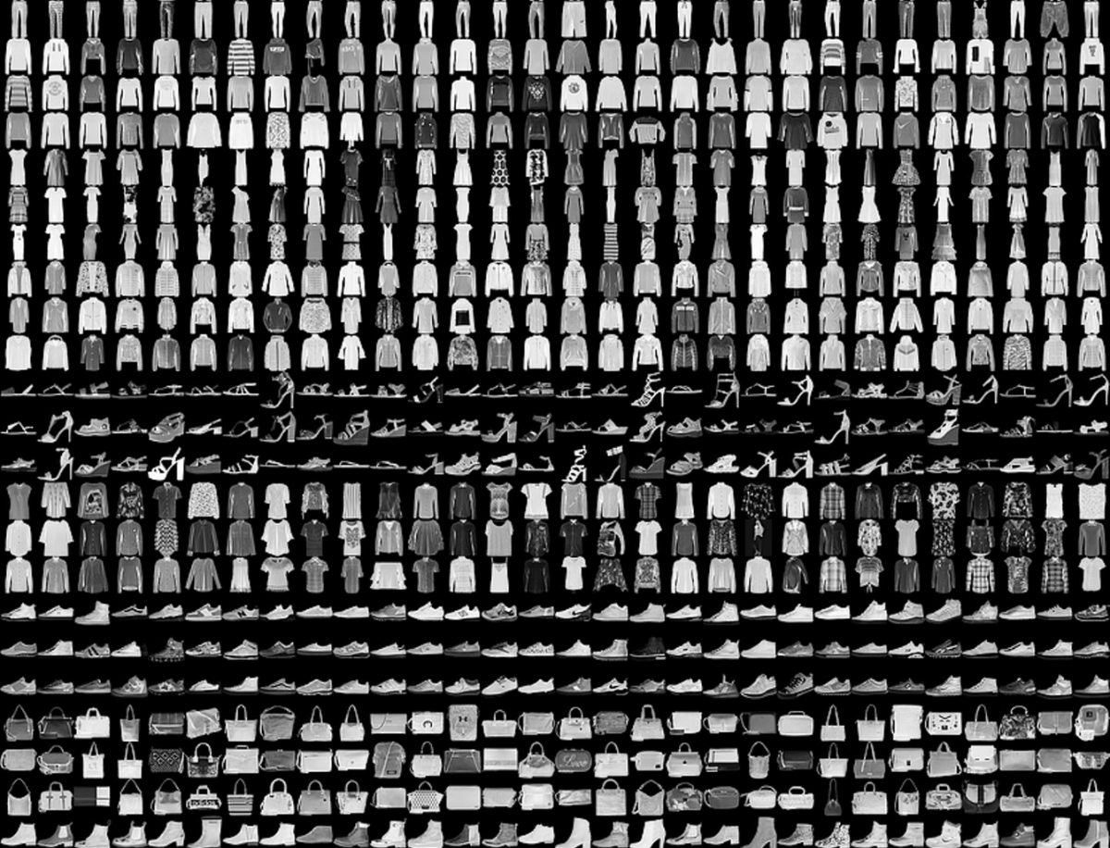
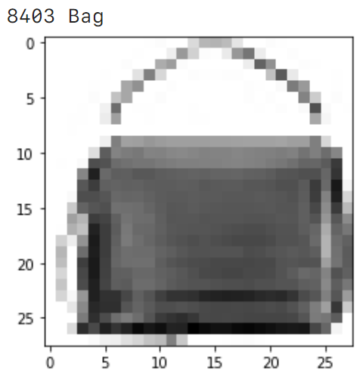
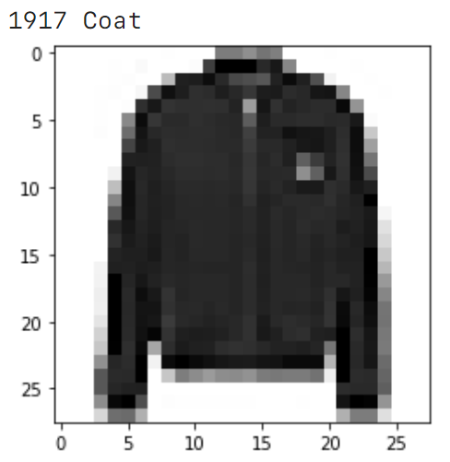
Fashion MNIST
Label | Description
0 | T-shirt/top
1 | Trousers
2 | Pullover
3 | Dress
4 | Coat
5 | Sandal
6 | Shirt
7 | Sneaker
8 | Bag
9 | Ankle boot

Slide 4
Dataset
Size of training set: 60 000 images
Size of test set: 10 000 images
Each image
height: 28 pixels
width: 28 pixels
each pixel has integer value in [0, 255]
(normalized to [0,1])
784 total

Slide 5
Multiclass classification
Goal: learn an image classifier
Machine learning techniques:
Logistic regression
Gaussian Naïve Bayes
Gaussian processes
Bayesian logistic regression + stochastic variational inference
Deterministic and bayesian neural networks

Slide 6


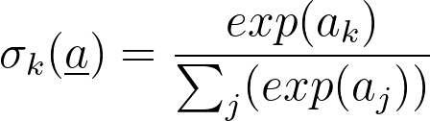

Logistic regression
(k x M) matrix: k = number of classes (k=10)
M = number of features (M=784)
Maximum likelihood

Slide 7
Logistic regression
sklearn.linear_model.LogisticRegression(penalty, tol, solver, max_iter, multi_class)
solver | penalty | tol | max_iter | multi_class | Accuracy | Time
lgbfs | l2 | 0.001 | 5000 | multinomial | 84% | 08:24 m
sag | l2 | 0.001 | 5000 | multinomial | 84% | 04:32 m
saga | l1 | 0.001 | 5000 | multinomial | 84% | 19:00 m

Slide 8
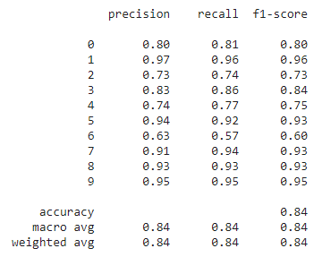
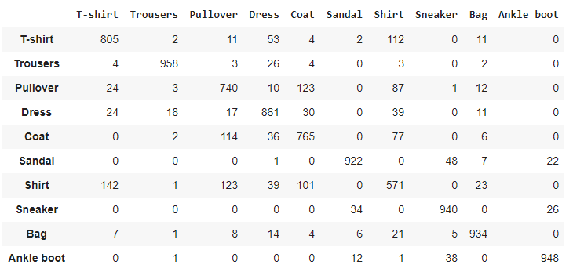
Logistic regression (solver=’sag’)
Classification report
Confusion matrix

Slide 9
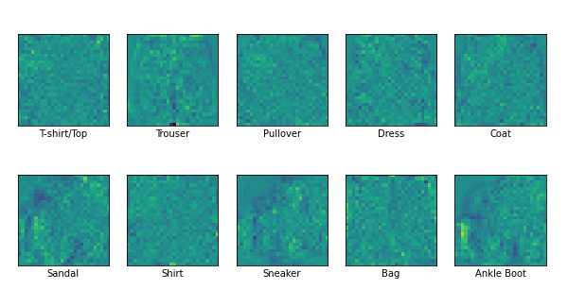
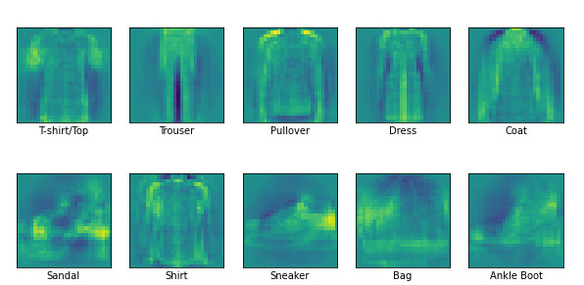
Logistic regression (solver=’sag’)
training set = 60 000 images
training set = 5000 images

Slide 10
Gaussian Naive Bayes
Assumptions:
features are independent, given a certain class
likelihood of the features is Gaussian
Bayes’ theorem is used
prior distribution of classes is trivial (uniform, in this case)
likelihood of features is Gaussian
predicted class is the one that maximizes the posterior
Results:
fast and efficient method
accuracy is not so great: 0.59

Slide 11
Gaussian Processes (GPs)
Classification with GPs:
extension of logistic regression
GP is the argument of the logistic function
GP is characterized by mean and kernel
compute posterior with approximation
Different kernels:
some “famous” choices (e.g. RBF, Matern)
combination of different kernels
Each kernel has a set of parameters

Slide 12
GPs: procedure
Fix type of kernel
Set bounds for possible values of parameters
Perform 100 optimizer runs, picking uniformly from set of parameters
Find optimal parameters
Fit the final model
Issue: using entire dataset (60k observations) is not possible given time and memory limitation
Solution: only 4k observations have been used for training
Notes:
Optimizer is L-BFGS-B

Slide 13
GPs: results
Kernel | Parameter(s) | Accuracy
Linear | None | 0.81
Quadratic | None | 0.83
RBF | length_scale = 7.4 | 0.80
Matern | length_scale = 1.0 ν = 1.5 | 0.81
Results are similar
Changing parameters lead to different (worse) results
Some classes are predicted better than others

Slide 14
Stochastic Variational Inference (SVI)
Approximate the posterior distribution of some variables given the observed data
Restricting the posterior distribution to a tractable distribution family
Model:
w: samples from a normal distribution for each pixel for the 10 labels
b: samples from a normal distribution for each label
ŷ = xw + b
Non-linear softmax activation function
Guide:
Same distributions for w and b
loc and scale randomly initialized

Slide 15
Stochastic Variational Inference (SVI)
Optimizer: Adam
Trained using exponential learning rate decay for fine tuning
Accuracy: 84%
Large difference in accuracy for different classes
Low accuracy of 60%-70% on some classes (Pullover, Coat, Shirt)
Over 90% accuracy on some classes (Trouser, Sandal, Sneaker, Bag, Boot)
Issue about long training times unless using GPU acceleration

Slide 16
Bayesian Neural Networks
Starting from a deterministic neural network
A composition of functions stacked in sequential layers
Each neuron in a layer transforms the output of the previous layer
Weighted linear summation
non-linear activation function
Able to learn complex non-linear relationship in the data
BNN’s learn an ensemble of parameters instead of a fixed value
The weights become random variables

Slide 17
Bayesian Neural Networks
Places a prior probability distribution on the parameters of the network
Compute the likelihood using the observed data
Obtain the posterior probability from Bayes’ theorem
The posterior distribution is impossible for Neural networks
Approximate inference methods

Slide 18
Bayesian Neural Networks
Robustness to Adversarial attacks
Interpretability
Stability of interpretation
Model | Accuracy | Adversarial attack accuracy
Deterministic | 89% | 12%
Bayesian | 73% | 71%

Slide 19
Comparison
Technique | Accuracy
Logistic Regression | 84%
Gaussian NB | 60%
GP linear | 81%
GP quadratic | 83%
GP RBF | 80%
GP Matern | 81%
SVI | 84%
Technique | Accuracy
Deterministic NNs | 89%
Bayesian NNs | 73%
DNN w/ adv. attack | 12%
BNN w/ adv. attack | 71%

Slide 20
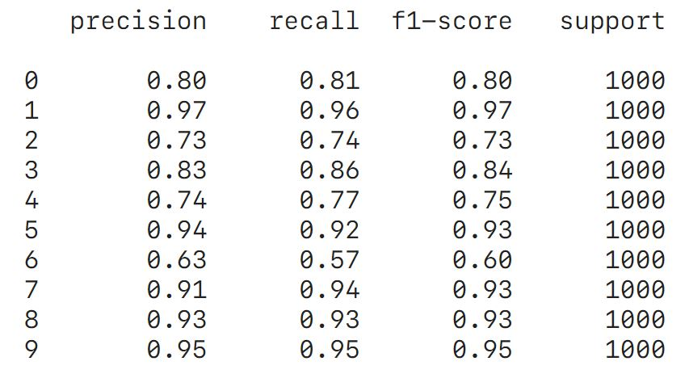
Conclusion: class accuracy & adv. attacks
Some classes are predicted worse than others
especially class 6, “shirt”
some classes are very similar
Gaussian Naive Bayes showed the worst performance
assumption of independence doesn’t really hold
BNNs showed less accuracy but way greater robustness to adversarial attacks, with respect to DNNs

Slide 21
Conclusion: issues & improvements
Some methods (i.e. GPs) required more resources than what was available to us
Using the whole training set would have produced better results in terms of accuracy

Slide 22
THANKS!

Slide 23
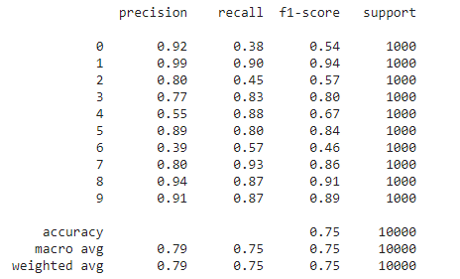
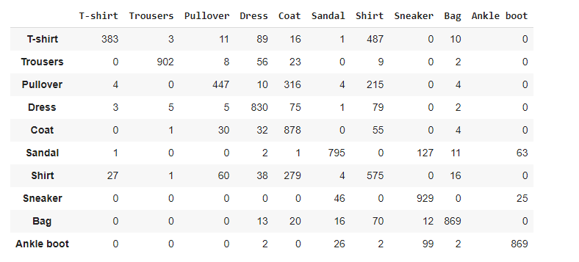
Logistic regression 5000 images

Slide 24
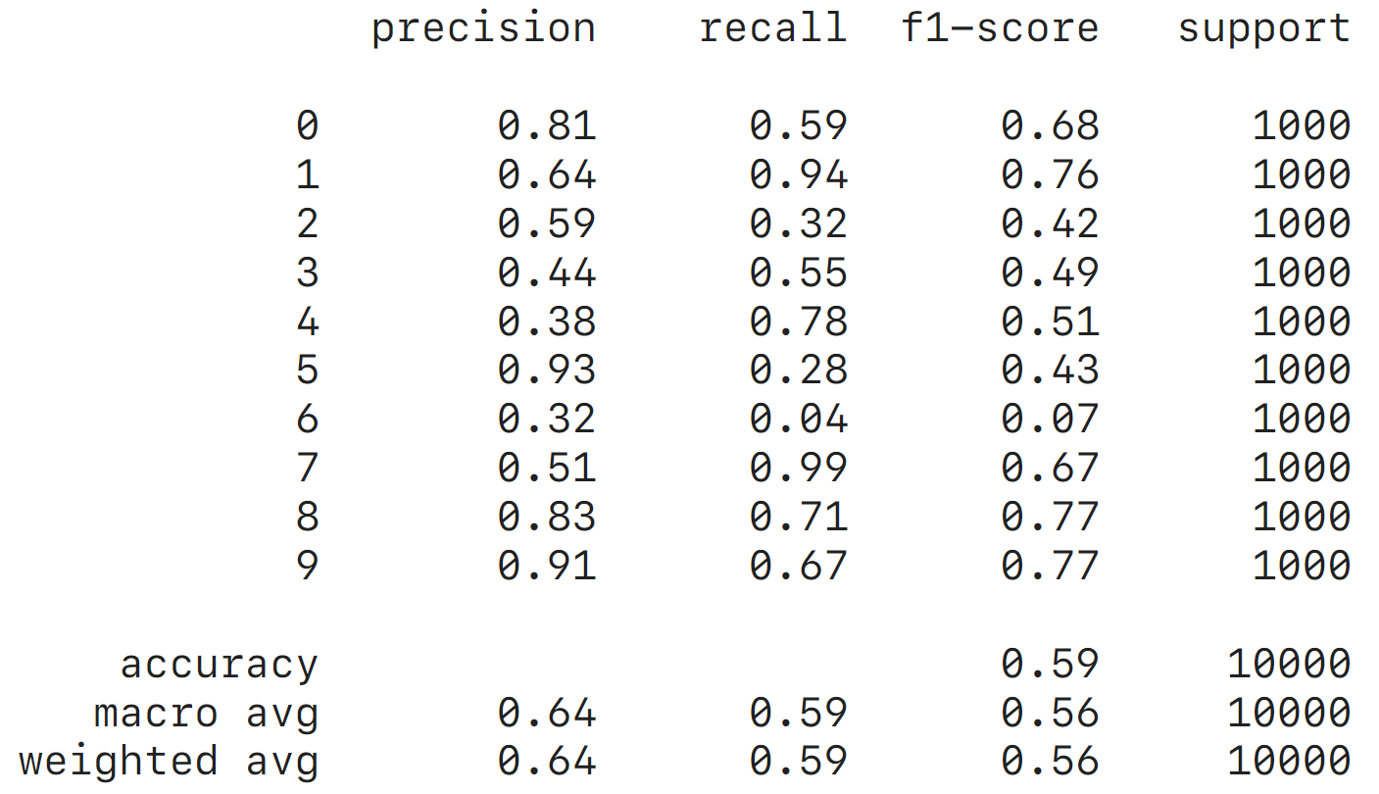
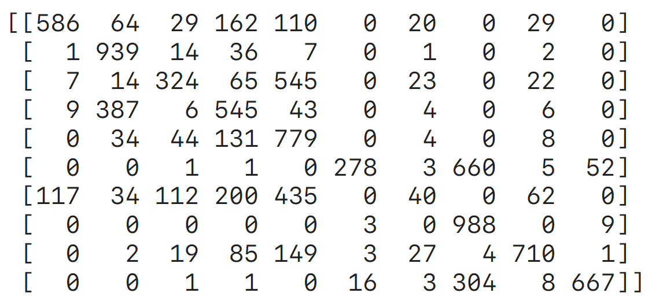
Gaussian Naive Bayes
Notes:
80% precision for class 1 = 80% of what I predicted to class 1 is actually class 1
80% recall for class 1 = 80% of class 1 has been correctly predicted to class 1

Slide 25
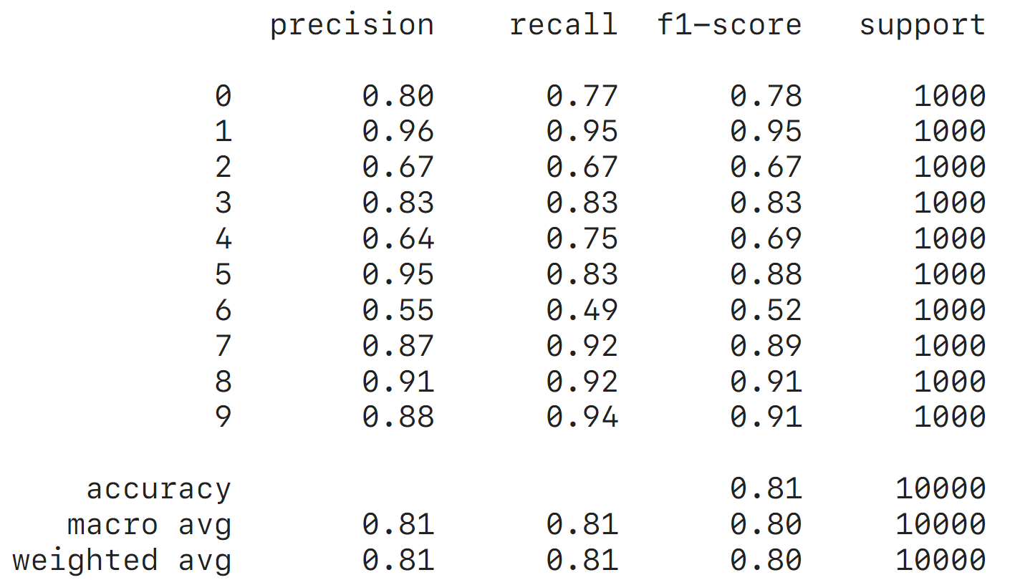
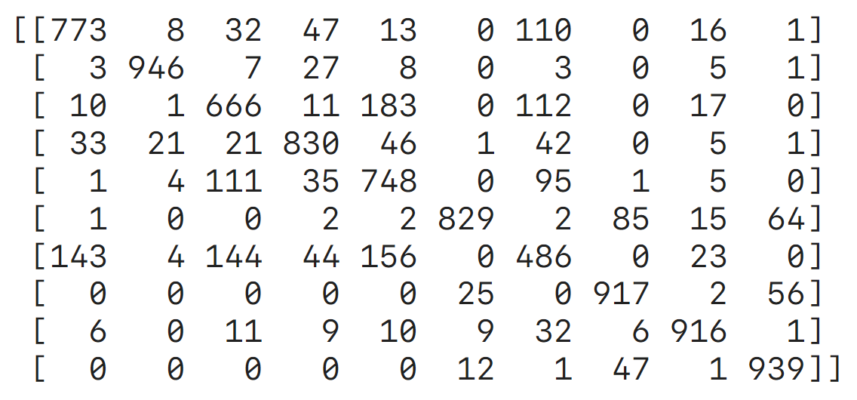
GP linear

Slide 26
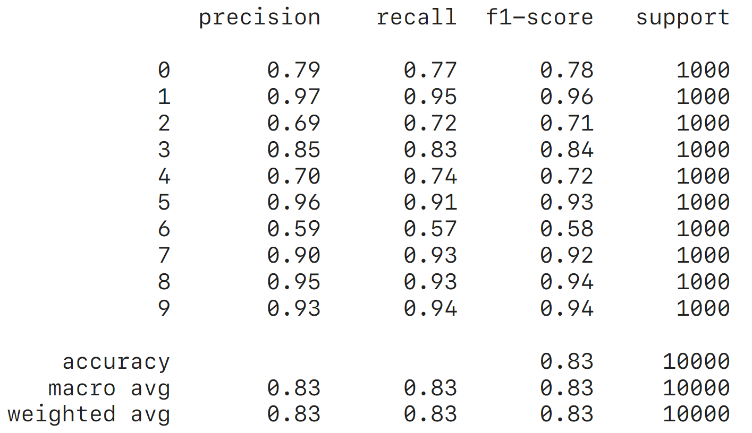
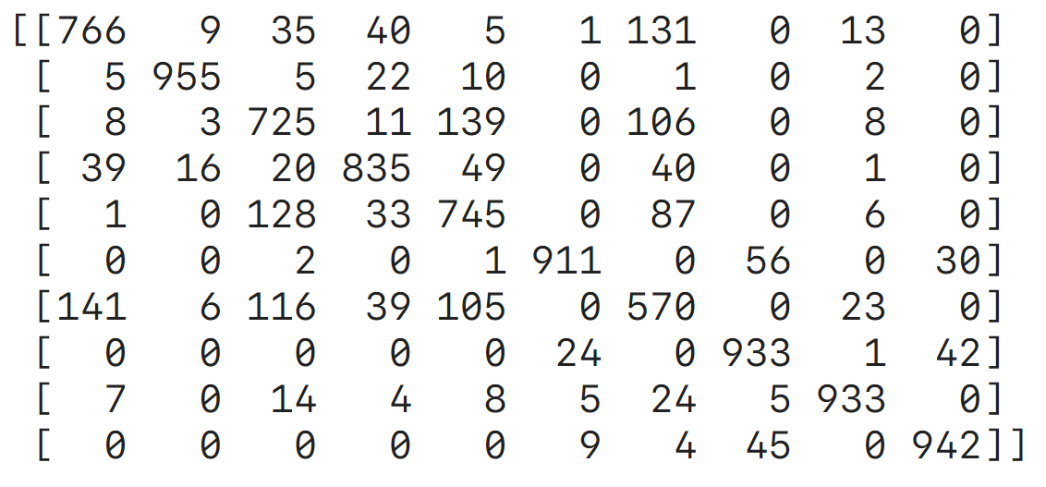
GP quadratic

Slide 27
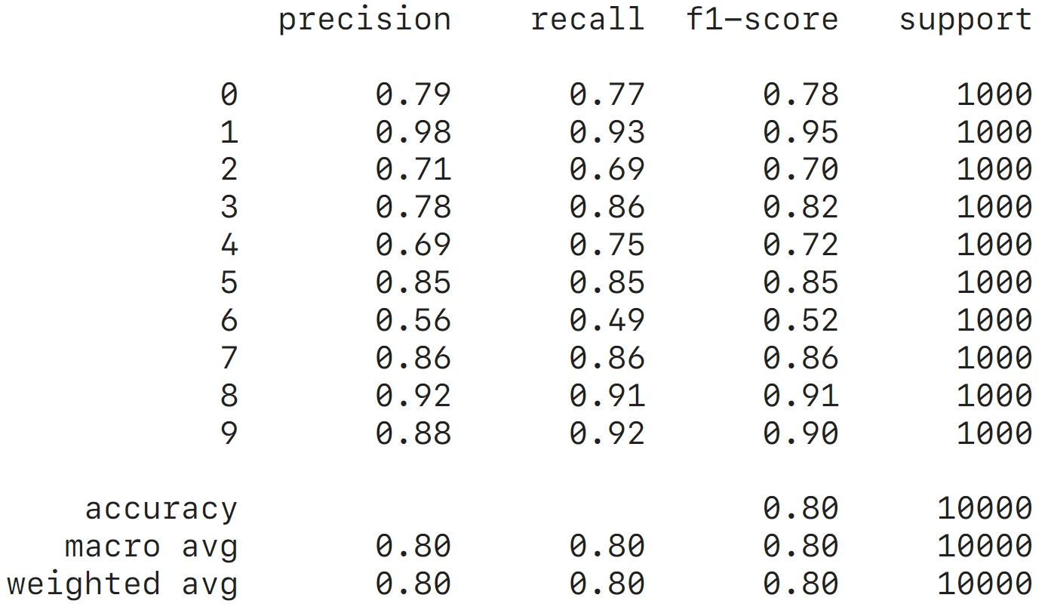
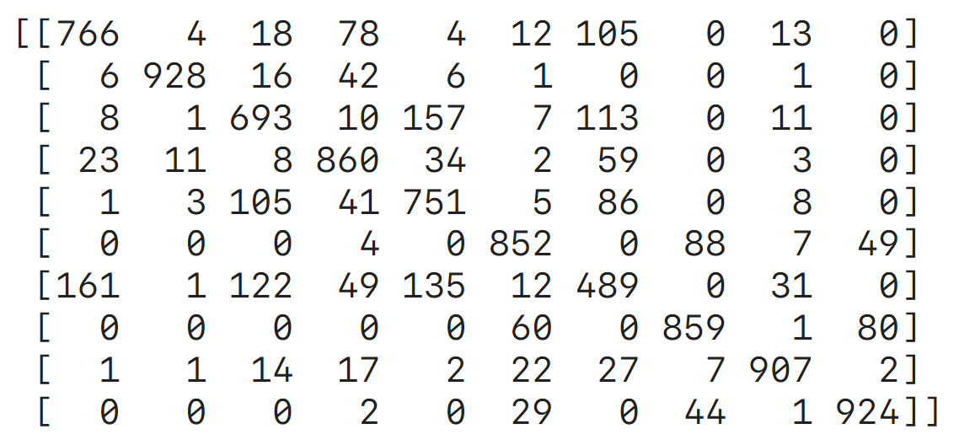
GP RBF

Slide 28
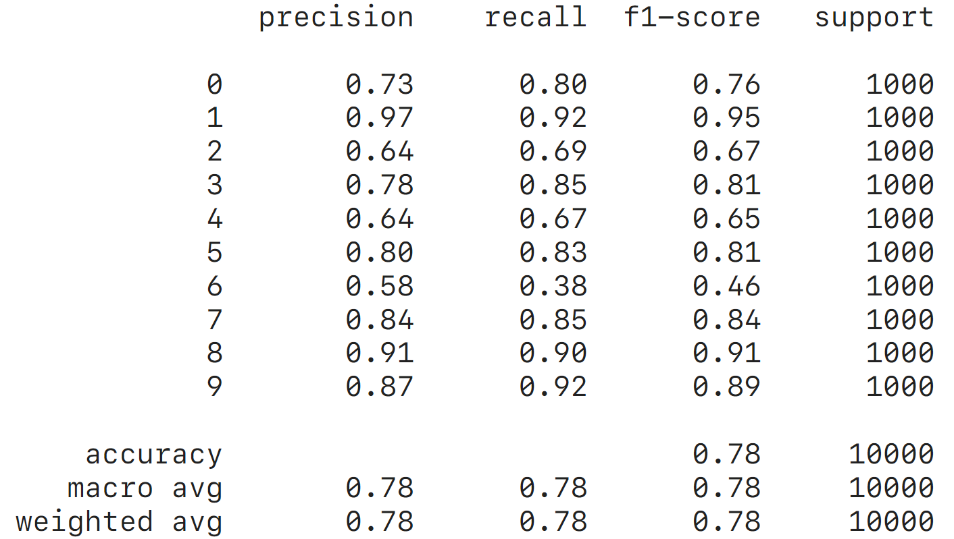
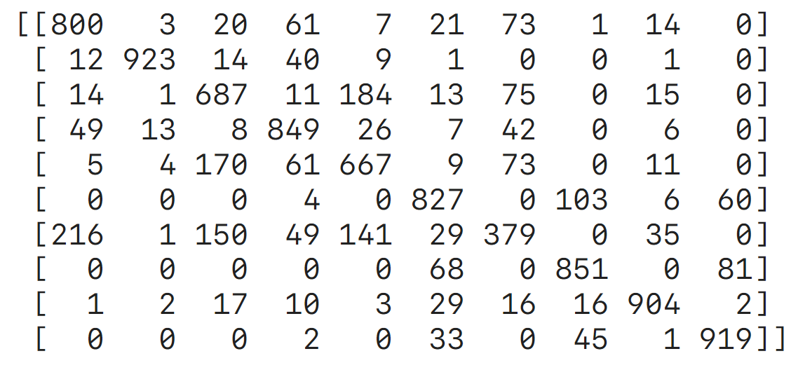
GP Matern

Slide 29
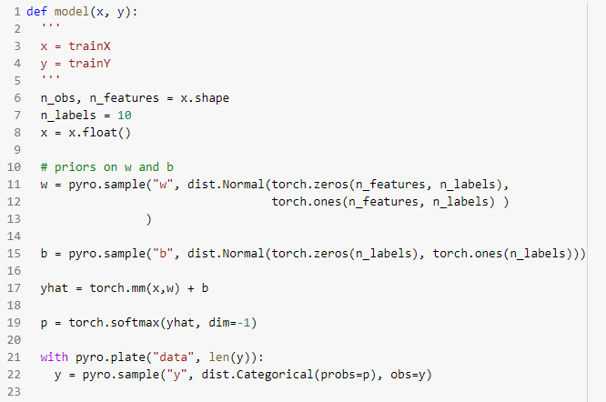
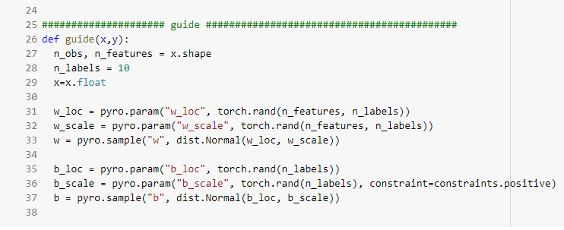
SVI model and guide

Slide 30
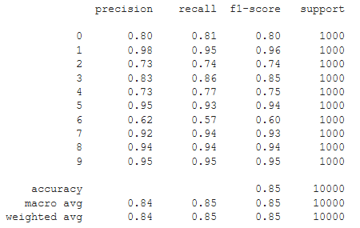
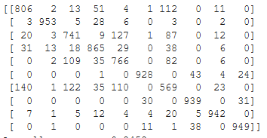
SVI confusion matrix and report

Slide 31
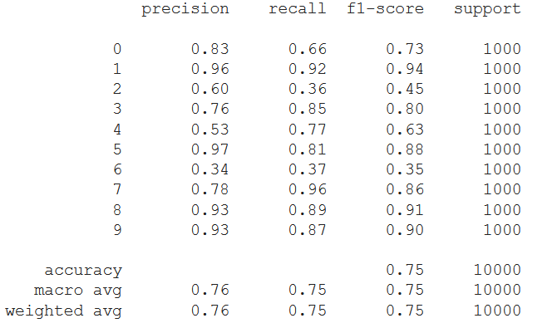
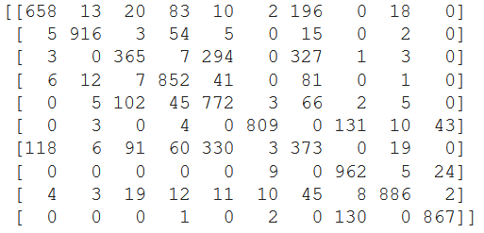
BNN confusion matrix and report

