Slide 1
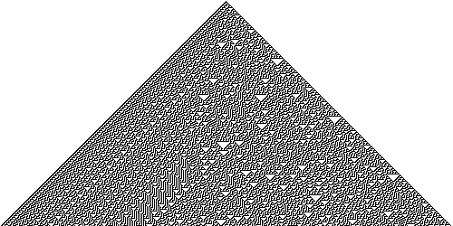
1D Stencil Example:
Rule 30 Cellular Automaton
t
The state at time t + 1 depends on the state of the red cells at time t
Time
t+1
t+2
Rule 30 cellular automaton

Slide 2
Example
Rule 30 cellular automaton
Initial
configuration
Configuration
at time 1
Configuration
at time 2

Slide 3
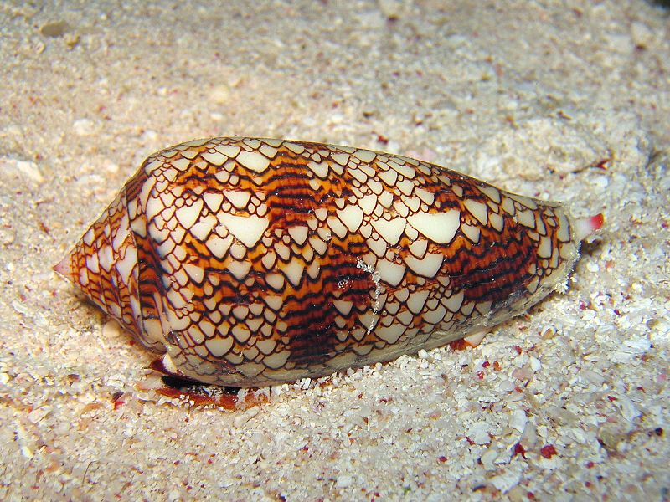
Rule 30 cellular automaton
Conus textile shell
Rule 30 CA

Slide 4
1D Cellular Automata
On distributed-memory architectures, care must be taken to properly handle cells on the border
We use ghost cells to augment each sub-domain
P0
P1
P2
Cur
Next

Slide 5
Example
Rule 30 cellular automaton
P0
P1
P2
Communication
Compute next step
Communication
Compute next step
Communication

