Slide 1
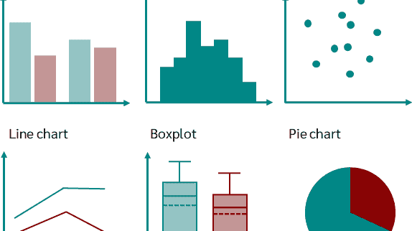
Digitizing GRAPH IMAGES
Matt Mascarelli

Slide 2
CONTEXT
Goal: Address educational barriers for students with learning, physical, or visual disabilities in engaging with STEM educational materials. While technology can make the written word accessible, adapting visuals remains complex and resource intensive.
Approach: Utilize machine learning to automate digitization of various graph types.

Slide 3
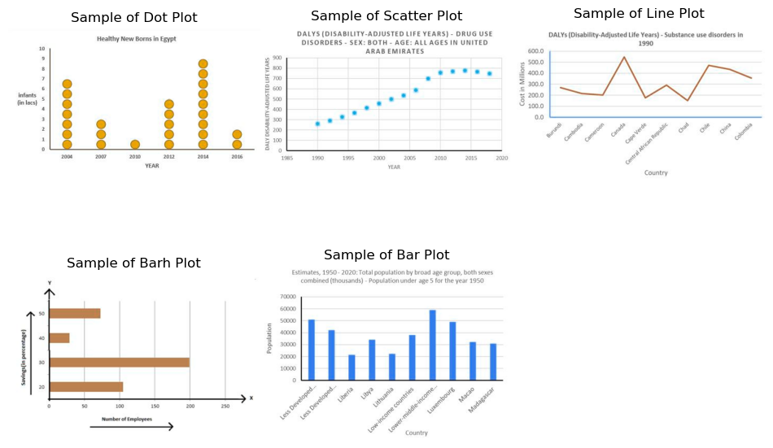
The Data
Kaggle
60,578 images and annotations
24,942 line plots
19,189 vertical bars plots
11,243 scatter plots
5,131 dot plots
73 horizontal bar plots

Slide 4
Project Pipeline
Classify Image (CNN)
Object Detector Models (YOLOv8)
Rescale detected objects to match graph
Output a data table and digital version of graph
Classify
Detect Objects
Rescale
Input Image
Output table and graph

Slide 5
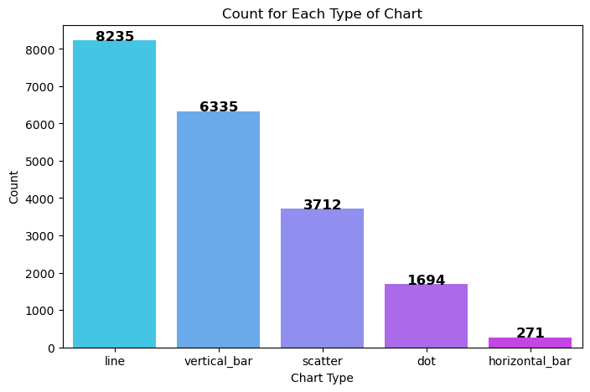
Classifying Charts
Subset of Images: 20,247
Training: 13,767
Validation: 3,442
Testing: 3038
Note: Some synthetic images were created for horizontal bar plots

Slide 6
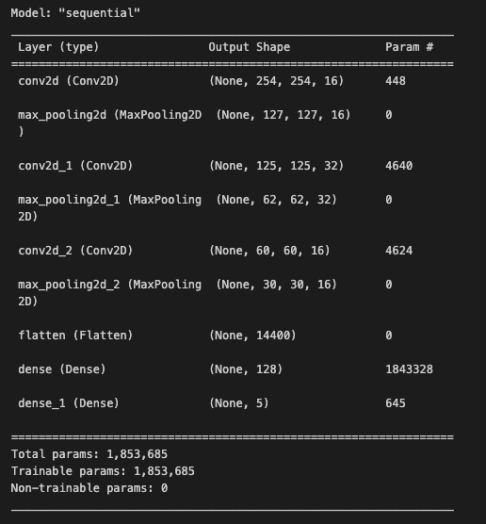
Model Architecture

Slide 7
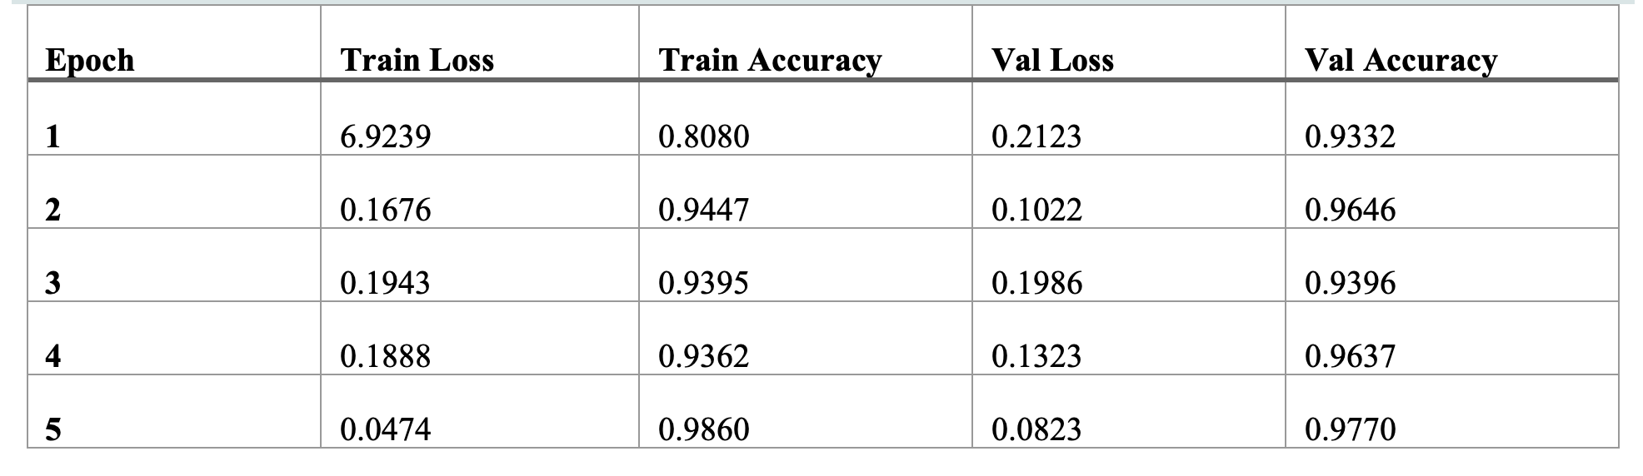
Train/Val Results

Slide 8
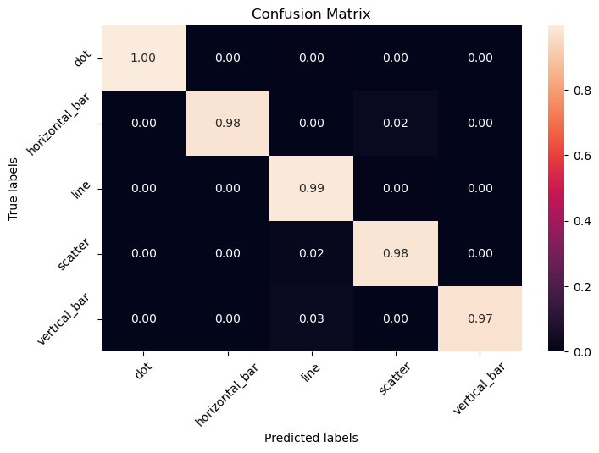
Test Results
Overall Accuracy: 98.4%

Slide 9
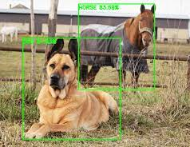
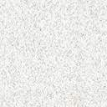
Object Detection
YOLO (You only look once)

Slide 10
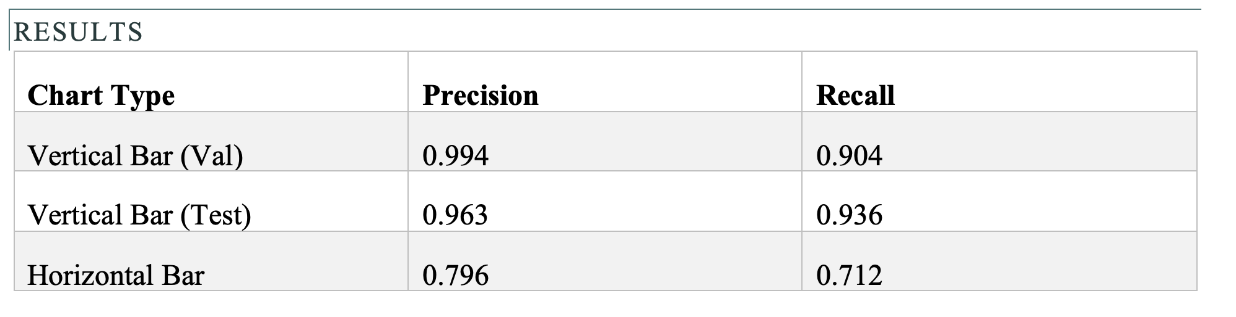
YOLO for Bar plots
Vertical bar: Trained on 400 images
Horizontal bar: Trained on 73 images

Slide 11
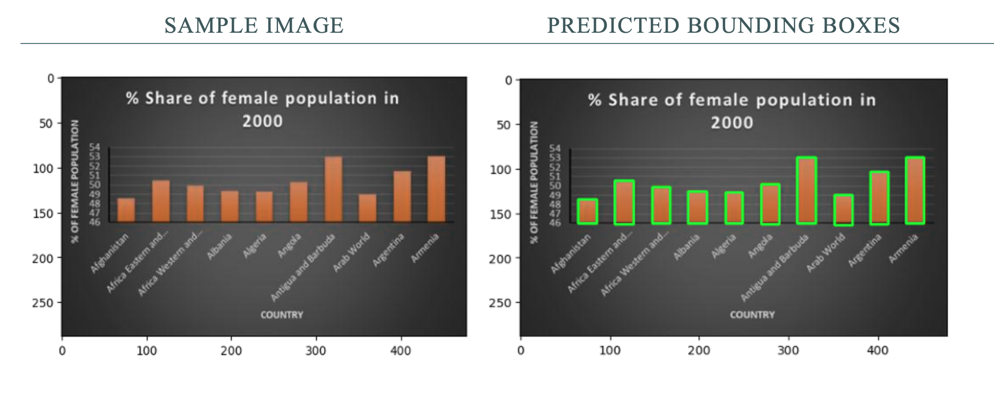

Slide 12
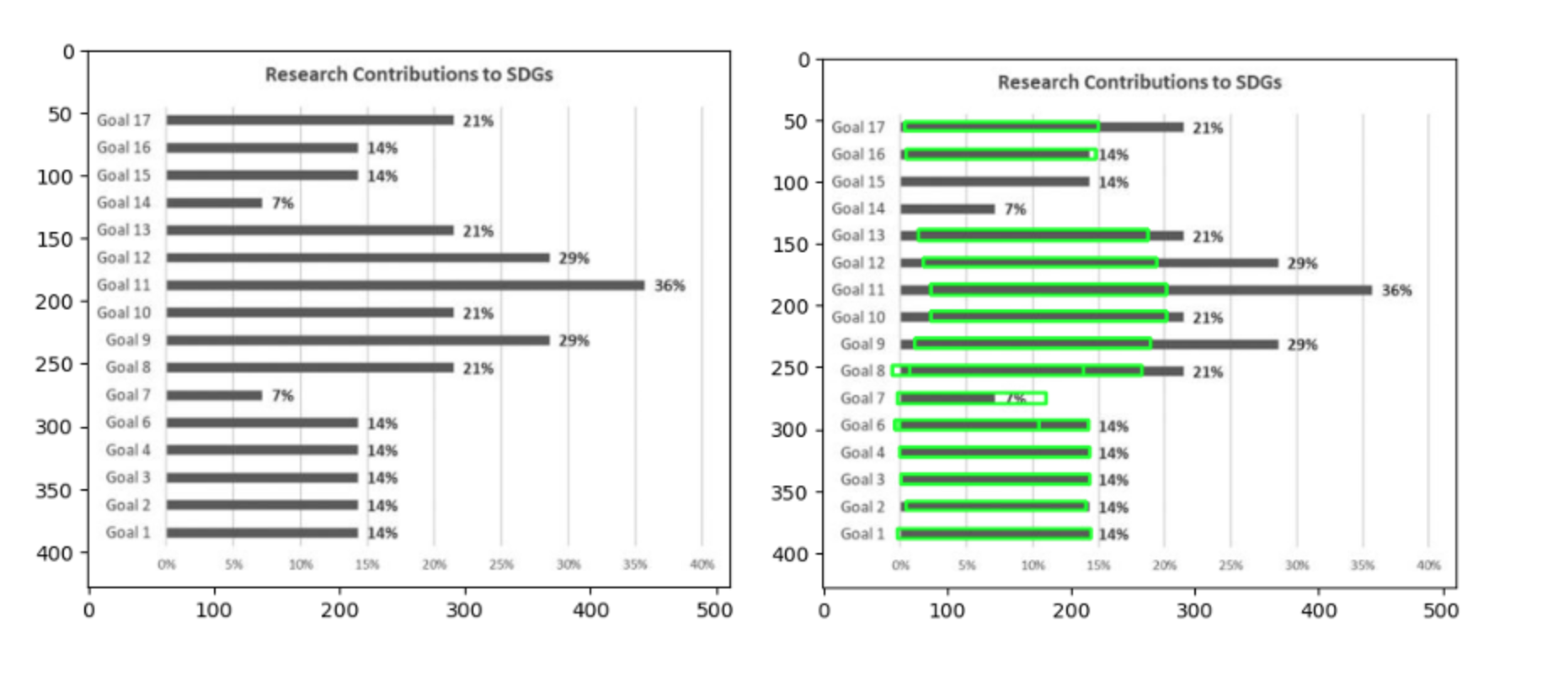

Slide 13
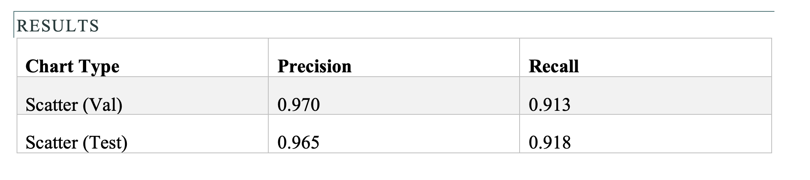
YOLO for Scatter plots
Trained on 3200 images

Slide 14
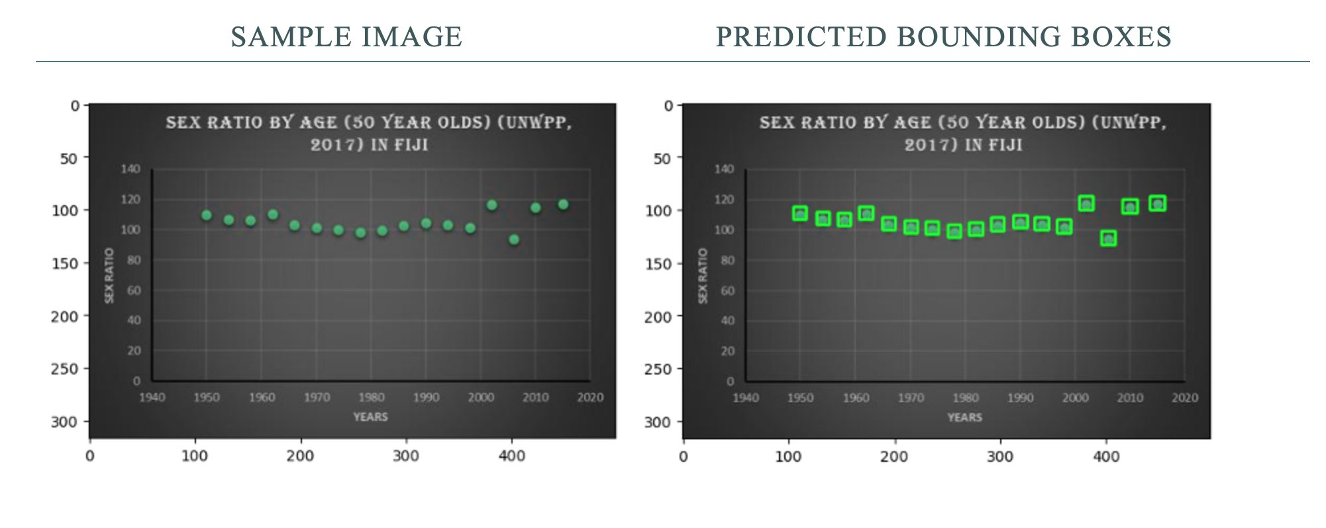

Slide 15
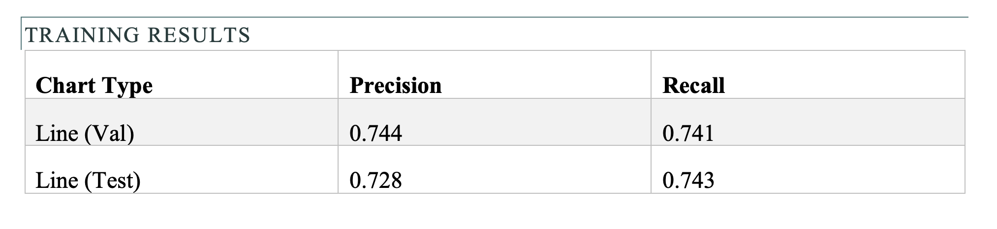
YOLO for Line plots
Trained on 4000 images

Slide 16
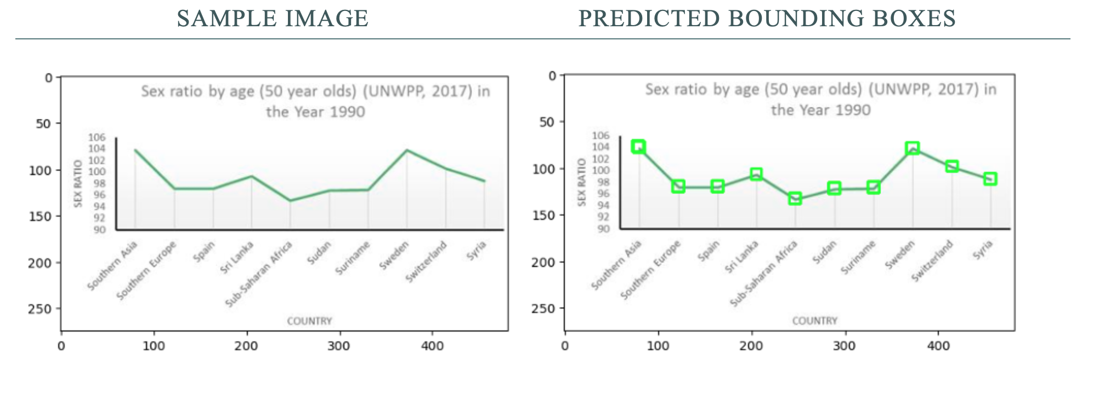

Slide 17
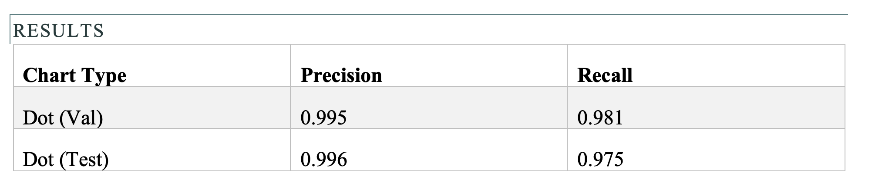
YOLO for Dot plots
Trained on 2400 images

Slide 18
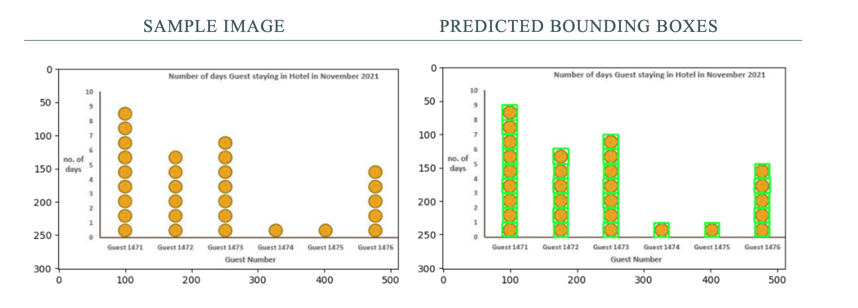

Slide 19
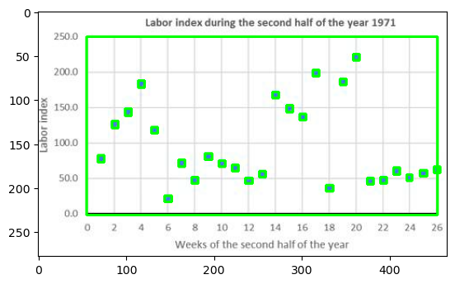
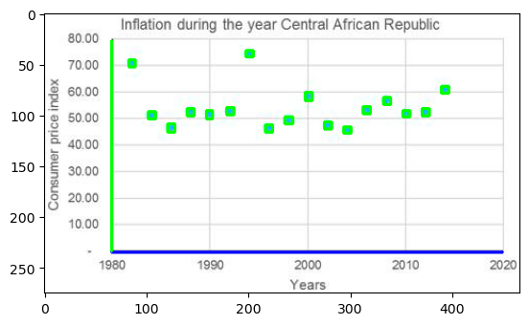
Rescaling the Predicted Data
Image processing to detect XY plane (or axes)
Scales need to be inputted manually
Note: OCR can be used to read XY tick marks

Slide 20
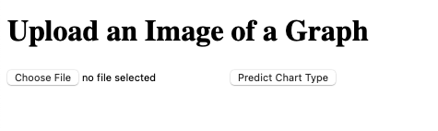
Using the Algorithm
Web app built with Flask

Slide 21
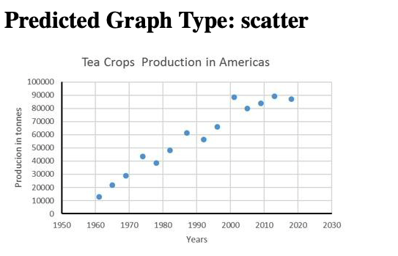
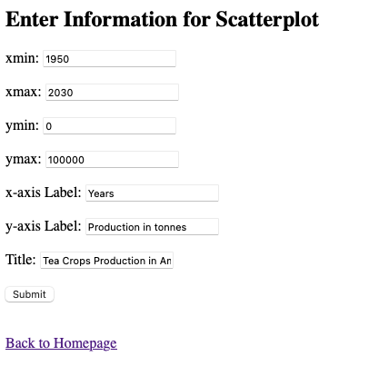

Slide 22
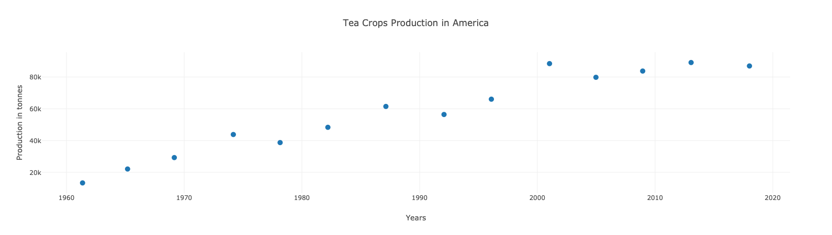

Slide 23
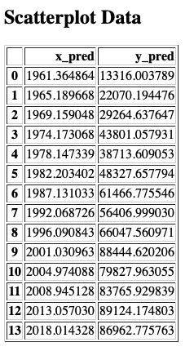

Slide 24
Further Work
Improving accuracy by including more training data.
Collect more horizontal bar plots and manually annotate the bar bounding boxes.
Automating the rescaling process by using OCR algorithms to extract XY tick labels.
Currently, the web app only works for scatter, vertical bar, and line plots. I would like to update it to work for horizontal bar and dot plots.

